Slide 1
Large-Scale Circulation Patterns and High-Impact Weather During the Winter of 2010–2011
Thomas J. Galarneau, Ph.D.
National Center for Atmospheric Research
Boulder, Colorado
Earth Networks Sixth Annual Energy Trader Seminar – Winter Outlook 2011–2012
6 October 2011 – New York, NY
Acknowledgements:
Lance Bosart, University at Albany (for providing a subset of the slides)
Mel Shapiro, National Center for Atmospheric Research (for scientific discussions)

Slide 2
Overview of Winter 2010–2011
Dominated by disruption of the Northern Hemisphere polar vortex
  Allowed cold arctic air to reach low latitudes
  Allowed warm maritime air to reach high latitudes
Characterized by extreme weather events along the periphery of arctic air masses
Extreme change in phase of Arctic Oscillation (AO)
Varying cyclone structure in difference AO phases

Slide 3
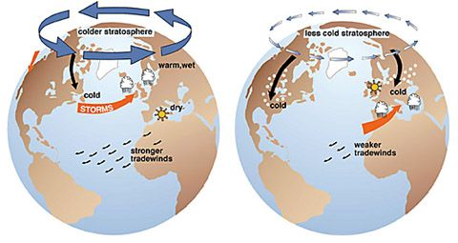
Arctic Oscillation
A Northern Hemispheric flow pattern index that illustrates climate and weather variability
Negative AO Regime
Positive AO Regime
Source: L. Bosart

Slide 4
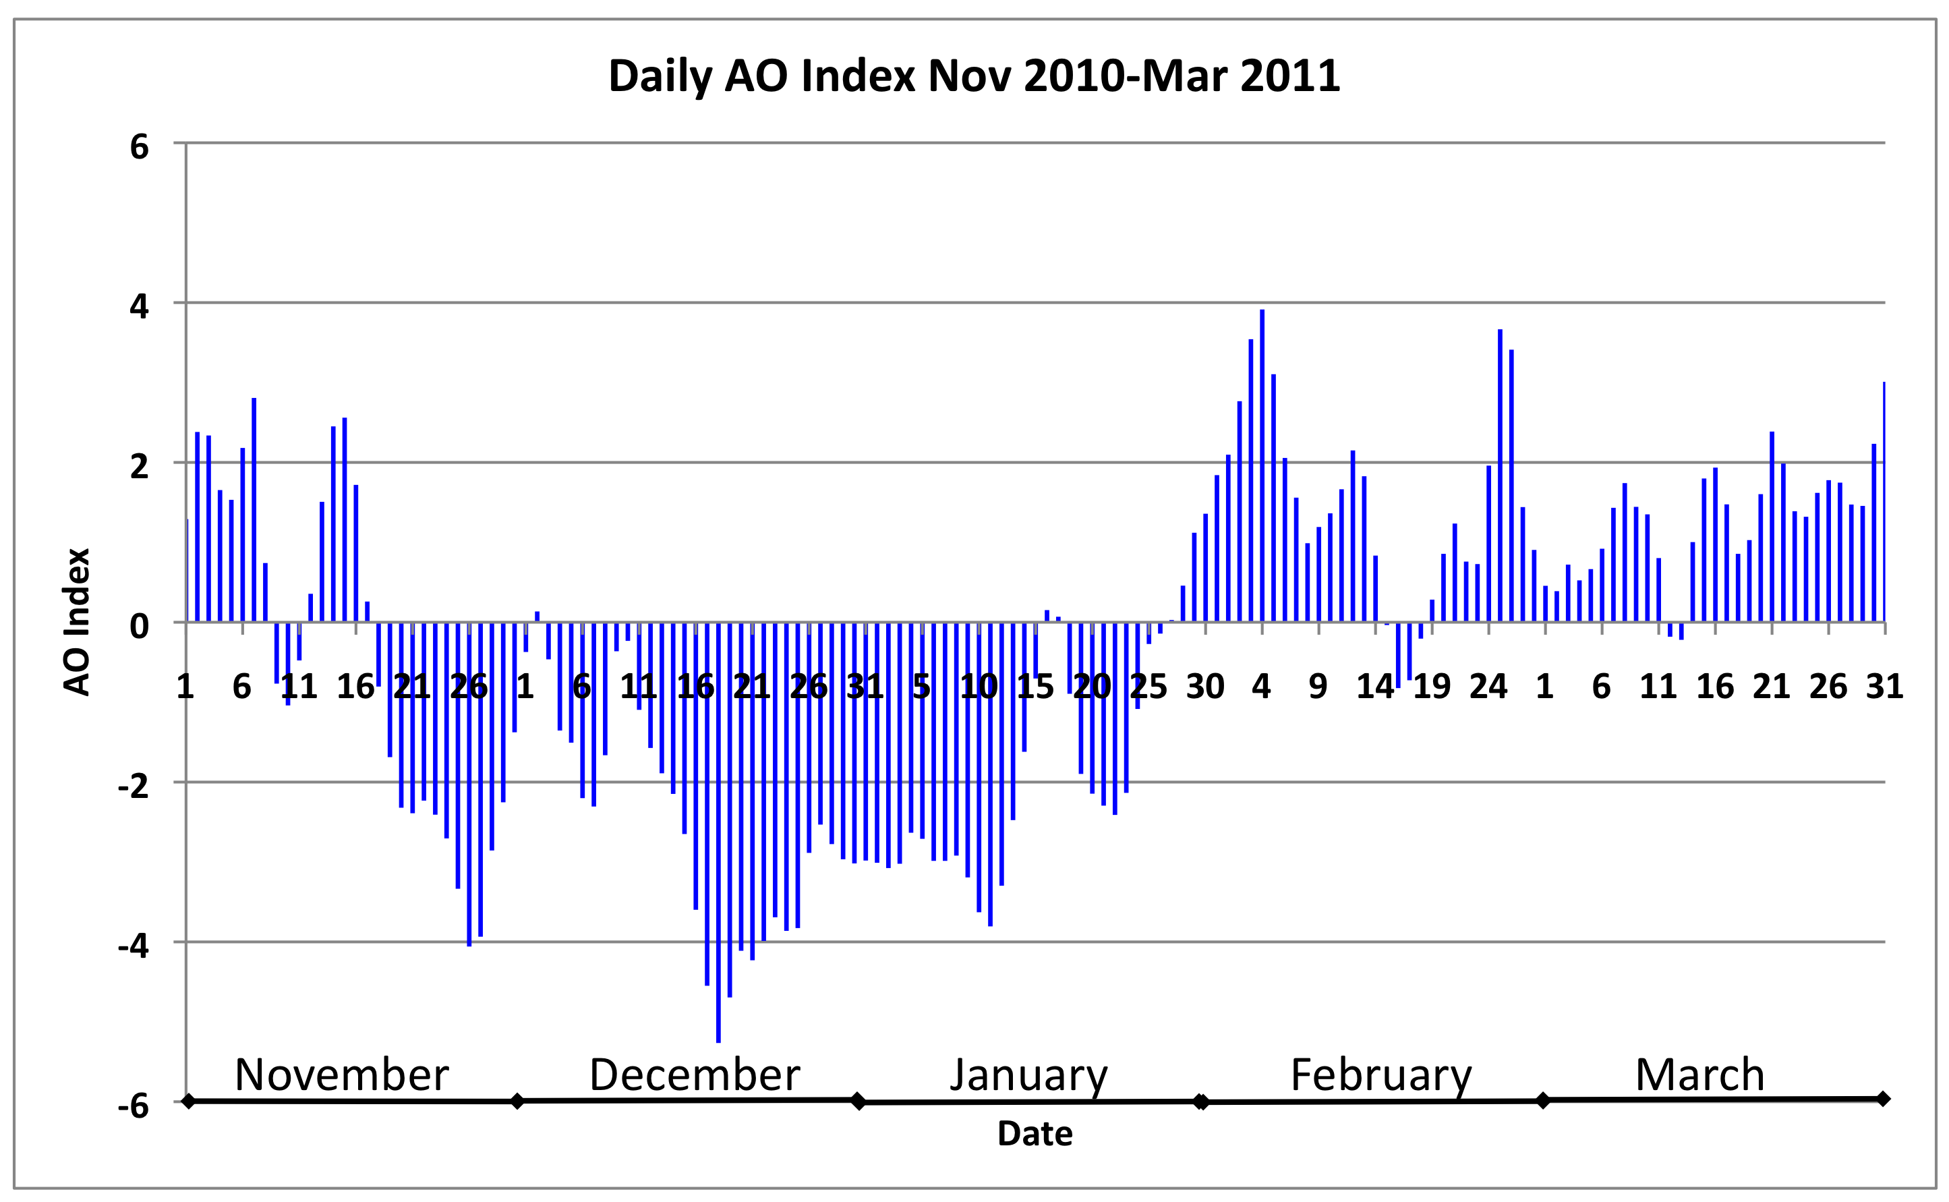
Daily AO Index Nov 2010–Mar 2011
Positive AO regime
AO regime transition
Negative AO regime
Daily AO index is constructed by projecting the daily (00Z) 1000mb height anomalies poleward of 20°N onto the loading pattern of the AO.
For more information, consult the CPC website [http://www.cpc.ncep.noaa.gov/products/precip/CWlink/daily_ao_index/ao.shtml].

Slide 5
Notable Weather Events: Winter 2010–2011
 | Day | Month | Year | Event
Dec 2010 | 10−12 | Dec | 2010 | Heavy rain in Pacific Northwest
 | 18−22 | Dec | 2010 | Heavy rain/snow in southern California
 | 26−27 | Dec | 2010 | Coastal Northeast snowstorm
Jan 2011 | 9−10 | Jan | 2011 | Southeast snow and ice storm
 | 18−19 | Jan | 2011 | NY/NJ and southern New England snowstorm
 | 20−21 | Jan | 2011 | Northeast snowstorm
 | 26−27 | Jan | 2011 | Northeast snowstorm
Feb 2011 | 1−3 | Feb | 2011 | Southern Plains to lower Great Lakes snowstorm
 | 8−10 | Feb | 2011 | OK/AR snowstorm
 | 10 | Feb | 2011 | OK breaks all-time minimum temperature (−30.5°F)
Source: L. Bosart

Slide 6
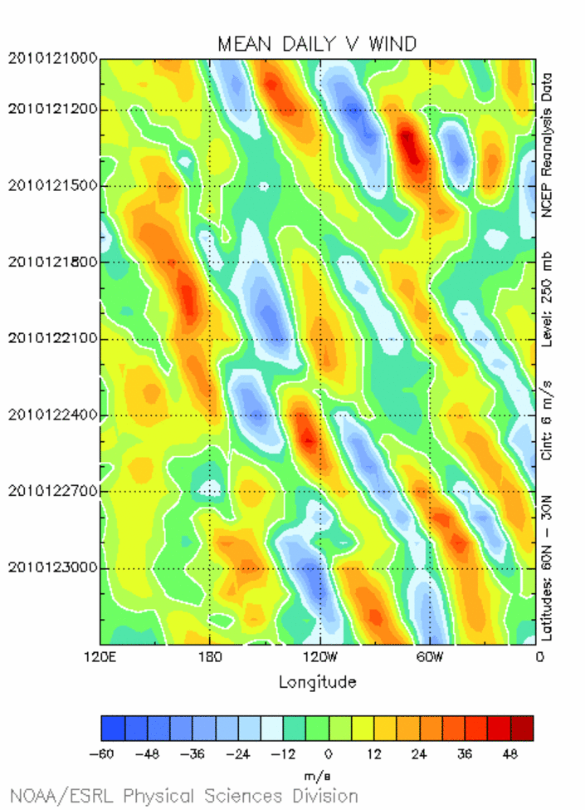
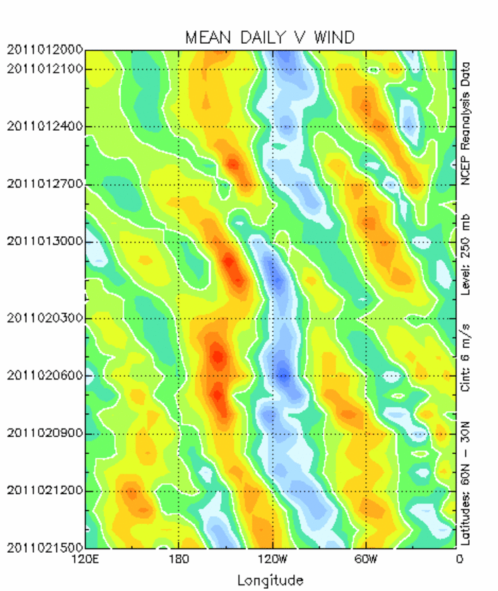
250 hPa Meridional Wind Component (lat avg 30–60°N)
Negative AO Regime
Positive AO Regime
X
X
Northeast US
snow storm
10-12 Dec
Pacific NW
heavy rains
18-22 Dec
southern CA
heavy rain
and snow
X
X
1-3 Feb
snow storm
X
26-27 Dec
coastal storm
X
OK/AR
snow storm
X
Record cold
in OK
X
Transient “wave packets”
associated with high-impact weather
Persistent blocking pattern
associated with high-impact weather
Hovmoller diagrams were computed using the NOAA/ESRL Physical Sciences Division Interactive Plotting and Analysis website

Slide 7
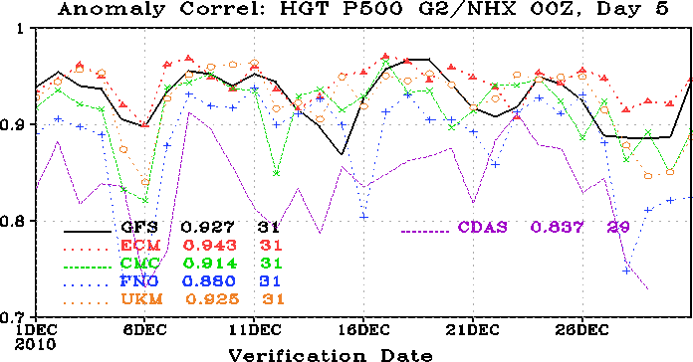
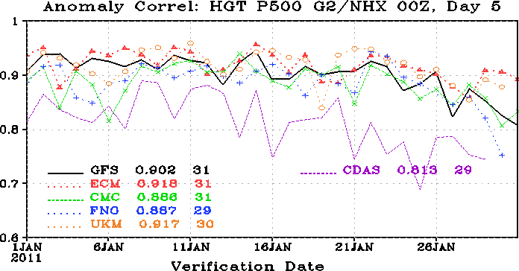
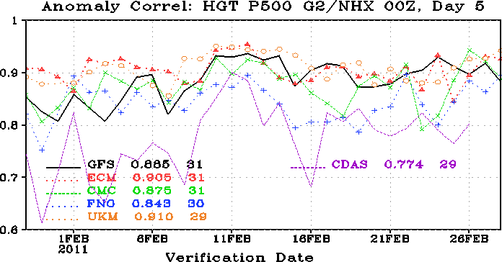
NH AC Scores
Dec 2010-Feb 2011
AO regime transition
AO regime transition
Decreased skill during transient synoptic
scale events in December 2010
Extended period of decreased skill during negative to positive AO transition in late January through early February

Slide 8
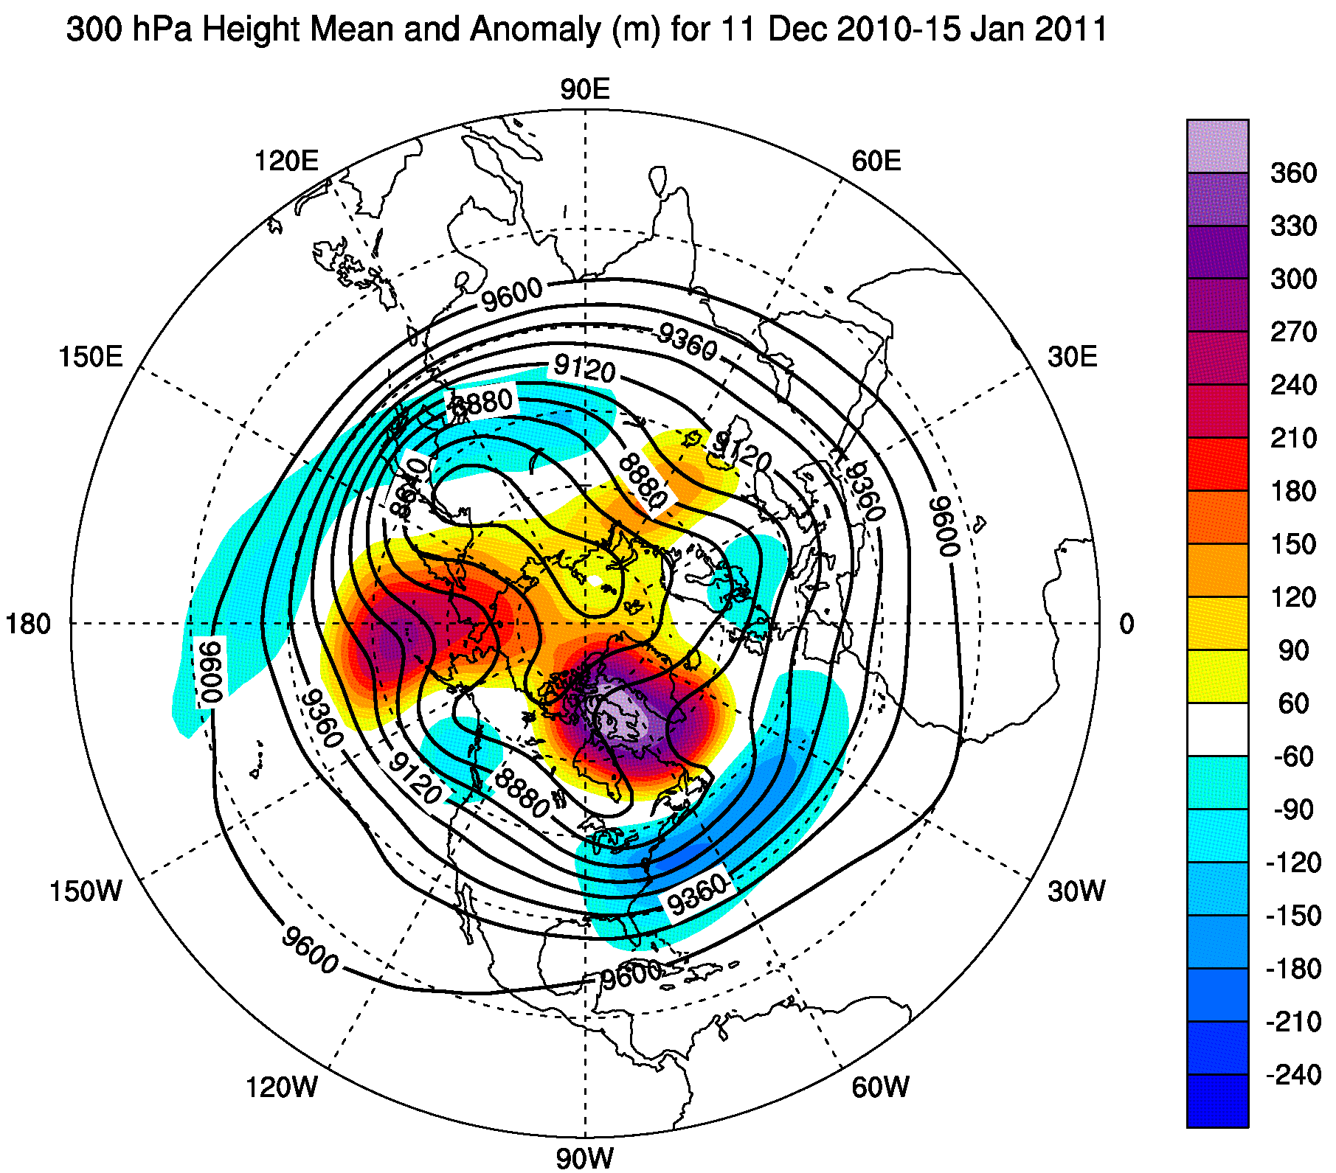
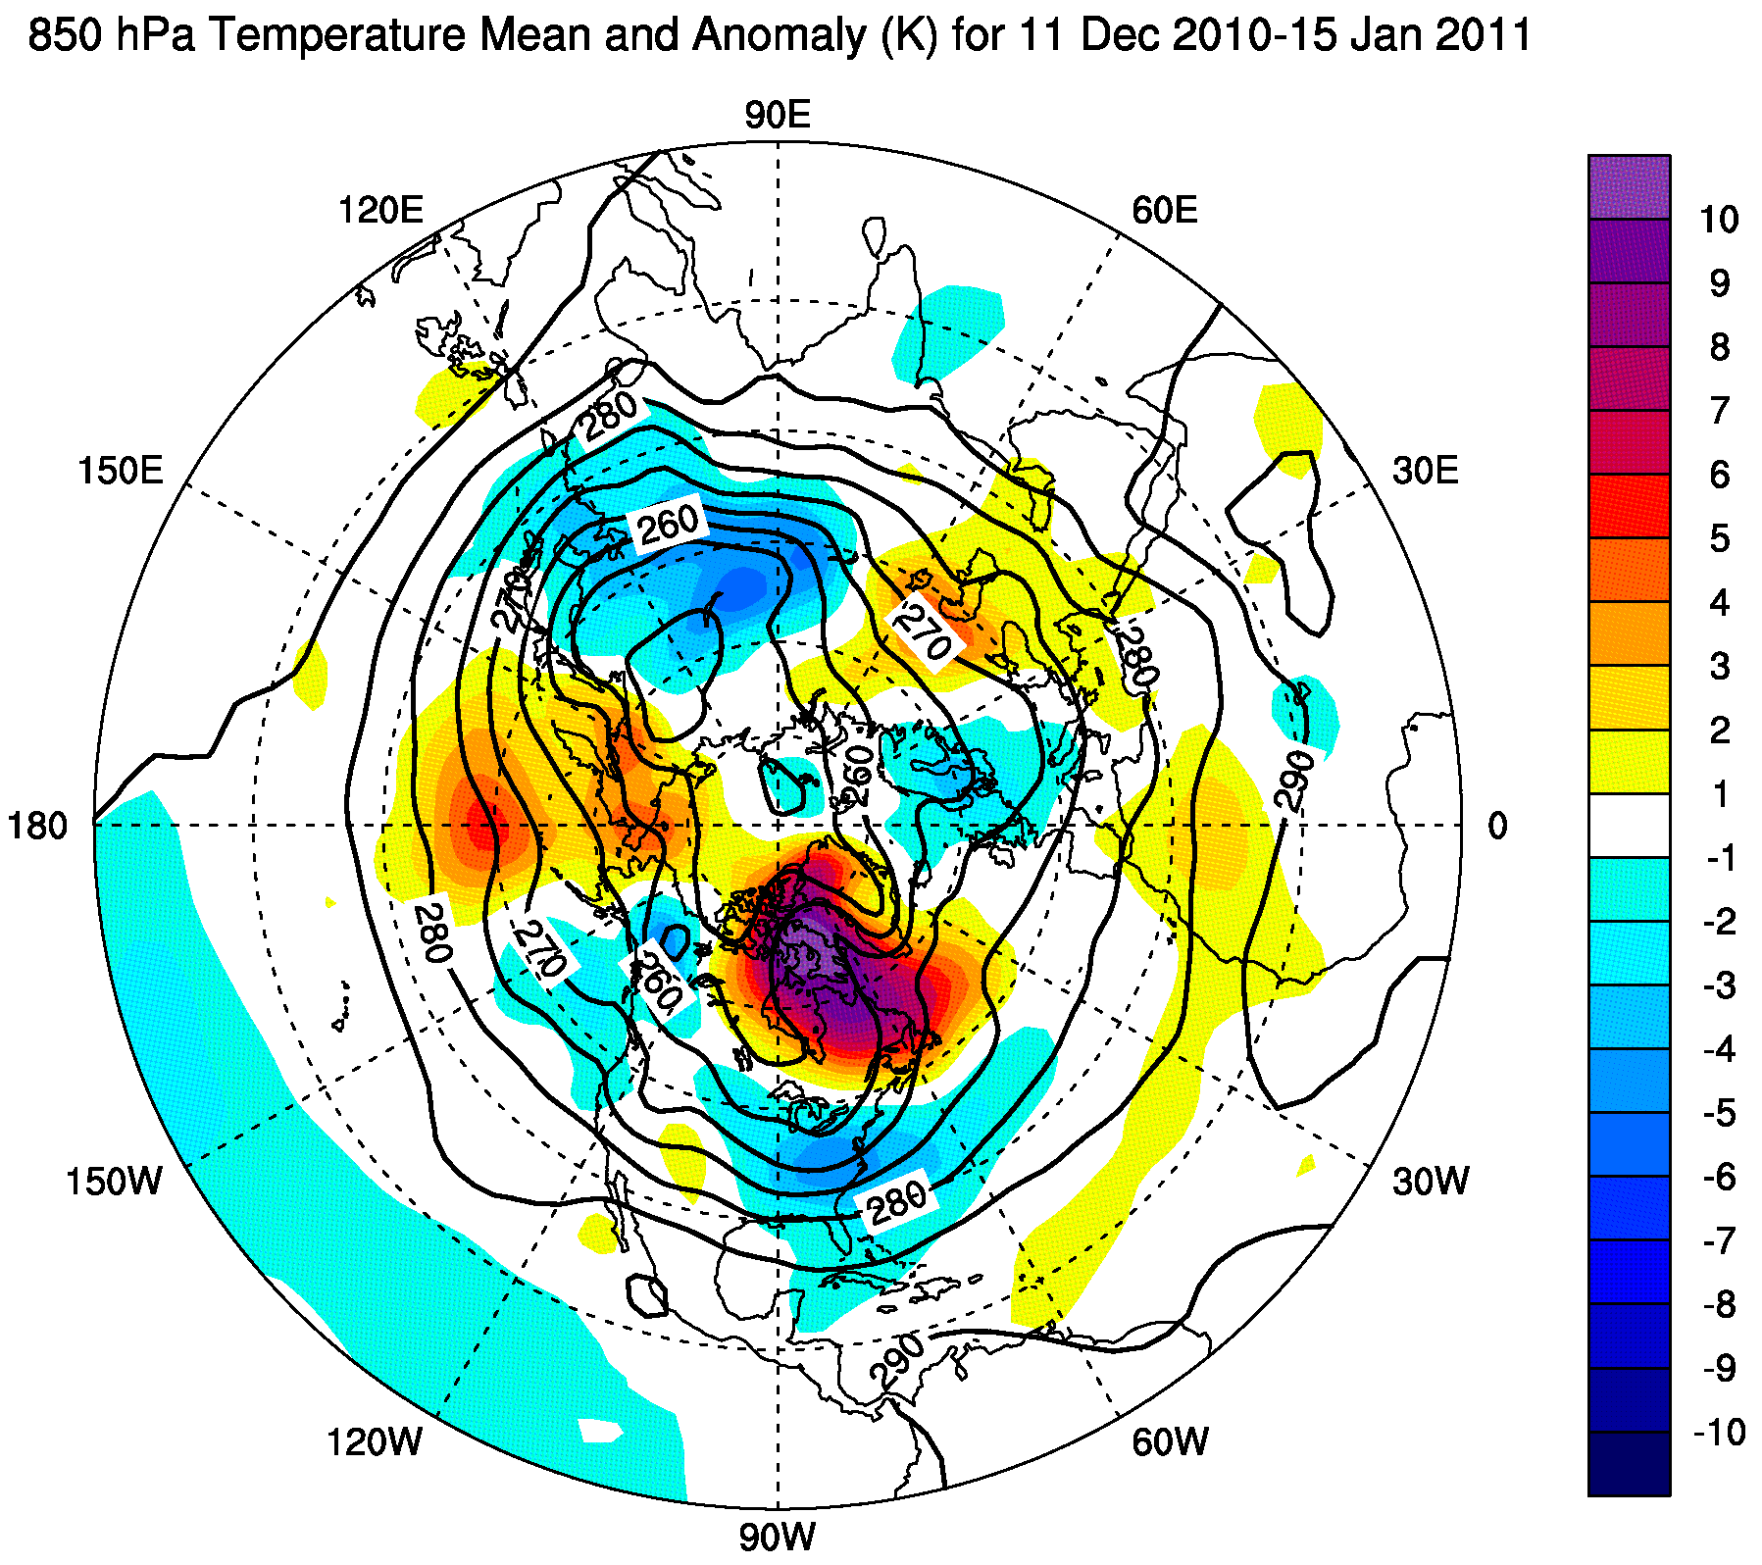
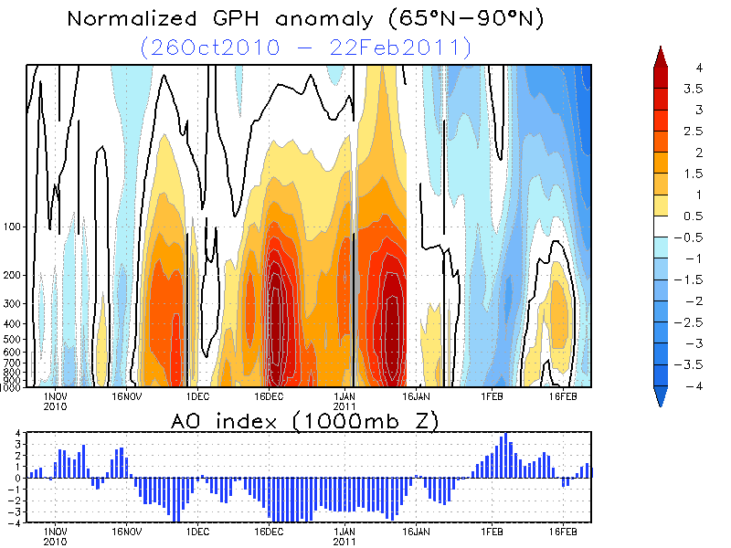
Mean Flow Pattern: Negative AO Phase
Highly amplified flow pattern – large meridional fluxes of heat
CPC AO Index: 1 Dec 2010–15 Feb 2010
+4
+4
Source: Climate Prediction Center
Index (SD)
0
0
-4
-4
1 Dec 10
16 Dec 10
1 Jan 11
16 Jan 11
1 Feb 11

Slide 9
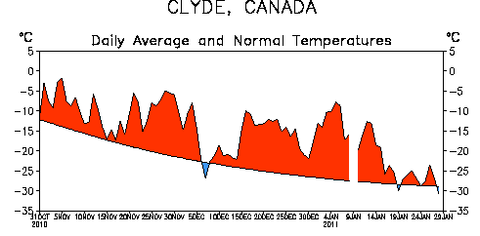
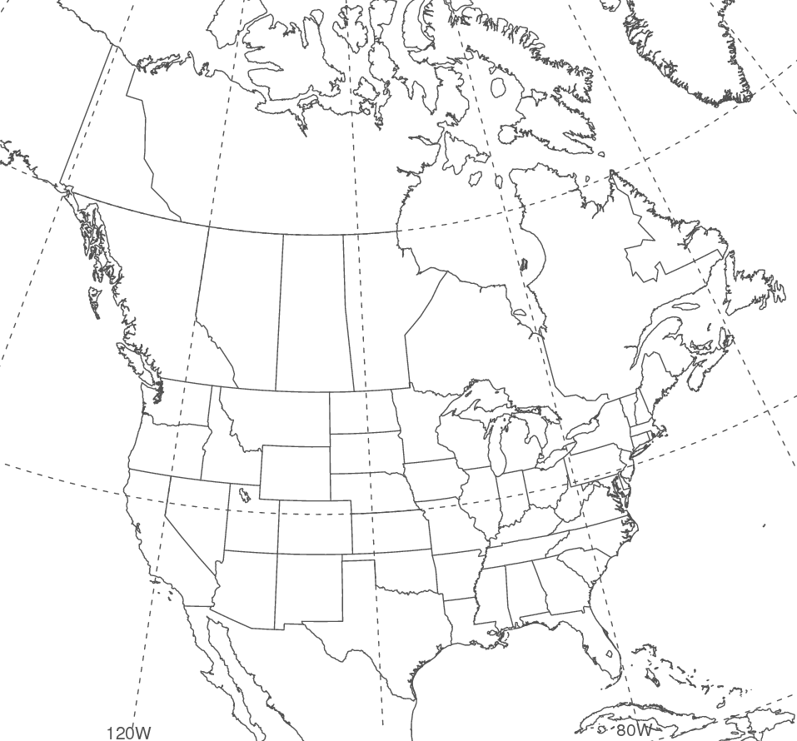
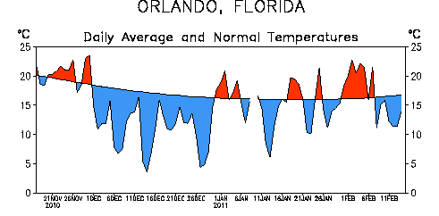
90-Day Temperature Time Series
31 October 2010 – 28 January 2011
Clyde
Hudson
Bay
Canada
United States
Orlando
Anomalous high-latitude warming as maritime air surges into Canada on western flank of
North Atlantic ridge
Anomalous low-latitude cooling as arctic air surges equatorward over continental regions

Slide 10
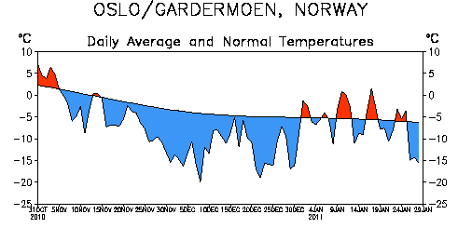
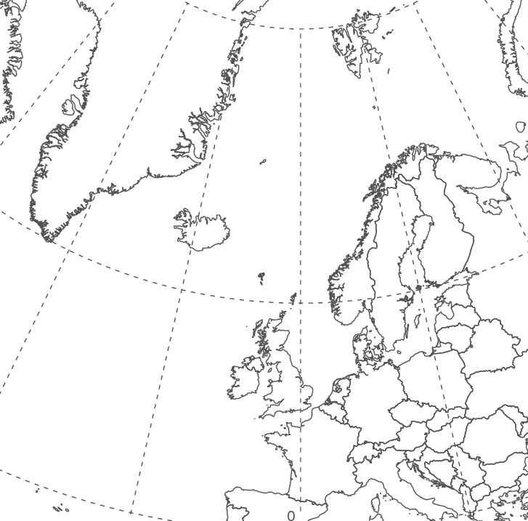
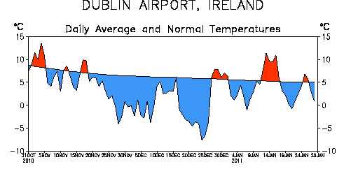
90-Day Temperature Time Series
31 October 2010 – 28 January 2011
Greenland
Atlantic
Ocean
Oslo, Norway
Dublin, Ireland
Anomalously cool on eastern flank of prominent ridge over North Atlantic
Source: L. Bosart

Slide 11
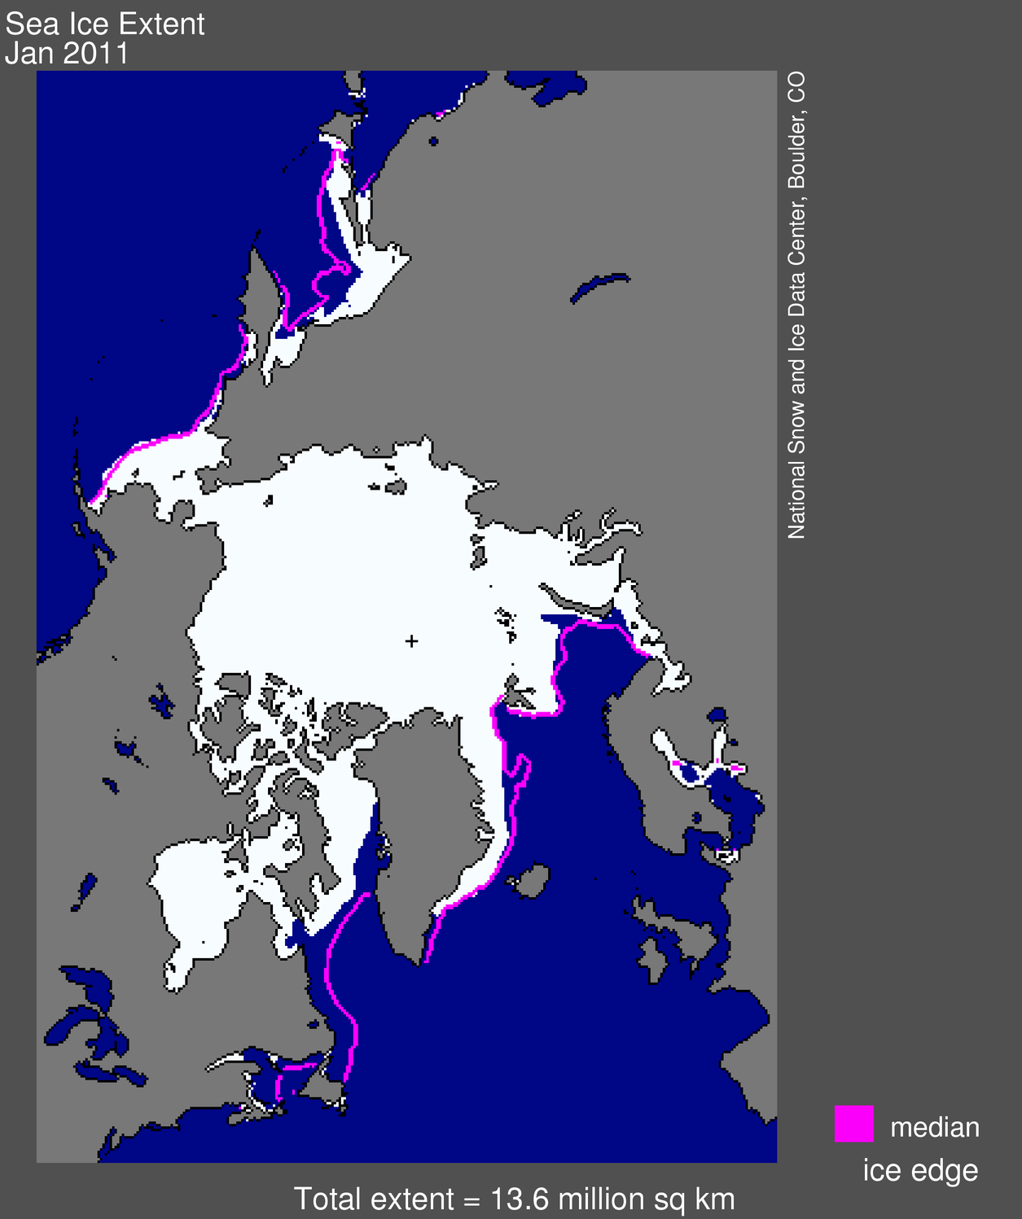
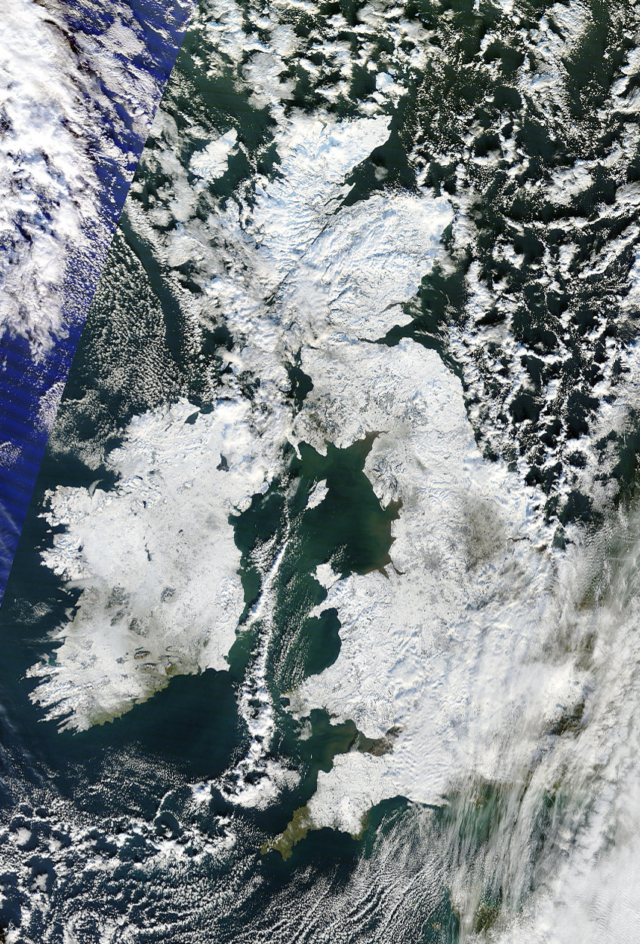
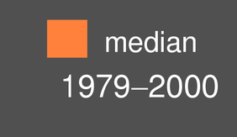
Negative AO Regime – North Atlantic Blocking
2 Jan 2011 Sea Ice Extent
24 Dec 2010 Visible Image
Glasgow
Dublin
London
Source: National Snow and Ice Data Center
Source: MODIS Rapid Fire Online Server
Mild, onshore flow over eastern Canada limits extent of sea ice
Anomalous cold air over northern Europe promotes extensive U.K. snow cover
Source: L. Bosart

Slide 12
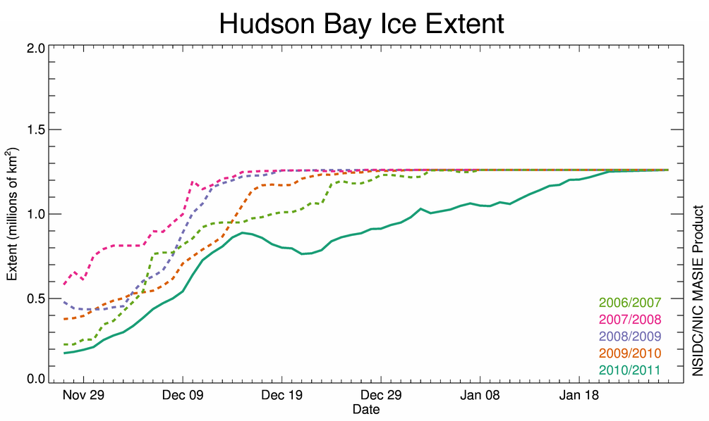
Hudson Bay Sea Ice Extent: Nov–Jan 2006–2011
2010/2011
Source: L. Bosart

Slide 13
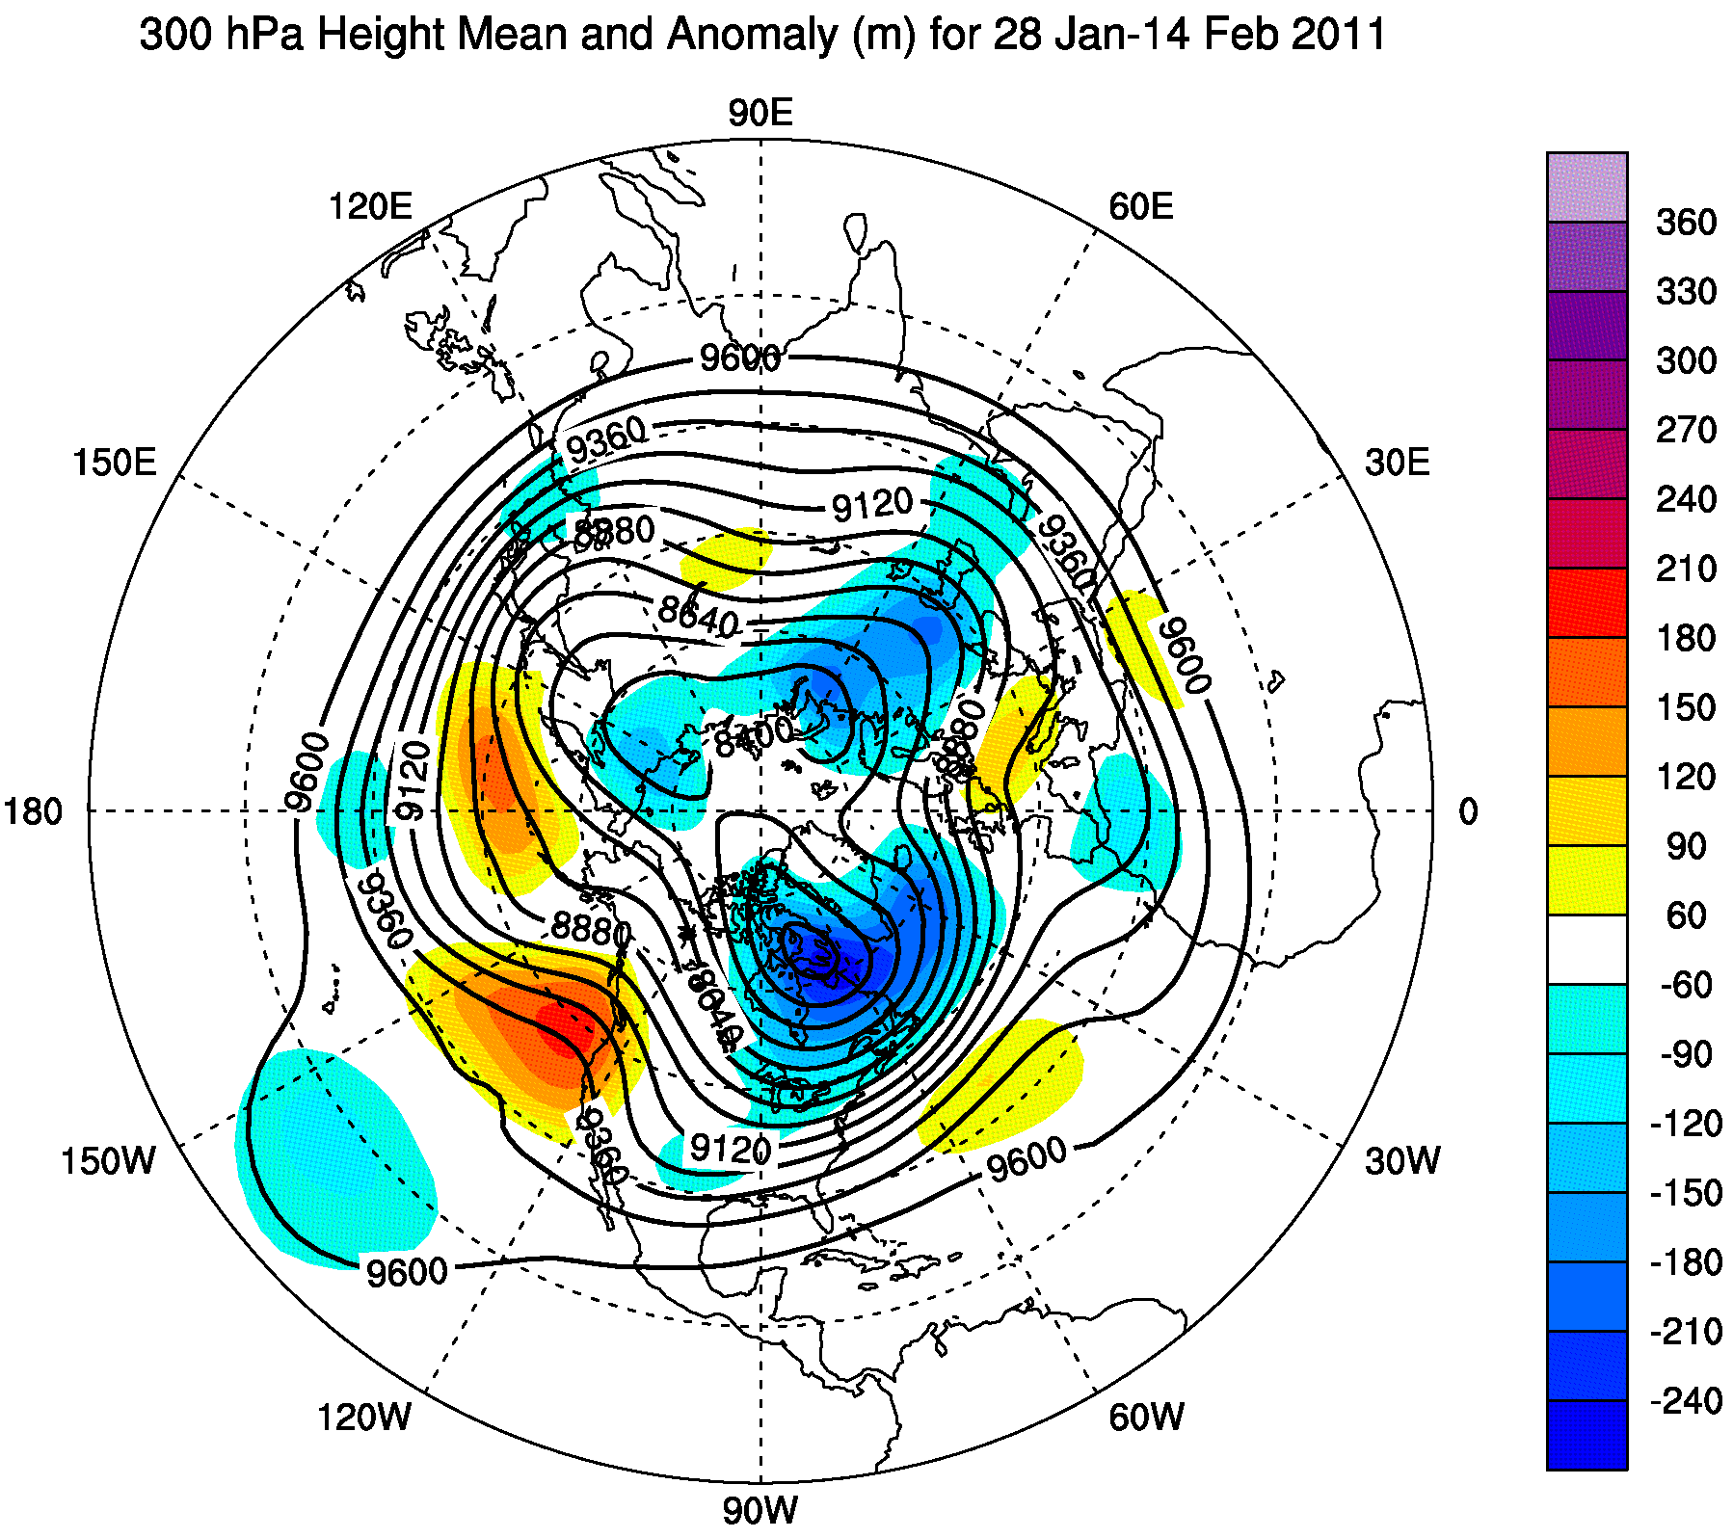
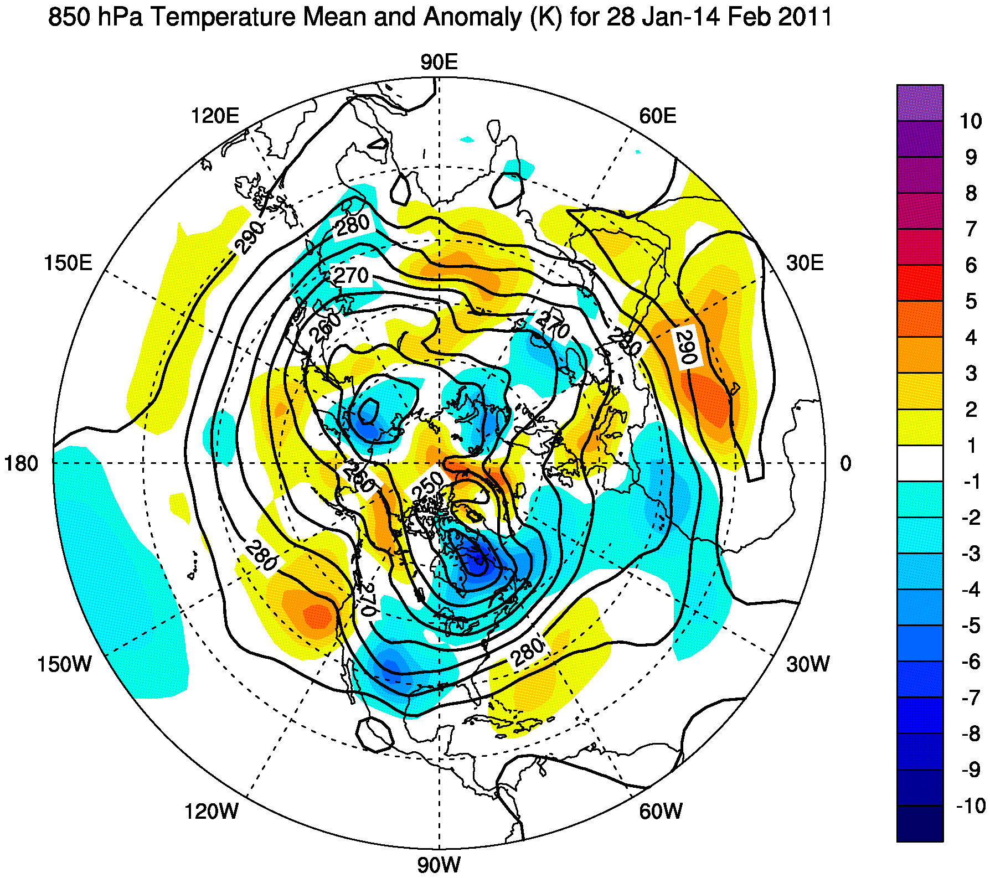
Mean Flow Pattern: Positive AO Phase
Polar vortex re-established over northeast Canada – strong jet and baroclinicity over southern US
CPC AO Index: 1 Dec 2010–15 Feb 2010
+4
+4
Source: Climate Prediction Center
Index (SD)
0
0
-4
-4
1 Dec 10
16 Dec 10
1 Jan 11
16 Jan 11
1 Feb 11

Slide 14
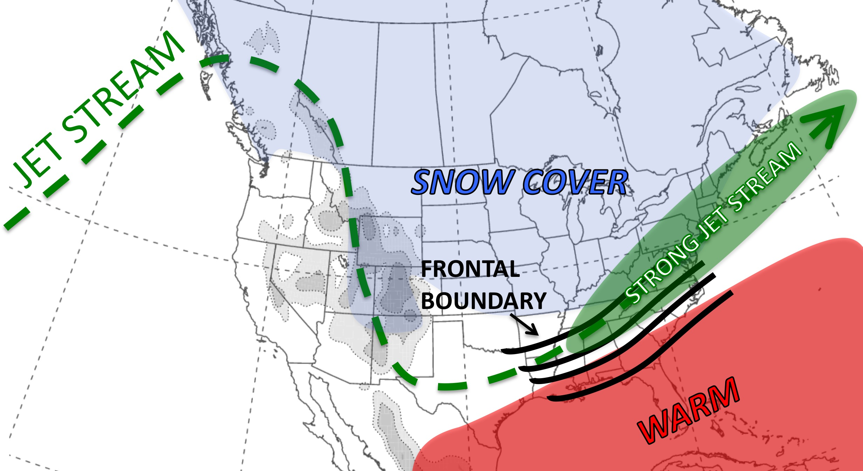
Schematic of Key Meteorological Features
Early February 2011
Source: L. Bosart

Slide 15
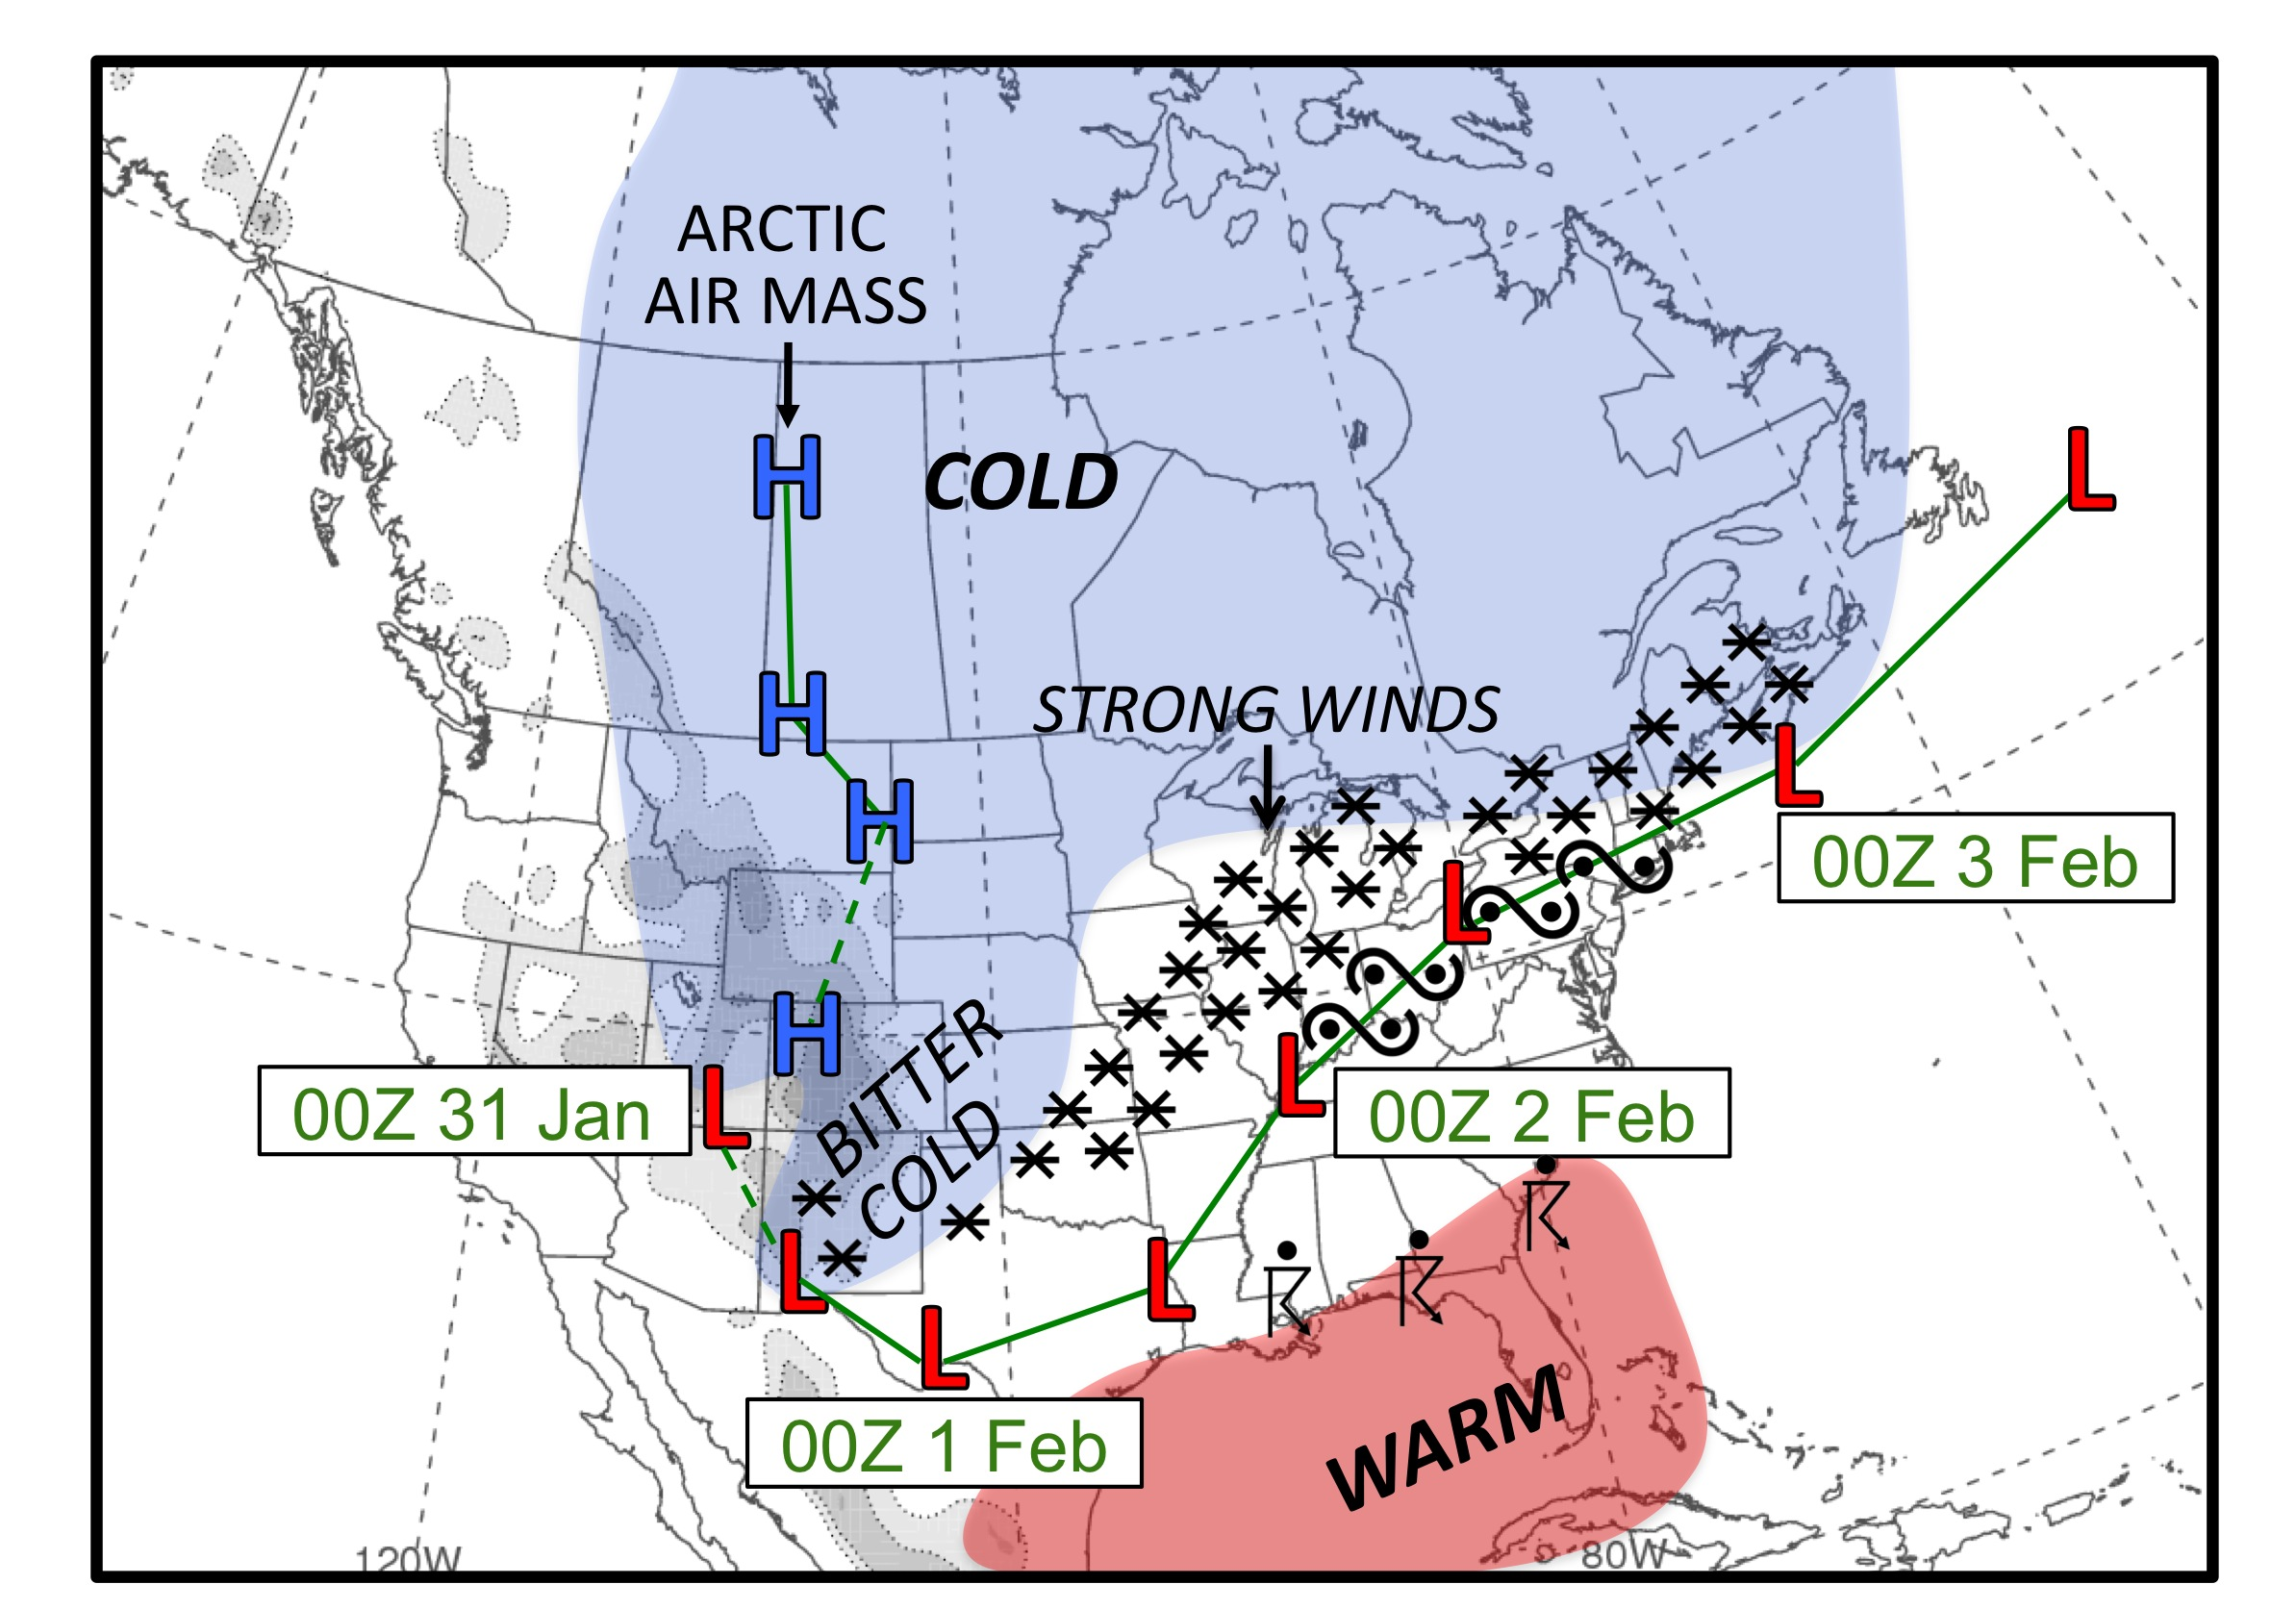
Schematic of 1–3 February 2011 Snowstorm
Source: L. Bosart

Slide 16
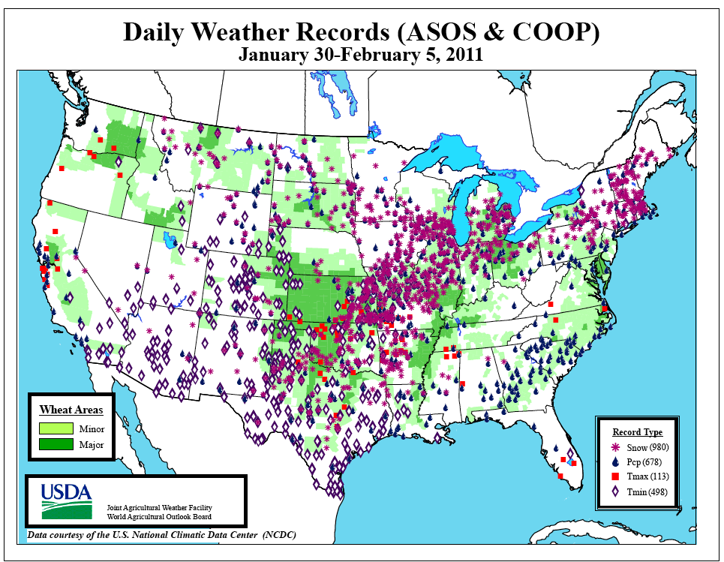
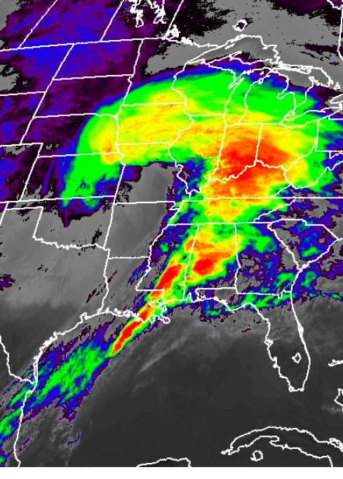
1–3 February 2011 Snowstorm
Daily Snow, Precipitation, and Temperature Records for 30 Jan–5 Feb 2011
GOES East IR Satellite Image: 3:01 pm EST on 1 Feb 2011
Source: L. Bosart
Images taken from Weekly Weather and Crop Bulletin

Slide 17
Summary of Large-Scale Conditions
Extreme winter weather during 2010–2011 can be related to:
  Amplified flow pattern allowing mild Atlantic air to reach eastern Canada and cold air to reach western Europe and the southern U.S. during negative AO phase
  Cold high pressure systems that deliver cold air to the southern U.S.
  Extensive snow cover at lower latitudes east of the Rockies that reinforces frontal boundaries
  Frequent storminess along these reinforced frontal boundaries also linked to “wave packets”

Slide 18
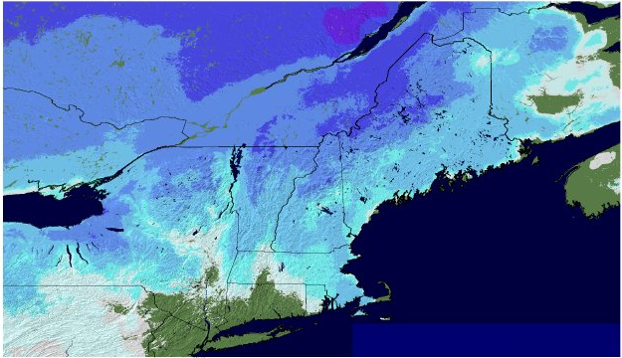
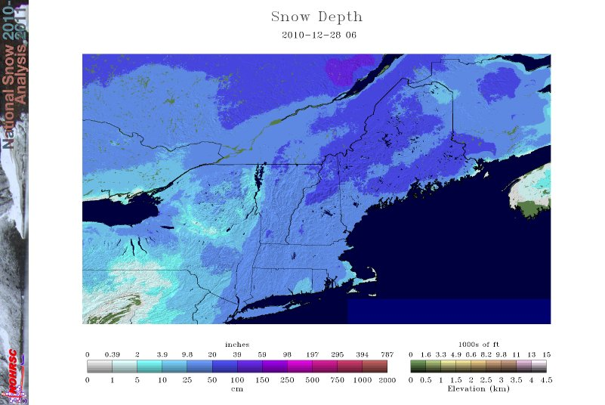
Storm Structure Differences in +/- AO Regimes
26–27 December 2010 coastal storm
  Significant snows and blizzard conditions
  One to two feet of snow east of Hudson River
Snow Cover
26 Dec 2010
28 Dec 2010
Source: NOAA National Operational Hydrologic Remote Sensing Center

Slide 19
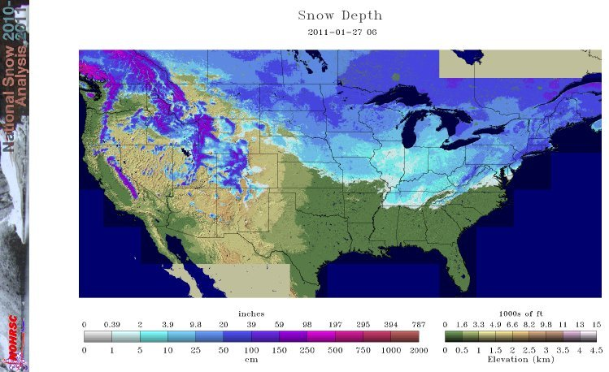
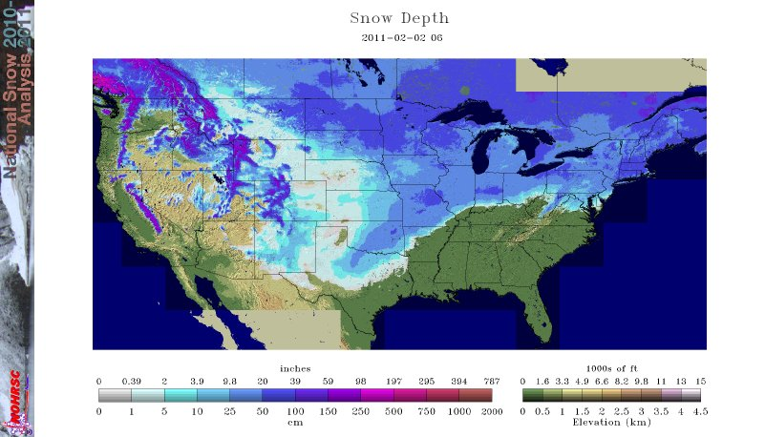
Storm Structure Differences in +/- AO Regimes
1–3 February 2011 snow storm
  Record-breaking snow from OK to northeast
  Record cold over southern Plains
Snow Cover
27 Jan 2011
3 Feb 2011
Source: NOAA National Operational Hydrologic Remote Sensing Center

Slide 20
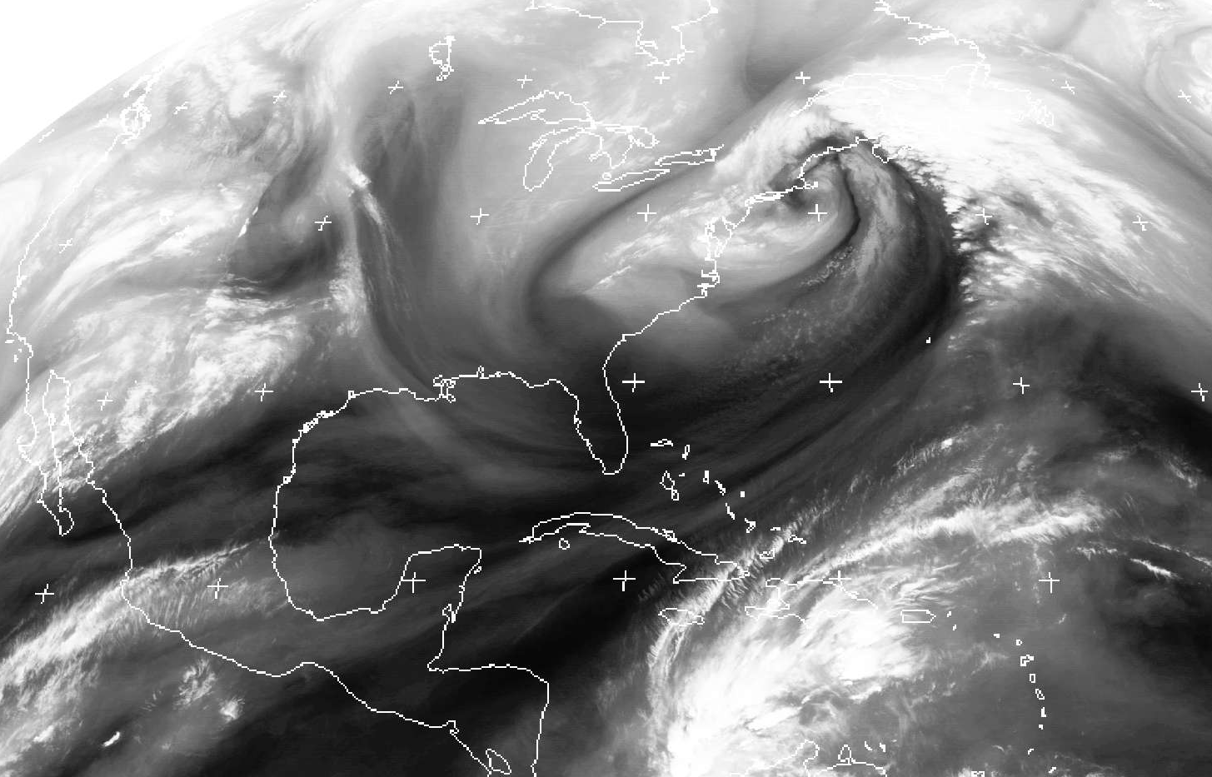
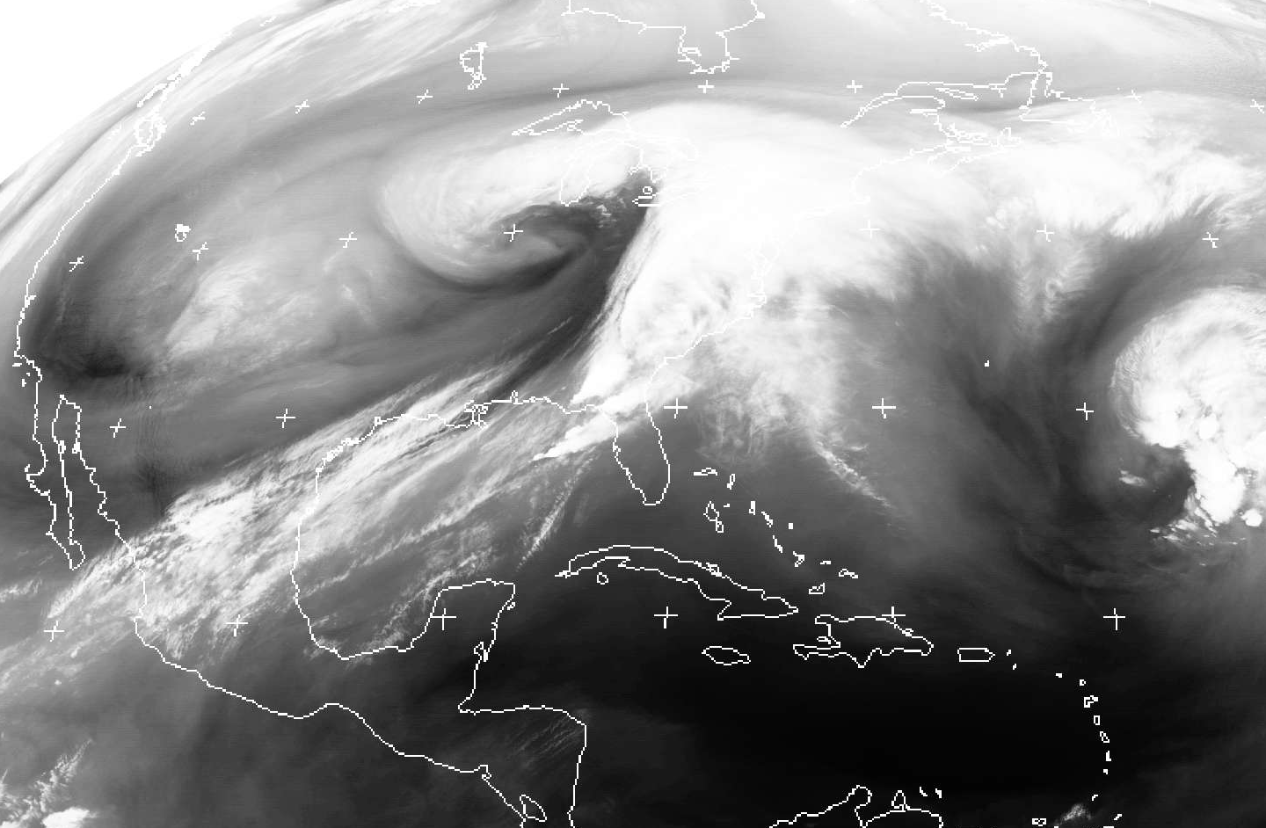
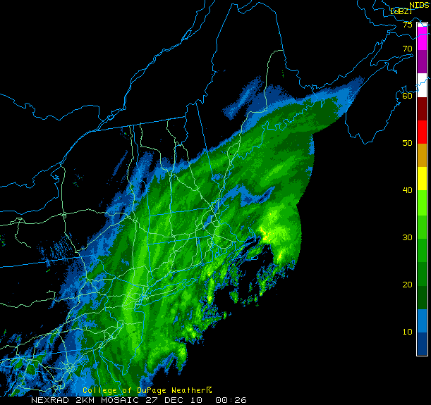
GOES-12 Water Vapor Imagery
L
L
1200 UTC 27 Dec 2010
Negative AO Regime
0600 UTC 2 Feb 2011
Positive AO Regime
L=surface low position at MSL

Slide 21
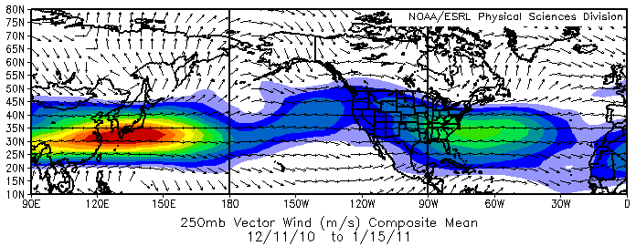
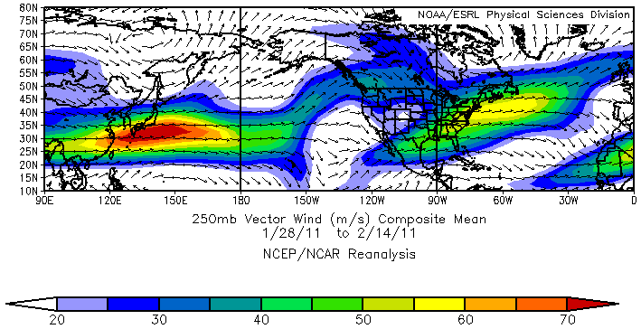
11 Dec 2010–15 Jan 2011
- Negative AO phase
- Storms over US and western North Atlantic occur on cyclonic shear side of mean jet
- Favors negatively-tilted troughs and east coast snowstorms.
L
L
L
28 Jan–14 Feb 2011
- Positive AO phase
- Storms over US and western North Atlantic occur along axis of mean jet
- Favors positively-tilted troughs and fast-moving cyclones.
L
L
L
L

Slide 22
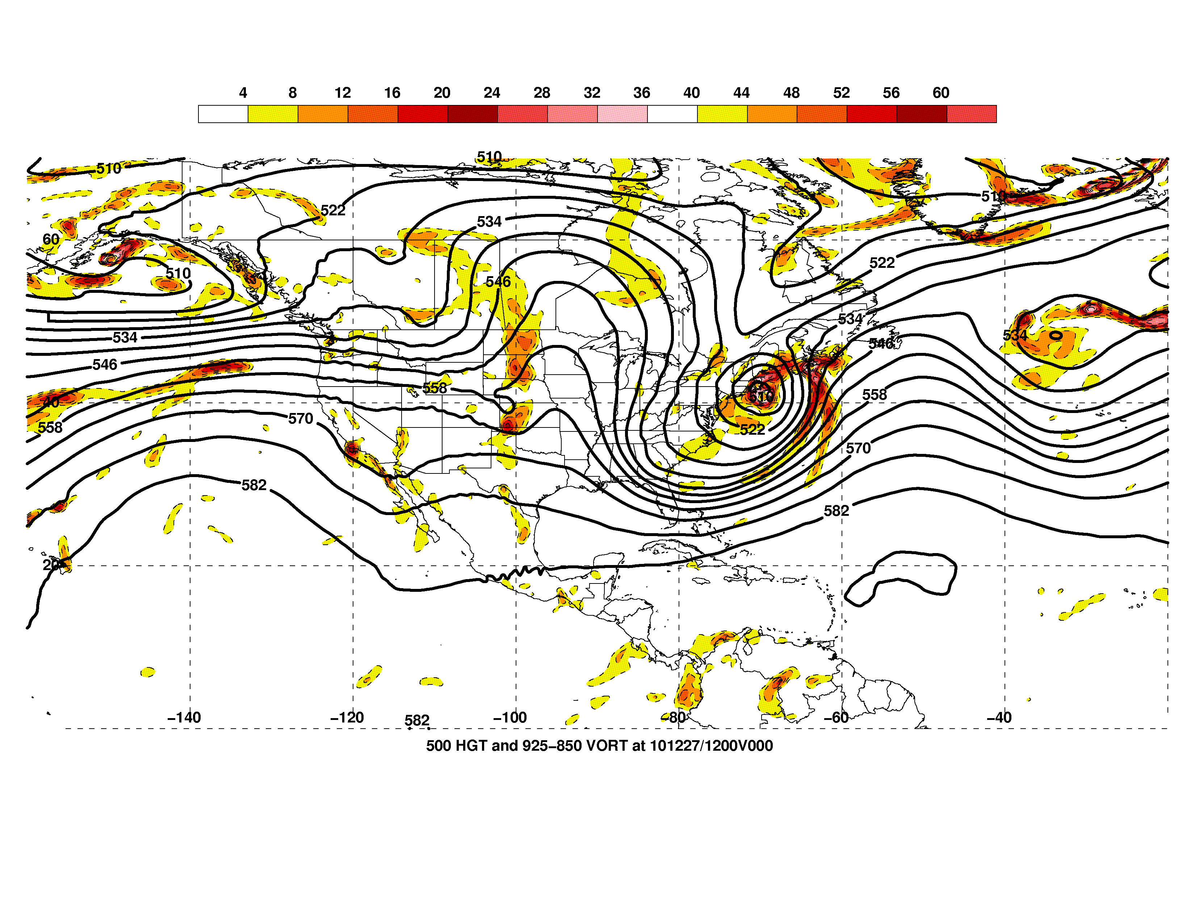
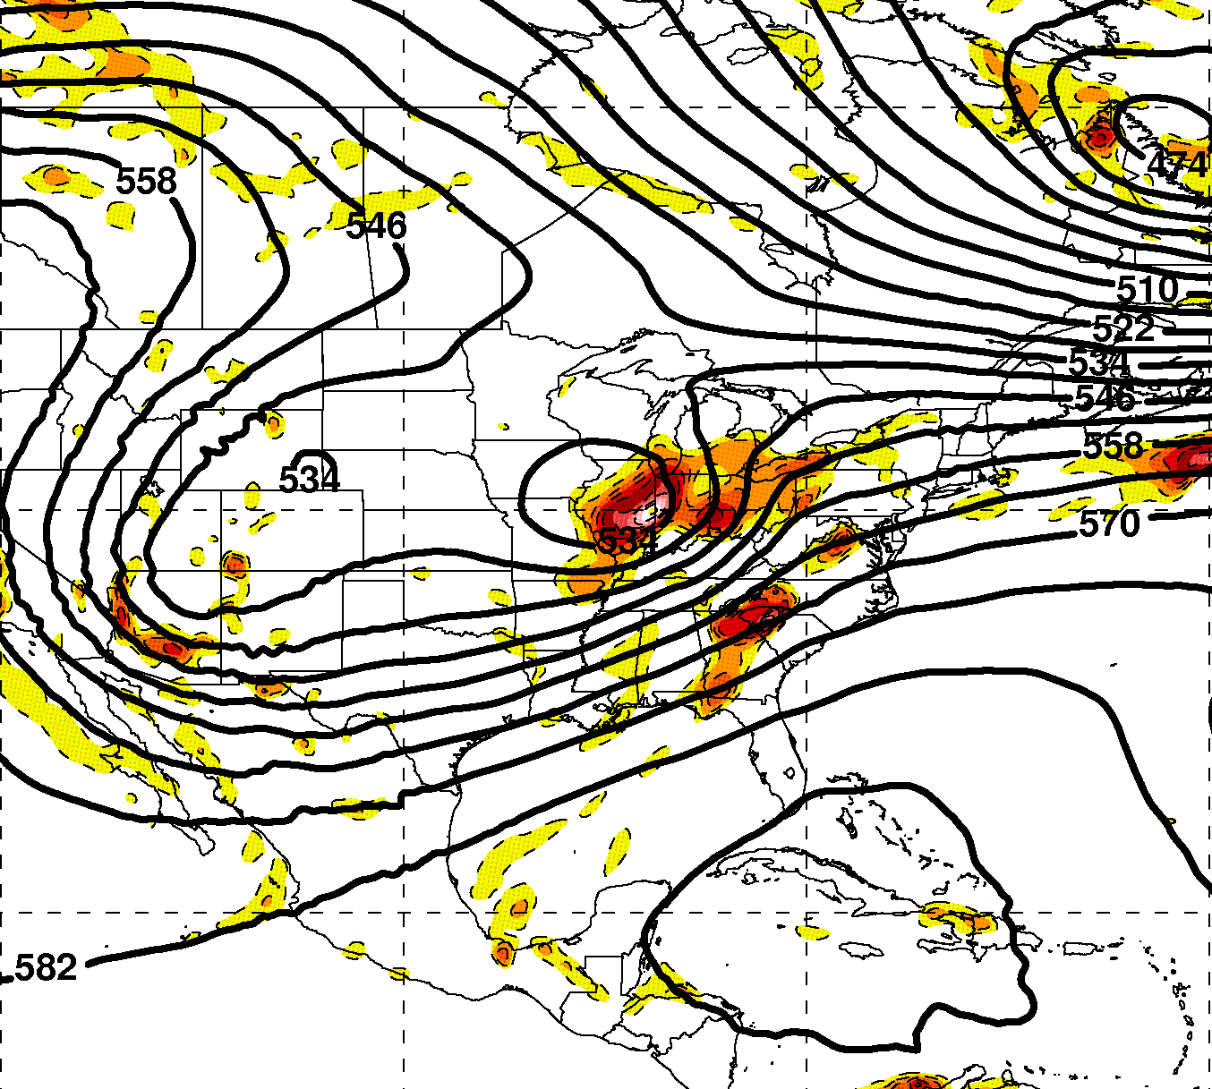
500-hPa Height (contours in dam)
and 925–850-hPa ζ (shaded in 10⁻⁵ s⁻¹)
L=surface low position at MSL
L
L
1200 UTC 27 Dec 2010
Negative AO Regime
0600 UTC 2 Feb 2011
Positive AO Regime
“Roll-up” on cyclonic shear-side of jet
Amplified flow pattern
Neutral to negative trough tilt
Fast-moving cyclone embedded along jet axis
Confluent jet entrance region
Positive trough tilt

Slide 23
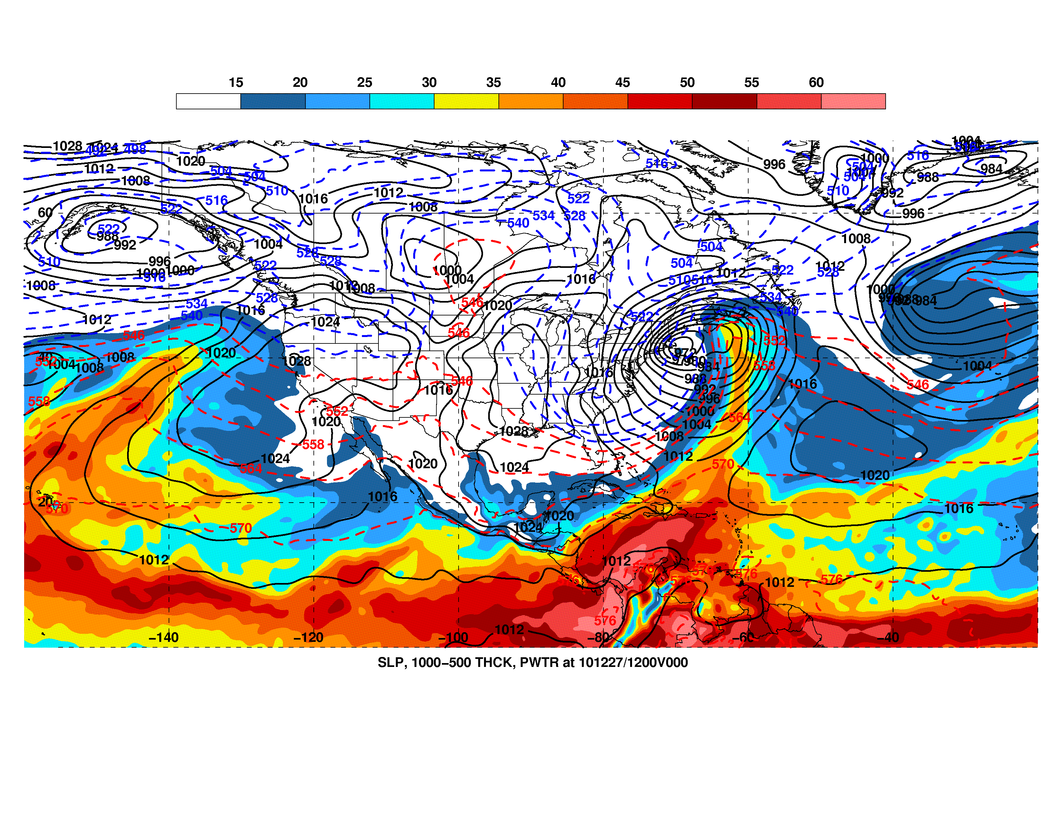
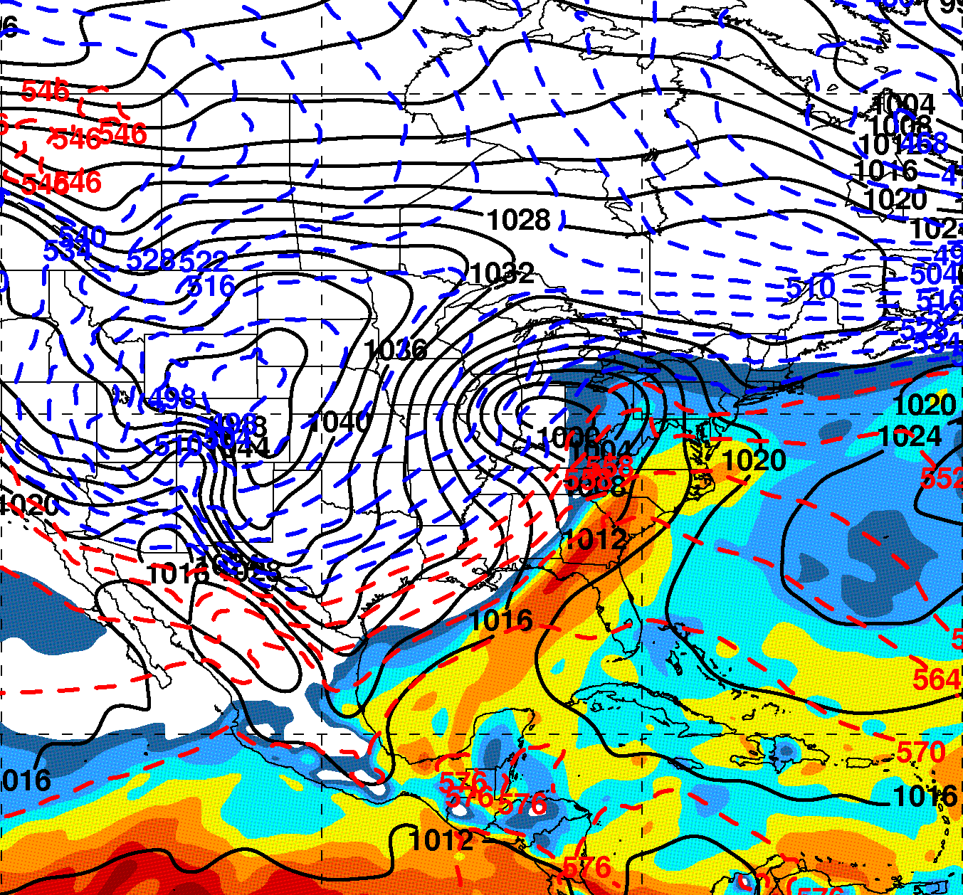
Precipitable Water (shaded in mm), MSLP (contours in hPa),
and 1000–500-hPa thickness (dashed contours in dam)
L=surface low position at MSL
L
L
1200 UTC 27 Dec 2010
Negative AO Regime
0600 UTC 2 Feb 2011
Positive AO Regime
Strongest surface winds on NW side of low
Heavy snowfall on NW side of low
is disconnected from tropical moisture feed
Snowfall over and NE of low directly fed by
tropical moisture feed

Slide 24
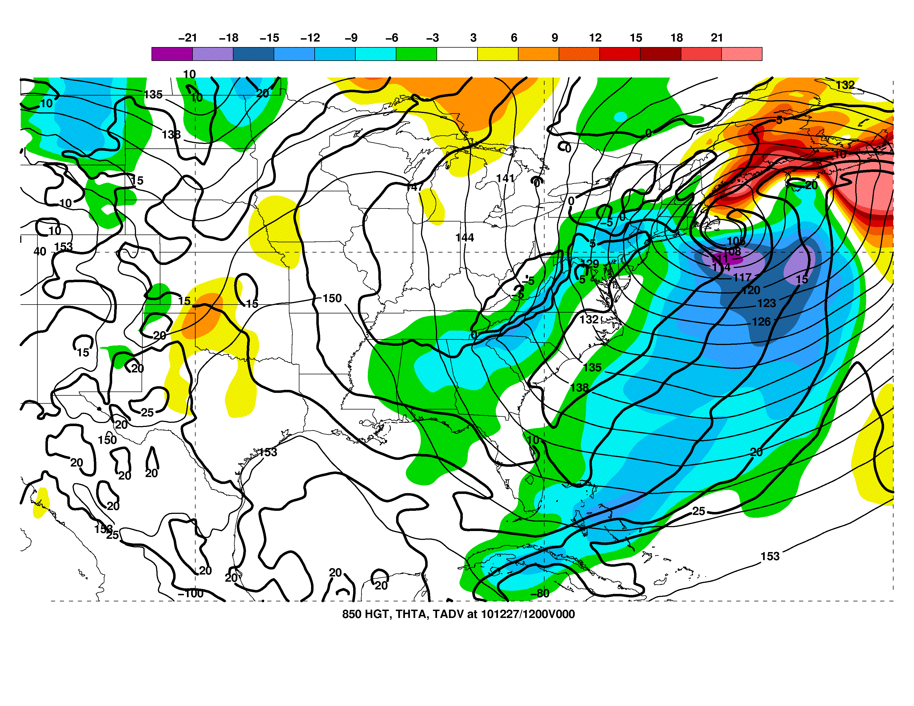
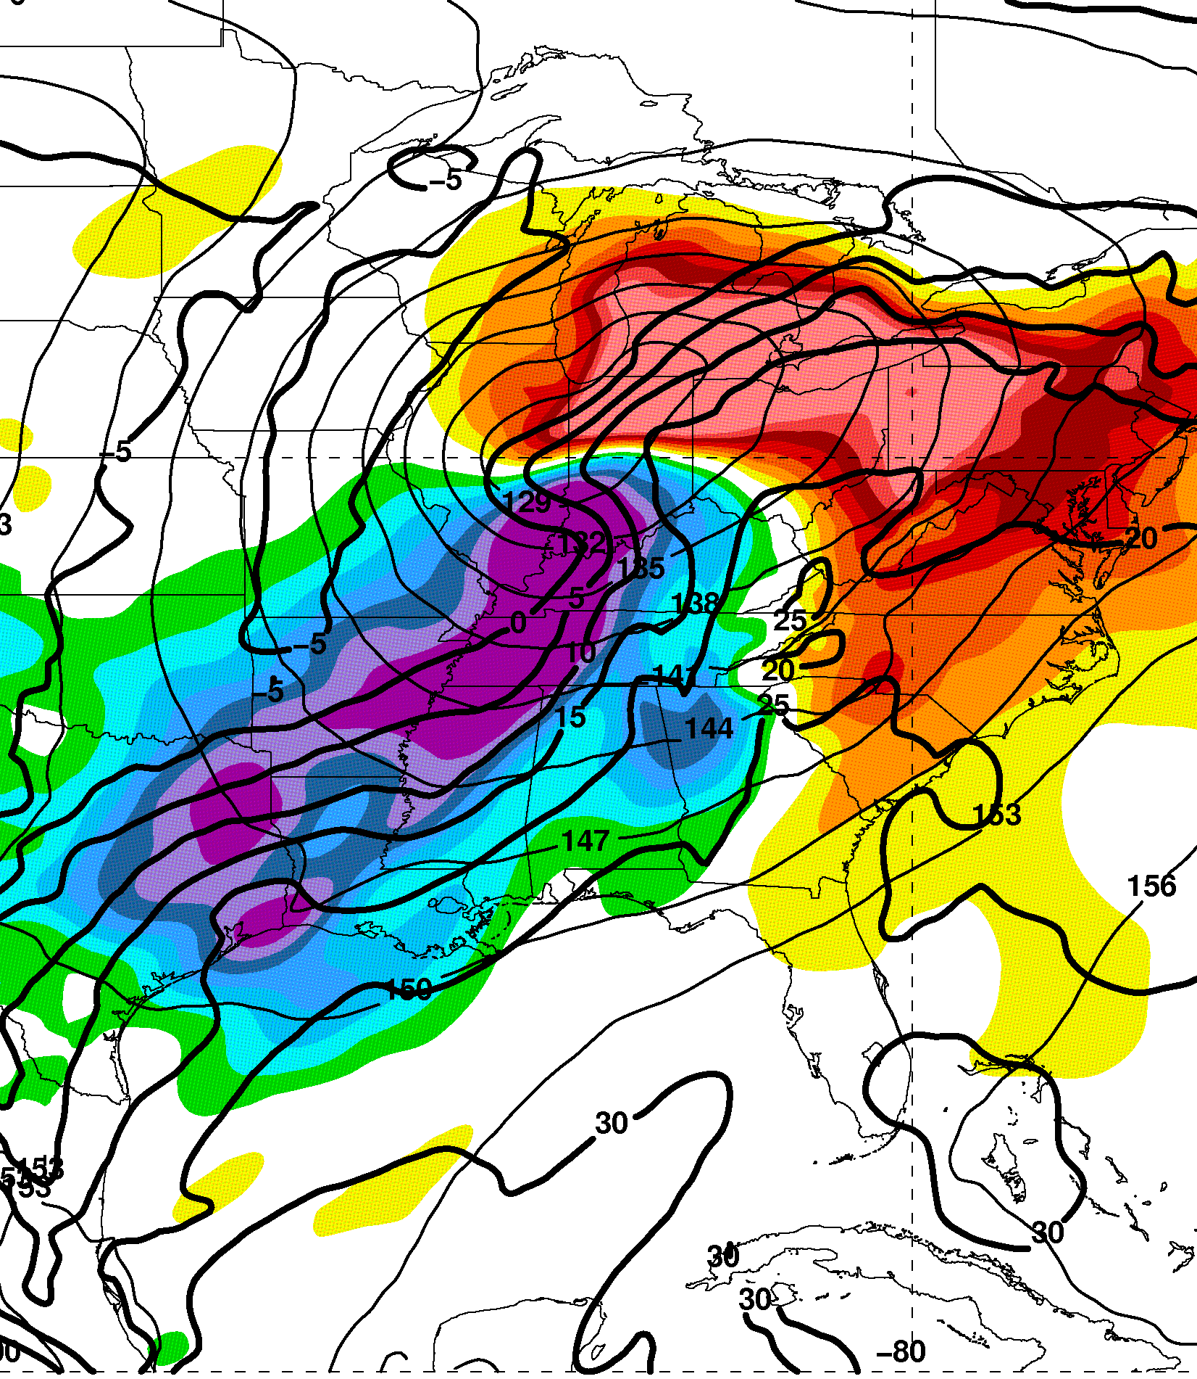
850-hPa Φ (thin contours in dam), θ (thick contours in K),
and thermal advection (shaded in K/12 h)
L=surface low position at MSL
L
L
1200 UTC 27 Dec 2010
Negative AO Regime
0600 UTC 2 Feb 2011
Positive AO Regime
Heavy snowfall on NW side of low
in conjunction with warm advection
Development of warm seclusion
Snowfall developed over large region in
conjunction with warm advection

Slide 25
Summary of Storm Structure Differences
26-27 Dec 2010 coastal storm: negative AO
  Surface cyclone developed on cyclonic-shear side of upper-level jet and along axis of enhanced baroclinicity along US east coast
  Amplified flow pattern and negatively-tilted trough
  Vertically-stacked cyclone with development of warm seclusion
1-3 Feb 2011 snow storm: positive AO regime
  Fast-moving surface cyclone developed along axis upper-level jet and enhanced low-level baroclinicity
  Positively-tilted trough and downstream confluent jet entrance region

Slide 26
High-Impact Weather Threats
26-27 Dec 2010 coastal storm: negative AO
  Heavy precipitation, organized in intense bands, focused on NW side of cyclone in conjunction with warm air advection
  Very strong surface winds on NW side of warm seclusion – can reach hurricane force with stronger storms (more typical over oceans)
1-3 Feb 2011 snow storm: positive AO regime
  Strong surface winds (near surface low) and heavy precipitation focused along broad axis of warm air advection NE of fast-moving cyclone – impacts over a large geographical region
  Heavy precipitation fed by deep tropical moisture feed

Slide 27
Schematic Summary
Coupled upper-level jets
Confluent upper-level jet
entrance region
Focused ascent
driven by WAA
Focused ascent assoc. w/
warm air advection
L
L
Strong near-surface
winds on back side of
warm seclusion
Southerly feed of
tropical moisture
Southerly feed of
tropical moisture
26–27 Dec 2010 cyclone
Negative AO regime
1–3 Feb 2011 cyclone
Positive AO regime

