Slide 1
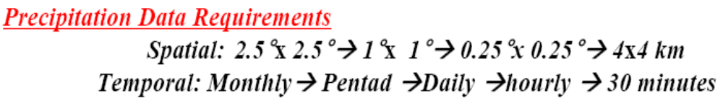
Integration of GEO and LEO satellites
Integration of information from GEO(VIS/IR) and LEO (PMW) Satellites has been an active area of research.

Slide 2
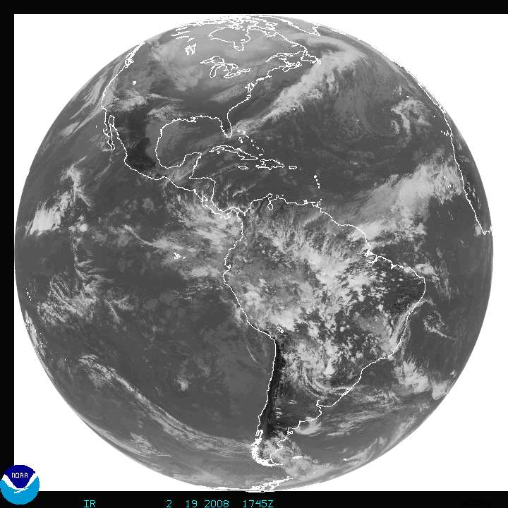
Satellite precipitation retrieval instruments:
Satellite resources available for precipitation estimation
Using GEO satellites
(Infrared/Visible channels)
Advantage:
Good temporal and spatial resolution
(30 min or less, 4 km)
very good coverage
Disadvantage:
Receives mostly cloud –top information
Indirect estimation of precipitation.

Slide 3

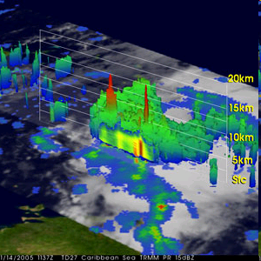
Satellite precipitation retrieval instruments:
2) Microwave
Advantage:
- Respond directly to hydrometeors and penetrates into cloud
- More accurate estimates
Disadvantage:
- low temporal and spatial resolution (~5-50km)
Heterogeneous emisivity over land
(e.g., problem with warm rainfall over land)
2) Radar
Advantage:
More accurate
good space resolution
Disadvantage:
Very Poor temporal resolution
http://www.nasa.gov/mission_pages/hurricanes/archives/2005/h2005_gamma.html

Slide 4
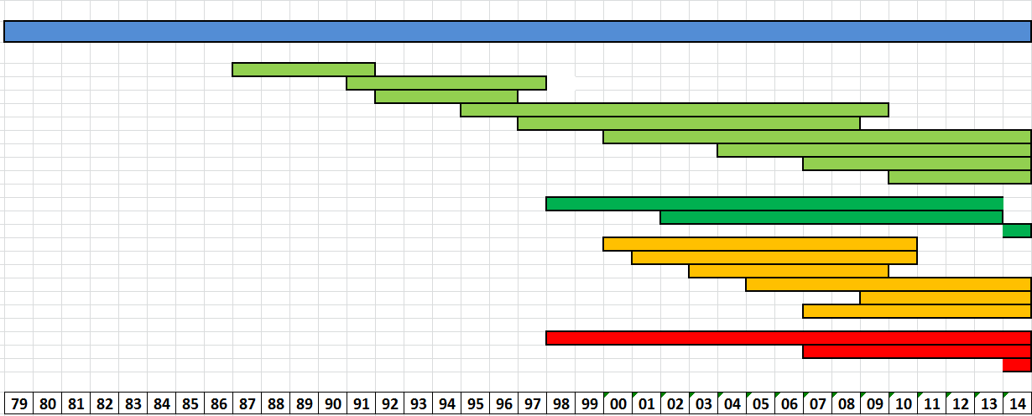
Precipitation sensors
Since 1979 we use satellites to estimate precipitation from space
Geostationary (visible/Infrared)
Microwave
Imagers
DMSP (SSMI/SSMIS)
TRMM (TMI)
AQUA (AMSR-E
GPM (GMI)
Microwave
sounders
GPM
core
NOAA/Metop
(AMSU/MHS)
Radars
TRMM (PR)
CloudSat (CPR)
GPM (DPR)
GPM
core
TRMM
Tropical Rainfall Measuring Mission
GPM
Global Precipitation
Measurement Mission

Slide 5
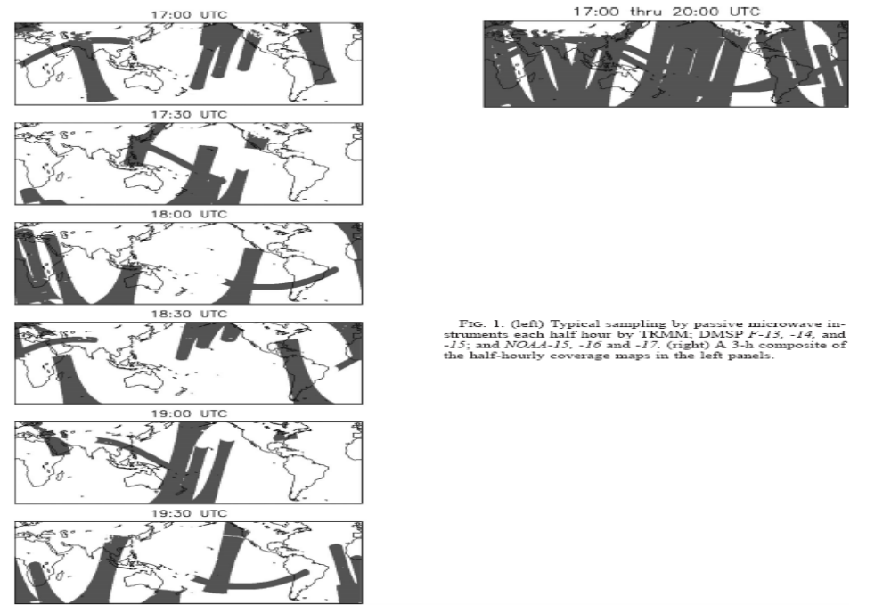
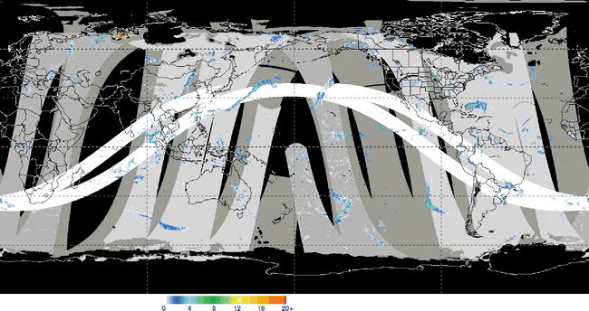
Microwave temporal sampling
Coverage every
½ hr.
In Average ~ 80% global coverage between 50N-S every 3 hours
(Reference: Huffman et al. 2007)

Slide 6
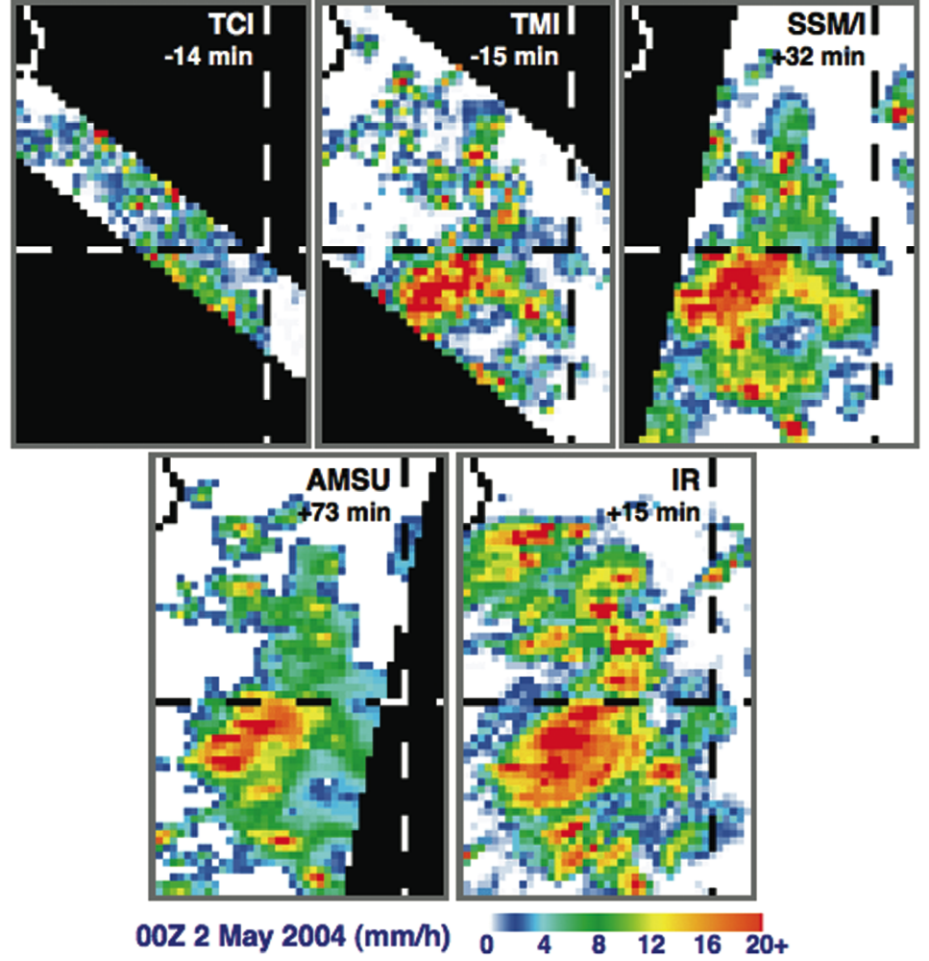
Consistency among MW sensor precipitation
00Z, 2 May 2004 S.E. of Sri Lanka
0.25°, 3-hourly
Non-trivial differences remain due to time-of-observation and sensor characteristics
Courtesy of G. Huffman

Slide 7
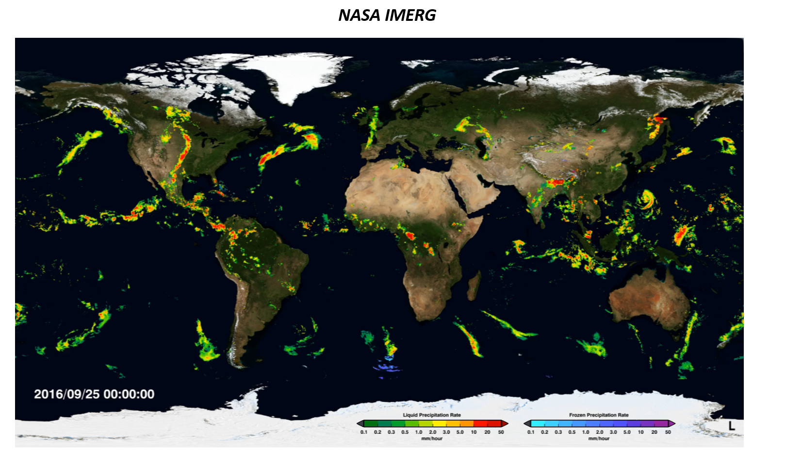

Slide 8
Precipitation TEMPORAL resolution need for hydrology
Rain started between 3-hr period
Missed the peak
Rain ended between 3-hr period
-
Short-life event
+
+
-
+
T+3hr
T+6hr
t+3hr
T
T
Credit: K. Hsu et al.

Slide 9
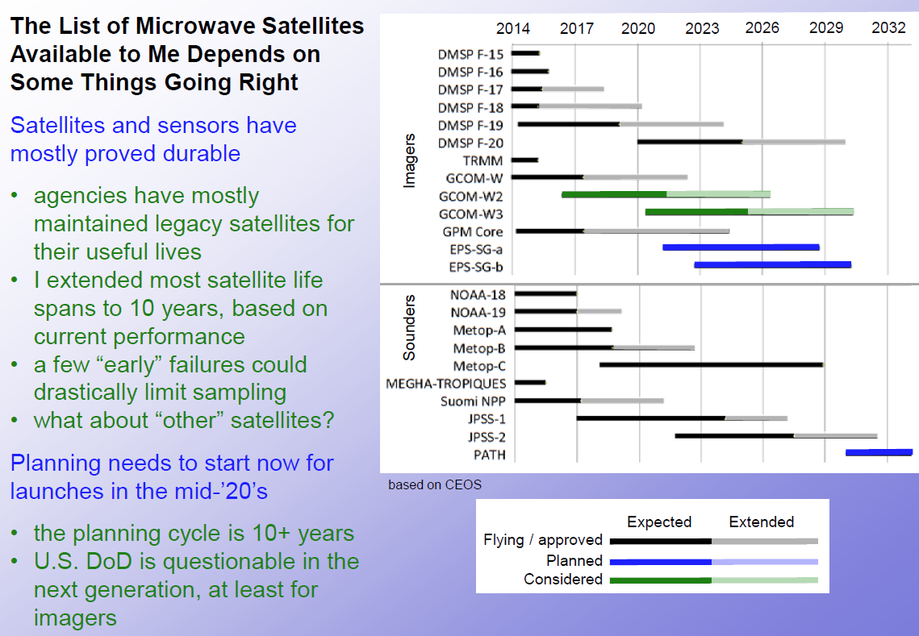
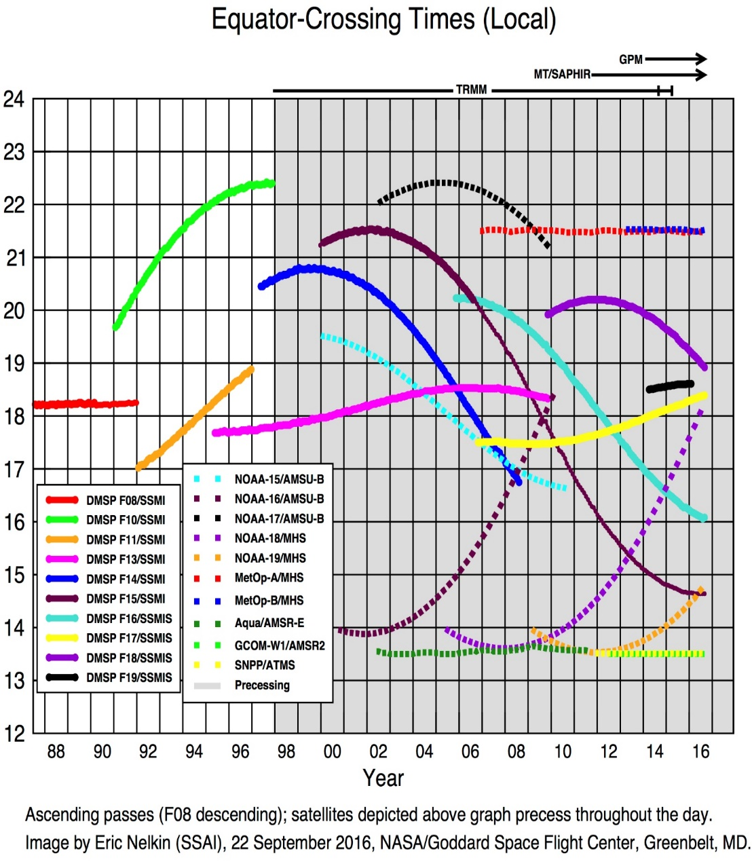
PMW constellation continuity and crossing time aspects
Flying/Planned/Expected PMW sensors
Equator crossing times (local)
Credit: Chris Kidd

Slide 10
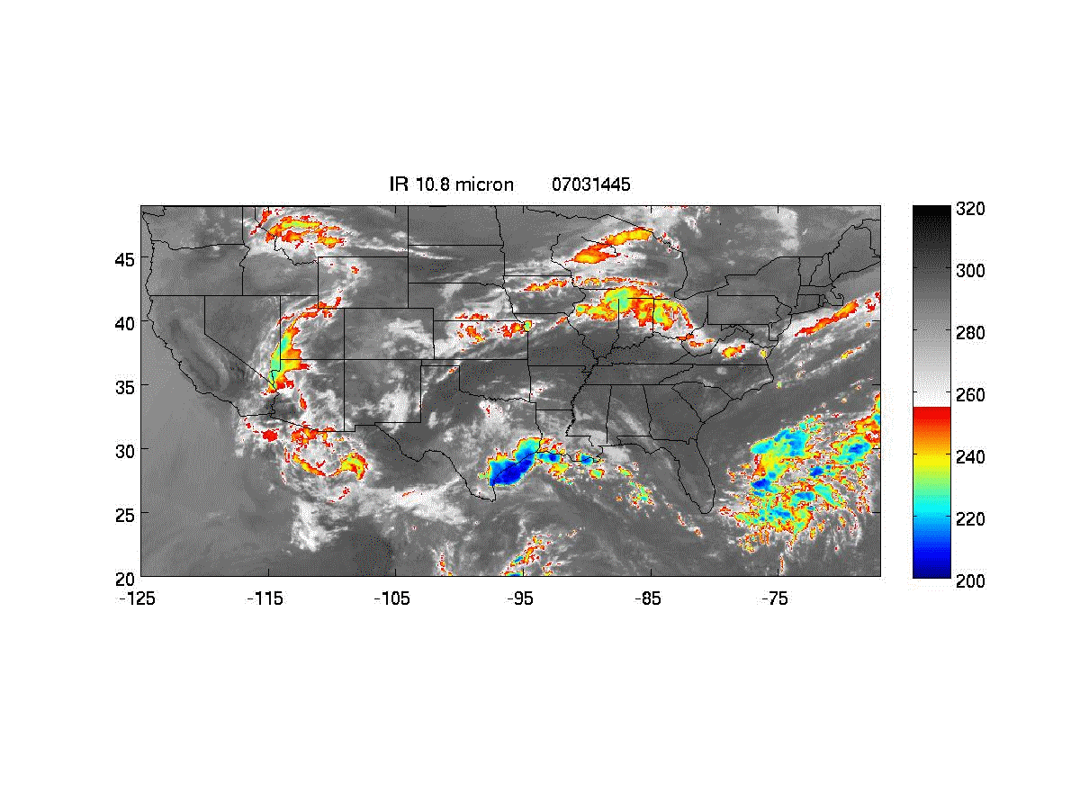
Tb (k)

Slide 11

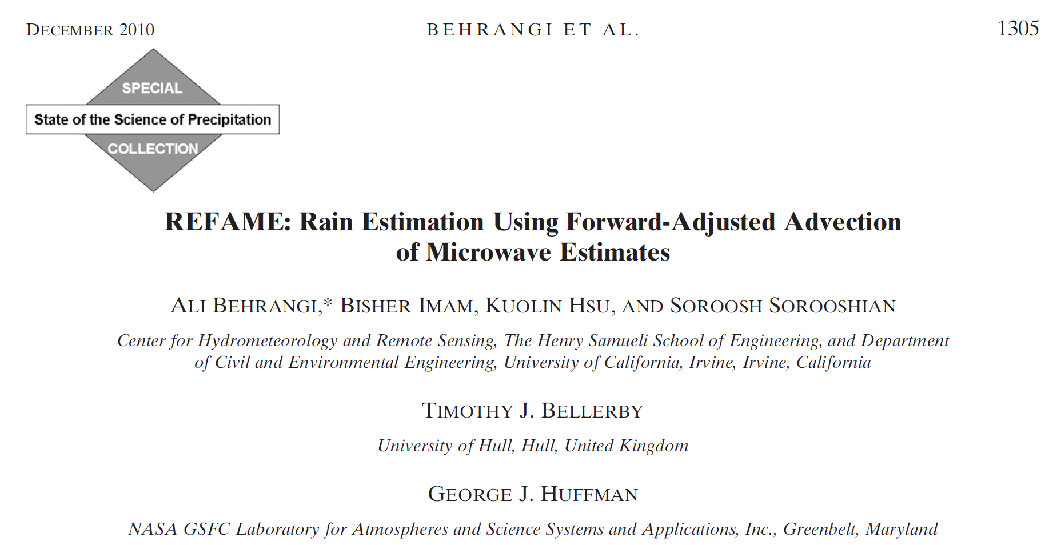
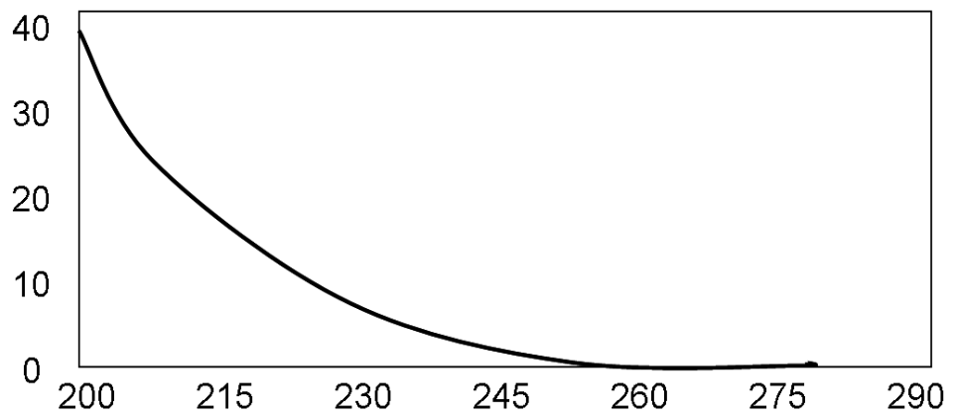
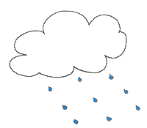
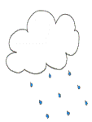
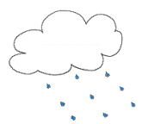
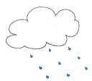

REFAME:
Rain Estimation using Forward Adjusted Advection of Microwave Estimates
We have no idea what is going to happen until next PMW overpass
PMW Rain
observation
~ 3hr or more
3
4
2
5
6
7
High-frequency
observation of cloud- top temperature & size
1
0
Warm
Cloud motion vector
4
Cold
5
3
Mean rain rate for GEO-based cloud-classes obtained from long term GEO-LEO observations
Cluster
Mean rain rate
(mm/hr)
6
2
1
7
0
Brightness temperature (Tb) feature
Cloud motion vector
Forward propagation of precipitation field
NASA Earth and Space Science (NESSF) fellowship
(Behrangi et al. 2010)
Notes:
11
11
This slide shows a concept to improve forward propagation of pmw rain estimation in time using
1) motion vectors obtained from cloud tracking algorithm of Tim Bellerby (2004), which gives a Lagrangian representation of cloud development. his algorithm provides a wind field and explicitly incorporates the effect of cloud growth, deformation and dispersal (decay)
2) Using the cloud classification techniques to classify different satellite pixels into number of distinct classes using extracted features
( such as temperature of the pixel, pixel’s textural properties (e.g., std & gradient) and also dynamic of cloud evolution using gradient of temperature in time between the same cloud pixel at two consecutive satellite imagery)

Slide 12
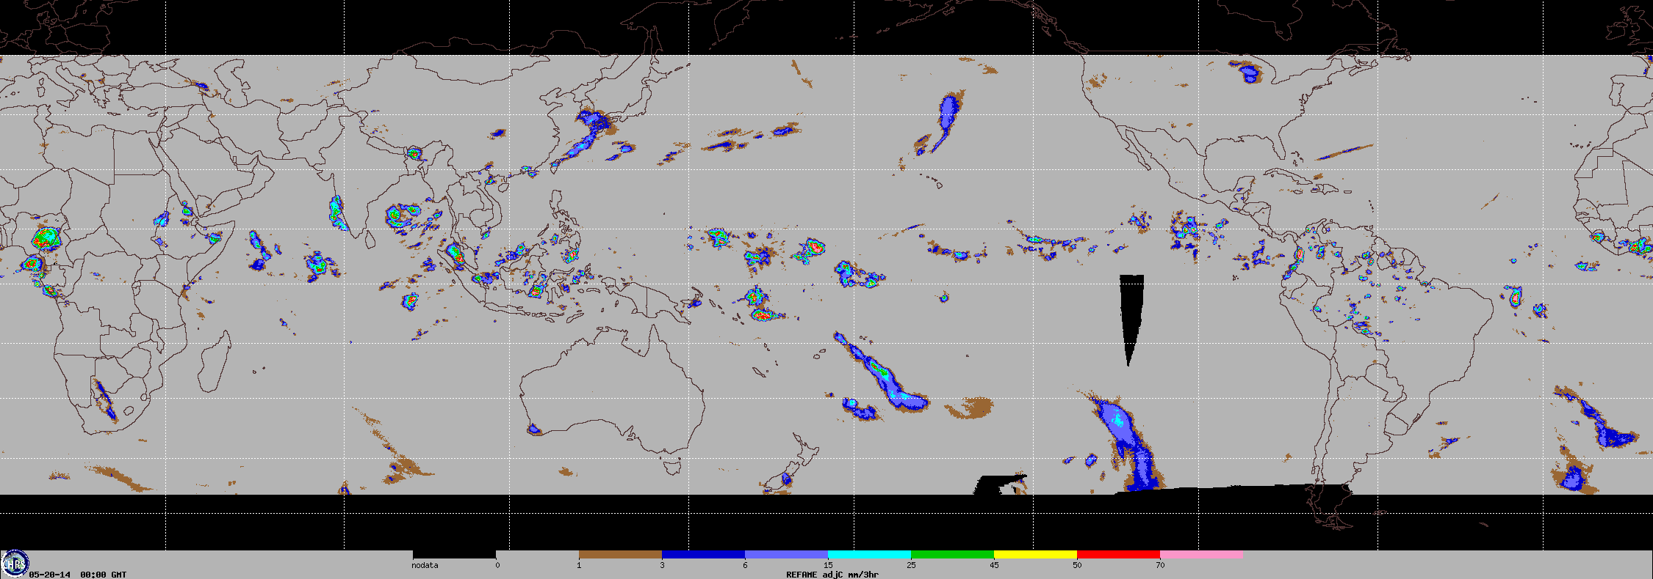
REFAME:
Rain Estimation using Forward Adjusted Advection of Microwave Estimates
Passive microwave sensors used in combined products during TRMM era
Global Operational REFAME
Every 30 min at ~ 0.08x0.08 deg. resolution

Slide 13
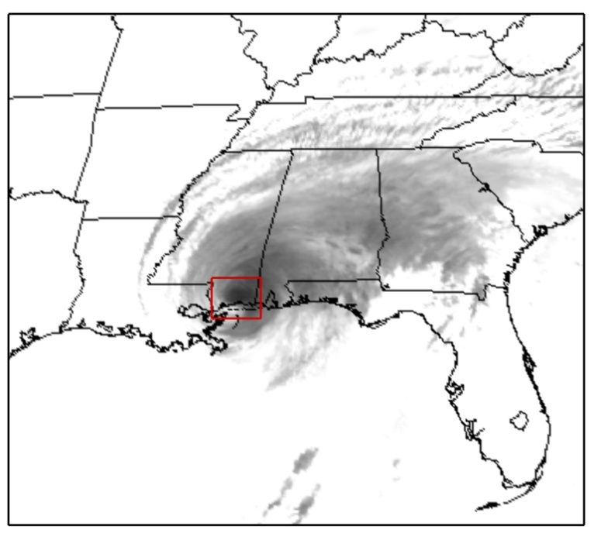
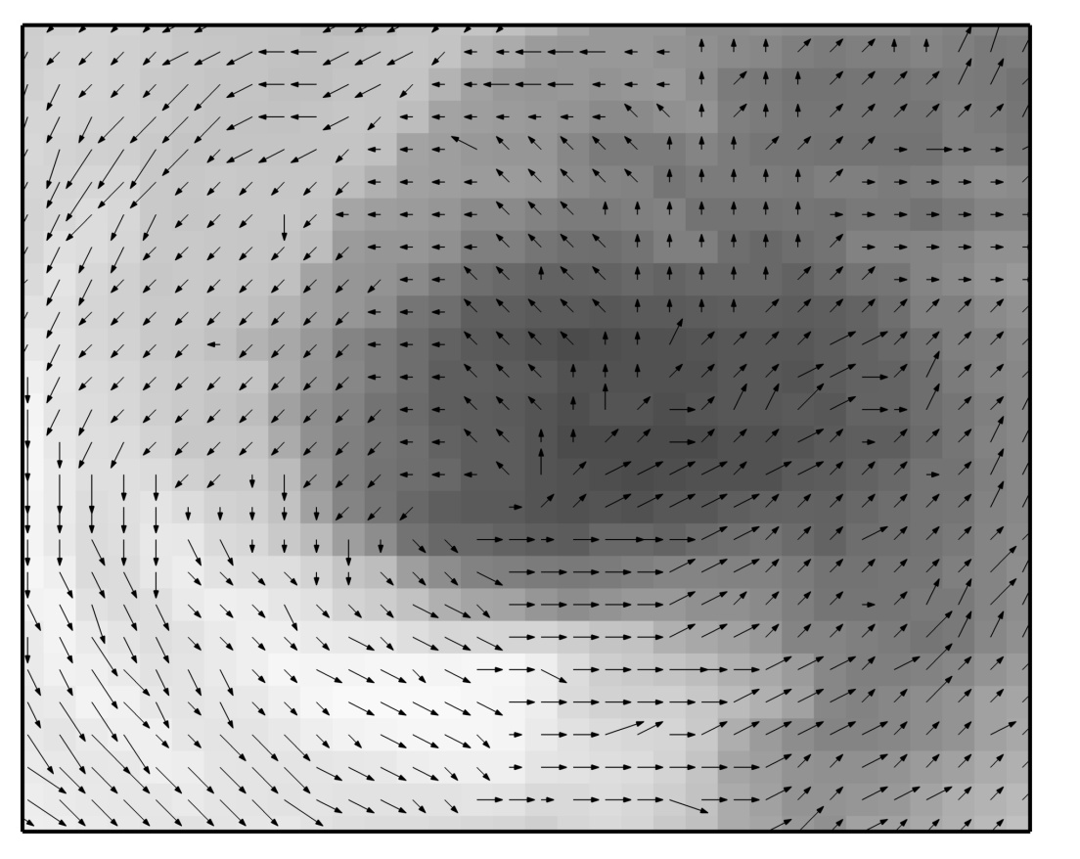

Cloud Advection Vector
Tracking cloud movement using GEO IR Image
GOES-East TIR (Band 4)
Hurricane Georges,
17:02-17:15 GMT, 28th September 1998.
(above) GOES-East IR image for 17:02 GMT
(right) Forward displacement vectors, scaled to 40% of their true magnitudes
Reference: Bellerby, TGARS, 2006

Slide 14
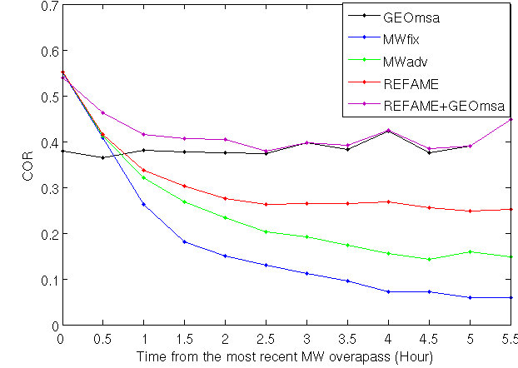
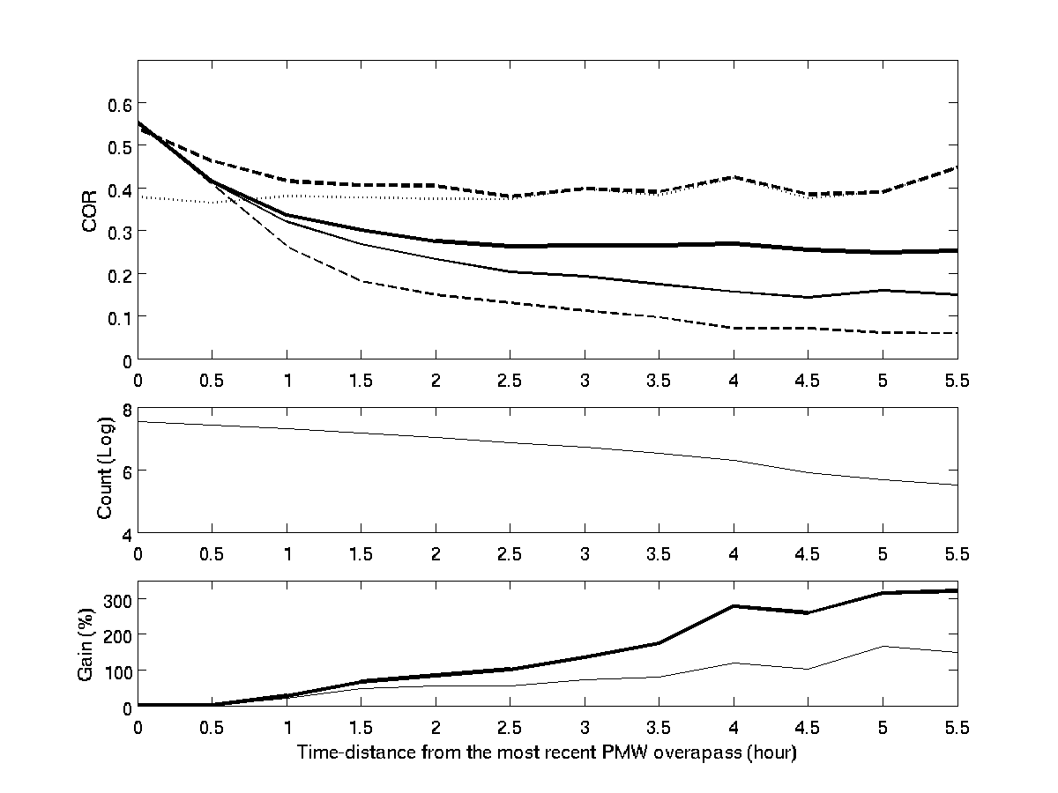
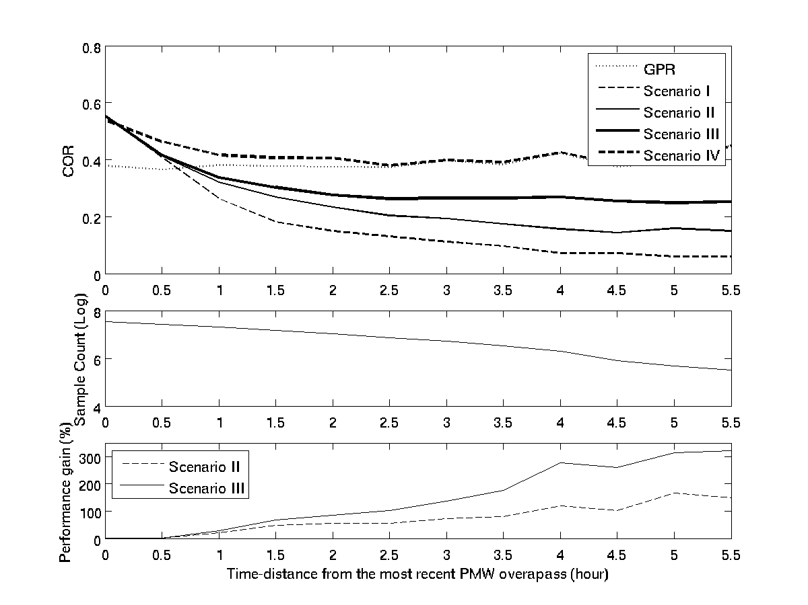
COR compared to NEXRAD
MWadv
REFAME

Slide 15
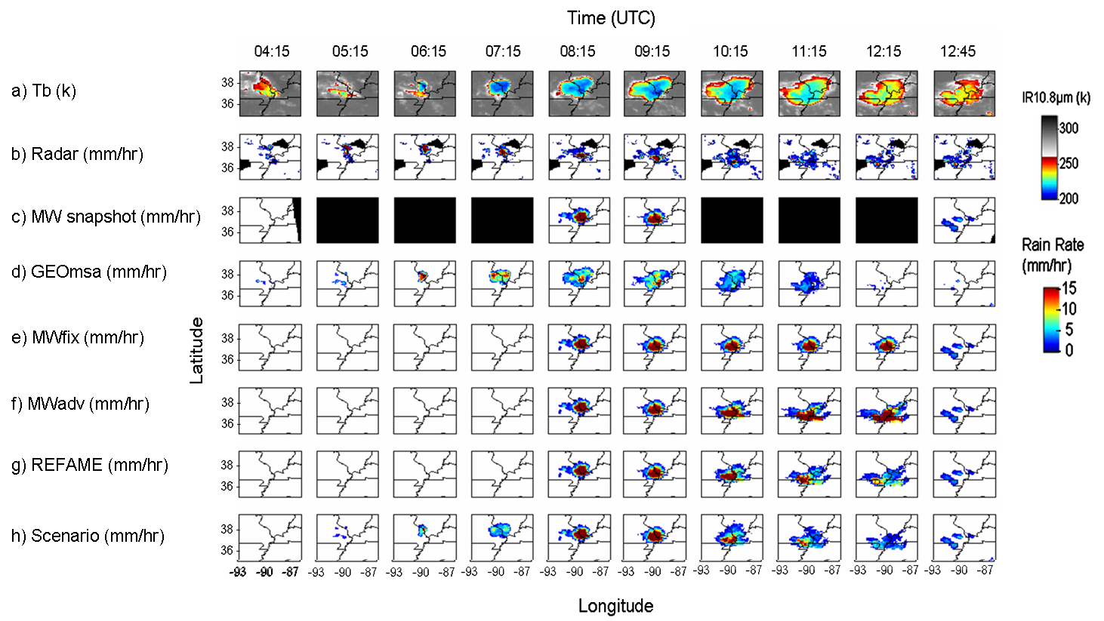
Case study
Behrangi et al. 2010

Slide 16
Fundamentals of VIS/IR-based precipitation estimation
/ra1/ali/test

Slide 18
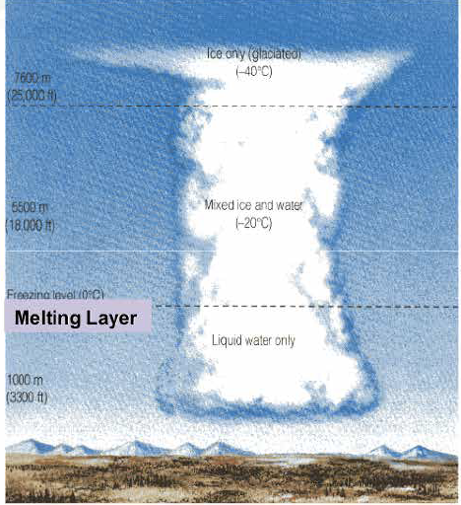
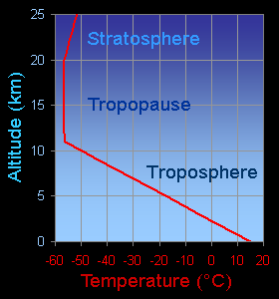
Infrared (IR) Spectrum/Image

Slide 19


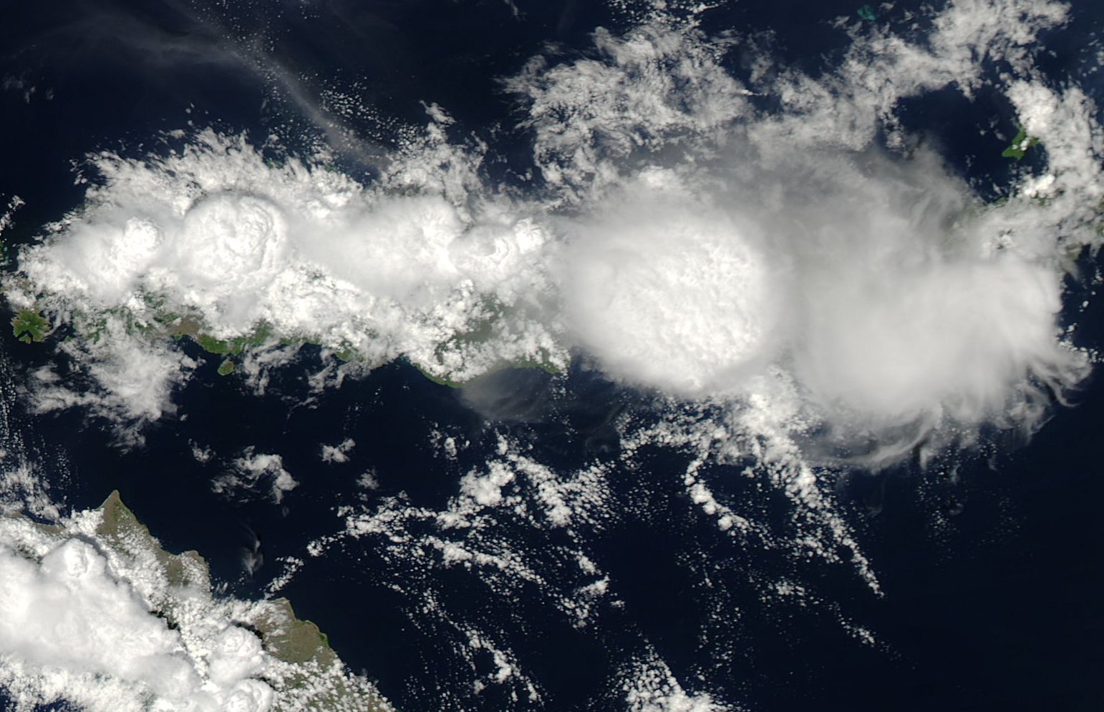
Visible Spectrum/Image

Slide 20
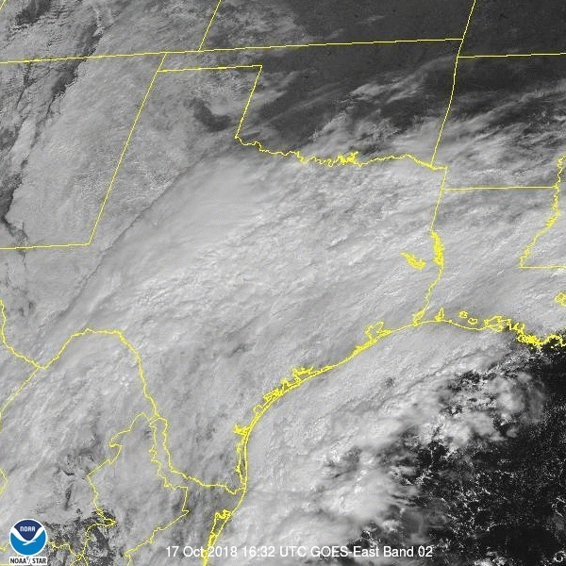
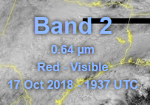
GOES-East - Regional sector view: Southern Plains

Slide 21
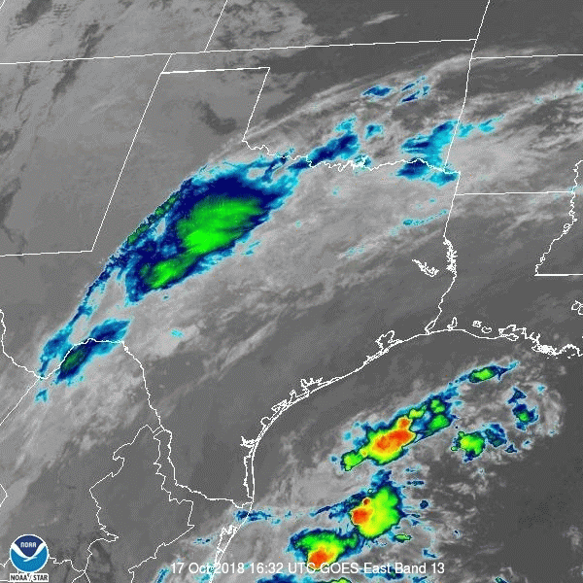


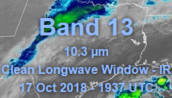
GOES-East - Regional sector view: Southern Plains

Slide 22
