Slide 1
How far in the past can tree ring analysis be used as a proxy to estimate climate change?
100-200 years
1000-2000 years
10,000-20,000 years
One to two million years

Slide 2
Survey: What’s your opinion on whether anthropogenic climate change is a critical societal issue?
  What problem?
  It might be a problem, but a small one.
  Could be big. Could be small. I don’t really know.
  It’s probably a significant problem.
  It’s not a problem. It’s THE problem facing the world.

Slide 3
Review questions from last time
tophat questions

Slide 4
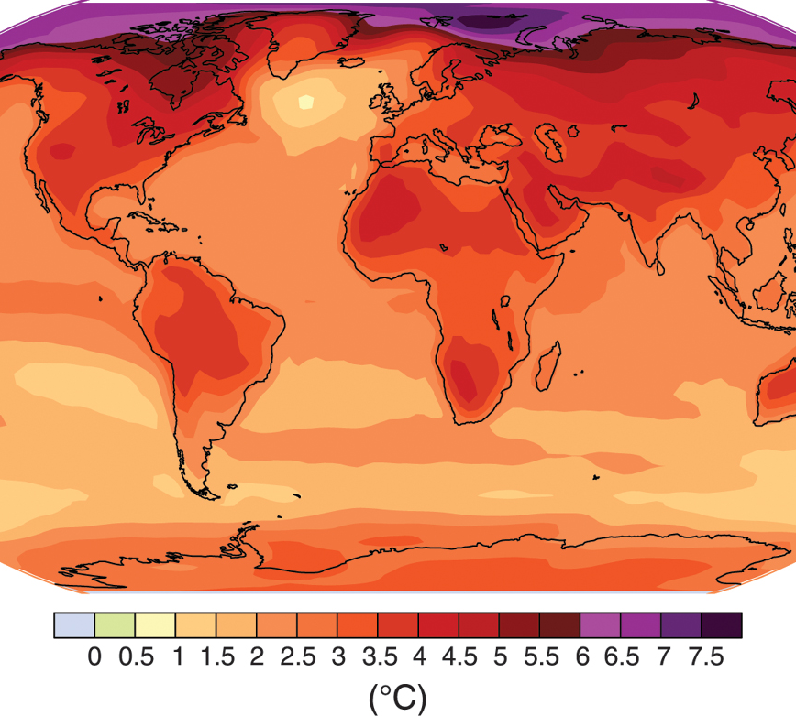
ATMO 170
Recent Climate Change Detection and Attribution
International Panel on Climate Change

Slide 5
Responsibilities as an instructor when speaking about global warming
To provide students with accurate information, as best as the consensus of the scientific community currently understands this issue.
To provide my professional, scientific opinion with respect to the science.
To not insert my own personal or political viewpoints in the discussion.

Slide 6
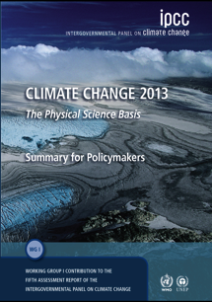
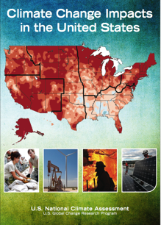
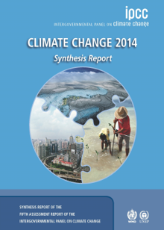
Results that I will be showing
Most results are from
2013 IPCC* Summary For
Policymakers and Synthesis
Report, or the U.S. National
Climate Assessment (2014).
Although these documents do not necessarily speak for all climate scientists, it the best attempt by the scientific community to create a consensus opinion on the issue.
Other results will be either from peer reviewed literature, textbooks, credible online sites (e.g. NASA, NOAA, EPA) or presentations at professional conferences.
*Intergovernmental Panel on Climate Change

Slide 7
What might be the potential problem?

Slide 8
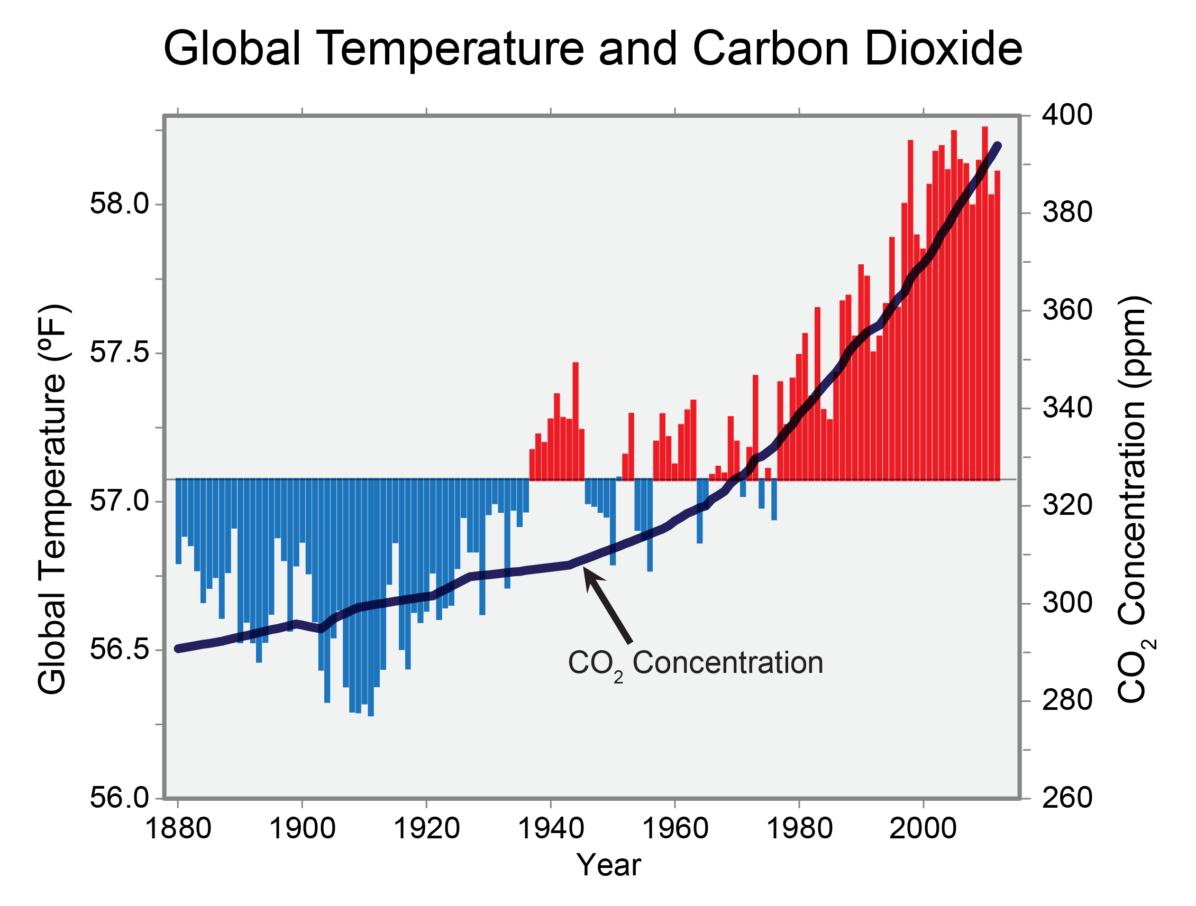
U.S. National Climate Assessment

Slide 9
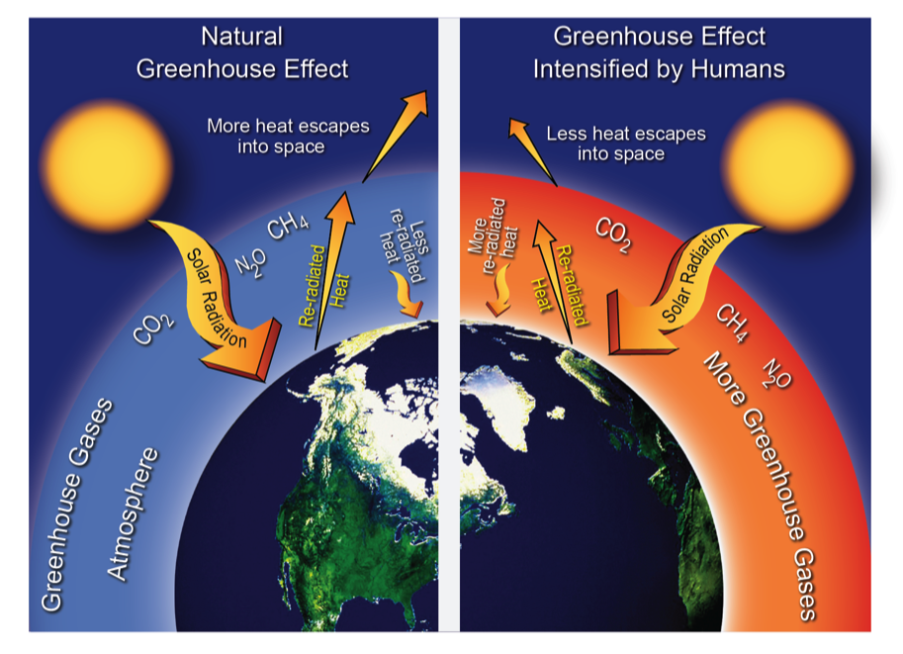
Addition of more GH gases makes the atmosphere more opaque to IR radiation.
Irrefutable Mechanism!
U.S. National Climate Assessment
GH gases increase the net amount of IR radiation received at the Earth’s surface, so the surface temperature would increase.

Slide 10
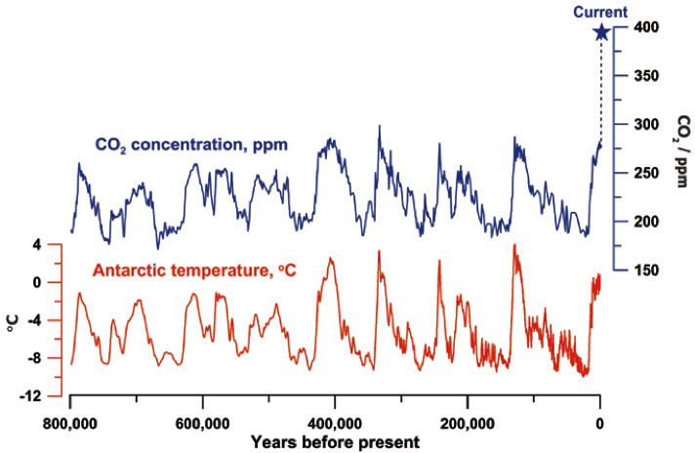
CO₂ and Temperature
Past 800,000 years
The abrupt rise in CO₂
is unprecedented.
The Royal Society
CO₂ AT HIGHEST LEVEL IN 800,000 YEARS
OTHER GHG’s SHOW SIMILAR TRENDS
NOTE RECENT RATE OF CO₂ INCREASE

Slide 11
Taken alone, a doubling of atmospheric CO₂ from pre-industrial levels would increase the global mean temperature by 2°C.
But the climate system is VERY complex, with numerous interrelated components.
The impact of GHG increases on climate cannot be considered in isolation

Slide 12
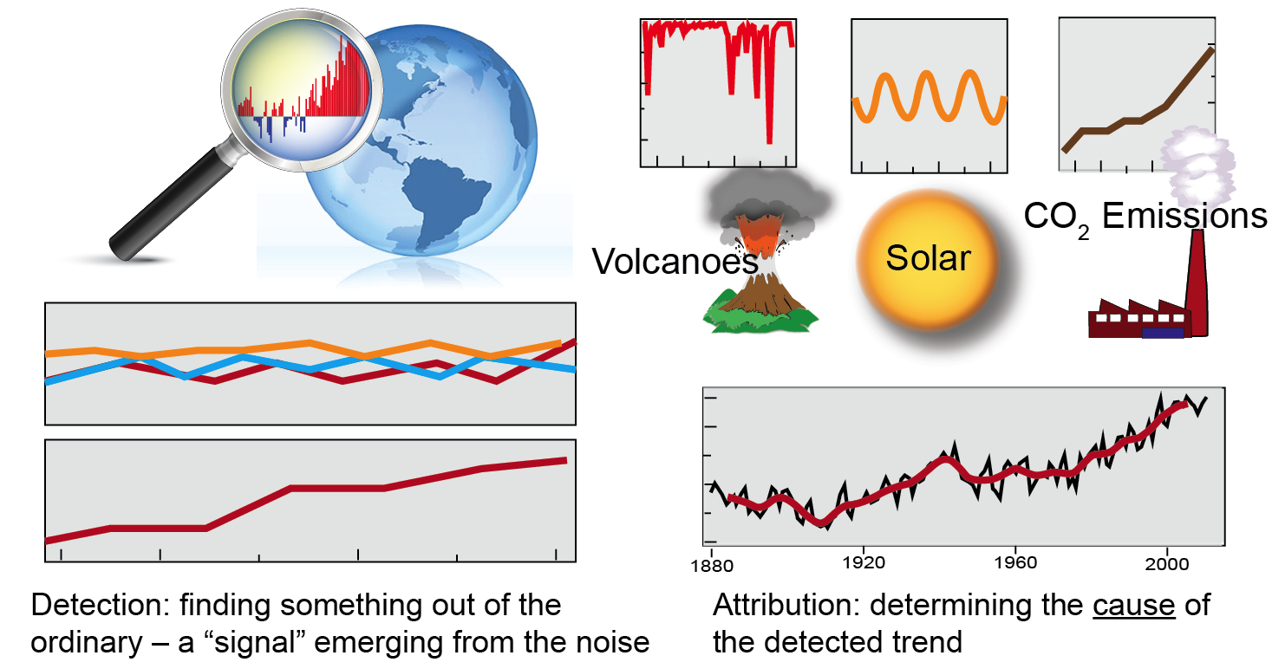
Detection and Attribution
Recent Climate Change
https://upload.wikimedia.org/

Slide 13
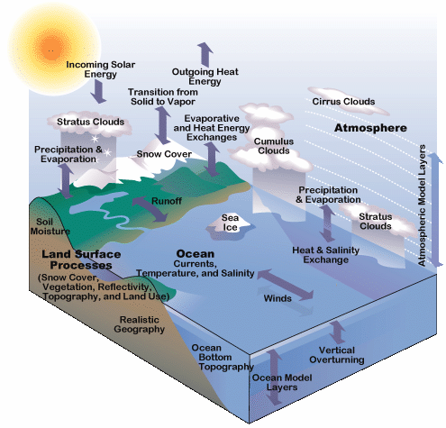
Earth’s Climate System is Very Complex
Presence of interrelated processes produces feedbacks
Feedbacks: Other atmospheric processes that reinforce or weaken an initial change.
Positive Feedback: Reinforces initial change
Ice/Snow Cover Decreases
=> Lower reflectivity
=> More solar energy absorbed
=> More melting
Negative Feedback: Weakens initial change
Atmosphere Warms
=> More infrared radiation loss
=> More cooling
www.ucar.edu

Slide 14
How do we detect climate changes in view of climate complexity?
By independent analyses
of separate components
of the climate system that
yield a consistent picture
IPCC AR5

Slide 15
Detection of recent climate changes
What has happened over the past 100-150 years that leads scientists to conclude that the climate has warmed when greenhouse gases were rising?

Slide 16
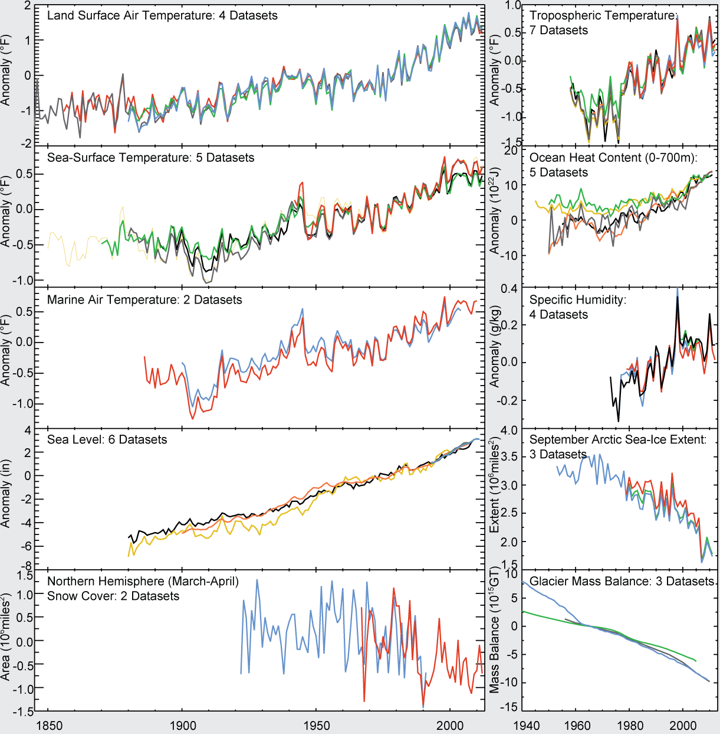
Consistent indicators of a warming world
U.S. National Climate Assessment

Slide 17
Let’s first focus on the United States
It is a good place to look because there is a lot of data there.

Slide 18
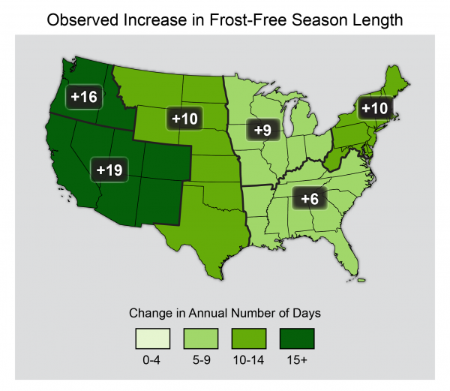
2012-1991 relative to 1960-1901
U.S. National Climate Assessment

Slide 19
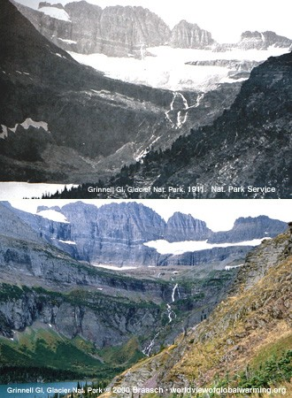
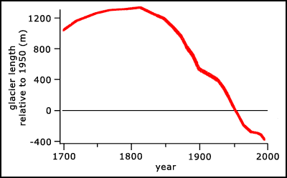
Example of Climate
Related Changes
Glacier National Park
1911 and 2000
144 glaciers
142 retreated

Slide 20
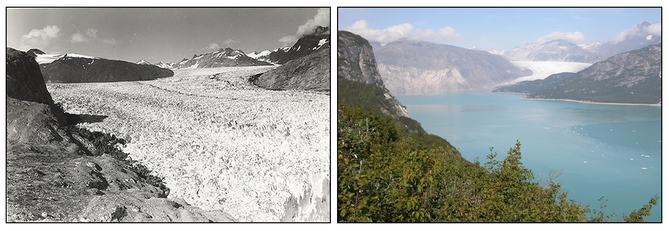
Example of Climate
Related Changes
144 glaciers
142 retreated
Glacier Bay National Park
1941 and 2004
https://www2.usgs.gov/climate_landuse/glaciers/repeat_photography.asp
Muir Glacier AK 1941
Muir Glacier AK 2004

Slide 21
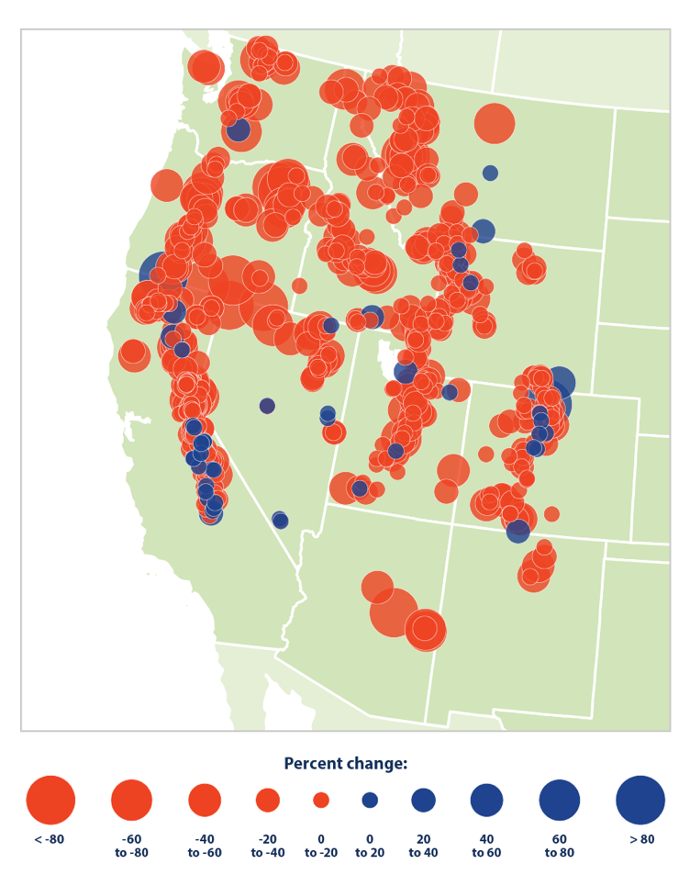
Trends (1955-2016) in Apr 1 snowpack water content at western snow sites
How much is due to
Less snowfall?
Earlier melt?
Is this a fingerprint of anthropogenic change, or is it a manifestation of natural variability?
Dry Red
Wet Blue
https://www.epa.gov/climate-indicators/climate-change-indicators-snowpack

Slide 22
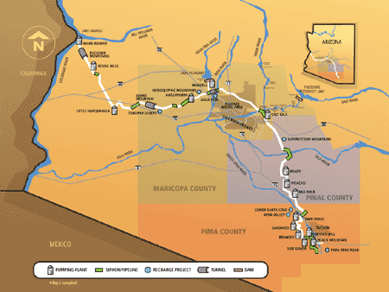
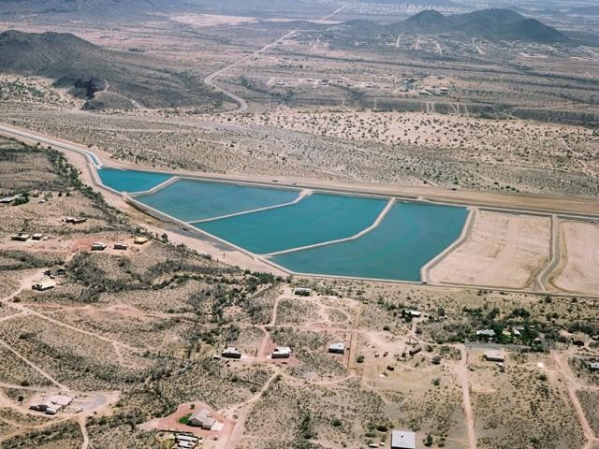
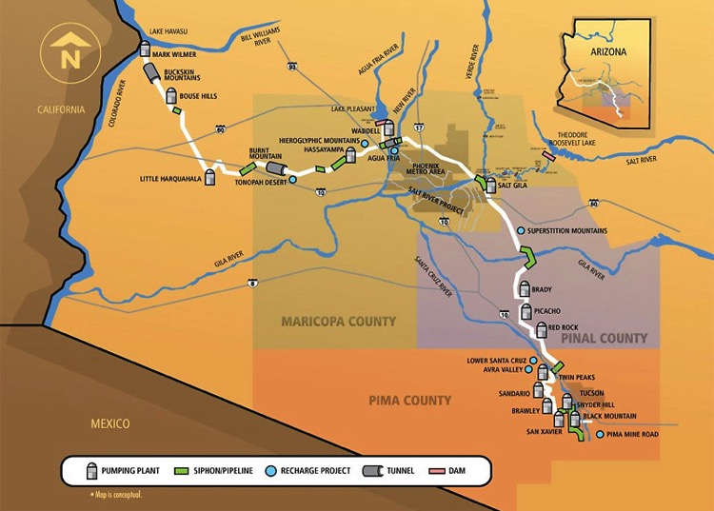
The Central Arizona Project
The main artery that supplies water to Arizona. Water comes from snow melt in the Rocky Mts.
(www.cap-az.com)

Slide 23
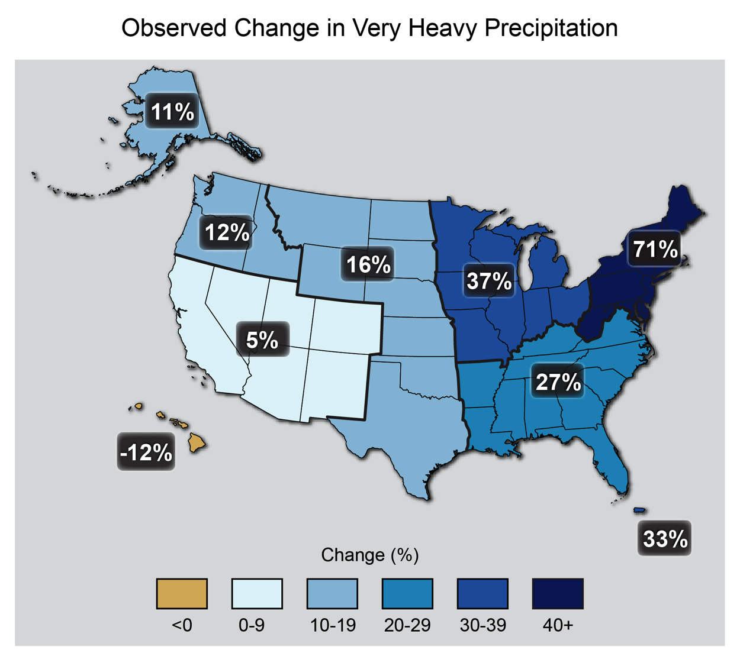
Upper 1% of events
http://toolkit.climate.gov/

Slide 24
Terms used by IPCC to quantify the confidence of a result or conclusion: virtually certain……………..99–100% very likely…………………...90–100% likely…………………………66–100% about as likely as not……...33–66% unlikely………………………0–33% very unlikely………………...0–10% exceptionally unlikely………0–1% extremely likely……………..95–100% more likely than not………...>50–100% extremely unlikely…………..0–5%
Terminology of 2013 IPC
High confidence: “very”, “virtually”, “extremely”, “exceptionally”

Slide 25
Conclusion of 2013 IPCC
Warming of the climate system is unequivocal, and since the 1950s, many of the observed changes are unprecedented over decades to millennia.
The atmosphere and ocean have warmed, the amounts of snow and ice have diminished, sea level has risen, and the concentrations of greenhouse gases have increased.

Slide 26
Each of the last three decades has been successively warmer at the Earth’s surface than any preceding decade since 1850.
In the Northern Hemisphere, 1983–2012 was likely (66%-100%) the warmest 30-year period of the last 1400 years.
Conclusion of 2013 IPCC
Atmosphere

Slide 27
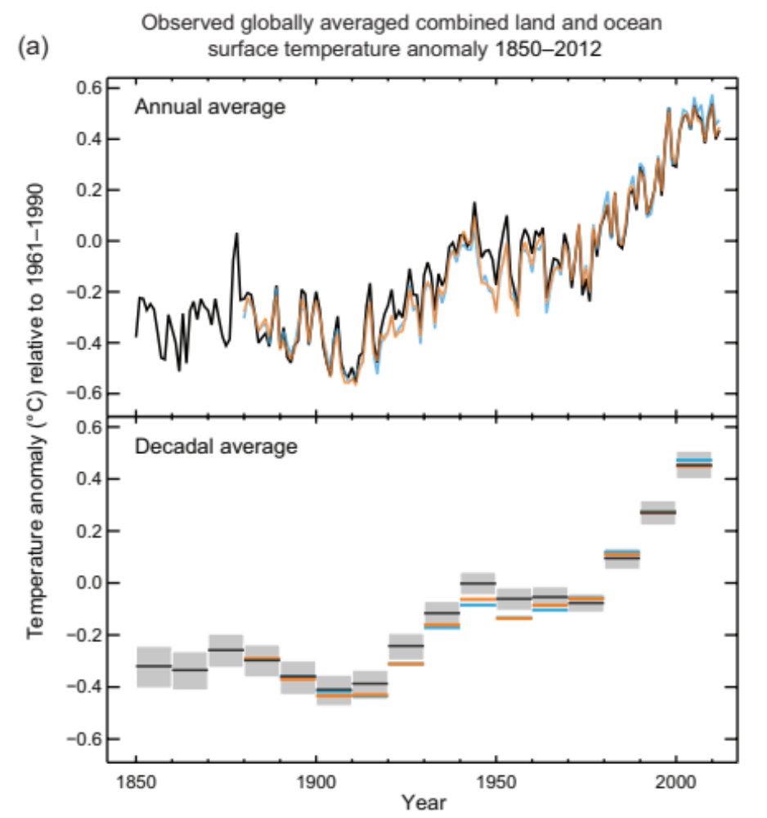
Global Mean Surface Temperature
(Difference from 1985-2005 average)
Observed global mean surface temperature increased by almost 1°C.
Greatest rate of warming occurred after 1980.
11 of 12 warmest years since 1850 occurred since 1995.
Results ARE CONSISTENT with upper-air and satellite observations, although the warming trend is not as dramatic in these data…
which is the expected result for warming due to GHG’s.
IPCC AR5
1850
1900
1950
2000
(a) Observed global mean combined land and ocean surface temperature anomalies, from 1850 to 2012 from three data sets. Top panel: annual mean values. Bottom panel: decadal mean values including the estimate of uncertainty for one dataset (black). Anomalies are relative to the mean of 1961−1990.

Slide 28
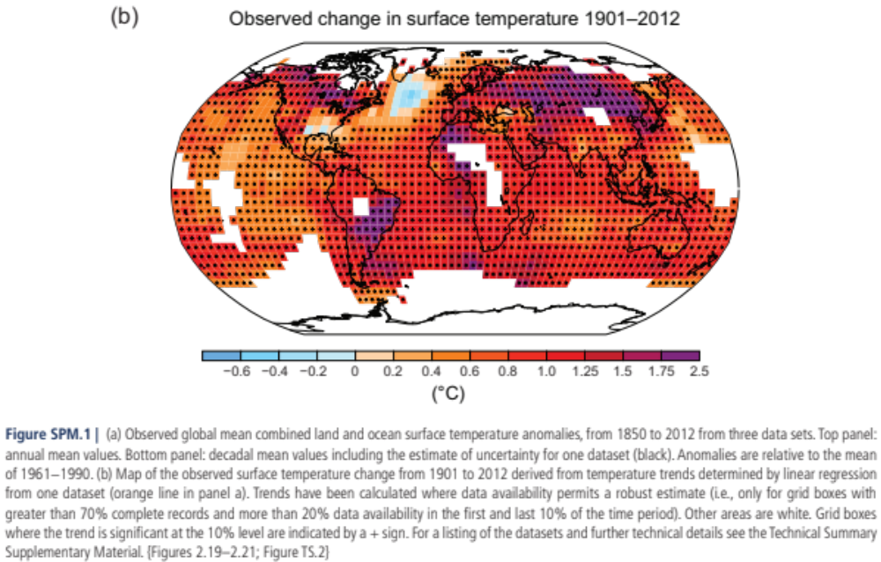
Pattern of warming is NOT uniform
MOST WARMING OVER ARCTIC, CONTINENTS
IPCC AR5

Slide 29
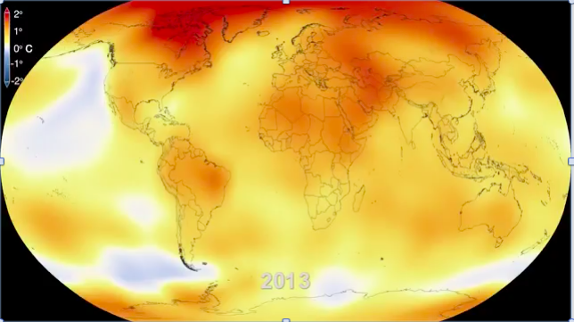
Temperature change 1950 through 2013, as compared to average global temperature for the period 1951-1980
NASA video link at youtube.com

Slide 30
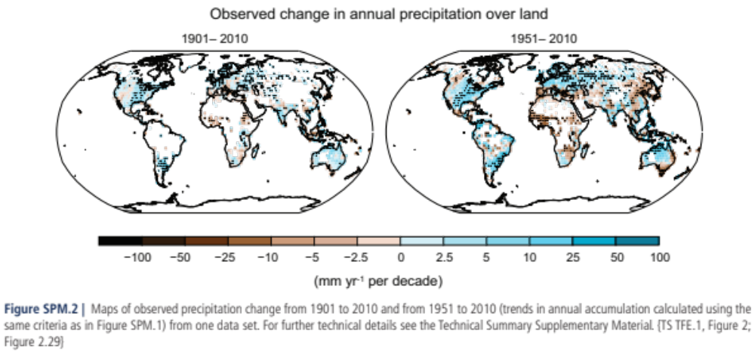
Precipitation changes are NOT uniform
There are Winners. There are Losers.
IPCC AR5

Slide 31
Conclusion of 2013 IPCC
Oceans
Ocean warming dominates the increase in energy stored in the climate system, accounting for more than 90% of the energy accumulated between 1971 and 2010 (high confidence).
It is virtually certain (99-100%) that the upper ocean (0−700 m) warmed from 1971 to 2010

Slide 32
Conclusion of 2013 IPCC
Sea Level
The rate of sea level rise since the mid-19th century has been larger than the mean rate during the previous two millennia (high confidence).
Over the period 1901 to 2010, global mean sea level rose by 0.19 [0.17 to 0.21] meters.

Slide 33
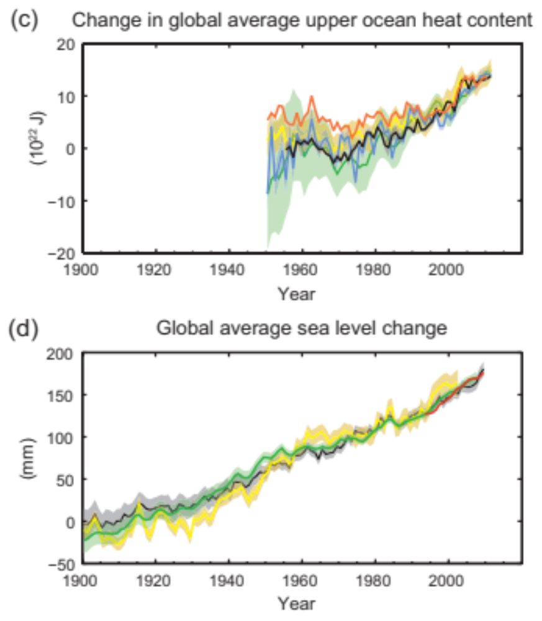
Ocean Changes
More than 60% of net heat gain is stored in oceans.
Greatest increase has occurred after 1980.
Increase is reflected by the rise of global mean sea-level. Causes:
1) Thermal expansion
2) Glacial melt
IPCC AR5
(c) change in global mean upper ocean (0–700 m) heat content aligned to 2006−2010, and relative to the mean of all datasets for 1970; (d) global mean sea level relative to the 1900–1905 mean of the longest running dataset, and with all datasets aligned to have the same value in 1993, the first year of satellite altimetry data.

Slide 34
Conclusion of 2013 IPCC
Cryosphere
Over the last two decades, the Greenland and
Antarctic ice sheets have been losing mass, glaciers have continued to shrink almost worldwide, and Arctic sea ice and Northern Hemisphere spring snow cover have continued to decrease in extent (high confidence)

Slide 35
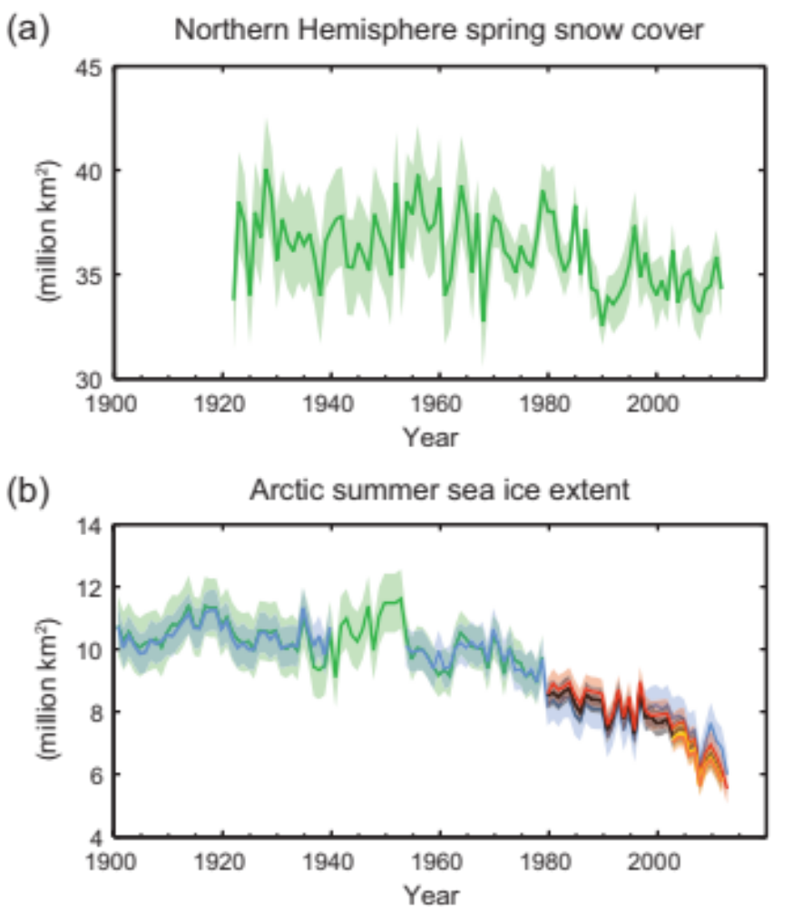
Cryosphere Changes
Some evidence that total snow cover is decreasing.
Rate of sea ice melt is increasing. Expect ice free Arctic during the summer within your lifetime.
Greatest rate of decrease has occurred after 1980.
IPCC AR5
(a) Extent of Northern Hemisphere March-April (spring) average snow cover; (b) extent of Arctic July-August-September (summer) average sea ice;

Slide 36
Conclusion of 2013 IPCC
Carbon and Other Biogeochemical Cycles
The atmospheric concentrations of CO₂, CH₄, and N₂O have increased to levels unprecedented in at least the last 800,000 years.
CO₂ concentrations have increased by 40% since pre-industrial times, primarily from fossil fuel emissions and secondarily from net land use change emissions.
The ocean has absorbed about 30% of the emitted anthropogenic carbon dioxide, causing ocean acidification.

Slide 37
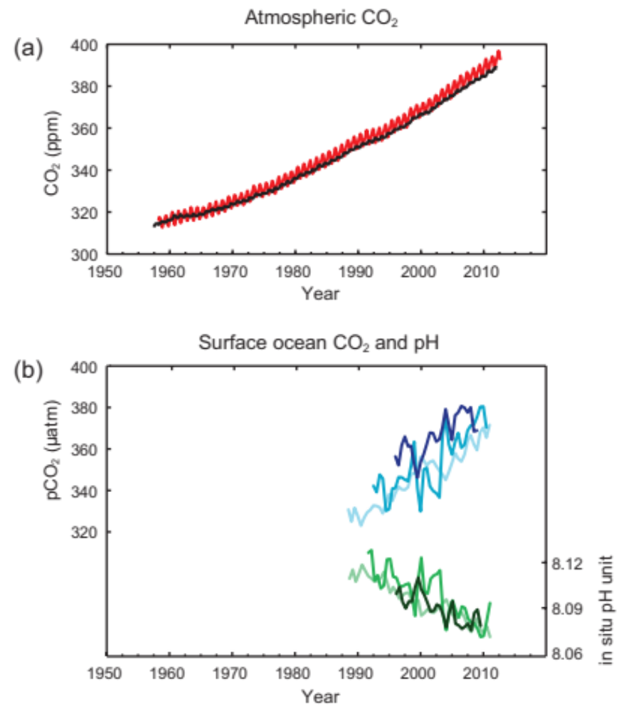
Carbon and Other Biogeochemical Cycles
CO2 increasing at a rate of almost 2 ppmv per year.
As CO₂ is absorbed by oceans, CaCO₃ decreases. Retards grown of shells and “bleaches” coral.
Ocean acidifies through
CO₂ + H₂O ⇌ H₂CO₃
Carbonic Acid
H₂CO₃ + CaCO₃ ⇌ Ca(HCO₃)₂
acid + shells ⇌ calcium bicarbonate
Oceanic Acidification
As CO₂ increases
H₂CO₃ increases
pH decreases
CaCO₃ decreases
IPCC AR5
(a) atmospheric concentrations of carbon dioxide (CO2) from Mauna Loa (19°32’N, 155°34’W – red) and South Pole (89°59’S, 24°48’W – black) since 1958; (b) partial pressure of dissolved CO2 at the ocean surface (blue curves) and in situ pH (green curves), a measure of the acidity of ocean water. Measurements are from three stations from the Atlantic (29°10’N, 15°30’W – dark blue/dark green; 31°40’N, 64°10’W – blue/green) and the Pacific Oceans (22°45’N, 158°00’W − light blue/light green).

Slide 38
Conclusion of 2013 IPCC
“It is extremely likely (95%-100%) that more than half of the observed increase in global average surface temperature from 1951 to 2010 was caused by the anthropogenic increase in greenhouse gas concentrations and other anthropogenic forcings”

Slide 39
How can the observed recent warming be attributed to human activities?
By necessity, we have to use numerical models of the atmosphere and oceans to address this question.
The specific tool is a coupled land-atmosphere-ocean general circulation model with active biology.
IPCC bases its evaluation of present climate and future projections as the average of many different general circulation models from all over the world.

Slide 40
Weather/Climate Models
First, some comments on model architecture and the ability of models to simulate atmospheric parameters

Slide 41
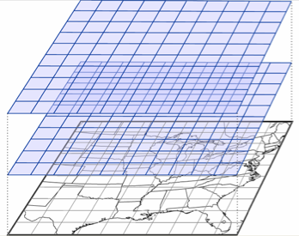
Structure of atmospheric models
Dynamical Core
Mathematical expressions of the governing laws
Conservation of momentum (i.e. Newton’s 2nd law F = ma)
Conservation of mass
Conservation of energy
Conservation of water
These must be put into a form that can be run
on a computer…such as on a uniform lattice.
Grid spacing of global models is typically:
Horizontal
~100 km
Vertical
~1.0 km
These are “equally” spaced, horizontal grid points.

Slide 42
Structure of atmospheric models
Dynamical Core
Mathematical expressions of the governing laws
Conservation of momentum (i.e. Newton’s 2nd law F = ma)
Conservation of mass
Conservation of energy
Conservation of water
These must be put into a form that can be run
on a computer…such as on a uniform lattice.
Grid spacing is typically:
Horizontal
~100 km
Vertical
~1.0 km
These are “equally” spaced, horizontal grid boxes.
Models compute
average conditions
inside thin “wafers”

Slide 43

Model Grids
These are “equally” spaced, horizontal grid points.
Models compute average conditions inside thin “wafers”.
Grid spacing is typically:
Horizontal
100’s of kilometers
Vertical
100-1000’s of meters
https://www.e-education.psu.edu/worldofweather/book/export/html/2026

Slide 44
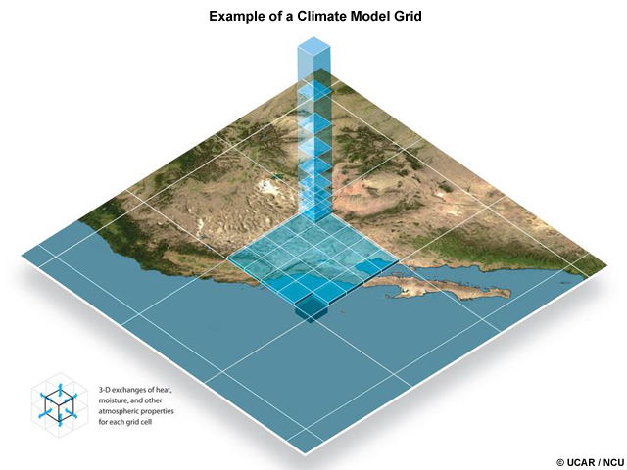
What do models do accurately?
Exchanges between
grid boxes
by the wind.
www2.ucar.edu

Slide 45
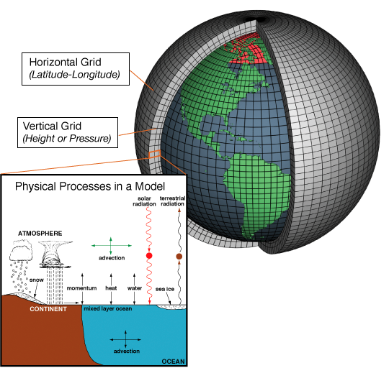
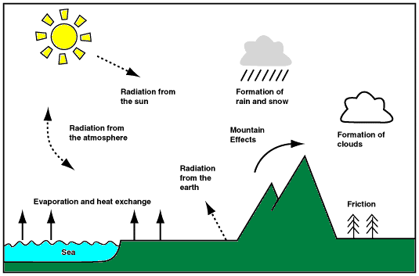
Climate Models
Model Grids
100 km
100-1000 m
Representation of sub-grid cell
physics is not straightforward
Shoreline Grid Box
NOAA
Parameterizations –
Model must approximate fine-scale physics from grid-box values of
Wind-Temp-Moisture.
Computers forecast average conditions inside a thin box
Stuff falls between the cracks

Slide 46
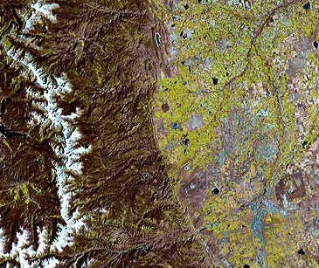
“A Lot Happens Inside a Grid Box”
(Tom Hamill, CDC/NOAA)
Continental Divide
Approximate size of a grid box for a climate model that is run by NOAA.
Note Spatial Differences in Elevation
Ground Cover
Land Use
Denver Metro
Representation of sub-grid cell
physics is not straightforward
~50 km
Size of developing thunderstorm cell
http://www.aaccessmaps.com/

Slide 47
What the model grid “feels” as its Front Range of the Rockies
Model grid box has one
Elevation
Ground Cover
Land Type
12,000’
Model Altitude
8,000’
Model terrain is a mesa at elevation of 8,000’.
Model computes fields for a 8,000’ mesa.
Denver
5,000’
~50 km

Slide 48
Illustration of a crude (rarely used?) method to add sub-grid variability: use climatology
Consider temperature
Standard lapse rate is 6.5°C/km or about 3.5°F/1000 ft
Can adjust for altitude differences by assuming 3.5°F/1000 ft
If T₅₀₀₀= 32°F, then
T₁₂₀₀₀=T₈₀₀₀ − (3.5°F/1000’)*4000’
= 18°F
T₅₀₀₀ =T₈₀₀₀ + (3.5°F/1000’)*3000’
= 42.5°F
12,000’
Model Altitude
8,000’
Denver
5,000’
~50 km

Slide 49
“All models are wrong, but some are useful.”
      Box, G.E.P and N.R. Draper (1987)

Slide 50
Which surface field is simulated the most accurately by climate model projections for the past 100 years?
Temperature
SLP
Wind
Precipitation
tophat question

Slide 51
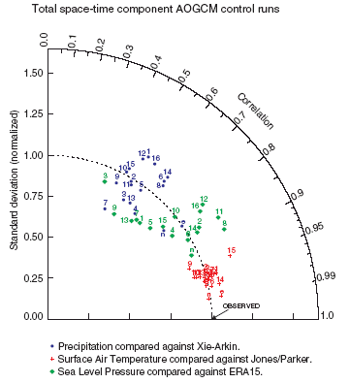
How “good” are GCMs?
A comparison with observations
Temperature simulated accurately. Consistency between models.
SLP and wind are quite skillful. Large variability between models.
Precipitation is somewhat useful. Large variability between models.
General Rule
The more dependent a process is on the physical parameterizations within a model (stuff smaller than a grid box), the greater the error and variability between models.
Precipitation is one such field.
Averaging reduces error
Pattern Match
Closer
… but at the cost of loss of detail
Amplitude
Too Small
Too Large
IPCC TAR
Results circa 2000

Slide 52
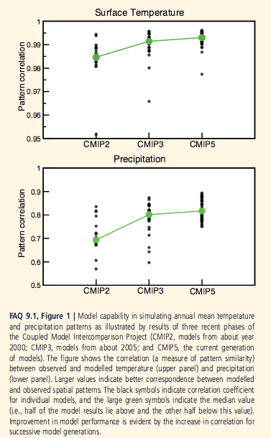
How “good” are GCM’s of today at replicating the current climate?
Models do improve over time.
SFC temperature is simulated accurately. Models are consistent.
Precipitation is improving. Error and variability is decreasing.
General Rule
The more dependent a process is on the physical parameterizations within a model (stuff smaller than a grid box), the greater the error and variability between models.
Precipitation is one such field.

Slide 53
Attribution of recent warming

Slide 54
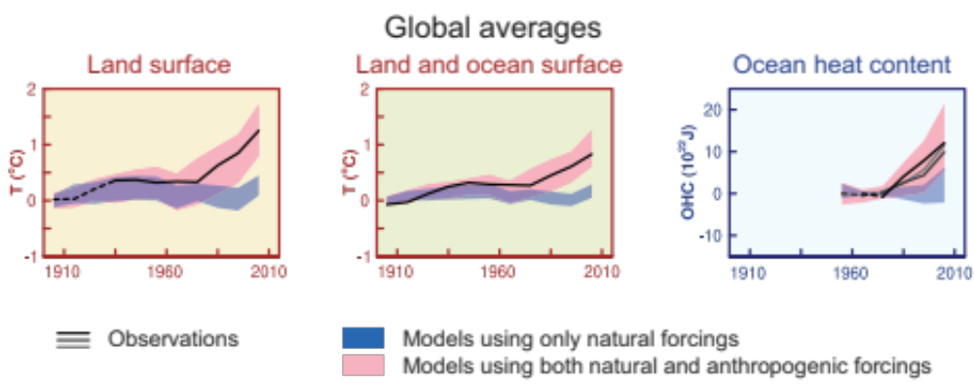
IPCC Scenarios for Past Changes
IPCC AR5
Conduct model experiments incorporating various radiative forcings.
Control experiment incorporates only the factors which would occur naturally such as ENSO events and aerosols from volcanic eruptions.
Attribution experiment incorporates human factors of greenhouse gases (warm), aerosols (cool) and surface land changes.
CONCLUSION: NEED HUMAN FACTORS TO ACCOUNT FOR THE RECENT OBSERVED WARMING, ESPECIALLY AFTER 1980.

Slide 55
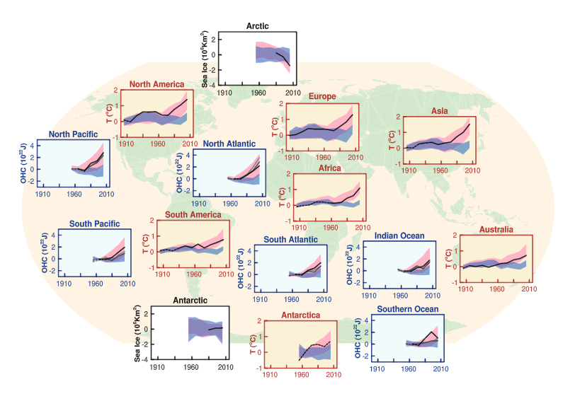
IPCC Regional Attribution
IPCC AR5

Slide 56
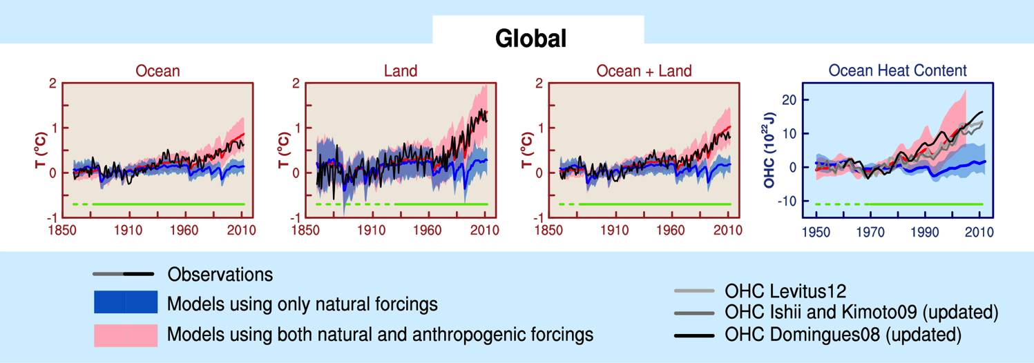
IPCC Scenarios for Past Changes
IPCC AR5
IPCC 2013
Conduct model experiments incorporating various forcings
Control experiment incorporates only the factors which would occur naturally such as aerosols from volcanic eruptions and ENSO events.
Attribution experiment incorporates human factors of greenhouse gases (warm), aerosols (cool) and land changes.
RESULT: NEED HUMAN FACTORS TO ACCOUNT FOR RECENLTY OBSERVED WARMING, ESPECIALLY AFTER 1980.

Slide 57
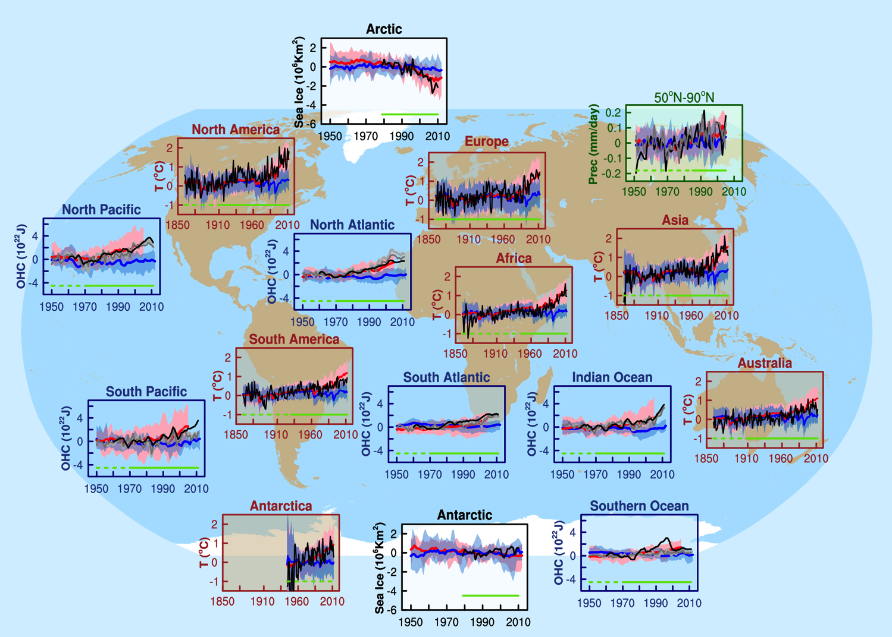
IPCC Scenarios for Past Changes
IPCC Regional Attribution
Conduct model experiments incorporating various radiative forcings
Control experiment incorporates only the factors which would occur naturally such as aerosols from volcanic eruptions and ENSO events.
Attribution experiment incorporates human factors of greenhouse gases (warm) and aerosols (cool).
RESULT: NEED HUMAN FACTORS TO ACCOUNT FOR RECENLTY OBSERVED WARMING, ESPECIALLY AFTER 1980.
IPCC AR5

Slide 58
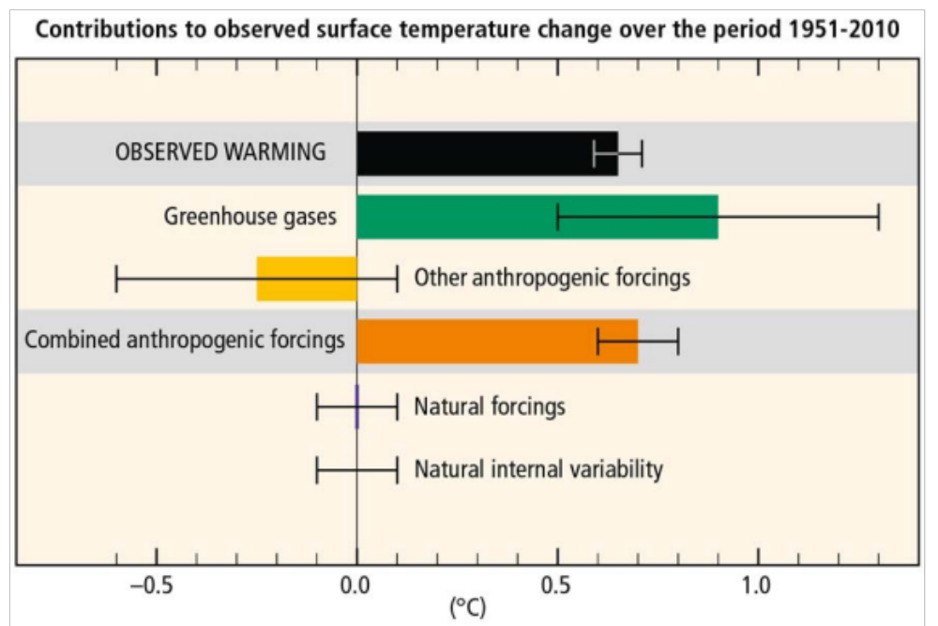
Contributions to observed warming 1951-2010
Aerosols
Land Use
IPCC AR5
Figure 1.9: Assessed likely ranges (whiskers) and their mid-points (bars) for warming trends over the 1951–2010 period from well-mixed greenhouse gases, other anthropogenic forcings (including the cooling effect of aerosols and the effect of land use change), combined anthropogenic forcings, natural forcings, and natural internal climate variability (which is the element of climate variability that arises spontaneously within the climate system, even in the absence of forcings). The observed surface temperature change is shown in black, with the 5%– 95% uncertainty range due to observational uncertainty. The attributed warming ranges (colours) are based on observations combined with climate model simulations, in order to estimate the contribution by an individual external forcing to the observed warming. The contribution from the combined anthropogenic forcings can be estimated with less uncertainty than the separate contributions from greenhouse gases and other anthropogenic forcings separately. This is because these two contributions are partially compensational, resulting in a signal that is better constrained by observations. {Based on Figure WGI TS.10}

Slide 59
Your professor’s opinion
The conclusion of the IPCC seems reasonable given
- the paleoclimate record
- the ability of global models to simulate changes in the climate of the past 100-150 years
- the soundness of proposed physical mechanisms
Note: Reasonable ≠ Certain

Slide 60
Assignment for Next Lecture
Climate Change
Reading - Ahrens
  Pg. 397-428
  Focus on parts of the chapter (mostly last half) that deals with anthropogenic climate change
Suggested Study Problems – Ahrens
  Pg. 428: 14, 16, 17, 20, 21

Slide 61
Quiz #5
Date: Dec 7
Day: Wednesday
Place: In Class
Form: D2L
Remember to do Cloud ID homework.

Slide 62
Final Exam
Counts as quizzes 6 and 7
Date: Dec 15
Day: Thursday
Time: 10:30 am-12:30 pm
Place: In Class (Why? It’s mandated.)
Form: D2L
Final counts the same as two quizzes. Remember, lowest two quizzes are discarded. Final could replace up to two lower quiz scores.

