Slide 1
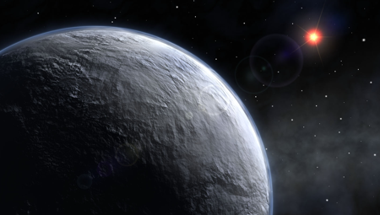
ATMO 170A1
MWF
Natural Climate Variability
Artist’s rendition of snowball earth, 650 Mya

Slide 2
Which two primary pollutants are the cause of acid rain?
CH₄ and CO
CO₂ and H₂O
NO₂ and SO₂
Pb (Lead) and PM2.5
tophat question

Slide 3
Where and when is the “ozone hole” biggest?
Antarctica, Early Spring (Sept-Oct)
Antarctica, Late Fall (Mar-Apr)
Arctic Ocean, Mid-Winter (Jan-Feb)
Arctic Ocean, Late Summer (Aug-Sept)
tophat question

Slide 4
Where and when is the “ozone hole” biggest?
3 µm and 1 µm
3 mm and 1 mm
3 cm and 1 cm
3 m and 1 m
tophat question

Slide 5
What is Climate Change?
Climate change - A significant shift in the mean or event frequency of the atmosphere.
Climate change is a normal component of the Earth’s natural variability.
Climate change occurs on all time and space scales.
A plethora of evidence exists that indicates the Earth’s climate was radically different than today. What is that evidence? How do we know what we know?

Slide 6
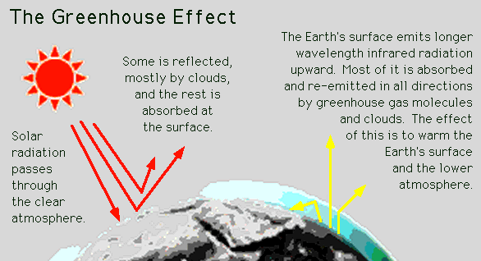
Causes of Climate Change
Astronomical
Composition
Surface

Slide 7
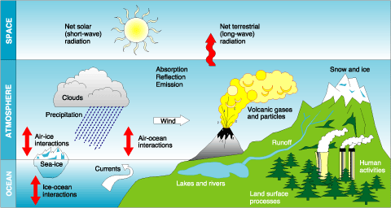
Causes of Climate Change
Astronomical
http://www.meteorologyclimate.com/climate-varition-factors.gif
Composition
Surface

Slide 8
Detecting Change With Proxies
How do we “measure” paleo climate change? Infer from another property/qty that is a function of property of interest.
Think apPROXImate
The measured property is a PROXY for the one of interest.
Following slides courtesy of J Thornton, U Wash

Slide 9
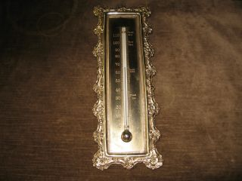
Unlocking “Stored” Climate Change
Modern Instruments
Direct Measurements
Tree Rings
Ice Cores
Sediment cores
Rock formations/types
Link
Record: 1800’s to Present
Temperature
Precipitation
Length of growing season
J. Thornton, U Wash

Slide 10
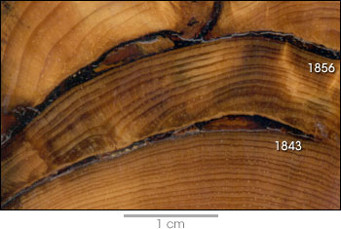
Unlocking “Stored” Climate Change
Modern Instrument
Record
Tree Rings
Ice Cores
Sediment cores
Rock formations/types
Record: few 1000 years
Good vs. stressed years
Major fires
World’s premier tree ring
research group at UA

Slide 11
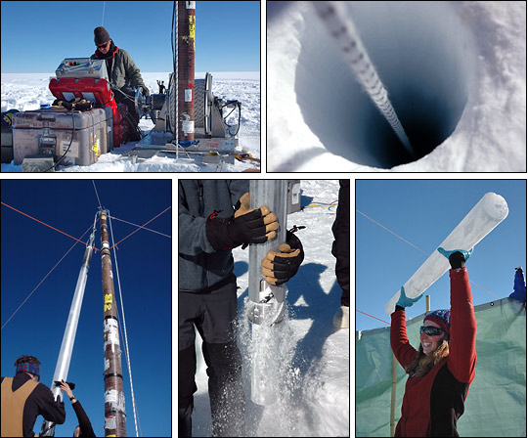
Unlocking “Stored” Climate Change
Modern Instrument
Record
Tree Rings
Ice Cores
Sediment cores
Rock formations/types
Record: ~1Mya to 20th cent
Inert gases (CO₂, CH₄, N₂O,…)
Particulates (soot, ash, etc)
Temperature

Slide 12
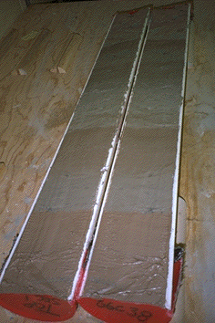
Unlocking “Stored” Climate Change
Modern Instrument
Record
Tree Rings
Ice Cores
Sediment cores
Rock formations/types
Record: ~ 100’s Mya
Microfossils (ocean T)
Volcanic glass
Magnetic pole location

Slide 13
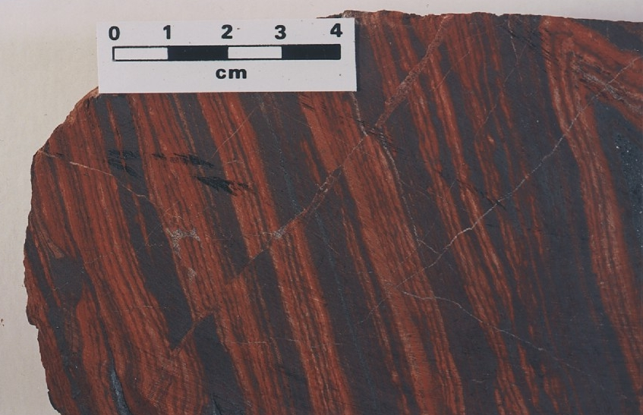
Unlocking “Stored” Climate Change
Modern Instrument
Record
Tree Rings
Ice Cores
Sediment cores
Rock formations/types
Banded Iron Formations BIFs tied up oceanic O₂ Prevented atmospheric O₂ Date no later than ~2 GYA
Record: ~ 4.5 Gya
Geologic formation
Geochemical analysis
Magnetic pole
Continent Location
Fossil record

Slide 14
Survey
How much colder than today was the average temperature during the most recent ice age (18,000 yrs ago)?
2°C
5°C
10°C
20°C

Slide 15
Survey
How much colder than today was the average temperature during the most recent ice age (18,000 yrs ago)?
2°C
5°C
10°C
20°C

Slide 16
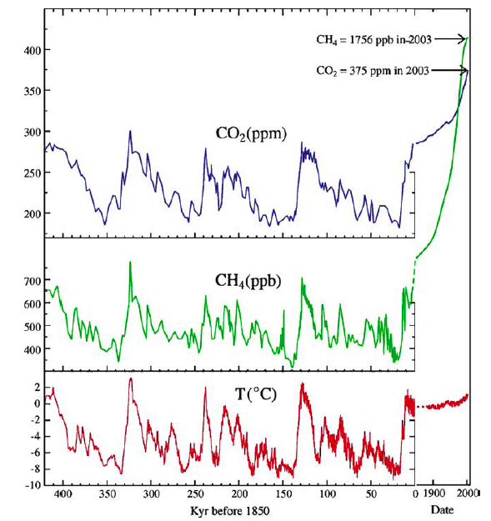
Vostok Ice Core Record
During peak of last ice age (18 Kya)
CO₂ levels 30% lower
CH₄ levels 50% lower
Temps 6ºC colder
(sea level ~100 m lower)
than pre-industrial (1850) interglacial values
Last Ice Age
T based on water isotope O¹⁸/O¹⁶ proxy
Low O¹⁸/O¹⁶ ice ⇒ Cold
T and GHG correlated
Causality?

Slide 17
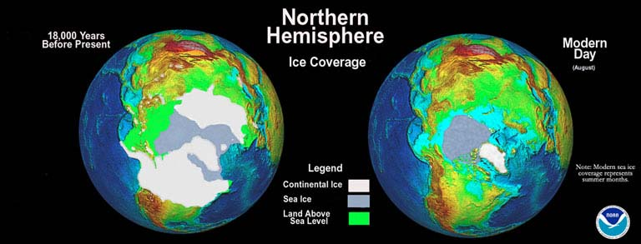
Most Recent Ice Age
Extend of continental glaciers 18,000 years BP.
Sea level was 100-125 m lower than present.
Bering land bridge between Siberia and Alaska.

Slide 18
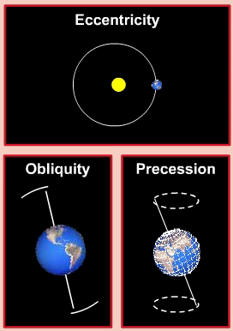
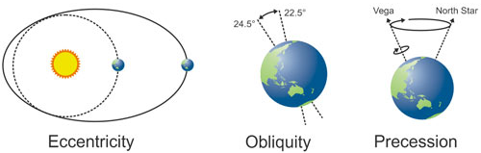
Milankovich Cycles and Ice Ages
Eccentricity (100 Kya cycle)
Aphelion/perihelion distance
Currently 153/148 million km
7% difference in solar intensity
can be nearly 30% difference
Obliquity (41 Kya cycle)
Tilt of earth’s axis 21.5°-24.5°
Currently 23.5°
Precession (26 Kya cycle)
Wobble of earth’s axis
Affects perihelion-season phasing
http://www.sciencecourseware.org/
Ice ices favored by
Summer aphelion
Large eccentricity

Slide 19
How far in the past can tree ring analysis be used as a proxy to estimate climate change?
100-200 years
1000-2000 years
10,000-20,000 years
One to two million years

Slide 20
How far in the past can tree ring analysis be used as a proxy to estimate climate change?
100-200 years
1000-2000 years
10,000-20,000 years
One to two million years

Slide 21
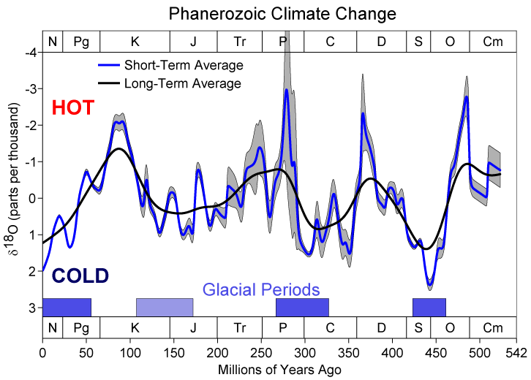
540 Mya of Climate Change from O₁₈
http://en.wikipedia.org/wiki/Oxygen_isotope_ratio_cycle

Slide 22
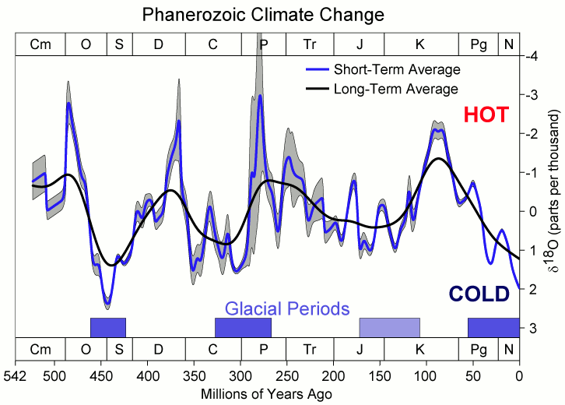
540 Mya of Climate Change from Ocean O₁₈
http://en.wikipedia.org/wiki/Oxygen_isotope_ratio_cycle
Proxy for ocean temperatures
Low O¹⁸/O¹⁶ shells ⇒ Warm

Slide 23
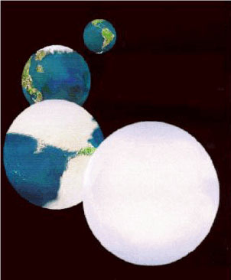
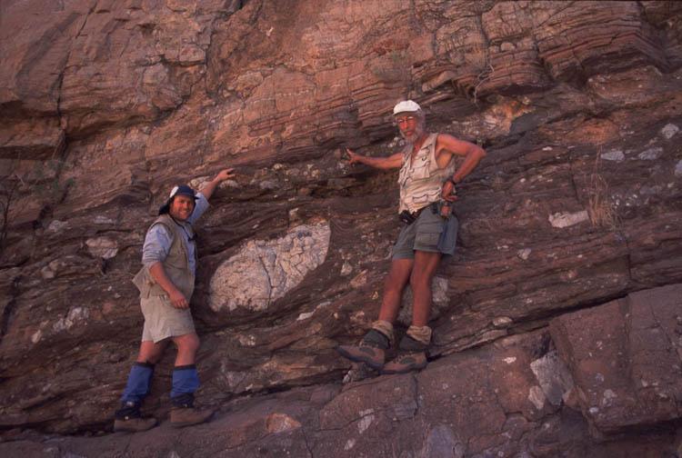
Snowball Earth? The Evidence
cap carbonates
dropstones
http://www-eps.harvard.edu/people/faculty/hoffman/Snowball-fig11.jpg
Basic physics are understood: Runaway ice-albedo feedback
Did all of the tropics freeze? How does earth thaw? CO₂ increase?
http://nai.nasa.gov/newsletter/03182005/snowball.jpg

Slide 24
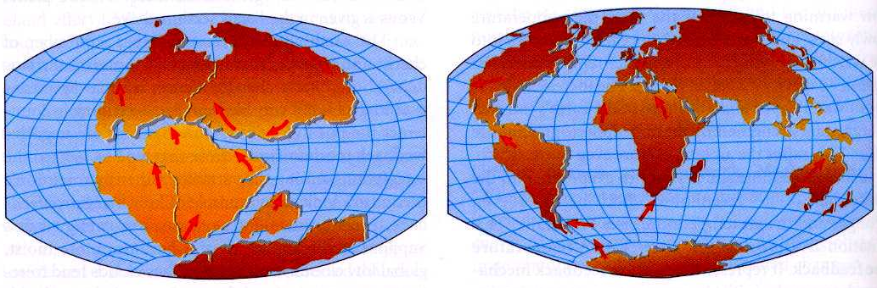
Long-Term Climate Change
NA
E-A
NA
E-A
India
Af
SA
Af
Aus
SA
India
Aus
Ant
Ant
180 M BP
Today
Ahrens, Fig 13.6
250 million years ago, the world’s landmasses were joined together and formed a super continent termed Pangea.
As continents drifted apart to their present configuration, they moved to different latitude bands, created/closed ocean basins and causeways.
This altered prevailing winds and ocean currents.

Slide 25
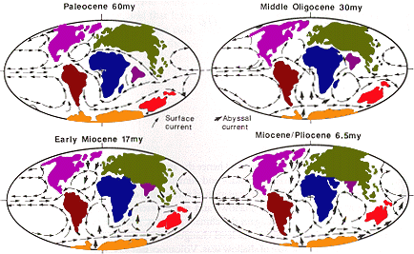
Long-Term Climate Change
250 million years ago, the world’s landmasses were joined and formed a super continent, Pangea, that split into the seven continents of today.
As continents drifted apart to their present configuration, they moved to different latitude bands, opened/closed ocean basins and seaways.
Altered prevailing winds and ocean currents.

Slide 26
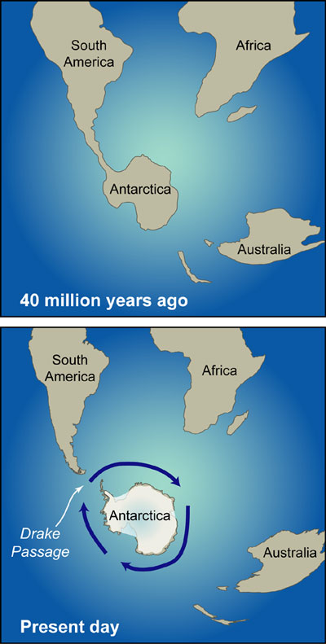
Glaciation of Antarctica
40 Mya, Antarctica separated from Australia, at which time the first iced began to form on the continent. Before then, the Antarctic climate was mostly tropical or sub-tropical.
23 Mya, Antarctica separated from South America resulting in the Circumpolar Current.
Antarctic
Circumpolar Current
Link

Slide 27
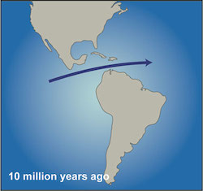
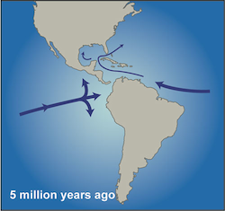
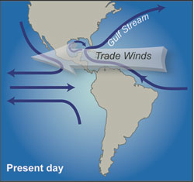
Formation of the Gulf Stream
Link
10 Mya ago, North America and South America were separated. Water flowed between the Pacific Ocean to the Atlantic Oceans through the Central American Seaway.
5 Mya ago, the Seaway closed and flow between the two oceans ceased. The Gulf Stream then began to strengthen. The changes in ocean currents may have set the stage for the glacial-interglacial periods of the Northern Hemisphere that began ~2.7 Mya and continue today.

Slide 28
How far in the past can tree ring analysis be used as a proxy to estimate climate change?
100-200 years
1000-2000 years
10,000-20,000 years
One to two million years

Slide 29
How far in the past can tree ring analysis be used as a proxy to estimate climate change?
100-200 years
1000-2000 years
10,000-20,000 years
One to two million years

Slide 30
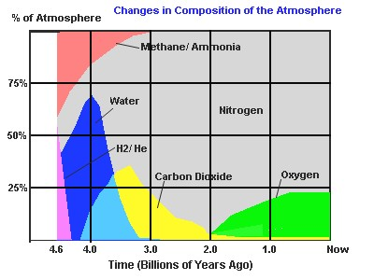
Composition of the Earth’s atmosphere has changed radically through the ages
Dimmer Sun
Brighter Sun
http://www.ozh2o.com/atmos.jpg

Slide 31
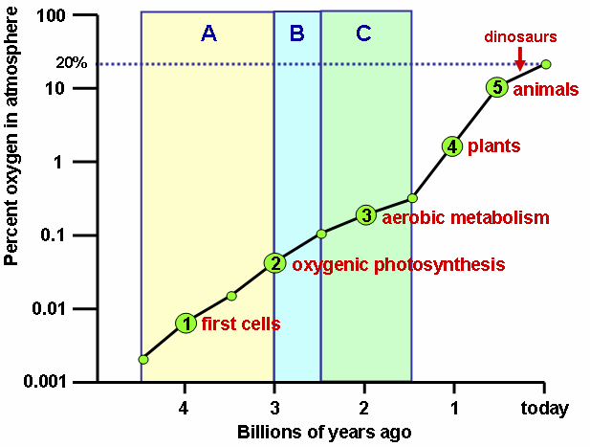
Life is responsible for the “recent” rise of oxygen
Cambrian explosion
Multicell organisms
Use of oxygen for metabolism. H₂O and CO2 are byproducts.
Use of sunlight for metabolism. Oxygen is a byproduct.
http://upload.wikipedia.org/

Slide 32
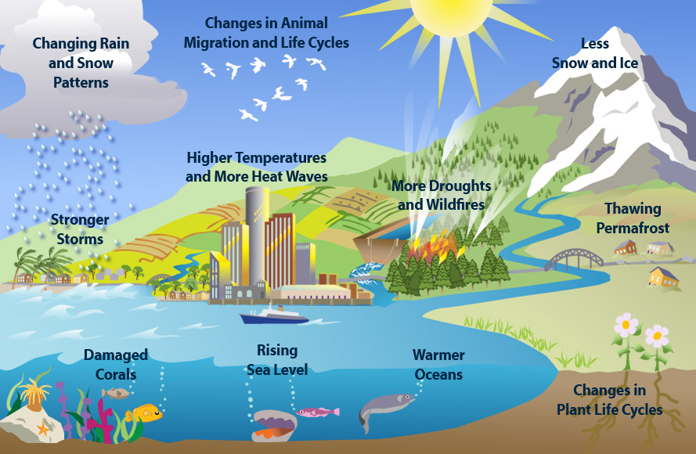
Fingerprints of Climate Change
Warmer Temps
Higher Water Vapor
CO₂ Uptake
Acidification
Glacial Melt
Thermal Expansion
Longer
Growing Season

Slide 33
Fingerprints of Climate Change

Slide 34
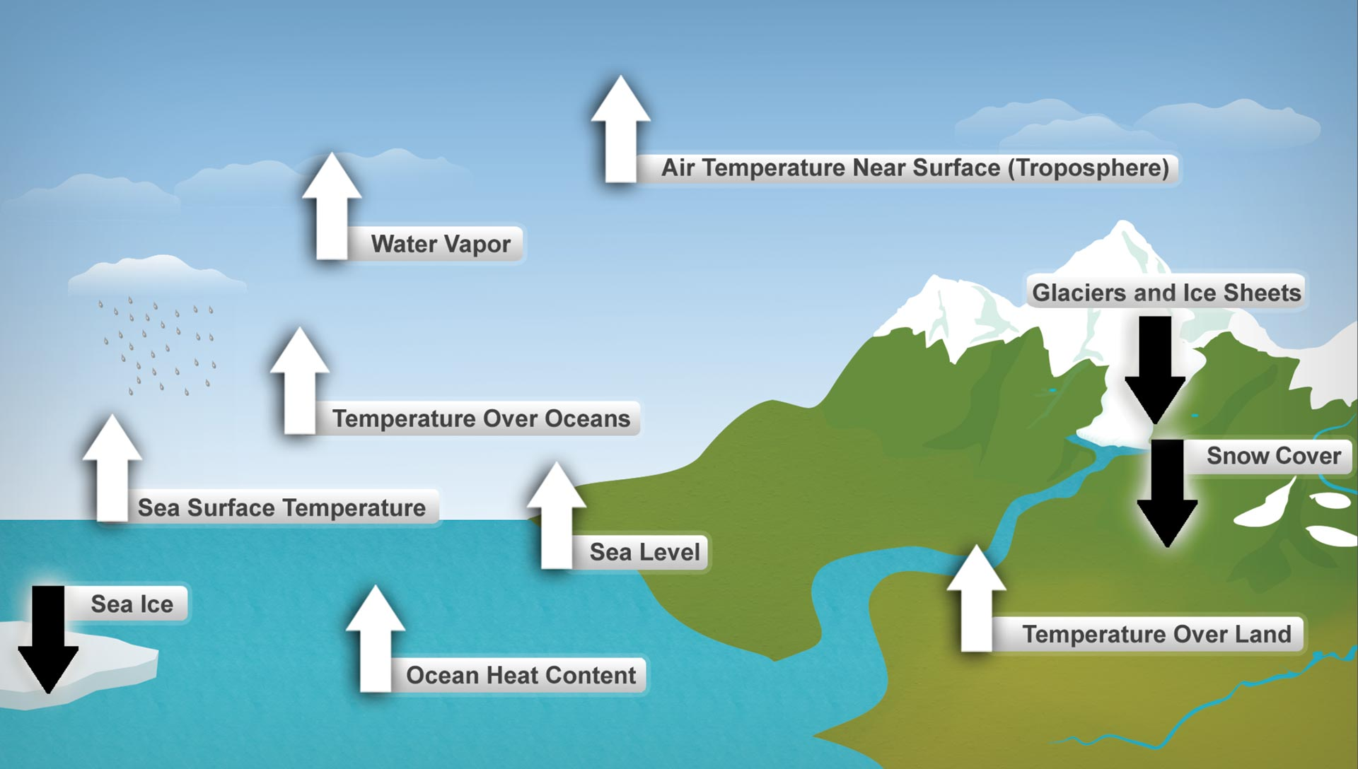
Fingerprints of Climate Change

Slide 35
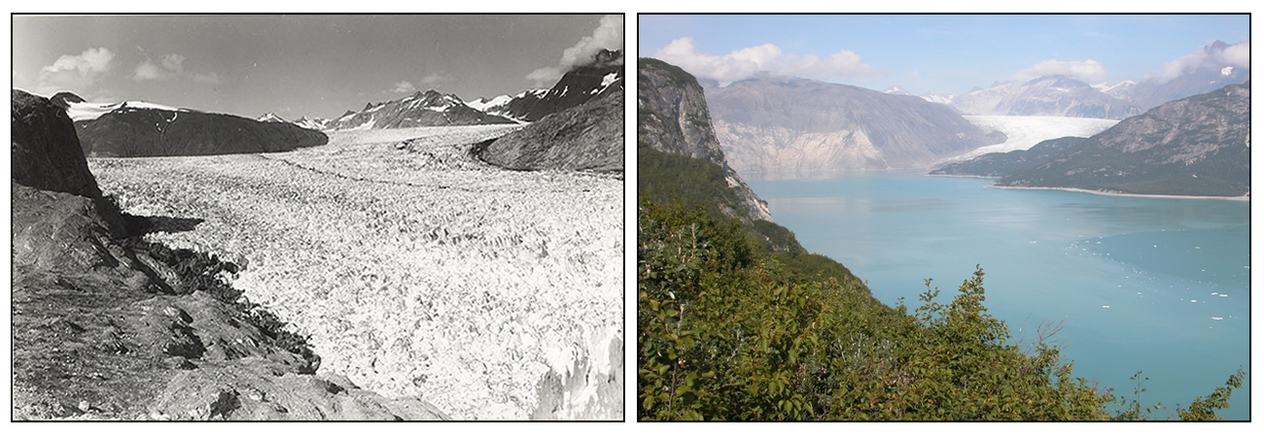
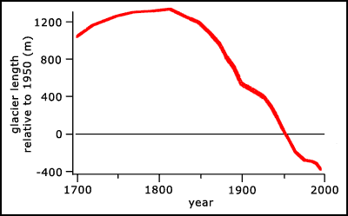
Recent Glacial Retreat
Muir Glacier AK 1941
Muir Glacier AK 2004
144 glaciers
142 retreated

Slide 36
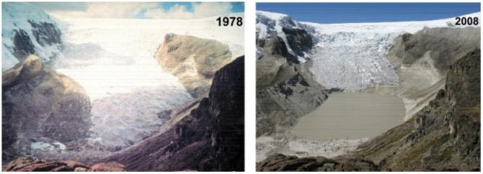
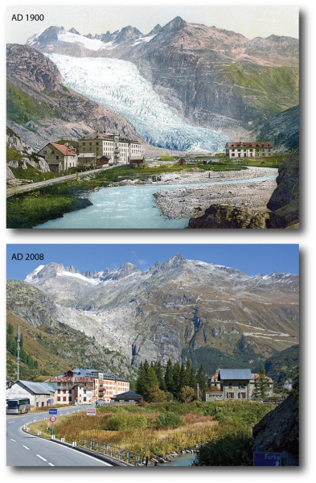
More Glacial Retreat
Qori Kalis Glacier, Andes
Lonnie Thompson OSU
Rhone Glacier, Alps
blogs.ei.columbia.edu

Slide 37
Key Points: Climate Change
Three general climate change mechanisms:
    Astronomical
    Atmospheric composition
    Earth’s surface
Humans modify 2 on global scale and 3 on regional scale
Are recent climate and weather changes due to natural causes or human activities?
Next Time: IPCC Projections
Attribution of recent change
Future change

Slide 38
Assignment for Next Lecture
Climate Change
Reading - Ahrens
  Pg. 397-428
  Focus more on the last half of chapter that deals with anthropogenic climate change
Questions for Review – Ahrens
  Pg. 428: 14, 16, 17, 20, 21

