Slide 1
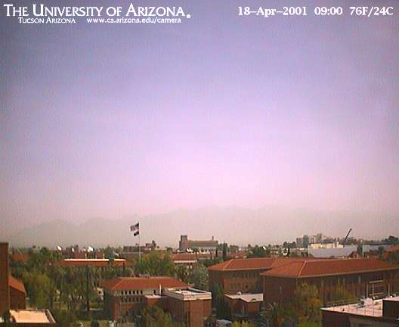
ATMO 170A1
Online
Air Pollution
Primary & Secondary Pollutants
Particulate Matter
Photochemical Smog
Pollution Weather
Hazy skies over Tucson

Slide 2
Goals
Air Pollution
  Primary vs. Secondary
  Historic Levels vs. Current Levels
Common Pollutants
  Visible, Infrared, Water Vapor
  Characteristics, Advantages, and Limitations of Each Image Type
Trends in Pollutants
Notes:
Types of Satellites
- Geostationary with respect to the earth’s surface.
- Polar Orbit: (almost) over the North Pole and South Pole.
Types of Images
- Visible (eyeball), Infrared (energy emitted by earth to space), and touch on Water Vapor (limited IR emission)
Tangentially touch on Interpretation of Satellite Imagery

Slide 3
Learning Outcomes Addressed
1) Explain how the distribution of heating of the earth by the sun and energy transfer through the atmosphere drives weather and climate change.
2) Read surface weather maps and upper-air maps, and understand the connection between surface weather and conditions aloft in midlatitudes.
3) Recognize from weather maps commonly occurring, large-scale atmospheric phenomena, including midlatitude cyclones, upper-level troughs and ridges, jet streams, and trade winds, and their impact on local weather.
4) Identify commonly occurring, high-impact mesoscale weather phenomena such as severe thunderstorms and hurricanes, and recognize the larger-scale weather conditions in which they form.
5) Identify the primary cloud types and types of precipitation, and recognize their underlying formation mechanisms in terms of concurrent weather conditions.
6) Explain the impact that weather and climate have on life, and that life has on the evolution of the atmosphere and climate.
Notes:
Addressed to varying degree

Slide 4
What is Air Pollution?

Slide 5
American Meteorology Society Glossary of Meteorology
  air pollution—The presence of substances in the atmosphere, particularly those that do not occur naturally.
  These substances are generally contaminants that substantially alter or degrade the quality of the atmosphere.
  The term is often used to identify undesirable substances produced by human activity, i.e. anthropogenic air pollution.
  Air pollution usually designates the collection of substances that adversely affects human health, animals, and plants; deteriorates structures; interferes with commerce; or interferes with the enjoyment of life.

Slide 6
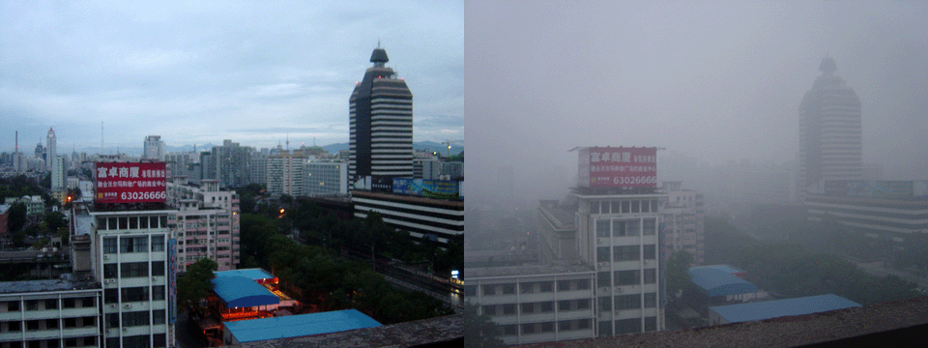
Beijing on the day after a rainy day and on a sunny but smoggy day
en.wikipedia.org
Economic growth—but at what environmental cost?
Some of the slides that follow are courtesy of Prof. C. Castro, HAS

Slide 7
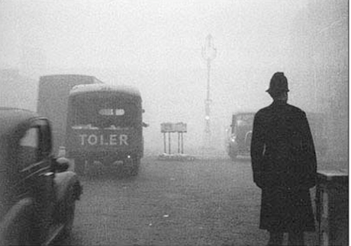
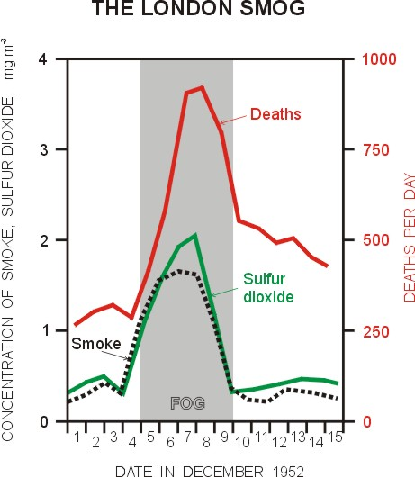
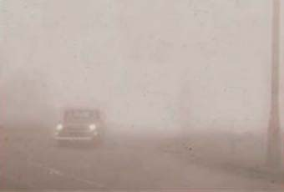
Brief History: London Death Fog
Some of the worst events in the last
two centuries occurred in London.
1952 Event resulted in 4000 deaths!
Key ingredients: calm winds, fog, smoke particles from coal burning.
Motivated parliament to pass a Clean Air Act in 1956.
http://www.ems.psu.edu/~lno/Meteo437/Smoglond.jpg

Slide 8
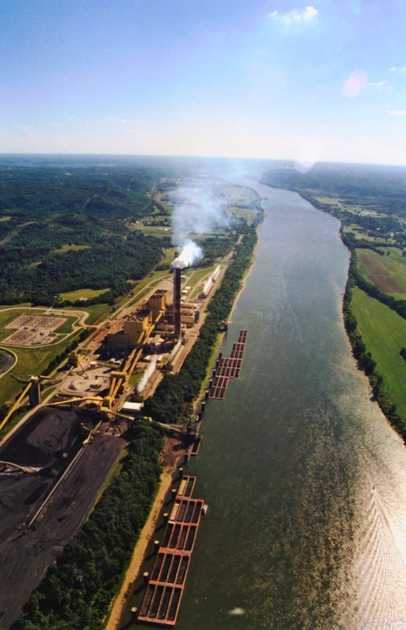
Air pollution from burning of coal
Much of the air pollution in the eastern part of the United States was and is still from burning coal.
Many of the coal plants today are located on or near the Ohio River
Why might that be?
Other places with a similar story:
Rhine River Valley in Germany
Northern China (Manchuria)

Slide 9
The U.S. passed its air pollution control act in 1955.
But this act left out one VERY BIG thing!

Slide 10
SMOG
SMoke + fOG

Slide 11
Pollution from vehicle transportation sources was a rapidly growing problem
It was a new kind of pollution,
different from the traditional smog
of London or U.S. eastern cities.
And the worst place for it in the U.S. was (and still is) Los Angeles

Slide 12
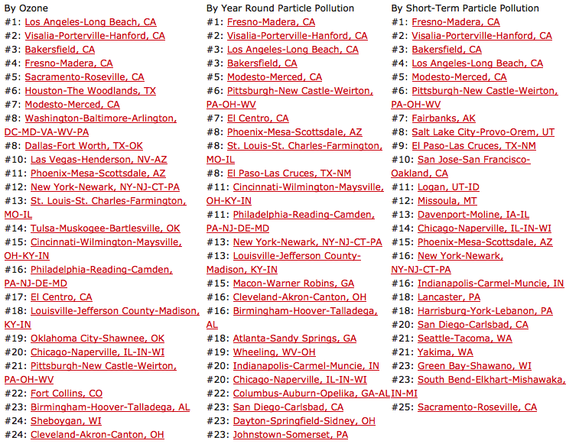
Most Polluted Cities 2014
American Lung Association

Slide 13
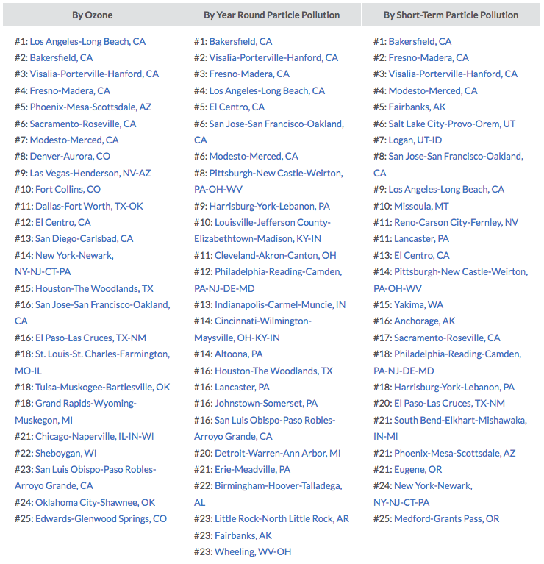
Most Polluted U.S. Cities 2016
American Lung Association

Slide 14
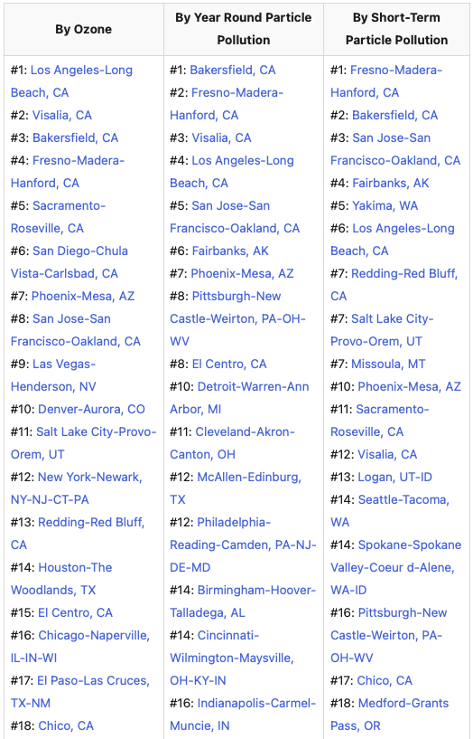
Most Polluted U.S. Cities 2020
State of the Air
American Lung Association
Cleanest Cities

Slide 15
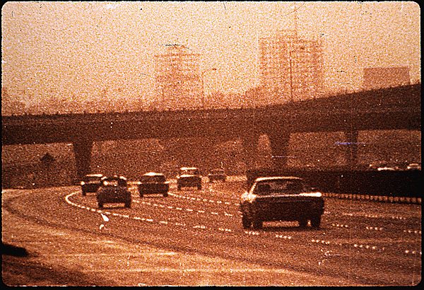
Pollution controls on vehicles
Photochemical smog, was a rapidly growing problem
This problem was especially prevalent in western U.S. cities, like Los Angeles.
Severe air pollution lead to the Clean Air act of 1970 and the establishment of the EPA.
This act and its subsequent additions placed emission control standards on vehicles that each state must meet.
Credit: LA TImes
Los Angeles in the 1960s
Memories, sweet memories

Slide 16
Even with the Clean Air Act and oversight by the EPA, air pollution is still a big problem in the U.S. today.
Reason: Although today’s cars are less polluting, there are a lot more of them and people drive them farther than four decades ago.

Slide 17
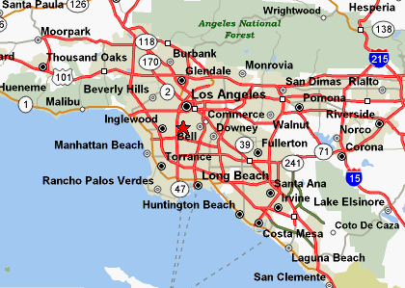
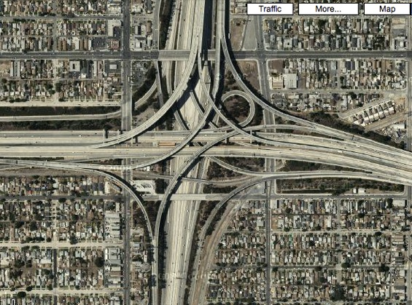
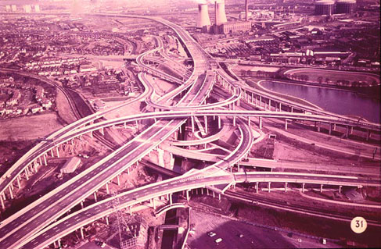
You’ve got to have a car in L.A.
Current L.A. freeway system
“Spaghetti Junction”
Figure Credit: maps.google.com
How did it get this way?
Urban mass transit systems dismantled (i.e. trolley systems).
Cities grew outward, not upward.
Freeways built but development followed—along with long commutes.
Similar story across the United States…and it still continues today!

Slide 18
What is the environmental consequence?

Slide 19
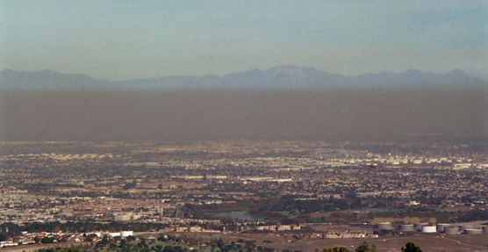
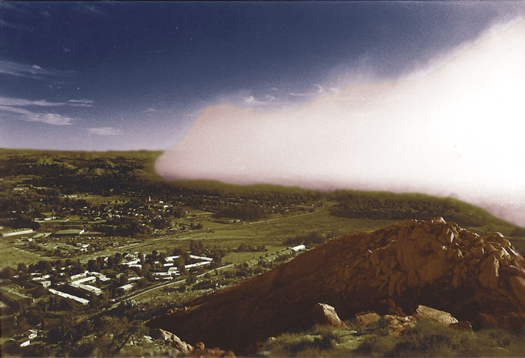
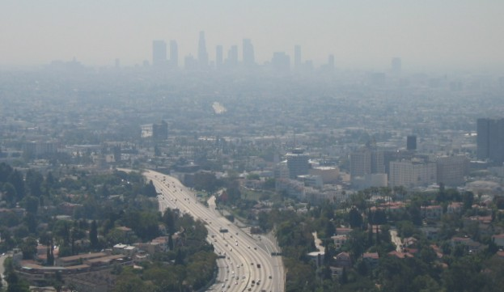
Photochemical smog
(Los Angeles type smog)
L.A. Sky Colors Dec 2000
Downtown L.A. on a smoggy day
Mark Z. Jacobson
Credit: Ahrens, earlier ed.
Smog “front” as sea breeze approaches Riverside CA
Photochemical smog: Ozone near the ground, caused by chemical reactions involving nitrogen oxides (NO_{x}) and volatile organic compounds (VOC’s) in the presence of sunlight. VOC’s mainly come from incomplete combustion of fossil fuels.
What are the health effects of living in this? How is smog made?

Slide 20
But photochemical smog is not unique to Los Angeles, it occurs in every major city in the Southwest U.S.

Slide 21
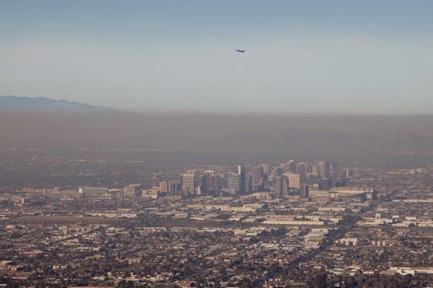
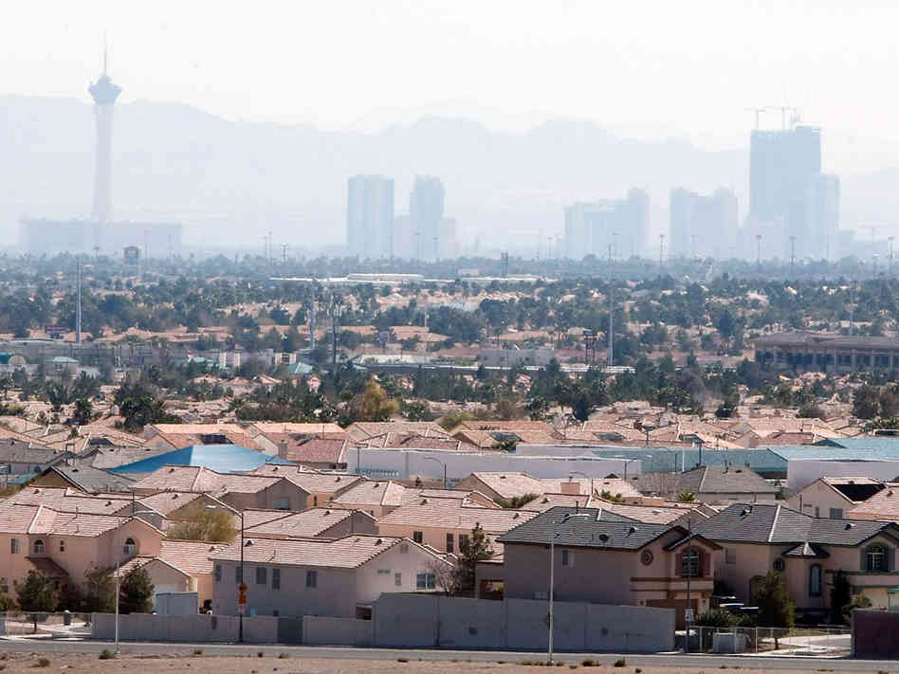
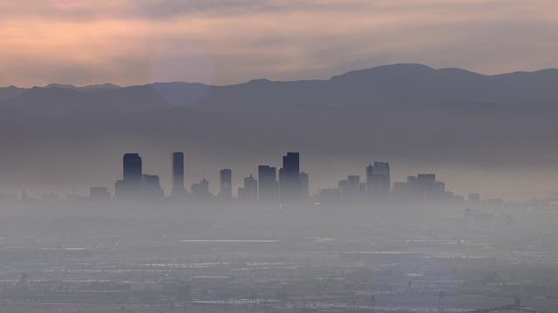
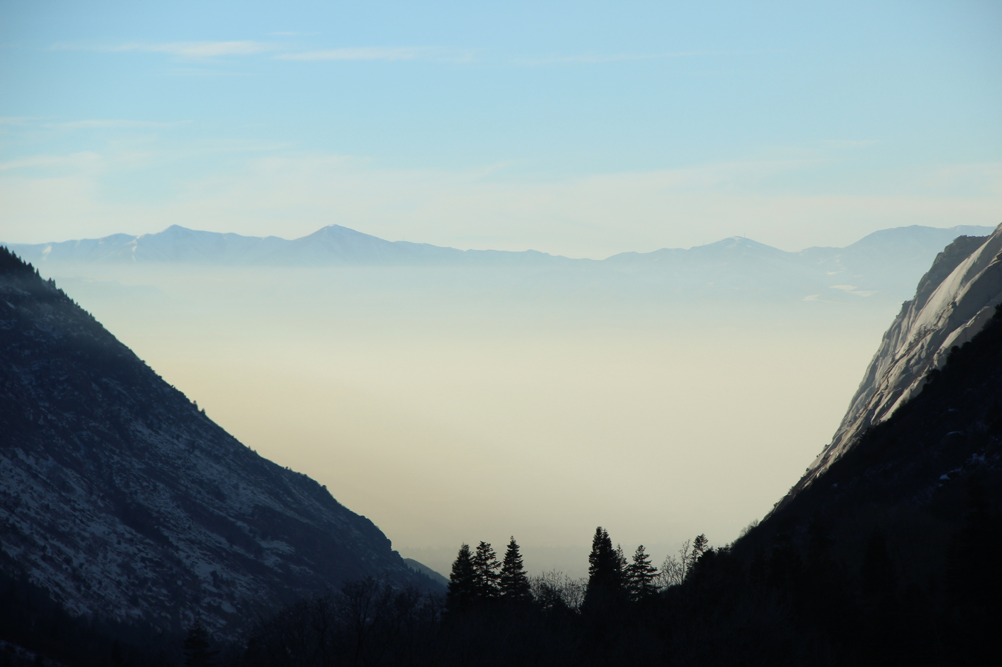
Phoenix, Arizona
Las Vegas, Nevada
Salt Lake City, Utah
Denver, Colorado

Slide 22
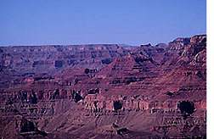
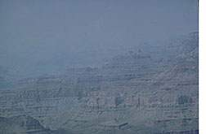
And you can’t escape it if you leave the city either…
Grand Canyon
on a clear day.
Grand Canyon
on a smoggy day.
http://apollo.lsc.vsc.edu/classes/met130/notes/

Slide 23
Two types of air pollutants
Primary pollutants
Enter the atmosphere directly from (anthropogenic) sources.
HARMFUL EXHAUST FROM SMOKESTACKS AND TAILPIPES…
Secondary pollutant
Forms as a result of chemical reactions between primary pollutant(s) and/or some other atmospheric constituent.
Examples: photochemical smog and acid rain

Slide 24
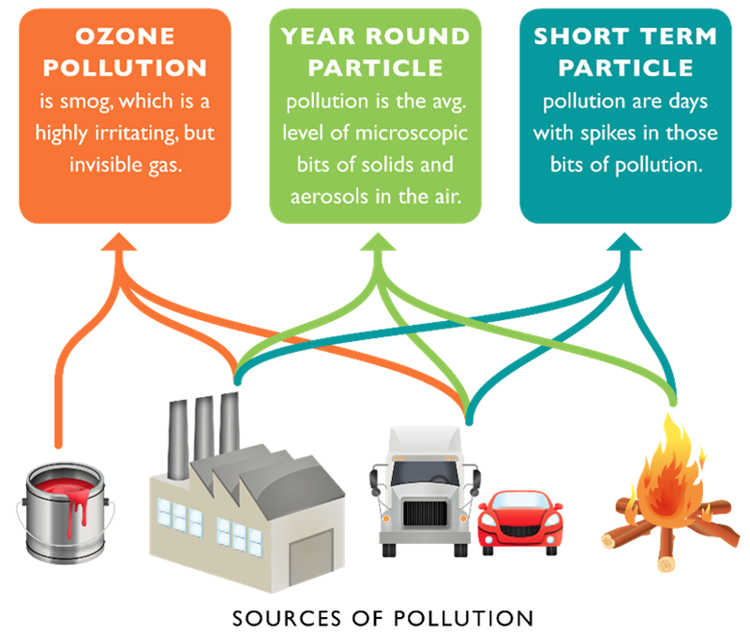
American Lung Association

Slide 25
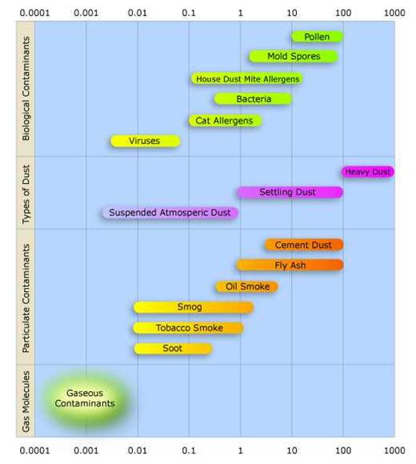
Primary Pollutants
<= microns =>
Particulate Matter
Solid particles and liquid droplets that are small enough to remain suspended in the air.
Particles smaller than 10 microns are more likely to lounge in the respiratory system where they can adversely affect the body.
Smaller the particle, in general the more dangers it imposes.
https://en.wikipedia.org/wiki/Particulates

Slide 26
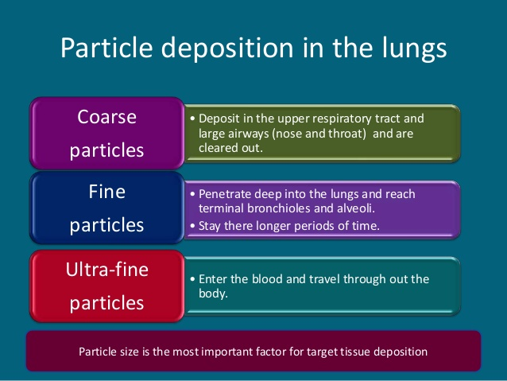
Primary Pollutants
Coarse PM10 – deposit in upper respiratory tract (nose/throat) and can be expectorated.
Fine PM2.5 – penetrate deep into lungs. Reach bronchioles an alveoli.
Ultra-fine PM < 0.1 μm – Enter blood and travel throughout body.
PM10
PM2.5
< 0.1 μm
Credit: B. Victor

Slide 27
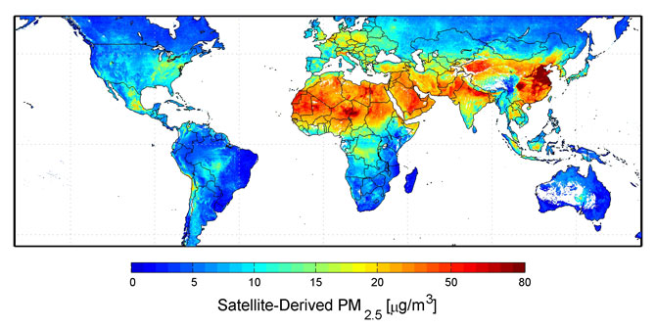
PM2.5 concentration for 2006-2011
http://www.nasa.gov/images/content/483897main_Global-PM2.5-map.JPG
NASA aerosols animation 200602910
Green: Biomass Burning Red/Orange: Dust
White: Sulfites (from coal primarily) Blue: Salt

Slide 28
More Anthropogenic Primary Pollutants
Carbon monoxide (CO)
Forms from incomplete combustion of carbon containing fuels. Can be lethal in high concentrations because it replaces oxygen in the hemoglobin of the blood.
Sulfur Dioxide (SO₂)
Colorless gas that comes primarily from burning of coal and oil.
Nitrogen oxides (NO_{X})
Gases that form when some of the nitrogen in the air reacts with oxygen during fuel combustion process. Can be harmful to respiratory and cardiovascular systems and is carcinogenic.
Volatile organic compounds (VOCs)
Mainly complex hydrocarbon compounds mostly from incomplete combustion of fuel and biomass burning.
TO CREATE PHOTOCHEMICAL SMOG AS A SECONDARY POLLUTANT YOU NEED NITROGEN OXIDES AND VOLATILE ORGANIC COMPOUNDS.

Slide 29
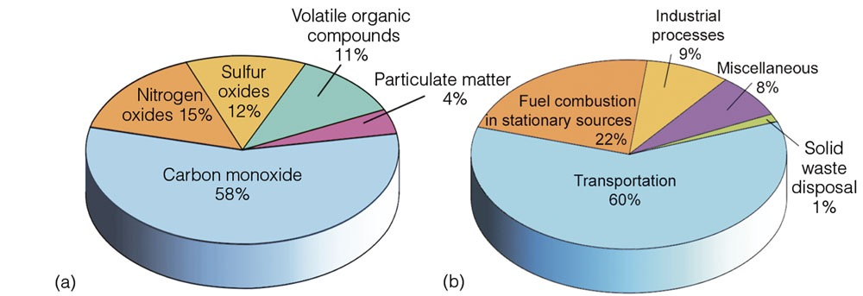
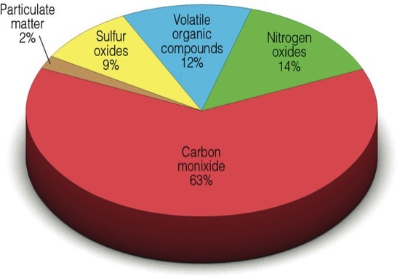
Emissions and sources of primary pollutants in the U.S.
Ahrens
9th ed.
EPA estimates

Slide 30
How do nitrogen oxides (NO_{x}) and volatile organic compounds (VOCs) make photochemical smog?

Slide 31
Ozone Production
Motor vehicle exhaust contains the nitrogen dioxide (NO₂) and nitric oxide (NO), the NO_{x} gases.
At the high temperatures of internal combustion, nitrogen and oxygen from the air react to form nitric oxide (NO), a colorless gas:
Step 1: N₂ + O₂ + heat → 2NO Creates nitric oxide.
Some of the nitric oxide (NO) reacts with oxygen to form nitrogen dioxide (NO₂), a toxic brown gas:
Step 2: 2NO + O₂ → 2NO₂ + O Creates nitrogen dioxide and atomic oxygen.
When the nitrogen dioxide (NO₂) concentration is well above clean air levels and there is plenty of sunlight, an oxygen atom splits off from the nitrogen dioxide molecule:
Step 3: NO₂ + sunlight → NO + O Creates atomic oxygen.
This oxygen atom (O) can react with molecular oxygen (O₂) in the air to form ozone (O₃):
Step 4: O + O₂ → O₃ Creates ozone.
Nitric oxide can remove ozone by reacting with it to form nitrogen dioxide (NO₂) and oxygen (O₂):
Step 5: NO + O₃ → NO₂ + O₂ Removes ozone.
When the ratio of NO₂ to NO exceeds 3, production of ozone dominates. Maximized at 8. If the ratio is less than 3, then the nitric oxide reaction destroys the ozone at about the same rate as it is formed, keeping the ozone concentration below harmful levels.
Ozone causes breathing difficulties, headaches, fatigue and aggravates respiratory problems.
The reaction of hydrocarbons (unburned petrol) with nitric oxide and oxygen produce nitrogen dioxide also in the presence of sunlight, increasing the ratio of nitrogen dioxide to nitric oxide.

Slide 32
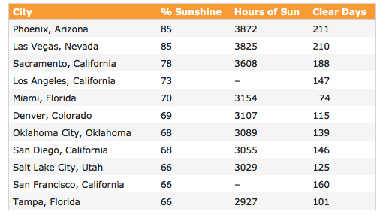
Favorable factors for ozone air pollution in Southwest U.S.
Big metropolitan areas with a lot of vehicles
Long commutes
Lots of sunshine
Meteorological conditions
that “trap” the air over a metro area for a long time.
Most ideal combination:
Ample sunshine
Weak winds
City located under an inversion
City situated in a basin or valley surrounded by mountains
VIRTUALLY ANY MAJOR CITY WESTERN U.S. FITS THIS DESCRIPTION SOMETIME DURING THE YEAR!
source unknown

Slide 33
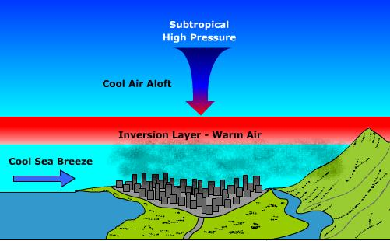
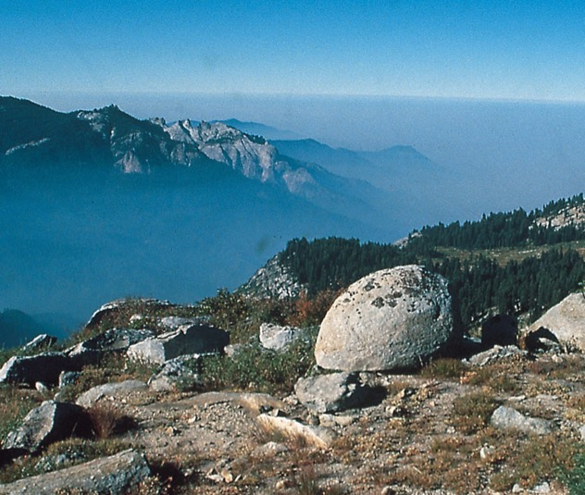
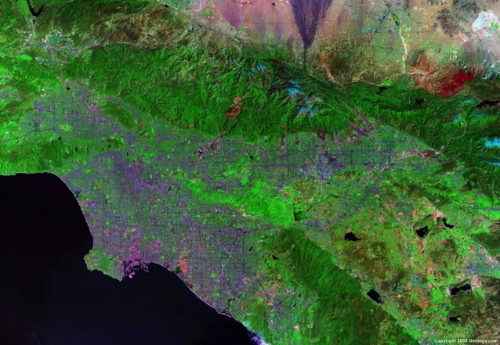
Topographic influence
Subtropical High Pressure
Warm Air Aloft
Inversion Layer – Air Warms with Height
Cool Sea Breeze
Inversion Entrapment
Smog trapped in subsidence inversion over L.A. Basin
Los Angeles is located in a basin.
Cool afternoon sea breezes.
When the winds are weak, the mountains are a physical barrier that prevent pollution from escaping.
Cool Sea
Breeze
Topography of the L.A. Basin

Slide 34
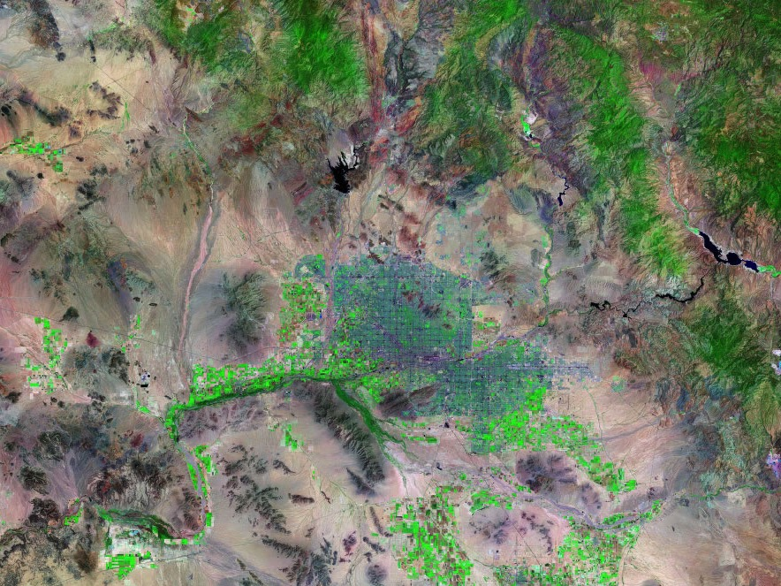
Phoenix is a LOT like Los Angeles!
Mountains
Prevailing Wind
Landsat image of Phoenix Area

Slide 35
But if you think it is bad in the U.S., other parts of the world are worse, a WHOLE LOT worse

Slide 36
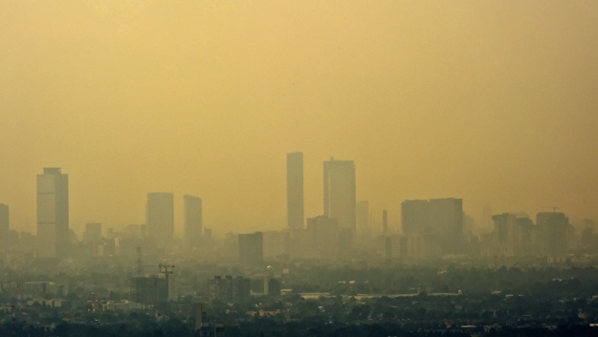
Meet Mexico City: THE WORST place for air pollution in North America
Factors
Located at high elevation
surrounded by very high mountains on three sides
A dry and sunny winter under a ridge of high pressure most of the time.
A population of about 9 million people.
Lower environmental standards than U.S.
Mexico City
March 18, 2016
Smog in Mexico City
SIMILAR STORY IN SANTIAGO, CHILE, AND SAO PAULO, BRAZIL

Slide 37
And Mexico City can’t hold a candle to

Slide 38
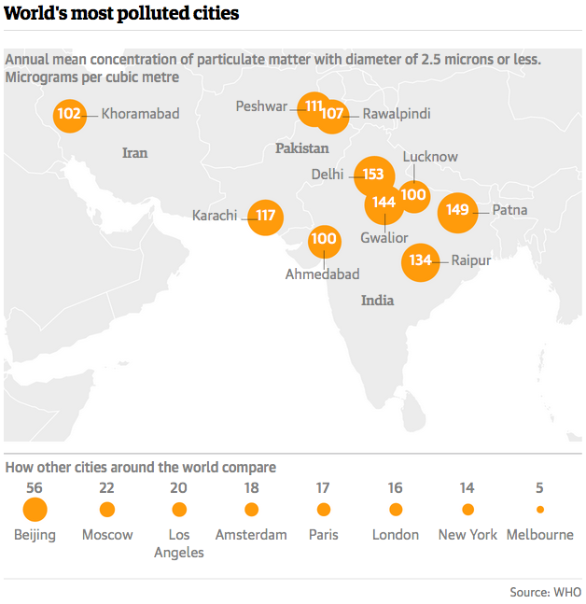
2015 WHO rankings for PM2.5 (μg/m³)
http://www.theguardian.com/

Slide 39
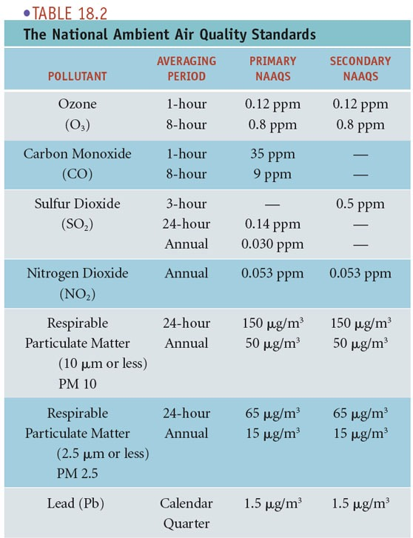
National Ambient Air Quality Standards
These are the EPA’s federal standards for air pollution measurements.
If pollution levels exceed these standards, then the area is designated the status “Non-Attainment”
Ahrens (early edition)

Slide 40
Non-Attainment Counties
6 Pollutants: CO, Pb, NO₂, O₃, PM, SO₂
www.epa.gov

Slide 41

Health Effects of Polluted Air
AQI = 100% (ratio of actual/acceptable) levels
Ahrens & Henson
8th ed.

Slide 42
AQI > 150 for CO, SO₂, NO₂, O₃, PM
Ahrens & Henson
8th ed
Current/Forecast AQI
Notes:
The number of unhealthful days(by county) across the United States for any one of the five pollutants(CO, SO2, NO2, O3, and particulate matter) during 2013. (Data courtesy of United States Environmental Protection Agency.)

Slide 43
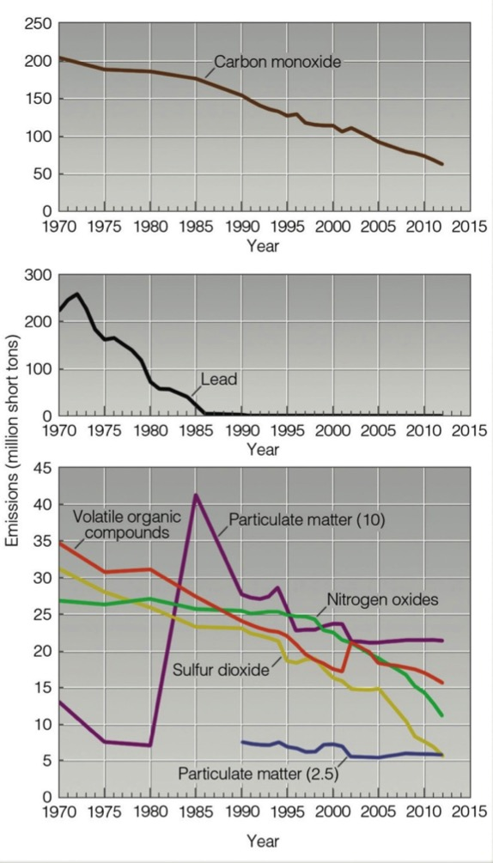
Our environmental record shows
Most emissions are better.
But some are not…PM2.5
SO WHAT’S THE SOLUTION?
Ahrens & Henson
8th ed.

Slide 44
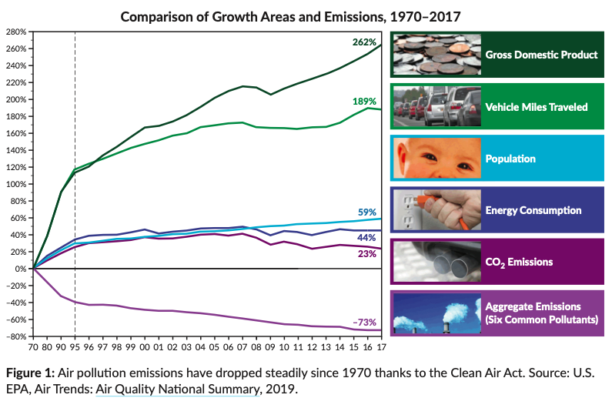
American Lung Association
SOME GOOD NEWS FOR THE U.S…SOME NOT SO GOOD TOO.
Smaller environmental footprint per person…but…
Americans still have one of the highest footprints in the world.

Slide 45
Summary of Air Pollution
Primary air pollutants include particulate matter PM, carbon monoxide CO, nitrogen oxides NO_{X}, sulfur dioxide SO₂, and volatile organic compounds VOC. These are largely the result of fuel combustion processes.
Pollution knows no boundaries. Global problem.
London-type smog is caused by particles and sulfur from coal burning. It is more prevalent in the eastern U.S.
Photochemical smog (or L.A.-type smog) is caused by chemical reactions involving nitrogen oxides and volatile organic compounds that produce ozone O₃. It is found in regions with sunny climates since sunlight is necessary for the ozone creation.

Slide 46
Summary of Air Pollution
Every major city in the Southwest U.S. suffers from a photochemical smog problem because of meteorological conditions that trap air over the metro areas for long periods of time. These include:
1) Weak winds
2) Subsidence inversions
3) Sunshine
4) Warm temperatures
5) Location in a basin or valley
Air quality standards are defined by the federal government. EPA monitors six criteria air pollutants: CO, NO_{x}, SO₂, O₃, PM, and Pb.
Air pollution has numerous negative effects on human health. The air quality index AQI of EPA gives a guide for the health effects of pollution and recommended actions.

Slide 47
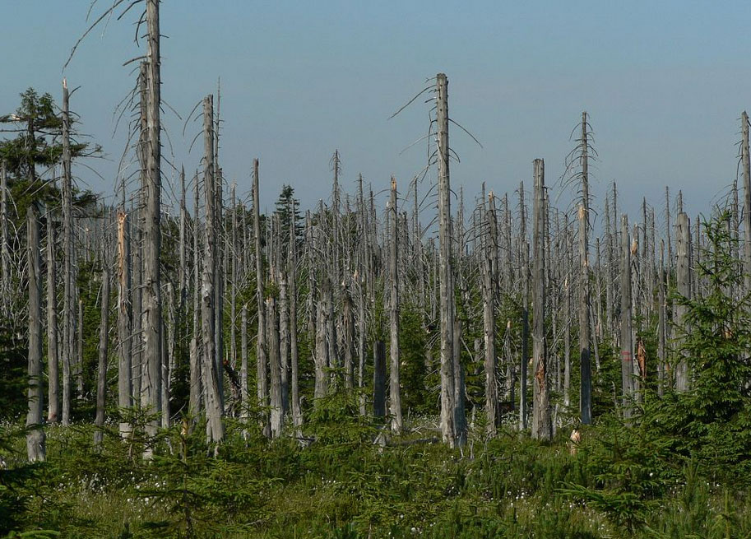
ATMO 170A1
Online
Acid Rain
Effects of Acid Rain in the Jizera Mountains, Czech Republic (2006)
Notes:
Next regional-scale air pollution topic we’ll cover is acid rain.

Slide 48
Goals
Acid Rain
  Chemistry of Acid Rain
  Role of Coal Burning in Its Formation
  Damage from Acid Rain
  Trends in Acid Rain over the U.S.

Slide 49
Learning Outcomes Addressed
1) Explain how the distribution of heating of the earth by the sun and energy transfer through the atmosphere drives weather and climate change.
2) Read surface weather maps and upper-air maps, and understand the connection between surface weather and conditions aloft in midlatitudes.
3) Recognize from weather maps commonly occurring, large-scale atmospheric phenomena, including midlatitude cyclones, upper-level troughs and ridges, jet streams, and trade winds, and their impact on local weather.
4) Identify commonly occurring, high-impact mesoscale weather phenomena such as severe thunderstorms and hurricanes, and recognize the larger-scale weather conditions in which they form.
5) Identify the primary cloud types and types of precipitation, and recognize their underlying formation mechanisms in terms of concurrent weather conditions.
6) Explain the impact that weather and climate have on life, and that life has on the evolution of the atmosphere and climate.
Notes:
Addressed to varying degree

Slide 50
Next regional-scale air pollution topic we’ll cover is acid rain.

Slide 51
Assignment for Next Lecture
Ozone Hole, Climate Change
Reading- Ahrens
  Pg. 438-442;
  Pg. 397-428
“Questions for Review” - Ahrens
  Pg. 458: 14.10, 14.11
  Pg. 428: 13.5, 13.6, 13.7, 13.8, 13.12

Slide 52

Although London-type smog in the eastern U.S. has lessened in recent years, coal burning in the Ohio Valley and surrounding areas is associated with another problem…
ACID RAIN
Ohio River coal power plant

Slide 53
Brief Review of Basic Chemistry of
Acids and Bases
Acidity: Refers to the concentration of hydrogen (H+) ions.
Alkalinity: Refers to the concentration of hydroxide (OH-) ions.
The degree of acidity or alkalinity is given by the pH scale (1-14).
Acids are at the low end of the scale
pH of 7 is neutral
Bases are at the high end of the scale
Characteristics of strong acids
Sting and burn the skin
Highly corrosive
Toxic

Slide 54
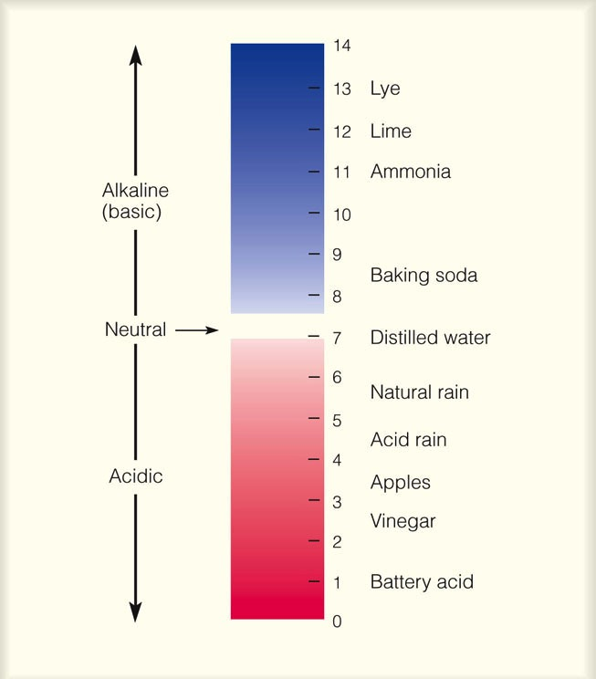
pH Scale: Degree of Acidity and Alkalinity
Pristine rain is weakly acidic (pH = 5 to 6)
Acid rain has a pH of about 4 to 4.5
The pH is scale is LOGARITHMIC, so for each numerical value lower on the scale, it is times more acidic.
Acid rain is about times more acidic than natural rain.

Slide 55
pH Scale: Degree of Acidity and Alkalinity
Pristine rain is weakly acidic (pH = 5 to 6)
Acid rain has a pH of about 4 to 4.5
The pH is scale is LOGARITHMIC, so for each numerical value lower on the scale, it is 10 times more acidic.
Acid rain is about 10 times more acidic than natural rain.

Slide 56
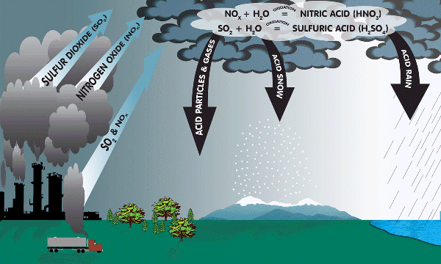
Chemistry Acid Rain
2NO_{2(g)} + H₂O_{(l)} → HNO_{2(aq)} + HNO_{3(aq)}
SO₂(g) + H₂O(l) → H₂SO₃(aq)
2SO₂(g) + O₂(g) → 2SO₃(g)
SO₃(g) + H₂O(l) → H₂SO₄(aq)
http://www.dec.ny.gov/images/air_images/acidrain.gif

Slide 57
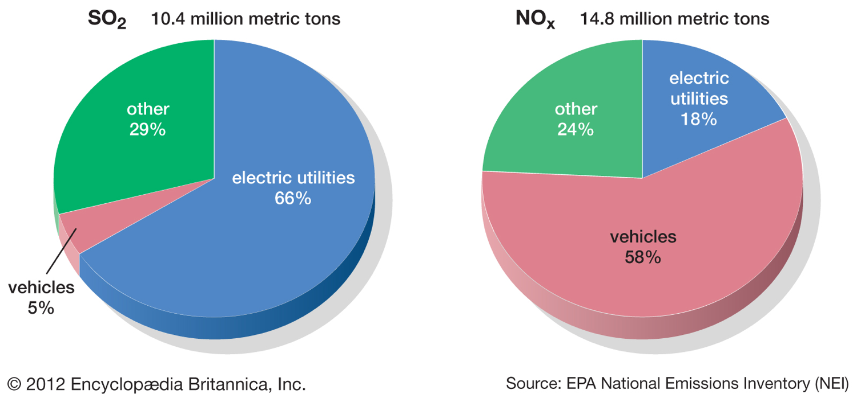
SO₂ and NO_{X} sources

Slide 58
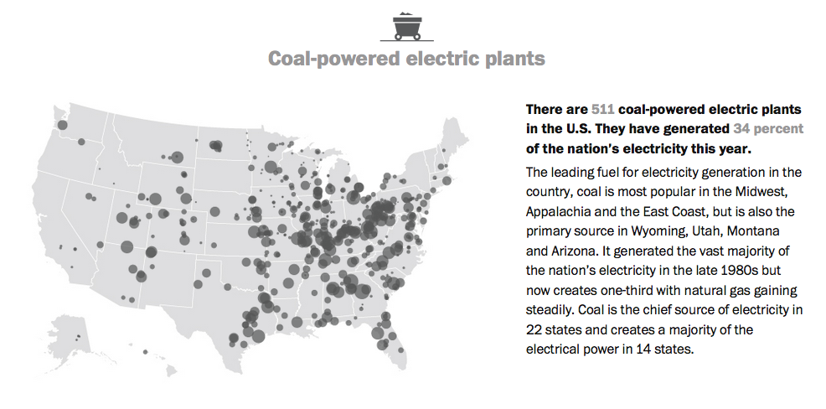
Coal Burning Power Plants in U.S.
https://www.washingtonpost.com/graphics/national/power-plants/
Updated March 28, 2017

Slide 59
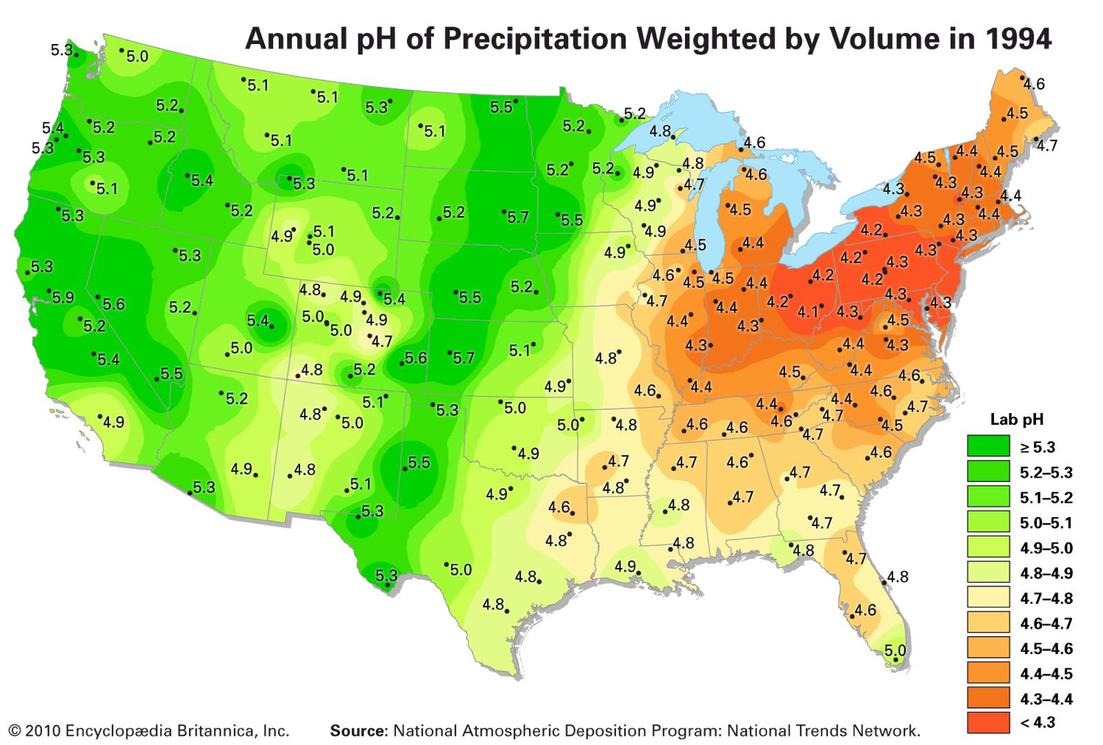
Acid Rain in the U.S.
Annual pH of Precipitation Weighted by Volume in 1994
https://www.britannica.com/science/acid-rain/History
Most acidic rain in the eastern part of the country, downwind of coal plants in the Ohio River Valley area. Where are the worst places?
Most acidic rain is in the northeastern part of the country, downwind of coal-burning power plants in the Ohio River Valley area.

Slide 60
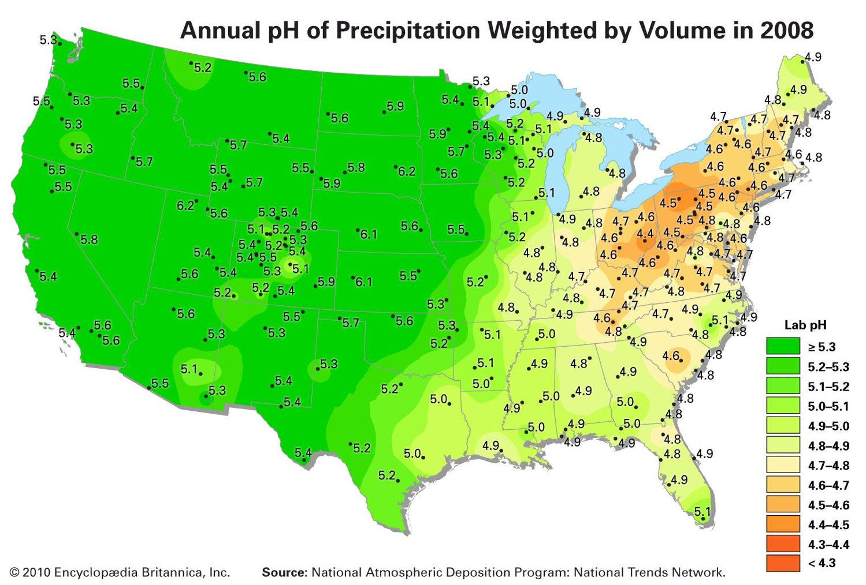
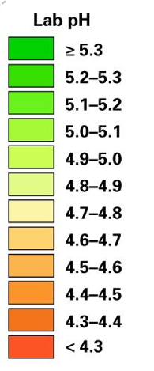
Annual pH of Precipitation Weighted by Volume in 2008
https://www.britannica.com/science/acid-rain/History
Improvements from 1994 to 2008 after enactment of 1990 Clean Air Act

Slide 61
Annual pH of Precipitation Weighted by Volume in 1985
https://commons.wikimedia.org/wiki/File:Pluja_àcida_USA_1985.jpg
Most acidic rain is in the northeastern part of the country, downwind of coal-burning power plants in the Ohio River Valley area.

Slide 62
Annual pH of Precipitation Weighted by Volume in 2015
https://commons.wikimedia.org/wiki/File:Pluja_àcida_USA_2015.jpg
Improvements from 1985 to 2015. Enactment of 1990 Clean Air Act

Slide 63
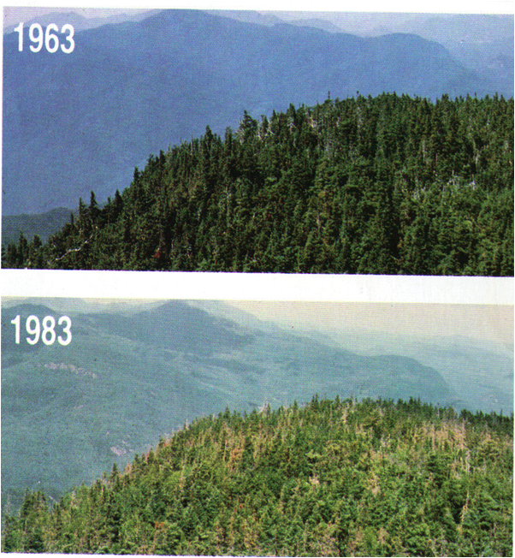
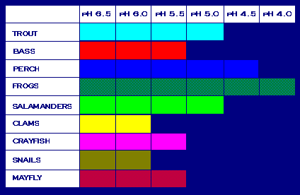
Acid Rain Impacts
Freshwater aquatic ecosystems are particularly sensitive to changes in acidity.
Many small lakes in New York’s Adirondack Park are no longer able to support fish populations.
In many eastern U.S. forests, acid rain has lead to severe tree damage by changing the soil chemistry.
http://people.emich.edu/mcliffo1/PollutionWebquest/AcidRain.html
https://commons.wikimedia.org/wiki/File:Waterspecies.gif
Damaged trees in the Great Smoky Mountains

Slide 64
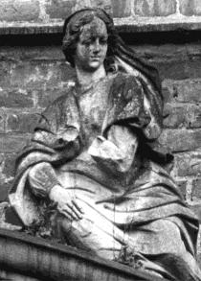
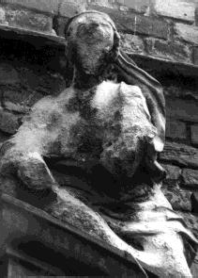
Acid Rain Effects on
Buildings and Monuments
Sandstone figure in Germany
1908
Same figure
1968

Slide 65
Reducing Acid Rain
Main Sources:
Power plants and automobiles
What can you do?
Turn off “stuff” when not in use; use only when needed.
Use and demand energy efficient products.
Use electronic gadgets only when you need them.
Carpool, use public transportation, walk or bicycle.
Drive low NO_{x} emissions, properly maintained cars.

Slide 66
Summary of Air Pollution
Primary air pollutants include particulate matter PM, sulfur dioxide SO₂, carbon monoxide CO, nitrogen oxides NO_{X}, and volatile organic compounds VOC. These are largely the result of fuel combustion processes.
Pollution knows no boundaries. Global problem.
London-type smog is caused by particles and sulfur from coal burning. It is more prevalent in the eastern U.S.
Photochemical smog (or L.A.-type smog) is caused by chemical reactions involving nitrogen oxides and volatile organic compounds. It is found in regions with sunny climates since sunlight is necessary for the ozone creation.

Slide 67
Summary of Air Pollution
Every major city in the Southwest U.S. suffers from a photochemical smog problem because of meteorological conditions that trap air over the metro areas for long periods of time. These include:
1) weak winds
2) subsidence inversions
3) location in a basin or valley
Air quality standards are defined by the federal government.
Air pollution has numerous negative effects on human health. The air quality index AQI of EPA gives a guide for the health effects of pollution and recommended actions.

Slide 68
Summary of Acid Rain
Acid rain is about 10 times more acidic than normal rain. It forms when sulfur dioxide and nitrogen oxides interact within a cloud water drop.
Acid rain occurs downwind of pollution sources (mainly coal plants). It causes damage to forests, aquatic ecosystems, and buildings and monuments.
Acid rain provides unequivocal evidence that air pollution from anthropogenic activities can affect large regions downwind of point sources of pollution.

Slide 69
Assignment for Next Lecture
Ozone Hole, Climate Change
Reading- Ahrens
  Pg. 438-442;
  Pg. 397-428
“Questions for Review” - Ahrens
  Pg. 458: 14.10, 14.11
  Pg. 428: 13.5, 13.6, 13.7, 13.8, 13.12

