Slide 1
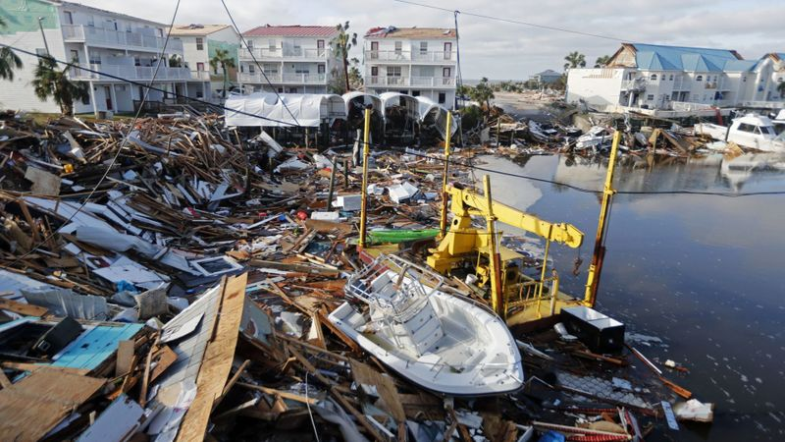

ATMO 170A1
Online
Hurricane Hazards
Damage from Hurricane Michael (2018) in Mexico Beach, FL
https://www.latimes.com/nation/la-na-florida-hurricane-mexico-beach-20181013-story.html

Slide 2
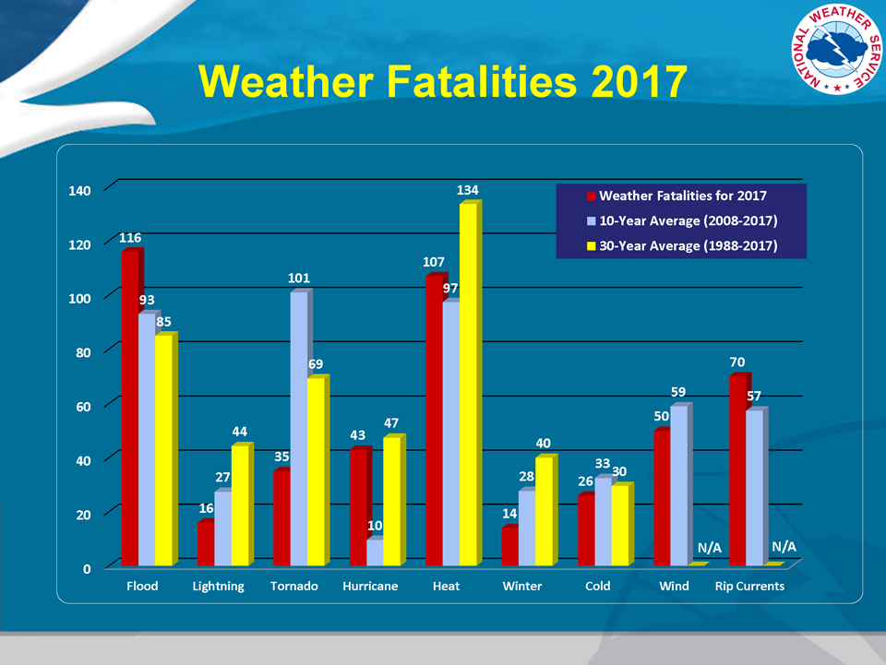
http://www.nws.noaa.gov/om/hazstats.shtml

Slide 3
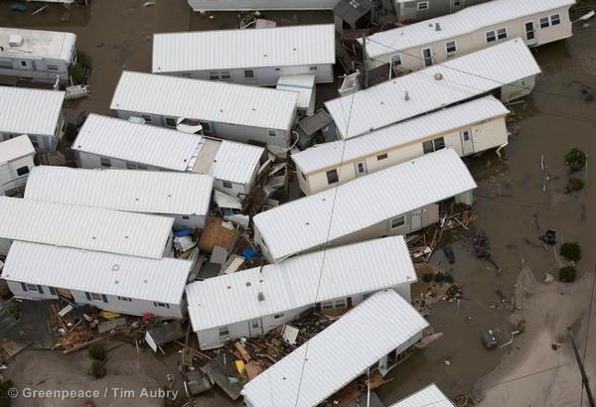
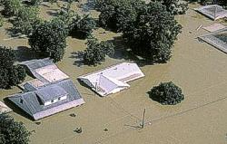
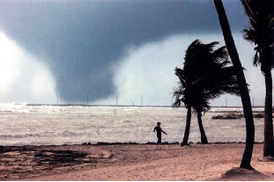
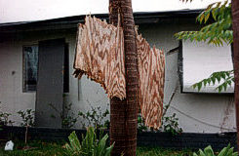
What are hurricane hazards?
Inland Flooding
Sandy’s Storm Surge
Hurricane Winds Montage
Embedded Tornadoes
Hurricane Winds
Edwards 2012

Slide 4
Primary Hurricane Hazards
- Wind Damage and Flying Debris
Hurricane-Scale Circulation Itself
Embedded Tornadoes
- Flooding
Storm Surge along Shoreline
Heavy Rains Inland – Flooding
Greater than 5”-10” Common
✔

Slide 5

Hurricane Winds Montage
National Geographic

Slide 6
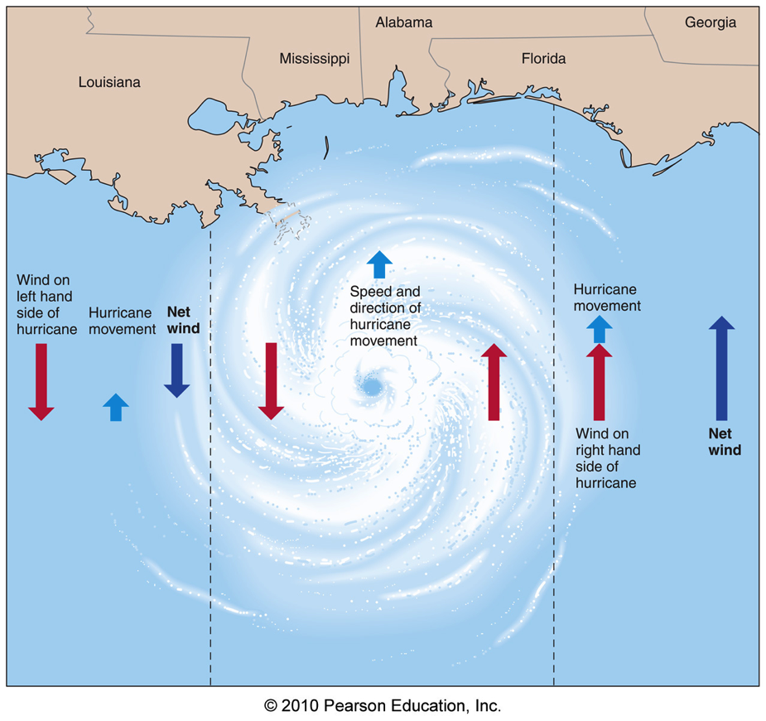
Winds and Storm Surge
Pushes water onshore
Strongest winds in the direction
of the cyclone’s forward motion
Aguado and Burt
Floyd wave height forecast from RSMAS
http://orca.rsmas.miami.edu/floyd/

Slide 7
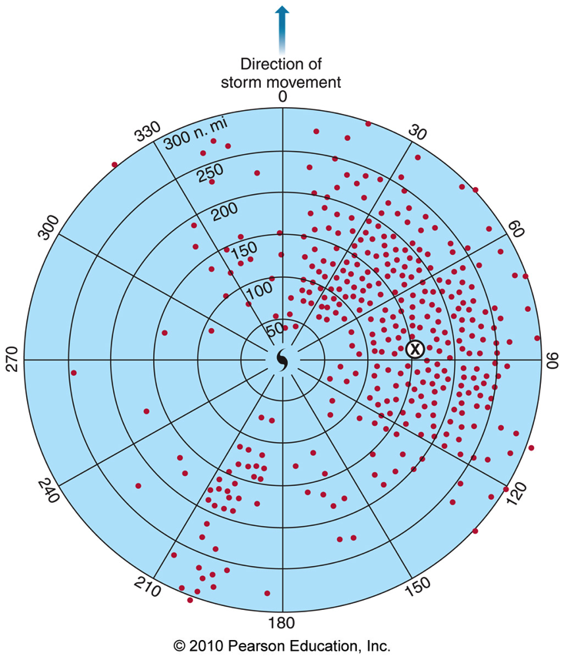
Hurricanes Spawn Tornadoes
Tornadoes embedded within hurricane (category EF1-EF2)
But they are embedded within an environment with wind speeds up to hurricane force.
Can produce highly localized damage.
Aguado and Burt

Slide 8
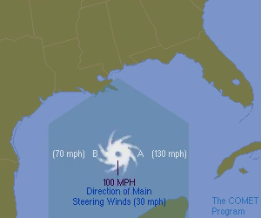
Hurricane Winds and Storm Surge
Biggest
Surge
Rotational Winds 100 mph
Steering Winds 30 mph
https://www.meted.ucar.edu/hurrican/chp/

Slide 9
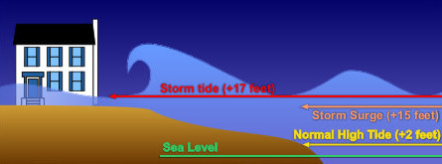
Winds and Storm Surge
Winds “push” water inland.
http://www.srh.noaa.gov/jetstream//
If hurricane hits at high tide, the two effects superimpose
A 2 ft tide plus a 15 ft surge rises water 17 ft above mean sea level
Penetration of storm-whipped waves inland worsens damage
causing more destruction than the high water alone
Floyd wave height forecast from RSMAS
http://orca.rsmas.miami.edu/floyd/

Slide 10
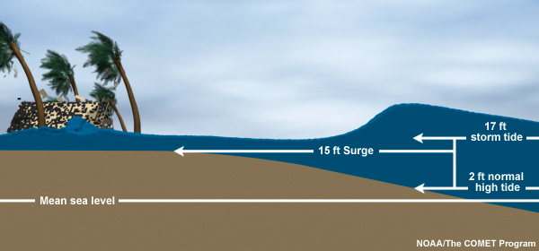
Winds and Storm Surge
Winds “push” water inland.
http://www.nhc.noaa.gov/surge/
If hurricane hits at high tide, the two effects superimpose
A 2 ft tide plus a 15 ft surge rises water 17 ft above mean sea level
Penetration of storm-whipped waves inland worsens damage
causing far more destruction than the high water alone
Floyd wave height forecast from RSMAS
http://orca.rsmas.miami.edu/floyd/surface_waves.php

Slide 11
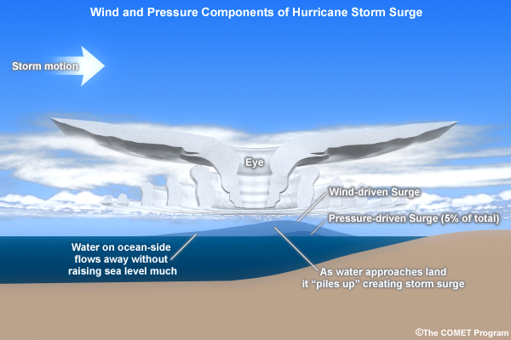
“Pressure” Surge
http://www.nhc.noaa.gov/surge/
http://www.nhc.noaa.gov/surge/
Lower pressure in center of hurricane is like drinking from a straw.
As the surface pressure decreases, the water level rises.
Can produce a 2’-3’ rise in the deepest hurricanes over open ocean.

Slide 12
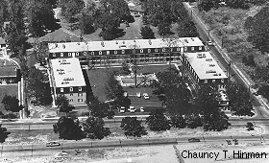
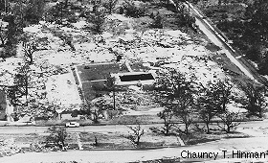
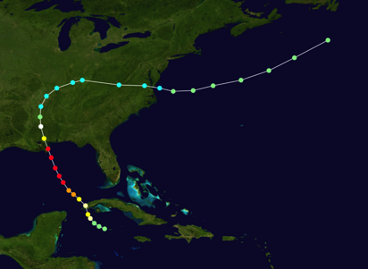
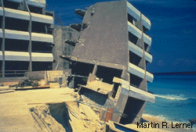
Surge Damage
Richelieu Apartments before and after landfall of Camille 1969.
Camille was category 5 storm.
Sustained winds of 180 mph at landfall.
Storm surge was 24 feet along the coast
Many tired rescue workers took refuge
in the apartments. All but one died.
https://en.wikipedia.org/wiki/Hurricane_Camille

Slide 13
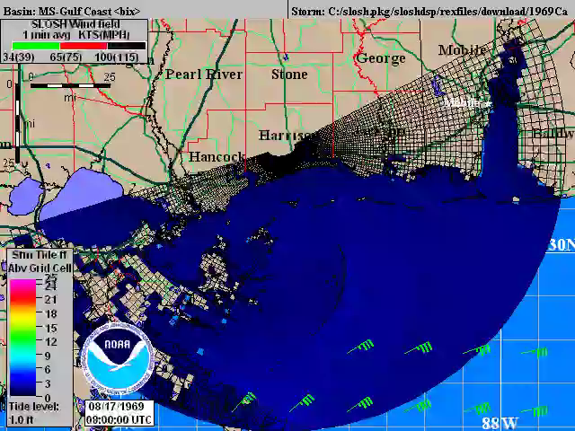
NOAA SLOSH Model
Hurricane Camille (1969)
https://www.nhc.noaa.gov/surge/
Notes:
Sea Lake Overland Surge Model

Slide 14
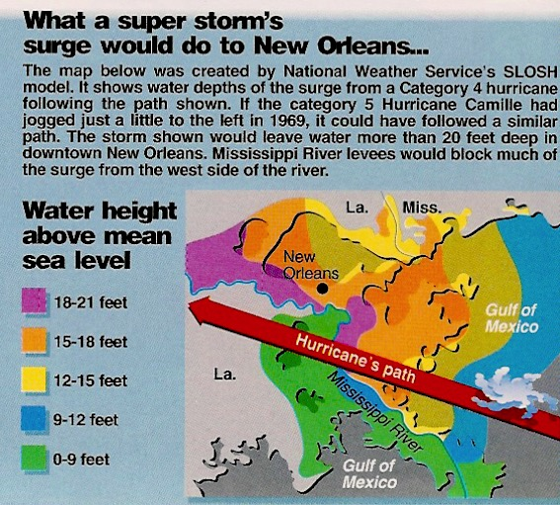
New Orleans: A Long-Recognized Disaster Waiting to Happen
Williams, The Weather Book (1992)
SLOSH model for a category 4 hurricane. Track shown.
http://www.atmo.arizona.edu/~mullen/atmo170A1/animations/PAM-Winds.mov http://www.atmo.arizona.edu/~mullen/atmo170A1/animations/PAM-NewOrleans-zoom.mov

Slide 15
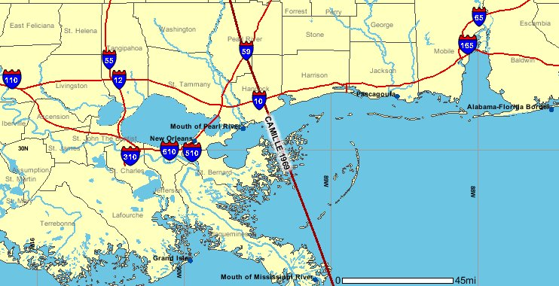
How Close was Category 5 Camille to New Orleans?
KATRINA
http://www.nhc.noaa.gov/HAW2/english/history.shtml#camille

Slide 16
NWS Warning for Katrina
I have never seen another forecast anything close to this ominous in 40+ years in meteorology
8/28/05... NWS WARNED IN A BONE CHILLING FORECAST:
"MOST OF THE AREA WILL BE UNINHABITABLE FOR WEEKS... PERHAPS LONGER... THE MAJORITY OF INDUSTRIAL BUILDINGS WILL BECOME NON FUNCTIONAL... HIGH RISE OFFICE AND APARTMENT BUILDINGS WILL SWAY DANGEROUSLY... A FEW TO THE POINT OF TOTAL COLLAPSE... ALL WINDOWS WILL BLOW OUT... AIRBORNE DEBRIS WILL BE WIDESPREAD... AND MAY INCLUDE HEAVY ITEMS SUCH AS HOUSEHOLD APPLIANCES AND EVEN LIGHT VEHICLES... SPORT UTILITY VEHICLES AND LIGHT TRUCKS WILL BE MOVED... POWER OUTAGES WILL LAST FOR WEEKS... AS MOST POWER POLES WILL BE DOWN AND TRANSFORMERS DESTROYED... WATER SHORTAGES WILL MAKE HUMAN SUFFERING INCREDIBLE BY MODERN STANDARDS…”

Slide 17
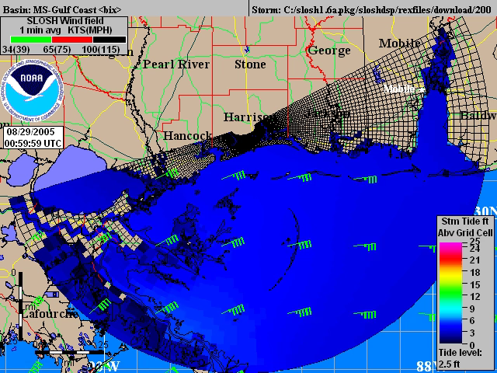
NOAA SLOSH Model
Hurricane Katrina (2005)
https://www.nhc.noaa.gov/surge/
Notes:
Sea Lake Overland Surge Model

Slide 18
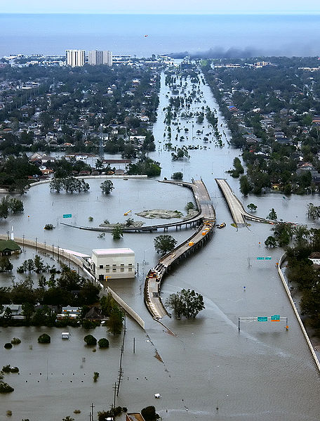
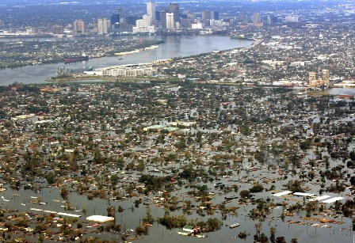
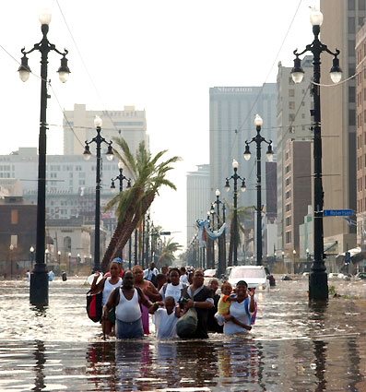
But Katrina was a little closer the city, and its circulation wider
Downtown New Orleans in Background www.omik2008.info/Wednesday.html
I-10/I-610 Interchange www.wikipedia.org
PBS NOVA Katrina
https://www.pbs.org/wgbh/nova/video/storm-that-drowned-a-city
Canal Street http://www.depweb.state.pa.us/news/lib/news/

Slide 19
Rainfall and Inland Flooding

Slide 20
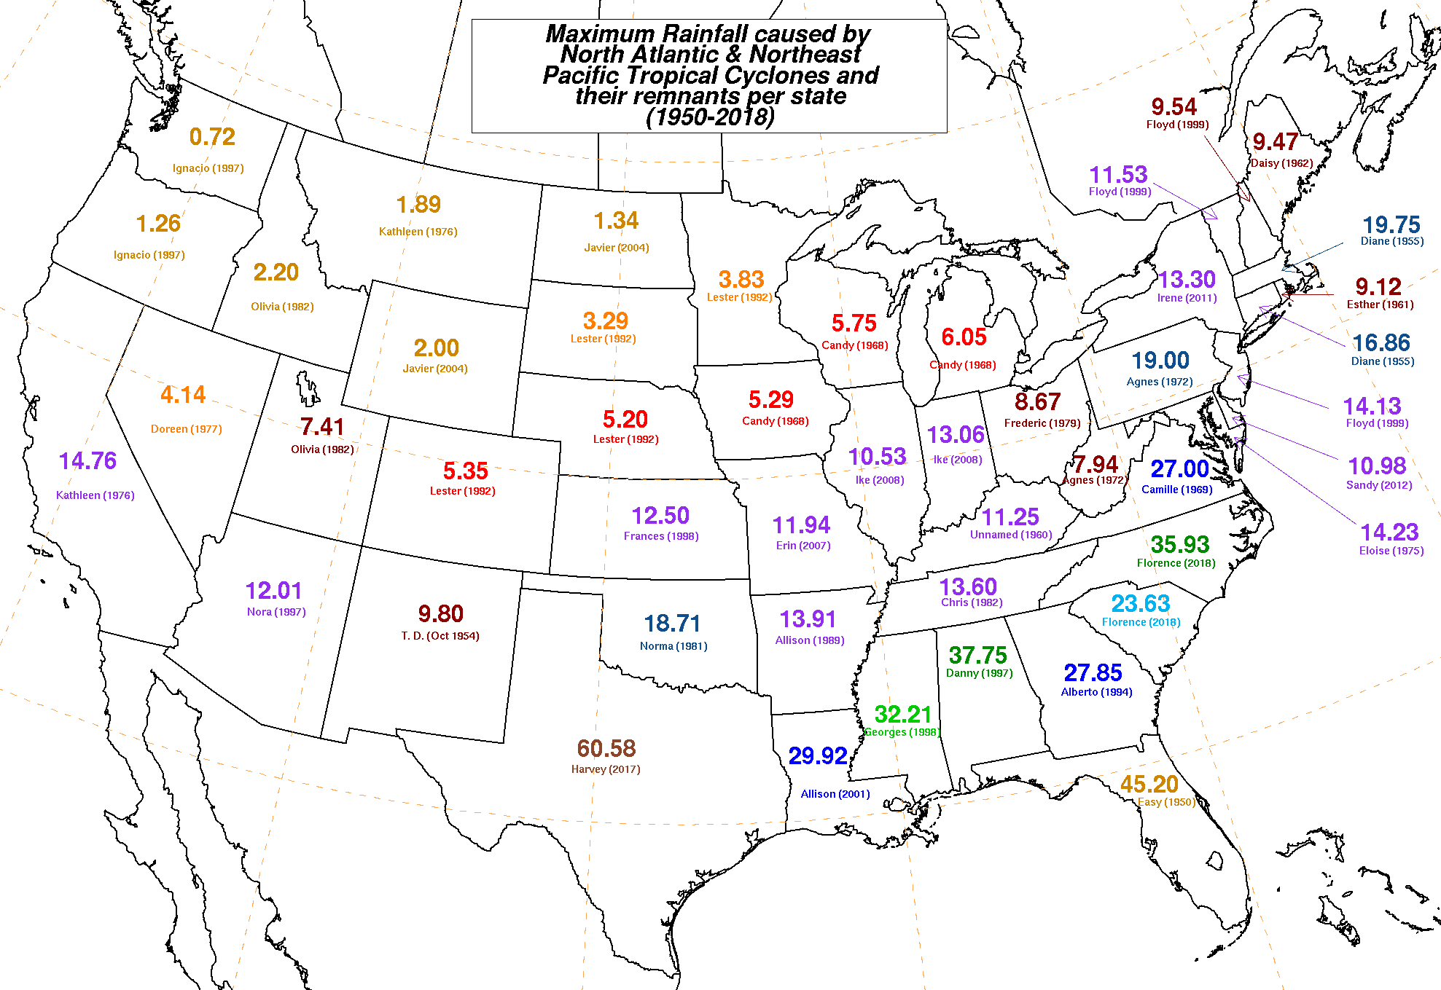
Extreme Inland Rainfalls
http://www.wpc.ncep.noaa.gov/tropical/rain/tcstatemaxima.gif

Slide 21
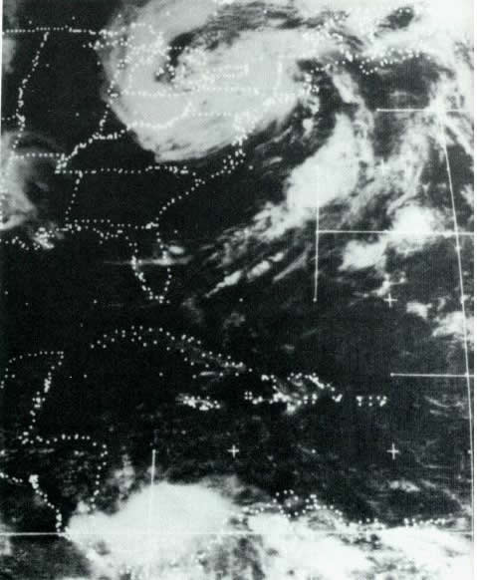
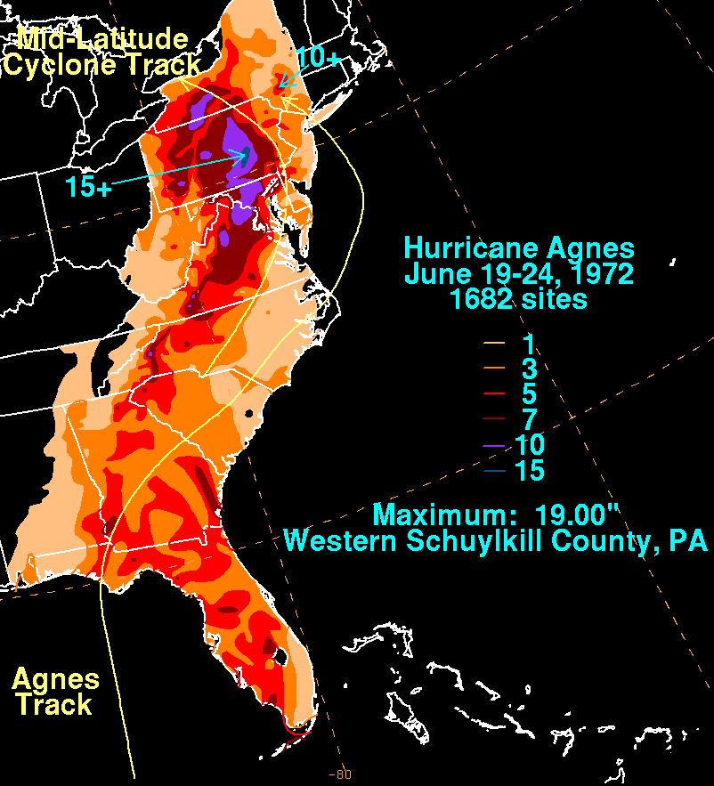
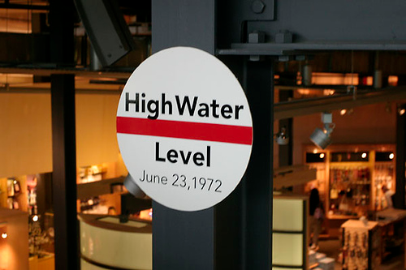
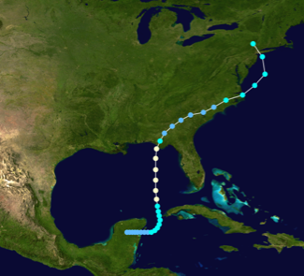
Agnes Flooding
Weak cat 1 status
http://en.wikipedia.org/wiki/Hurricane_Agnes

Slide 22
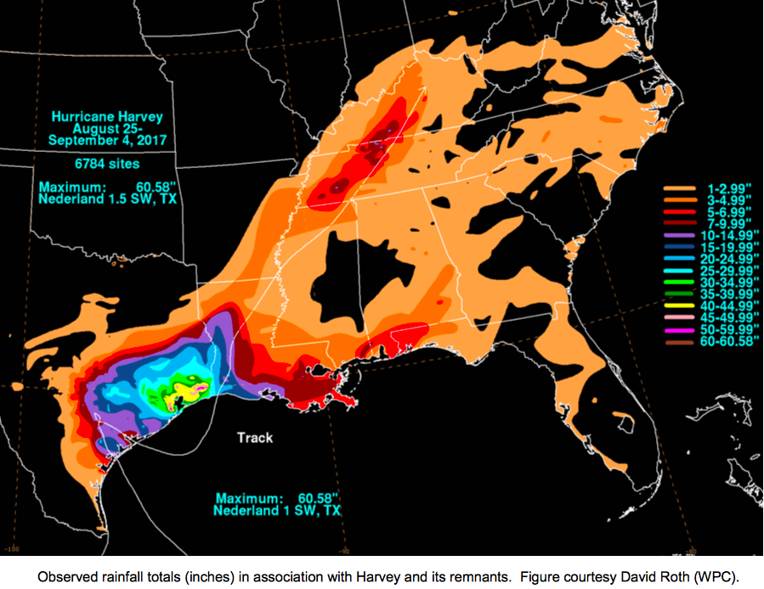
Rainfall - Hurricane Harvey (2017)
https://www.nhc.noaa.gov/data/tcr/AL092017_Harvey.pdf

Slide 23
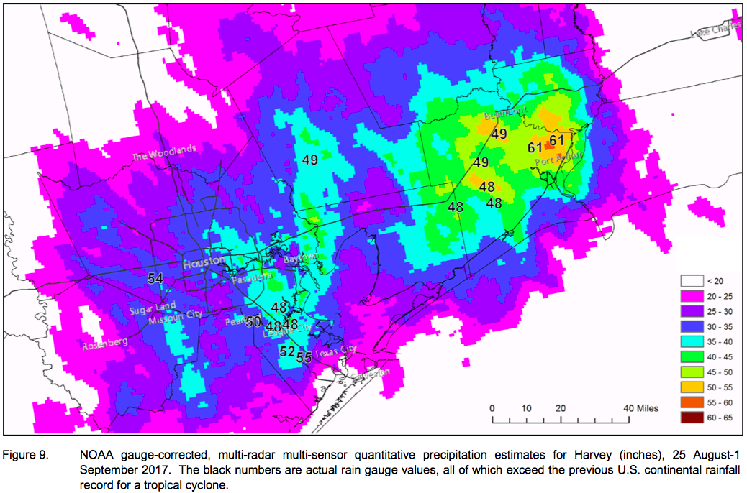
Rainfall - Hurricane Harvey (2017)
https://www.nhc.noaa.gov/data/tcr/AL092017_Harvey.pdf

Slide 24
How accurate are hurricane forecasts?

Slide 25
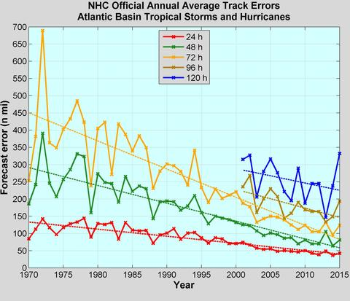
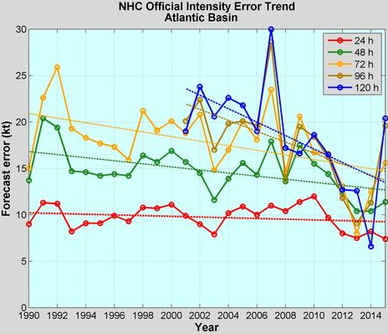
Hurricane Forecast Trends
Position and Intensity Errors
https://www.nhc.noaa.gov/verification/verify5.shtml
Little progress for intensity forecasts Subject of vigorous research

Slide 26
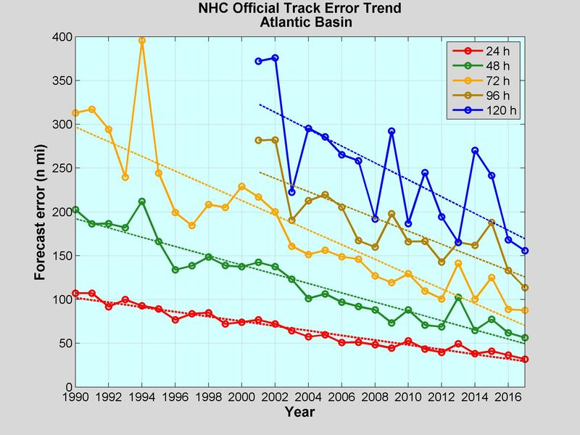
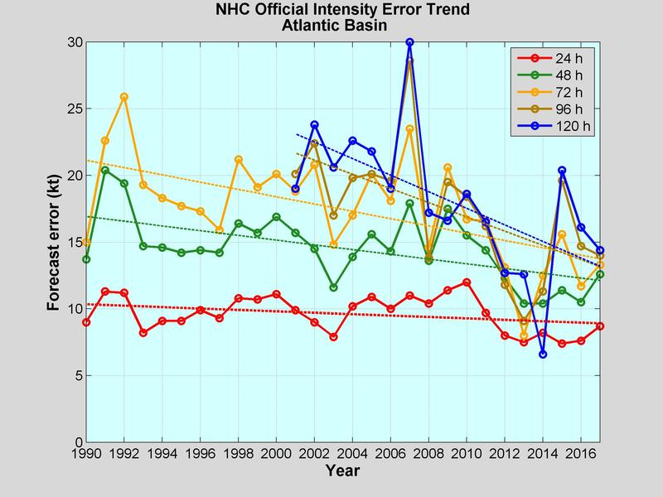
Hurricane Forecast Trends
Steady improvement in track forecasts
Position and Intensity Errors
https://www.nhc.noaa.gov/verification/verify5.shtml
Less progress for intensity forecasts

Slide 27
Summary: Hurricanes Hazards
Damage that hurricanes inflict can be
Catastrophic due to high winds, coastal storm surges, torrential rains and fresh water flooding.
Most fatalities by drowning from
Coastal storm surge near the shoreline
Torrential rains and fresh water flooding inland

