Slide 1
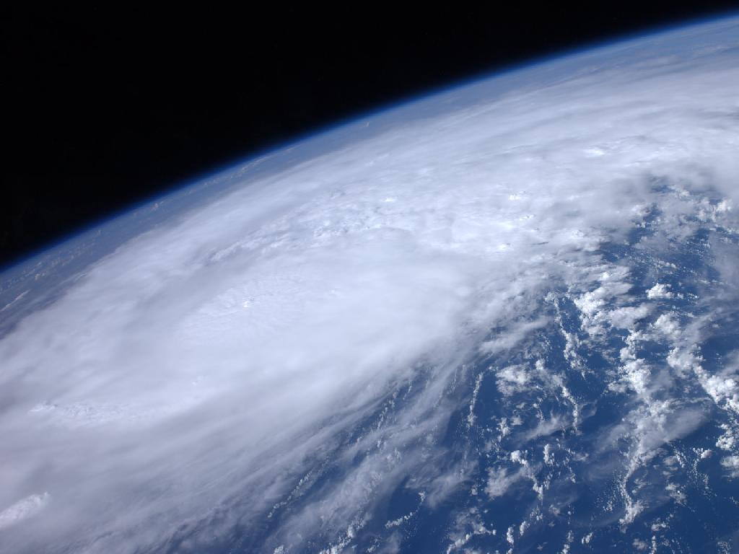

ATMO 170A1
Online
H&P §12.1-12.4
Tropical Cyclones: Structure and Development, Part II
(30’ total for both parts)
Hurricane Irene from the International Space Station as it passed over the Caribbean on 22 August 2011
http://www.nasa.gov/multimedia/imagegallery/image_feature_2043.html

Slide 2
Why do hurricanes form?

Slide 3
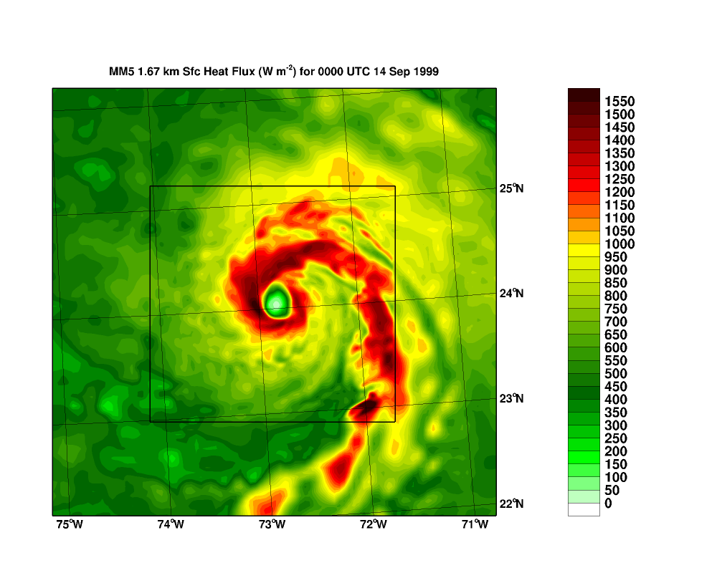
Surface Heat Flux for Hurricane Floyd
Compare Heat Flux to 345 W/m² and 1380 W/m²
http://orca.rsmas.miami.edu/floyd/1999091400-sh.4d-new.gif

Slide 4
What environmental ingredients are needed to make a hurricane?

Slide 5
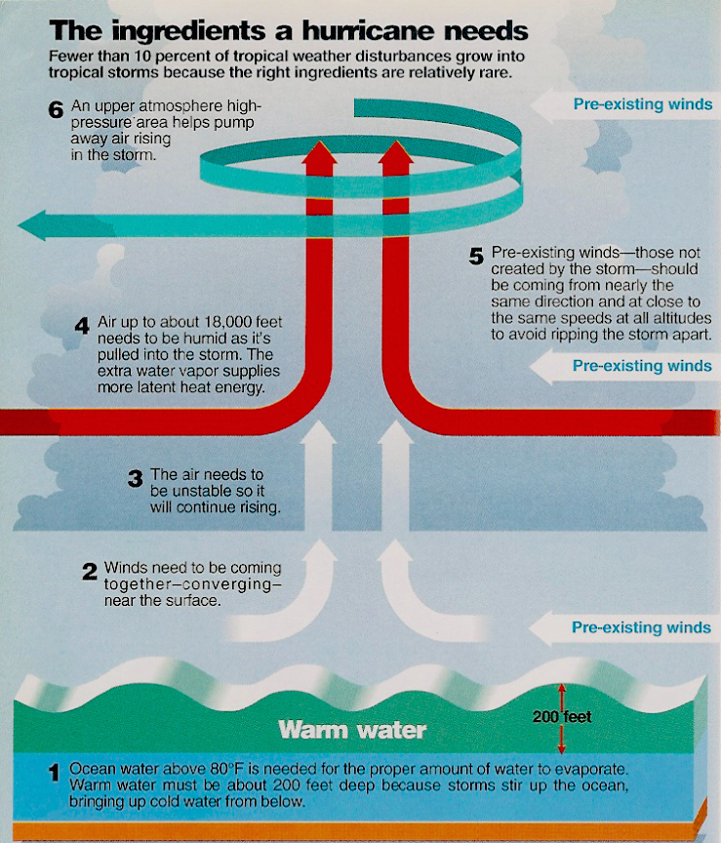
How do hurricanes form?
Necessary conditions
6) Diverging Winds Aloft
5) Weak Vertical Wind Shear Shear Shreds Storm Apart
4) Humid Air Mid-Troposphere
3) Conditionally Unstable Air Supports Deep Convection
2) Converging Surface Winds Seedling Low Required
1) Warm Water with T ≥ 27ºC Deep Warmth > 50 m or more
✔
✔
Williams, The Weather Book
Katrina Formation from Nat Geo
http://video.nationalgeographic.com/video/environment/environment-natural-disasters/hurricanes/katrina-formation/

Slide 6
What is the structure of hurricanes?

Slide 7
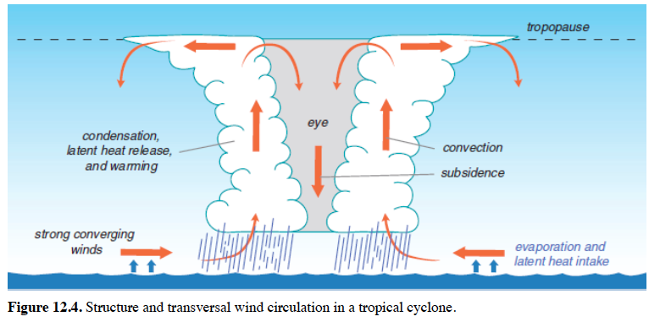
Structure of Hurricanes
Notes:
Eye – Lowest pressure. Calm, light winds. Dry, sometimes clear. Sinking motion. Adiabatic warming.
Eyewall - Inner most rain band. Fastest winds. Most intense rainfall. Winds spiraling in toward the cyclone can penetrate no farther than eyewall

Slide 8
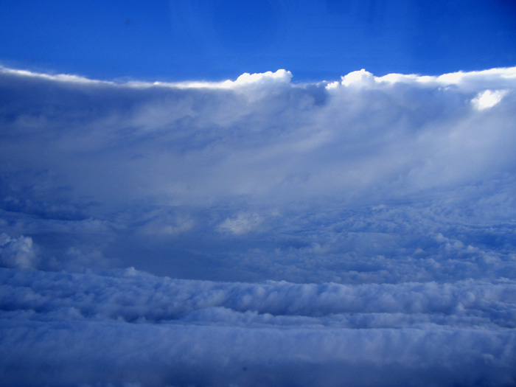
Katrina Eyewall Flight
8-29-2005
http://www.katrina.noaa.gov/eyewall/eyewall.html
(Link no longer words)

Slide 9
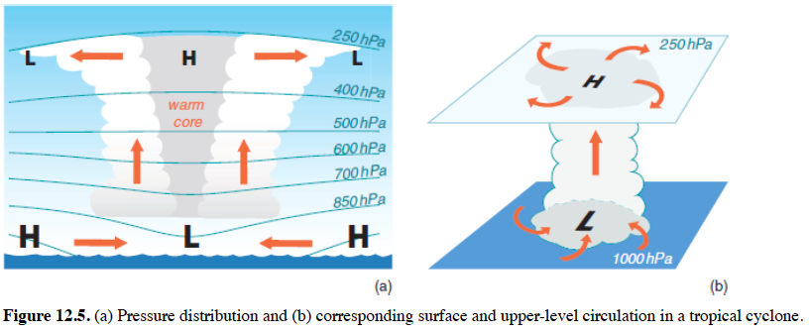
Structure of Hurricanes
WARM CORE CENTER
Notes:
Eye – warm core
Isobars bow upward aloft, bow downward at the surface. As shown to the left.
Leads to spiraling outward, clockwise (NH) flow aloft. As shown to the right.

Slide 10
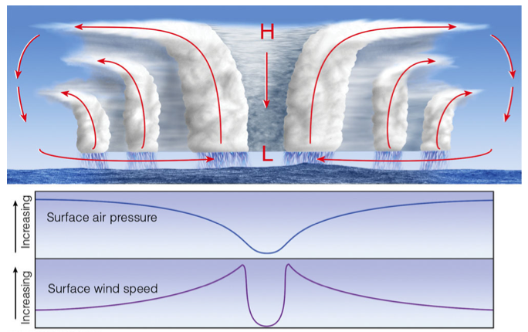
Cross Section of Hurricane
Ahrens 6th 11.08
Notes:
Rainbands on outer edges of hurricane.
Rain is more intense in the inner bands.
Winds strongest at eyewall.

Slide 11
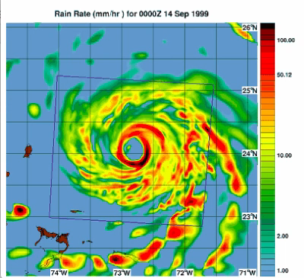
Floyd Rainfall Rate
(mm/hour)
http://orca.rsmas.miami.edu/floyd/model_sensitivity.php

Slide 12
When and why do hurricanes dissipate?

Slide 13
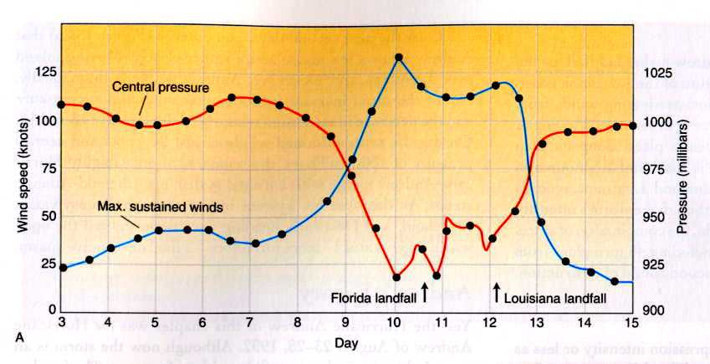
Hurricane Decay
Andrew Central Pressure
Landfall on Mainland
Danielson et al. Fig. 13.26
Hurricanes weaken when they make landfall or go over colder water.
(Surface energy fluxes are cut off)
Hurricanes weaken when they move into a region of strong wind shear.

Slide 14
Hurricane Structure and Development
Hurricanes intensify
Surface energy fluxes from the warm ocean water
Conversion potential energy to kinetic energy
through latent heat release inside the eyewall
Structure of a hurricane
Eye – warm, dry, light winds, sinking air, lowest SLP
Eyewall – strongest winds, heaviest rain
Rainbands – rainfall decreases with distance from eye
Hurricanes dissipate
They go over land or go over cold water
They move into a region of strong wind shear

