Slide 1
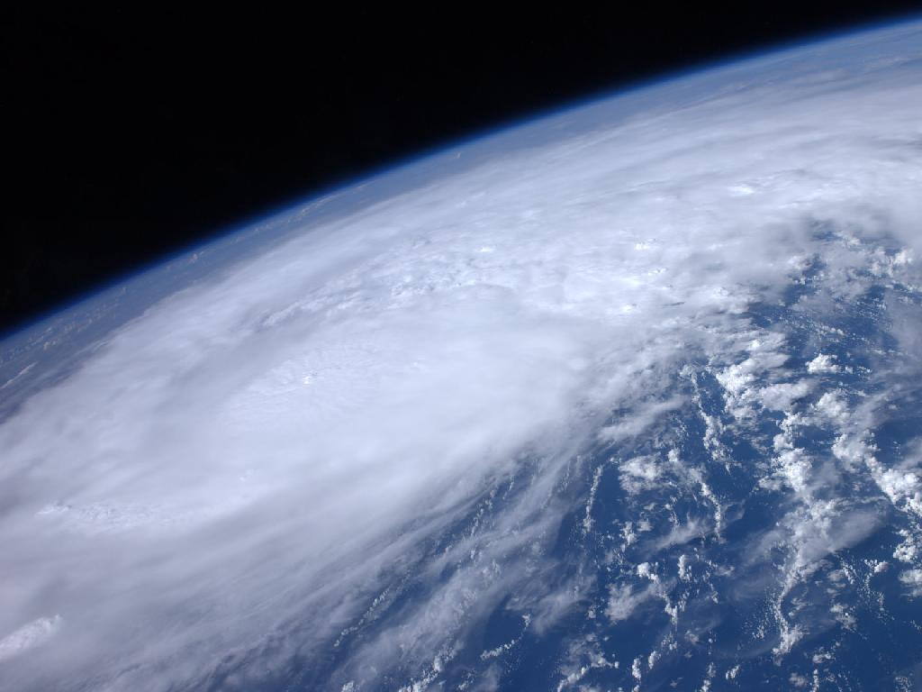

ATMO 170A1
Online
H&P §12.1-12.4
Tropical Cyclones: Structure and Development, Part I
(30’ total for both parts)
Hurricane Irene from the International Space Station as it passed over the Caribbean on 22 August 2011
http://www.nasa.gov/multimedia/imagegallery/image_feature_2043.html

Slide 2
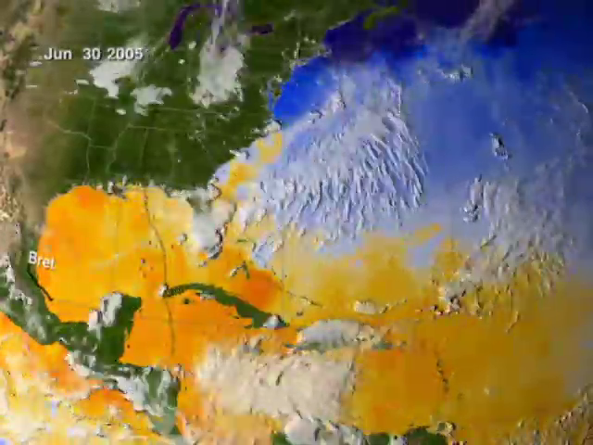
2005 Atlantic Hurricanes
1 July – 31 October
Note cooler water in wake of Emily, Katrina, Rita, Wilma

Slide 3
Tropical Cyclones
Cyclone Type Max Wind
Tropical Disturbance < 25 mph
Tropical Depression 25-39 mph
Tropical Storm (named) 40-74 mph
Hurricane ≥ 75 mph
Most Depressions do not develop into a Named Storm
But 55% of Named Storms develop into Hurricanes

Slide 4
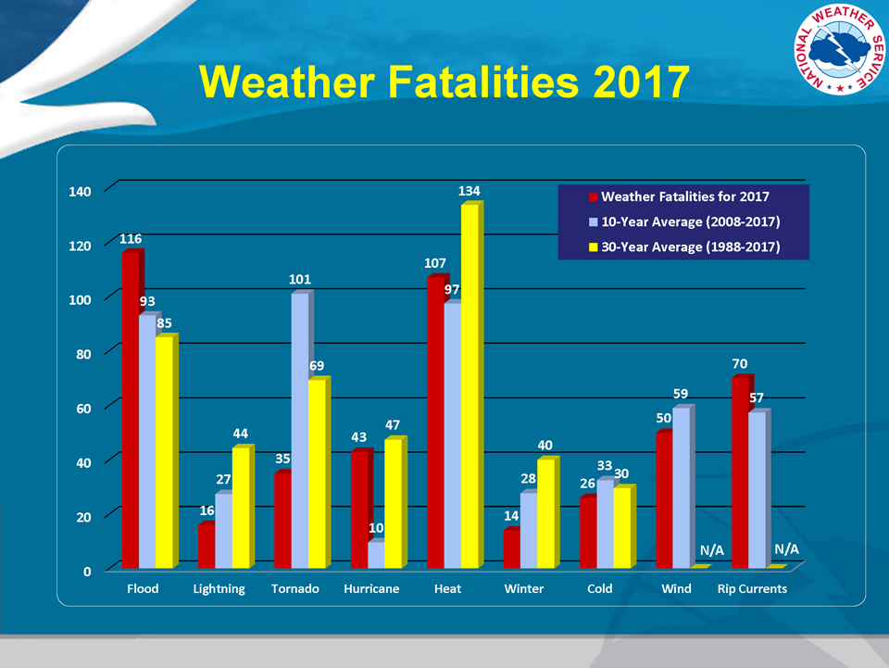
http://www.nws.noaa.gov/om/hazstats.shtml

Slide 5
Some Tropical Cyclone Extremes
Lowest Central Pressure Pressure
Pacific: Typhoon Tip 1979 870 mb
Atlantic: Hurricane Wilma 2005 882 mb
Costliest Hurricanes (2005 USD) Cost
“Galveston” 1900 $ 99 billion
“Miami” 1926 $157 billion
Katrina 2005 $125 billion¹
Harvey 2017 $100 billion²³
Deadliest Tropical Cyclone Loss
East Pakistan Cyclone 1970 500,000 est.
¹https://en.wikipedia.org/wiki/Hurricane_Katrina
² https://en.wikipedia.org/wiki/Hurricane_Harvey
³ https://www.usinflationcalculator.com

Slide 6
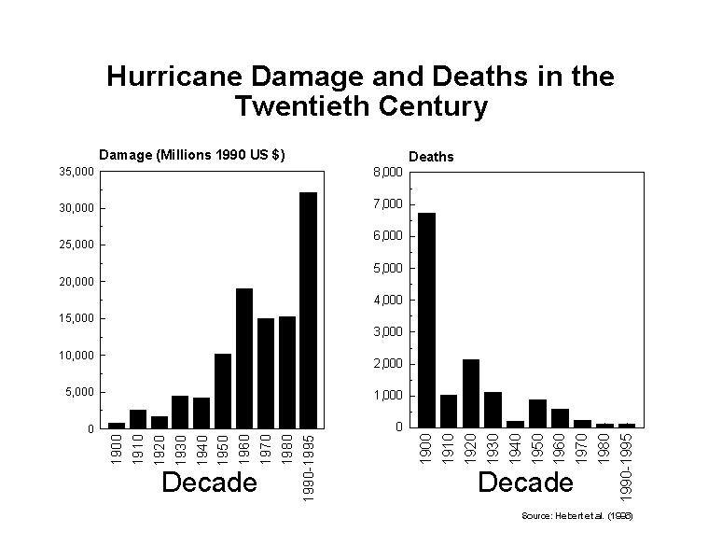
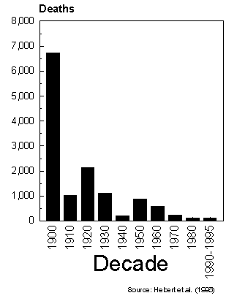
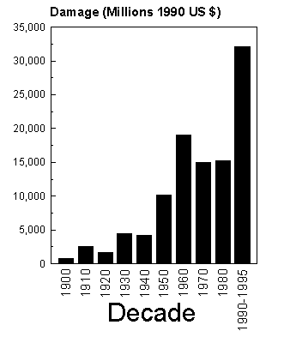
U.S. Fatality and Cost Trends
While the U.S. has fewer deaths from hurricanes
Costs of hurricane damage are rising
Trend continues today
Katrina “spike” in deaths
(2005) not included

Slide 7
Hurricanes Overview
What are the primary differences between hurricanes and extratropical cyclones?
Where and when do tropical cyclones form?
How and why do tropical cyclones intensify?
What is the structure of a tropical cyclone?
When, where and why do hurricanes dissipate?
What kind damage do hurricanes inflict?
How good are hurricane forecasts?

Slide 8
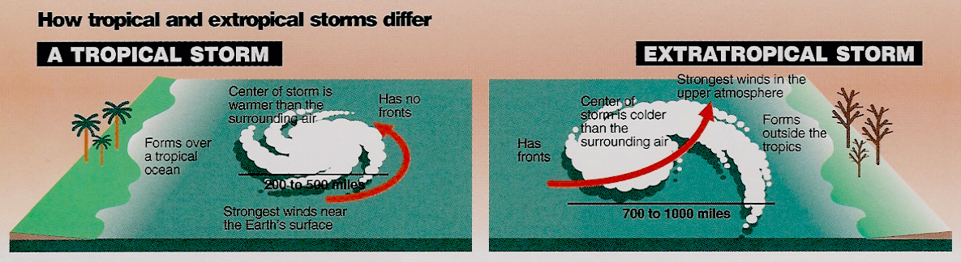
What are the primary differences between hurricanes and extratropical cyclones?
Williams, The Weather Book
No Fronts
Warm at Storm Center Aloft
Strongest Winds near Surface
Forms over Tropical Oceans
Diameter of 200-500 miles
Energy Source: Heat Fluxes from Warm Ocean to Air
Strong Fronts
Cold at Storm Center Aloft
Strongest Winds Aloft
Forms outside of Tropics
Diameter of 500-1000 miles
Energy Source: Horizontal Temperature Contrast

Slide 9
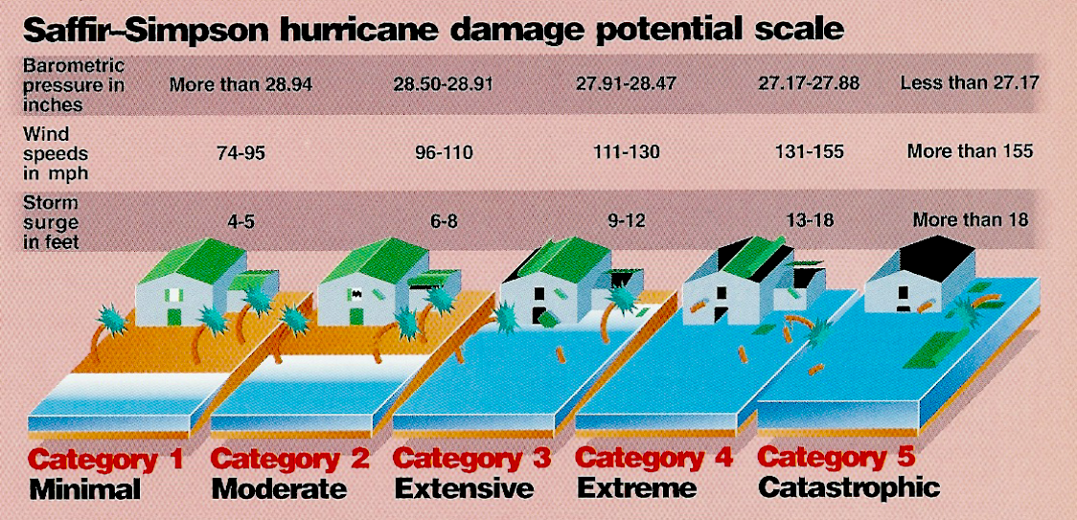
Hurricane Intensity Scale
(> 980 mb)
(965-979 mb)
(945-964 mb)
(920-944 mb)
(< 920 mb)
(64-82 kts)
(83-95 kts)
(96-113 kts)
(114-135 kts)
(>135 kts)
Williams, The Weather Book

Slide 10
When and where do tropical cyclones form?

Slide 11
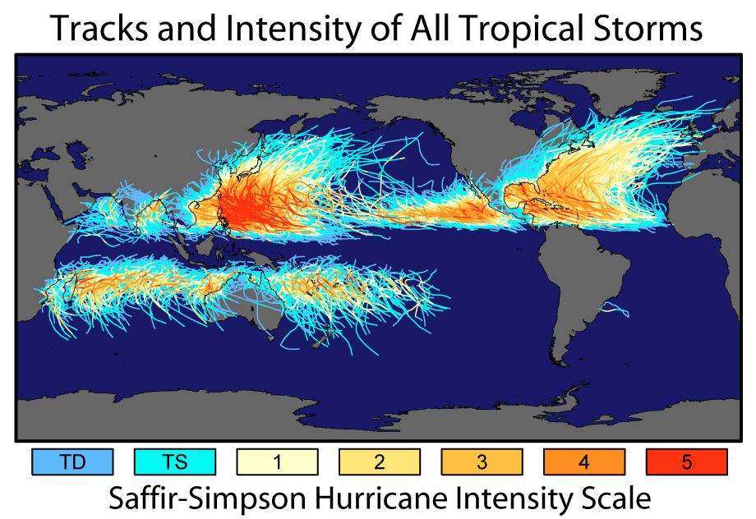
Form over tropical Atlantic Ocean and Caribbean Sea, and over tropical East Pacific
Propagate westward before turning northward
Dissipate over land or cold water
30%
12%
12%
15%
12%
7%
12%
Credit: https://earthobservatory.nasa.gov/images/7079/historic-tropical-cyclone-tracks
H&P: Fig. 12.01a

Slide 12

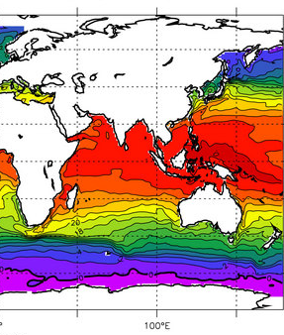
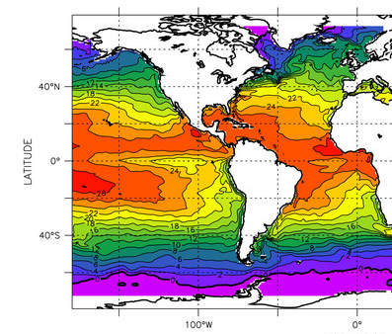

12%
12%
30%
15%
12%
7%
12%
Figure Credit: http://www.aquarius.umaine.edu/images/ed_mean_temp_sfc.jpg
Tropical systems develop to hurricane strength where SST’s are warmer than 27°C to 28°C

Slide 13
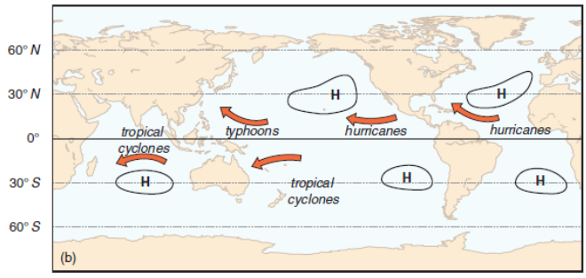
Names of Tropical Cyclones in Each Ocean Basin
Form over tropical Atlantic Ocean and Caribbean Sea, and over tropical East Pacific
Propagate westward before turning northward
Dissipate over land or cold water
Credit: https://earthobservatory.nasa.gov/images/7079/historic-tropical-cyclone-tracks
H&P: Fig. 12.01b
Overall direction of movement of tropical cyclones and names used in each ocean basin.

Slide 14
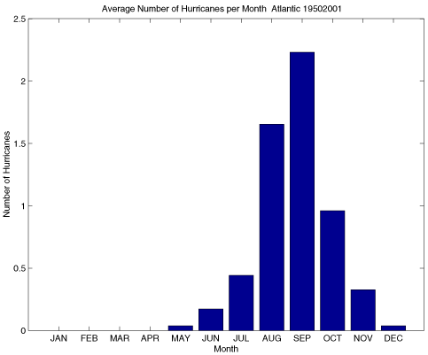
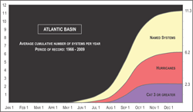
When do Atlantic hurricanes form?
Atlantic Basin Hurricanes
Credit: iri.columbia.edu
Warm season
Most likely when SST’s are warmest-Sept.
Average of ~6 Per Year
Large annual variability Fewer in El Nino Years More in La Nina Years

Slide 15
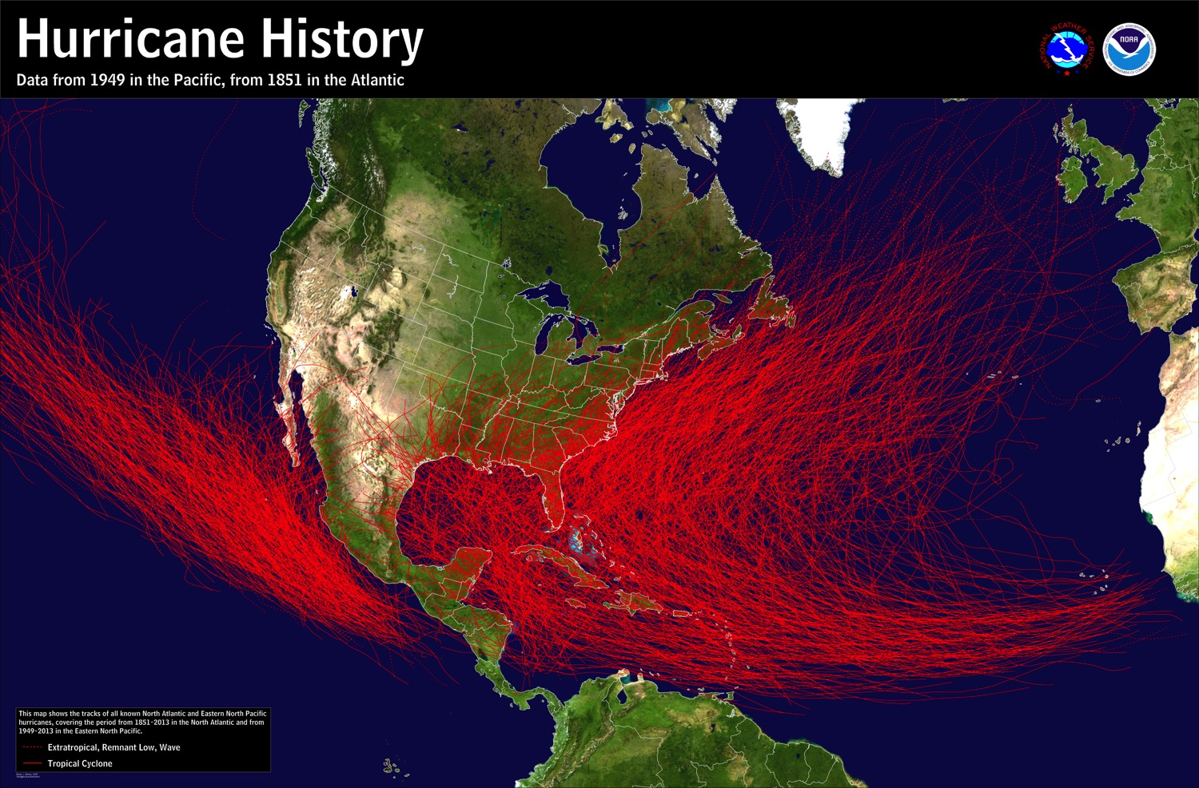
Form over tropical Atlantic Ocean and Caribbean Sea, and over tropical East Pacific
Propagate westward before turning northward
Dissipate over land or cold water
Credit: https://www.nhc.noaa.gov/climo/images/1851_2013_hurr_sm.jpg

Slide 16
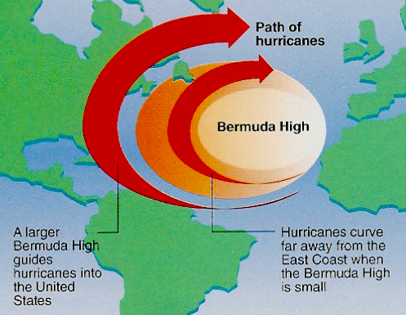
Hurricane Steering
Large-scale flow controls where hurricanes track.
Williams, The Weather Book

Slide 17
Tropical Cyclone Structure and Development
What are the differences between tropical cyclones and extratropical cyclones?
- Many significant ones. See earlier slide.
Tropical cyclones form over most tropical oceans
- But they go by different terms in different regions
Where do hurricanes form?
- 5˚-25˚ latitude (not on the equator)
- SST’s are warm (>80˚ F) and the warmth is deep
- Wind shear is weak
- Atmosphere is conditionally unstable and moisture is deep
When do hurricanes form?
- SST’s are the warmest, Aug-Sept in North Atlantic

Slide 18
Part II is a separate file.

