Slide 1
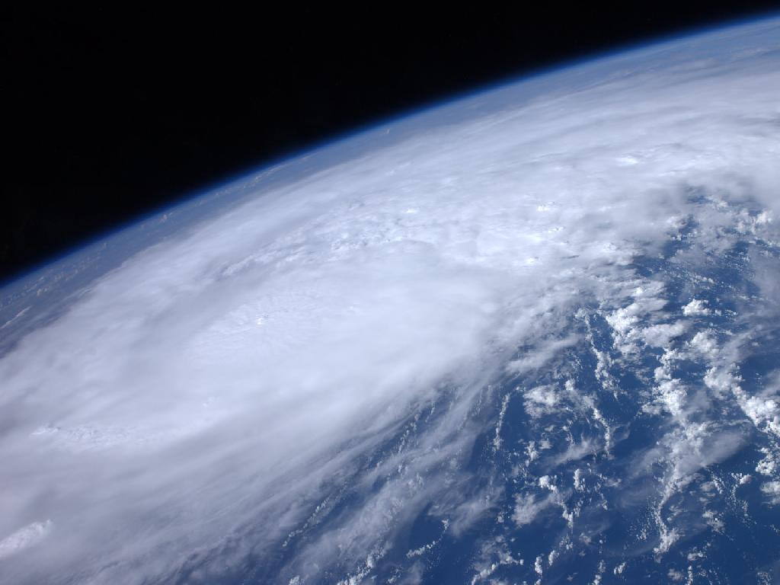

ATMO 170A1
Online
H&P §12.1-12.4
Hurricanes: Structure and Development
(Long 30’)
Hurricane Irene from the International Space Station as it passed over the Caribbean on 22 August 2011
http://www.nasa.gov/multimedia/imagegallery/image_feature_2043.html

Slide 2
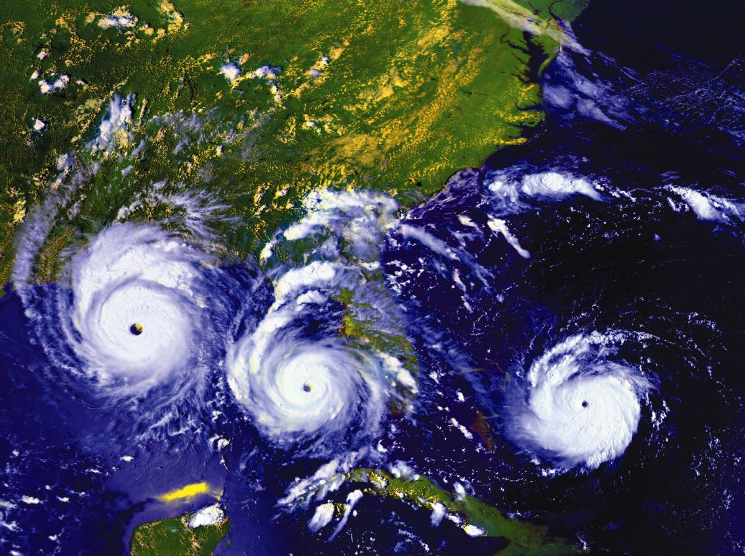
Andrew 1992 Time Sequence
2005 Atlantic Hurricanes NASA
Note cooler water in wake of Dennis, Katrina, Rita, Wilma

Slide 3
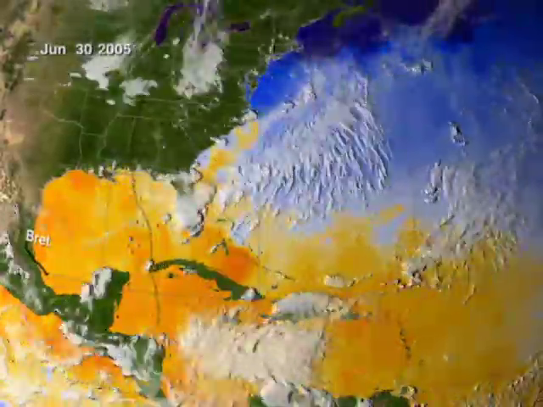
2005 Atlantic Hurricanes
1 July – 31 October
Note cooler water in wake of Emily, Katrina, Rita, Wilma

Slide 4
Tropical Cyclones
Cyclone Type Max Wind
Tropical Disturbance < 25 mph
Tropical Depression 25-39 mph
Tropical Storm (named) 40-74 mph
Hurricane ≥ 75 mph
Most Depressions do not develop into a Named Storm
But 55% of Named Storms develop into Hurricanes

Slide 5
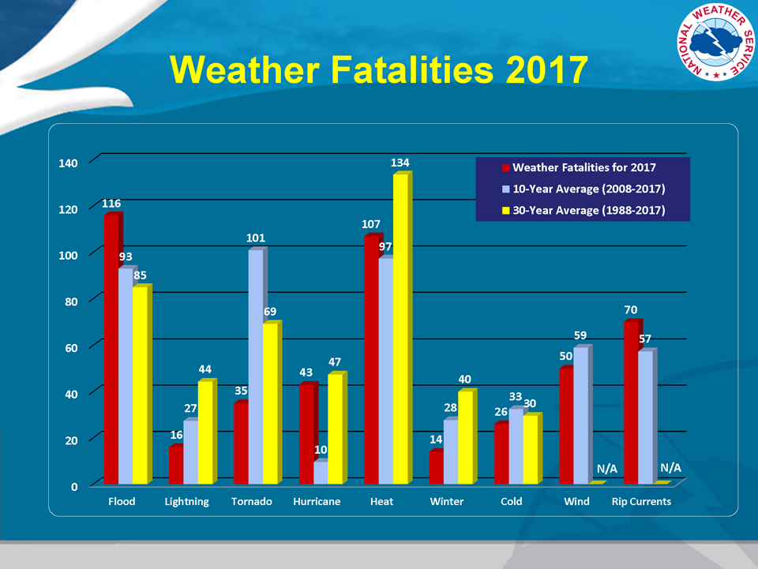
http://www.nws.noaa.gov/om/hazstats.shtml

Slide 6
Some Tropical Cyclone Extremes
Lowest Central Pressure Pressure
Pacific: Typhoon Tip 1979 870 mb
Atlantic: Hurricane Wilma 2005 882 mb
Costliest Hurricanes (2005 USD) Cost
“Galveston” 1900 $ 99 billion
“Miami” 1926 $157 billion
Katrina 2005 $125 billion¹
Harvey 2017 $100 billion²³
Deadliest Tropical Cyclone Loss
East Pakistan Cyclone 1970 500,000 est.
¹https://en.wikipedia.org/wiki/Hurricane_Katrina
² https://en.wikipedia.org/wiki/Hurricane_Harvey
³ https://www.usinflationcalculator.com

Slide 7
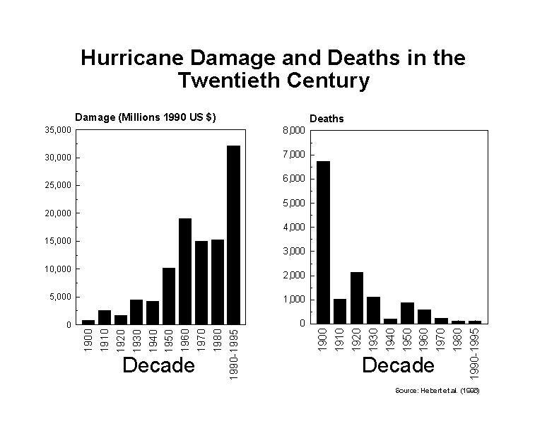
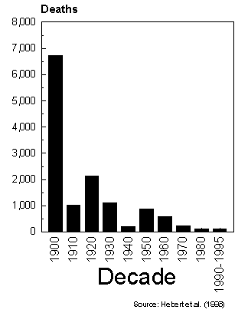
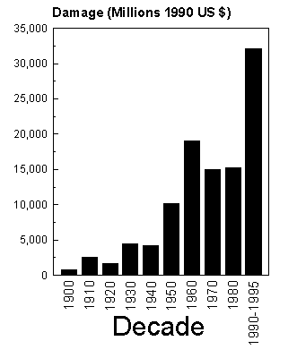
U.S. Fatality and Cost Trends
While the U.S. has fewer deaths from hurricanes
Costs of hurricane damage are rising
Trend continues today
Katrina “spike” in deaths
(2005) not included

Slide 8
Hurricanes Overview
What are the primary differences between hurricanes and extratropical cyclones?
Where and when do tropical cyclones form?
How and why do tropical cyclones intensify?
What is the structure of a tropical cyclone?
When, where and why do hurricanes dissipate?
What kind damage do hurricanes inflict?
How good are hurricane forecasts?

Slide 9
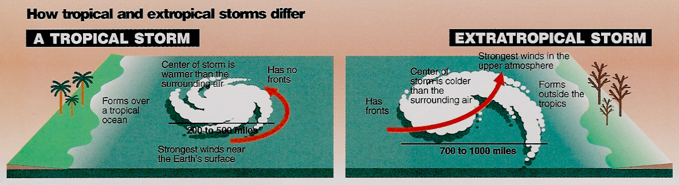
What are the primary differences between hurricanes and extratropical cyclones?
Williams, The Weather Book
No Fronts
Warm at Storm Center Aloft
Strongest Winds near Surface
Forms over Tropical Oceans
Diameter of 200-500 miles
Energy Source: Heat Fluxes from Warm Ocean to Air
Strong Fronts
Cold at Storm Center Aloft
Strongest Winds Aloft
Forms outside of Tropics
Diameter of 500-1000 miles
Energy Source: Horizontal Temperature Contrast

Slide 10
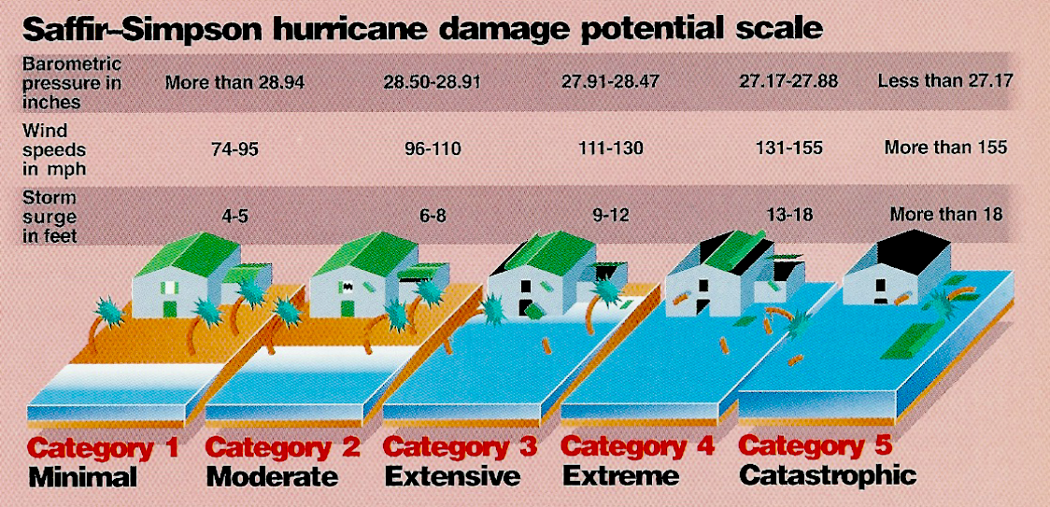
Hurricane Intensity Scale
(> 980 mb)
(965-979 mb)
(945-964 mb)
(920-944 mb)
(< 920 mb)
(64-82 kts)
(83-95 kts)
(96-113 kts)
(114-135 kts)
(>135 kts)
Williams, The Weather Book

Slide 11
Where do tropical storms form?

Slide 12
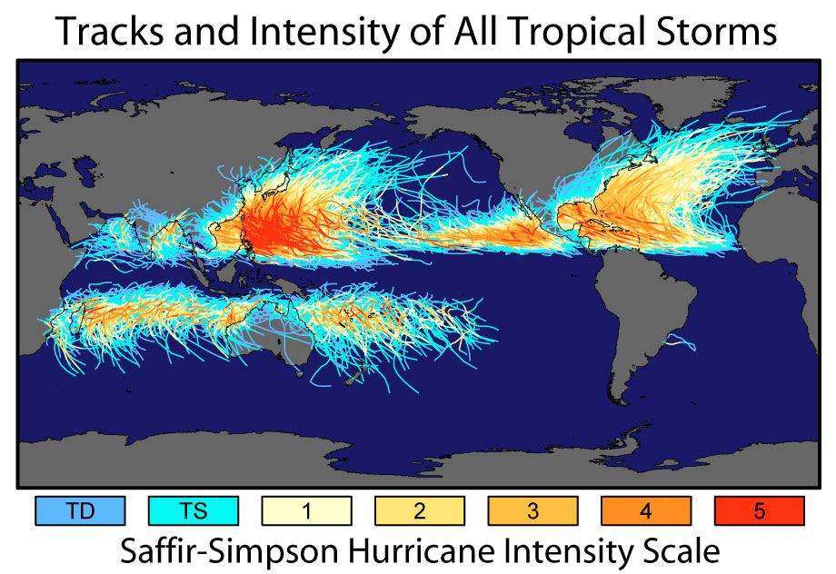
Form over tropical Atlantic Ocean and Caribbean Sea, and over tropical East Pacific
Propagate westward before turning northward
Dissipate over land or cold water
30%
12%
12%
15%
12%
7%
12%
Credit: https://earthobservatory.nasa.gov/images/7079/historic-tropical-cyclone-tracks
H&P: Fig. 12.01a

Slide 13

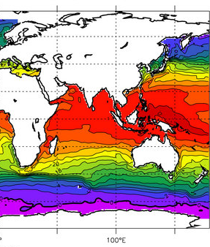
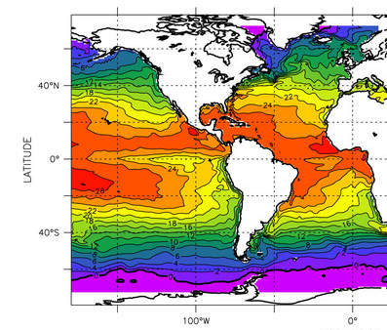

12%
12%
30%
15%
12%
7%
12%
Figure Credit: http://www.aquarius.umaine.edu/images/ed_mean_temp_sfc.jpg
Tropical systems develop to hurricane strength where SST’s are warmer than 27°C to 28°C

Slide 14
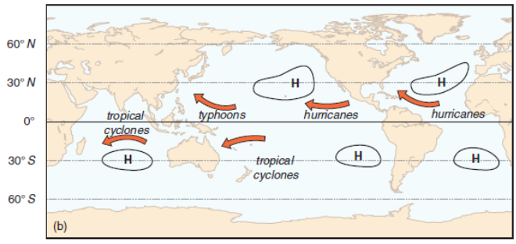
Names of Tropical Cyclones in Each Ocean Basin
Form over tropical Atlantic Ocean and Caribbean Sea, and over tropical East Pacific
Propagate westward before turning northward
Dissipate over land or cold water
Credit: https://earthobservatory.nasa.gov/images/7079/historic-tropical-cyclone-tracks
H&P: Fig. 12.01b
Overall direction of movement of tropical cyclones and names used in each ocean basin.

Slide 15
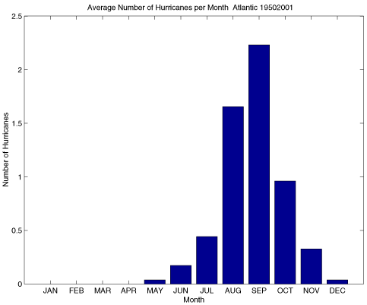
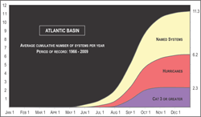
When do hurricanes form?
Atlantic Basin Hurricanes
Credit: iri.columbia.edu
Warm season
Most likely when SST’s are warmest-Sept.
Average of ~6 Per Year
Large annual variability Fewer in El Nino Years More in La Nina Years

Slide 16
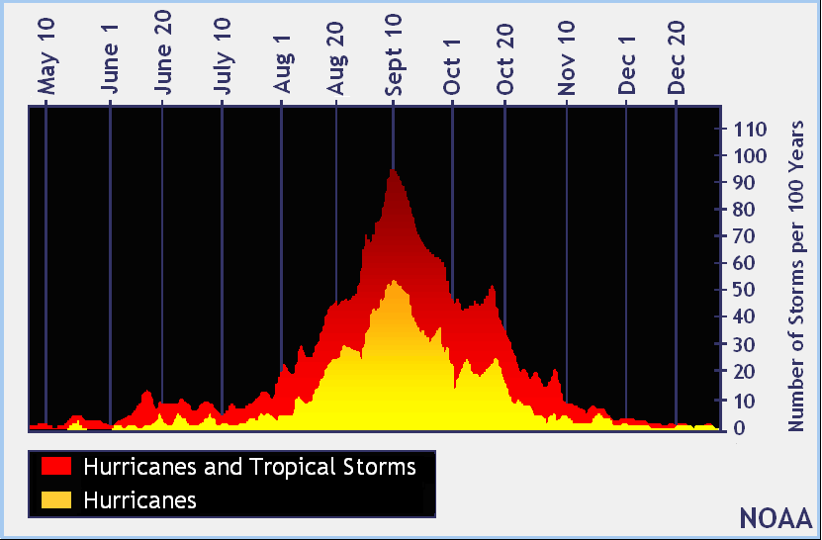
When do Atlantic tropical storms form?
Warm season
Most likely when SST’s are warmest-Sept.
Average of ~6 Per Year
Large annual variability Fewer in El Nino Years More in La Nina Years
Atlantic Basin tropical storm
https://www.nhc.noaa.gov/climo/images/peakofseason.gif

Slide 17
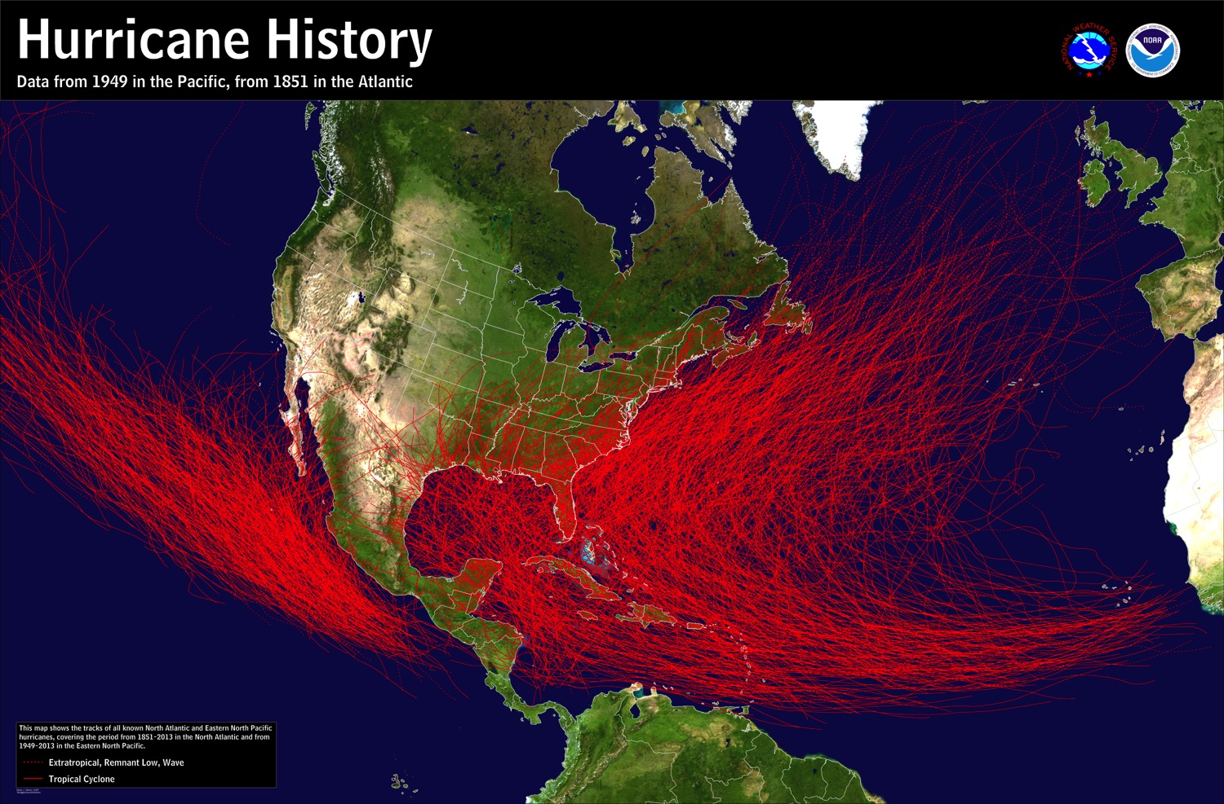
Form over tropical Atlantic Ocean and Caribbean Sea, and over tropical East Pacific
Propagate westward before turning northward
Dissipate over land or cold water
Credit: https://www.nhc.noaa.gov/climo/images/1851_2013_hurr_sm.jpg

Slide 18
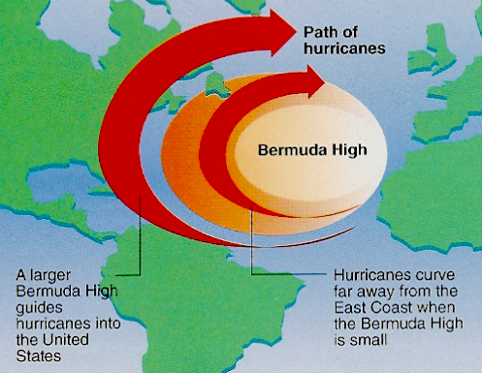
Hurricane Steering
Large-scale flow controls where hurricanes track.
Williams, The Weather Book

Slide 19
Why do hurricanes form?

Slide 20
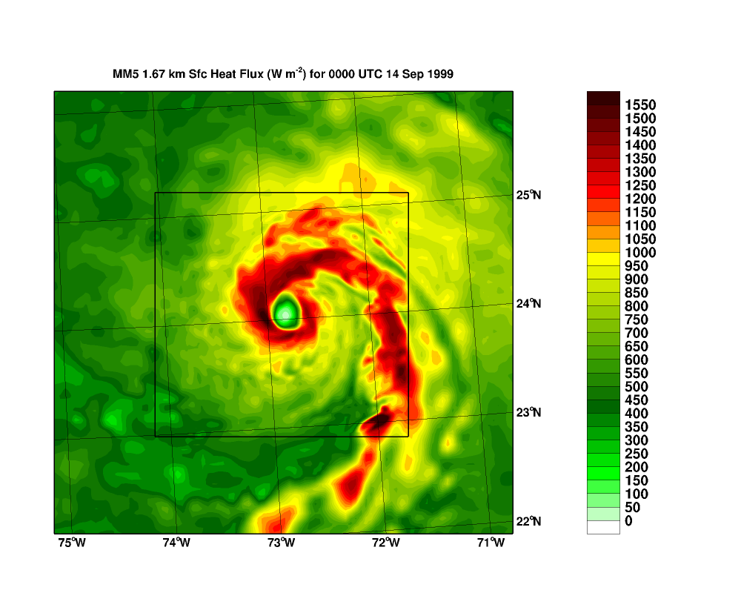
Surface Heat Flux for Hurricane Floyd
Compare Heat Flux to 345 W/m² and 1380 W/m²
http://orca.rsmas.miami.edu/floyd/1999091400-sh.4d-new.gif

Slide 21
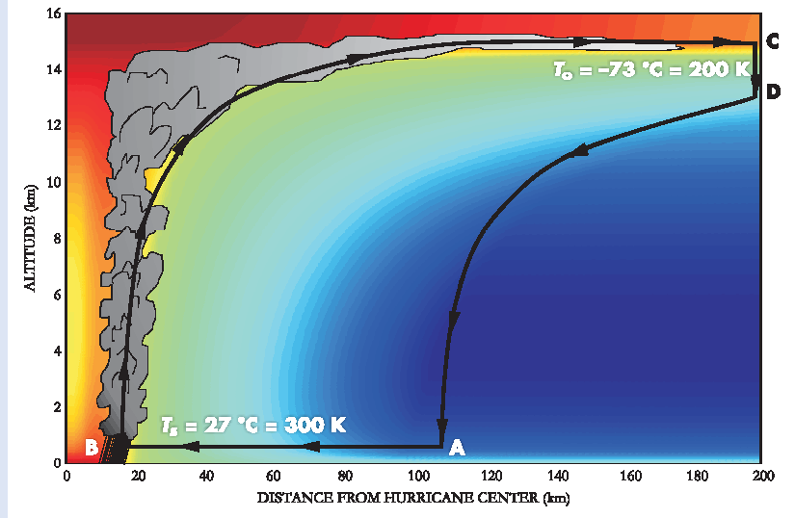
Hurricanes as Heat Engines
When heat is transferred from a warm region to a cool region, some of that energy is converted to do mechanical work —> It generates kinetic energy…the energy of macroscopic motion.
Tropopause
COOL REGION
LATENT HEAT
RELEASE
Isothermal Expansion
SLP at A > SLP at B
pressure drop equivalent of air parcel rising up to 1 km
WARM REGION
Surface
(Emanuel)
In the hurricane:
Warming region = warm moist air above ocean surface (the fuel intake)
Cooling region = cold cloud top (the exhaust)
Energy conversion to KE takes place by latent heat release in the cloud.
Figure credit: https://physicstoday.scitation.org/doi/10.1063/1.2349743
Notes:
Surface air spirals into the low-pressure center cools owing to adiabatic expansion (explain).
The cooling is offset by heat transfer from the warm ocean waters. Air temperature remains nearly that of the seawater.
Evaporation of seawater transfers more energy from the sea to the air.
When the air rises in the eyewall, it cools and condenses. The loss of internal energy is converted to the kinetic energy of macroscopic motion.
Air loses energy to space through IR cooling.

Slide 22
What environmental ingredients are needed to make a hurricane?

Slide 23
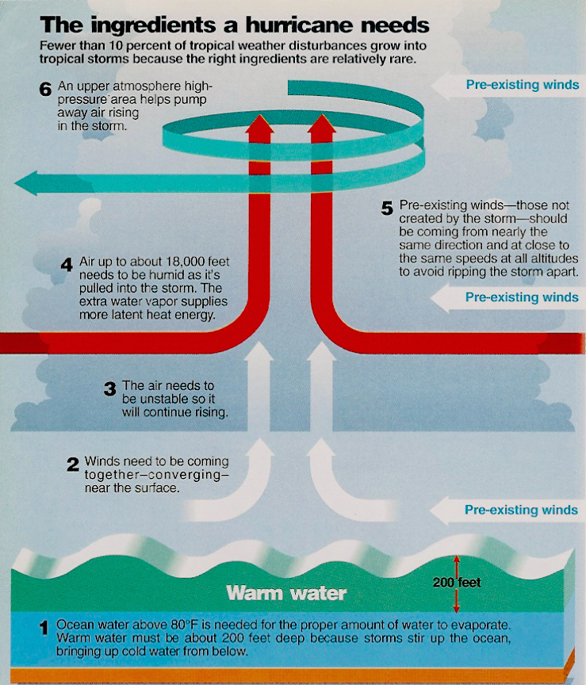
How do hurricanes form?
Necessary conditions
6) Diverging Winds Aloft
5) Weak Vertical Wind Shear Shear Shreds Storm Apart
4) Humid Air Mid-Troposphere
3) Conditionally Unstable Air Supports Deep Convection
2) Converging Surface Winds Seedling Low Required
1) Warm Water with T ≥ 27ºC Deep Warmth > 50 m or more
✔
✔
Williams, The Weather Book
Katrina Formation from Nat Geo
http://video.nationalgeographic.com/video/environment/environment-natural-disasters/hurricanes/katrina-formation/

Slide 24
What is the structure of hurricanes?

Slide 25
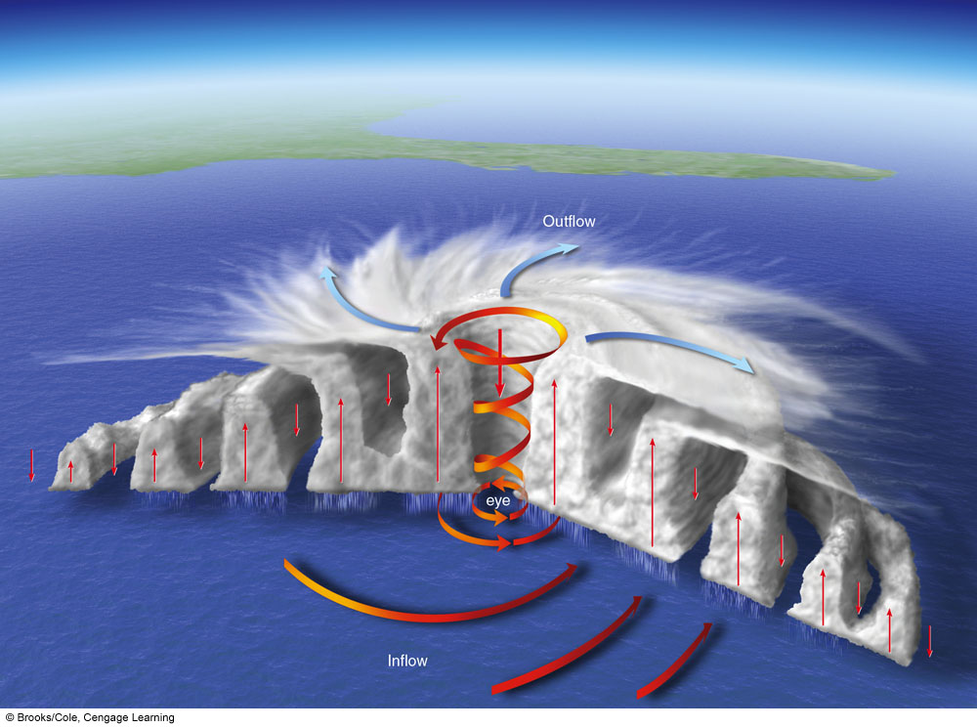
Hurricane Structure
Rainbands spiral inward
Winds aloft spiral outward clockwise
Eyewall winds spiral upward counterclockwise
Winds inside eye sink
Surface winds spiral inward counterclockwise in “rainbands”
Ahrens

Slide 26
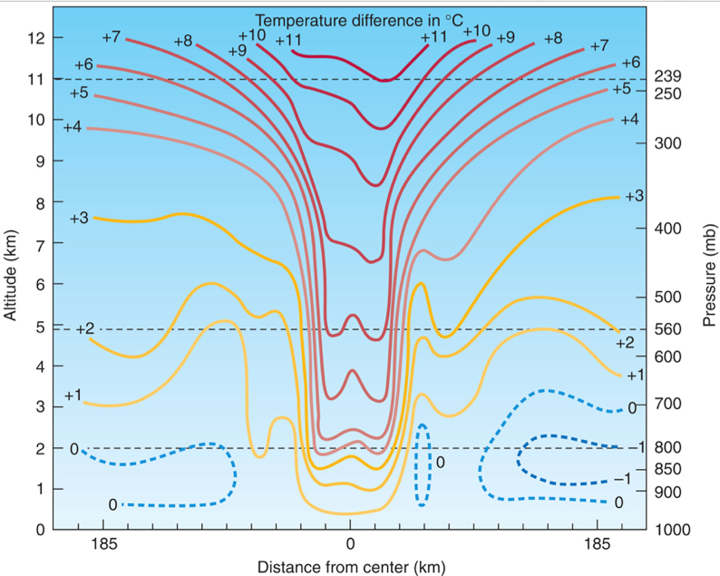
Thermal Structure of Hurricanes
WARM CORE CENTER Adiabatic Warming
Aguado and Burt 6th

Slide 27
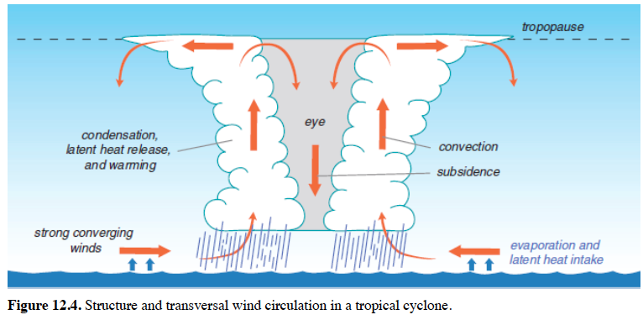
Structure of Hurricanes
Notes:
Eye – Lowest pressure. Calm, light winds. Dry, sometimes clear. Sinking motion. Adiabatic warming.
Eyewall - Inner most rain band. Fastest winds. Most intense rainfall. Winds spiraling in toward the cyclone can penetrate no farther than eyewall

Slide 28

Katrina Eyewall Flight
8-29-2005
http://www.katrina.noaa.gov/eyewall/eyewall.html
(Link no longer words)

Slide 29
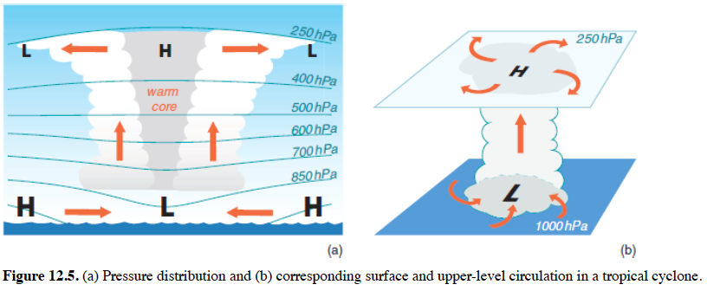
Structure of Hurricanes
WARM CORE CENTER
Notes:
Eye – warm core
Isobars bow upward aloft, bow downward at the surface. As shown to the left.
Leads to spiraling outward, clockwise (NH) flow aloft. As shown to the right.

Slide 30
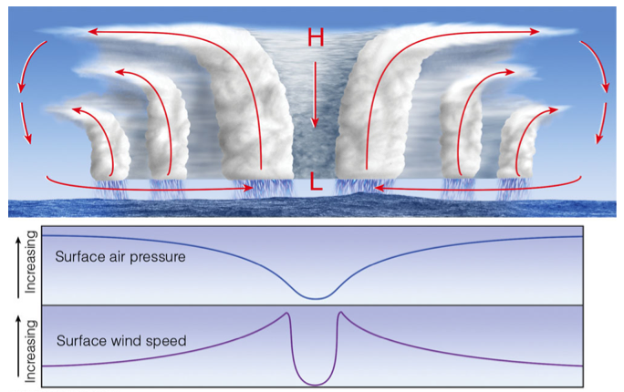
Cross Section of Hurricane
Ahrens 6th 11.08
Notes:
Rainbands on outer edges of hurricane.
Rain is more intense in the inner bands.
Winds strongest at eyewall.

Slide 31
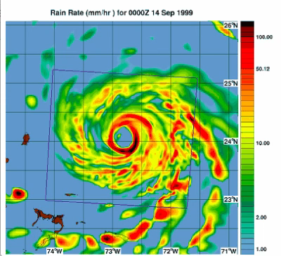
Floyd Rainfall Rate
(mm/hour)
http://orca.rsmas.miami.edu/floyd/model_sensitivity.php

Slide 32
When and why do hurricanes dissipate?

Slide 33
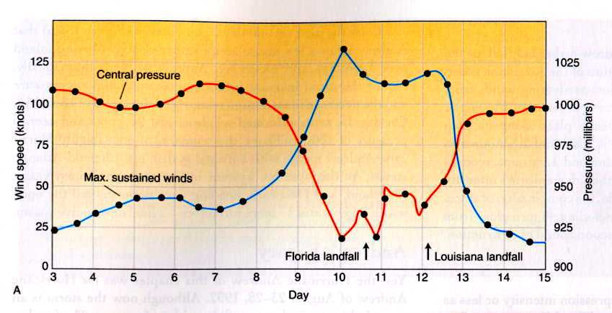
Hurricane Decay
Andrew Central Pressure
Landfall on Mainland
Danielson et al. Fig. 13.26
Hurricanes weaken when they make landfall or go over colder water.
(Surface energy fluxes are cut off)
Hurricanes weaken when they move into a region of strong wind shear.

Slide 34
Hurricane Structure and Development
What are the differences between hurricanes and extratropical cyclones?
Many significant ones. See earlier slide.
Where do hurricanes form?
5°-25° latitude (not the equator) where …
- SST’s are warm (>80°F) and the warmth is deep
- Wind shear is weak
- Atmosphere is conditionally unstable
- Atmospheric moisture is deep

Slide 35
Hurricane Structure and Development
Hurricanes intensify
Surface energy fluxes from the warm ocean water
Conversion potential energy to kinetic energy
through latent heat release inside the eyewall
Structure of a hurricane
Eyewall – strongest winds, heaviest rain
Eye – warm, dry, light winds, sinking air, lowest SLP
Hurricanes dissipate
They go over land or go over cold water
They move into a region of strong wind shear

