Slide 1
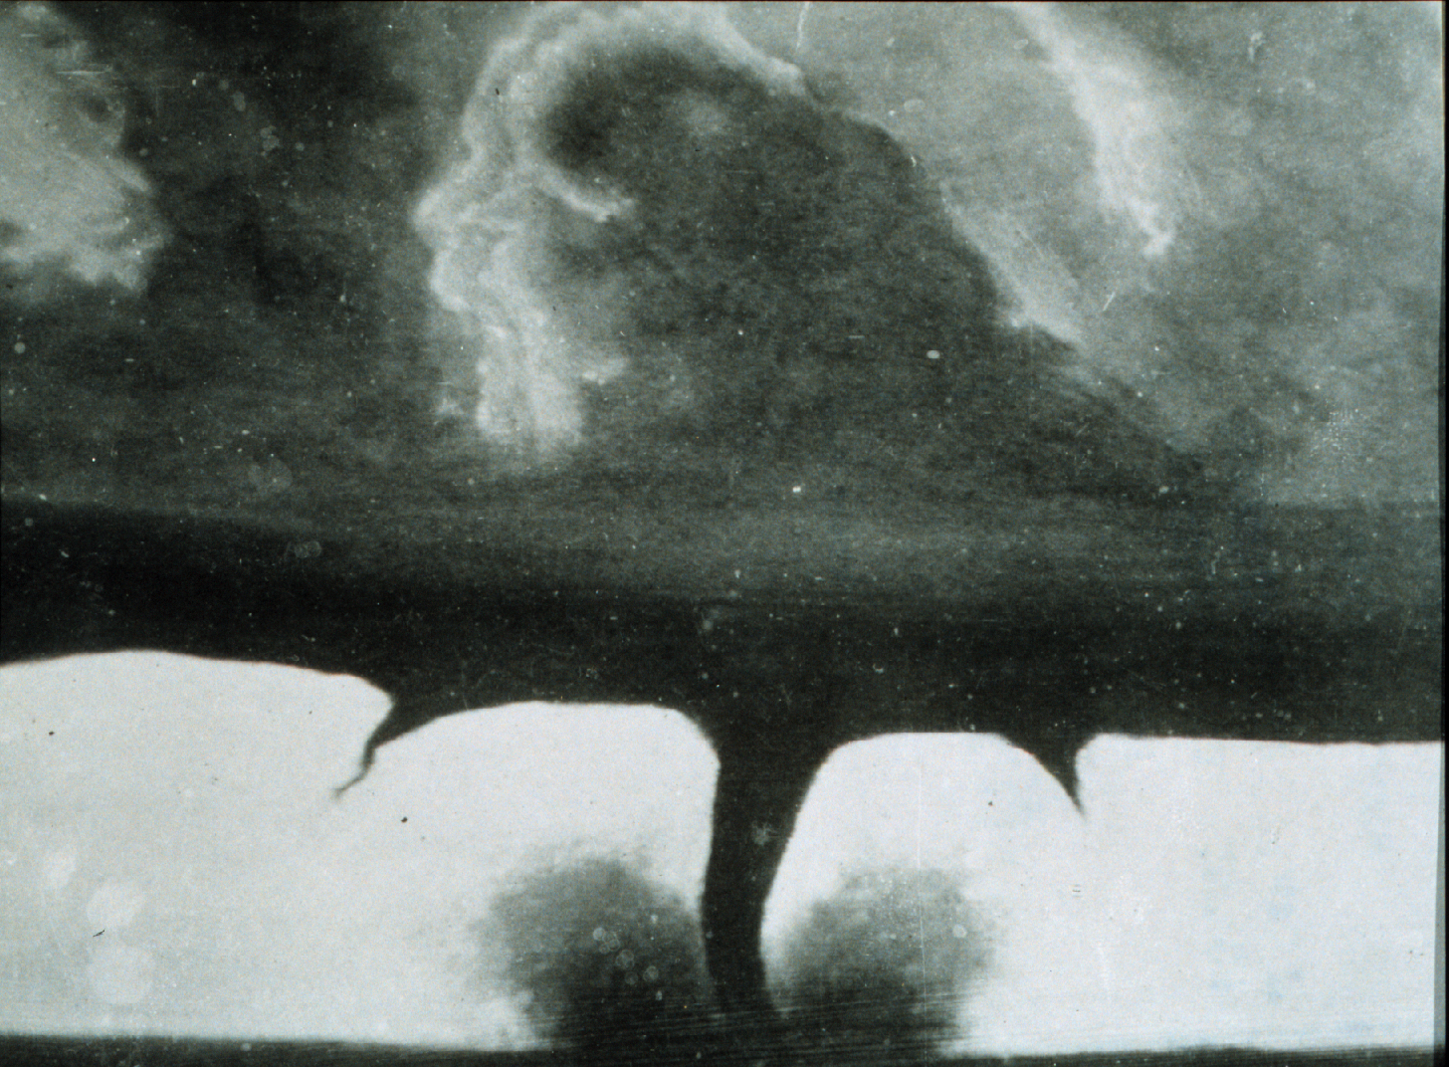

ATMO 170A1
Online
H&P §11.4-11.5
Tornadoes
Oldest known photograph of a tornado
22 miles SE of Howard, South Dakota
28 August 1884
NOAA PhotoLib

Slide 2
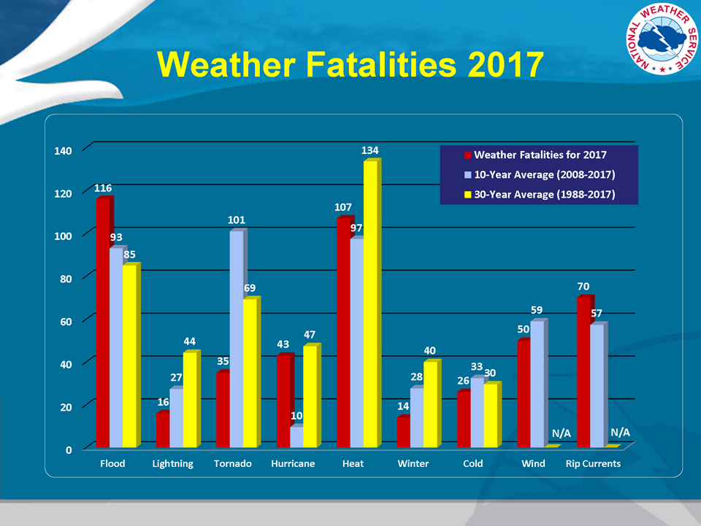
Tornadoes- consistently one of the biggest killers
http://www.nws.noaa.gov/om/hazstats.shtml

Slide 3
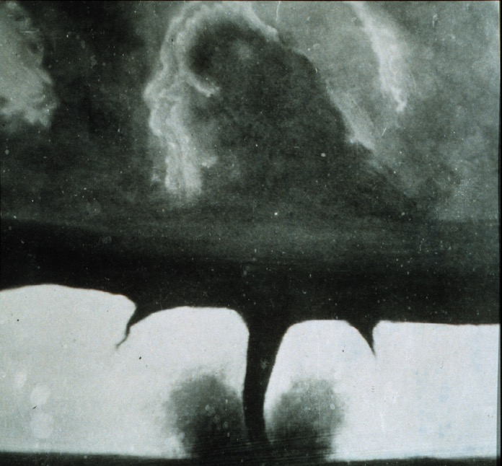
What is a Tornado?
A violently rotating column of air, in contact with the ground, either pendant from a cumuliform cloud or underneath a cumuliform cloud, and often (but not always) visible as a funnel cloud
Glossary of Meteorology (Glickman 2000)
Oldest known photograph of a tornado
22 miles SE of Howard, South Dakota
28 August 1884
NOAA PhotoLib

Slide 4
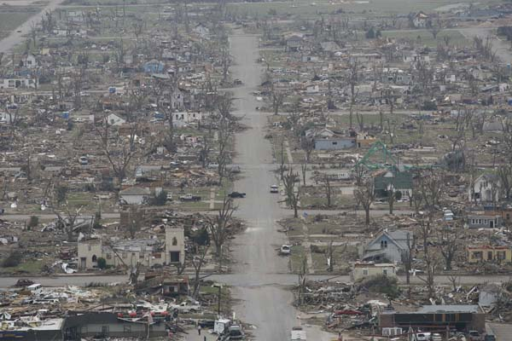
Greensburg Kansas May 4, 2007 after suspected EF5

Slide 5
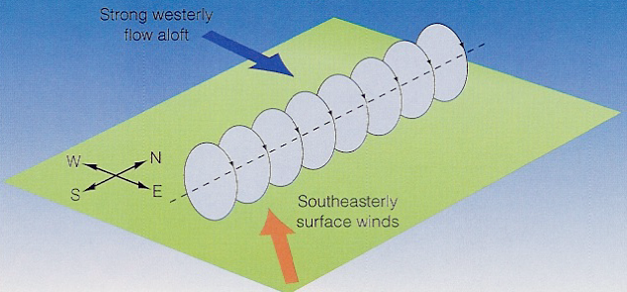
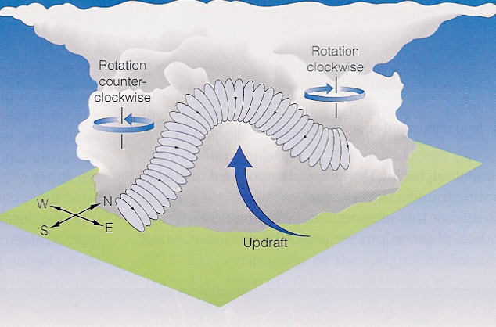
How Do Tornadoes Form?
Horizontal wind shear lead to rotation about horizontal axis
Updraft of developing thunderstorm tilts the axis of rotation from horizontal to vertical
Causes thunderstorm to rotate about vertical axis
Ahrens Older Ed.
Low-level moisture supply gets cutoff
Tornado 101 Nat Geo
Tornado Animation
OKC Debris Animation
NCSA Simultations
Low-level moisture flow
Ahrens Older Ed.

Slide 6
When and Where Do Tornadoes Occur?
What is Tornado Weather?
Notes:
Graphic showing tornado frequency vs. tornado deaths. (NOAA/NWS)

Slide 7
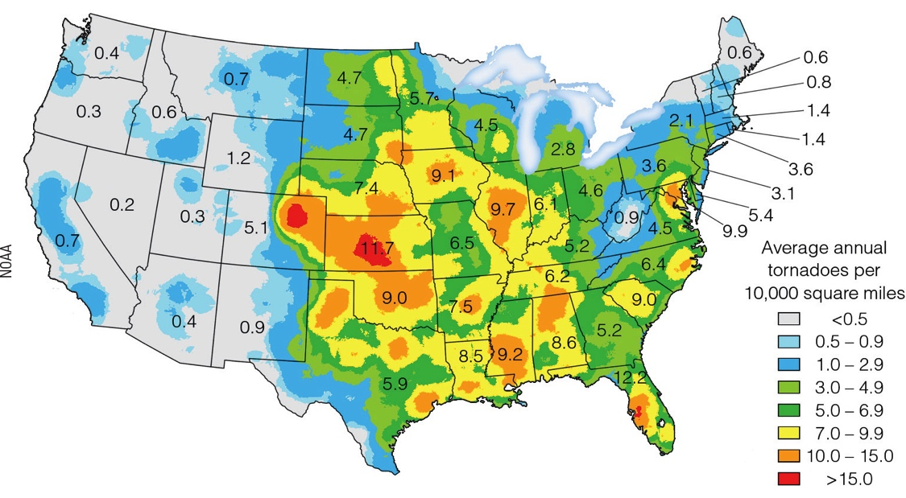
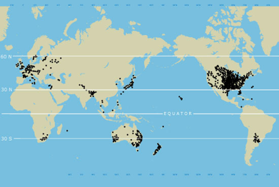
Where Do Tornados Occur?
PBS NOVA Link
Ahrens & Henson
About 75% of all reported tornadoes occur in the U.S.
where the three air masses (cP-cT-mT) clash most often.
Highest occurrence is in Tornado Alley and Dixie Alley.
Probability of Any Tornado
http://www.spc.noaa.gov/new/SVRclimo/climo.php?parm=allTorn
Notes:
World distribution in lower-left.
U.S. most prevalent with 75% of all tornadoes.
Number U.S. tornadoes per 100 x 100 miles during 1991-2012.
Two regions of frequent formation: Tornado Alley (Central Plains) in spring and Dixie Alley (AL, MS) in winter

Slide 8
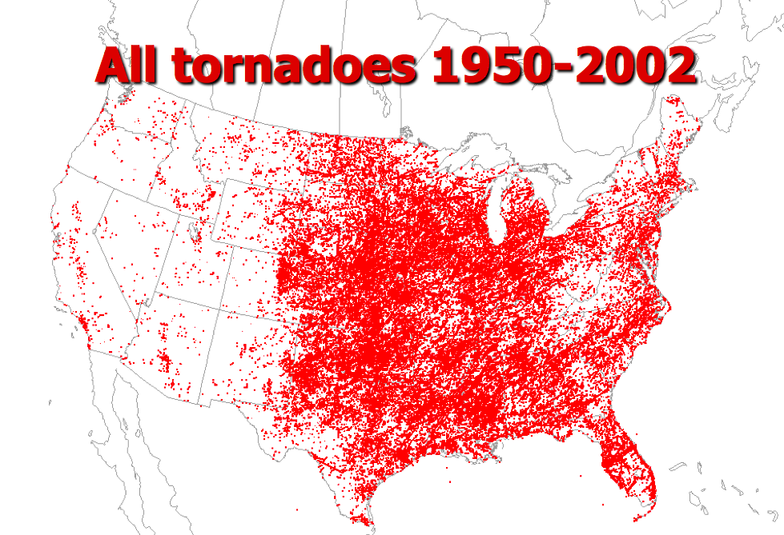
Where Do Tornados Occur?
PBS NOVA Link
Credit: Jeff Smith, SPC
About 75% of all reported tornadoes occur in the U.S.
where the three air masses (cP-cT-mT) clash most often.
Highest occurrence is in Tornado Alley and Dixie Alley.
Probability of Any Tornado
http://www.spc.noaa.gov/new/SVRclimo/climo.php?parm=allTorn
Notes:
World distribution in lower-left.
U.S. most prevalent with 75% of all tornadoes.
Number U.S. tornadoes per 100 x 100 miles during 1991-2012.
Two regions of frequent formation: Tornado Alley (Central Plains) in spring and Dixie Alley (AL, MS) in winter

Slide 9
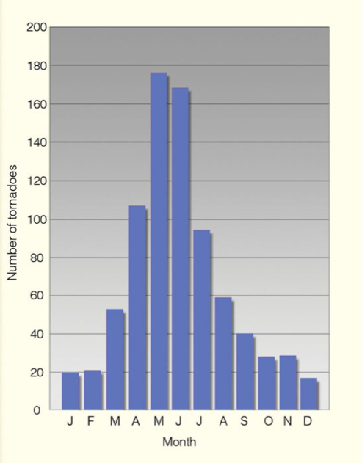
What Month are Tornadoes Most Likely?
Spring (AMJ) is when tornadoes are most likely to occur
SPC Annual Cycle Tornadoes
USA Today Web Site www.usatoday.com

Slide 10
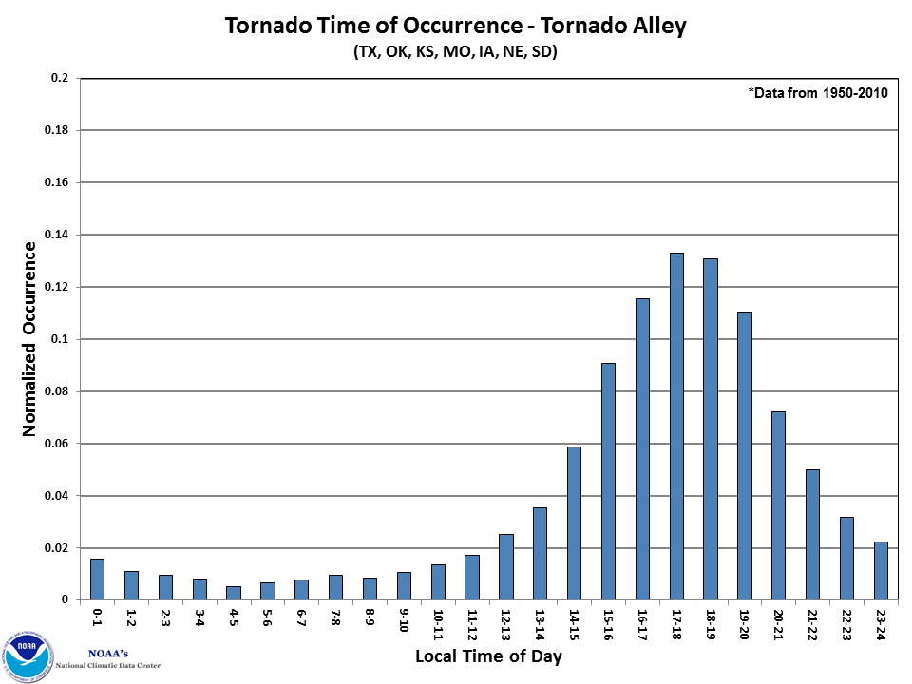
What Time of Day do Tornadoes Occur?
USA Today Web Site www.usatoday.com
Typically late afternoon or early evening when
conditional instability is greatest

Slide 11
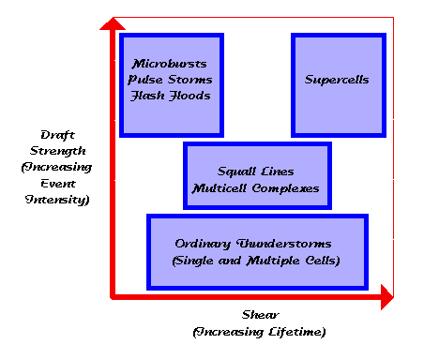
Tornado Weather is Upper-End
Severe Weather Conditions
Large CAPE + Strong Wind Shear
CAPE
AZ summer Cb’s
Cyclone Strength

Slide 12
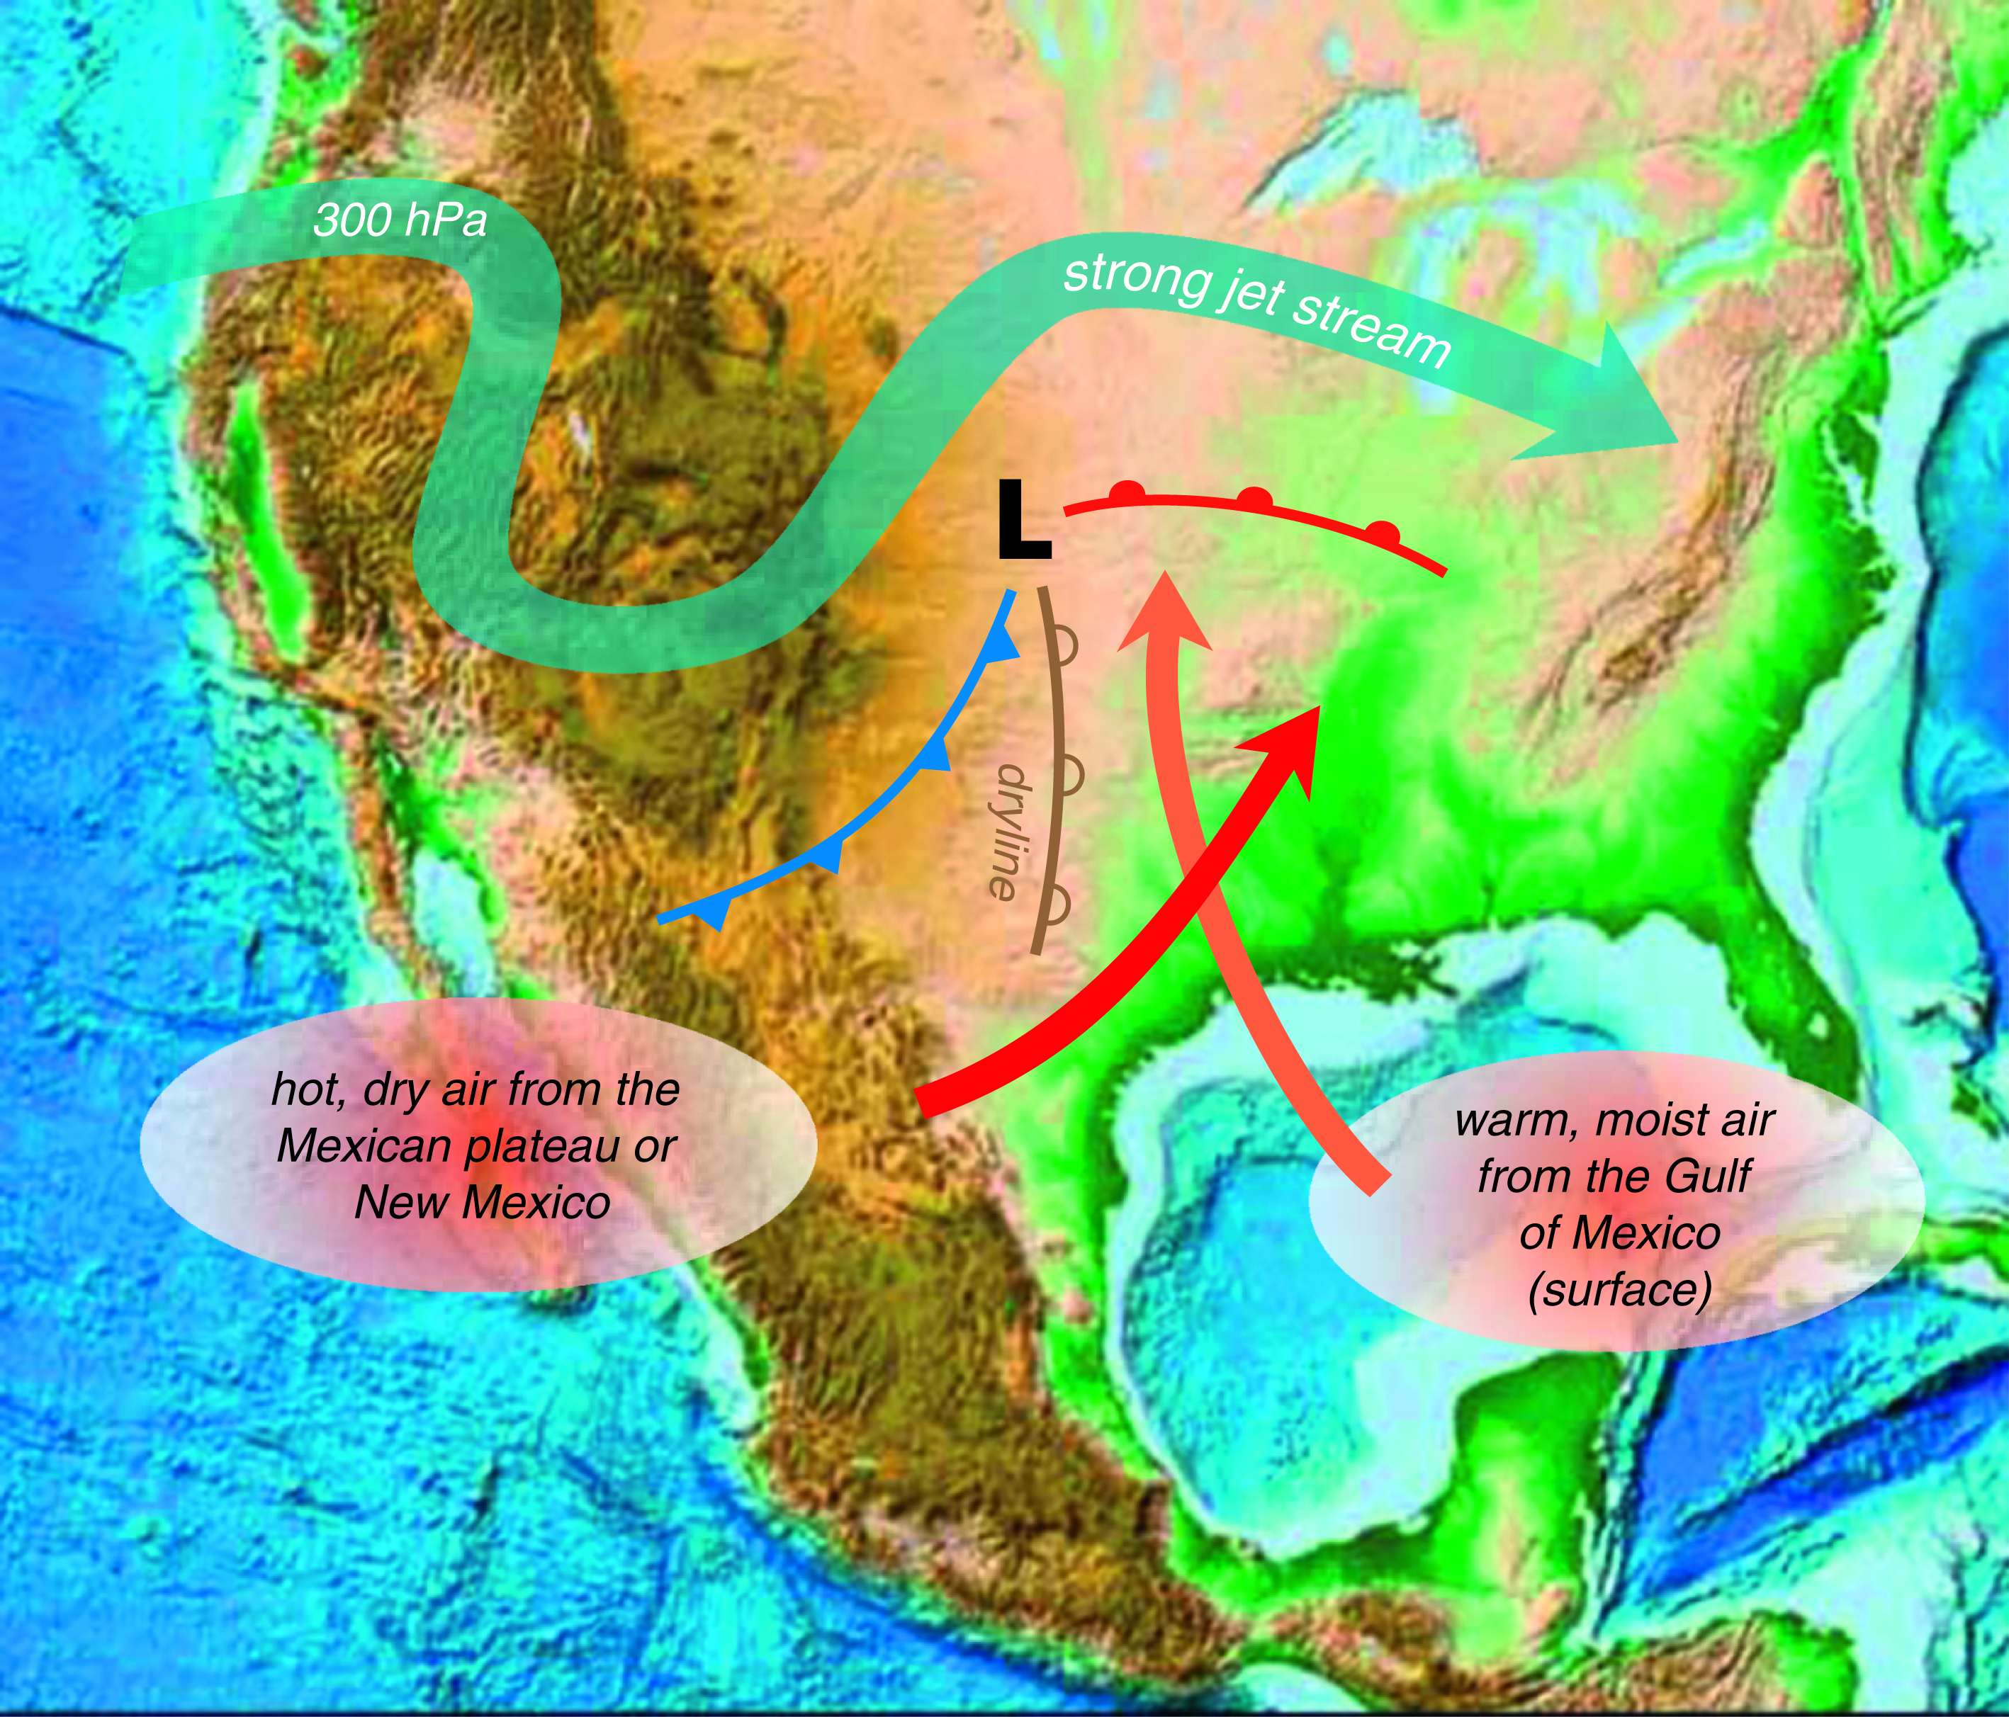
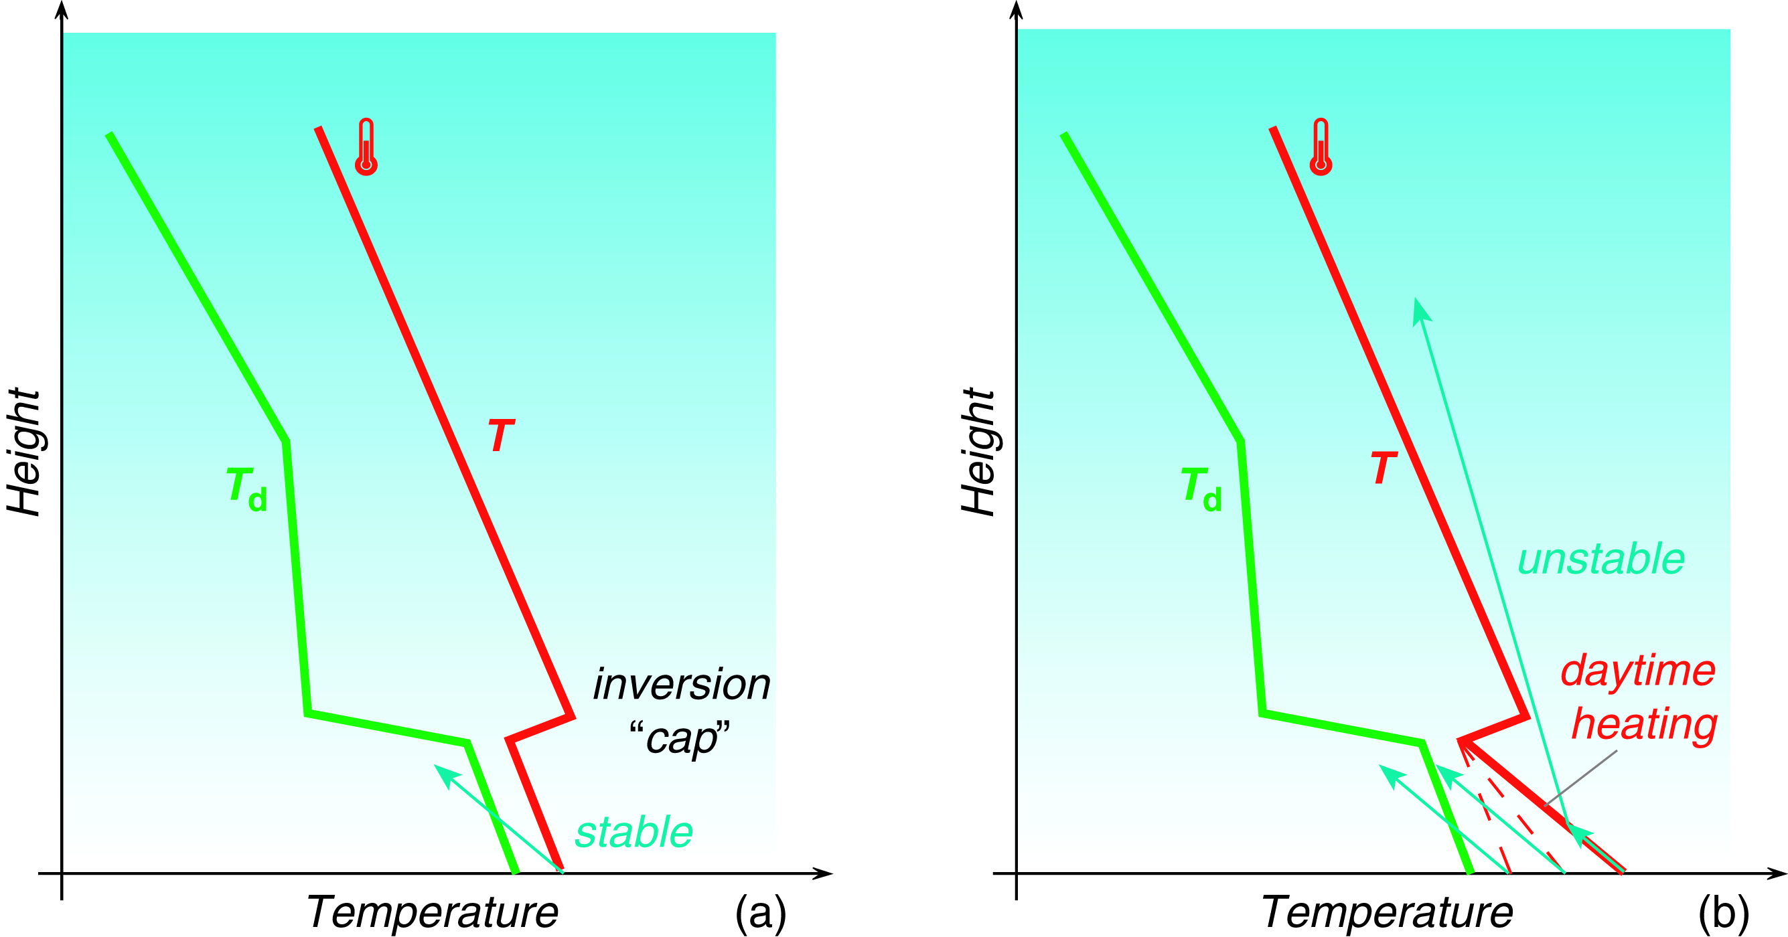
Tornado Weather
cP/mP
cT
mT
cT
mT
Fig. 11.20 H&P –
Vertical temperature profiles
-Hot, dry cT air sits over cool, moist mT air
-Produces strong inversion that prevents
convection from occurring early in the day
-Allows instability to build during the day
and be explosively released late in the day
Fig. 11.19 H&P –
Synoptic situation conducive to tornadoes
mT air from Gulf of Mexico
cT air from Mexican Plateau
mP/cP air from Pacific/Canada

Slide 13
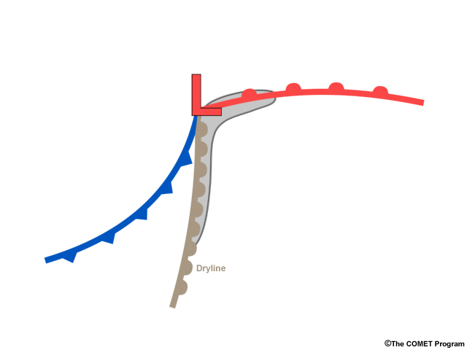
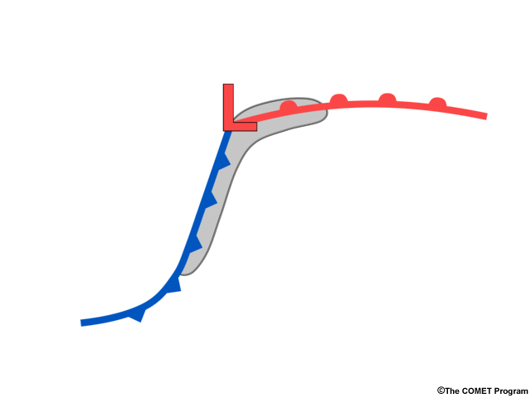
Where Supercells Form
mP/cP
mP/cP
mT
mT
cT
Where supercell thunderstorms tend to form relative to dry line systems and Norwegian cyclone systems.

Slide 14
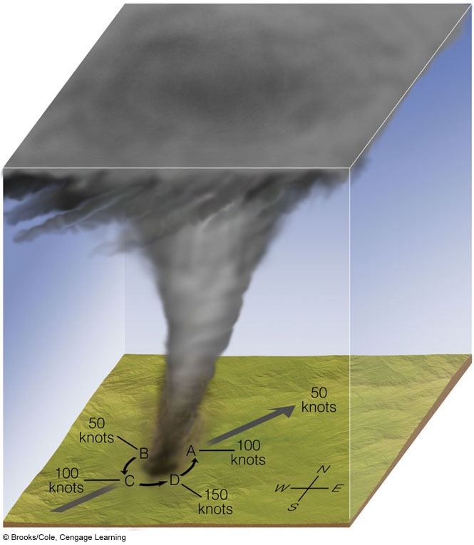
Where are Strongest Winds?
Total speed is the sum of rotational velocity (can exceed 100 kts) + translational velocity (can exceed 50 kts)
Helps explain asymmetric damage pattern along tornado path
Slowest
winds
Ahrens Fig. 10.27
Most tornadoes rotate counterclockwise
Fastest
winds
Notes:
Rotation speed = 100 knots
Translation speed = 50 knots
Fastest winds = 150 knots
Slowest winds = 50 knots

Slide 15
What is the fastest surface wind speed for a tornado ever measured?
  75 mph
  205 mph
  295 mph
  770 mph

Slide 16
What is the fastest surface wind speed for a tornado ever measured?
  75 mph
  205 mph
  295 mph (5-31-2013 El Reno OK)¹
  770 mph
¹ https://weather.com/storms/severe/news/2018-04-10-most-extreme-winds-earth-surface

Slide 17
Tornado Classification
(Classified by Maximum Winds)
Scale | Category | Speed (mph) | Damage
EF0 | Weak | 65-85 | tree branches broken, sign boards damaged
EF1 | Weak | 86-110 | trees snapped, windows broken
EF2 | Strong | 111-135 | large trees uprooted, weak structures damaged
EF3 | Strong | 136-165 | trees leveled, cars over-turned, walls removed
EF4 | Violent | 166-200 | frame house destroyed
EF5 | Violent | >200 | car-sized structures moved, steel structures damaged
Notes:
Moments later, a strong tornado develops within the area of rotation. Softball-size hail and damaging "straight-line" thunderstorm winds also accompanied this storm. (Woodward, Oklahoma-Ron Przybylinski)

Slide 18
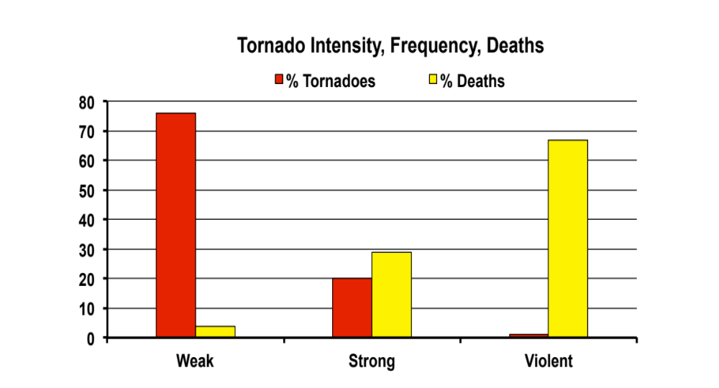
Violent tornadoes are rare (≈1%),
but they are responsible
for the most fatalities
% of Tornadoes
EF0 or EF1
EF2 or EF3
EF4 or EF5
Tornado Intensity
Notes:
Tornadoes frequently, but not always, shrink in size during the dissipating stage. A dissipating tornado remains capable of producing extensive damage.
Dissipating tornado near Union City, Oklahoma, Note the near complete destruction in the foreground. (NOAA/NWS)

Slide 19
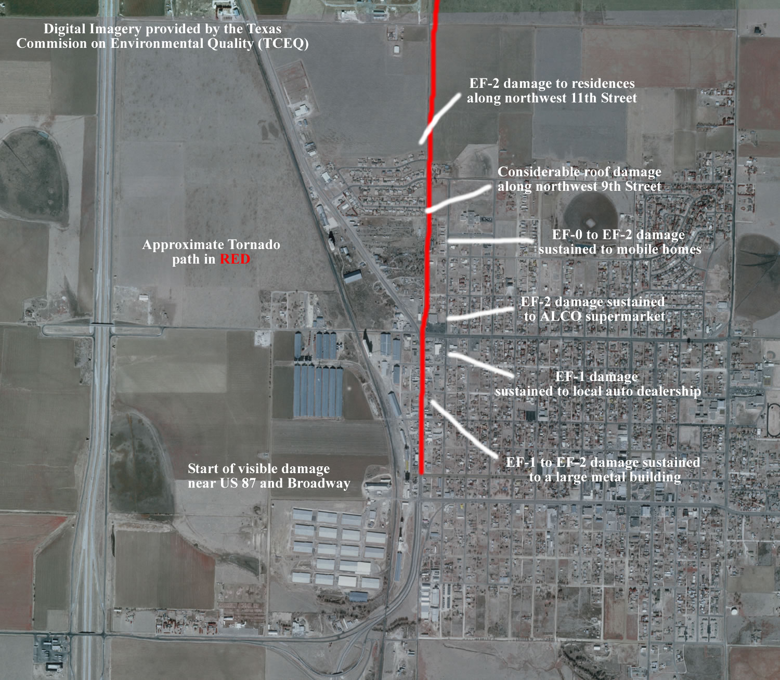
Asymmetric Damage Path
Tulia, TX
21 Apr 2007
Approximate path of tornado
Damage skewed towards side with the fastest winds
NWS Damage Survey
Notes:
Waterspouts are weak tornadoes that occur over water.
Waterspout taken in the Florida Keys, September 10, 1969, (Dr, Joseph Golden, NOAA)

Slide 20
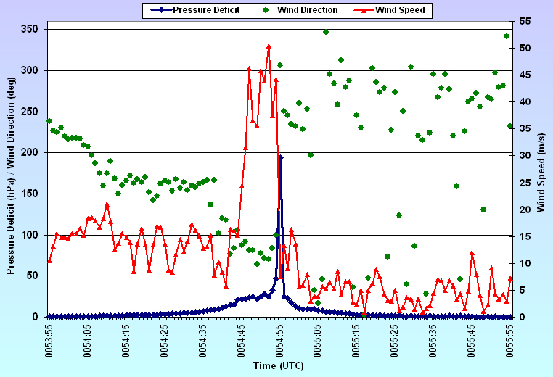
Tulia, TX
21 Apr 2007
Blair et 2008

Slide 21
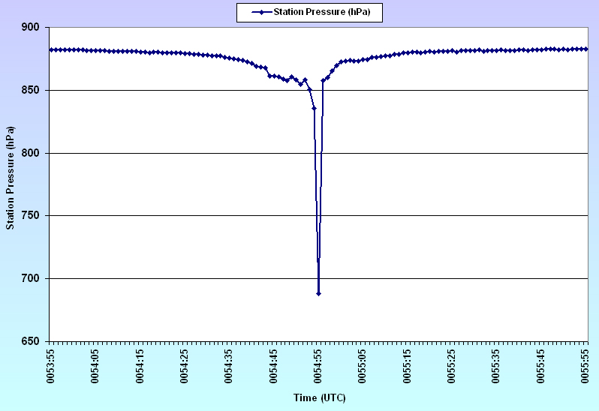
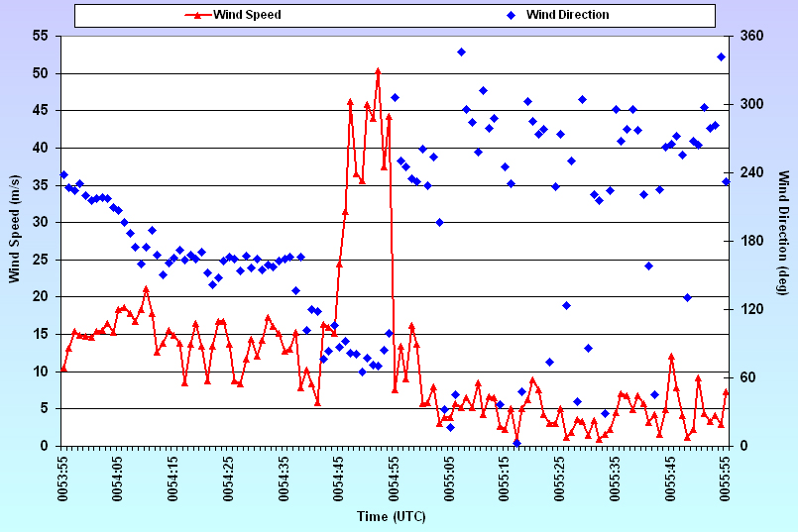
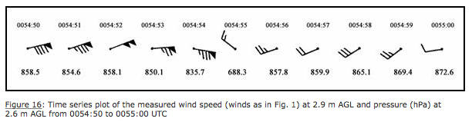
Tornado Intercept
Tulia TX on 21 Apr 2007
Blair et 2008

Slide 22
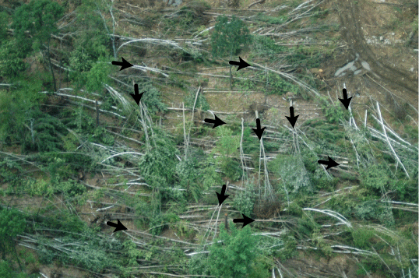
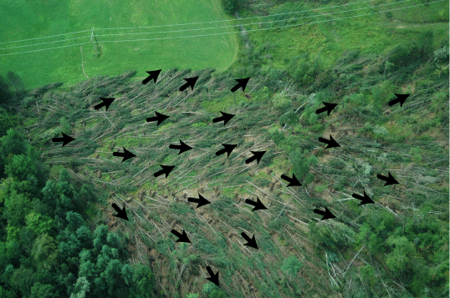
Tornado Damage
Circular Damage
Fan Out Pattern
Downburst Damage
Notes:
Waterspouts are weak tornadoes that occur over water.
Waterspout taken in the Florida Keys, September 10, 1969, (Dr, Joseph Golden, NOAA)

Slide 23
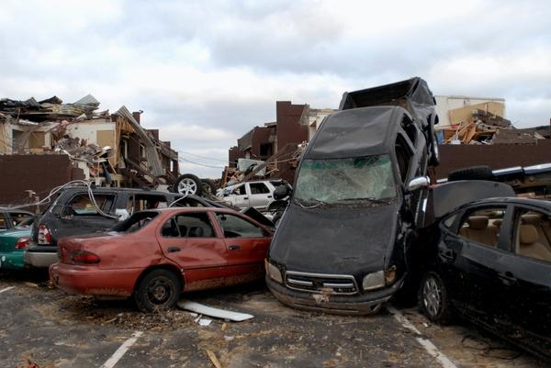
Do Not Stay in Your Car
www.denverpost.com
Notes:
Strong tornadoes account for 29 percent of all tornadoes and approximately 27 percent of all tornado deaths. Wind speeds range from 110 to 205 mph, and these tornadoes may last 20 minutes or longer.
Strong tornado in Illinois. (Mary Hurley)

Slide 24
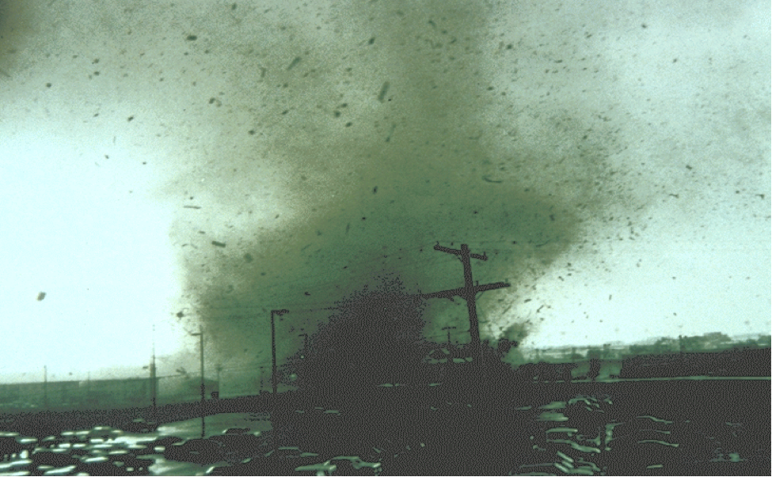
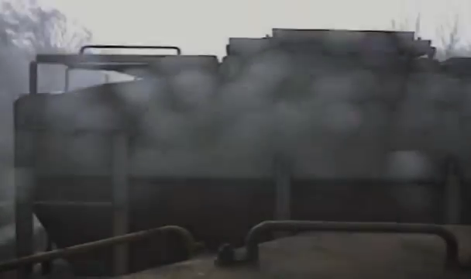
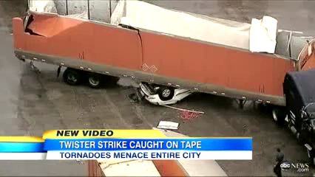
Damage
Pampa TX 6-8-95
(6:45 pickup)
EF2 Tornado
Harvard IL Derailment
McConnell AFB
Dallas/Lancaster Tornado
EF2 Tornado
Notes:
Strong tornadoes account for 29 percent of all tornadoes and approximately 27 percent of all tornado deaths. Wind speeds range from 110 to 205 mph, and these tornadoes may last 20 minutes or longer.
Strong tornado in Illinois. (Mary Hurley)

Slide 25
Tornado
Damage
EF2 Tornado
Harvard IL Derailment
Dallas/Lancaster Tornado
EF2 Tornado
Notes:
Strong tornadoes account for 29 percent of all tornadoes and approximately 27 percent of all tornado deaths. Wind speeds range from 110 to 205 mph, and these tornadoes may last 20 minutes or longer.
Strong tornado in Illinois. (Mary Hurley)

Slide 26
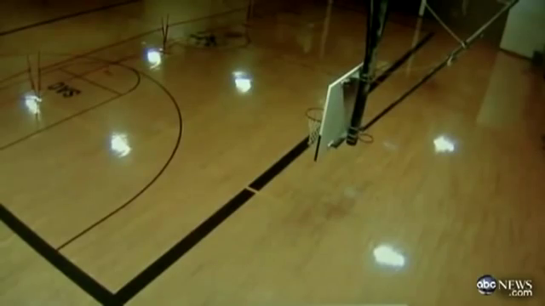
Airborne Debris
Video of destroyed basketball gym
Start at 0:54 for ground camera
Notes:
Strong tornadoes account for 29 percent of all tornadoes and approximately 27 percent of all tornado deaths. Wind speeds range from 110 to 205 mph, and these tornadoes may last 20 minutes or longer.
Strong tornado in Illinois. (Mary Hurley)

Slide 27
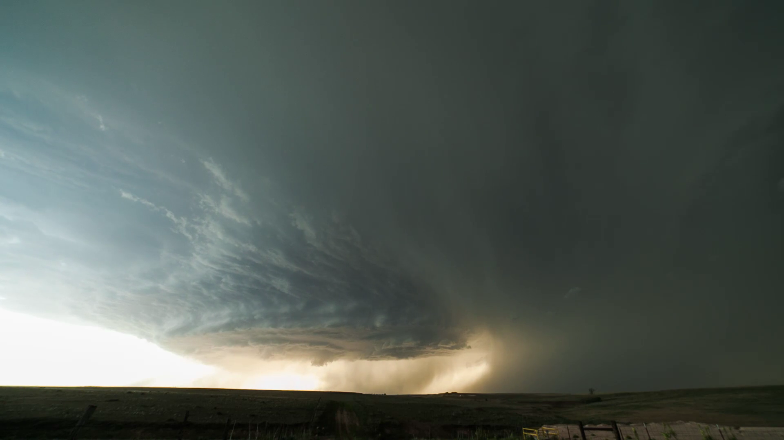
Supercell Recognition
Always know what the local forecast is.
When in tornado country, always have a plan
for safe shelter before weather deteriorates.
Credit: Mike Olbinski
http://player.vimeo.com/video/67995158?title=0&amp;portrait=0
See H&P §11.4
Notes:
Most strong and violent tornadoes form within this area of rotation.
Graphic showing location of vertical rotation within a thunderstorm. (NOAA/NWS)

Slide 28
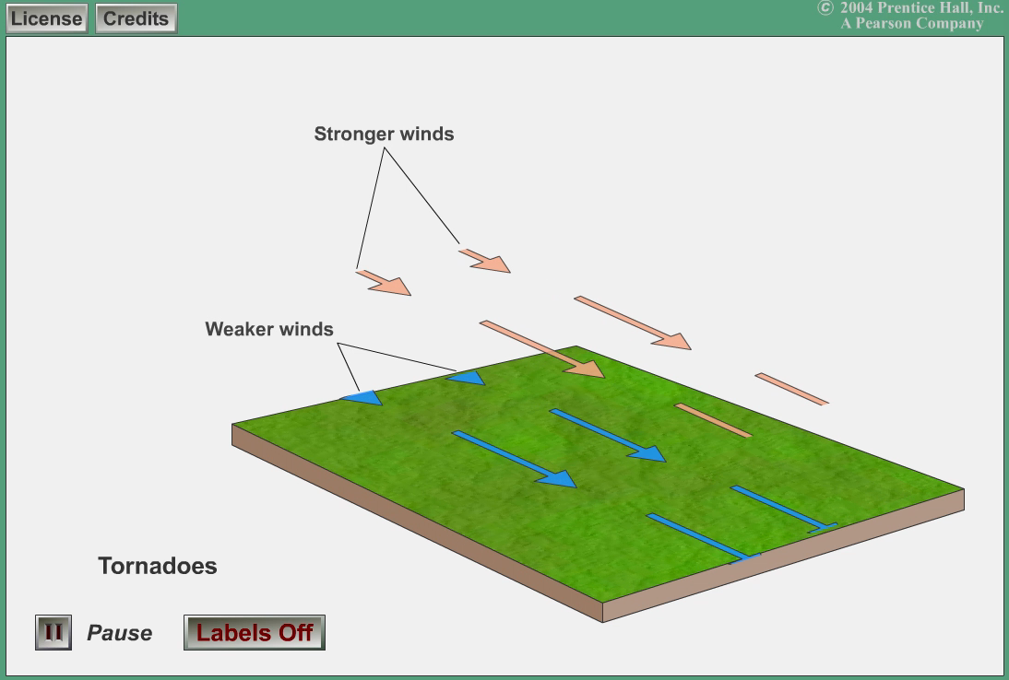
How a Supercell Forms
Lutgens and Tarbuck
http://www.atmo.arizona.edu/~mullen/atmo170A1/flash/Tornadoes_Lutgens&Tarbuck@PrenticeHallI2004.swf

Slide 29
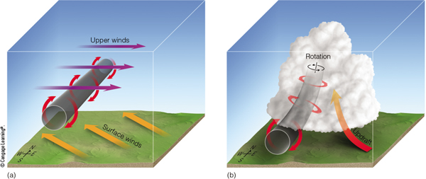
How a Supercell Forms
Ahrens & Henson
1) Rotation about a horizontal axis
2) Axis of rotation is tilted by a thunderstorm updraft
3) Rotation occurs about a vertical axis, leading to the thunderstorm rotating.

Slide 30
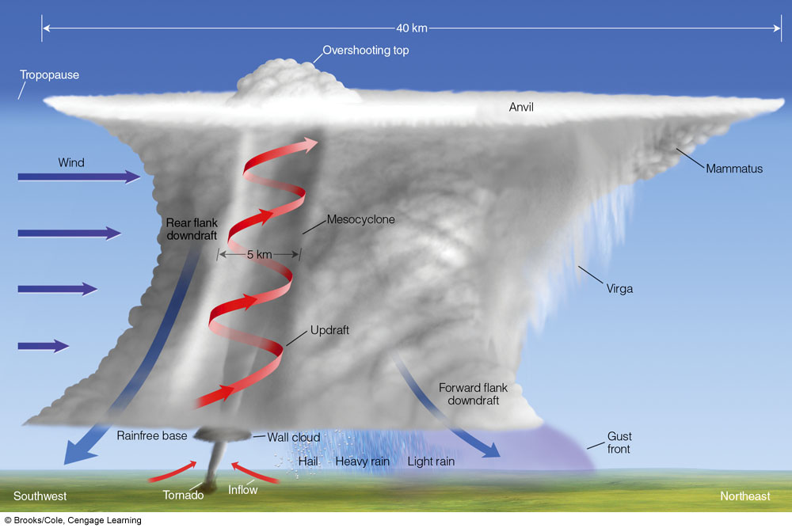
Tornadic Supercell
cell
motion
Structure/Formation Nat Geo 0:55
Ahrens Fig. 14.19 Met. Today
- Cell moves with upper-level winds, typically from SW toward NE
- Updraft rotates and tilts, and can be so strong that no precipitation can fall
- Tornado usually (but not always) occurs in precipitation free region of supercell
- Weather as cell passes: gust front, rain to heavy rain, hail (if present), updraft “vault” (often precipitation-free), wall cloud, tornado (if present), rain-free base
Notes:
Cell moves from left to right, tornado is behind updraft (no heavy precipitation … usually).

Slide 31
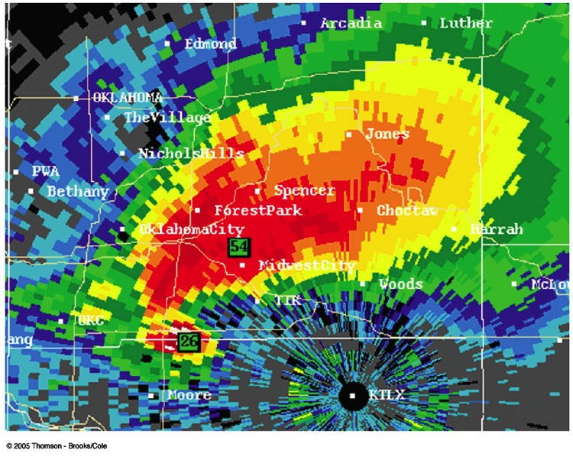
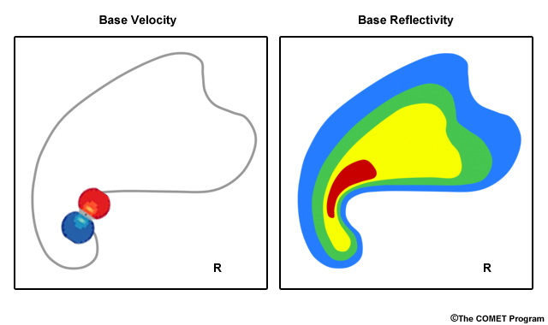
Radar Reflectivity
Tornadoes are located in regions where the radar reflectivity shows a “hook echo”
tornado location
T
Ahrens & Henson

Slide 32
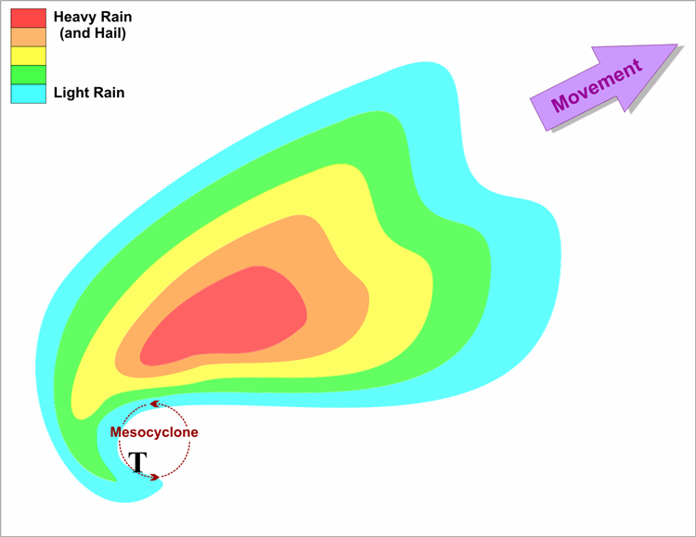
Radar Reflectivity
Tornadoes are located in regions where the radar reflectivity shows a “hook echo”
tornado location
Ahrens & Henson
<= BWER-Bounded Weak Echo Region
https://www.youtube.com/watch?time_continue=17&v=mcWpYY8WcGE

Slide 33
Key Points
Tornado - a rapidly rotating column of air that swirls around a small area of intense low pressure that reaches the ground.
Although a tornado can occur with any type of thunderstorm, the strongest tornadoes are those that occur in supercells.
Supercells from in a very unstable, strongly sheared environment
  Three parts: Forward flank downdraft,
  updraft, and rear flank downdraft
  Tornado forms in mesocyclone updraft

Slide 34
Key Points
Radar signature of tornado
  Hook echo in the reflectivity
  Rapid rotation in wind radial velocity (not covered)
  BWER (Bounded Weak Echo Region)
Most tornadoes occur in the Central U.S. where the geography is conducive to the frequent clashing of three (cP, cT, mT) very different air masses.
Tornado strength is measured by Enhanced Fujita scale (EF0-EF5).
If a tornado warning is issued, know the necessary actions to take to save your life.
Excellent overview on tornadoes from National Geographic
https://video.nationalgeographic.com/video/news/101-videos/00000144-0a31-d3cb-a96c-7b3d903d0000

