Slide 1
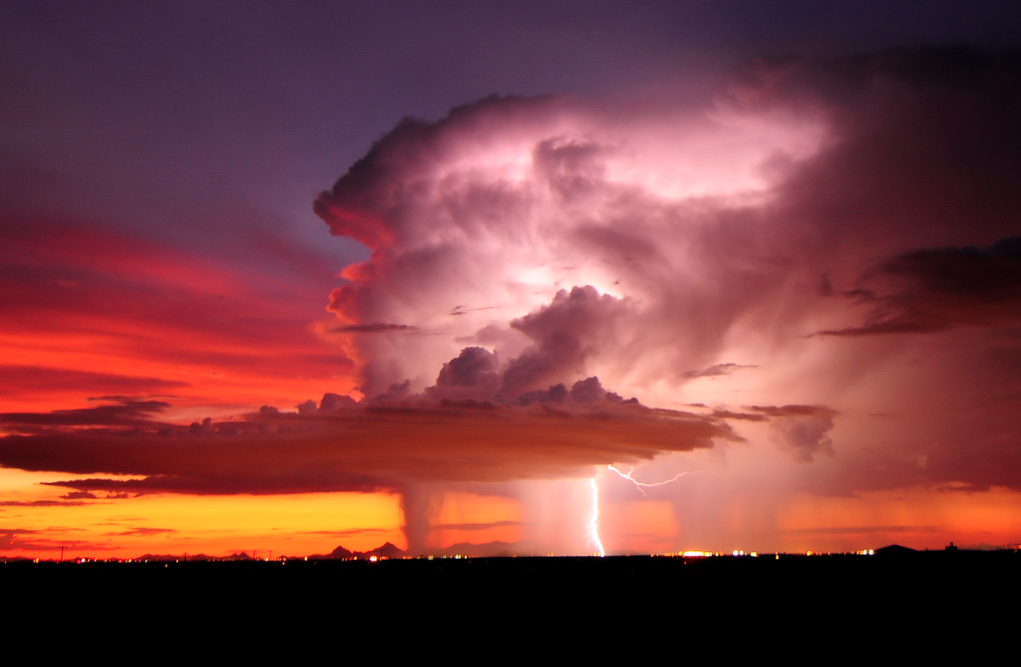

ATMO 170A1
Online
Microburst
Winds
S>
Image credit: Lightning over Tucson AZ John Forrey photo

Slide 2
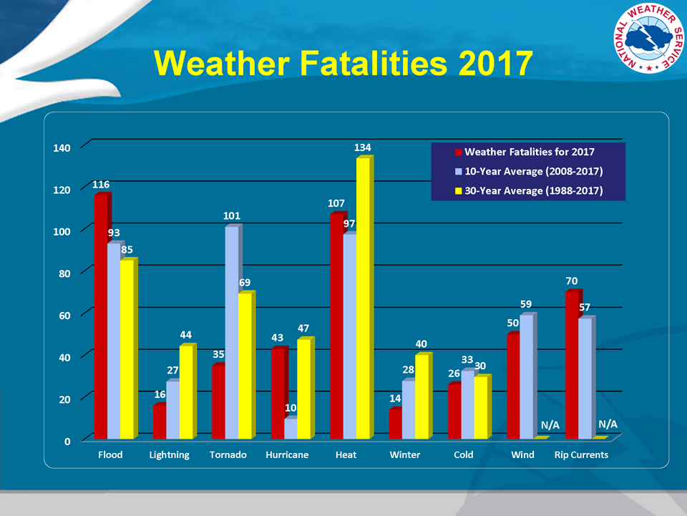
Wind – also a road hazard from reduced visibilities
http://www.nws.noaa.gov/om/hazstats.shtml
Notes:
Not all non-tornadic, wind fatalities are due to thunderstorms.

Slide 3
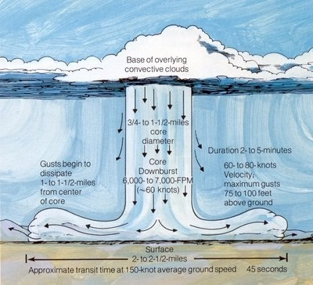
Microbursts
http://nashvillesevereweather.com/
Evaporation of falling raindrops cools air below cloud.
The denser, cooled air accelerates downward.
Weight of the dense raindrops enhances acceleration.
Rapidly falling air hits the ground and fans out as a ring of high winds up to 150 mph in extreme cases.

Slide 4
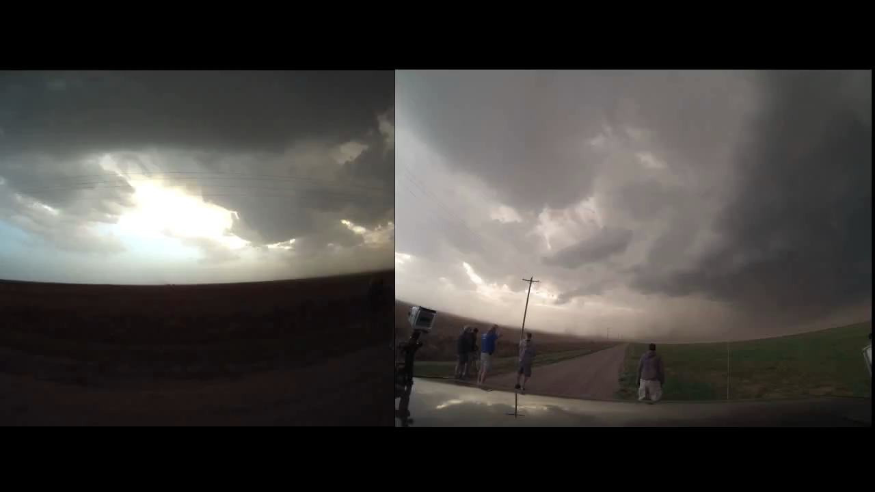
Dry Microburst
Absence of rain shaft that reaches the ground
Dust is often the only visible sign of dry microbursts.
24 May 2013
http://www.youtube.com/
Notes:
Dry Microbursts
Virga, precipitation shaft does not reach the ground.

Slide 5
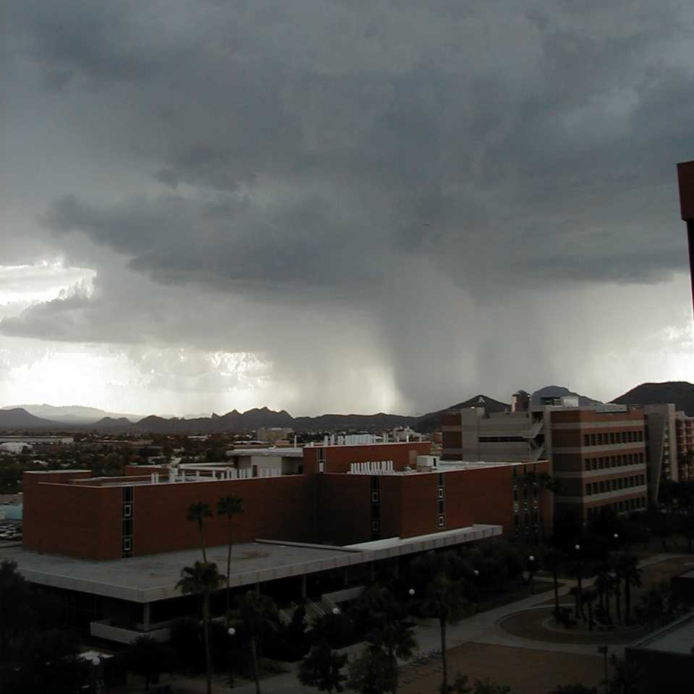
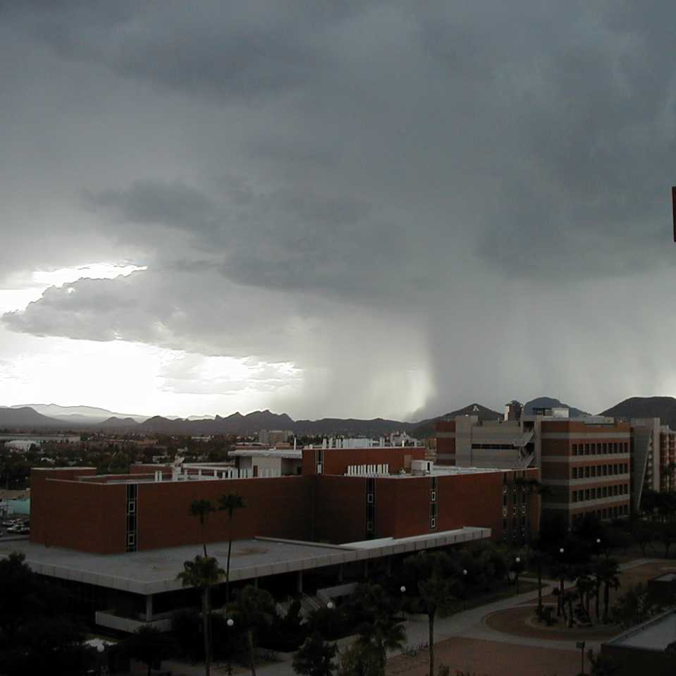
Wet Microburst
Rain Shaft
Credit: M. Leuthold
Credit: M. Leuthold
Time sequence of wet microburst that produced 108 mph winds at Ryan Field on 16 August 1999. Recommended vids…
Tucson microburst: vimeo.com/135811823
Phoenix microburst: vimeo.com/175329108
Notes:
Wet Microbursts
Precipitation shaft reaches the ground.
Falling rain itself contributes significantly to downward acceleration.
More severe than dry microbursts.

Slide 6
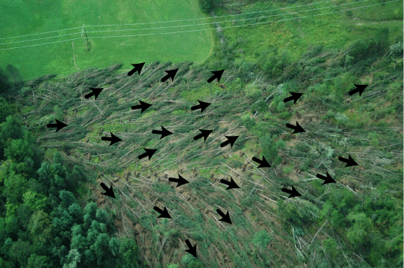
Microburst damage pattern
Damage pattern fans out
http://apollo.lsc.vsc.edu/classes/met130/notes/chapter14/graphics/microburstdamageex1.gif

Slide 7
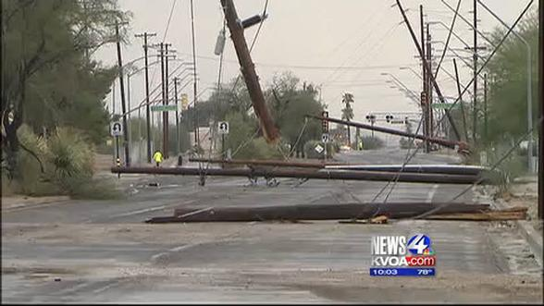
Common damage from microbursts in Tucson

Slide 8
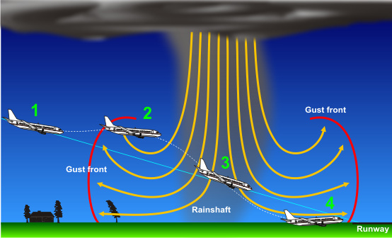
Microbursts are a Hazard to Aviation
4) Tail wind
decreases lift
2) Head wind
increases lift
3) Downdraft forces jet downward
loss of headwind decreases lift
http://www.srh.noaa.gov/jetstream//tstorms/wind.htm

Slide 9
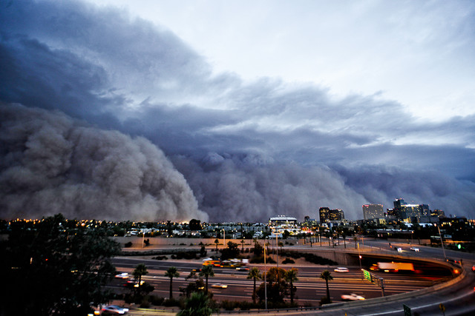

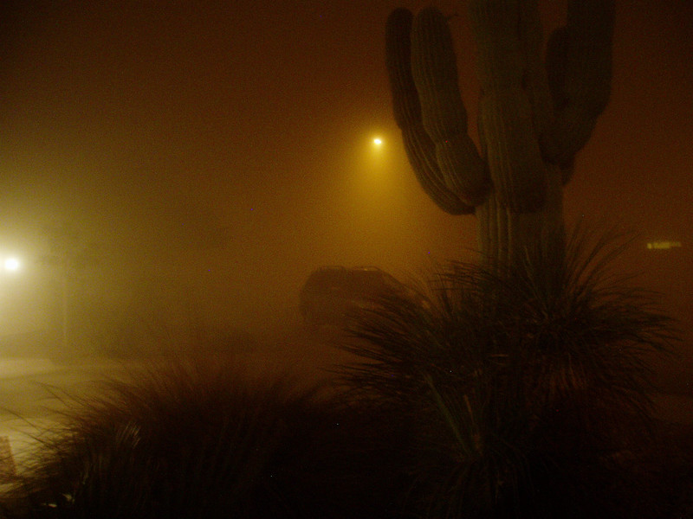
Haboobs
https://vimeo.com/26045314
wunderground.com
Caused by fast winds from the gust front of a thunderstorm.
Common during our summer thunderstorm season, especially when the season begins because the preceding months are so dry.
Very common in Middle East.
Phoenix, Arizona
July 5, 2011
wunderground.com

Slide 10
Summary: Microbursts
Wind gusts from downdraft and gust front can exceed hurricane force
Little risk to people if they take shelter in a building away from windows before the winds start
Disrupts auto travel primarily by reducing visibility
Poses a major risk to aviation sector
Microburst causes much of the damage associated with summertime thunderstorms in Arizona

