Slide 1
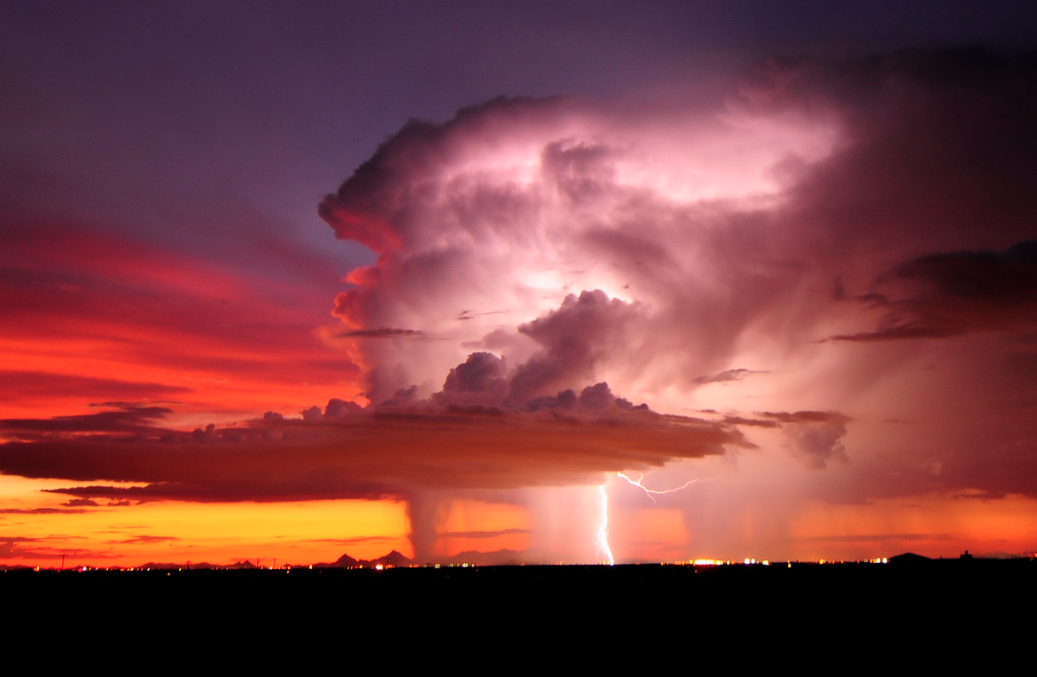

ATMO 170A1
Online
Heavy Rain
Flash Flooding
]
:
Image credit: Lightning over Tucson AZ John Forrey photo

Slide 2
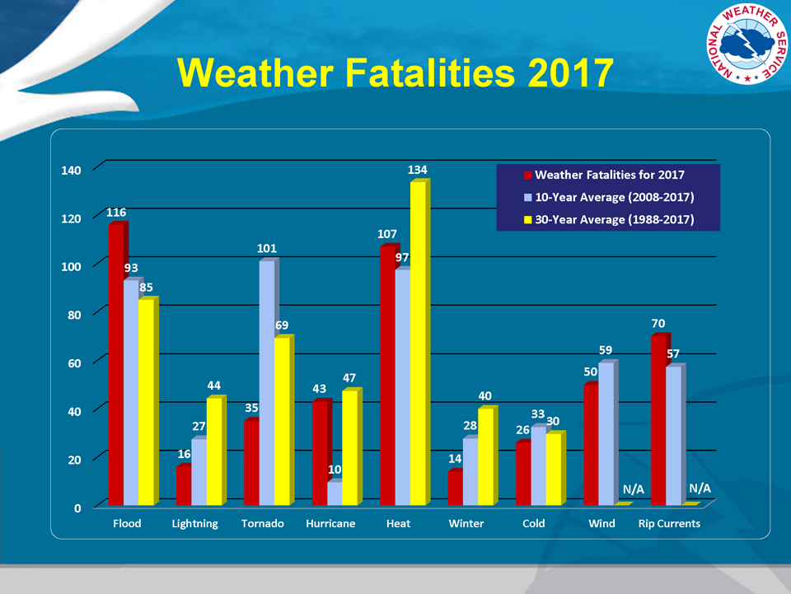
Flooding- consistently one of the biggest killers
http://www.nws.noaa.gov/om/hazstats.shtml
Notes:
Flooding consistently a major killer, only headed by Heat.
Statistics exclude fatalities from coastal storm surges associated with hurricanes.
Flash flooding is a major piece of flooding fatalities.

Slide 3
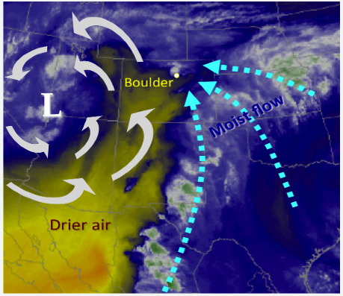
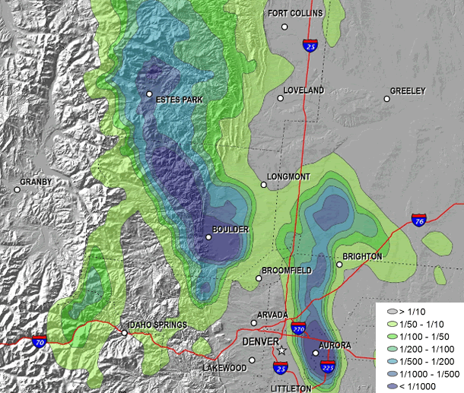
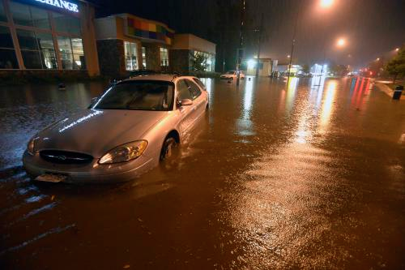
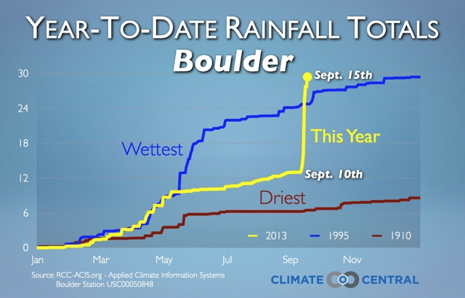
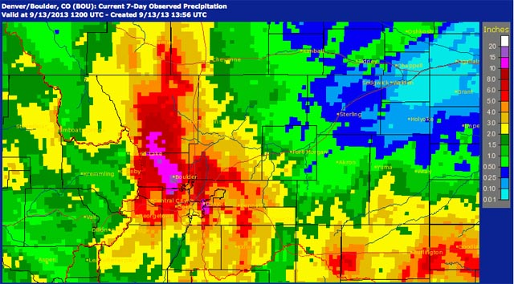
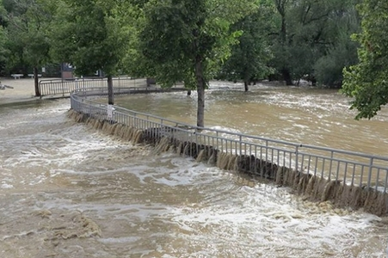
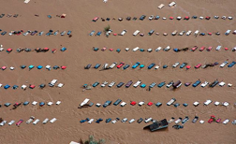
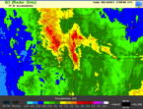
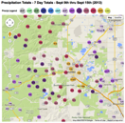
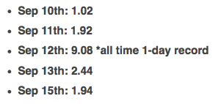
Flooding
Boulder, CO
Sept 9-15, 2013
Exceedance
Probabilities
esrl.noaa.gov
Figure Credit: https://wwa.colorado.edu/resources/front-range-floods/assessment.pdf
dailycamera.com
accuweather.com
Storm rainfall (inches)
Notes:
16” rain over 5 days, majority fell on 9-12-13. (Previous record was 4.80” in 24 hours.)
Fell into “smallish” catchment area.
Record-levels of total water vapor.
“Stalled” weather system.
Low-level flow focused up the eastern slopes of the Front Range of Rockies
Not a convectively driven.

Slide 4
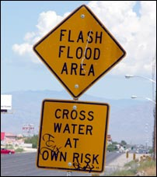
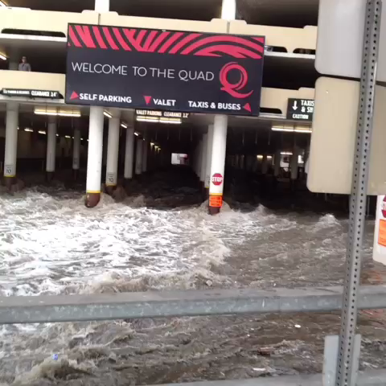

WHEN STREETS OR ARROYOS FLOOD DON’T TRY TO CROSS THEM!!
Figure Credit: https://www.youtube.com/playlist?list=PL755EE86050B3021D
youtube link
Las Vegas
Sept 2014
Southern Utah
July 2012
Notes:
Skip to 0:20 in Utah flood. Note debris at the head of flood waters.
Obey road signs.

Slide 5

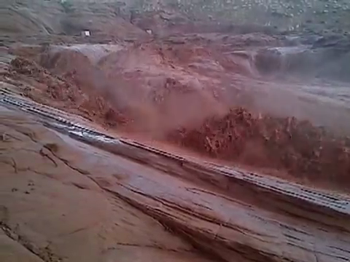
Antelope Canyon
Page, Arizona
Link to Video of 11 August 2013:
https://www.youtube.com/watch?v=m44gkjMukP0
Link to Antelope Canyon Picture:
http://www.bobestrin.com/antelopecanyon.htm

Slide 6
Summary: Flash Flooding
Poses negligible risk if you stay out the arroyos.
Obey do not enter signs in front of running arroyos.
Never cross an arroyo of unknown deep in a car. Just 6”-8” of water can cause a small car to lose traction and be pushed into the deeper waters.

