Slide 1
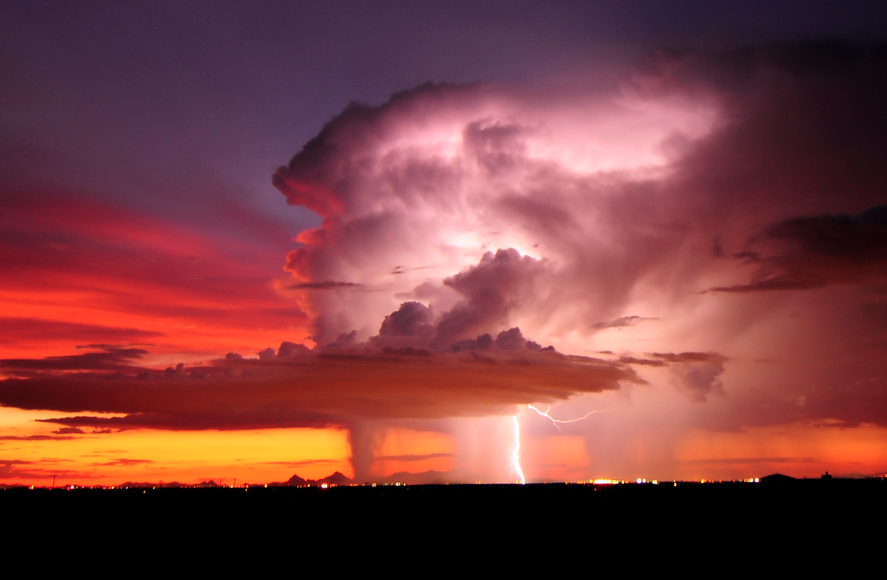

ATMO 170A1
Online
Hail
Image credit: Lightning over Tucson AZ John Forrey photo

Slide 2
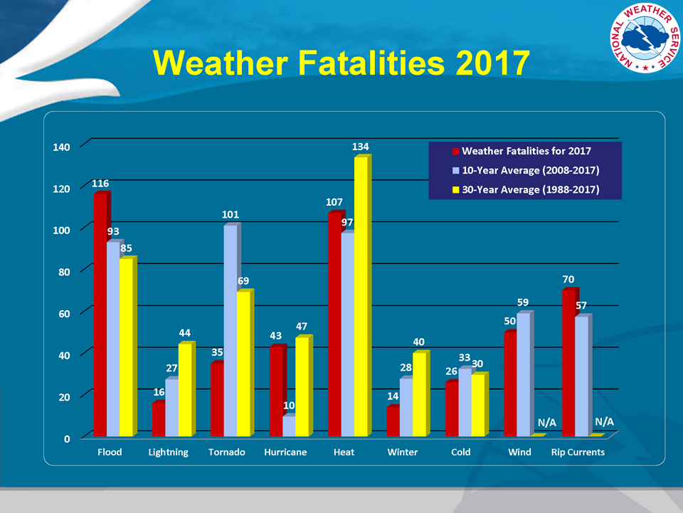
Hail-Fatalities are rare but crop damage can be catastrophic
http://www.nws.noaa.gov/om/hazstats.shtml

Slide 3
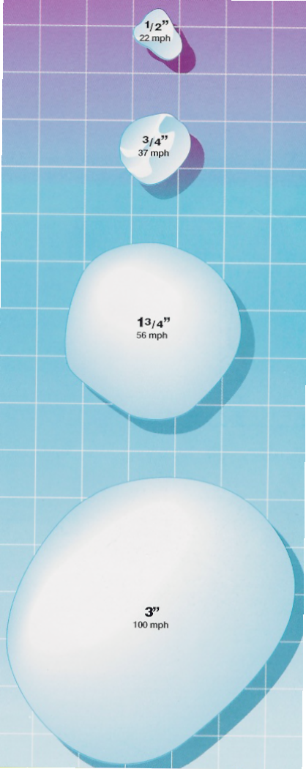
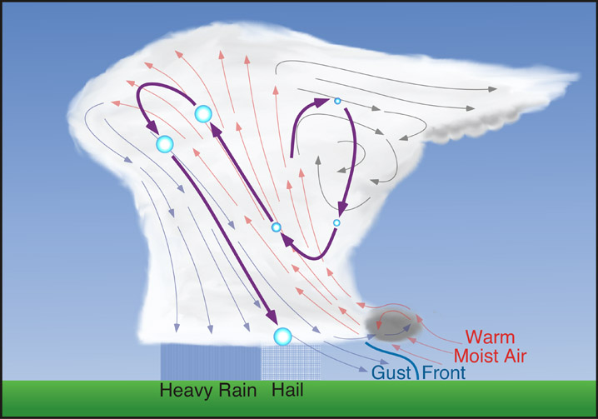
Hail
1/2”
22 mph
3/4”
37 mph
Cycles of Uplift and Falling Back into Updraft
2”
56 mph
http://www.physicalgeography.net
Ice particles are repeatedly cycled inside thunderstorm
Size related to updraft speed 3” hail -> 100 mph fall speed
Hail poses a major economic threat to agriculture
3”
100 mph
Williams, The Weather Book

Slide 4
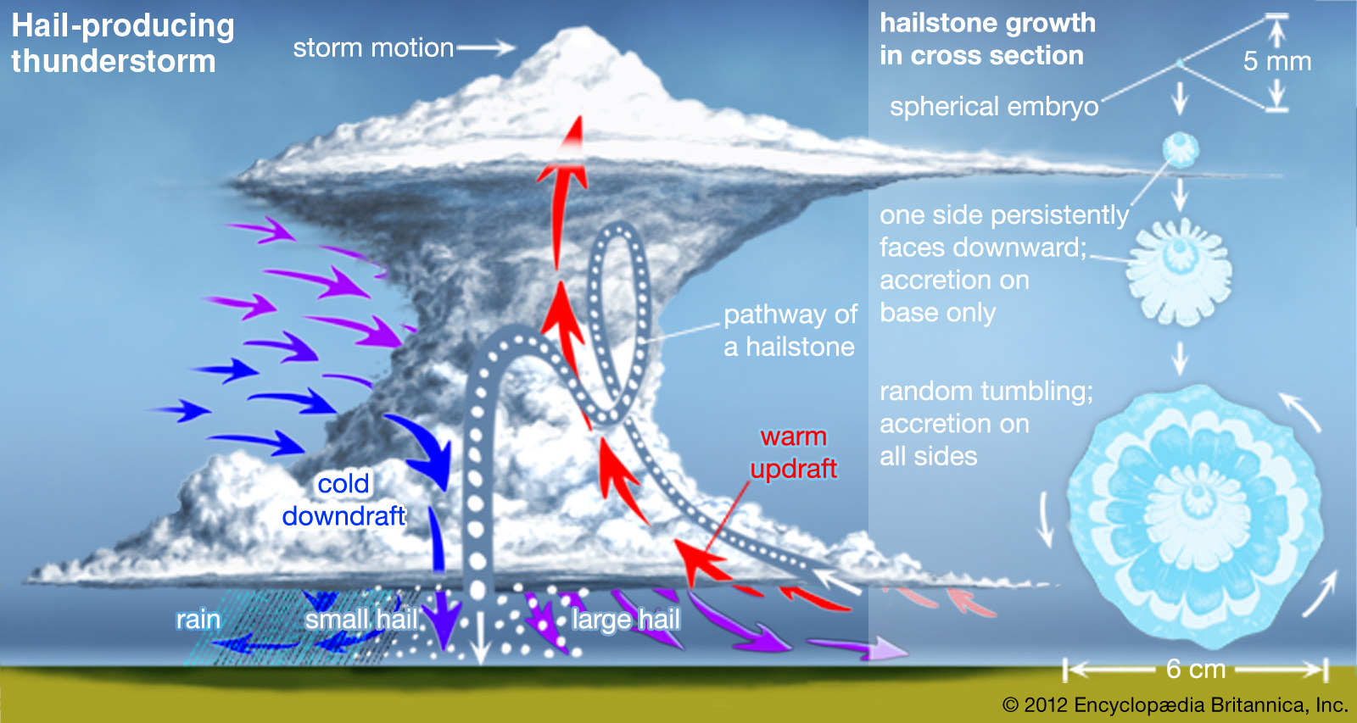
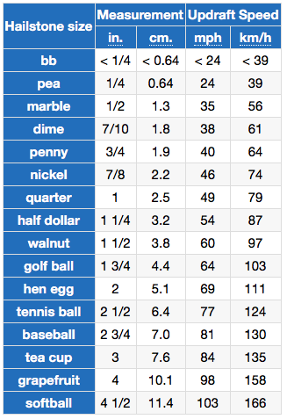
Hail
Formation
Requires strong, tilted updraft
Ice may make multiple vertical loops inside thunderstorm
Size related to updraft speed 3” hail -> 80 mph fall speed
Hail poses a major economic threat to agriculture
Table Credithttps://awww.weather.gov/jetstream/hail
Notes:
Hail formation requires
Strong, tilted updraft.
An ice embryo falls and grows, rises and grows, falls again and grows…growing with each cycle.
Vertical cycling can repeat multiple times, until the hailstone can no longer be supported by the updraft.
Baseball size hail (~3”) requires ~80 mph updraft. See table to the right.
Hail poses a major economic threat to agriculture and transportation.

Slide 5
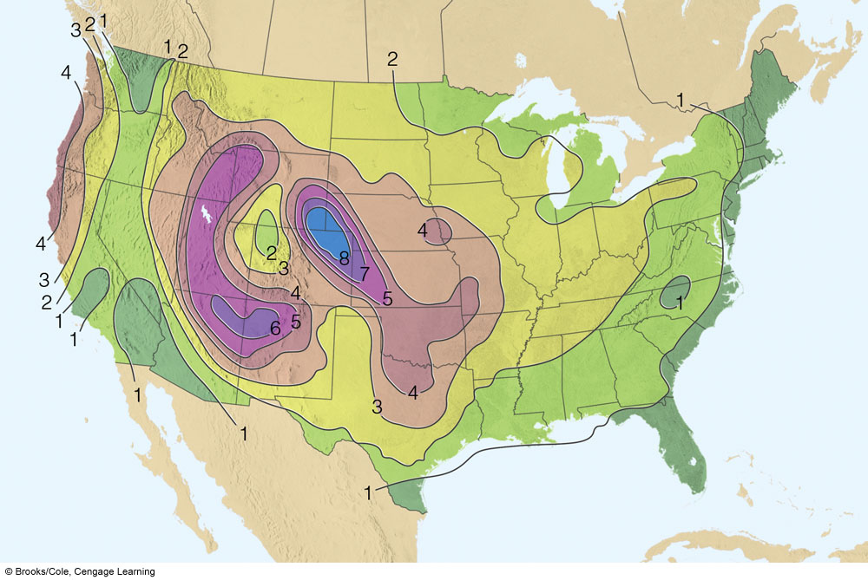
Annual Average Days with Hail
Ahrens, Fig 10.27 Met. Today
Maxima: High Plains and Four Corners
Hail preferentially occurs over high terrain

Slide 6
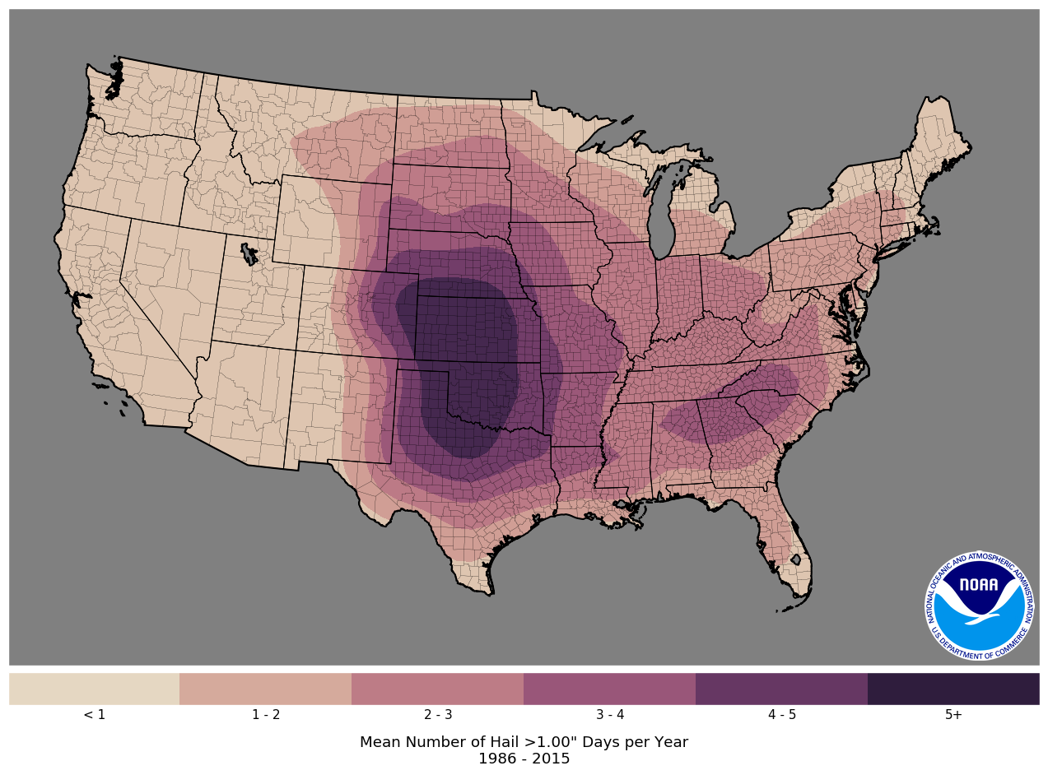
Annual Number of Hail >1” Days
Credits: NOAA/NWS Storm Prediction Center
http://climate.ok.gov/index.php/climate/map/1.00_inch_hail_days_1986_2015
Maximum Occurrence Southern Plains

Slide 7
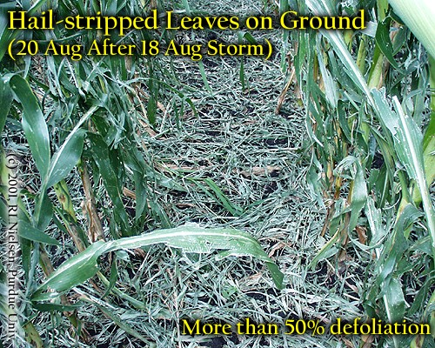
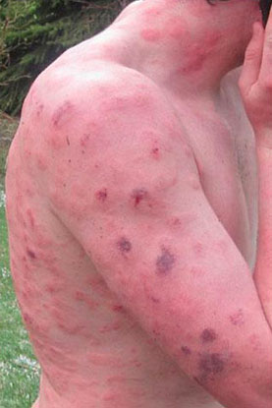
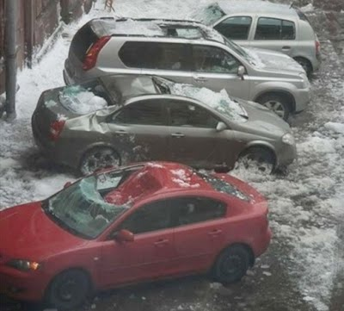
Hail Damage
Corn Damage
http://www.agry.purdue.edu/ext/corn/news/articles.01/Images/Hail_P8200015.jpg
Bad Day for Good Hands People
Jogger who encountered hail … allegedly
http://realneo.us/system/files/images/100408_hail_hits_jogger.jpg
http://4.bp.blogspot.com/_G3R4xrEhSpE/S6ygRaLsFqI/AAAAAAAABPU/ecPutpzJV7Q/s400/HailStormDamage.jpg

Slide 8
Severe Hailstorms Do Occur in Arizona
Video of 2-3” hail near Scottsdale Airport in October 2010.
https://www.youtube.com/watch?v=DuMX9AM9BrE
https://en.wikipedia.org/wiki/October_2010_Arizona_tornado_outbreak

Slide 9
Summary: Hail Risks
Hail – Ice hydrometeor. Diameter can exceed 6”. Size depends on updraft speed.
Forms by the vertical cycling of ice hydrometeors inside the cumulonimbus.
Poses little risk to people if they take cover
Exposed livestock at higher risk though
Disrupts transportation
Damages cars, planes and infrastructure
Large hail can inflict major damage to crops and lead to total loss of a season’s harvest

