Slide 1
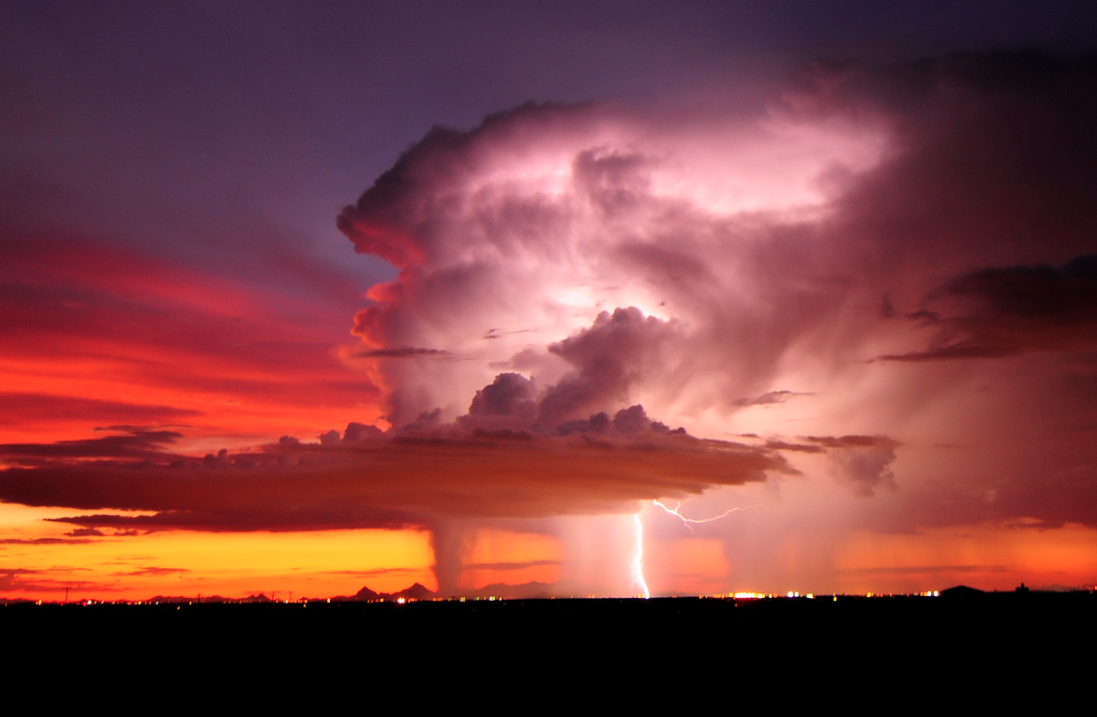

ATMO 170A1
Online
Thunderstorm Hazards
Lightning
Hail
Heavy Rain
Winds
Tornadoes
●/✽
]
:
Image credit: Lightning over Tucson AZ John Forrey photo

Slide 2
Thunderstorm Hazards
Lightning
Hail
Heavy Rain & Flash Flooding
Microburst Winds (aircraft very vulnerable)
Tornadoes
Turbulence and Icing (aviation)
Visibility

Slide 3
Thunderstorm Hazards
Lets examine more closely a few of the hazards associated with (usually severe) thunderstorms

Slide 4
ATMO 170A1
Online
H&P §11.3
Lightning
●/✽
Image credit: Lightning over Tucson AZ John Forrey photo

Slide 5
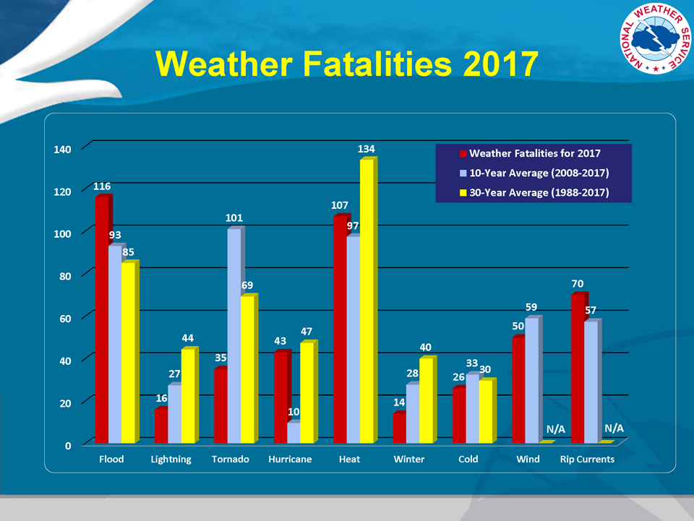
Lightning - poses a major danger in Arizona during the summer
http://www.nws.noaa.gov/om/hazstats.shtml

Slide 6
Lightning Basics
What is lightning?
An electric discharge, or spark, that occurs in thunderstorms (usually)
80% occurs within clouds
20% occurs between cloud and ground
Lightning is ubiquitous, with more than 6,000 ground strikes per minute from 40,000 thunderstorms per day worldwide

Slide 7
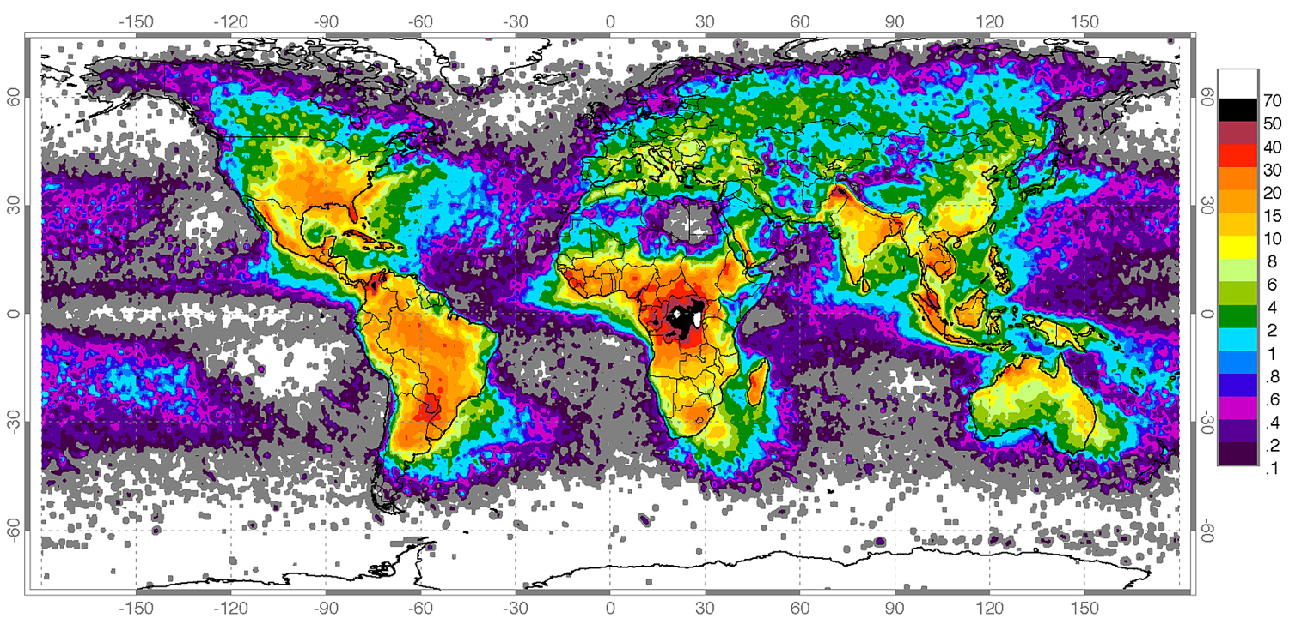
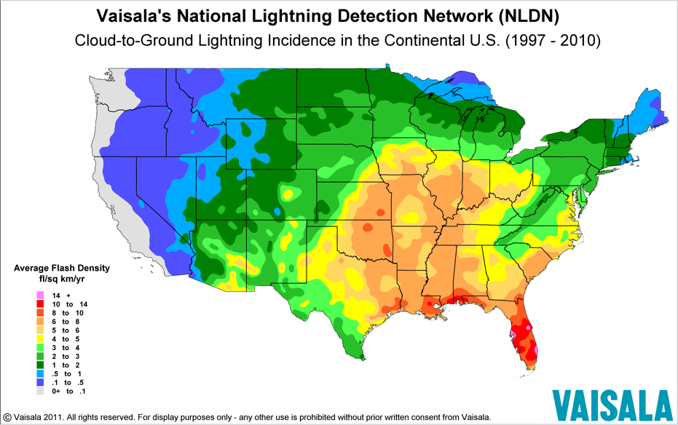
Frequency of Lightning Strikes
1995-2003
⚡️ Tucson 4 per km² per year
⚡️ Florida has 3x-4x CG of Tucson
http://en.wikipedia.org/wiki/Lightning_strike
Lightning is a warm air, land phenomena.

Slide 8
Charge Separation
Lightning requires the separation of different charges into different regions of a cloud.
How does charge separation in clouds occur?
We don’t know every detail with 100% certainty, but we observe:
- Lightning occurs in cold clouds with supercooled droplets and temperatures below -10ºC (15ºF).
- Hence, ice crystal processes that are responsible for precipitation in cold clouds undoubtedly play an critical role in charge separation.

Slide 9
Thermoelectric Effect in Ice
Idea: A separation in charge occurs when there is a temperature difference across ice
ICE BLOCK
−
+
WARMER TEMPERATURE
Higher number of negative ions
NEGATIVE CHARGE
COLDER TEMPERATURE
Higher number of positive ions
POSITIVE CHARGE
Notes:
Water molecule alignment leads to charge polarity

Slide 10
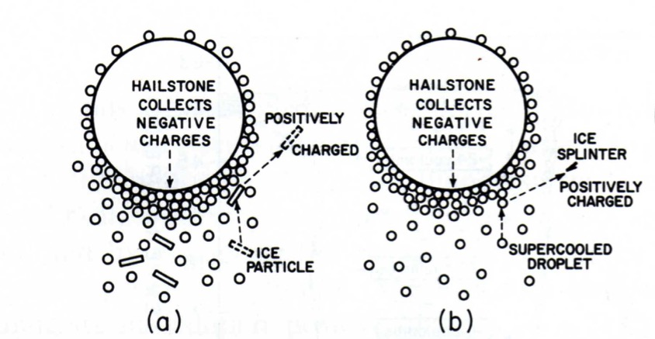
Charging of ice crystals
Consider a hailstone falling in a cloud updraft
(Wallace and Hobbs)
Hailstone collides with a colder ice particle or supercooled cloud drop.
When collision occurs:
The warmer hailstone becomes negatively charged and FALLS.
The colder ice particles become positively charged and RISE.
NET RESULT: TOP PART OF CLOUD IS POSITIVELY CHARGED
BOTTOM PART OF CLOUD IS NEGATIVELY CHARGED

Slide 11
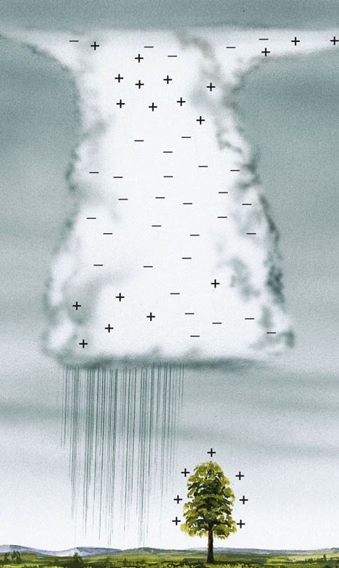
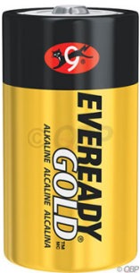
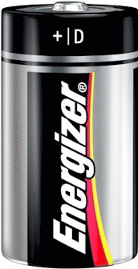
Charge Separation
+
Polarization
Upper/lower cloud top has a positive/negative charge
Charge separation in cloud maintains the earth’s fair weather electric field denoted by the arrow E
Negative charge at cloud bottom attracts positive charge at ground
3·10^{–12} A·m^{–2} 150 V·m⁻¹
E
–
Ahrens & Henson

Slide 12
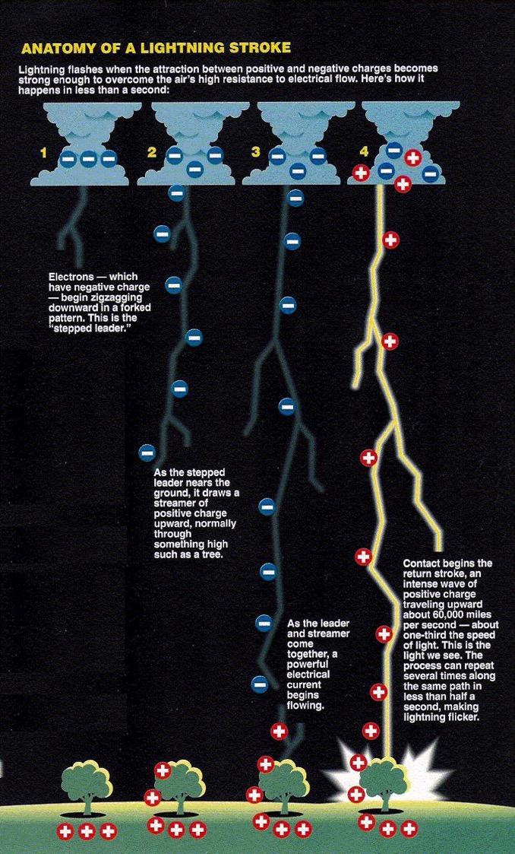
Lightning Stroke
Negative Cloud-to-Ground Sequence
- Downward stepped leader.
Stepped leader is invisible.
- Upward visible return stroke.
- Downward dart leaders.
Dart leaders are invisible.
- Upward return strokes.
Return strokes are visible
Dart leaders-return strokes: Up to 25 cycles; 3-4 usually.
Ground strikes are usually negative, i.e. electrons flow from cloud to ground.
Slow Mo Video of Lightning Strike
http://gizmodo.com/watching-lightning-strike-a-building-in-super-slow-moti-1795726758
(May need to C&P URL into browser)
Williams, The Weather Book

Slide 13
Summary: Key Points
Lightning - electric discharge in thunderstorms
80% stays in cloud/sky, 20% cloud/sky to ground
Ubiquitous, with more than 6,000 cloud-to-ground strikes per minute from more than 40,000 thunderstorms per day worldwide.
A warm season, land phenomenon.
Requires the separation of different charges into different regions of cloud.
Causes ~20-30 fatalities per year in U.S.

