Slide 1
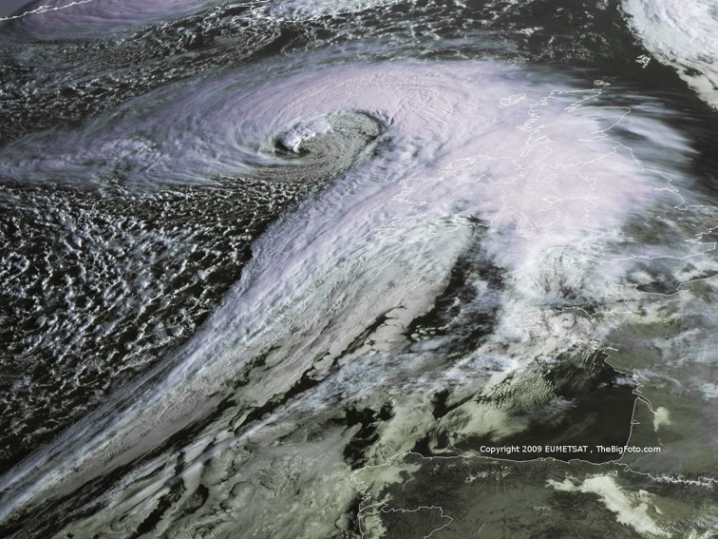

ATMO 170A1
Online
Mid-Latitude Cyclones
§10.3 H&P
Visible image of a deep cyclone over the North Atlantic Ocean

Slide 2
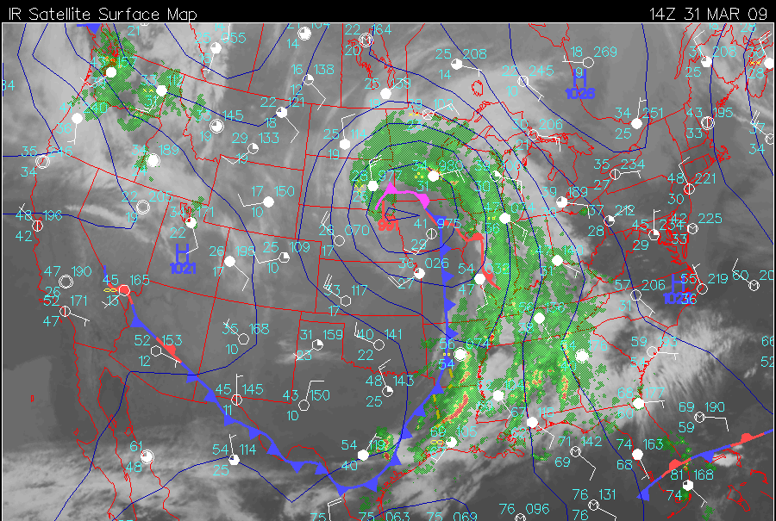
Is cyclone L a) deepening b) filling c) little change
L₉₉₁

Slide 3
Let’s figure out how to answer the question
L₉₉₁

Slide 4
How do extratropical cyclones develop?

Slide 5
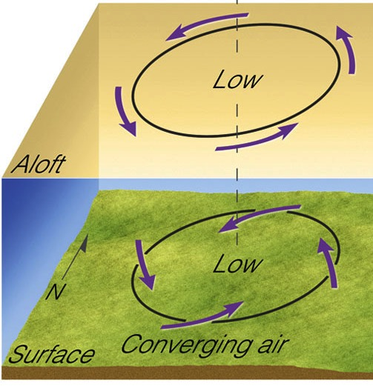

What doesn’t work… Upright Vertical Alignment
Such a vertical alignment cannot develop a cyclone.
It can only fill a surface low (raise surface pressure).
no divergence
mass gain
mass flows into cyclone
SFC pressure rises
Ahrens & Hanson

Slide 6
There must be upper-level divergence over a surface low to deepen it… and the divergence must exceed the convergence into the surface low.

Slide 7
Review: Where are UL Winds Divergent?
To understand surface low development, you must understand dynamics aloft.
faster winds
Ridge
Divergence
Trough
Region downwind of a trough is the region that is conducive to forming surface cyclones.
slower winds
Divergence aloft removes mass from the atmosphere underneath it, causing
surface pressure to fall.
=>
Lows intensify underneath areas upper-level divergence, or downwind upper-level troughs.

Slide 8
What Increases Divergence #1?
faster winds
Ridge
Divergence
Trough
Stronger PGF. Faster winds require larger centripetal accelerations (V²/r).
Divergence stronger along axis of jet stream.
slower winds

Slide 9
What Increases Divergence #2?
faster winds
Ridge
Divergence
Trough
Higher amplitude waves. Sharper curvature requires larger centripetal accelerations.
Divergence stronger downwind of higher amplitude troughs.
slower winds

Slide 10
What Increases Divergence #3?
faster winds
Ridge
Divergence
Trough
Shorter wavelengths. Sharper curvature requires larger centripetal accelerations.
Divergence stronger downwind of shortwave troughs.
slower winds

Slide 11
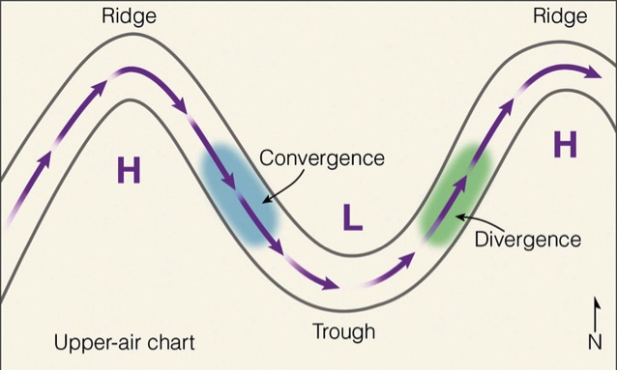
Summary of Divergence Aloft
Divergence is largest…
Where wind speeds are fast (jet stream)
Downwind of deep troughs
Downwind of shortwave troughs
Favored Region
Ahrens & Hanson, Met. Today
Divergence in the upper troposphere is what removes mass from an air column so pressure falls at the surface

Slide 12
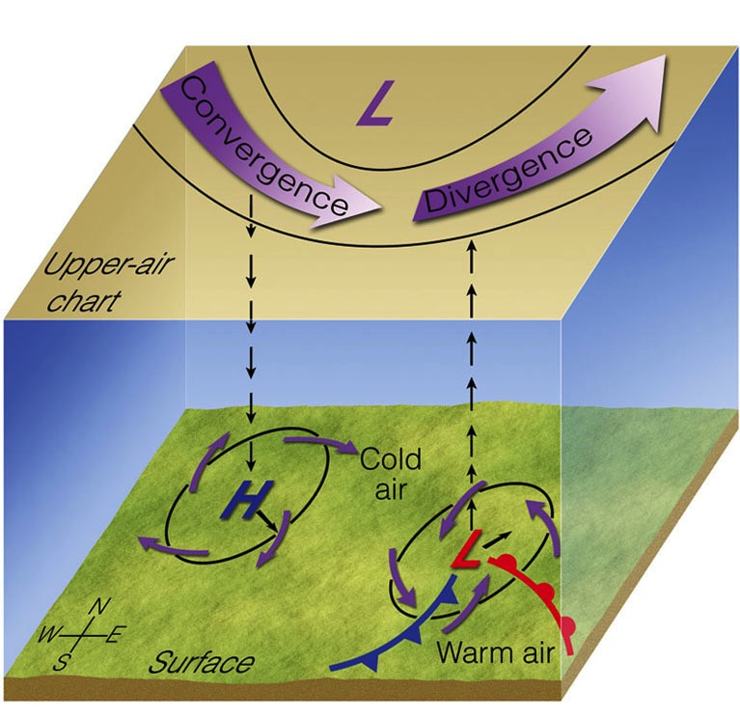
Vertical Structure that Deepens a Surface Cyclone
Cyclone deepens only if divergence aloft exceeds convergence into low
A trough that tilts westward with height places the upper-level divergence over the surface low
Results in low deepening
Trough must tilt westward to deepen the low. Only this vertical alignment works!
TILT
Ahrens & Hanson

Slide 13
Why do extratropical cyclones exist?
Disperse air around the planet
Weaken jet stream wind speeds
Transport clouds (and rain) inland
Weaken equator-to-pole temperature differences
Give weather enthusiasts (like me) something to do
Notes:
OUT of PLACE?

Slide 14
Why do extratropical cyclones exist?
Disperse air around the planet
Weaken jet stream wind speeds
Transport clouds (and rain) inland
Weaken equator-to-pole temperature differences
Give weather enthusiasts (like me) something to do
Notes:
OUT of PLACE?

Slide 15
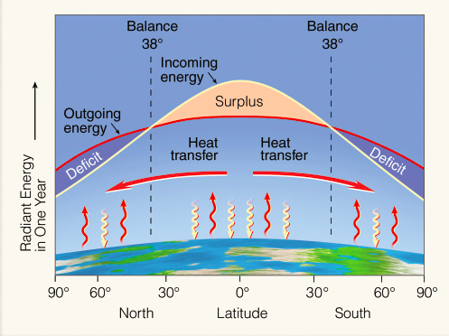
Ahrens & Hanson
Most of the poleward heat transport in the middle latitudes is done by cyclones, with some contribution by the oceans

Slide 16
So why do they exist?

Slide 17
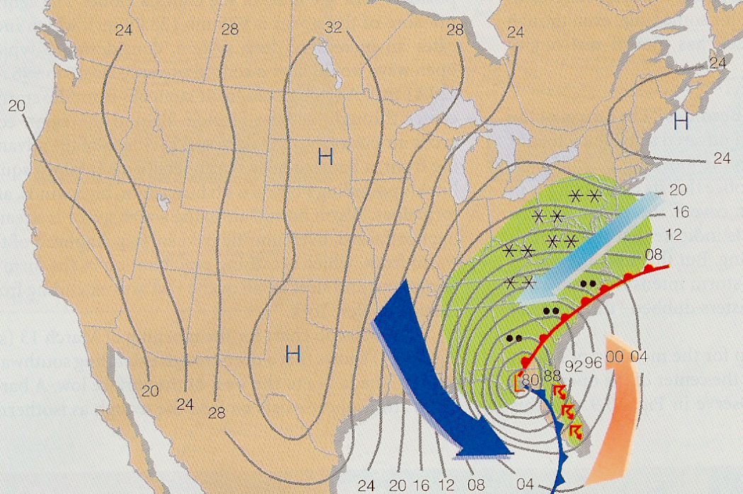
Storm of Century
mT air moves poleward cP air flows equatorward Transports heat poleward
Cyclones act to weaken the equator to pole temperature contrast
mP
cP
930313/0900
mT
Ahrens, Met. Today, 5th Ed.

Slide 18
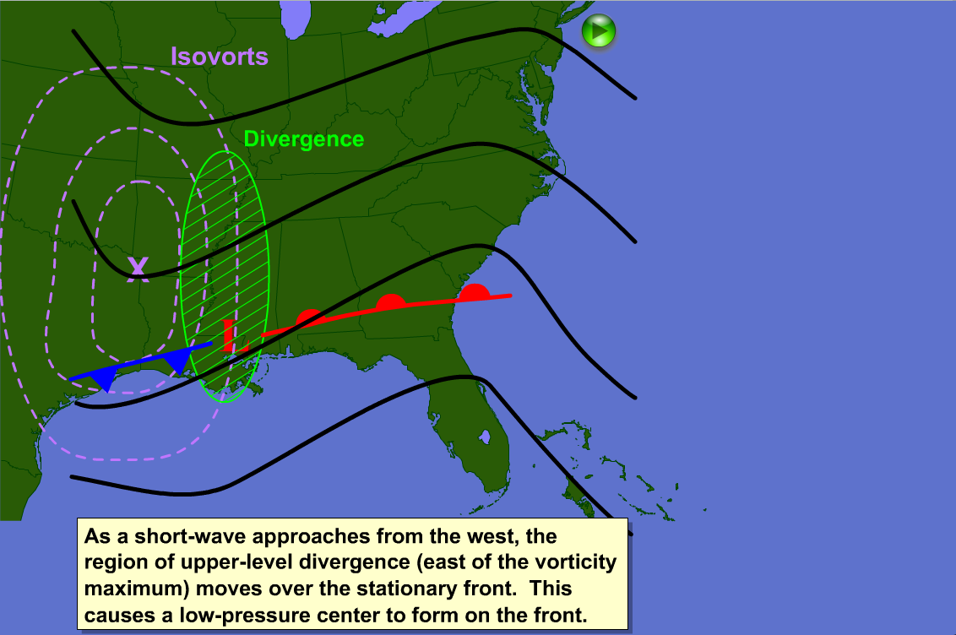
Life Cycle of Mid-Latitude Cyclone
http://www.atmo.arizona.edu/~mullen/atmo170A1/flash/
MLcyclone.swf
On D2L
Content>Supplemental Reading>Module 2: Dynamics>PSU Cyclogenesis Applet
Or
Content>Supplemental Reading>Module 2: Dynamics>PSU Cyclogenesis Applet & SLM narrative
Applet credit: www.e-education.psu.edu

Slide 19
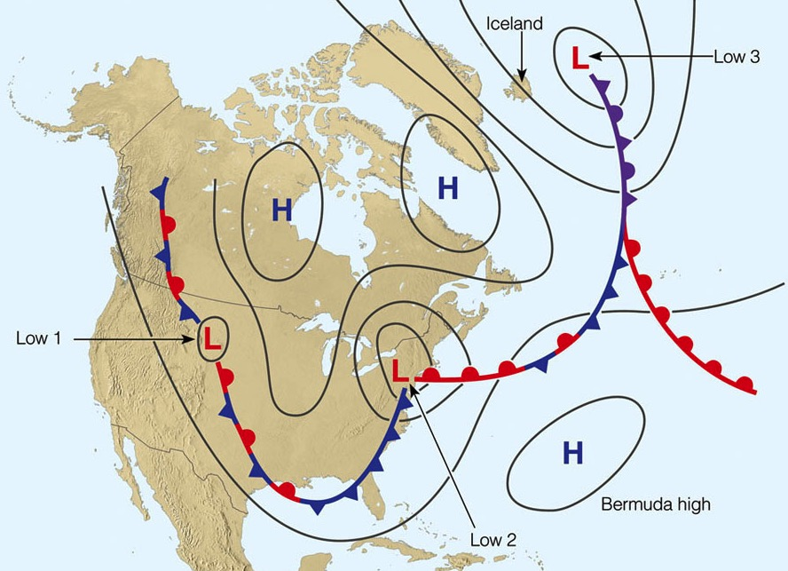
Cyclone Family
Parent
jet stream axis
Child
Grand Child
Animation
Ahrens & Hanson

Slide 20
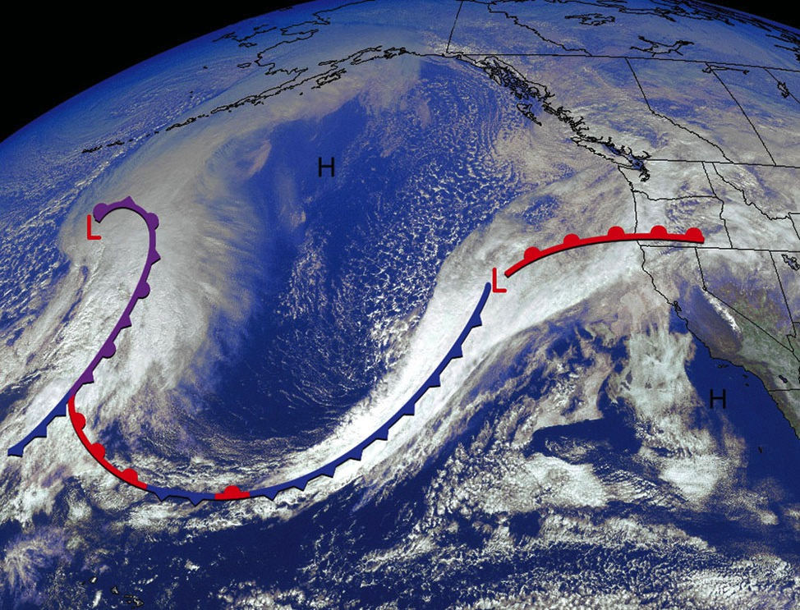
Pacific cyclone family
North Pacific Cyclone Families February 2000
Ahrens & Hanson, Met. Today

Slide 21
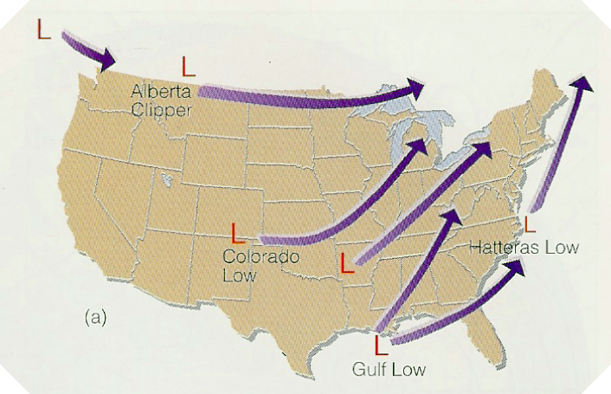
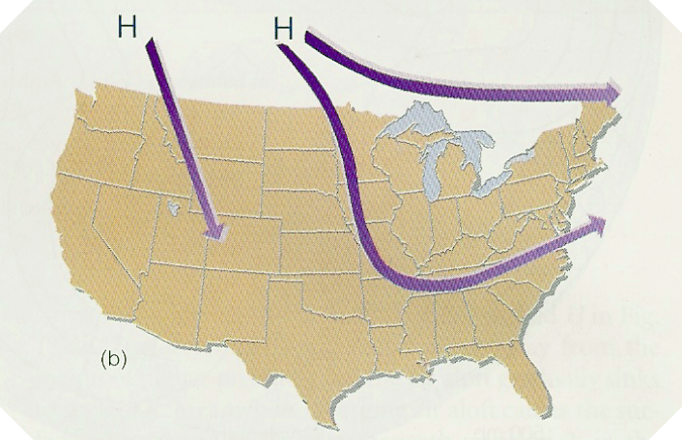
Where Do Cyclones Form and Track?
Ahrens
Cyclones Form Over
Along the Lee of Rockies Eastern Colorado, Alberta
Warm Coastal Ocean Regions Gulf of Mexico, East Coast
Anticyclones Form or Come From
Northern Canada (cP air)
North Pacific Ocean (mP air)

Slide 22
Back to the original question.

Slide 23
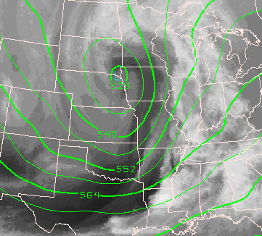
Which location would have the largest upper-level divergence?
A
D
B
C

Slide 24
Which location would have the largest upper-level divergence?
A
D
B
C

Slide 25
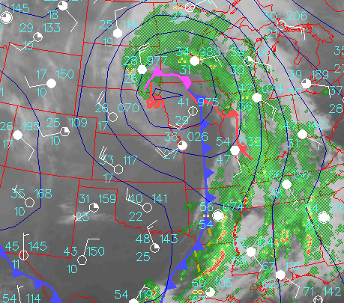
Is the surface cyclone
a) deepening b) filling c) little change
A
L
991
D
B
C

Slide 26
Is the surface cyclone
a) deepening b) filling c) little change
A
L
991
D
B
C

Slide 27
Summary: Extratropical Cyclones
Cyclone definition Circulation around a low pressure center
Most cool-season weather is associated with Extratropical Cyclones
Affect an area order of 1000 km x 1000 km. Extend through the depth of troposphere Large spatial extent

Slide 28
Summary: Extratropical Cyclones
ET cyclones derive their energy from Horizontal temperature contrasts
They form on a boundary between a warm and cold air mass, near the jet axis Form along fronts
Transport warm air poleward and upward and cold air equatorward and downward Transport heat poleward

Slide 29
Summary: Extratropical Cyclones
Follow a similar lifecycles
Form underneath areas of UL divergence, downwind of UL troughs
Surface low center tends to move in the direction of 500 mb flow
Cyclones create new frontal zones that serve as breeding grounds for future ET cyclones

Slide 30
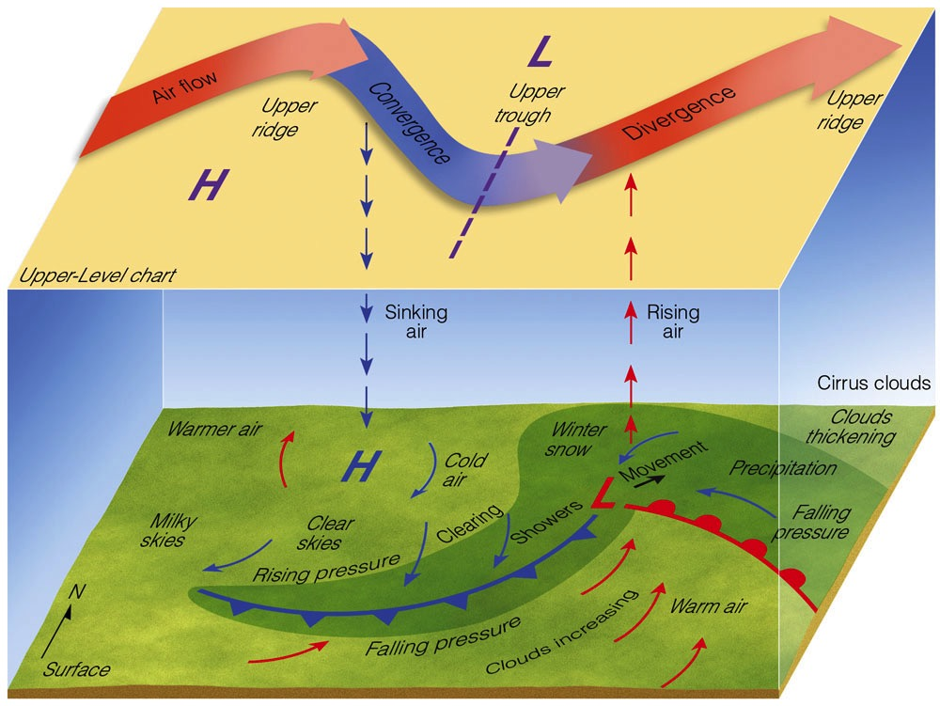
Summary
Ridge Tilt
Trough Tilt
Ahrens & Hanson

Slide 31
Summary: Frontal Weather
L
Temp: Slow Warming
Press: Falling
Wind: E-SE
Dew Pt: Rising
Sky: Lowering Ceiling
Wx: Precip, Low Vis
Air Mass: mP (cP)
Temp: Rapid Cooling
Press: Rapid Rising
Wind: W-NW
Dew Pt: Falling
Sky: Clearing
Wx: Improving
Air Mass: cP (mP)
Temp: Warm
Press: Steady
Wind: S-SW
Dew Pt: High
Sky: Variable
Wx: Showers
Air Mass: mT (cT)

Slide 32
This ends the discussion of cyclones and the topics of Module #2.

