Slide 1
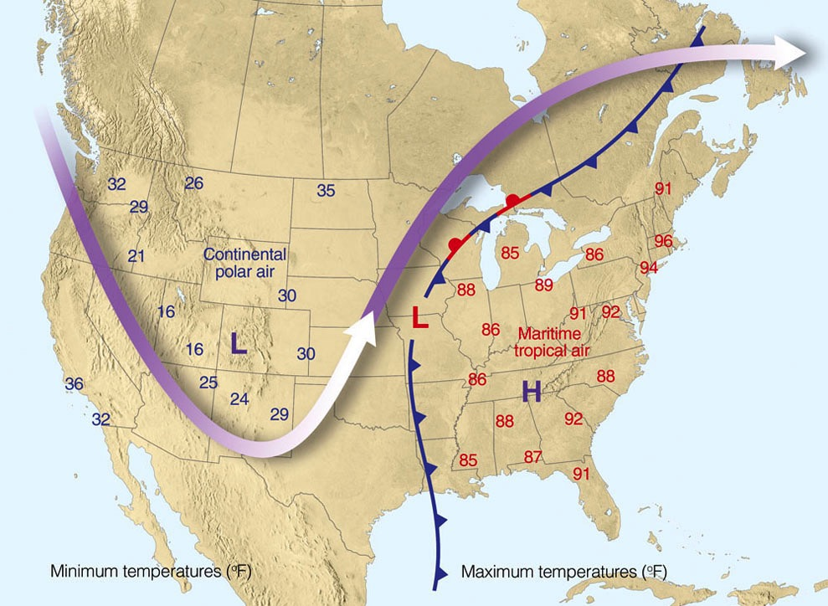

ATMO 170A1
Online
Fronts
§10.2 H&P
17 Apr 1976
Ahrens & Hanson

Slide 2
Goals for Fronts
Learn four types of fronts
Weather associated with each type of fronts
How to find fronts on weather maps

Slide 3
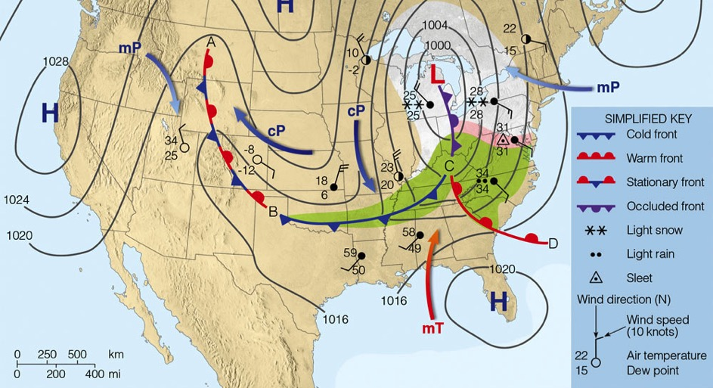
Four types of fronts
Ahrens & Hanson
COLD FRONT: Cold air overtakes warm air. B to C
WARM FRONT: Warm air overtakes cold air. C to D
OCCLUDED FRONT: Hybrid of cold and warm front. C to L
STATIONARY FRONT: No movement of air masses. A to B

Slide 4
Characteristics of a front
Large temperature changes over a short distance
Large changes in moisture content
Wind shifts across the front
Lie along a pressure trough
Similar sequencing of clouds and precipitation type
We’ll see how these characteristics manifest themselves for fronts in North America…

Slide 5
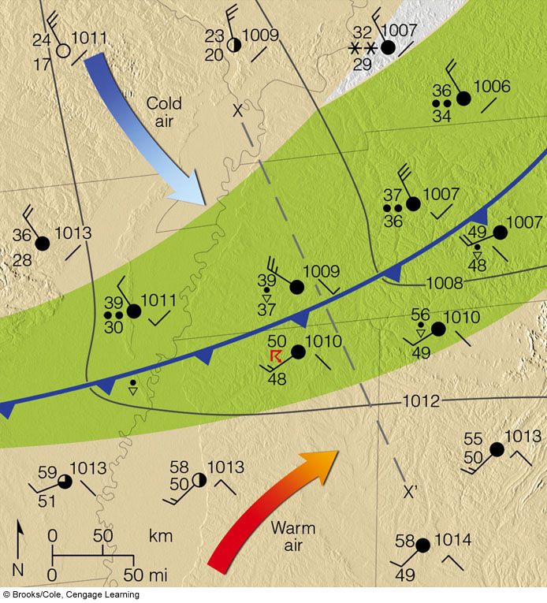
2) Frontal Passage
Pressure Trough
Abrupt Wind Shift
Rapid Temp Fall
Rain, T-Showers
3) Post-Cold Front
Temp: Rapid Cooling
Press: Rapid Rising
Wind: W-NW
Dew Pt: Lowering
Sky: Clearing
Wx: Drying
1) Pre-Cold Front
Temp: Warm
Press: Steady/Falls
Wind: S-SW
Dew Pt: High
Sky: Variable
Wx: Showers
2D view
3D view
Ahrens & Hanson

Slide 6
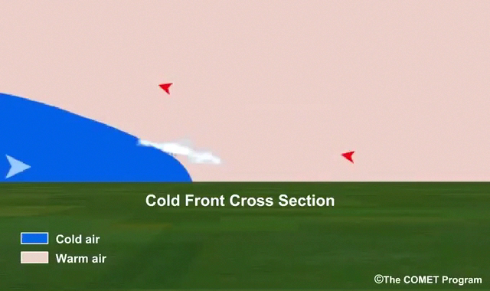
Cold Front
mT
cP

Slide 7
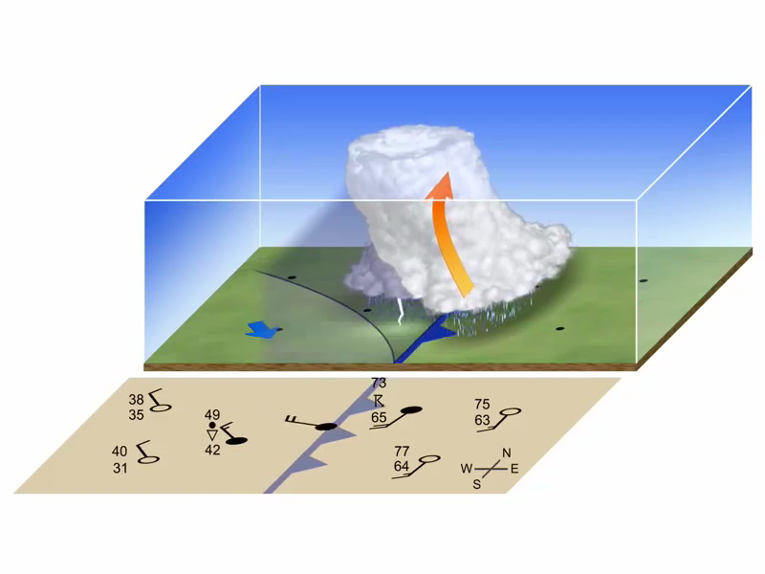
Ahrens & Hanson

Slide 8
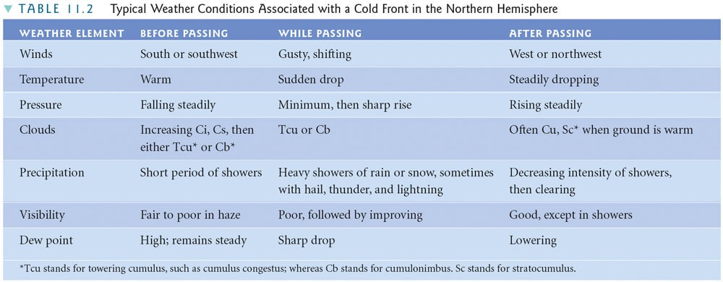
Typical Cold Front Weather
Suggestion: study at home

Slide 9
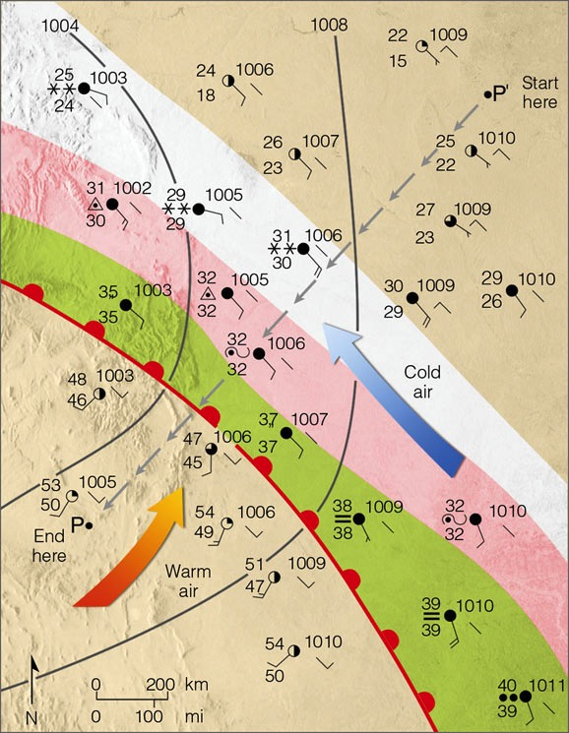
2) Frontal Passage
Press: Falls Slowdown
Wind: Gradual Shift
Temp: Warming Slows
Wx: Rain Ends
1) Pre-Warm Front
Temp: Warming
Press: Falling
Wind: E-SE
Dew Pt: Rising
Sky: Lowering Ceiling
Wx: Widespread Precip
3) Post-Warm Front
Temp: Warm/Steady
Press: Steady/Rises
Wind: S-SW
Dew Pt: High
Sky: Variable
Wx: Showers
2D view
3D view
Ahrens & Hanson

Slide 10
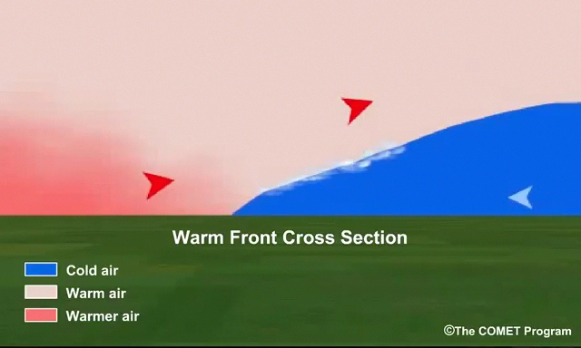
Warm Front
cP
mT

Slide 11
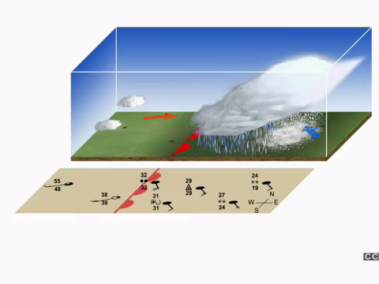
Ahrens & Hanson

Slide 12
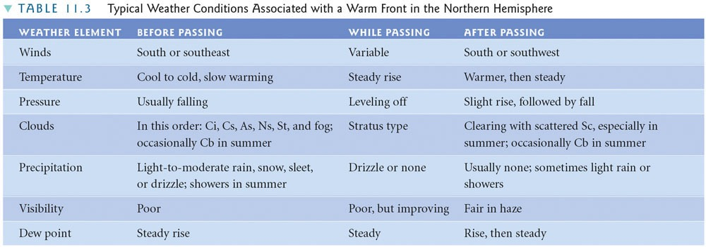
Typical Warm Front Weather
Suggestion: study at home

Slide 13
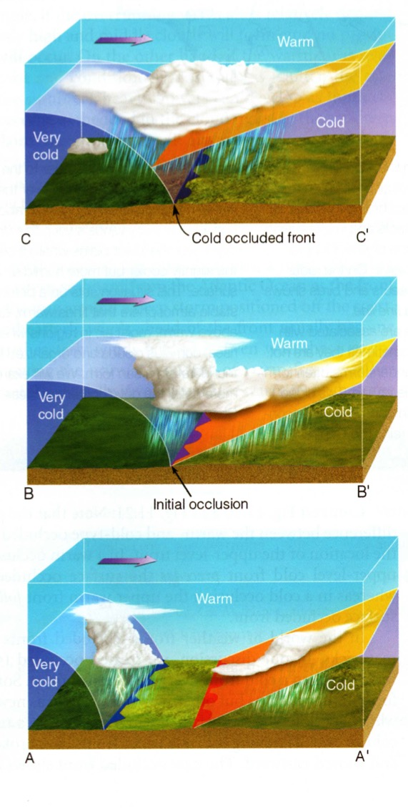
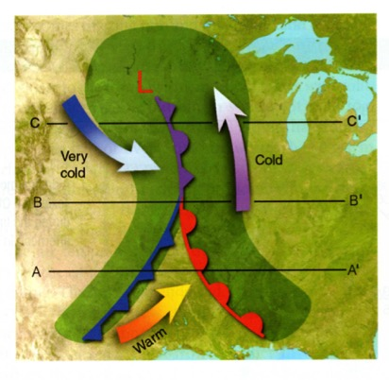
OCCLUDED FRONT
Cold front “catches up” to the warm front, forming a wedge of warm air above the ground.
At the occlusion, precipitation may range from widespread and steady to localized and heavy.
Near the center of the low pressure.
Cold Occlusion Warm Occlusion
Animation

Slide 14
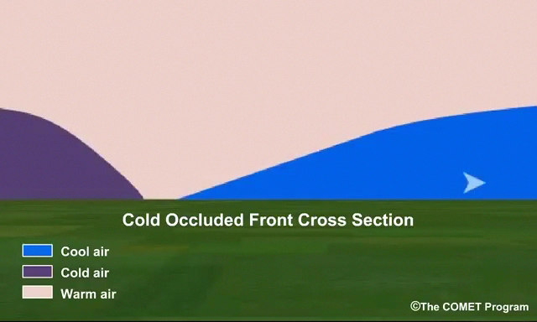
Cold Occlusion
mT
mP
cP

Slide 15
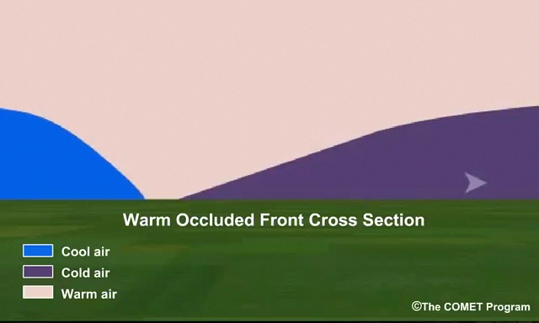
Warm Occlusion
mT
mP
cP

Slide 16
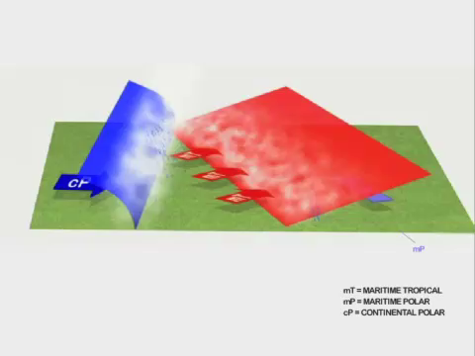
3D Perspective of Cold Occlusion
Ahrens & Hanson

Slide 17
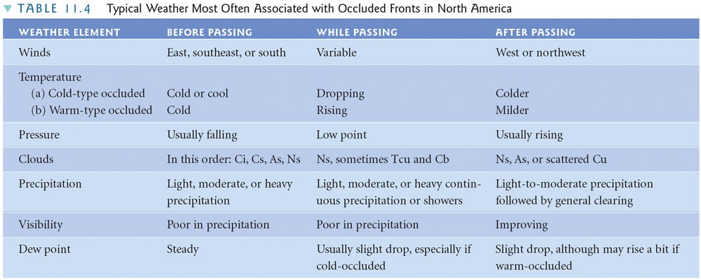
Typical Occluded Front Weather
Pre-Warm Front
Warmest Air at Front
Post-Cold Front
Suggestion: study at home

Slide 18
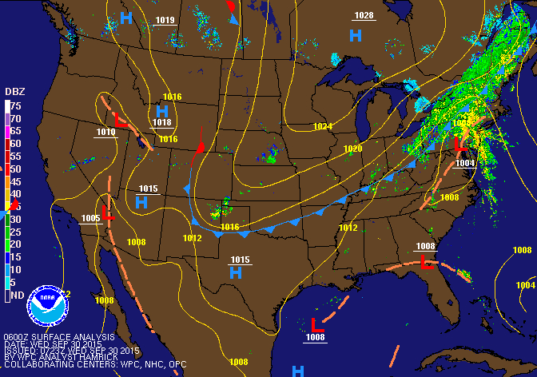
WPC Front Position Loop

Slide 19
Summary Fronts
Fronts form between contrasting air masses. The region of high contrast between the air masses is called the frontal zone.
Fronts are a byproduct of an extratropical cyclone as it goes through its life-cycle
Classified by their movement. Each front has its own symbol and characteristic weather
Cold, Warm, Stationary, Occluded

Slide 20
Summary: Frontal Weather
Temp: Warming
Press: Falling
Wind: E-SE
Dew Pt: Rising
Sky: Lowering Ceiling
Wx: Precipitation, Low Vis.
Air Mass: mP (cP)
L
Temp: Rapid Cooling
Press: Rapid Rising
Wind: W-NW
Dew Pt: Falling
Sky: Clearing
Wx: Improving
Air Mass: cP (mP)
Temp: Warm
Press: Steady/Falling
Wind: S-SW
Dew Pt: High
Sky: Variable
Wx: Showers
Air Mass: mT (cT)

Slide 21
This ends the discussion of fronts.
We will next look at life-cycle of extratropical cyclones that characterize weather during the cool season.
Three practice questions follow that I will leave for you to do on your own.

Slide 22
The front shown below is moving toward the ___.
The coldest air lies on the ___ side of the front.
southwest; southwest
southwest; northeast
northeast; southwest
northeast; northeast
Northeast
Southwest

Slide 23
The front shown below is moving toward the ___.
The coldest air lies on the ___ side of the front.
southwest; southwest
southwest; northeast
northeast; southwest
northeast; northeast
Northeast
Southwest

Slide 24
The front shown below is moving toward the ___.
The pressure is rising fastest on the ___ side of the front.
West; West
West; East
East; West
East; East
West
East

Slide 25
The front shown below is moving toward the ___.
The pressure is rising fastest on the ___ side of the front.
west; west
west; east
east; west
east; east
West
East

Slide 26
The front that is shown below is _____ front.
The warmest air lies ___ the front.
an occluded; along
a cold; west of
an occluded; east of
a stationary; along
West
East
mP
cP

Slide 27
The front that is shown below is _____ front.
The warmest air lies ___ the front.
an occluded; along
a cold; west of
an occluded; east of
a stationary; along
West
East
mP
cP

Slide 28
Next Week
A Surface Map Tutorial
How to analyze a surface weather map.
Individual/group (students choice) homework assignment
Term Project
Description of Two Part Project

