Slide 1
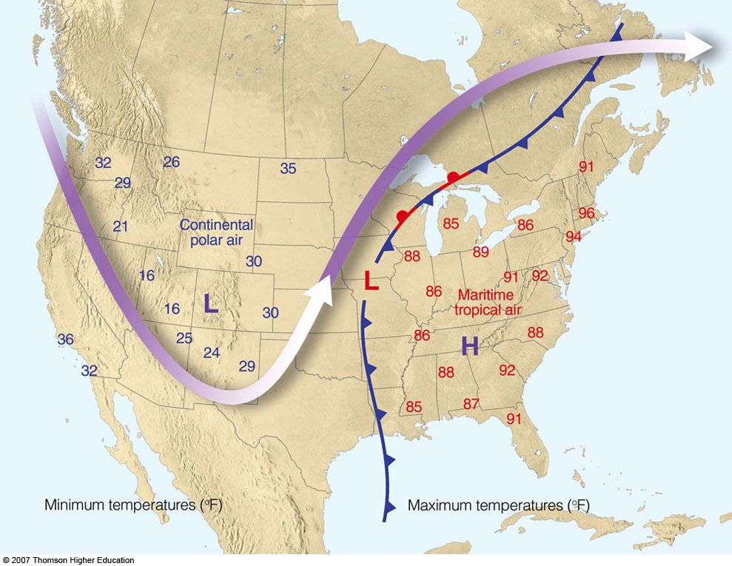

ATMO 170A1
Online
Air Masses
§10.1 H&P
Ahrens & Hanson

Slide 2
Goals of Overview
Learn four basic air masses
Where and how air masses form
Weather associated with each type of air mass
What happens when air masses collide

Slide 3
A large body of air (larger than 1000 x 1000 miles) that has (sort of) uniform horizontal distributions of temperature and moisture.
What is an Air Mass?

Slide 4
Air Mass Source Regions
Typically have the following characteristics:
Generally flat and spatially expansive
Have a uniform composition
Light winds, so air stays over the region for a relatively long time (several days or longer)
Good places for air mass generation:
Over the oceans (because of their high specific heat capacity)
Interior of the continents under areas of high pressure
Subtropical deserts, especially during summer
Polar regions like Canada and Siberia (especially in winter)

Slide 5
Air Mass Classification System
First Lowercase Letter:
Indicates whether air originates over an ocean or a continent
m = Maritime c = Continental
Second Uppercase Letter
Indicates whether air originates over tropical or polar latitudes.
T = Tropical P = Polar
By combining these four, the primary air masses can be described.*
*There are two other air mass designations:
cA => continental Arctic and mE => maritime Equatorial.
cA is extremely cold cP air mass. mE is extremely humid mT air mass.
We will ignore fine-scale gradation and stick to the basics.

Slide 6
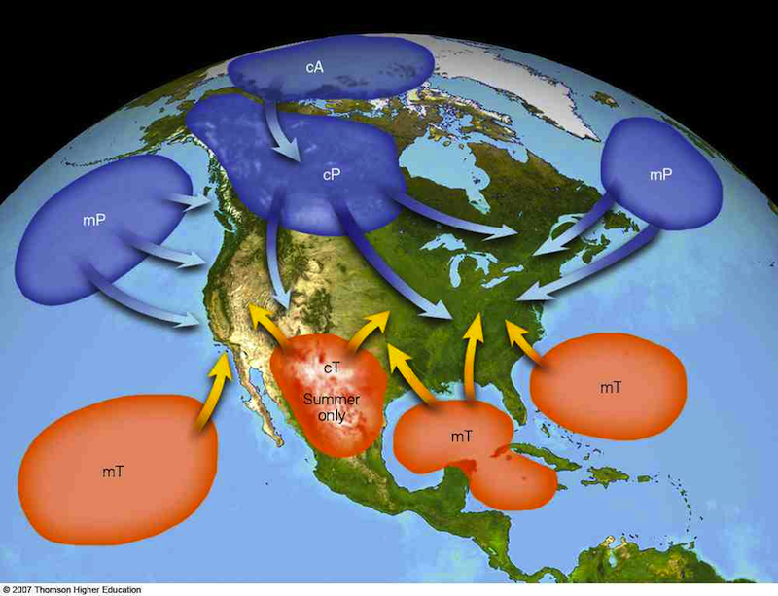
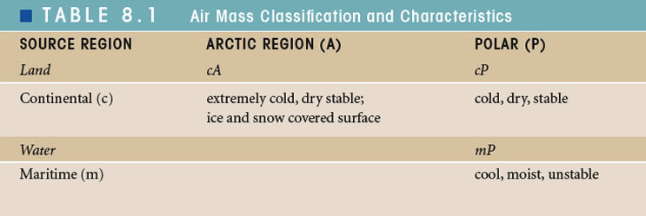
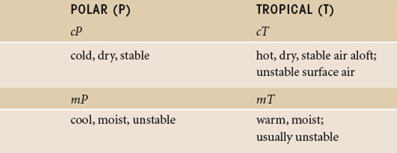
Air masses that affect North America
CONTINENTAL
POLAR (cP)
MARITIME POLAR (mP)
MARITIME POLAR (mP)
MARITIME
TROPICAL (mT)
CONTINENTAL
TROPICAL (cT)
MARITIME
TROPICAL (mT)
Weather Characteristics

Slide 7
cP air masses of the Northern Hemisphere originate in the northernmost parts of North America and Asia over vast snow covered plains
Continental Polar Air (cP)
EXCEPT for Antarctica, these are the coldest spots on Earth.

Slide 8
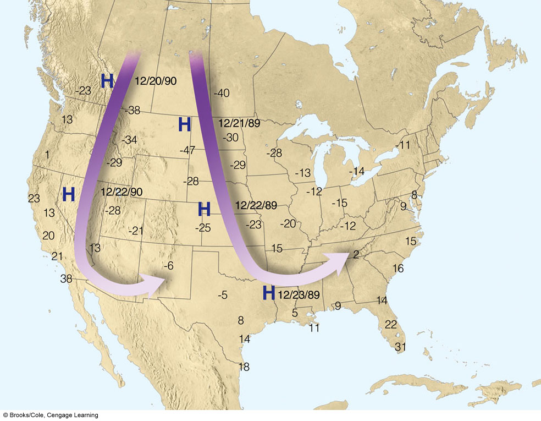
Arctic Outbreaks in U.S.
Flow directs cP air from Canada or Siberia
East of the Rockies favored because of no topographic barriers to impede arctic air from advancing south.
In severe arctic outbreaks, below freezing temperatures reach the Gulf of Mexico.
Artic air occasionally spills over the Continental Divide and reaches Tucson
Common Path East of Rockies
Rare Path
Airflow and temperatures during severe December arctic outbreaks

Slide 9
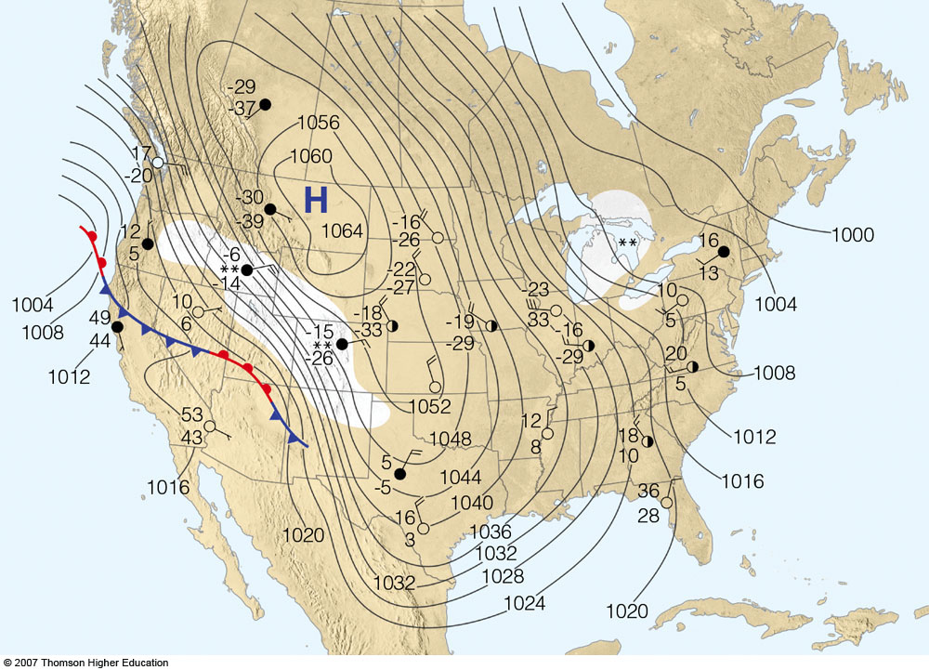
December 1983 Arctic Outbreak
Ahrens
The “core” of the cold air is located underneath the surface high.
Very high SLP’s are associated with coldest outbreaks.
cP air is often so shallow and dense it can’t cross the Rockies.

Slide 10
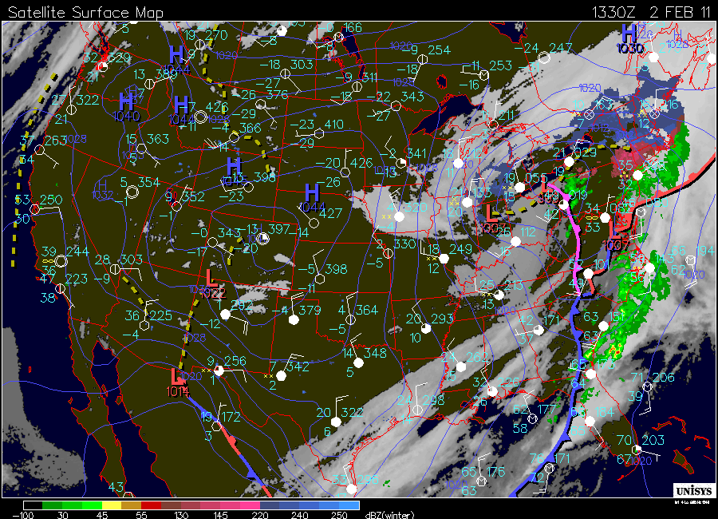
cP Air in Arizona
Feb 02, 2011: cP air spills over Continental Divide
Two nights of record cold for the date of 17°F in Tucson

Slide 11
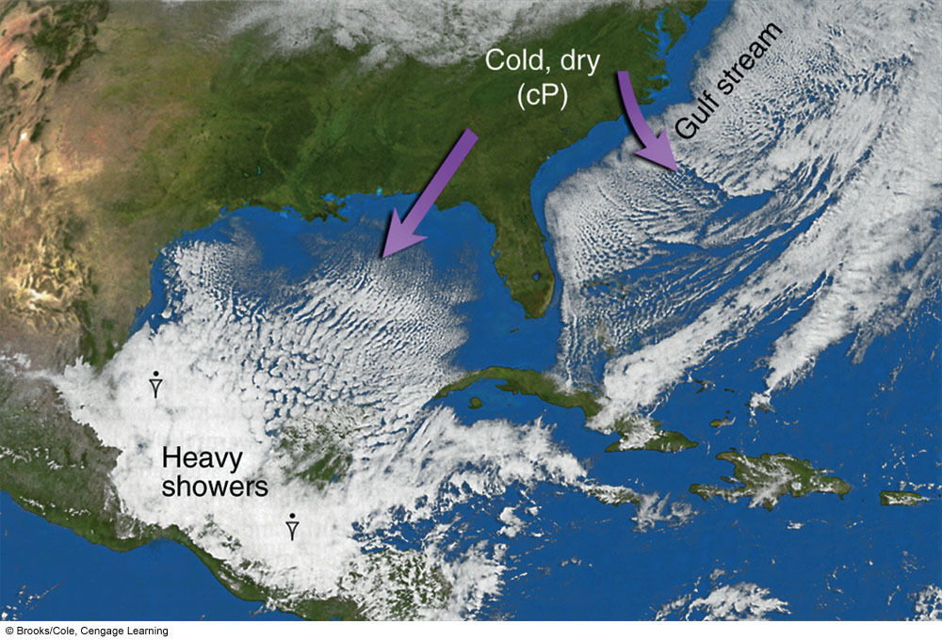
Modification of cP Air Masses
cP
cP
warm ocean
mP
warm ocean
mP
Ahrens & Hanson
Ahrens Fig 8.4
cP air is rapidly modified when it flows over warm ocean waters

Slide 12
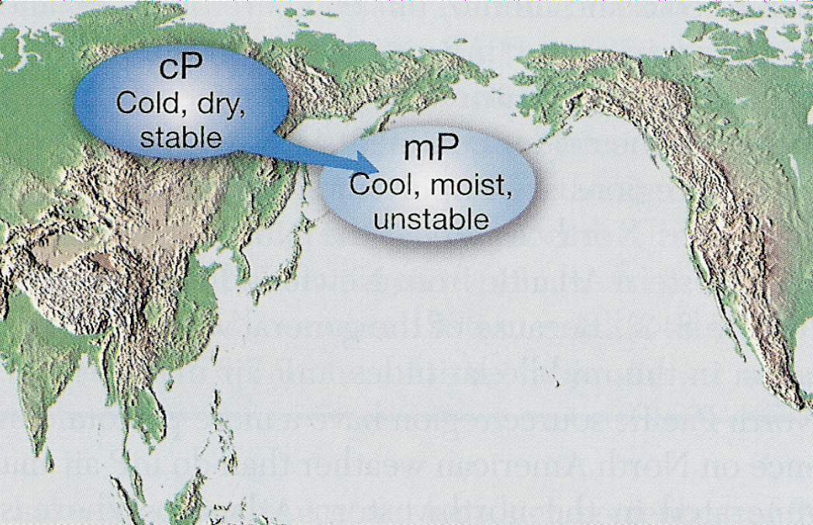
Creation of Pacific mP air masses
L
Lutgens and Tarbuck
Forms when cP air moves from Siberia over the warmer ocean. The surface air warms and moistens, producing showery weather.
mP air is then carried eastward by westerly winds and numerous cyclones that transit across thousands of kilometers of water.

Slide 13
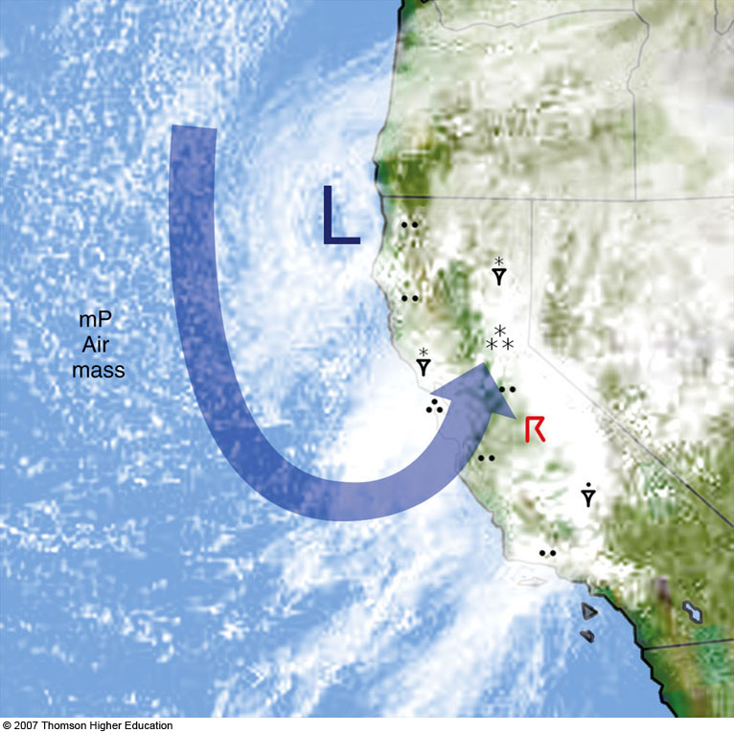
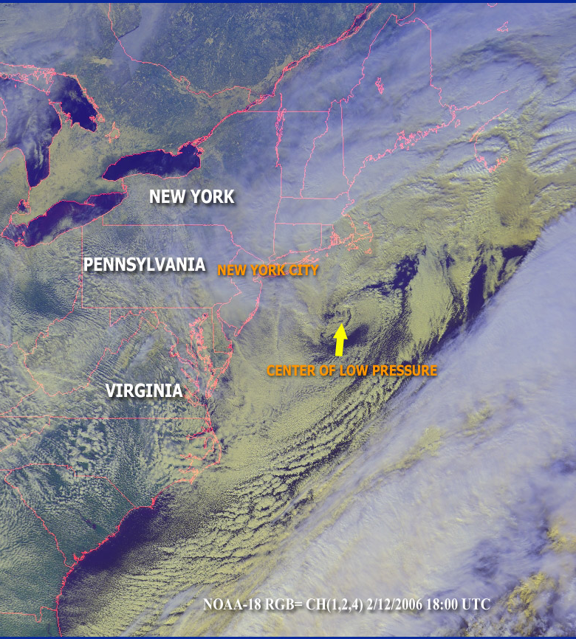
mP Air Masses
Air mass modified further as it crosses the mountain ranges of the western U.S.
East Coast Snow Storms
mP
Winter rains over West Coast
Ahrens
Ahrens

Slide 14
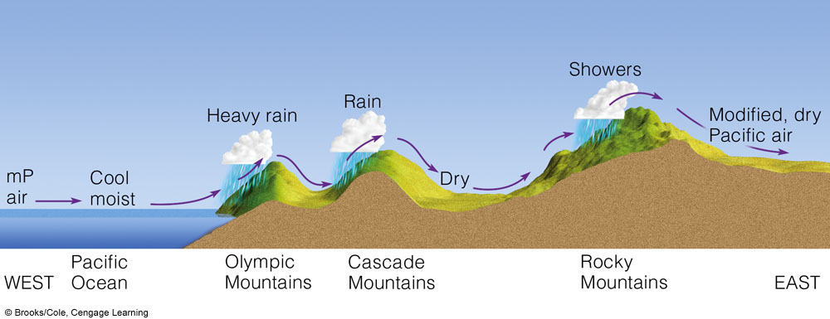
Continental modification of mP air mass
mP air continues to dry with each crossing of a higher mountain range

Slide 15
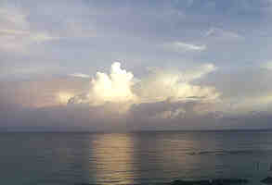
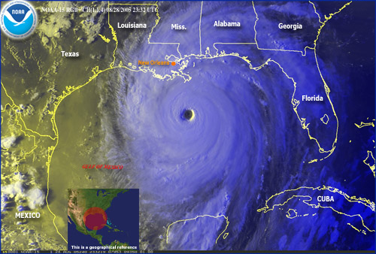
mT air mass form over topical oceans
Warm moist air in mT air has A LOT of potential energy. Why??
This energy in the form of latent heat can be released in thunderstorms— which sometimes organize into tropical cyclones.

Slide 16
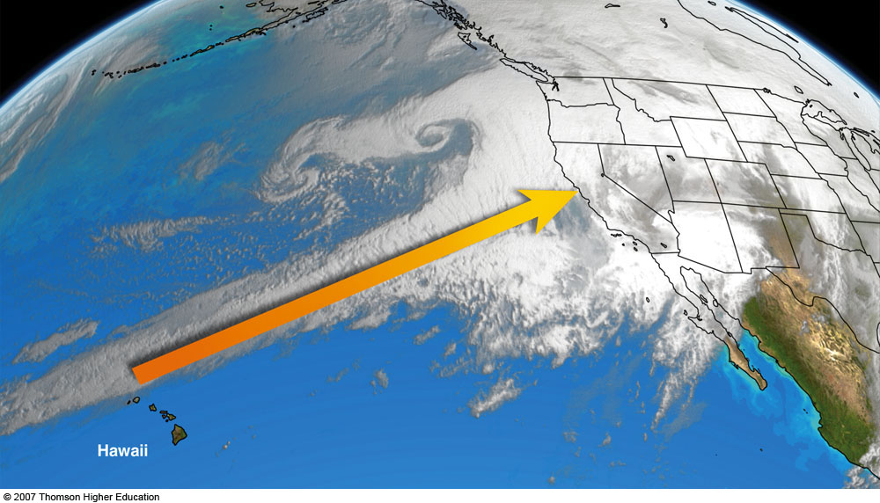
Winter mT Pacific Air Masses
mP
Atmospheric River
“Pineapple Express”
mT
Ahrens
Can cause heavy precipitation and flooding along West Coast

Slide 17
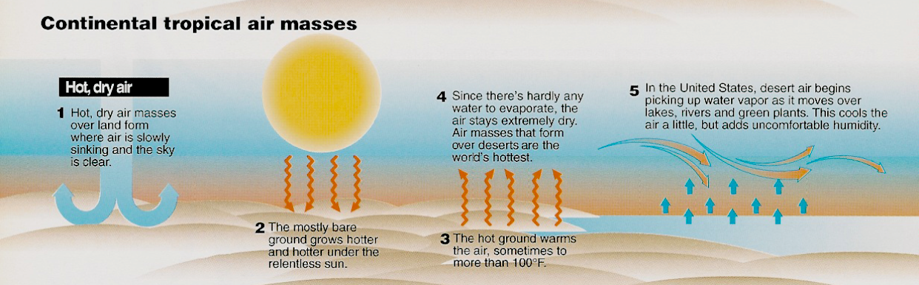
Creation of cT Air Mass
Williams p24
cT air forms in the interior of continents over deserts.
The Chihuahuan/Mojave/Sonoran Desert regions are the source of cT air masses that affect North America.

Slide 18
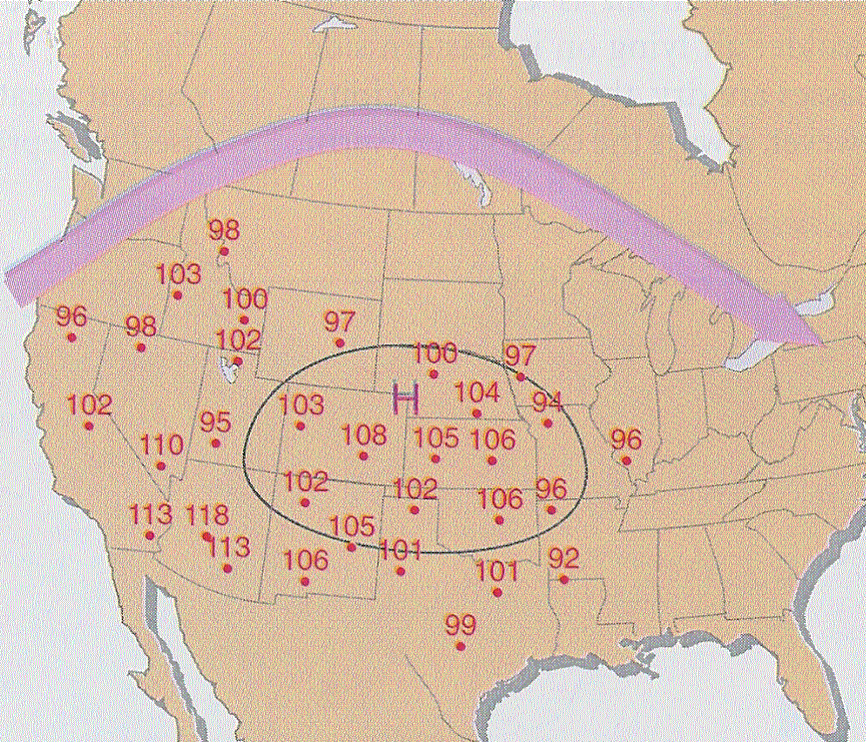
cT air can produce record heat
Record Heat over Western U.S.
29-30 Jun 1990
Ahrens

Slide 19
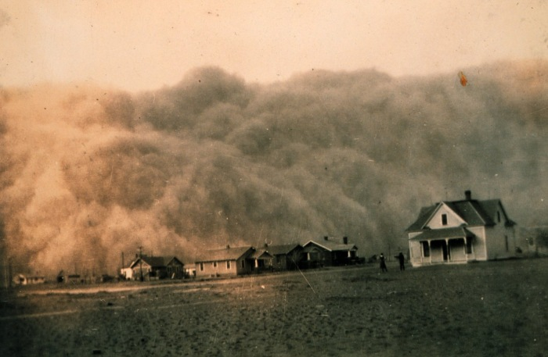
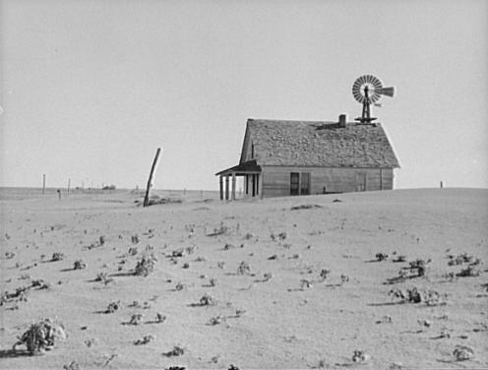
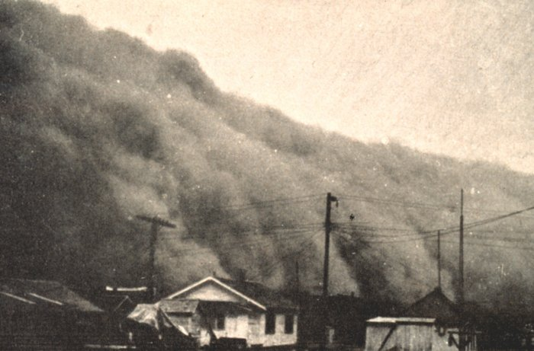
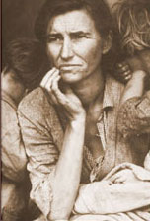
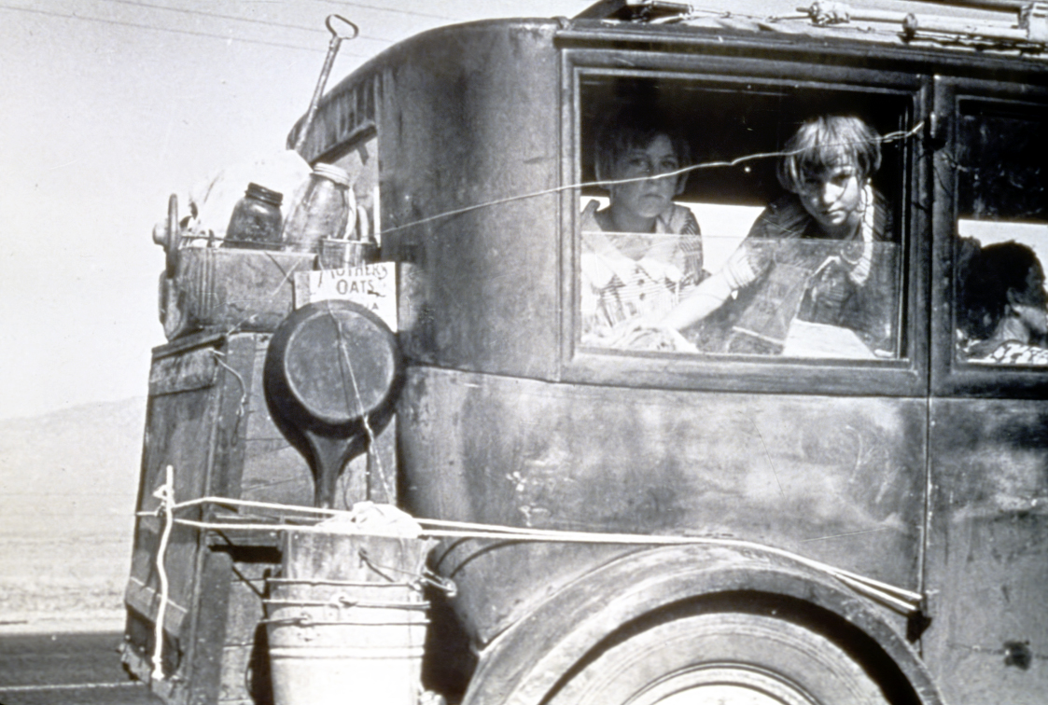
Great Plains Dust Bowl: Mid-1930s
Prolonged persistence of cT air

Slide 20
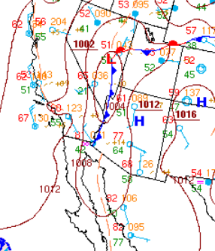
Arizona experienced a change of air masses from ___ air that is shown on the map to ___ air the following day.
  mT to mP
  cT to cP
  cP to mT
  mP to cP
2014/09/27 11:00 am MST

Slide 21
Arizona experienced a change of air masses from ___ air that is shown on the map to ___ air the following day.
  mT to mP
  cT to cP
  cP to mT
  mP to cP
mP
mT
2014/09/27 11:00 am MST

Slide 22
What happens when one air mass approaches another air mass?
A front forms between the contrasting air masses!
17 Apr 1976
Ahrens

Slide 23
Summary: Air Masses
Four major air masses − defined by source regions
  cP (continental Polar) => cold and dry
  cT (continental Tropical) => hot and dry
  mP (maritime Polar) => cool and moist
  mT (maritime Tropical) => warm and humid
Each air mass has its characteristic weather (that varies depending upon the season)
Fronts form when highly contrasting air masses “collide”

