Slide 1
Last Time
Review Thermally Direct ✔
Diurnal Circulations
  Land-Sea Breezes ✔
  Mountain-Valley Breezes ✔
Monsoons - Seasonal ✔
  Asian ✔
  North American ✔
  Air-Sea Interactions – Today

Slide 2
Thermally Direct Circulations
Warm Air Rises Cold Air Sinks
  Converts potential energy to kinetic energy
Examples include…
  Cyclones – warmer air flows toward poles and rises
  Fronts – warmer air side of front generally has rising air
  Thunderstorms – upward buoyancy
  Diurnal Winds – land/sea and mountain/valley
  Monsoons – seasonal swing in prevailing wind
  Hadley Cell – warm, humid air rises over the tropics
  Potential energy exists wherever there are horizontal temperature differences.

Slide 3
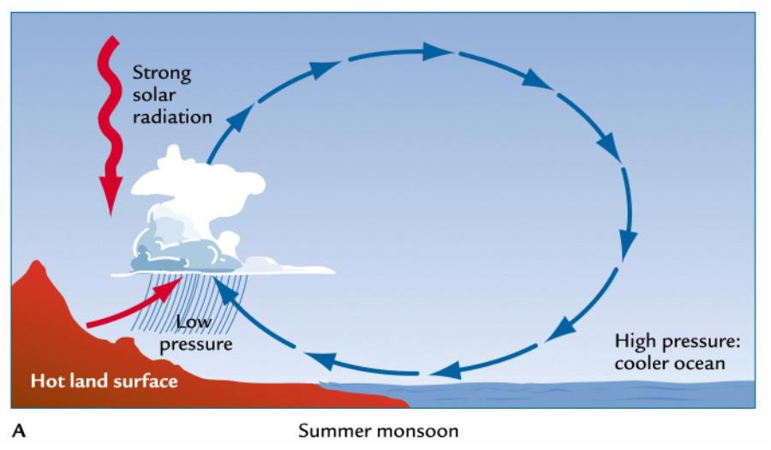
Sea Breeze/Summer Monsoon
www.atmosedu.com/Geol390

Slide 4
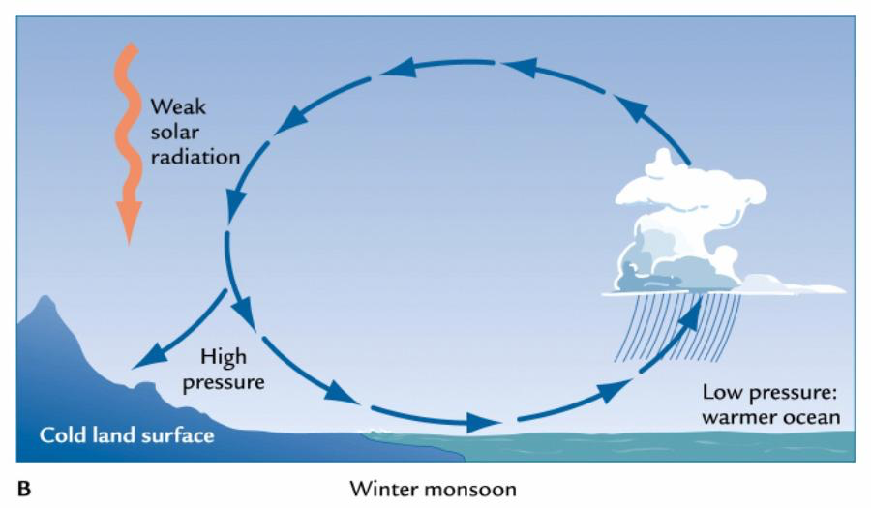
Land Breeze/Winter Monsoon
www.atmosedu.com/Geol390

Slide 5
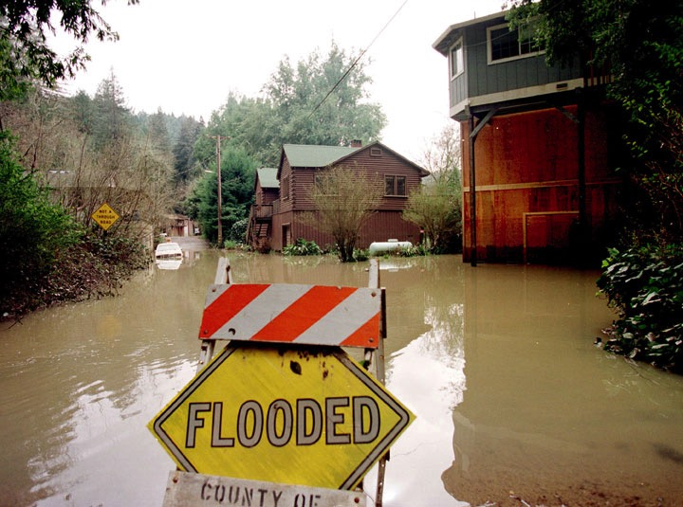

ATMO 170A1
Online
Air-Sea Interactions
El Niño-Southern Oscillation
§9.4.5 H&P
Flooding of Russian River CA from heavy rains in March 1998, an El Nino winter.

Slide 6
We now discuss a topic that gets a lot of press…
El Niño
I am sure all of you have heard it mentioned somewhere…
but what is it really?

Slide 7
What is El Nino?
  Anomalous winter warmth over the southern U.S.
  Excessive winter rains over the western U.S.
  Deadly fires followed by landslides in California.
  Anomalous warm water over the equatorial Pacific Ocean.
  Anomalous cold water over the North Pacific Ocean.

Slide 8
What is El Nino?
  Anomalous winter warmth over the southern U.S.
  Excessive winter rains over the western U.S.
  Deadly fires followed by landslides in California.
  Anomalous warm water over the equatorial Pacific Ocean.
  Anomalous cold water over the North Pacific Ocean.

Slide 9
In reality, El Niño is an example of an atmosphere-ocean interaction— perhaps the most important one.
Such interactions are important for climate variability across the globe, including here in Arizona.

Slide 10
Why is the ocean important?
Heat transport
Ocean currents transport heat from equator to pole (~25% of the total). Comparable to atmosphere in tropics. (20°N-20°S)
Climate regulator
Water moderates climate of regions near it.
Ocean supplies moisture to the atmosphere
which produces clouds, storms and precipitation.
Source of “memory” in the climate system
Because variability in the ocean occurs on very long timescales relative to atmospheric phenomena (like years to centuries),
it makes climate potentially more predictable (months in advance).

Slide 11
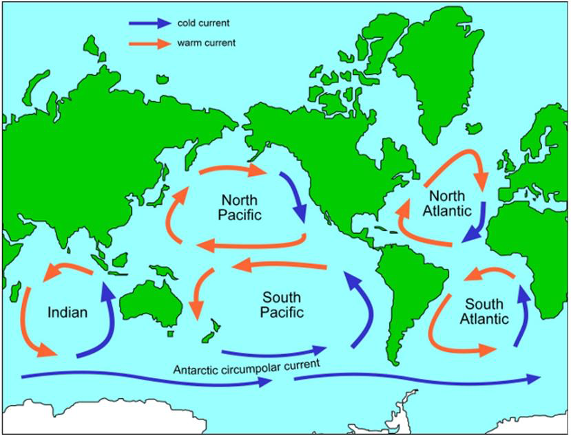
Major Ocean Currents of the World
Giant convective circulations (gyres) transport heat from equator to pole.
Warm current of a gyre is along the east coast of a continent.
Cold current of a gyre is along the west coast of a continent.
Ocean currents are forced by the surface prevailing winds
but the currents flow at an angle to the wind.
http://www.sciencelearn.org.nz/Contexts/The-Ocean-in-Action/Sci-Media/Images/Map-of-ocean-gyres

Slide 12
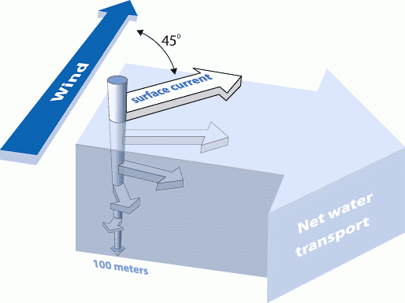
What causes Surface Ocean Currents?
Northern Hemisphere situation shown
Ekman Spiral
www.oceanservice.noaa.gov
As wind blows across the water, water is deflected to the right of the mean wind by the Coriolis force.
Net effect: Surface current is a little to the right of the prevailing wind.
Each successive layer of water below bends a little more towards the right as it is forced by the layer above.
Net result: surface layer of warm water moves perpendicular to the wind.

Slide 13
Upwelling
We start by introducing an important ocean concept that underlies some atmosphere-ocean interactions
Upwelling
Notes:
13

Slide 14
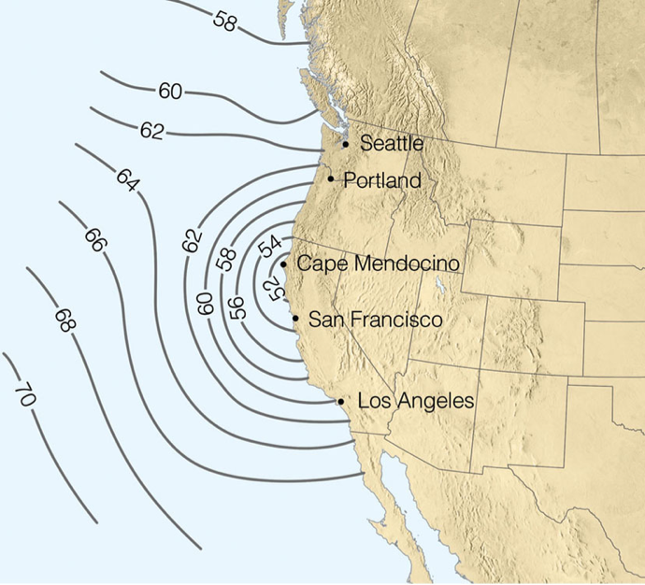
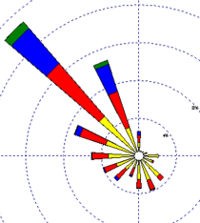
Summer SST Along West Coast
Sea surface temperatures (SST) along West Coast are cold during summer, especially along the Northern California.
Caused by upwelling of cold, bottom water that is forced by a prevailing N-NW wind.
Prevailing Winds
Coastal Surface Water
Ahrens 6th ed

Slide 15
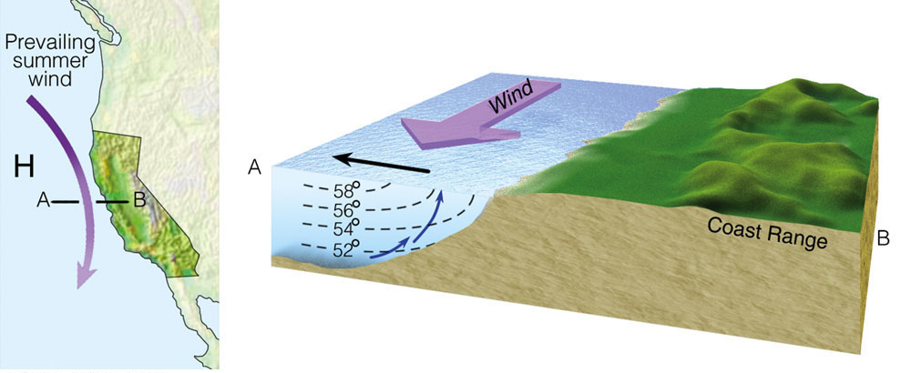
Coastal Upwelling
Wind pushes surface water southward.
Coriolis force deflects water to the right away from the shore.
Cold water from below rises to surface.

Slide 16
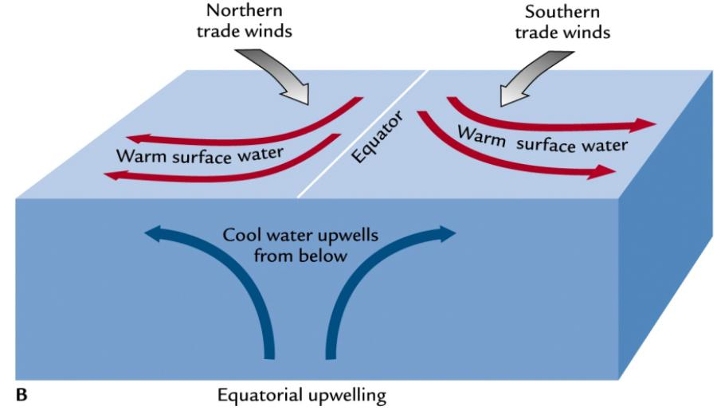
Equatorial Upwelling
Akin to Fig. 9.18 H&P
http://web.sonoma.edu/users/f/freidel/global/372lec2images.htm
Trade winds push surface water westward
Coriolis force deflects water to the North Pole in the Northern Hemisphere South Pole in the Southern Hemisphere
Cold water rises from below to surface

Slide 17
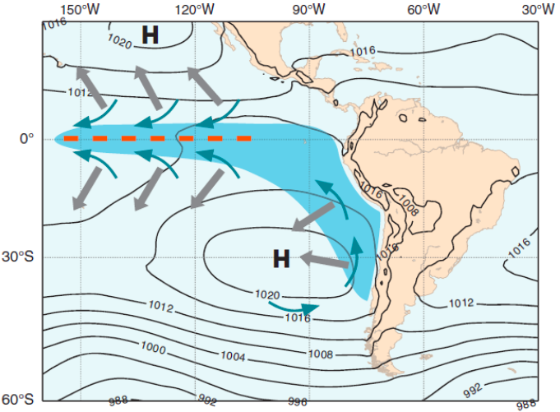
Equatorial Upwelling
Fig. 9.18 H&P
Figure 9.18.Formation of the cold tongue. The thin blue arrows represent the wind blowing northward along the coast of South America and converging along the equator. The thick gray arrows show the horizontal displacement of surface water, at a right angle to the wind. The blue cold tongue results from the upwelling of cold water from the deep ocean.
Notes:
Upwelling also exists along the west coasts of midlatitude continents.
Upwelling is especially strong along the coast of Peru and Chile.

Slide 18
Wind Patterns and Oceans
Now that we understand the basics of upwelling and ocean circulations, let’s talk about…
El Niño/La Niña (ocean component)
Southern Oscillation (atmo component)
Termed ENSO for short in recognition
that it is a coupled phenomenon.
Notes:
18

Slide 19
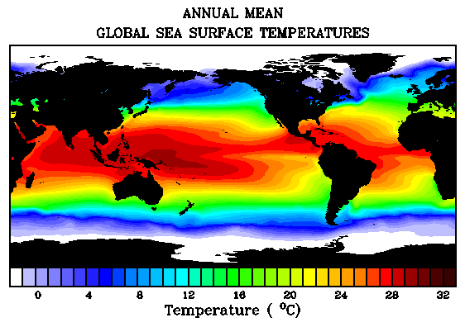
NOTE COLD WATER OVER EQUATORIAL EAST PACIFIC
LET’S LOOK AT THE EQUATORIAL PACIFIC IN MORE DETIAL
Figure credit: http://www.abc.net.au/science/slab/elnino/story.htm
Warm over tropics; cold near the poles.
Colder on the west coasts of continents
Colder along equator due to upwelling.

Slide 20
Something “odd” occurs very 2-7 years off the west coast of South America and the equatorial Pacific…
Trades and southerly winds off Peru weaken
Cold upwelling current STOPS off Peru and is replaced by warm water. It typically occurs around Christmas (an El Niño event), and it brings heavy rains and massive fish kills.
Alters global patterns of wind, temp and rain

Slide 21
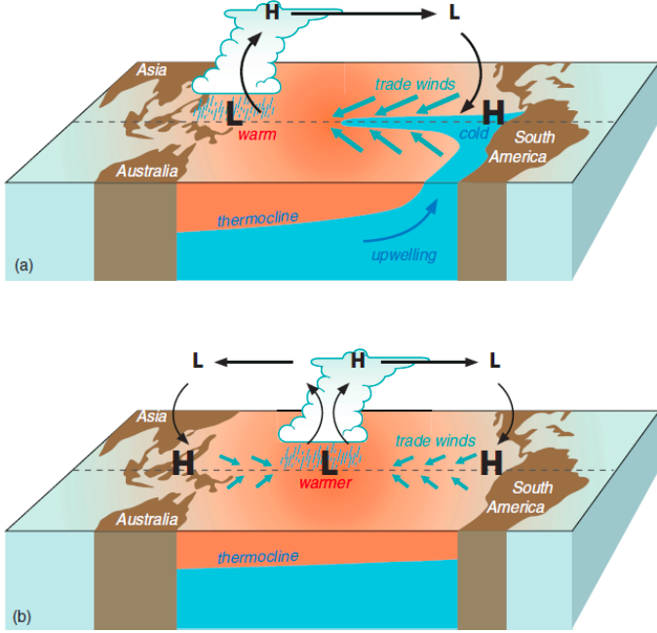
Walker Circulation
Fig. 9.19 Hakim & Patoux
Figure 9.19. Schematic representation of El Niño/Southern Oscillation. (a) Normal conditions: the Walker circulation spans the entire Pacific basin. (b) El Niño: the cold tongue weakens or disappears, the Walker circulation weakens, and a secondary circulation forms over the western half of the Pacific basin.
Notes:
TOP-normal with cold equatorial water
Strong trade winds
Strong upwelling
Rising air/precipitation over Micronesia/Melanesia
BOTTOM-El Nino with warm water
Weak trade winds. Westerly winds over Micronesia/Melanesia
Cessation of upwelling
Anomalous precipitation over Central Pacific
Sinking air and drought over Micronesia/Melanesia
Failed monsoons over India

Slide 22
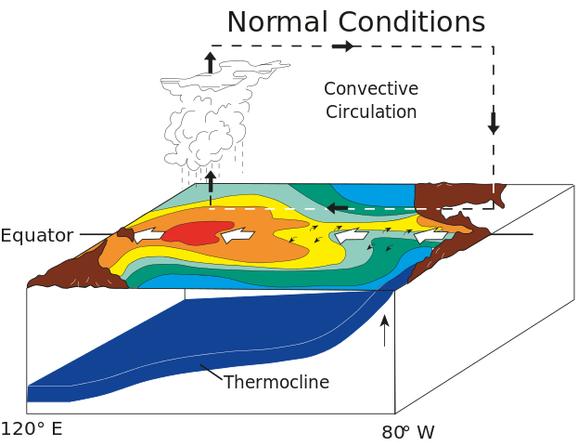

Neutral Conditions
Walker Circulation
http://www.pmel.noaa.gov/tao/proj_over/diagrams/

Slide 23
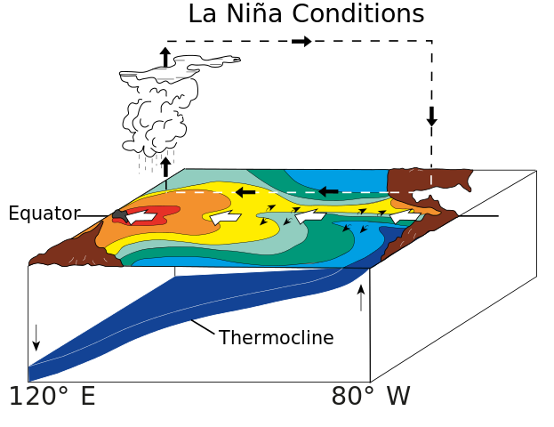
La Niña Conditions
Walker Circulation
http://www.pmel.noaa.gov/tao/proj_over/diagrams/

Slide 24
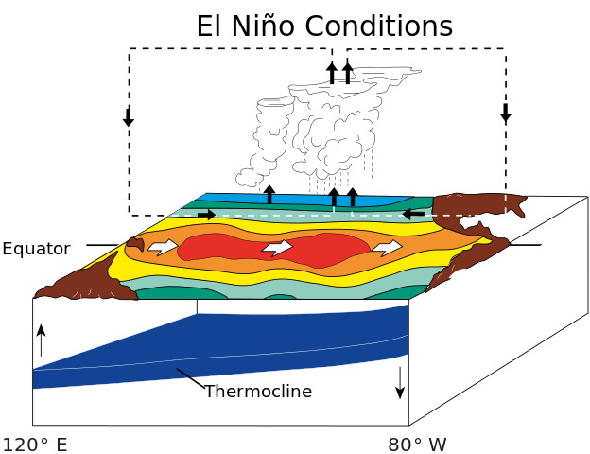
El Niño Conditions
Walker Circulation
http://www.pmel.noaa.gov/tao/proj_over/diagrams/

Slide 25
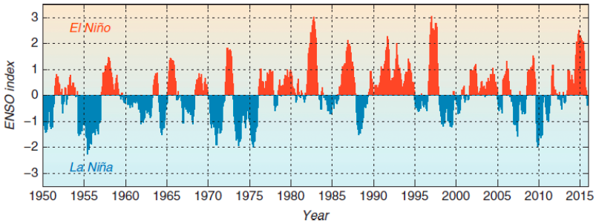
ENSO Index
Fig. 9.20 Hakim and Patoux
Notes:
Variant of a commonly used ENSO index since 1950. Positive index (red) denotes El Nino condition; negative index (blue) denotes La Nina conditions.

Slide 26
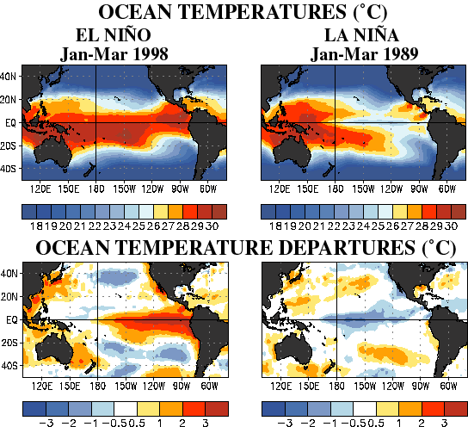


El Niño
La Niña
El Niño
La Niña

Slide 27
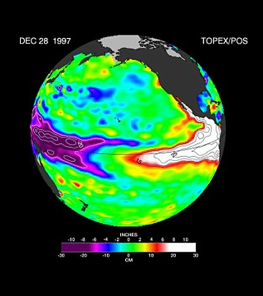
Sea-level anomalies
Credit: http://i.dailymail.co.uk/i/pix/2015/12/30/15/2FACCE0200000578-0-image-a-9_1451489889749.jpg
Notes:
Sea Surface Temperature and the height of Sea Level are related.

Slide 28
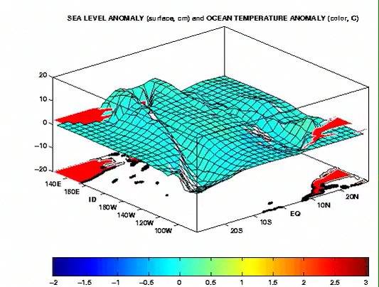
Animation of Idealized ENSO Cycle
Figure credit: https://www.esrl.noaa.gov/psd/people/joseph.barsugli/anim.html
Water sloshes back and forth across the Pacific.
Sea-level is anomalously high where temperatures are anomalously warm.
http://atmo.arizona.edu/~mullen/atmo170A1/animations/ENSO_SST_Cycle.gif
Notes:
The persistent, strong trade winds literal drag water from the eastern to the western equatorial Pacific Ocean.
When the trade winds relax, the warm water over the western Pacific rushes toward the east.

Slide 29
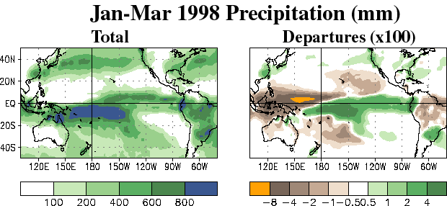


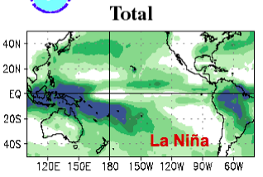

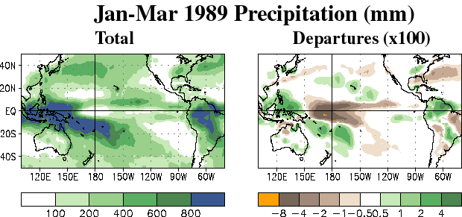


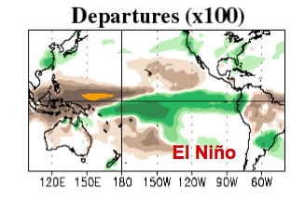

JFM 1998
JFM 1989
El Niño
El Niño
La Niña
La Niña

Slide 30
ENSO not only affects areas near the tropical Pacific—it alters the atmospheric circulation patterns and weather across the globe
These remote anomalies are called teleconnections
Hence, ENSO can have predictive value

Slide 31
How does ENSO impact the United States?
Its signal is strongest in winter
— which will be our focus — but it impacts the summer too.

Slide 32
Survey: How does El Nino affect Arizona’s winter weather?
  Dry, warm winters
  Dry, cool winters
  Wet, warm winters
  Wet, cool winters

Slide 33
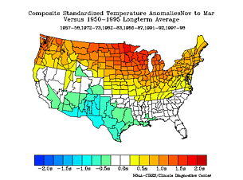
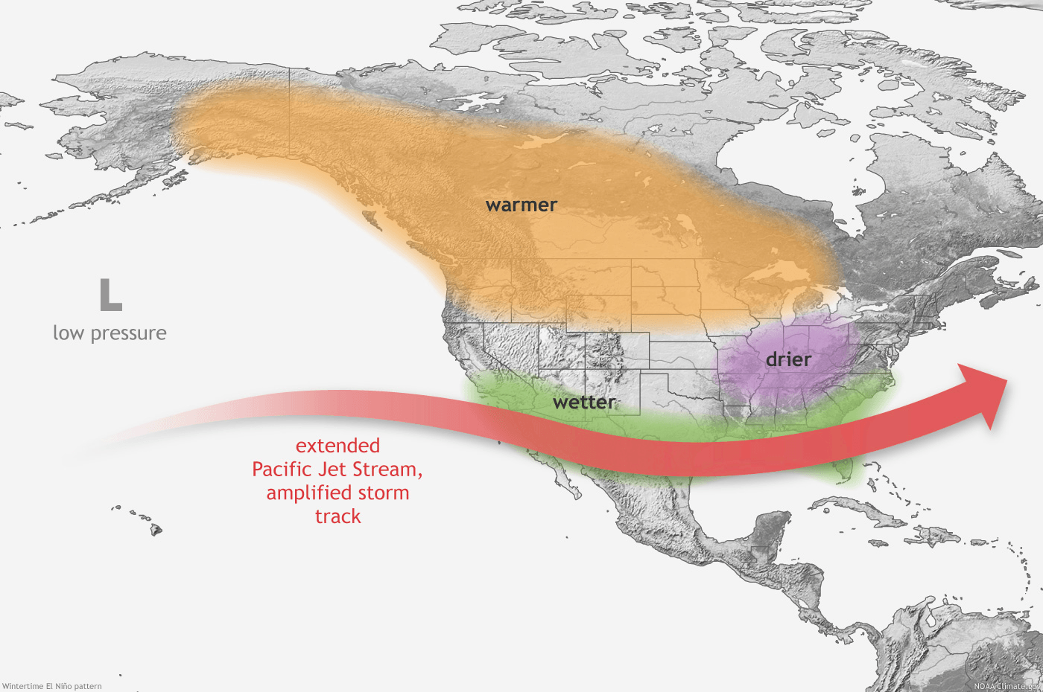
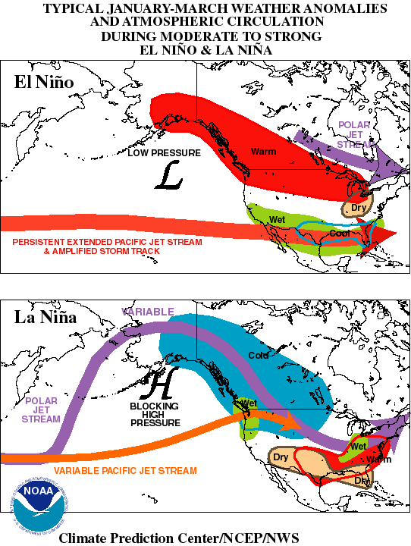
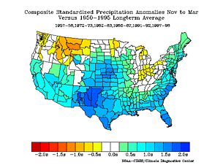
El Niño Impacts on United States: Winter
TEMPERATURE ANOMALY
RAINFALL ANOMALY
Figure credit: https://www.esrl.noaa.gov/psd/enso/
Akin to Fig. 9.21 H&P
(NOAA CDC)
Notes:
Pacific storm track depressed southward.
Colder than normal Southwest U.S.; warmer than normal northern tier.
Wetter than normal Southwest, South, and Southeast; drier than normal Northwest and northern Rockies.

Slide 34
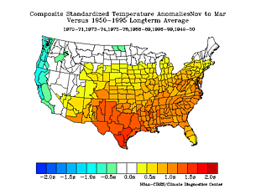
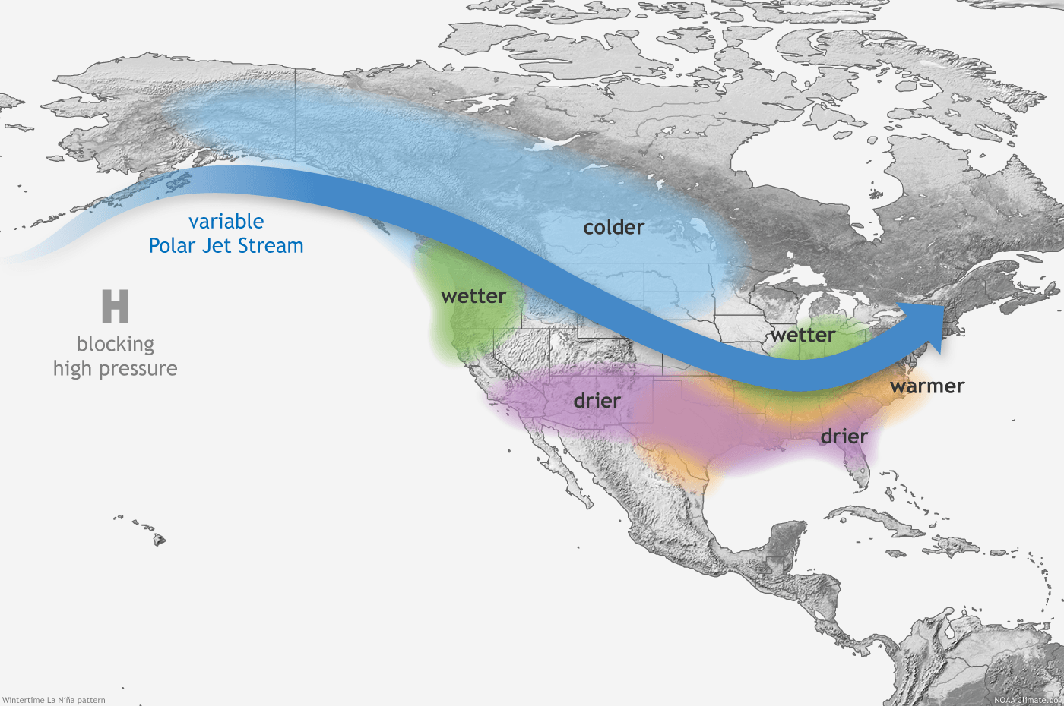
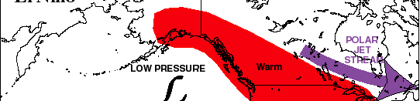
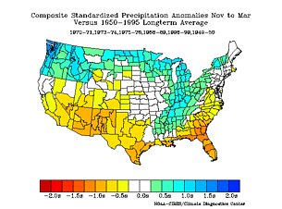
La Niña Impacts on United States: Winter
TEMPERATURE ANOMALY
RAINFALL ANOMALY
Figure credit: https://www.esrl.noaa.gov/psd/enso/
Akin to Fig. 9.21 H&P
(NOAA CDC)
Notes:
Pacific storm track “blocked” or “split”.
Colder than normal Pacific Coast. Warmer than normal Southwest to Southeast.
Wetter than normal Northwest, northern tier and Mississippi River Valley. Drier than California, Southwest and southern tier.

Slide 35
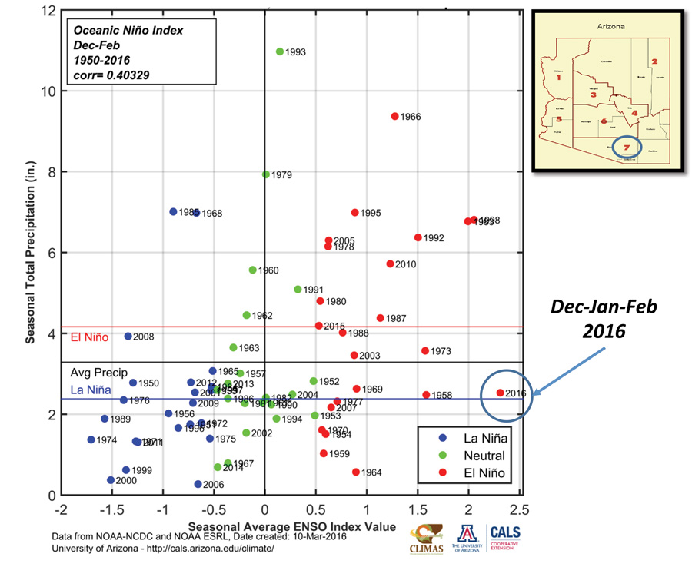
Less than a 50% chance that an El Nino winter has above average precipitation.
A 90% chance that a La Nina winter has below average precipitation.
Figure credit: https://wrrc.arizona.edu/el-niño-southern-oscillation
Notes:
El Niño seems to have a stronger, more variable response than La Niña in Arizona. At 500-mbar height: Red dots show El Nino years; blue dots show La Nina years; green dots neutral years. Note much larger variability of seasonal precipitation (vertical axis) of the red dots relative to the blue dots.

Slide 36
Review of the 2015-2016 Winter
A strong El Niño was predicted to last through the 2015-16 winter in the northern hemisphere.
Large temperature and precipitation anomalies were predicted to occur over North America that would be consistent with prior El Niño winters.
But did they happen?

Slide 37
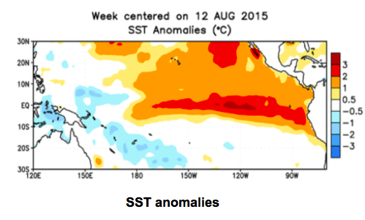
What occurred summer/fall 2015 leading up to the forecast.
Link to animation
http://atmo.arizona.edu/~mullen/atmo170A1/animations/20150812-20151028_SST_Anom.gif
Credit: http://www.cpc.ncep.noaa.gov/products/analysis_monitoring/enso_update/sstanim.shtml

Slide 38
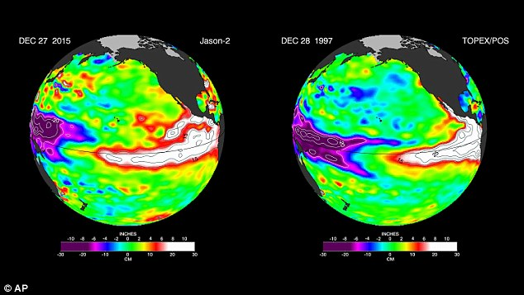
Sea-level anomalies
Credit: http://i.dailymail.co.uk/i/pix/2015/12/30/15/2FACCE0200000578-0-image-a-9_1451489889749.jpg

Slide 39

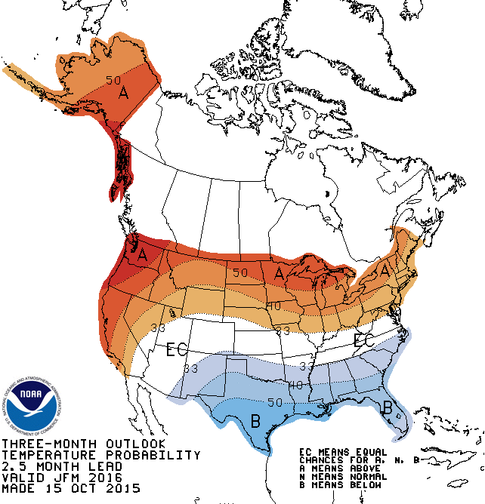
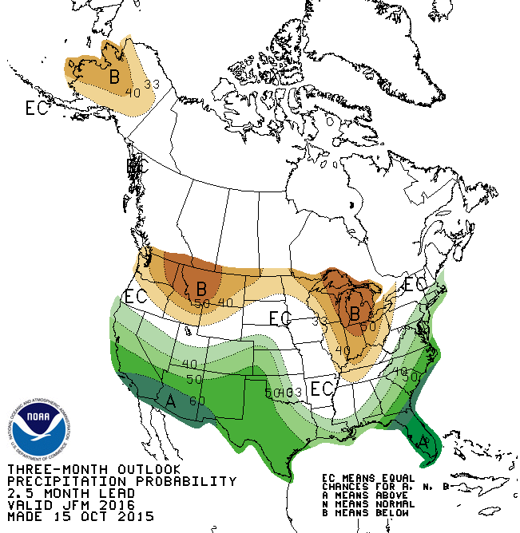
Official NOAA/CPC Outlook for JFM

Slide 40
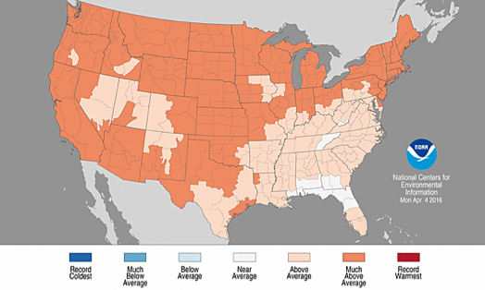
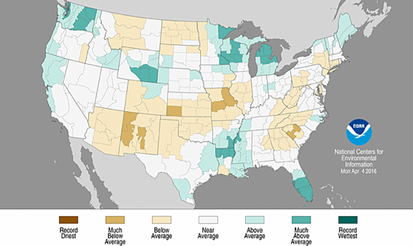
What happened?
NOAA/CPC Anomalies for JFM

Slide 41
What went wrong?

Slide 42
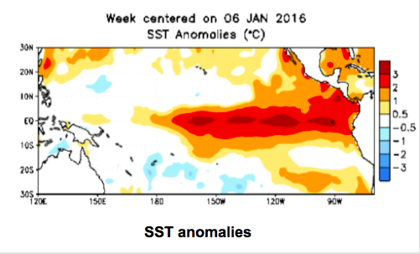
What occurred JFM 2016
Link to animaiton
http://atmo.arizona.edu/~mullen/atmo170A1/animations/20160106-20160323_SST_Anom.gif
Credit: http://www.cpc.ncep.noaa.gov/products/analysis_monitoring/enso_update/sstanim.shtml

Slide 43
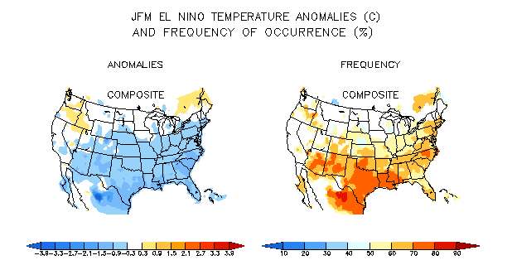
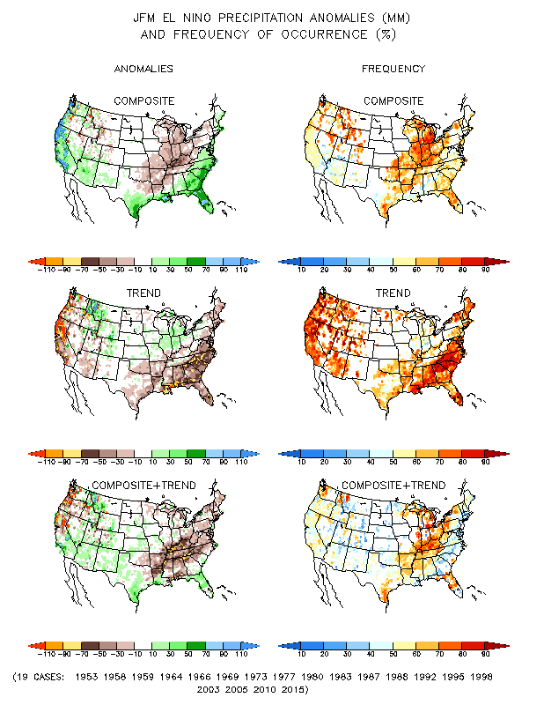
What does the historical record also tell us?
Credit: http://www.cpc.ncep.noaa.gov/products/precip/CWlink/ENSO/composites/
El Nino winters average about 0.5˚C below normal over Arizona.
The odds of getting a cooler than normal winter are around 70%!

Slide 44
What does the historical record also tell us?
Credit: http://www.cpc.ncep.noaa.gov/products/precip/CWlink/ENSO/composites/
Although the average amount of precipitation during El Nino winters is above normal over Arizona, …
The odds of getting above normal rains is close to 50-50!

Slide 45
High Points
Ocean is important to weather and climate because it
  Transports heat
  Acts as a climate regulator
  Provides a source of memory in the climate system
Major ocean currents are part of basin-wide gyres that transport heat from equator to pole.
  Gyres are forced by the prevailing wind.
  Warm/Cold currents are on east/west sides of continents.
Currents are cold along the west coasts of continents and along the equator due to upwelling.

Slide 46
High Points
El Niño Southern Oscillation (ENSO) refers to a 2-7 year shift in oceanic and atmospheric circulation patterns of the tropical Pacific.
ENSO affects weather and climate across the globe, including the U.S.
ENSO anomalies can be used as a predictor for skillful seasonal outlooks for the United States, but as 2015-16 showed, it is far from a perfect predictor!
There are other important atmosphere-ocean interactions that we have not examined
  Pacific Decadal Oscillation (PDO) reinforces anomalies associated with ENSO.
  North Atlantic Oscillation (NAO).

Slide 47
Assignment for Next Lecture
Thunderstorms
Reading – Ahrens
Pg. 287-300
Questions for Review– Ahrens
Pg. 310: 1, 7, 14, 19, 23, 24, 29

Slide 48
End of Overview

