Slide 1
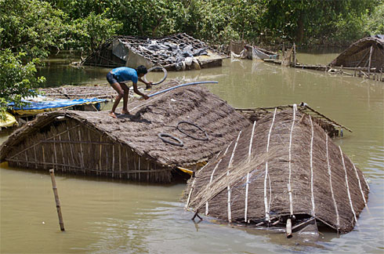

ATMO 170A1
Online
Monsoon Circulations
Asian Monsoon
North American Monsoon
Flooding from monsoon rains in Gorakpur district of northern India. August 2007. http://www.usatoday.com/news/world/2007-08-08-south-asia-floods_N.htm

Slide 2
Monsoon Circulations
Section 9.4, H&P
Same physical mechanism as frontal circulations … warm air rises-cold air sinks … but the circulation cycles on an annual time scale:
A thermally direct circulation oscillates over a continental scale where the change in the PGF is large enough to reverse the prevailing wind.
Driven by the seasonal cycle of solar heating.

Slide 3
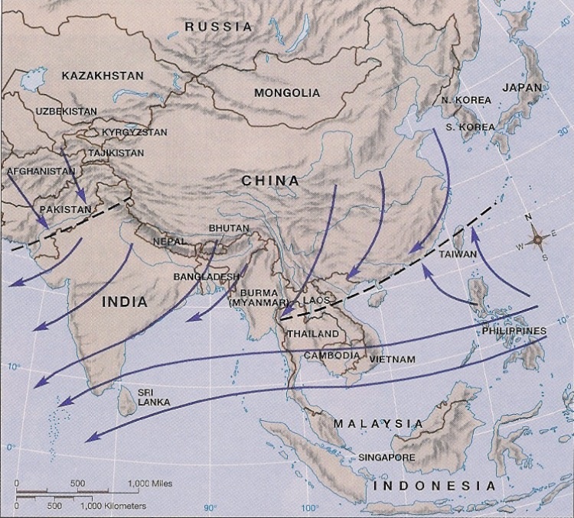
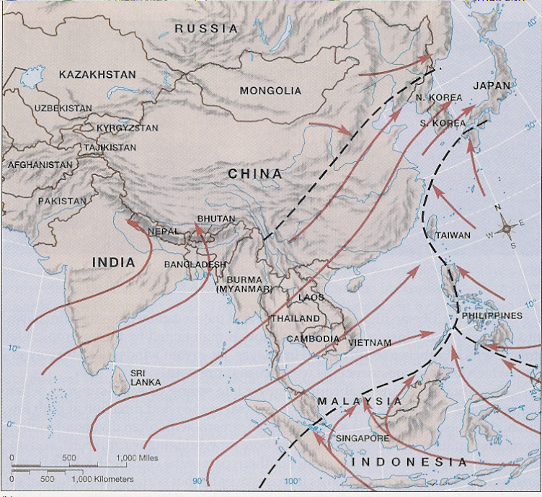
Winter
Asian Monsoon
Thermally direction circulation
Warm air rises Cold air sinks
Strongest manifestation over Southeast Asia
H
Cold
Cherrapunji
offshore flow
Summer
L
Warm
L
Warm
Akin to Fig. 9.17 H&P
Winter-cold continent/warm ocean offshore wind, arid land
Summer-warm continent/cold ocean onshore wind, wet land
Cherrapunji
onshore flow
H
Cold
Akin to Fig. 9.17 H&P
Aguado & Burt Fig 8-17

Slide 4
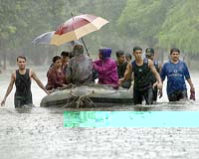
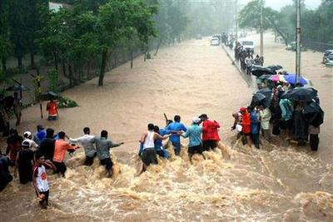
Survey: Wettest regions of the Asian monsoon average close to how many inches per year?
    200 inches
    400 inches
    800 inches
    1200 inches
BUT HOW WET
IS IT REALLY?
MONSOON IN INDIA
IS REALLY WET!

Slide 5
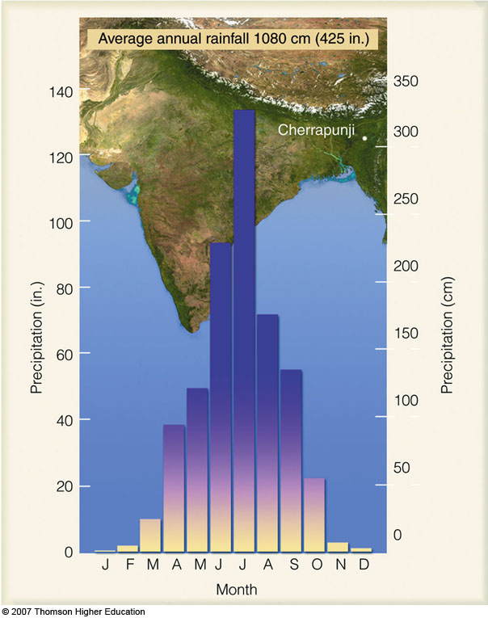
Survey: Wettest regions of the Asian monsoon average close to how many inches per year?
    200 inches
    400 inches
    800 inches
    1200 inches
Monthly rainfall
Cherrapunji, India
Ahrens & Henson
MONSOON IN INDIA
IS REALLY WET!
ONE OF THE WETTEST
SPOTS ON EARTH!

Slide 6
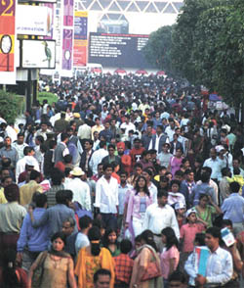
If the Indian monsoon is too dry or too wet it can be catastrophic ordeal for rapidly growing Asian countries.
Considering India and SE Asia have a combined population of more than 3 billion …
New Delhi, India

Slide 7
North America has a monsoon too--and it affects the Southwest U.S. and Mexico in a very big way!
First: Monsoon Climatology
Second: Societal Implications

Slide 8
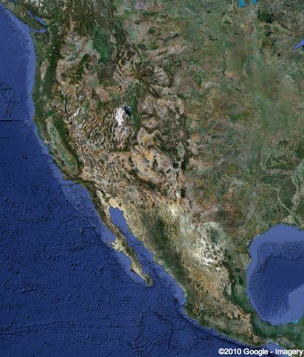
Why a North American Monsoon?
Similar to Asia, North America has a giant elevated plateau in the western U.S. and Mexico.
However, in our case, the Mexican plateau is only about 4,000-7,000 ft. in elevation, depending on where you are.
While it is not as high as Tibet, it IS high enough that there is a regular seasonal reversal of circulation.
COLORADO PLATEAU
MEXICAN PLATEAU

Slide 9
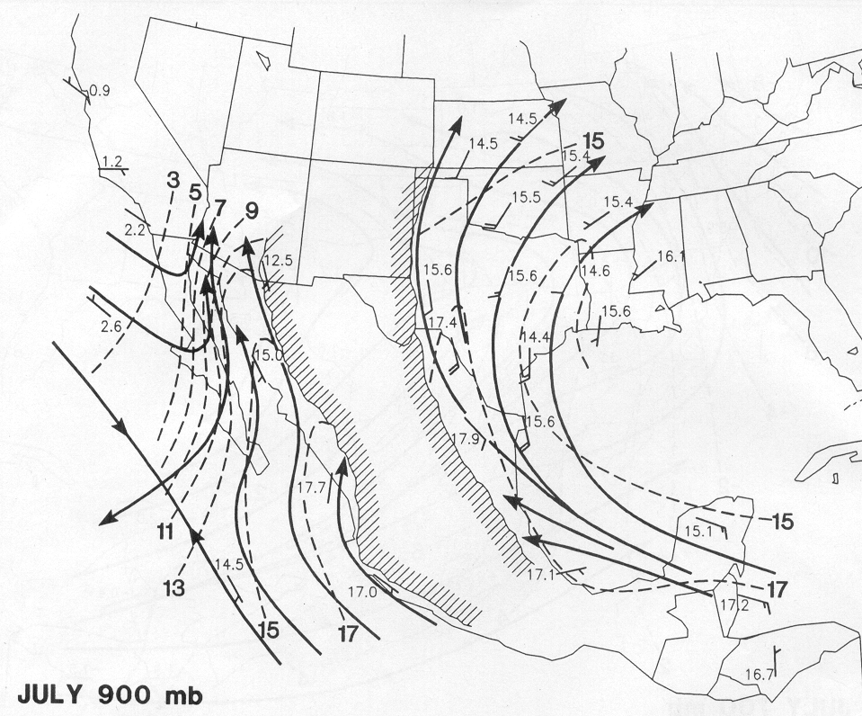
July 900 mb Flow
Mountains block flow of low-level moisture from Gulf of Mexico
tropical moisture
Douglas et al (1993)

Slide 10
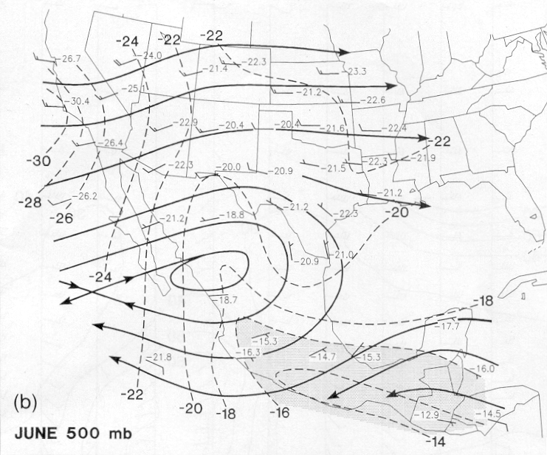
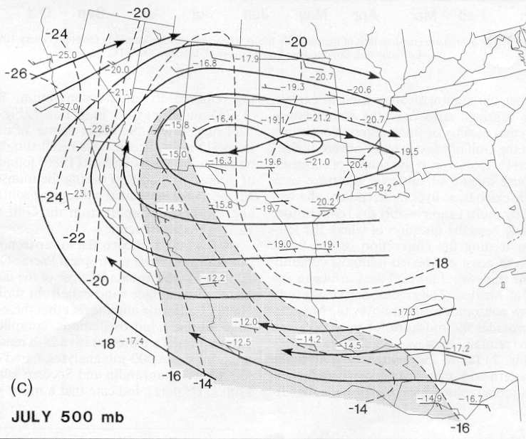
Evolution of Monsoon Ridge and Upper-Level Moisture
DRY AIR
★
★
MOIST AIR
MOIST AIR
(Douglas et al. 1993)
Shaded areas indicate regions of dew points > -16°C

Slide 11
Survey: How much of the average annual rainfall falls during the wet monsoon season over Phoenix-Tucson?
  < 10%
  20-30%
  40-50%
  60-70%
  80-90%

Slide 12
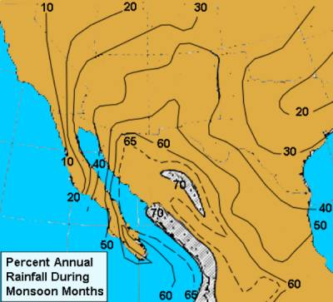
Survey: How much of the average annual rainfall falls during the wet monsoon season over Tucson?
  < 10%
  20-30%
  40-50%
  60-70%
  80-90%
Monsoon Core ~70%
Tucson ~50%
Phoenix ~40%
CORE

Slide 13
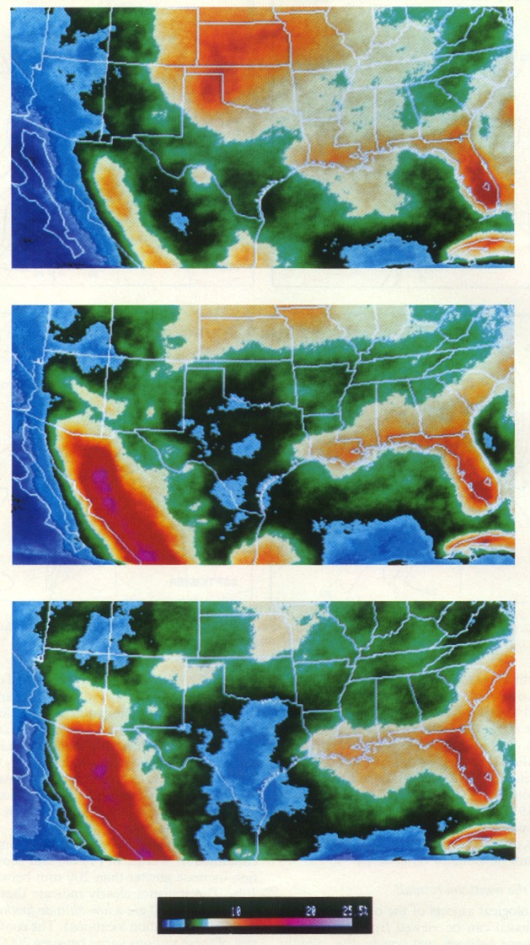
Monsoon Evolution from Satellite
★
June
Cold Cloud Temps < -38ºC Proxy for Deep T-storms
Centered over W. Mexico
June start over Mexico
Arizona at northern fringe of monsoon core
July start over SE Arizona
★
Max frequencies near 20%
July
★
Max frequencies near 20%
August
Douglas et al (1993)

Slide 14
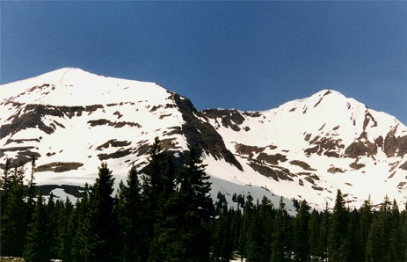
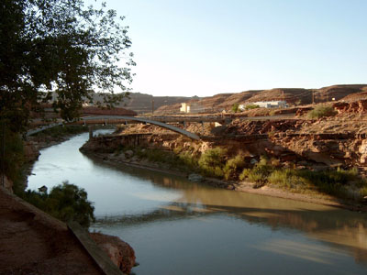
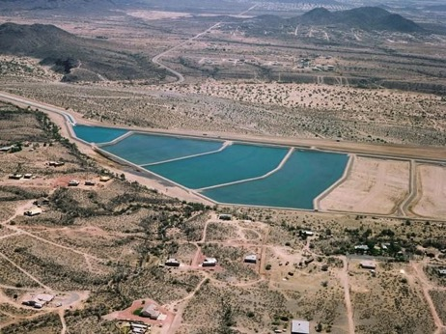
The Importance of the Monsoon to Water Resources for Arizona
Arizona: Depends mostly on spring melt and the storage of runoff of winter snow pack. Water is delivered from the Colorado River throughout lower deserts of Arizona by the Central Arizona Project.
Snow pack melt over Colorado Rockies
Colorado River
Central Arizona Project
Slide courtesy of C. Castro, UA/HAS

Slide 15
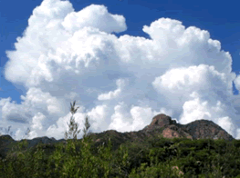
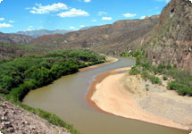
The Importance of the Monsoon to Water Resources for Sonora
Sonora: Depends heavily on runoff from monsoon thunderstorms along the western slopes of the Sierra Madre Occidental Mountains during the summer since wintertime snowpack dwindles rapidly south of the Colorado River Basin.
Thunderstorms during the monsoon
The flow of water in rivers
Slide courtesy of C. Castro, UA/HAS

Slide 16
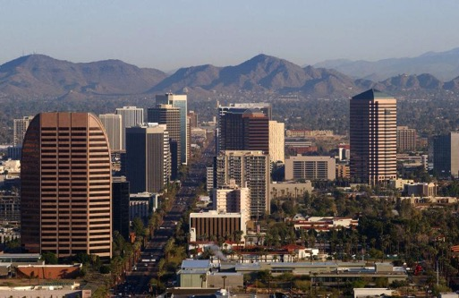
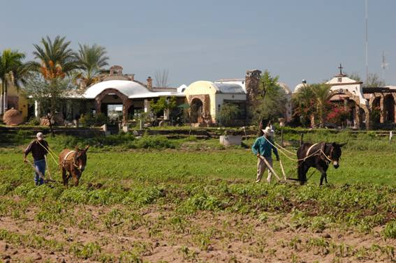
Importance of Monsoon
Arizona: We are less vulnerable to year-to-year fluctuations in rainfall owing to large storage capacity of Colorado River water and infrastructure to deliever it. But we are not imune to extended periods of drought.
Sonora: NW Mexico is very vulnerable to dry monsoons since summer rains provide most of the water resources to the region to grow crops and replenish reservoirs.
Slide courtesy of C. Castro, UA/HAS

Slide 17
Monsoonal Winds
Monsoons
Differential heating between land-sea
Seasonal reversal of temperature/wind
Onshore Summer – Offshore Winter
Rains Summer – Drought Winter
Regions Affected
Major monsoon occurs over SE Asia
Weaker versions occur over North America
Africa, Australia, South America

