Slide 1
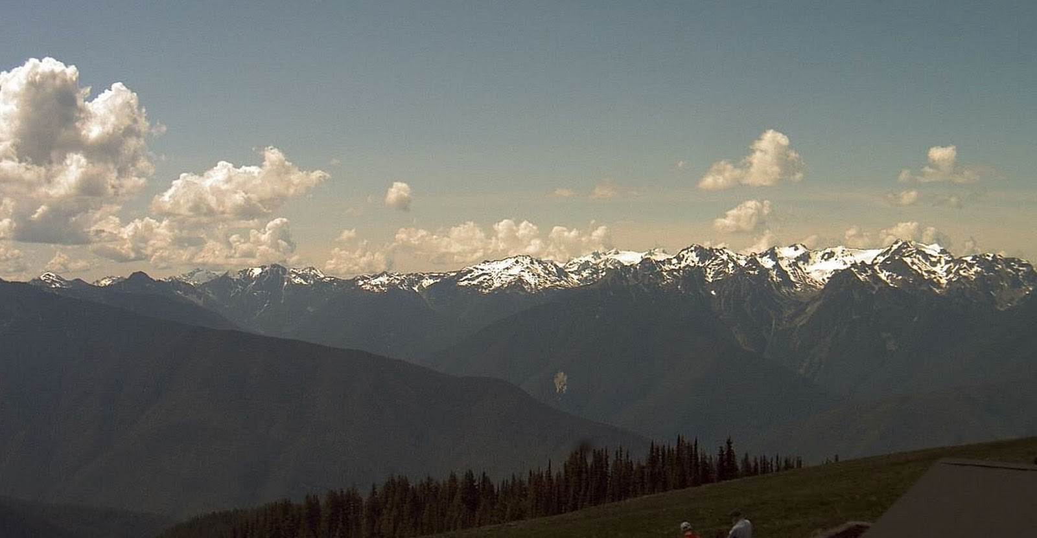

ATMO 170A1
Online
Diurnal Winds
Land-Sea Breeze
Mountain-Valley Circulation
Thunderstorms begin to form over Hurricane Ridge of the Olympic Mountains, aided by an afternoon valley breeze.. http://cliffmass.blogspot.com/2015/05/thunderstorms-and-convection-over.html

Slide 2
Concept Review:
Differential Bottom Heating Produces
Thermally Direct Circulation
DIV
CON
Warm
Rising
Sinking
Cold
Less Dense
More Dense
CON
DIV
BottomHeating
Bottom Cooling

Slide 3
Concept Review:
Differential Side Heating Produces
Thermally Direct Circulation Too
DIV
CON
Side Heating
Side Cooling
Warm
Rising
Sinking
Cold
Less Dense
More Dense
CON
DIV

Slide 4
Equivalently:
Heating over Sloping Terrain Produces
Thermally Direct Circulation
DIV
CON
Warm
Rising
Sinking
Cold
More Dense
Less Dense
Heat Flow
Heat Flow
CON
DIV

Slide 5
But Top-Down Heating Increases Stability and Inhibits Circulation Development
Top Heating
Warming
Lighter
Resists Vertical Displacements and Weakens Existing Thermal Circulations
Denser
Cooling
Bottom Cooling

Slide 6
Local Winds:
Land-Sea Breezes
Mountain-Valley Circulations
Basically the same physical idea for each one:
A thermally direct circulation develops that occurs where a daily reversal of the PGF is the dominant force that drives the wind.
Driven by the diurnal cycle of solar heating.

Slide 7
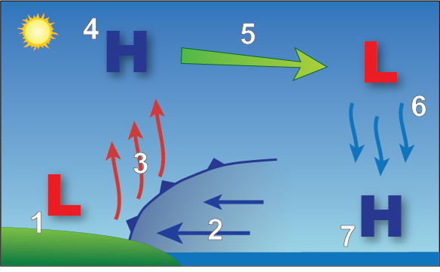
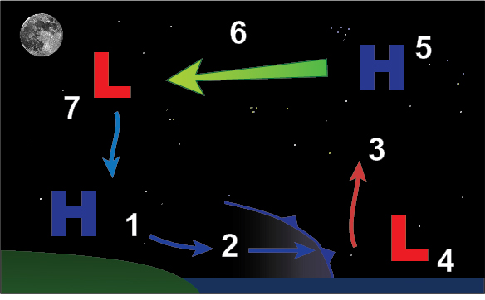
Sea-Land Breeze
Section 8.3, H&P
DAYTIME: Sea Breeze
NIGHTIME: Land Breeze
PGF
PGF
https://www.weather.gov/jetstream/seabreeze
https://www.weather.gov/jetstream/seabreeze
Water is relatively cool, dense
Land is relatively warm, light
Onshore flow at the surface
Offshore flow aloft.
Water is relatively warm, light
Land is relatively cool, dense
Offshore flow at the surface
Onshore flow aloft.
Occurs because water has a high heat capacity.
Diurnal temperature changes are negligible over water.
Notes:
First look at sea-breeze.
Air at ground warms during afternoon. Column air expands, producing high pressure aloft over land (label 4).
Higher pressure aloft (label 4) creates an offshore PGF. Air parcels aloft over land accelerate (label 5) to over the ocean.
SLP at the ground falls inland (label 1) as air parcels accelerate offshore (label 5); similarly, SLP rises over the water (label 7). This creates an onshore PGF.
Onshore push of dense, cold air from the sea (label 2) forces upward motion (label 3).
Onshore push of the marine air can extend more than 100 km inland.
Nightime land-breeze is analogous to afternoon sea-breeze, but land-breeze is weaker since the temperature contrast is typically smaller.

Slide 8
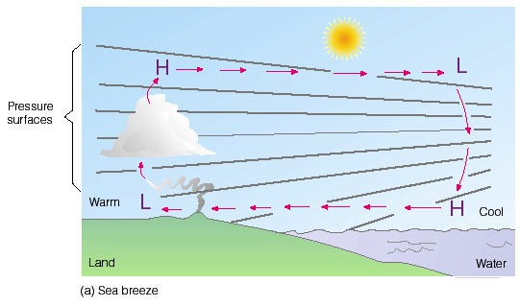
Sea-Land Breeze
Section 8.3, H&P
DAYTIME
NIGHTIME
DIV
CON
DIV
CON
Warm
Rising
Sinking
Cold
Warm
Rising
PGF
Sinking
Cold
PGF
CON
Heat
DIV
CON
Heat
DIV
Water is relatively cool, dense
Land is relatively warm, light
Onshore flow at the surface
Offshore flow aloft.
Water is relatively warm, light
Land is relatively cool, dense
Offshore flow at the surface
Onshore flow aloft.
Occurs because water has a high heat capacity.
Diurnal temperature changes are negligible over water.

Slide 9
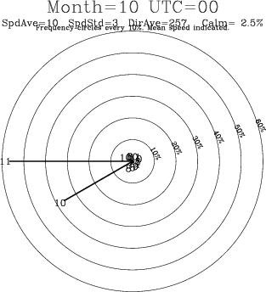
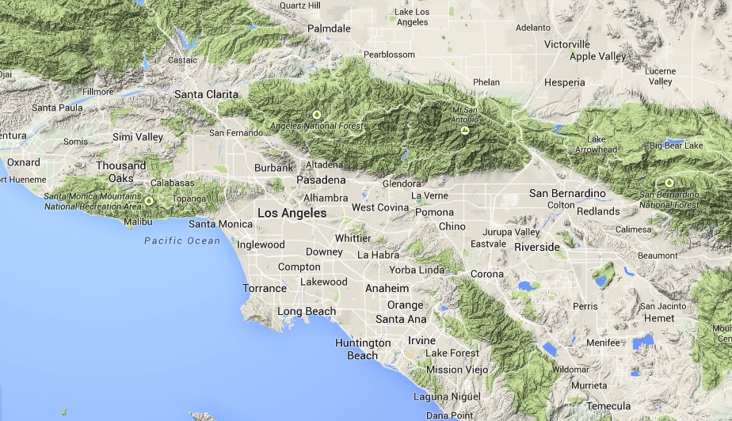
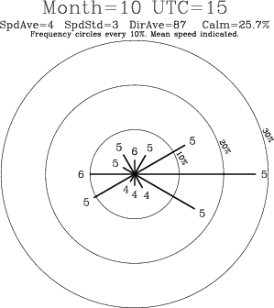
Los Angeles International Airport
LAX
4:00 PM
OCEAN
LAND
15°F difference
7:00 AM
OCEAN
LAND
LAX
⬥
Stronger temperature contrast in afternoon than morning
Sea breezes stronger than land breezes
10°F difference

Slide 10
Sea Breeze
Persistent feature of many coastal areas
California, Florida, Gulf Coast
Occurs also along large lakes-Great Lakes
Typically strongest during calm, sunny weather
Can penetrate inland 100 km or more
Temperatures can drop ~10º C within minutes
Nose of cool air can trigger thunderstorms

Slide 11
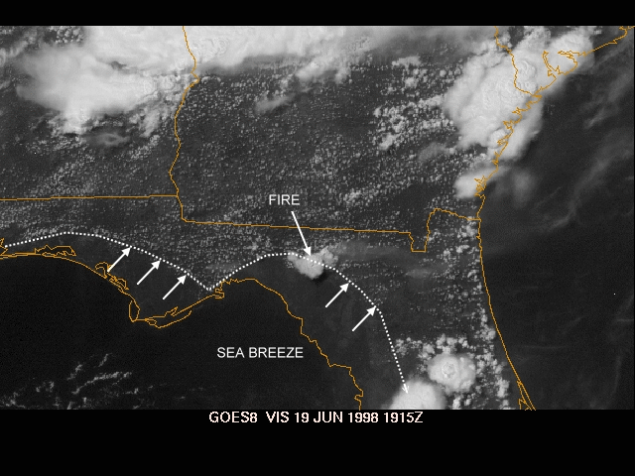
Florida Peninsula
Florida Satellite Loop
Sea breeze brings cool, stable air inland that suppresses thunderstorm activity. Note evidence of easterly sea breeze along eastern shoreline of FL and a line of thunderstorms along its nose. (FL Dept. of Forestry).

Slide 12
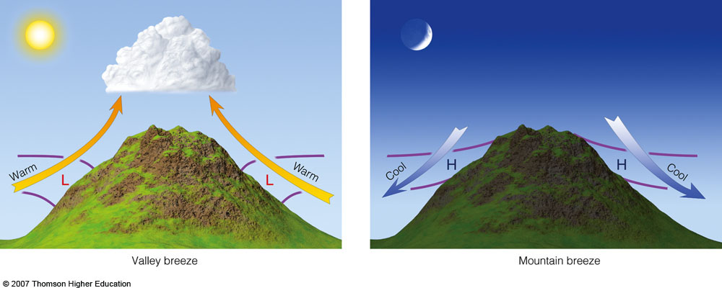
Mountain-Valley Breeze
Sun warms slopes Density decreases Air rises
DIV
CON
IR loss cools slopes Density increases Air drains
WARMER
Rising
Sinking
COLDER
constant height
constant height
CON
DIV
Heat
Heat
Ahrens, 6th ed.
Air is heated along the mountain slopes during sunny days
Warmed air is less dense than neighboring air above the valley.
Upslope flow
Air is cooled along the mountain slopes during the night
Cooled air is more dense than neighboring air above the valley.
Downslope flow
Notes:
Valley Breeze, left diagram
As the sun heats the slope of the mountain during the day, air next to the slope warms and its density decreases.
The air next to the slope is less dense than the air of the valley floor at the same height ASL.
The difference in density leads to the warm air along the slopes to rise to the top of the mountain.
If conditions to form thunderstorms exist, they will typically form over mountain peaks first owing, in part, to valley breezes.
Mountain Breeze is analogous to Valley Breeze with cooling of air next to the mountain slopes during the evening.

Slide 13
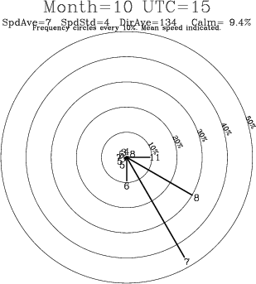
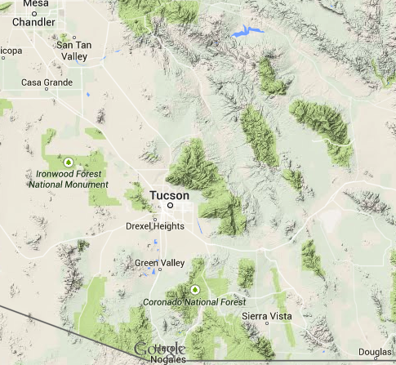
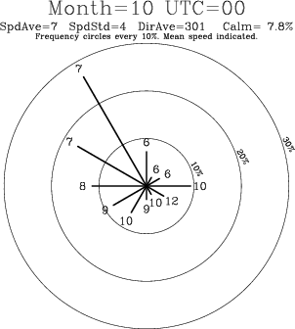
Topography near Tucson
AM
TUS
Lower Elevations
~1000’
We’re surrounded by mountains on three sides and sloping plain from NW to SE, so mountain valley circulations play a BIG role in our weather—especially during the monsoon!
Tucson is situated in the Santa Cruz River Valley, which slopes from NW to SE, so mountain valley circulations also play a role in our weather
CATALINA MTS.
★
PM
TUS
RINCON MTS.
Higher Elevations
~4000’
SANTA RITA MTS

Slide 14
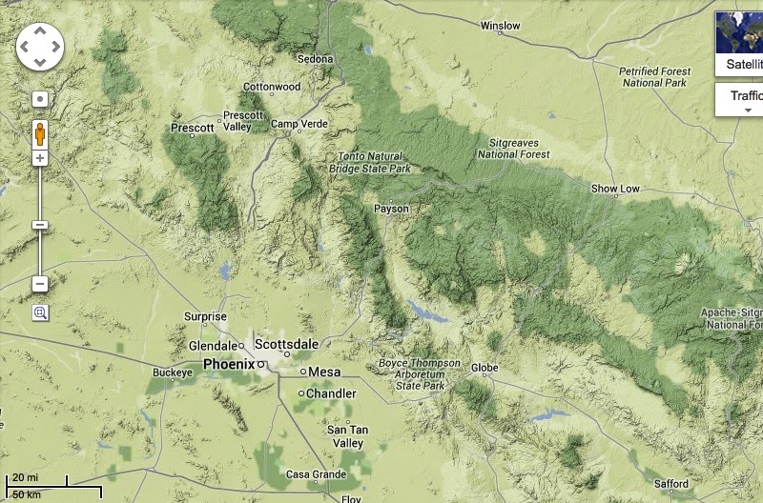
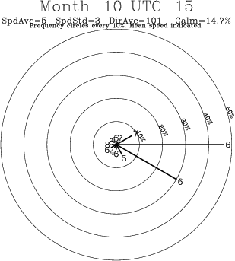
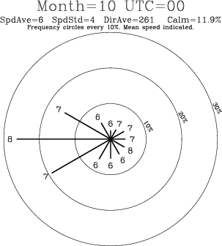
Topography near Phoenix
Phoenix is situated in the Salt River Valley, which slopes from WSW to ENE, so mountain-valley circulations also play a role in their weather
AM
PHX
PM
PHX
MOGOLLON RIM
Higher Elevations
WHITE MTS
★
Lower Elevations

Slide 15
Mountain-Valley Circulation
Feature of mountainous, inland climates
Arizona, Southwest U.S. and Mexico ...
Typically strongest during Summer
Can combine with land-sea breezes
Upward motion over mountain peaks during the afternoon aids thunderstorm development of mountains

Slide 16
Oscillating Thermally Direct Circulations: Diurnal Winds
Land-Sea Breeze
Differential heating between land-sea Diurnal reversal in temperature contrast Onshore wind PM – Offshore wind AM Sea breeze PM – Land breeze AM
Mountain-Valley Breeze
Differential heating between air-mountain slopes Diurnal reversal in temperature contrast Upslope wind PM – Downslope wind AM Valley breeze PM – Mountain breeze AM

