Slide 1
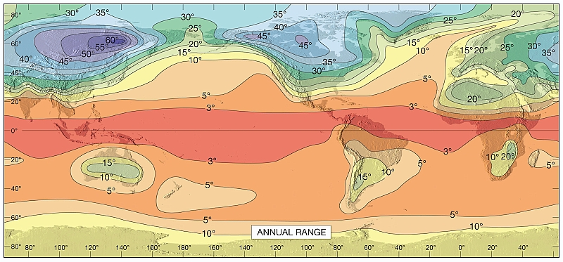

ATMO 170A1
Online
The Time-Average Atmosphere:
Seasonal & Spatial Differences
H&P §9.1
Lutgens and Tarbuck

Slide 2
Let’s Add the Missing Ingredients of Seasons and Land-Sea Contrast
What does this do?
Key idea: land heats and cools at faster rate than water, which has a high heat capacity
High pressure over cold land in the winter
Low pressure over warm land in the summer
+
Sun is not always directly over the Equator Three cells follow the sun’s north-south cycle

Slide 3
Seasonal differences in temperature.

Slide 4
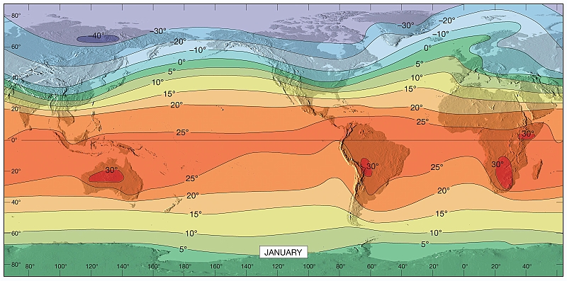
Boreal Winter (DJF) Surface Average Temperature
Lutgens and Tarbuck
Lutgens and Tarbuck
Akin to H&P, Fig. 9.1
Continents colder than oceans.
Arctic region 50°-60°C colder than tropics.
Temperature gradient stronger in winter NH than summer SH.
More undulations in NH pattern than SH pattern.

Slide 5
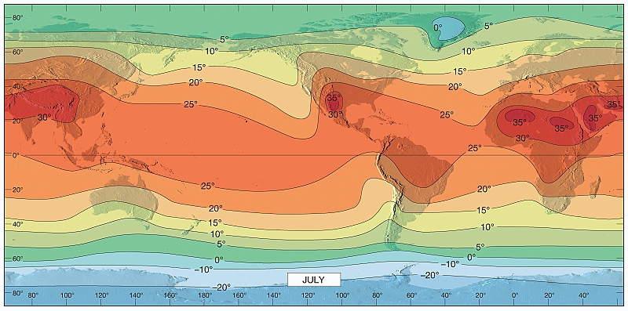
Boreal Summer (JJA) Surface Average Temperature
Lutgens and Tarbuck
Akin to H&P, Fig. 9.1
Continents warmer than oceans.
Arctic region 20°-25°C colder than tropics.
Temperature gradient stronger in winter SH than summer NH.
More undulations in NH pattern than SH pattern.

Slide 6
Warmest - Coldest Days Temperature Difference
Lutgens and Tarbuck
Continents undergo larger seasonal changes than oceans.
High latitudes undergo larger changes than low latitudes.
(Temperature changes at South Pole are close to 30°C.)

Slide 7
Seasonal differences in SLP.

Slide 8
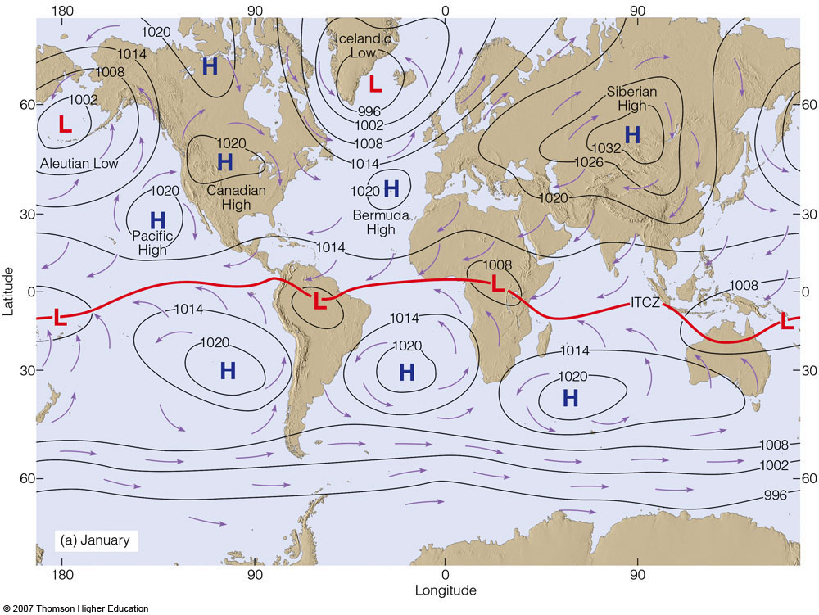
January
Ahrens & Henson
Notes:
JAN average SLP
Concentrate on N.H.
Low pressure over northern oceans: North Atlantic and North Pacific
High pressure over continents: North America and Asia
Note the weakness and latitudes of the subtropical highs: Pacific High and Bermuda High
Winds are predominately offshore.

Slide 9
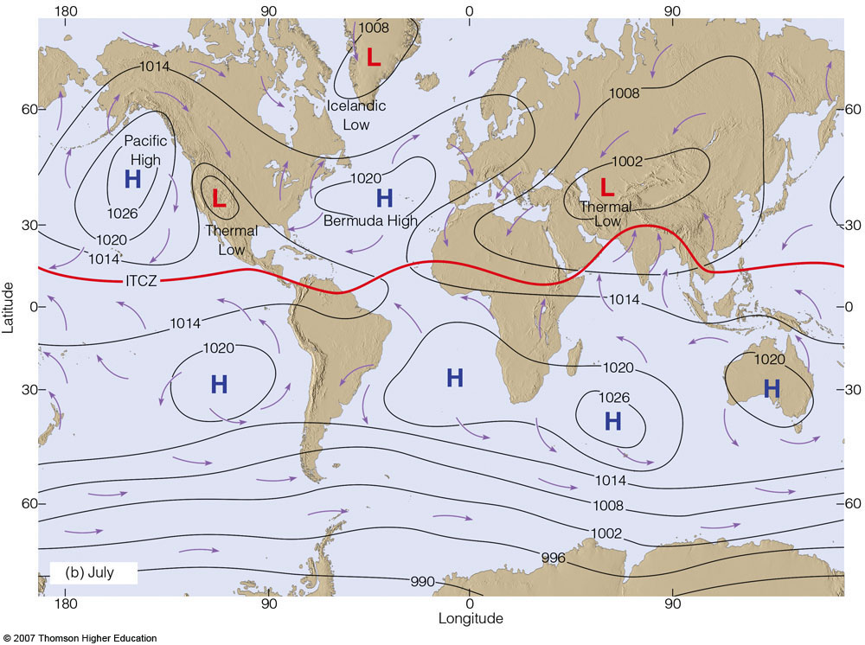
July
Ahrens & Henson
Notes:
JUL average SLP
Land-sea pressure differences reverse from winter
Low pressure over continents: North America and Asia
High pressure over northern oceans: North Atlantic and North Pacific
Winds are predominately onshore.

Slide 10
Seasonal reversal of land-sea pressure gradient
is another signature of a monsoon circulation.

Slide 11
Seasonal differences in upper-air winds.

Slide 12
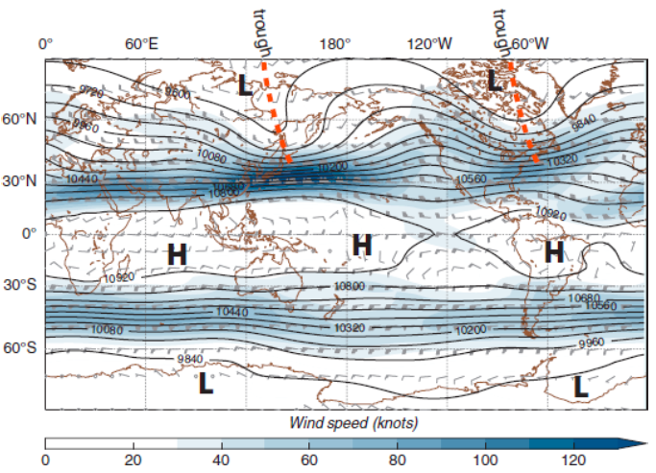
Figure 9.3. (a) Average 250 hPa heights, winds, and wind speeds for January with schematic representation of higher and lower pressures, and upper-level troughs. Areas of maximum wind speed indicate the position of the jet streams.

Slide 13
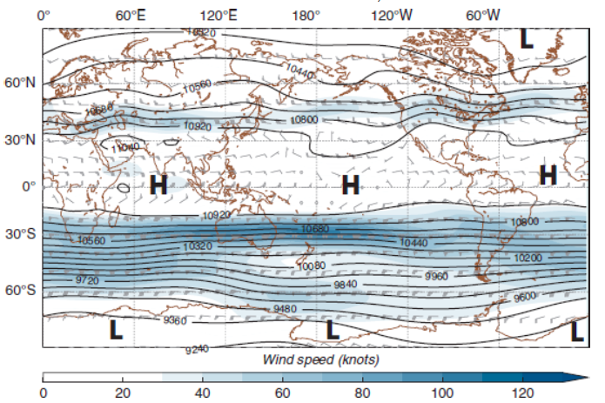
Figure 9.3. (b) Average 250 hPa heights, winds, and wind speeds for July, with schematic representation of higher and lower pressures. Areas of maximum wind speed indicate the position of the jet streams.

Slide 14
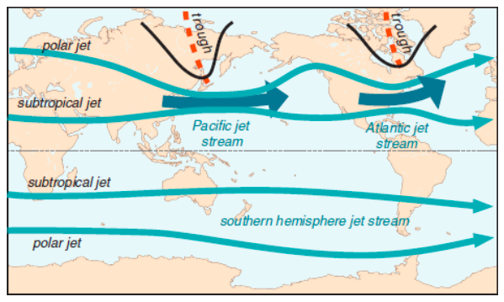
Figure 9.3. (c) Schematic representation of the semi-permanent jet streams and upper-level troughs (in winter for each hemisphere).

Slide 15
Seasonal differences in vertical motion.

Slide 16
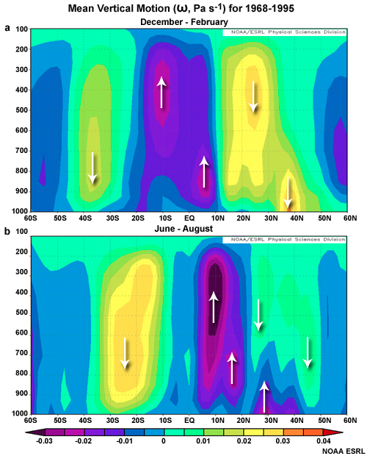
DJF & JJA Mean Vertical Motion
SH
DJF
NH
Hadley Core
Hadley Core
Hadley Cells follow the sun
Upward branches centered at
DJF: 0°-10° S
JJA: 10°-15° N
SH
JJA
NH
Hadley Core
Notes:
Vertical Velocity Fields NH Winter and NH Summer
Upward motion are purples. Downward are yellows.
Hadley cell has strongest upward motion.

Slide 17
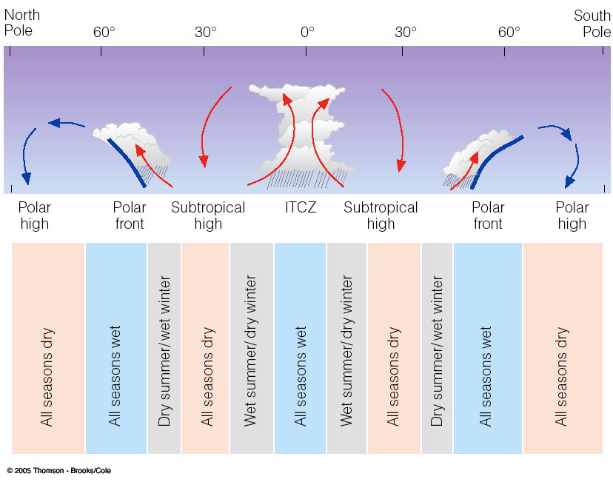
Vicinity of the ITCZ
Near constant rainfall
Tropical Rainforests
Subtropics
Wet-dry climates
Subtropical savannahs
Under subtropical high
Deserts: dry and hot
Mid-latitudes
Strong seasonality, but all seasons are wet for the most part along polar front
Polar
Dry and cold
Ahrens & Henson

Slide 18
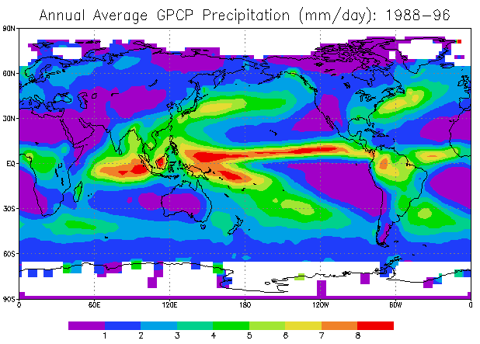
Largely explained by 3 cell circulation model
The global distribution of rainfall
Polar Fronts
Subtropical High
ITCZ
Subtropical High
Polar Fronts

Slide 19
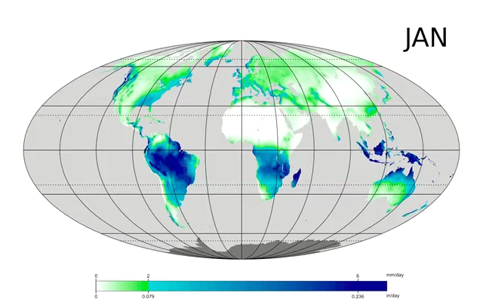
Long-Term Mean Precipitation by Month
Figure Credit: Wikimedia
Notes:
Monthly Mean Precipitation over Land
Maximum northward extent: JUL-AUG
Maximum southward extent: JAN

Slide 20
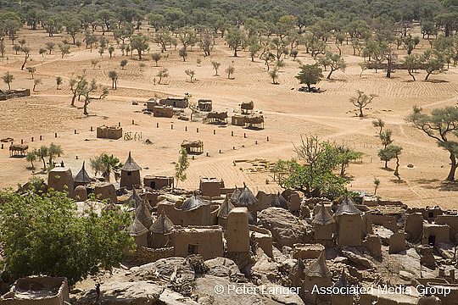
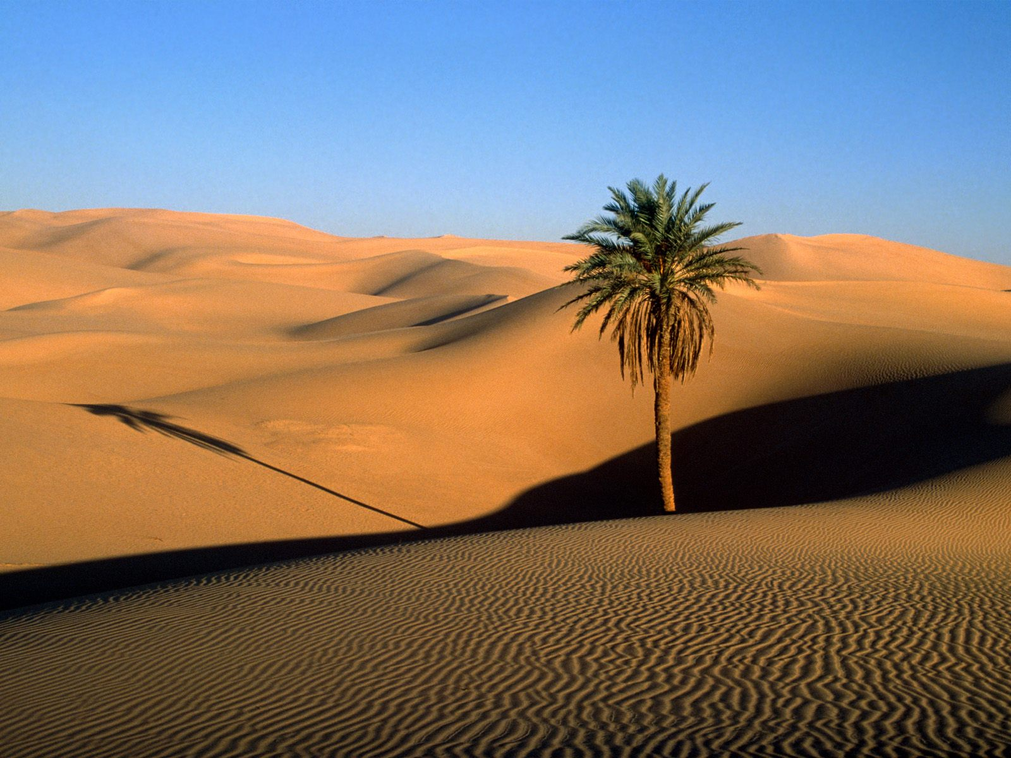
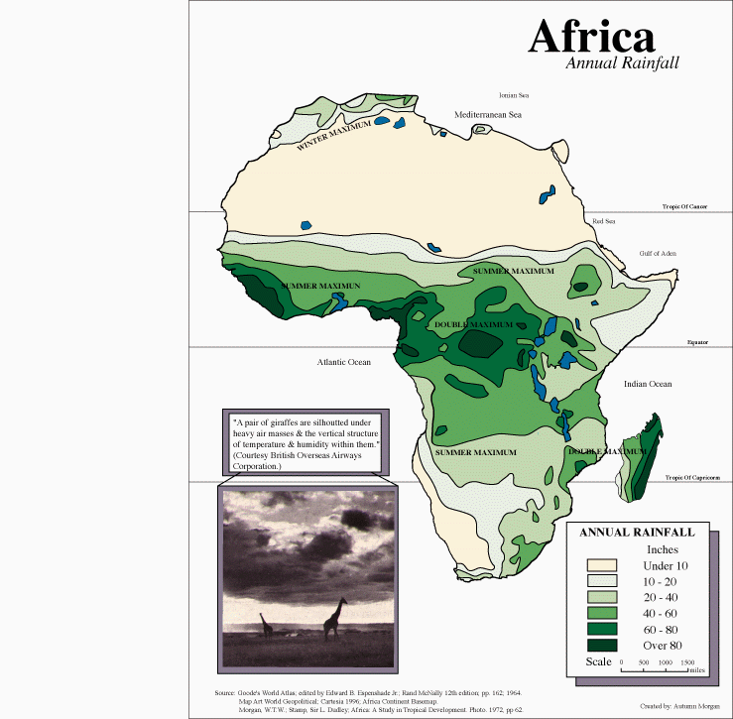
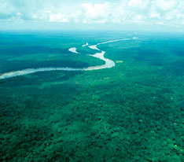
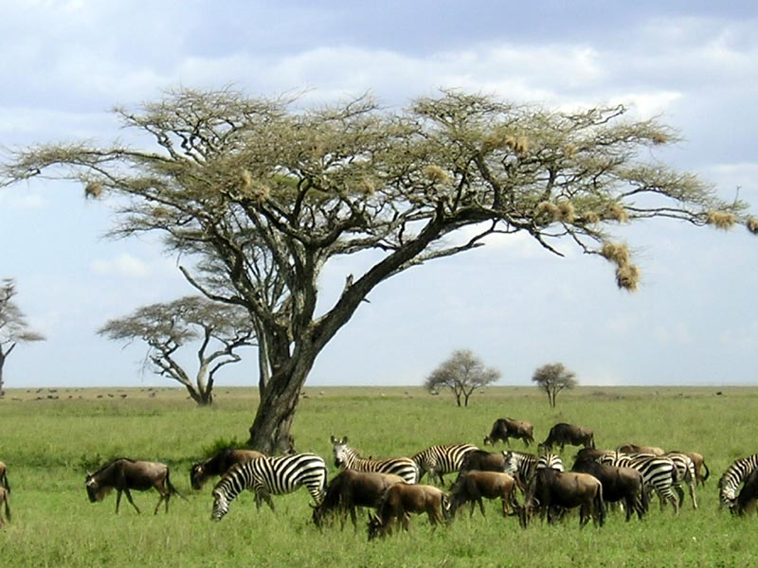
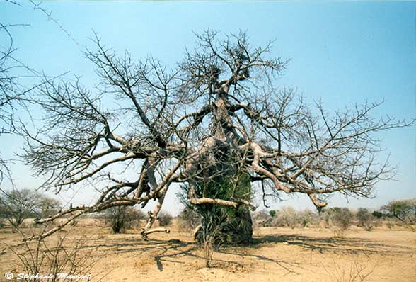
SAHEL
SAHARA DESERT
SAHARA DESERT
SAHEL
CONGO
RAIN FOREST
SARENGETI
CONGO
KALAHARI
DESERT
SARENGETI
(UNC Charlotte)
KALAHARI DESERT

Slide 21
Key Ideas
Time-Mean Global Circulation
Differential Heating between Tropics and Poles
3 Cells caused by Earth’s Rotation
Tropics: Trade Winds
Midlatitudes: Westerlies
Patterns Shift with Seasons
Precipitation
Wet Tropics in the ITCZ
Deserts occur with Subtropical Highs
Subtropics: Monsoon Circulations
Midlatitudes: Cyclones along Polar Front

