Slide 1
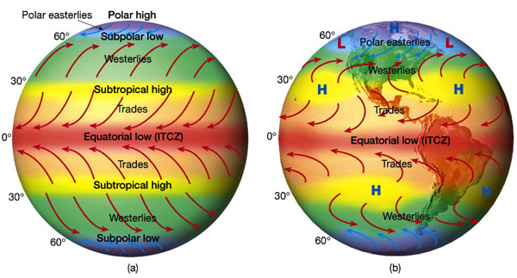

ATMO 170A1
Online
The Time-Average Atmosphere
Three-Cell Model
H&P: §9.2 and §9.3
Figure Credit: http://www.hort.purdue.edu/newcrop/tropical/lecture_03/11m.jpg

Slide 2
What is the Time-Average Circulation?
Weather throughout the world is averaged over a long period of time (over many winters, many summers, etc.)
  Local, varying weather patterns vanish
Distinct patterns in the prevailing winds and the average temperatures emerge
  Driven by the unequal distribution of heating of the earth’s surface

Slide 3

Consider A Simple World
Waterworld
Earth uniformly covered by water
  No terrain or land-sea heating differences
Sun is always directly over the equator
No seasons
  Earth doesn’t rotate
  No Coriolis effect
No diurnal cycle
Use average daily sun
Equatorial region
Greatest heating
Polar region
Least heating
Polar region
Least heating

Slide 4
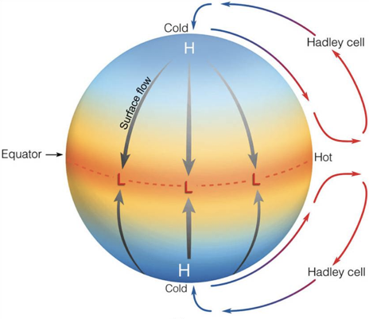
General Circulation of Waterworld
Single Equator to Pole Cell
Hadley Cell
HEAT TRANSPORT
THICK ARROWS
Akin to H&P, Figs. 9.7 & 9.8

Slide 5
Thermally Direct Circulations
Transport Heat Poleward
DIV
CON
H
L
Warm air toward poles
Heat
Heat
isobar
Heat Transport
Warm
Rising
Sinking
Cold
isobar
L
H
Cold air toward equator
CON
DIV
Tropics
Poles

Slide 6
But add the Earth’s rotation
And things get a bit more complicated…

Slide 7
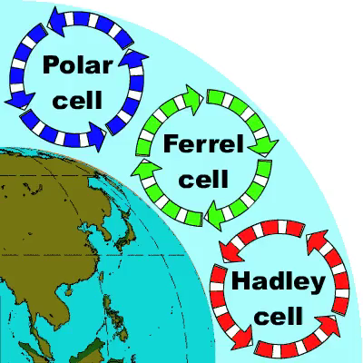
However, add rotation and you get…
Three Cell Circulation
Figure Credit: http://sparce.evac.ou.edu/q_and_a/air_circulation.htm

Slide 8
Consider a Rotating Waterworld
Three Cell Model
Rotation produces three circulation cells
  Hadley Cell (Strongest, Thermally Direct)
  Ferrel Cell (Weaker, Thermally Indirect)
  Polar Cell (Even Weaker, Thermally Direct)
Equator
Hadley
Ferrel
Polar
Pole
30 N
60 N

Slide 9
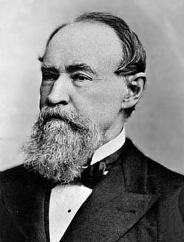
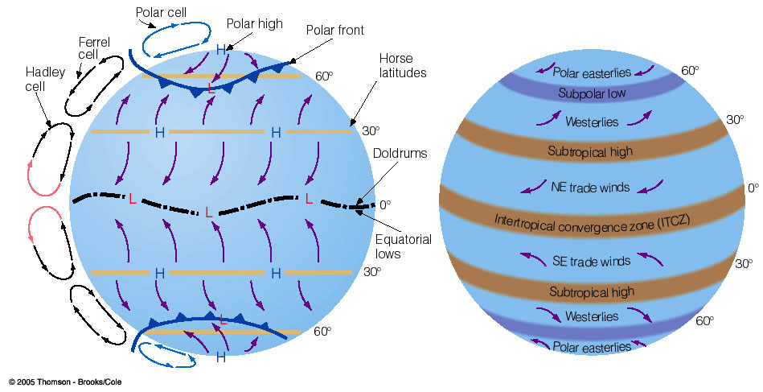
Rotating Waterworld
Prevailing Winds
William Ferrel
Coriolis deflects air to the right
Akin to H&P Fig. 9.11
Coriolis deflects air to the left
Ahrens
Notes:
Note Hadley cell, Ferrel cell, and Polar cell relative to surface features.
SFC low pressure along 0˚ and 60˚ latitudes underneath rising motion.
SFC high pressure along 30˚ and 90˚ latitudes underneath rising motion.
SFC winds flow equatorward between 0˚ and 30˚. Turn to the west (easterly trade winds) owing to Coriolis effect.
SFC winds flow poleward between 30˚ and 60˚. Turn to the east (westerly winds) owing to Coriolis effect.
Polar front lies along low pressure zone of 60˚.

Slide 10
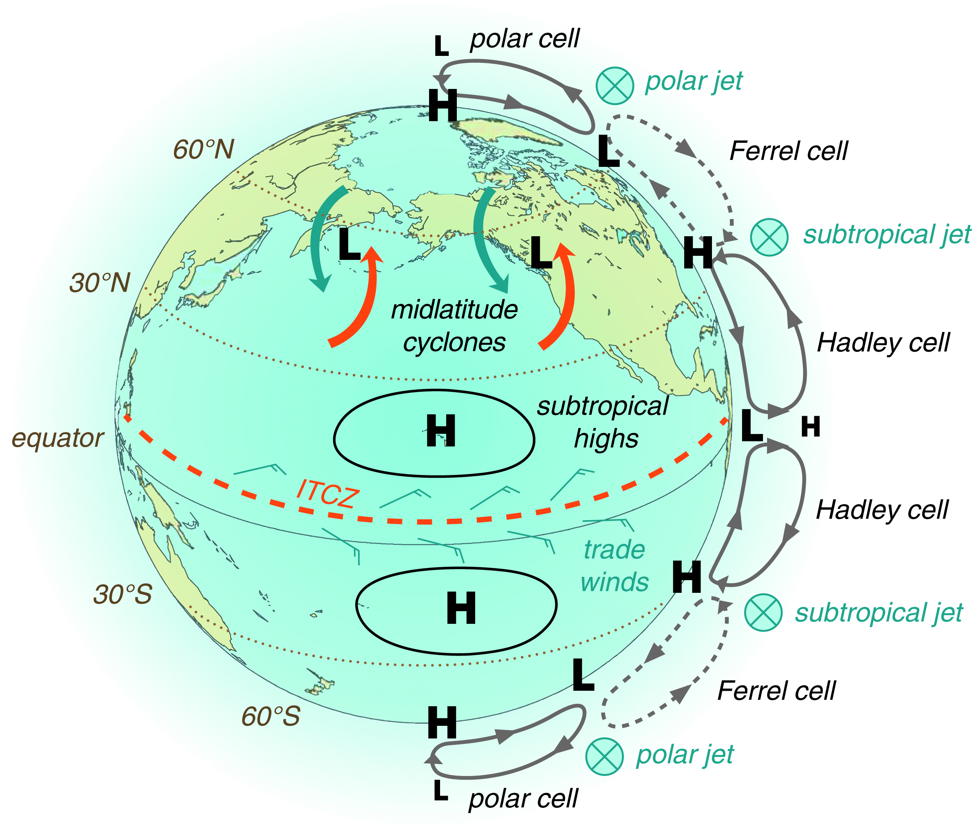
Rotating Waterworld
Prevailing Winds
William Ferrel
Coriolis deflects air to the right
Westerlies in midlatitudes
Easterly Trade Winds in tropics
Westerlies in midlatitudes
Coriolis deflects air to the left
H&P Fig. 9.11
Notes:
Fig. 9.11 from H&P. As in the prior figure, with two important additions.
Midlatitude cyclones form in the band between 30˚ and 60˚ latitudes. They move from west to east.
Two distinct jet streams marked: subtropical jet along 30˚ latitude, and polar jet along 60˚ latitude.
We comment on these figures next.

Slide 11
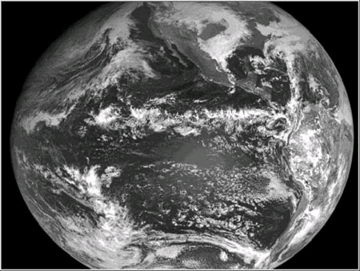
Inter Tropical Convergence Zone (ITCZ)
On a daily basis, the ITCZ is not a continuous band of clouds, but it is marked by clusters of thunderstorms.
Many processes modulate the occurrence and motion of these clusters in ITCZ.
Regions of the subtropical highs are not always clear.
Several midlatitude cyclones exist in the latitude band 30°-60°.
Midlatitude Cyclones
Subtropical Highs
ITCZ
ITCZ
Subtropical Highs
Midlatitude Cyclones
Akin
to H&P
Fig. 9.9
GOES Visible Image
Notes:
GOES visible image
ITCZ is not continuous.
Subtropics are not always clear.
Several cyclones simultaneously exist in the midlatitudes.

Slide 12
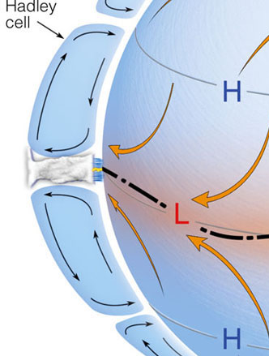
General circulation: Hadley Cell in tropics
3
2
4
1
Path of air through the Hadley Cell
Equator: Air converges at the surface and rises to form a band of clouds, called the Inter-Tropical Convergence Zone (ITCZ), and precipitation.
Upper level winds transport heat away from the equator.
Air aloft cools through emission of infrared radiation to space, air sinks at about 30° latitude, warms and dries, forming a subtropical high.
Air returns to toward the equator at the surface. Coriolis force causes easterly trade winds.

Slide 13
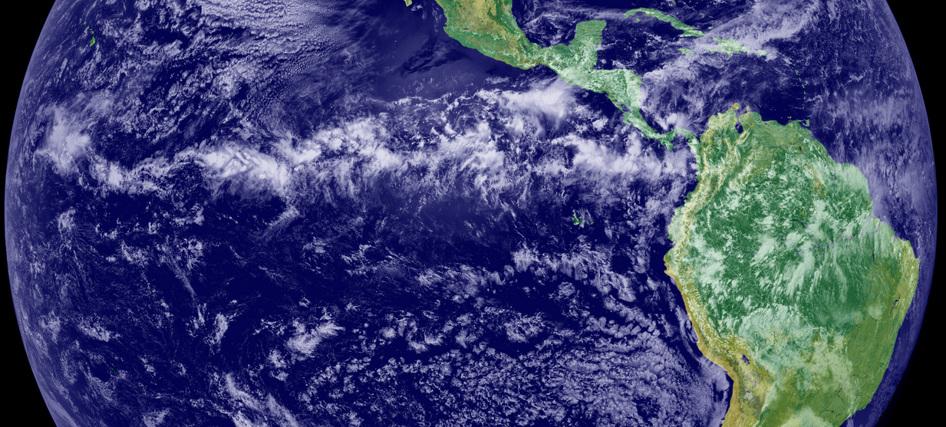
Inter-Tropical Convergence Zone (ITCZ)
SUBTROPICAL HIGH
ITCZ
ITCZ
SUBTROPICAL HIGH
GOES-11 Image
Figure Credit
Akin to H&P Fig. 9.9
In the real world, the ITCZ is not a continuous band of clouds, but it is patchy areas of moving clusters of thunderstorms.
Many processes modulate the occurrence and motion of Cb clusters

Slide 14
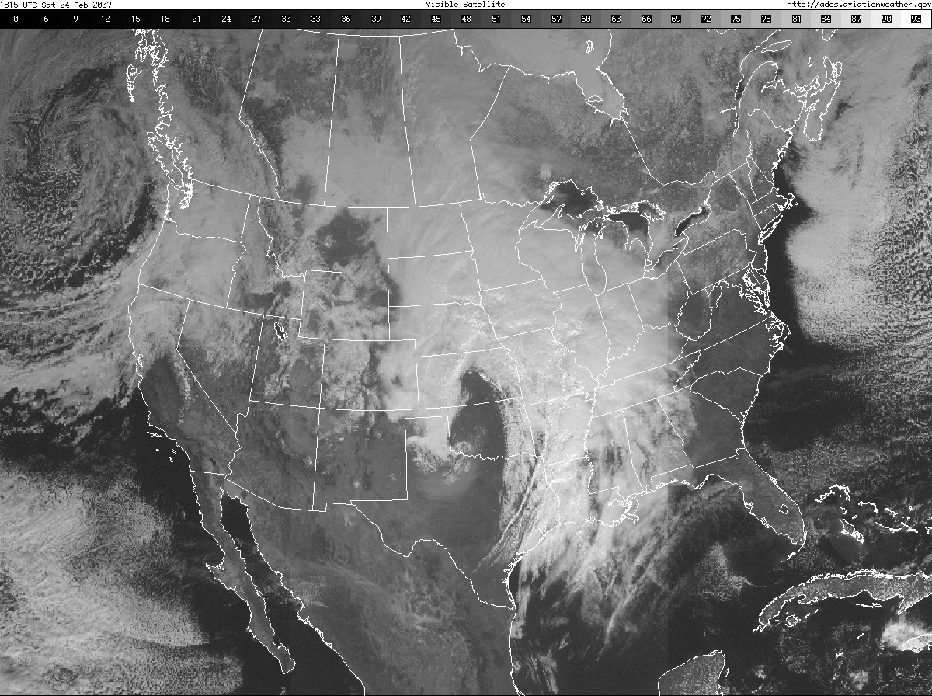
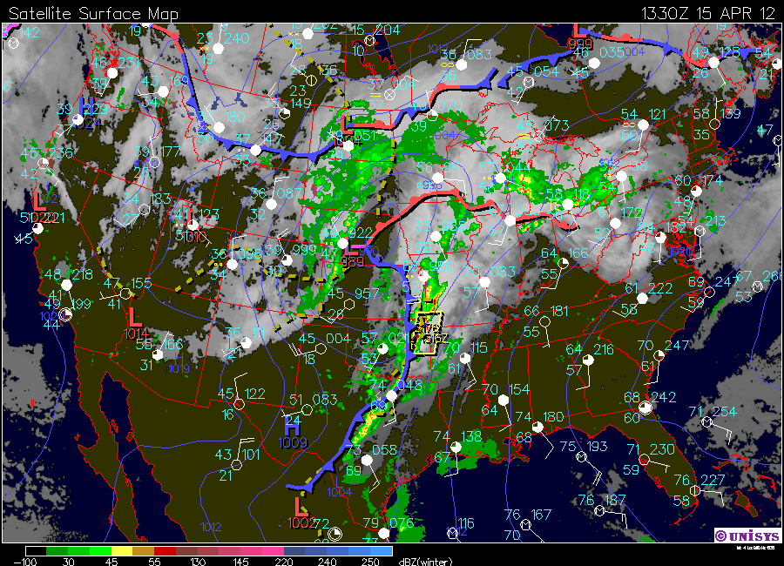
Midlatitude Cyclone Example
Poleward Heat Transport
WARM AIR
TOWARD POLE
COLD AIR TOWARD
EQUATOR
Notes:
Ferrel Cell is weak. It is as effective as Hadley cell in transporting heat poleward.
Midlatitude cyclones transport the bulk of heat poleward in midlatitudes.

Slide 15
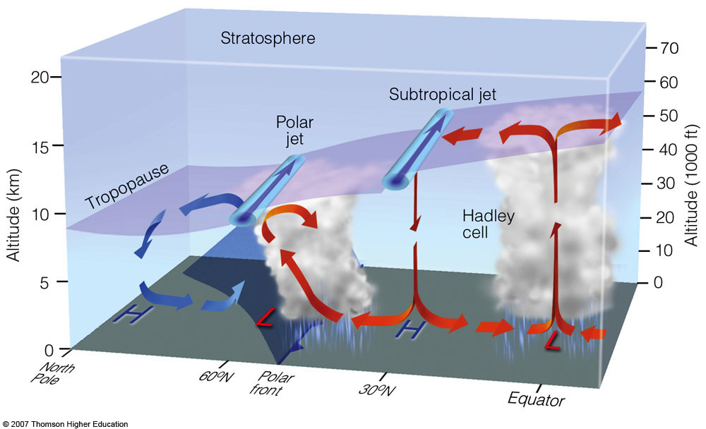
Complete 3 Cell Circulation
Ahrens 6th ed.
Jet streams near tropopause. Strong westerly winds
Subtropical Jet Stream: Defines limit of Hadley Cell
Polar Front Jet Stream: Equatorward of Polar Front

Slide 16
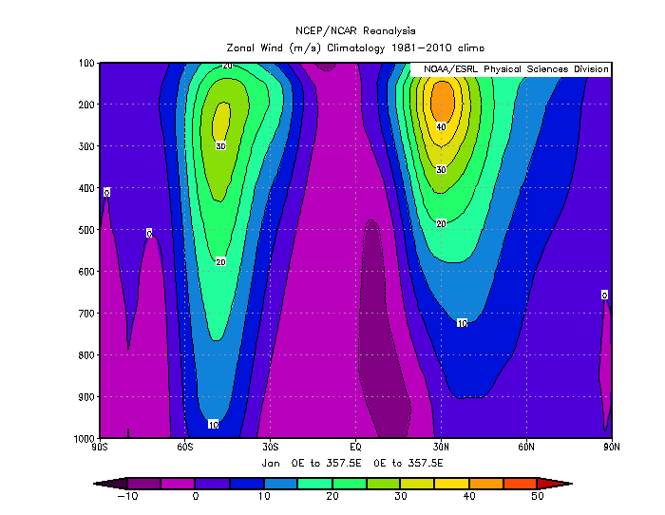
Notes:
January zonal (east-west) wind.
Note only one jet stream.

Slide 17
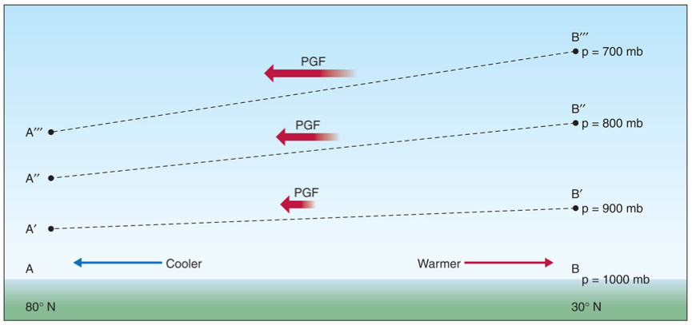
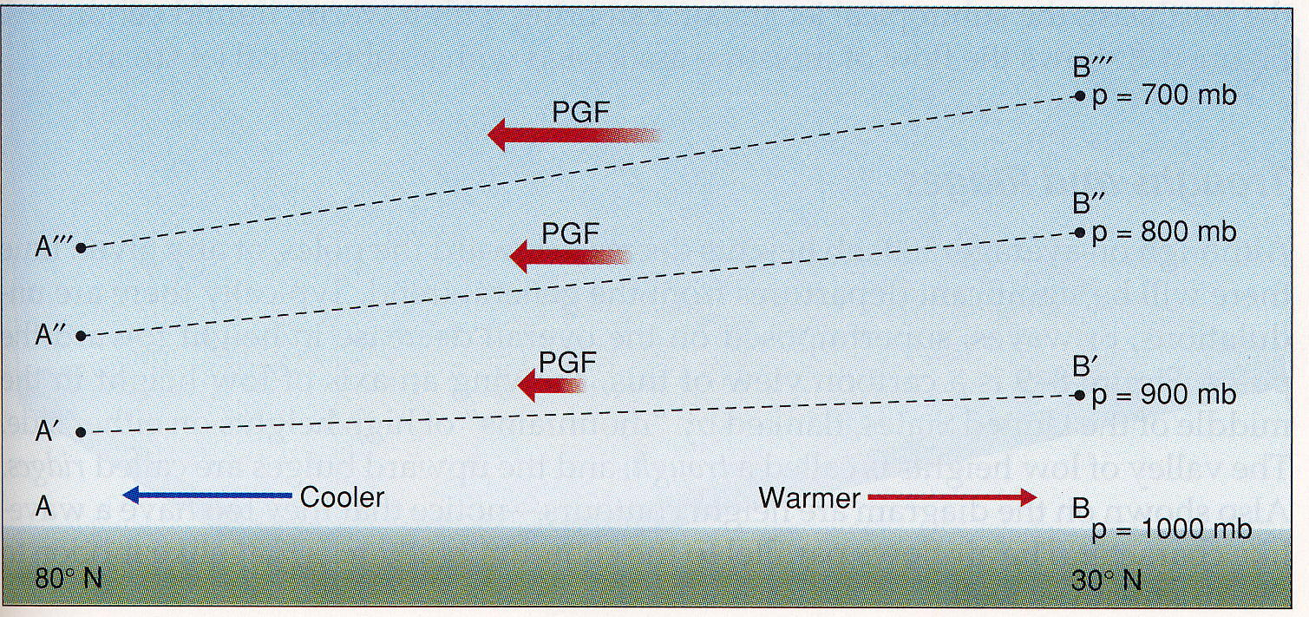
Polar Jet Stream over Middle Latitudes
Result of Strong N-S Thermal Contrast
Slope of isobaric surfaces is steepest around 200 to 300 hPa
Forces strong westerly geostrophic wind
Figure Credit: Aguado & Burt
Temperature gradient in midlatitudes produces an increasing PGF with height and thus increasing geostrophic winds.
Notes:
Why are jet streams located where they are?
Near the level of the tropopause, around 200-300 mb.
Above where the horizontal temperature contrast is the largest

Slide 18
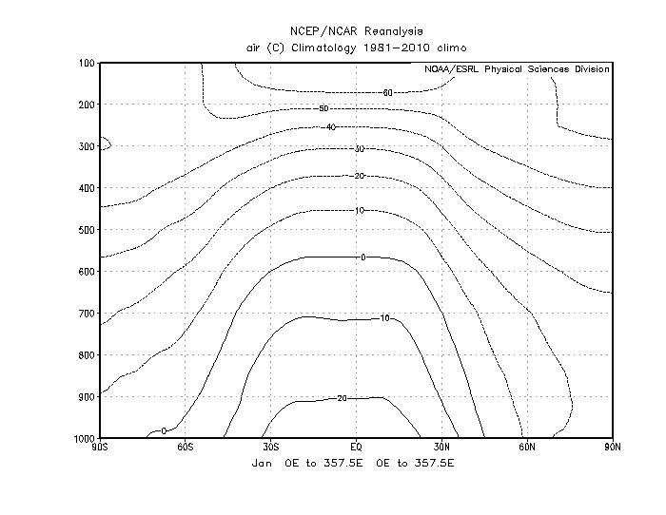
Notes:
Returning to zonal winds
Superimpose isotherms (every 10C)
Largest equator-to-pole

Slide 19
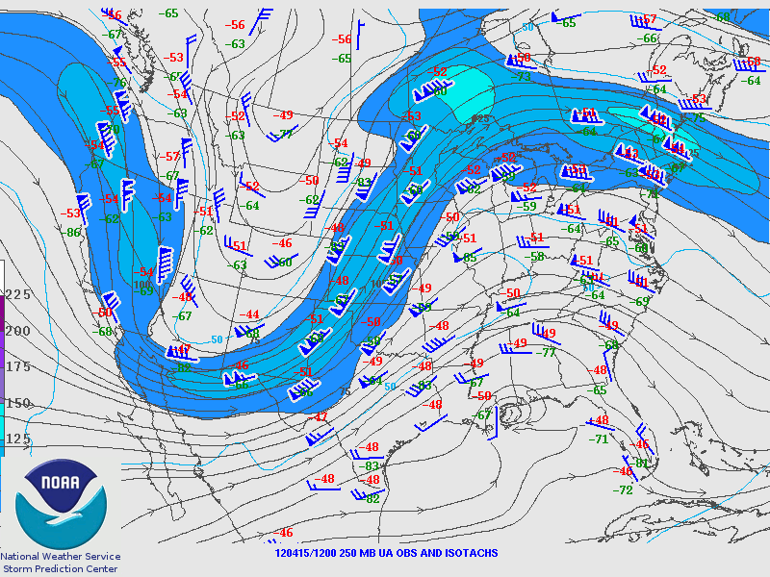
Polar Jet Stream
Midwest Storm Example
Note the slower winds around the trough, faster winds around the ridge (Rule 4, H&P p.135)
Jet stream is not a band of uniform fast westerly winds…
It has undulations
COLD AIR
WARM AIR
250 mb Winds & Isotachs
1200 UTC 15 APR 2012

Slide 20
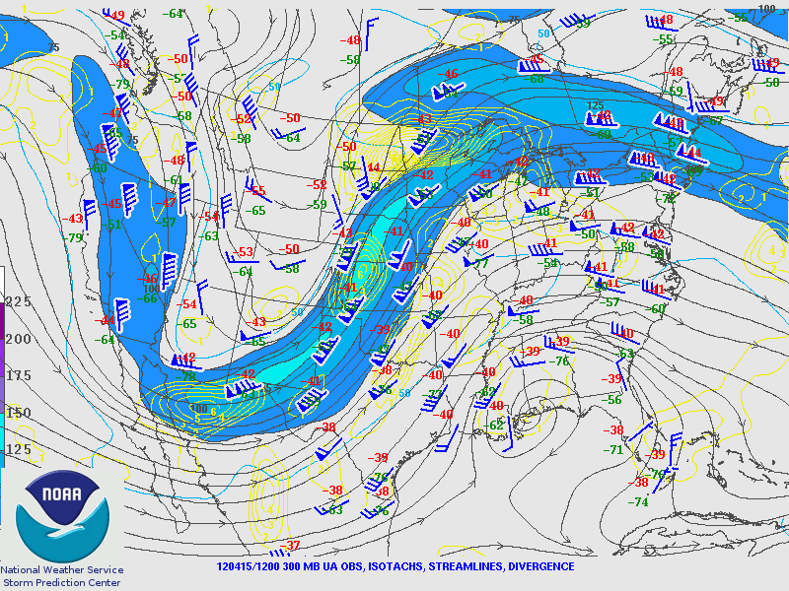
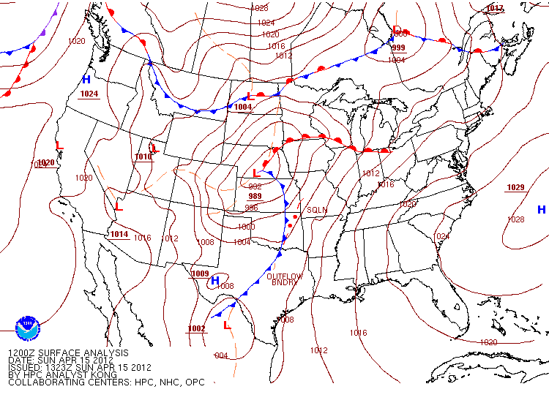
WARM AIR
TOWARD POLE
COLD AIR TOWARD
EQUATOR

Slide 21
Need to Add Missing Ingredients
Seasonal temperature differences.
Land-sea heating differences.

