Slide 1
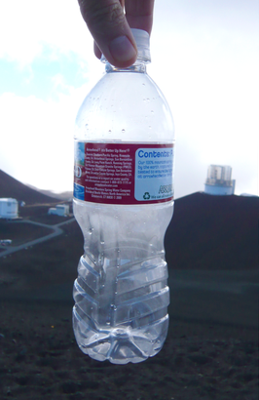
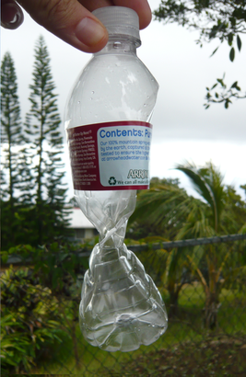

ATMO 170A1
Online
Air Pressure
Ideal GasLaw
View in Slide Show mode
http://en.wikipedia.org/wiki/Atmospheric_pressure
Bottle sealed at 14,000 ft; crushed at 1,000 ft
Notes:
We now start module #2 on “Air Motions”
Bottle sealed at top of Mauna Kea, Hawaii at 14,000’ where the air pressure is about 600 mb.
Driven to near MSL (1,000’) where pressure is almost 1000 mb.
Bottle is crushed by 400 mb pressure difference between the air outside the bottle and inside it.

Slide 2
Overview Goals
What is Pressure: Molecular Perspective
Ideal Gas Law ⟹ Pressure Differences

Slide 3
Air Pressure and Molecules
1 meter
What is a Force? It’s like a push or shove
Pressure = Force/Area
In an air filled container, pressure is due to molecules pushing the sides outward by recoiling off them
1 meter
1 meter
Recoil Force
Notes:
Review: Pressure is force distributed over an area: PSI; Newtons per squared meter (Pascals); millibars (100 Pascals)
While pressure can be considered the weight of the air overhead…
From molecular perspective, it arises from air molecules hitting objects and recoiling from them.
Our example shows molecules rebounding off the side of a box.

Slide 4
Air Pressure and Molecules
Concept applies to an “air parcel” surrounded by other air parcels, where molecules create pressure by rebounding off other air molecules
Recoil Force
Notes:
In the free atmosphere, the objects that air molecules routinely hit are other molecules
Pressure arises from a mind-boggling number collisions between molecules in a volume of air (2.5 x 10²⁵ per m³ at MSL),
where mind-boggling is an estimated 1.3 x 10³⁵ collisions per second in a cubic meter of air at MSL.
(5 x 10⁹ collisions per molecule per second) x (2.6 x 10²⁵ molecules per m³)

Slide 5
Air Pressure Differences
Weak Recoil Force
At any point, pressure is equal in all directions
but pressure can vary from one point to another point
Strong Recoil Force
Notes:
A distinction needs to made between pressure at a point and at a different location.
While pressure at a point pushes equally in all directions, its value can change from one point to another point

Slide 6
Lower Pressure
How to Change Pressure
Higher Density at the same temperature creates Higher Pressure from more collisions between molecules with the same average speed
Pressure is proportional to Density
Higher Pressure
Notes:
What can change pressure?
Increase density => higher pressure from more collisions
Analogous to atmosphere where density and pressure decrease with altitude

Slide 7
Lower Pressure
How to Change Pressure
Higher Temperature at the same density creates Higher Pressure from collisions between faster moving molecules
Pressure is proportional to Temperature
Higher Pressure
Notes:
What can change pressure?
Warm air => higher pressure from more collisions between faster moving molecules
This relation will prove important when we discuss pressure differences at MSL.

Slide 8
To Summarize
Pressure …
  Equal in all directions at a point
  Can vary from one point to another
  Proportional to density
  Proportional to temperature

Slide 9
Ideal Gas Law
Likely encountered Ideal Gas Law in the form:
PV = nRT where
P is pressure in Pascals
V is volume in meter³
n is moles of substance
R is universal gas constant (8.314 J mol⁻¹ K⁻¹)
T is absolute temperature in Kelvin (K)
Notes:
The ideas in the prior 6 slides can be quantified through the Ideal Gas Law
You may have first encountered the Ideal Gas Law in the form
PV=nRT
P=Pressure
V=Volume
n=amount of substance in moles
R=Universal gas constant
T=Temperature in Kelvin

Slide 10
Ideal Gas Law
The Ideal Gas Law quantifies the relationship between pressure-temperature-density. P = C × d × T where
P is pressure in millibars (mb)
d is density in kilograms/meter³ (kg m⁻³)
T is temperature in Kelvin (K)
C is a specific gas constant (2.87 mb m³ kg⁻¹ K⁻¹) (Parenthetical expressions are units)
Notes:
In meteorology, the Ideal Gas Law takes the form
P = C x d x T
P=Pressure (Pascals or mb)
d=Density (kg/m³)
C=specific gas constant for air (2.87 mb m³ kg⁻¹ K⁻¹ to get pressure in millibars) C=R/M where M is molecular mass for air (28.9 kgm/kmol)
T=Temperature in Kelvin

Slide 11
Ideal Gas Law
P = C × d × T
  is a combination of
  Boyle’s Law and Charles’ Law
  P ∝ 1/V T ∝ V
  if T constant if P constant

Slide 12
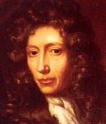
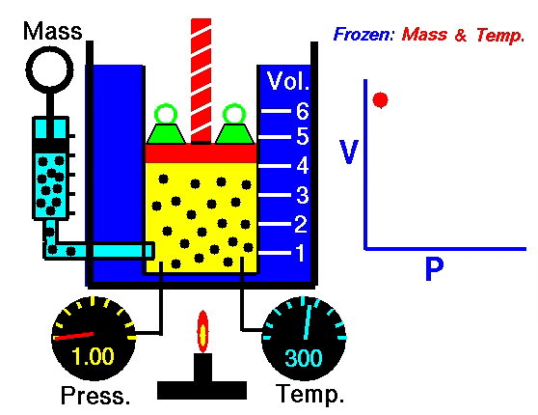
Ideal Gas Law
P = R × d × T (kept constant)
At constant T, Gas Law reduces to
☞ P proportional to d
Boyle's Law (1662)
When gases expand
Pressure decreases
Robert Boyle
https://www.grc.nasa.gov/
Notes:
Boyle’s Law
Pressure decreases when gases expand

Slide 13
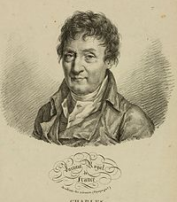
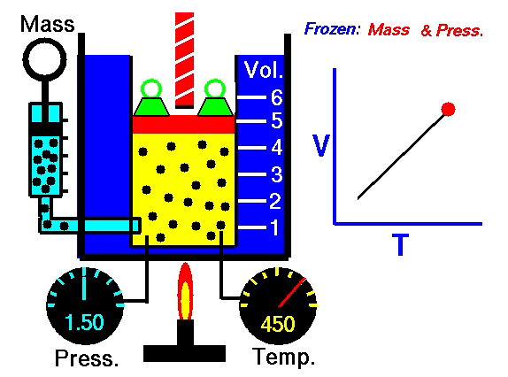
Ideal Gas Law
Jacques Charles
P (kept constant) = C × d × T
At constant pressure, Gas Law reduces to
☞ T proportional to 1/d
Charles’ Law (1787)
When heated
Gases expand
https://www.grc.nasa.gov/
Notes:
Charles Law
Temp inversely proportional to Density
Gases expand when heated

Slide 14
Summary
Ideal Gas Law quantifies relation between
Pressure-Density-Temperature
P = C × d × T
Fundamental relationship that governs the state of the atmosphere
Know it.
Understand it.

Slide 15
This ends the overview of the Ideal Gas Law.

Slide 16
What are some of the meteorological consequences of the ideal gas law?

Slide 17
Pressure-Temperature-Density
300 mb
Pressure
Decreases with height at same rate in air with the same temperature profile
Surface of constant pressure (Isobaric Surface)
Slopes are horizontal
400 mb
500 mb
600 mb
700 mb
800 mb
900 mb
1000 mb
Minneapolis
cooling
Houston
warming
Notes:
Consider the following thought experiment
Two columns of air that extend to 300 mb
Same temperature initially
Same pressure at ground
Pressure decreases with height at same rate in both columns
Slopes of constant pressure surfaces (so-called “isobaric surfaces”) are horizontal

Slide 18
Pressure-Temperature-Density
WARM
Pressure (vertical scale is greatly distorted)
Decreases faster with increasing height in cold air than warm air
Isobaric surfaces slope Downward to cold air Slope steepens with height
300 mb
COLD
400 mb
500 mb
600 mb
700 mb
800 mb
900 mb
1000 mb
Minneapolis
colder
Houston
warmer
Notes:
Consider what happens when we…
Warm the column over HOU
Cool the column over MSP
By Charles Law…
HOU expands to decrease density
MSP contracts to increase density
Pressure decreases a slower rate in the warmer air over HOU than the colder air over MSP
Note that isobaric surfaces slope downhill from HOU toward MSP (form warm air to cold air)

Slide 19
Pressure-Temperature-Density
WARM
Pressure aloft is
Higher along horizontal line in warm air than cold air
Pressure difference is a non-zero force
300 mb
COLD
400 mb
L
H
500 mb
600 mb
700 mb
800 mb
900 mb
1000 mb
Minneapolis
colder
Houston
warmer
Notes:
A horizontal line is draw from the 500 mb level over HOU to MSP
Note that pressure is higher along horizontal line in warm air column than colder column
Means higher pressure aloft is over HOU (denoted by the H) and lower pressure is over MSP (denoted by the L)

Slide 20
Pressure-Temperature-Density
WARM
Pressure aloft is
Higher along horizontal line in warm air than cold air
Pressure difference is a non-zero force
Pressure Gradient Force or PGF (black arrow)
PGF accelerates air molecules from HOU to MSP
In other words, the wind blows from HOU to MSP
300 mb
COLD
400 mb
L
PGF
H
500 mb
600 mb
700 mb
800 mb
900 mb
1000 mb
Minneapolis
colder
Houston
warmer
Notes:
The pressure difference between HOU and MSP…
exerts a a non-zero force from HOU to MSP, a so-called Pressure Gradient Force or PGF for short
The PGF acts to accelerate the air molecules aloft from higher pressure over HOU to lower pressure over MSP

Slide 21
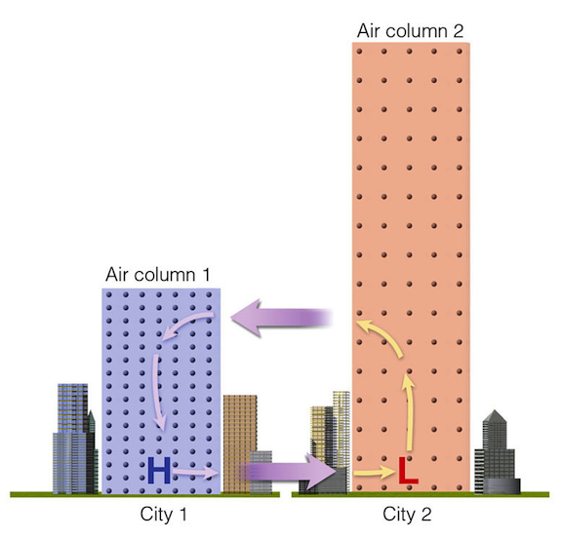
Thermally Direct Circulation
Warm air rises.
Cold air sinks.
Animation
SINKS
RISES
Ahrens
Minneapolis
Houston
Notes:
Once air flows from HOU to MSP
Air molecules are removed from the column over HOU
and deposited in the column over MSP
Hence, the pressure at the surface must fall at HOU and rise at MSP…
which establishes a non-zero PGF from MSP to HOU
The figure suggests a circulation is ultimately established where…
warmer air over HOU rises then flows toward MSP aloft
colder air over MSP sinks then flows toward HOU near the surface
Any circulation with warm air rising and cold sinking defines what is termed a “Thermally Direct Circulation”.
See short animation by clicking the link

Slide 22
Summary Points: Ideal Gas Law
Ideal Gas Law relates
  Pressure – Temperature – Density
As a consequent, gases expand when warmed. Pressure decreases more rapidly with height in a Cold air mass than a Warm air mass
Horizontal temperature differences ➔Horizontal pressure differences
Horizontal pressure differences ➔Air Motion or Why the Wind Blows
Notes:
We started by interpreting pressure from a molecular perspective, which allow us to deduce qualitative relationships
between Pressure and Density, and Pressure and Temperature
Our deductions were consistent with pioneering science of Boyle and Charles from ~300 years ago.
=> Temperature-Density if Pressure constant (Boyle’s Law) and Pressure-Temperature if Density constant (Charles’ Law)
Combining Boyle’s Law and Charles’ Laws quantification of the relationship gives the Ideal Gas Law
One important consequence of the Ideal Gas Law (Boyle’s Law) is when gases are warmed, they expand.
So a column of warmer air is vertically thicker than a column of colder air.
It follows that pressure must decrease at a faster rate with height in a COLD column than a WARM air.
Hence, horizontal temperature differences lead to horizontal pressure difference or a non-zero PGF
A non-zero PGF accelerates air parcels from higher to lower pressure.
HENCE, TEMPERATURE DIFFERENCES AT THE ULTIMATE CAUSE OF WINDS!

Slide 23
This ends the overview of the Ideal Gas Law and its meteorological consequences.

