Slide 1
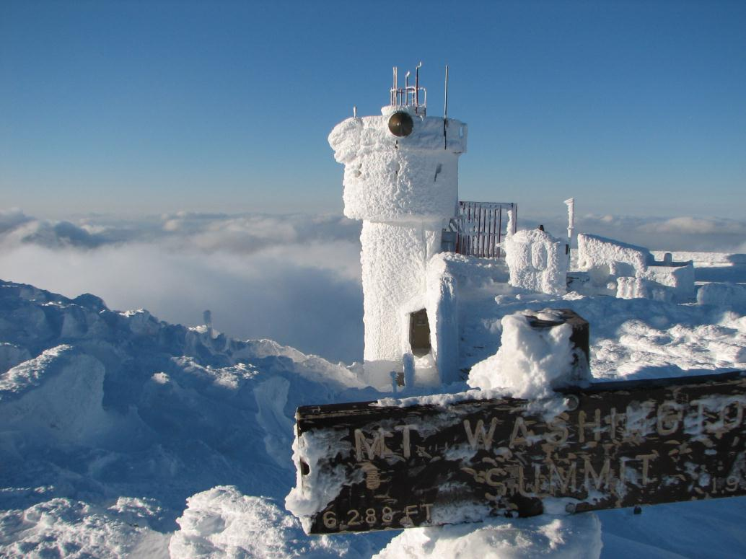

ATMO 170A1
Online
Precipitation
H&P 7.1-7.4
Rime ice coats the observatory on Mt. Washington, N.H. after a winter storm. Accretion is important in the formation of precipitation in cold clouds http://www.craterranch.com/Mt_Washington/Mt_Washington_Images/IMG_2672.JPG

Slide 2
Last Time
Buoyancy - upward force exerted on an object by the fluid that surrounds it.
If upward buoyancy force exceeds downward force of gravity, object floats.
Concept applies to an air parcel surrounded by air with a different density (temperature)
An air parcel warmer than the surrounding air temperature experiences a net upward force.

Slide 3
An air parcel at sea-level has a temperature of 20˚C and a dew point of 12˚C. The ELR is 8˚C/km. The air is then forced to rise over a 4 km high mountain range.
Does the parcel ever become positively buoyant?
What will be the temperature of the parcel at the top of the mountain range?
What would be the temperature and dew point of the parcel if it then sinks back to sea-level?
Altitude AGL | Env. Temp | Temp Ascent | Dew Point Ascent | Temp Descent | Dew Point Descent
4 km | -12˚C
3 km | -4˚C
2 km | 4˚C
1 km | 12˚C
0 km | 20˚C | 20˚C | 12˚C

Slide 4
An air parcel at sea-level has a temperature of 20˚C and a dew point of 12˚C. The ELR is 8˚C/km. The air is then forced to rise over a 4 km high mountain range.
Does the parcel ever become positively buoyant?
What will be the temperature of the parcel at the top of the mountain range?
What would be the temperature and dew point of the parcel if it then sinks back to sea-level?
Altitude AGL | Env. Temp | Temp Ascent | Dew Point Ascent | Temp Descent | Dew Point Descent
4 km | -12˚C
3 km | -4˚C
2 km | 4˚C
1 km | 12˚C | 10˚C | 10˚C
0 km | 20˚C | 20˚C | 12˚C

Slide 5
An air parcel at sea-level has a temperature of 20˚C and a dew point of 12˚C. The ELR is 8˚C/km. The air is then forced to rise over a 4 km high mountain range.
Does the parcel ever become positively buoyant? YES
If yes, at what level does it becomes positively buoyant? 2 km
What will be the temperature of the parcel at the top of the mountain range?
What would be the temperature and dew point of the parcel if it then sinks back to sea-level?
Altitude AGL | Env. Temp | Temp Ascent | Dew Point Ascent | Temp Descent | Dew Point Descent
4 km | -12˚C
3 km | -4˚C
2 km | 4˚C | 4˚C | 4˚C
1 km | 12˚C | 10˚C | 10˚C
0 km | 20˚C | 20˚C | 12˚C

Slide 6
An air parcel at sea-level has a temperature of 20˚C and a dew point of 12˚C. The ELR is 8˚C/km. The air is then forced to rise over a 4 km high mountain range.
Does the parcel ever become positively buoyant? YES
If yes, at what level does it becomes positively buoyant? 2 km
What will be the temperature of the parcel at the top of the mountain range? -8˚C
What would be the temperature and dew point of the parcel if it then sinks back to sea-level?
Altitude AGL | Env. Temp | Temp Ascent | Dew Point Ascent | Temp Descent | Dew Point Descent
4 km | -12˚C | -8˚C | -8˚C
3 km | -4˚C | -2˚C | -2˚C
2 km | 4˚C | 4˚C | 4˚C
1 km | 12˚C | 10˚C | 10˚C
0 km | 20˚C | 20˚C | 12˚C

Slide 7
An air parcel at sea-level has a temperature of 20˚C and a dew point of 12˚C. The ELR is 8˚C/km. The air is then forced to rise over a 4 km high mountain range.
Does the parcel ever become positively buoyant? YES
If yes, at what level does it becomes positively buoyant? 2 km
What will be the temperature of the parcel at the top of the mountain range? -8˚C
What would be the temperature and dew point of the parcel if it then sinks back to sea-level?
Altitude AGL | Env. Temp | Temp Ascent | Dew Point Ascent | Temp Descent | Dew Point Descent
4 km | -12˚C | -8˚C | -8˚C | -8˚C | -8˚C
3 km | -4˚C | -2˚C | -2˚C | 2˚C | -6˚C
2 km | 4˚C | 4˚C | 4˚C
1 km | 12˚C | 10˚C | 10˚C
0 km | 20˚C | 20˚C | 12˚C

Slide 8
An air parcel at sea-level has a temperature of 20˚C and a dew point of 12˚C. The ELR is 8˚C/km. The air is then forced to rise over a 4 km high mountain range.
Does the parcel ever become positively buoyant? YES
If yes, at what level does it becomes positively buoyant? 2 km
What will be the temperature of the parcel at the top of the mountain range? -8˚C
What would be the temperature and dew point of the parcel if it then sinks back to sea-level? 32˚C 0˚C
Altitude AGL | Env. Temp | Temp Ascent | Dew Point Ascent | Temp Descent | Dew Point Descent
4 km | -12˚C | -8˚C | -8˚C | -8˚C | -8˚C
3 km | -4˚C | -2˚C | -2˚C | 2˚C | -6˚C
2 km | 4˚C | 4˚C | 4˚C | 12˚C | -4˚C
1 km | 12˚C | 10˚C | 10˚C | 22˚C | -2˚C
0 km | 20˚C | 20˚C | 12˚C | 32˚C | 0˚C

Slide 9
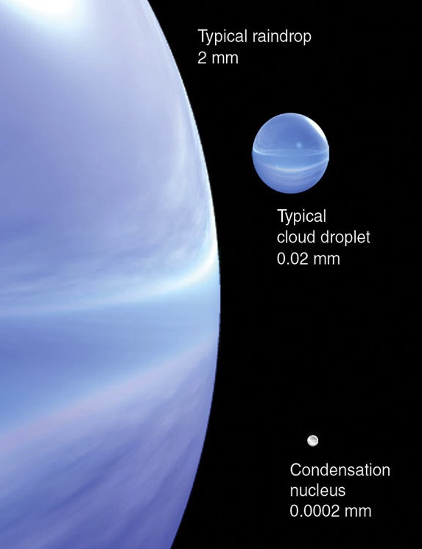
Cloud Droplets to Raindrops
Volume of a raindrop is 10⁶ bigger than that of a cloud droplet
Several days needed for condensation alone to grow raindrops
Raindrops can form in less than one hour
What processes account for such rapid growth?
10⁶ larger
10⁶ larger
Ahrens
Notes:
Text and caption are self explanatory. A raindrop is 1,000,000 times bigger in volume/mass than a cloud droplet.
What can cause growth to occur in less than one hour?

Slide 10
To understand how cloud droplets evolve to falling raindrops, we must consider
Drop mass, size and shape
Fall speed of cloud droplets and raindrops

Slide 11
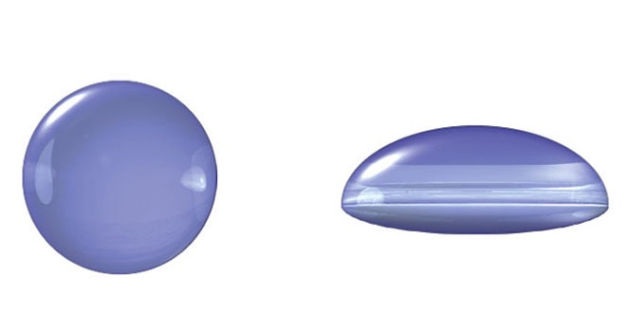
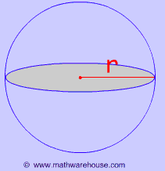
What Determines the Size-Shape-Fall Speed of Cloud Droplets and Raindrops
Air Resistance
sphere
parachute
Small Radius < 2.0 mm
Larger Radius > 2.0 mm
Gravitational = mg
Air Resistance = 1/2 × C × D_{AIR} × A × v²
C = 0.5 sphere; C ~ 2.0 irregular object
D_{AIR} => density; v => fall speed
A => Area shown in gray

Slide 12
Size-Shape-Fall Speed of Drops
Air Resistance Terminal
sphere
parachute
Small Radius < 2.0 mm
Larger Radius > 2.0 mm
Gravitational = mg
mg = 1/2 C D_{AIR} A v_{T}²
where v_{T} => terminal velocity
v_{T} = [2 m g /(K ρ_{AIR} A) ]^{1/2}
v_{T} = [ 16/3 r_{DROP} g (ρ_{H2O})/(ρ_{AIR}) ]^{1/2}
for a spherical raindrop

Slide 13
Size-Shape-Fall Speed of Drops
Air Resistance Terminal
sphere
parachute
Small Radius < 2.0 mm
Larger Radius > 2.0 mm
Gravitational = mg
Raindrops fall apart when their radii approach 5 mm or at fall speeds faster than 25-30 km/hr.
Reason: Air resistance! And air resistance increases rapidly as drops grow and increase their fall speed.

Slide 14
Terminal Drop Fall Speeds
Gravitational Force = Air Resistance
1.0 m/sec
1.0 cm/sec
0.1 μm/sec
CCN
1 km in 10¹⁰ sec
(several years)
Cloud Droplets => Drizzle
1 km in 10⁵ to 10³ sec
(1 day to ¼ hour)
Small => Large Raindrops
1 km in 10² sec
(couple minutes)
Notes:
Diagram gives terminal fall speeds for CCN, droplets and raindrops. NOTE logarithmic ordinate. It also gives the updraft speed required to keep the particle suspended.
CCN are easy to suspend via turbulent motions; just 0.1 microns per second updraft is needed.
Small cloud droplets need 1.0 cm/s, easily achievable by winter storms.
Large raindrops (5mm diameter) require a fast updraft 1.0 m/s.

Slide 15

Collision-Coalescence
Big drops fall faster than small drops
Big drops collide with small drops
Some smaller drops adhere to big drops
Collision-Coalescence
Drops can grow in this way with no ice (warm clouds)
Occurs in warm tropical clouds
Not a very efficient mechanism
Only 10-50% collisions cohere
Efficiency increases with drop size
Effective area swept is smaller than area of drop
small raindrop
Higher Pressure
Collection Efficiency 10-50%
Notes:
Define Coalesence…collection of smaller drops by larger, faster falling drops.
Inefficient mechanism, only 10-50% of smaller drops in path stick.
Important for Warm Clouds…no ice.

Slide 16
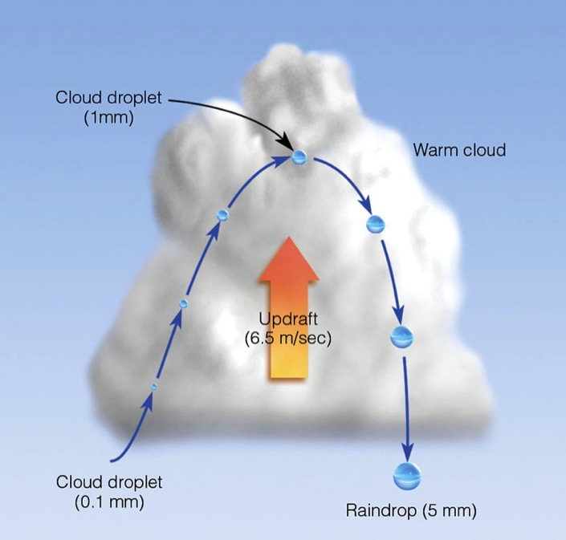
Warm Cloud Precipitation
Updraft speed also controls raindrop size
Droplets reach a height where updraft speed equals fall speed
Drops fall and grow by collision-coalescence
Ahrens 6th ed.
Notes:
Size of largest raindrop gives clues as to updraft speed (within limits).

Slide 17
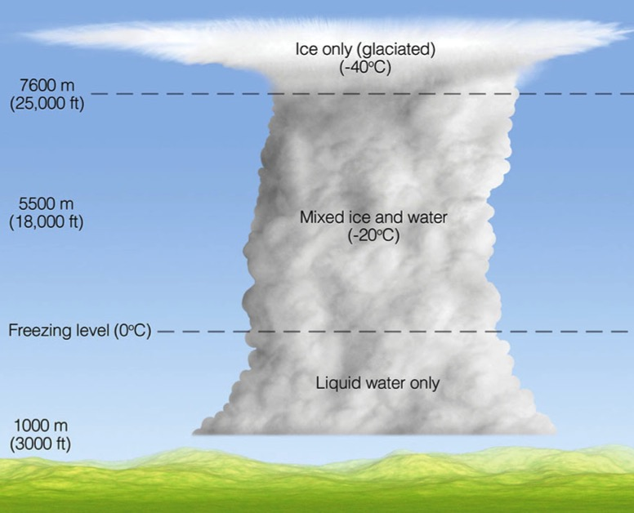
Mixed Water-Ice Clouds
Clouds that rise above freezing level have mixture of water-ice mixed phase clouds
Mixed region exists where -40ºC < T < 0ºC
Only ice crystals exist where T colder than -40ºC
Mid-latitude clouds that form precipitation are typically Cold Clouds Cloud Top Temps < 0ºC
glaciated region
Ahrens 6th ed
Notes:
Most midlatitude clouds contain a mixture of ice, liquid water, and SUPERCOOLED water.
Such clouds are called MIXED CLOUDS

Slide 18
We can have clouds with supercooled water droplets existing next to ice crystals at same temperature?
What is its significance on forming precipitation?
Answer: Big!

Slide 19
Recall that saturation is an equilibrium condition where condensation rate = evaporation rate.
But can we have equilibrium if there are droplets and ice existing at the same temperature?
Short answer: NO!

Slide 20
Saturation is an equilibrium condition where
the rates of condensation/evaporation over liquid
exceed those for sublimation/deposition over ice
SVP over liquid
SVP over Ice
Evaporation Condensation
Sublimation Deposition

Slide 21
When vapor pressure is too big for ice
deposition rate > sublimation rate
When vapor pressure is too small for water
evaporation rate > condensation rate
SVP over liquid
SVP over Ice
Sublimation Deposition
Evaporation Condensation

Slide 22
When deposition rate > sublimation rate
Ice grows
When evaporation rate > condensation rate
Water shrinks
SVP over liquid
SVP over Ice
Sublimation Deposition
Evaporation Condensation

Slide 23
When deposition rate > sublimation rate
Ice grows
When evaporation rate > condensation rate
Water shrinks
SVP over liquid
SVP over Ice
Sublimation Deposition
Evaporation Condensation

Slide 24
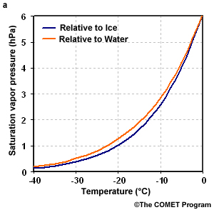
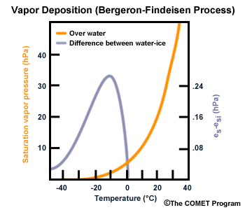
At what temperature is the difference between the SVP of supercooled water and ice the biggest?
Near -10°C

Slide 25
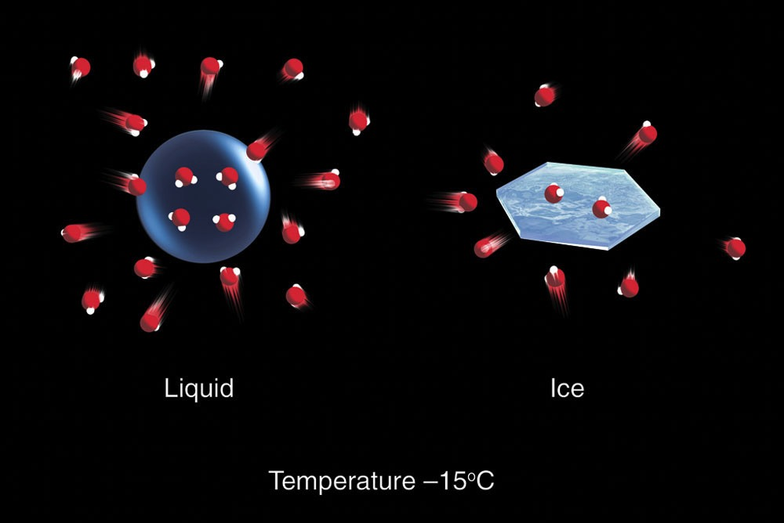
SVP near Droplets and Ice
More Vapor
Less Vapor
Ahrens & Henson
SVP is higher over supercooled water drops than ice.
Equilibrium concentration of H₂O vapor near droplets is too high for equilibrium near ice crystals.
Notes:
Higher SVP over liquid means more vapor around droplets than around ice crystals.

Slide 26
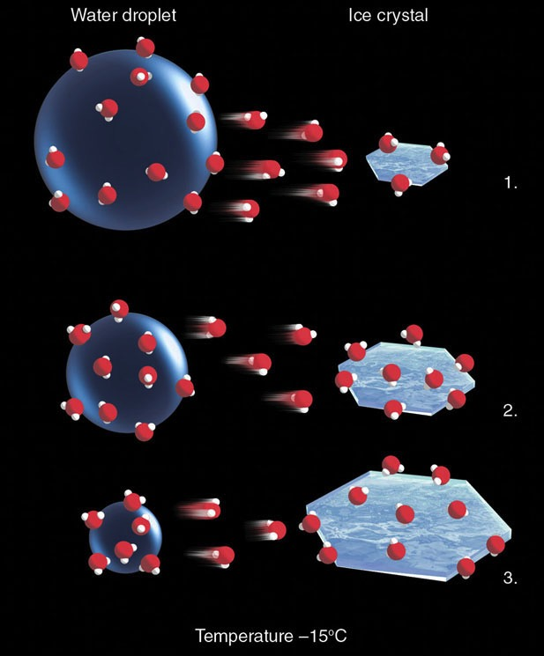
Ice Crystal Process
SVP for liquid is too big for ice, so vapor near droplets moves towards ice and droplet evaporates
Ice crystals grow at the expense of water drops, freeze on contact with ice Deposition
As ice crystals grow, they begin to fall
Animation: Ice Crystal Process
(Bergeron-Findeisen Process)
Process most efficient at -10ºC to -15ºC where SVP difference water-ice is largest
Ahrens & Hanson
Notes:
High vapor levels around droplets and lower concentrations over ice will tend to homogenized by random molecular motions…DIFFUSION.
Thus water vapor molecules over liquid will move towards ice crystals.
Vapor pressure over ice becomes larger than SVP over ice, smaller than SVP over liquid droplet.
Droplets will shrink as liquid evaporates to replace evacuated vapor molecules.
Supercooled water droplets will be attracted to ice crystal, where they freeze/adhere on contact.

Slide 27

Accretion-Aggregation Process
Supercooled water droplets will freeze on contact with ice
Small ice particles will adhere to ice crystals
snowflake
ice crystal
Ahrens & Hanson
Accretion (Riming)
Splintering
Aggregation
Bergeron-Findeisen Process named after the meteorologists who first recognized importance of the process
Notes:
Accretion-supercooled droplets freeze on contact with ice
Splintering-ice crystals shatter into smaller crystals.
Aggregation-small crystals adhere to other crystals to from SNOWFLAKES

Slide 28
Let’s look at video of the ice-crystal process
the explains the concept clearly

Slide 29
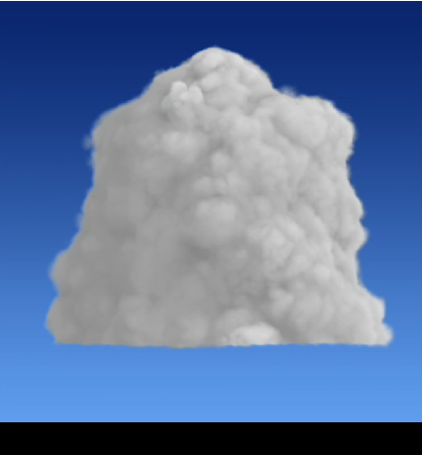
Ice Crystal Process of Precipitation Growth

Slide 30
Recap
Condensation alone cannot produce rain
Few days for condensation in lab conditions
Rain can form from CLR in less than 1 hour
Warm clouds (no ice)
Collision-Coalescence => Only effective in tropics
Cold clouds (with ice)
Ice Crystal Process => Very efficient outside of tropics
Crystals grow at expense of supercooled droplets
Accretion-Splintering-Aggregation
Notes:
Make certain that you get this far.

Slide 31
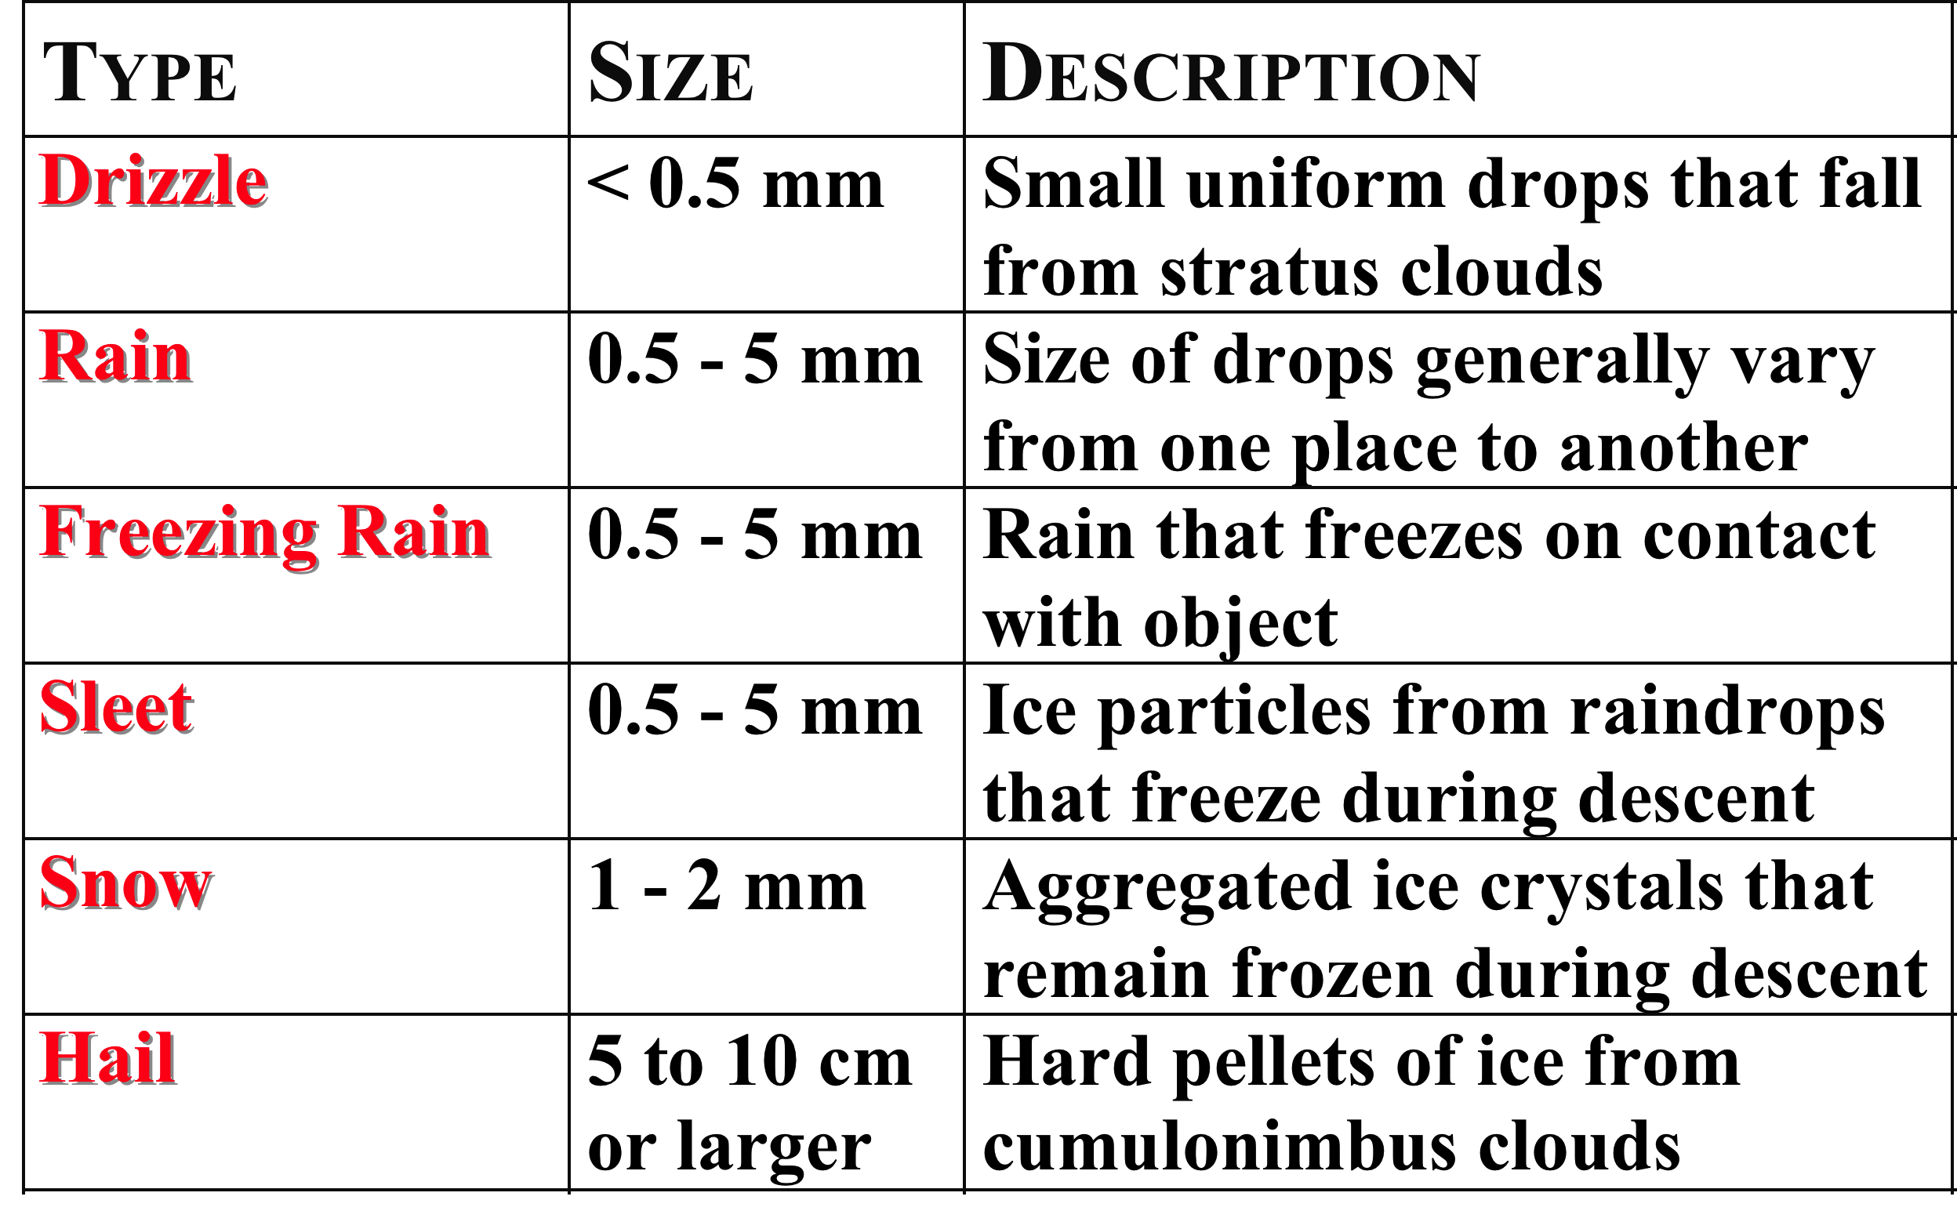
Types of Precipitation
Notes:
Table is self explanatory.

Slide 32
What determines whether precipitation will be
liquid (rain)
frozen (snow/sleet)
freezing rain

Slide 33
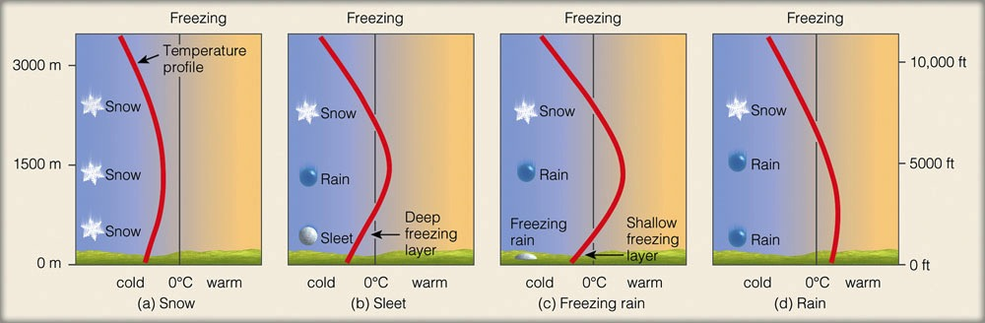
Temp Profiles for Precipitation
Ahrens Met. Today
Snow - Temp colder than 0ºC (almost) everywhere
Sleet - Melting aloft, deep freezing layer near ground
Freezing Rain - Melting aloft, shallow freezing layer at ground
Rain - Deep layer warmer than 0ºC near ground
Precipitation Type Animation

Slide 34
Summary: Key Concepts
Precipitation takes many forms
Drizzle-Rain-Sleet-Snow-Freezing Rain-Hail
Precipitation type depends on
Vertical temperature profile

