Slide 1
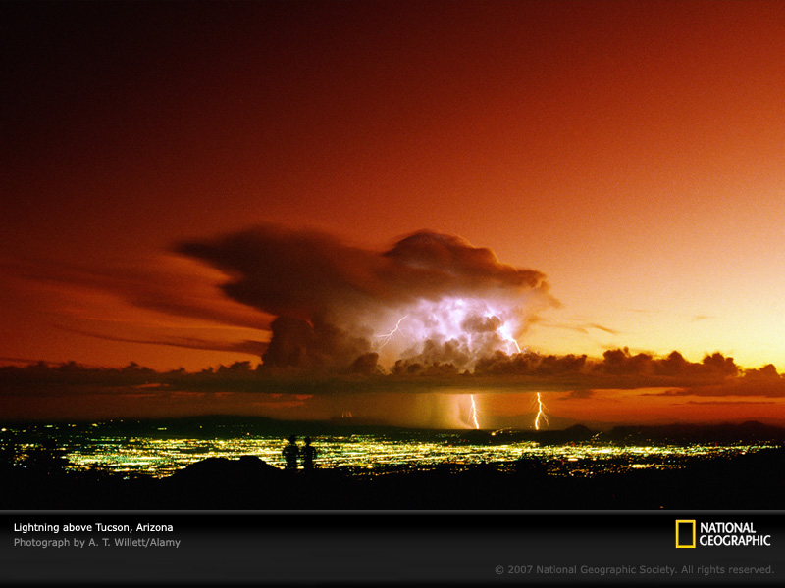

ATMO 170A1
Online
Vertical Stability and Convection
H&P§6.9

Slide 2
Stability and Buoyancy
In the atmosphere, the stability is related to the buoyancy, the upward force exerted on the air parcel by virtue of the temperature difference between the parcel and the surrounding air.
ABSOLUTELY
STABLE
ABSOLUTELY
UNSTABLE
CONDITIONALLY
UNSTABLE
Tparcel
PARCEL
COOLER
PARCEL
WARMER
PARCEL
WARMER
ONLY IF CONDENSATION
We determine which stability exists by comparing the environmental lapse rate to the dry adiabatic and moist adiabatic lapse rate.

Slide 3
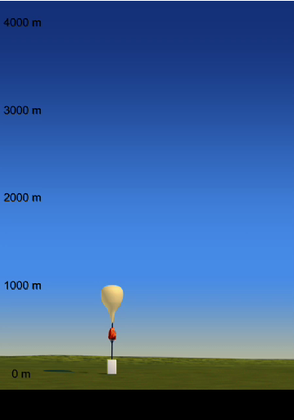
Absolutely Stable
Environmental lapse rate less than moist adiabatic lapse rate or about 6˚C per km.
Air resists upward motion.
Force must be applied to a parcel so it can rise.
If clouds form, they will spread out horizontally.
Absolute Stability Movie Link

Slide 4
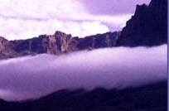
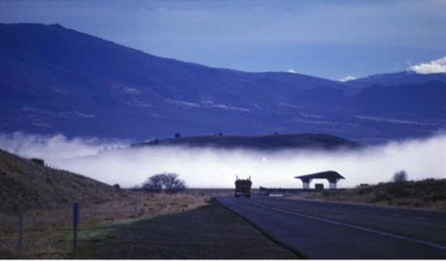
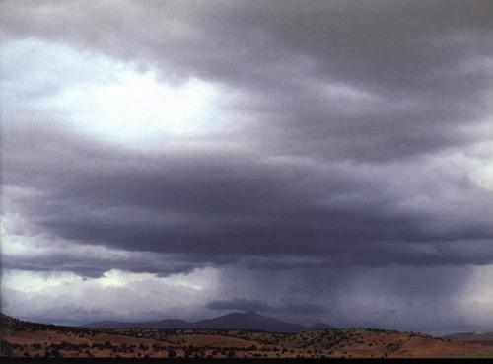
Clouds in a Stable Environment
STRATUS
RADIATION FOG
NIMBOSTRATUS
Forms in inversion caused by radiative cooling of the ground. The inversion acts like a “lid”.
Form because air is being forced up and over something, for example a front or terrain barrier.

Slide 5
How does the atmosphere make clouds
in a stable environment?
Forced Ascent
Convergence into surface lows
Frontal lifting
Flow over mountains
Thermals-indirectly (e.g. pileus clouds when the wind is forced over a rising cumulus cloud)

Slide 6
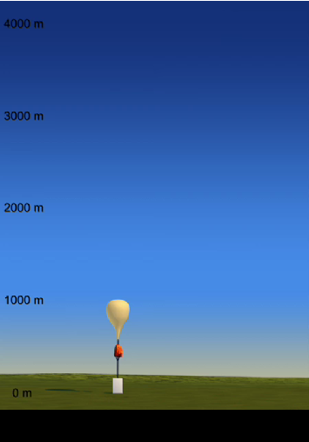
Absolutely
Unstable
Environmental lapse rate greater than dry adiabatic lapse rate or about 10°C per km
Air does not resist upward motion.
Condition is rare in the atmosphere.
Also called superadiabatic ELR.
Absolute Instability Movie Link

Slide 7
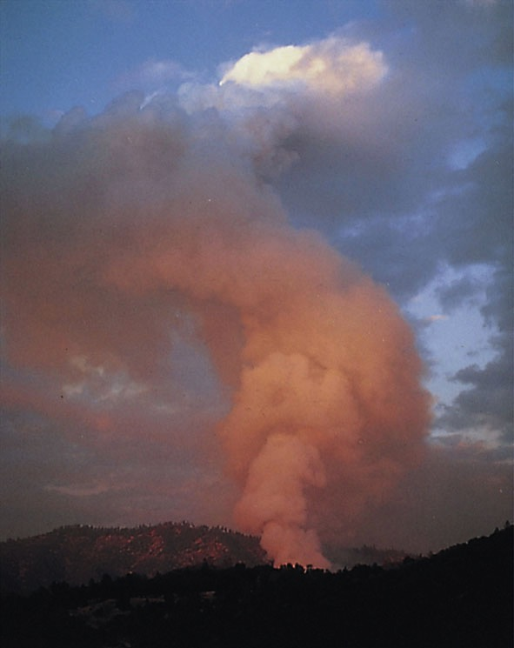
Where Can Absolutely Unstable Lapse Rates Exist?
FOREST FIRE SMOKE
Absolutely unstable lapse rates most commonly occur just above the ground (especially asphalt) in the afternoon on hot sunny days.
Occurs above forest fires and erupting volcanoes.
Forms when air is heated more rapidly from below than convective currents can transport heat upward.

Slide 8
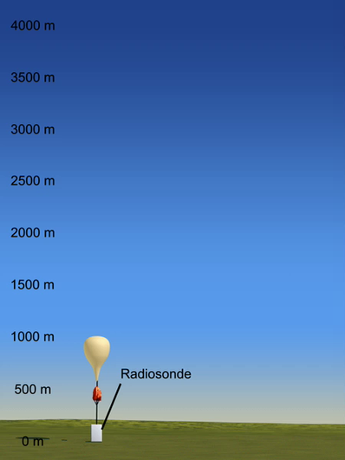
Conditionally Unstable
Environmental lapse rate between the moist and dry adiabatic lapse rate or between 6˚C and 10˚C per km.
Air does not resist upward motion if condensation is occurring.
Unlike the absolutely unstable case, this condition occurs frequently in the atmosphere!
Conditional Instability Movie Link

Slide 9
On your own time…
Look at the prior video again. (Link is HERE.) Pay close attention to the ELR on the left and the temperature change every ½ km of altitude. Then address the following questions…on your own.
At what altitude does layer of conditional instability end if it stops below 4 km? Compute the ERL using ½ km increments to get a precise estimate.
The video shows the cloud top terminating at 3 km. Is that above, below, or at the altitude that the conditional instability stops?
Why would the air parcel extend above the top of the layer of conditional instability?
According to the video, why does the cloud go no higher than 3 km? Is their reasoning complete? If not, what is fundamental factor is not considered that could account for the cloud top terminating somewhat above 3 km? (Hint: Newton’s Laws of Motion apply to cloud growth too.)

Slide 10
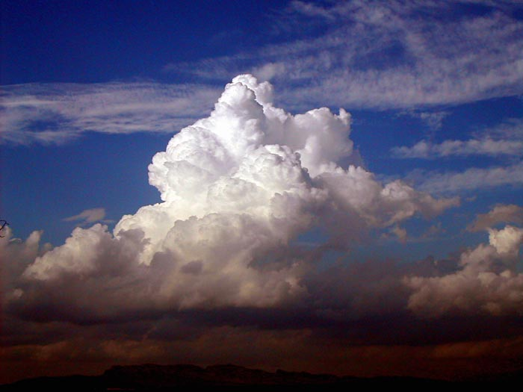
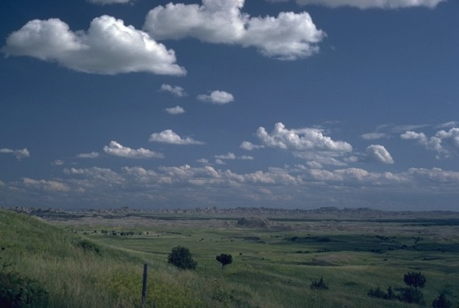
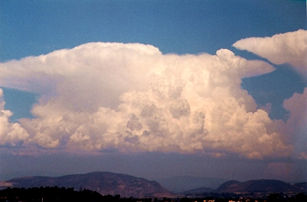
Clouds in a Conditionally Unstable Environment
Cumulus Congestus
Cumulus Humilis
Cumulonimbus
Basically any type of cumulus cloud indicates conditional instability somewhere in the atmosphere.

Slide 11
Causes of Instability in the Atmosphere
Can occur from any process that increases the environmental lapse rate. Any way you do it—chances of convection increase!
Cooling Aloft
Winds bringing in colder air
Cloud tops (radiative cooling)
Warming of the surface
Daytime solar heating
Winds bringing in warmer air
Air moving over a warm surface.
Similar to
Convection in boiling pot
Put in ice cubes
Heat from burner

Slide 12

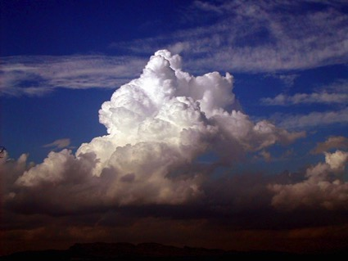
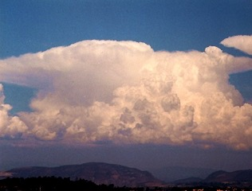
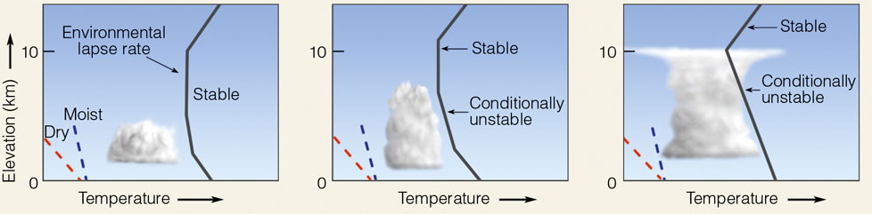
The severity of convection depends upon how much warmer the air parcel is than the environmental air and how deep the layer of conditional instability is (plus other factors TBA)
Cumulus humilis
Cumulus congestus
Cumulonimbus
Conditionally unstable in a shallow layer
Conditionally unstable about midway through troposphere
Conditionally unstable nearly to the tropopause

Slide 13
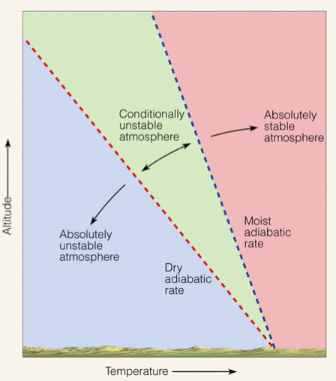
What determines whether the atmosphere is
stable, unstable or conditionally unstable?
Environmental Lapse Rate
6°C km⁻¹
10°C km⁻¹
Ahrens, Met. Today

Slide 14
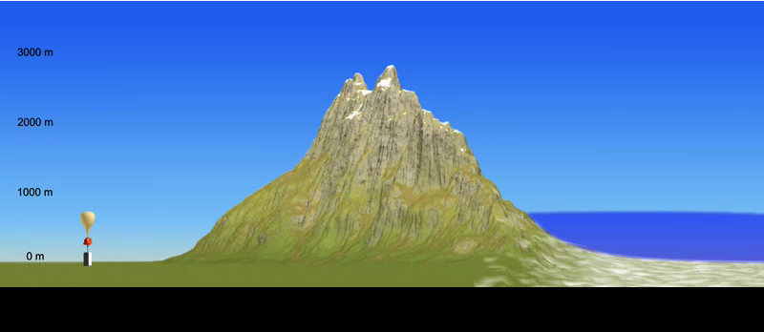
Moist Flow over Mountain Range
Ahrens: Rain Shadow Movie Link
Balloon measures ELR (environmental lapse rate)
Note parcel is always colder than environmental temperature
Presence of a conditionally unstable lapse rate does not guarantee convection.

Slide 15
Summary of Major Lecture Points
Stability refers to the tendency of an object to return to its original position when disturbed. In the atmosphere this is related to the buoyancy.
Absolutely stable: Air resists upward motion. Results in flat, spread out clouds.
Absolutely unstable: Air does not resist upward motion. Rare in the atmosphere.
Conditionally unstable: Air does not resist upward motion if a parcel is sufficiently lifted and condensation is occurring. Results in vertically developed clouds.

Slide 16
Summary of Major Lecture Points
Convective clouds are caused by warm air rising which condenses.
The severity of the updraft and how high the cumuliform cloud extends depends on the temperature difference between the environment and the warmer rising parcel and on the depth of the conditional instability.
Even the presence of a conditionally unstable lapse rate and a saturated parcel does not guarantee that cumuliform clouds will form.

