Slide 1


ATMO 170A1
Online
Stability
H&P Box 6.5
Zen Stones - stacked in a state of conditional instability where a small nudge of any stone will tumble the stack.

Slide 2
Goals
    Absolute stability.
    Absolute instability.
    Conditional instability.

Slide 3
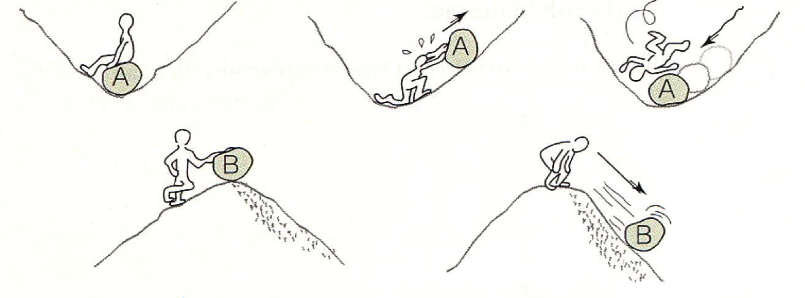
Concept of Stability
Stability refers to the tendency of an object to return to its original position when disturbed.
A classic example is a rock sitting in the bottom of a deep valley versus a rock balanced at the top of the hill.

Slide 4
Concept of Stability
Absolutely Stable
Absolutely Unstable
There are two distinct possibilities:
Rock always returns to its starting point => Absolutely Stable
Rock never returns to its starting point => Absolutely Unstable

Slide 5
Concept of Stability
Absolutely Stable
Absolutely Unstable
But there is a third possibility
Hybrid of the Stable/Unstable

Slide 6
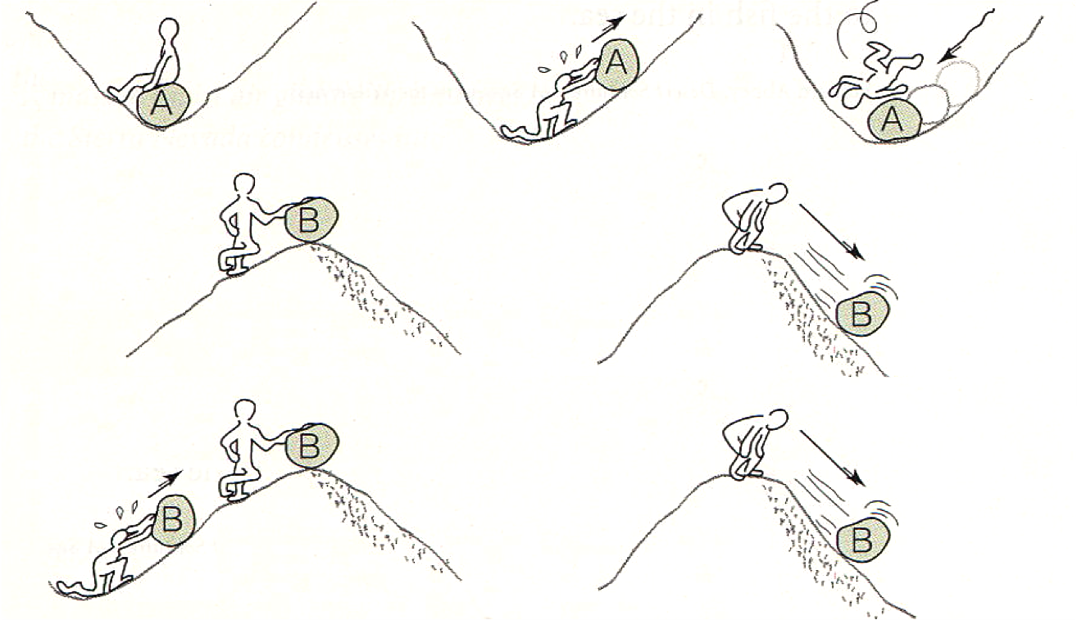
Concept of Stability
Absolutely Stable
Absolutely Unstable
Conditionally Unstable
Cumuliform Cloud form in this manner

Slide 7
Summary
Stability refers to the tendency of an object to return to its original position when disturbed.
Instability refers to tendency of an object to not return to its original position when nudged.
Conditional instability is a hybrid of Stable and Unstable. An object is stable respect to small displacements but it becomes unstable to displacements of sufficient size.
Cumuliform clouds form in conditionally unstable air… as we will soon see.

