Slide 1
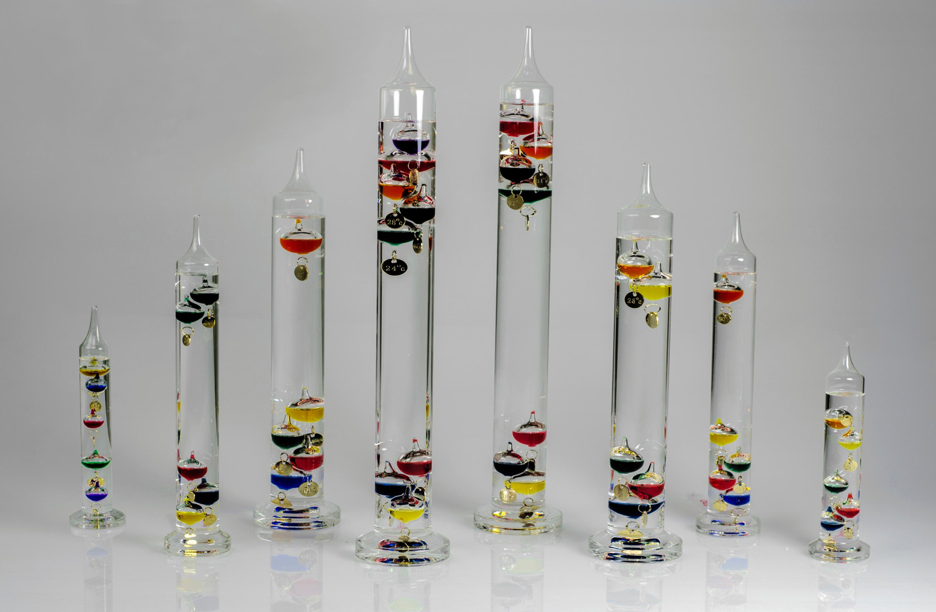

ATMO 170A1
Online
Buoyancy
H&P Box 6.4
Figure: www.amazon.com
Display of Galilean Thermometers.
Why do some bulbs float to the top while others sink to the bottom?
And why does one bulb float in the middle?

Slide 2
Goals
Buoyancy and Archimedes’ Law

Slide 3
Buoyancy
To understand atmospheric stability, we must first understand the concept of buoyancy.

Slide 4
Consider a mass submerged in a fluid
Lower Pressure
Because pressure increases with depth of the fluid, pressure along the bottom face of the object is bigger along its top face.
Net pressure gradient force exerted on a mass is upward since the net horizontal forces cancel
Higher Pressure

Slide 5
Buoyancy of a mass submerged in a fluid
Lower Pressure
Upward force exerted on the object is termed the buoyancy force B_{f} .
Archimedes Principle states
B_{f} is equal to the weight of the fluid that is displaced by the object.
But B_{f} is not the only vertical force that exists...
We must consider gravity.
B_{f}
Higher Pressure

Slide 6
Consider two air parcels of equal mass
but different densities
Parcel warmer, less dense
than surrounding air
Parcel colder, more dense
than surrounding air
P_{L}
B_{f}
B_{f}
P₀
mg
mg
P_{H}
B_{f} > mg
Parcel Rises
B_{f} < mg
Parcel Sinks
If gravity mg exceeds buoyancy, parcel sinks.
If buoyancy exceeds gravity mg, parcel rises.
Notes:
Comment on
P_{H} > P₀ > P_{L}
Lateral (horizontal) pressure forces along surface cancel
Net upward pressure force along surface bigger net downward forces for less denser object.

Slide 7
Stability and Buoyancy
In the atmosphere, the stability is related to the buoyancy, the upward force exerted on the air parcel by virtue of the temperature difference between the parcel and the surrounding air.
ABSOLUTELY
STABLE
ABSOLUTELY
UNSTABLE
CONDITIONALLY
UNSTABLE
Tparcel
PARCEL
COOLER
PARCEL
WARMER
PARCEL
WARMER
ONLY IF CONDENSATION
We determine which conditions exists in the atmosphere by the environmental lapse rate.

Slide 8
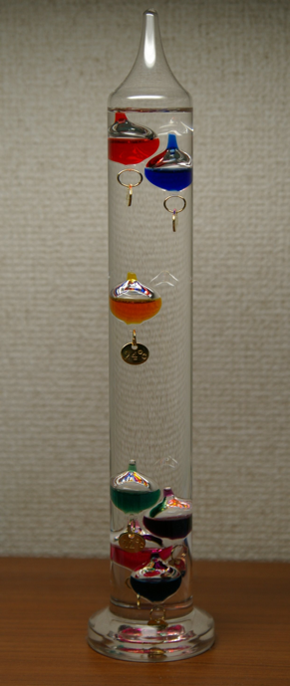
How a Galilean Thermometer Works
Bulbs at the top of the thermometer are
less dense than the fluid around them.
The bulb in middle of the thermometer is
same density as the fluid surrounding it.
Bulbs at the bottom of the thermometer are
less dense than the fluid surrounding them.
As the temperature of the fluid changes, its density changes.
Hence, the buoyancy force acting on each bulb changes too!

Slide 9
Summary of Major Points
Buoyancy is an upward force exerted on an object that is submerged in a fluid.
Buoyancy comes from the vertical pressure gradient force that acts on objects that are immersed in a fluid.
The size of the buoyancy force is determined by the weight of the fluid displaced by the object. This is Archimedes’ Law.
An object experiences a net upward force if its density is less than the density of the surrounding fluid.
In other words, an air parcel accelerates upward if it is warmer than the environmental air that surrounds it.

