Slide 1
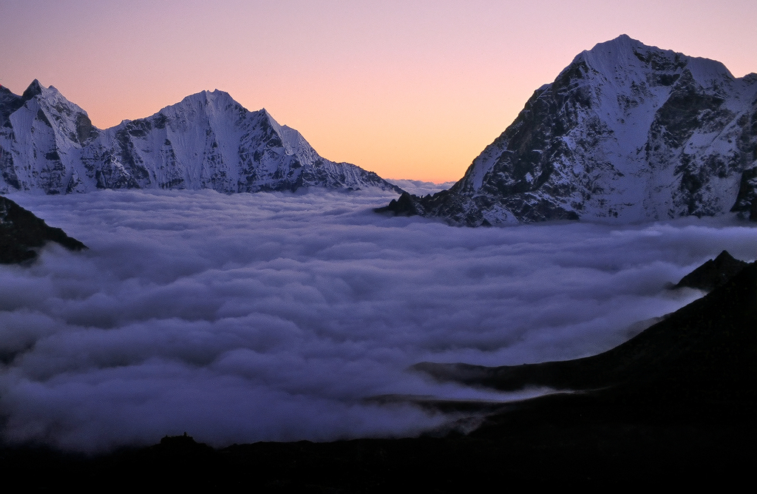

ATMO 170A1
Online
Fog
H&P Box 6.1
Figure credit: Valley Fog in the Himalaya Mountains

Slide 2
What is Fog?
Fog - a cloud whose base is at the ground
There are four basic types of fog
Radiation Fog
Advection Fog
Upslope Fog
Steam Fog
(also called Mixing Fog or Evaporation Fog)
Combinations exist (Radiation-Advection)

Slide 3
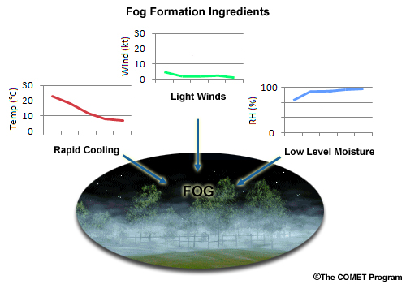
Radiation/Ground Fog Weather
Weak winds:
no mixing of warm air from aloft
Clear nights: IR loss to form inversion
Low-level moisture:
little cooling needed to hit dew point.

Slide 4
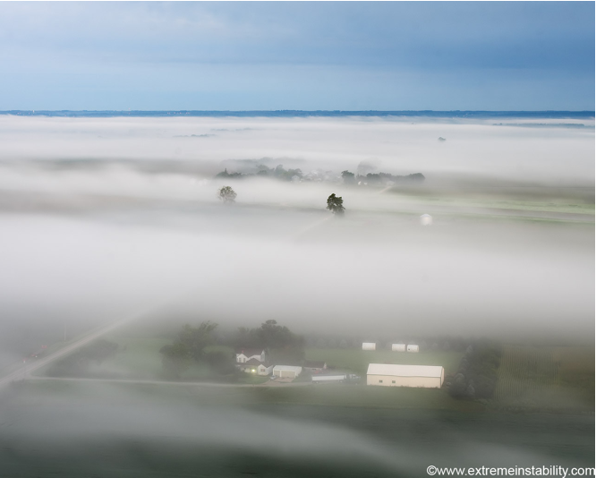
Radiation Fog over Iowa
Fog that forms over the lower deserts…when we get it
http://www.extremeinstability.com/

Slide 5
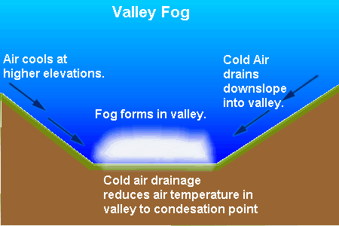
Valley Fog Conditions
https://www.ec.gc.ca/meteo-weather/
Valley fog is a deep (1,000 ft thick), long-lived radiation fog that occurs under persistent high pressure in cool season
Sun is too weak to evaporate fog completely during day
Fog persists until a winter storm with strong winds scours out the cold air that is trapped in the valley
Where: Central Valley of California, SLC, Valleys of Appalachian Mts

Slide 6
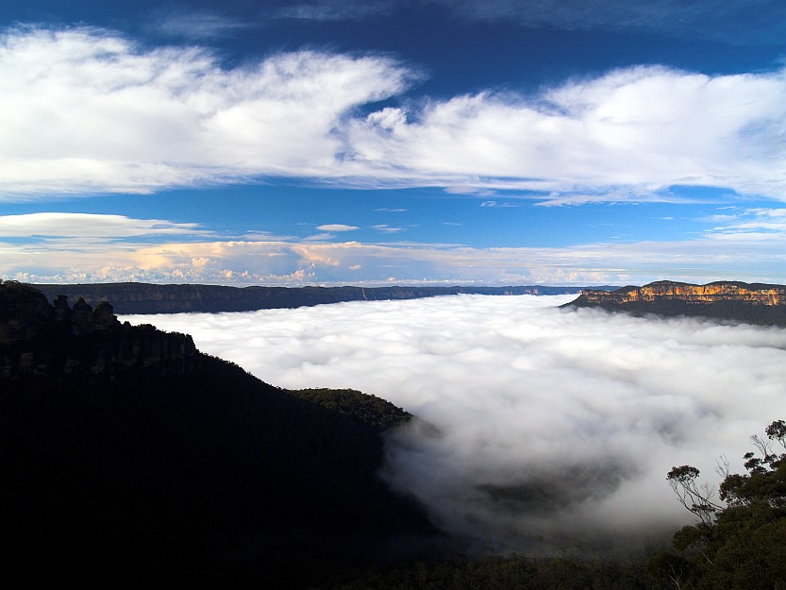
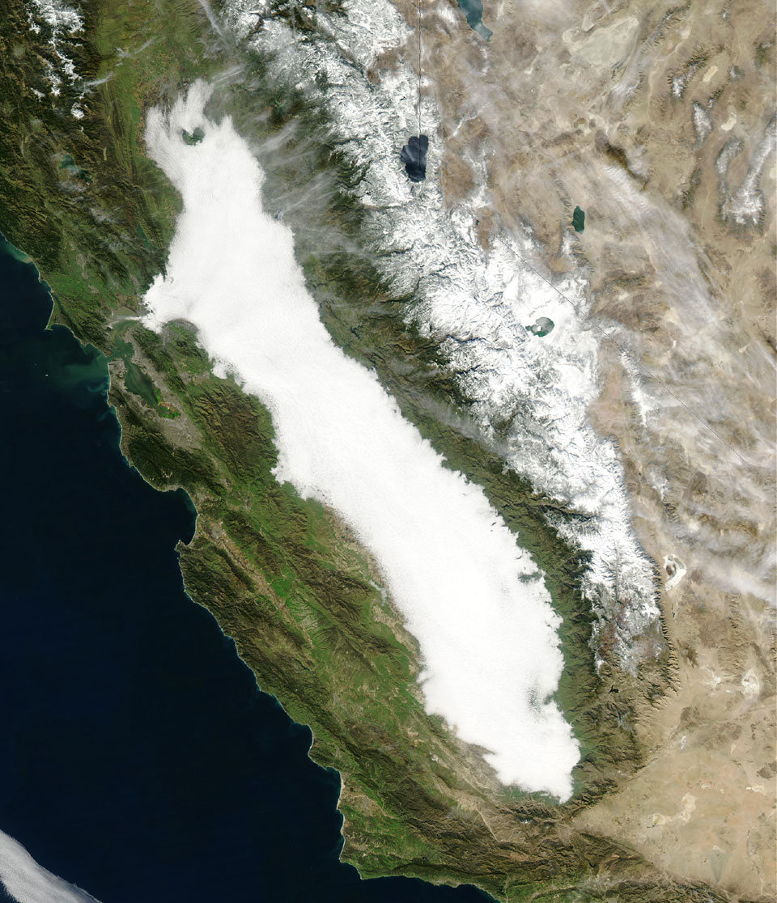
Radiation/Valley Fog
Tule Fog
Jameison Valley, New South Wales, Australia

Slide 7
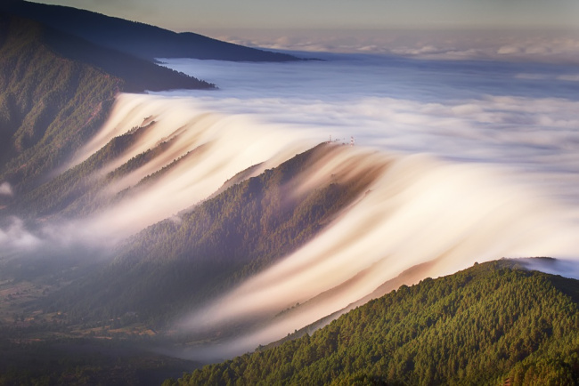
Radiation/Valley Fog
Valley fog spills over a ridge of the Appalachian Mountains

Slide 8
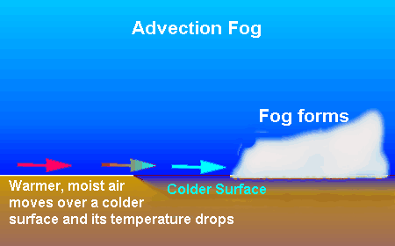
Advection Fog Weather
https://www.ec.gc.ca/meteo-weather/
Warm, humid air flows over colder ground or water.
Air cools to its dew point and fog forms.
Occurs over Central US in winter as warm moist air from Gulf of Mexico flows inland, especially over snow covered ground.
Occurs along West Coast during spring/summer when warm air from mid-Pacific flows over cold waters of California Current along coast.

Slide 9
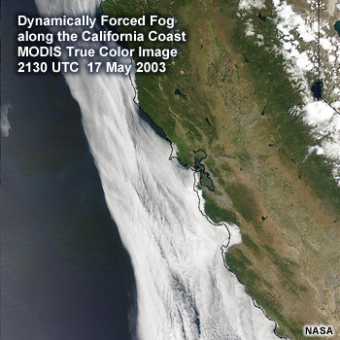
Advection Fog
Wind
Warm Water
65˚F
Cold Water
55˚F
http://www.meted.ucar.edu/mesoprim/dynfog/media/graphics/ca_dynfog.jpg

Slide 10
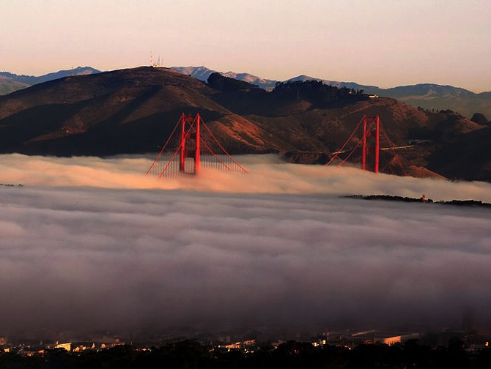
Advection Fog Engulfs the Golden Gate
  http://en.wikipedia.org/wiki/File:GGB_in_fog_2007_edit.jpg

Slide 11
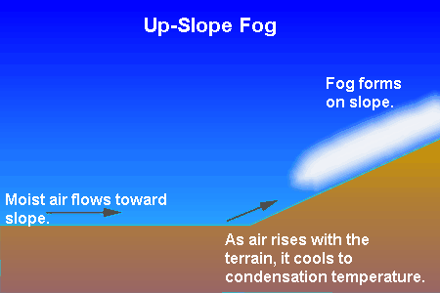
Upslope Fog
https://www.ec.gc.ca/meteo-weather/
Occurs along windward slopes of mountain ranges
Air cools to its dew point as it rises up the slope of a mountain (Air always cools as it rises as we shall soon understand.)
Fog drifts up the slope.
Widespread upslope fog common over Upper Great Plains

Slide 12
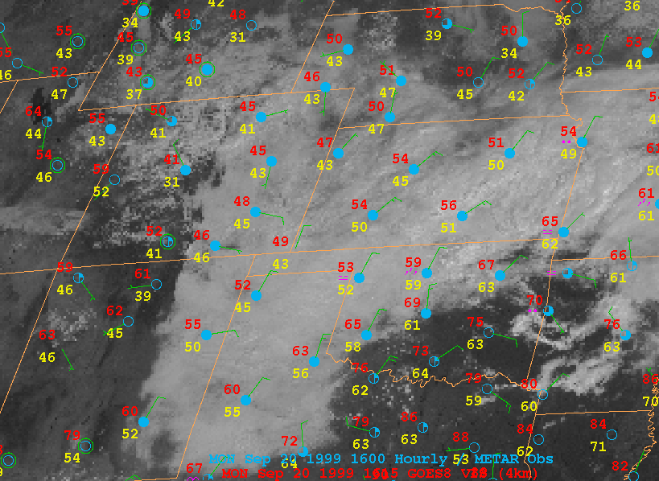
Upslope Fog Satellite
Wind
http://apollo.lsc.vsc.edu/classes/met130/notes/chapter5/graphics/upslope_sat.gif

Slide 13
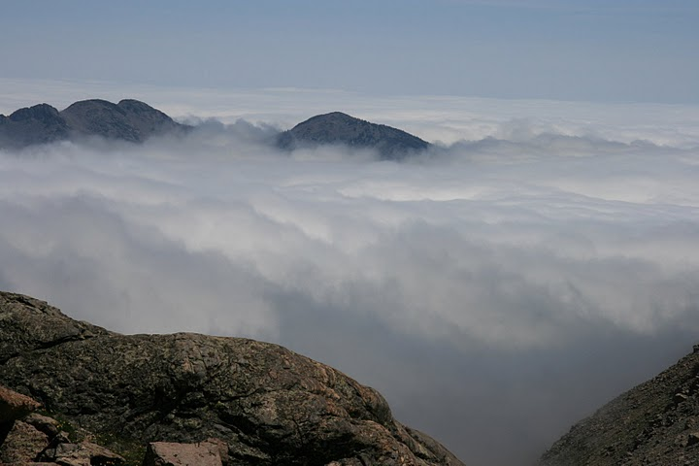
Upslope Fog
Chasm Trail Longs Peak, CO Looking east, toward the Upper Plains
http://lh4.ggpht.com/-oiee7XikZTQ/RpgLE5VscdI/AAAAAAAAATo/Kq59iGzZeII/s720/IMG_0347.JPG

Slide 14
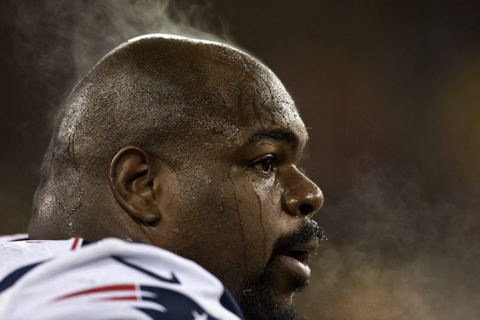
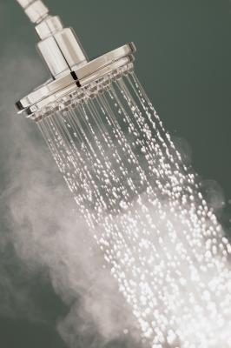
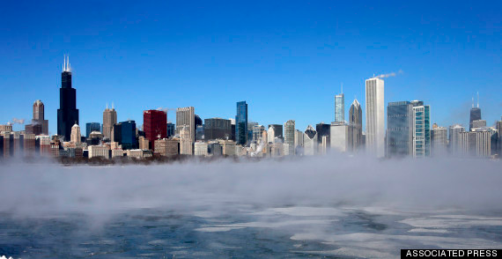
Evaporation or
Mixing Fog
bostonglobe.com
ehow.com

Slide 15
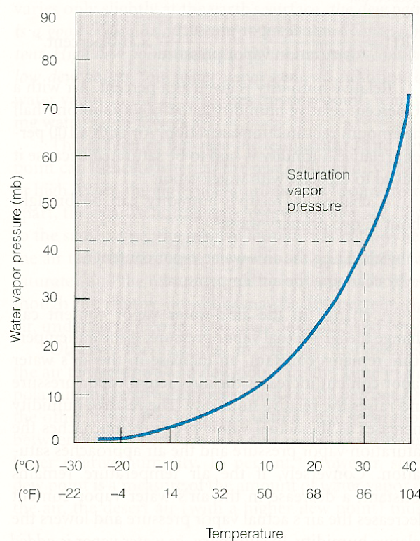
Mixing Fog: Why You See Your Breath on a Cold Winter Night
Condensation can occur if you mix moist warm air and cold dry air.
Temp RH SVP VP
Air 0ºC 20% 6 mb 1 mb
(clear)
Breath 36ºC 80% 63 mb 55 mb
(clear)
50-50 18ºC 140% 20 mb 28 mb (cloud)
90-10 4ºC 90% 8 mb 6 mb
(clear)
50-50 mix condenses into a cloud that quickly evaporates as your exhalation is diluted further by mixing with 0˚C, 20% RH air.
Breath
CloudySide
50-50
90-10
Clear Side
Air
Ahrens older ed.

Slide 16
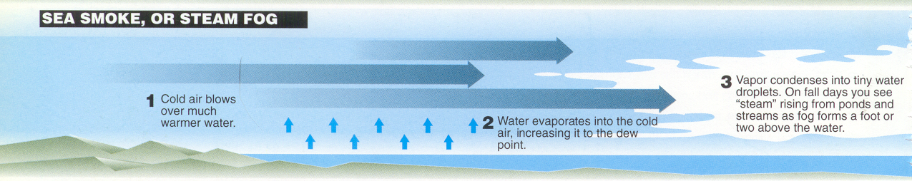
Steam Fog Conditions
Williams, The Weather Book, p68
Type of Evaporation Fog
Occurs when cold air flows over much warmer water
Cold air mixes with warm, moist air next to water surface
Mixture condenses into fog, a couple of feet above surface
Common off of East Coast of US during winter Over lakes, ponds and rivers during early fall

Slide 17
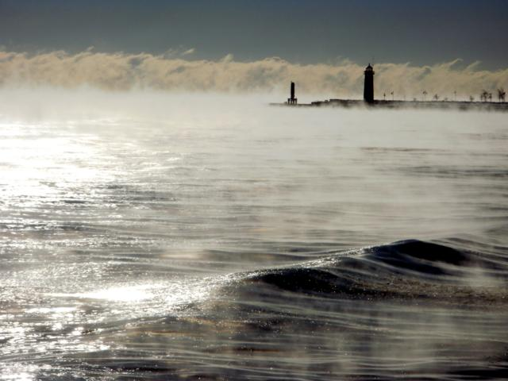
Steam Fog
Bitter cold January air over Lake Michigan
http://media.trb.com/media/photo/2011-01/216881120-24150101.jpg

Slide 18
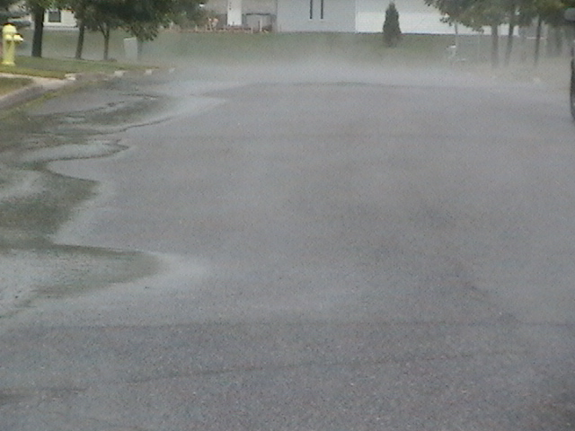
Steam Fog Rising from Hot Asphalt
http://farm3.static.flickr.com/2651/3724731423_abe14b195d_o.jpg

Slide 19
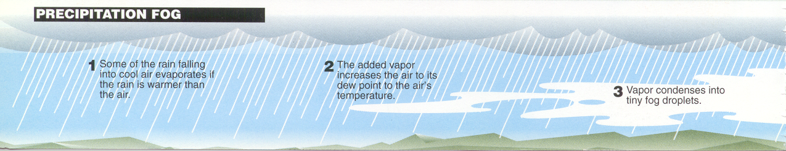
Precipitation/Frontal Fog Weather
Williams, The Weather Book, p68
A type of Evaporation Fog
Occurs when warm rain falls into colder unsaturated air
Warmer rain drops evaporate as they fall
Added water vapor increases dew point to saturate the air
Most common in the shallow layer of cold air, just ahead of warm fronts (rarely occurs in AZ)

Slide 20
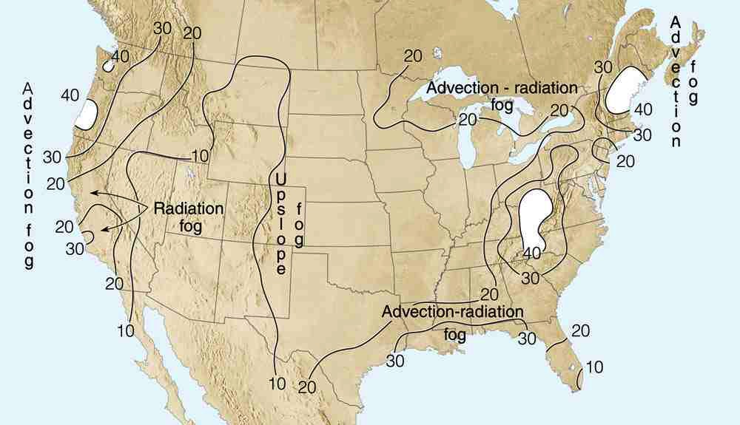
Number of Days with Fog
Common surface flows for fog types
COLD WATER
WARM AIR
COLD AIR
Valley
Fog
STEAM
WIND
CALM CLEAR
COLD WATER
WARM
AIR
WARM AIR
Ahrens, Fig 4.16

Slide 21
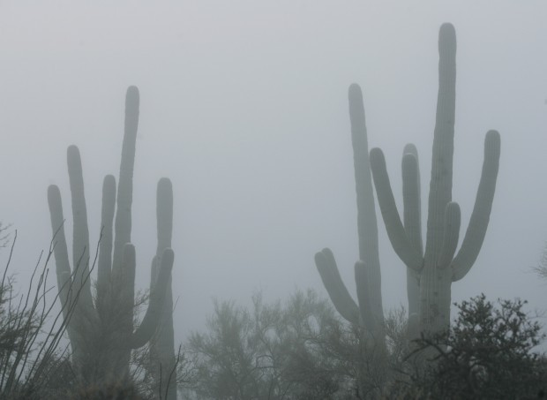
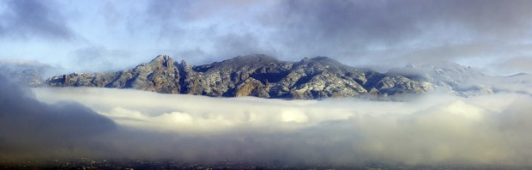
4 Dec 2011
And yes, it can get foggy in Tucson
http://tucson.com/gallery/news/local/photos-snow-and-fog-around-tucson-on-dec/collection_e8ffd55a-1eb3-11e1-b125-001871e3ce6c.html#2
Fog over Tucson.
4 Dec 2011

Slide 22
When the lower deserts of Arizona get fog during the winter, what type of fog is it?
  Advection
  Radiation
  Steam/Mixing
  Upslope
4 Dec 2011
http://tucson.com/gallery/news/local/photos-snow-and-fog-around-tucson-on-dec/collection_e8ffd55a-1eb3-11e1-b125-001871e3ce6c.html#2
Fog over Tucson.
4 Dec 2011

Slide 23
When the lower deserts of Arizona get fog during the winter, what type of fog is it?
  Advection
  Radiation
  Steam/Mixing
  Upslope
4 Dec 2011
http://tucson.com/gallery/news/local/photos-snow-and-fog-around-tucson-on-dec/collection_e8ffd55a-1eb3-11e1-b125-001871e3ce6c.html#2
Fog over Tucson.
4 Dec 2011

Slide 24
Summary: Fog
Fog - a cloud at the ground
Composed of small (~20 µm) water droplets
Four primary types of Fog
Radiation-Advection-Upslope-Steam
Occurs under distinct weather conditions for which fog types are named

Slide 25
This ends the overview.
Thank you for listening.

