Slide 1
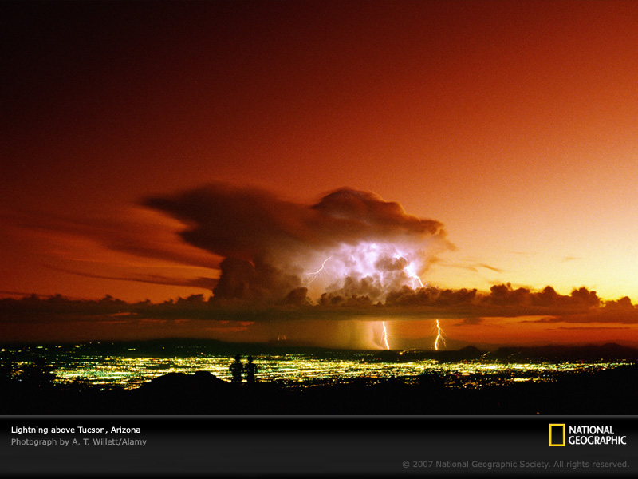
ATMO 170A1
Online
Vertical
Stability

Slide 2
Stability and Buoyancy
In the atmosphere, the stability is related to the buoyancy, the upward force exerted on the air parcel by virtue of the temperature difference between the parcel and the surrounding air.
ABSOLUTELY
STABLE
ABSOLUTELY
UNSTABLE
CONDITIONALLY
UNSTABLE
Tparcel
PARCEL
COOLER
PARCEL
WARMER
PARCEL
WARMER
ONLY IF CONDENSATION
We determine which conditions exists in the atmosphere by comparing the environmental lapse rate to the dry adiabatic and moist adiabatic lapse rate.

Slide 3
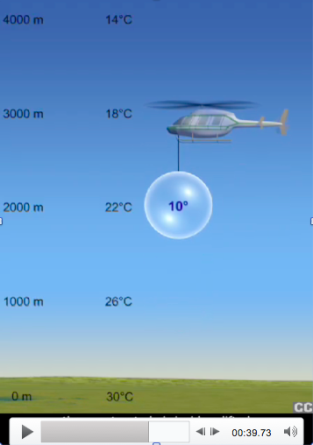
Absolutely Stable
Environmental lapse rate less than moist adiabatic lapse rate or about 6°C per km.
Air resists upward motion
Force must be applied to a parcel so it can rise
If clouds form, they will spread out horizontally.
Link to video
http://www.atmo.arizona.edu/~mullen/atmo170A1/animations/stable_atmosphere.mp4

Slide 4
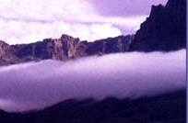
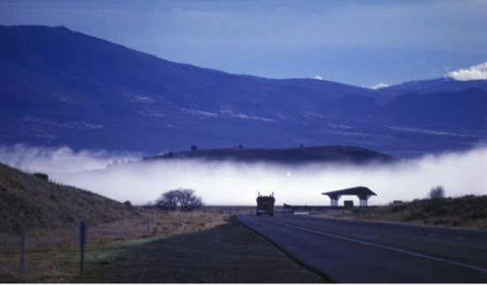
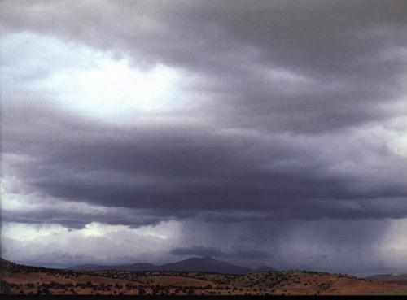
Clouds in a Stable Environment
STRATUS
RADIATION FOG
NIMBOSTRATUS
Forms in inversion caused by radiative cooling of the ground. The inversion acts like a “lid”
Form because air is being forced up and over something, for example a front or terrain barrier.

Slide 5
How does the atmosphere make clouds in a stable environment?
Forced Ascent
Convergence into surface lows
Frontal lifting
Flow over mountains
Thermals-indirectly (e.g. pileus clouds when the wind is forced over a rising cumulus cloud)

Slide 6
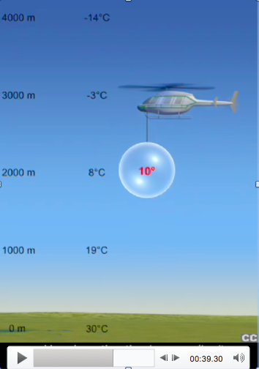
Absolutely
Unstable
Environmental lapse rate greater than dry adiabatic lapse rate or about 10°C per km
Air does not resist upward motion.
Condition is rare in the atmosphere.
Also called superadiabatic
Link to video
http://www.atmo.arizona.edu/~mullen/atmo170A1/animations/unstable_atmosphere.mp4

Slide 7
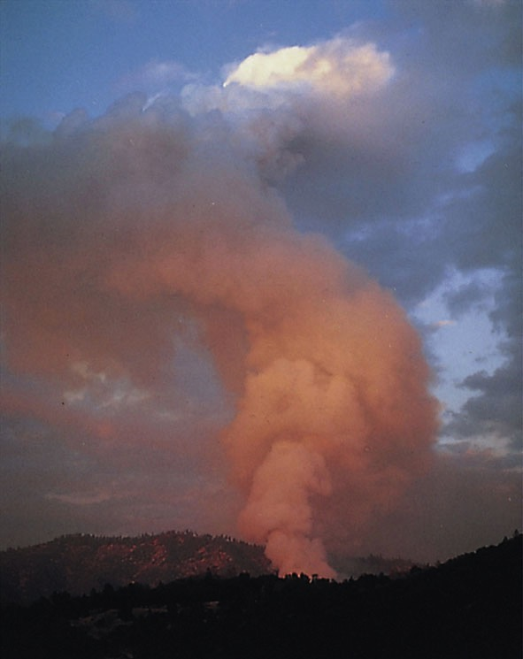
Where Can Absolutely Unstable Lapse Rates Occur?
FOREST FIRE SMOKE
Absolutely unstable lapse rates most commonly occur just above the ground (especially asphalt) in the afternoon on hot sunny days.
Occur above forest fires and erupting volcanoes
Forms when air is heated more rapidly from below than convective currents can transport heat upward

Slide 8
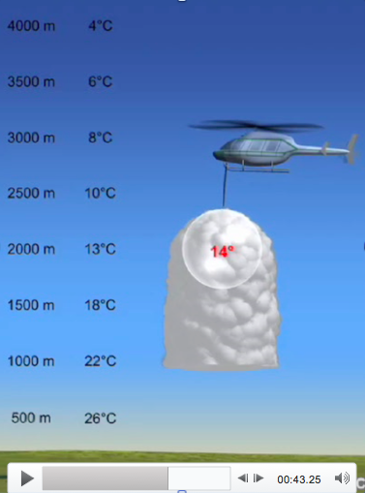
Conditionally Unstable
Environmental lapse rate between the moist and dry adiabatic lapse rate or between 6°C and 10°C per km.
Air does not resist upward motion if condensation is occurring.
Unlike the absolutely unstable case, this condition occurs frequently in the atmosphere!
Link to video
http://www.atmo.arizona.edu/~mullen/atmo170A1/animations/conditionally_unstable_atmosphere.mp4

Slide 9
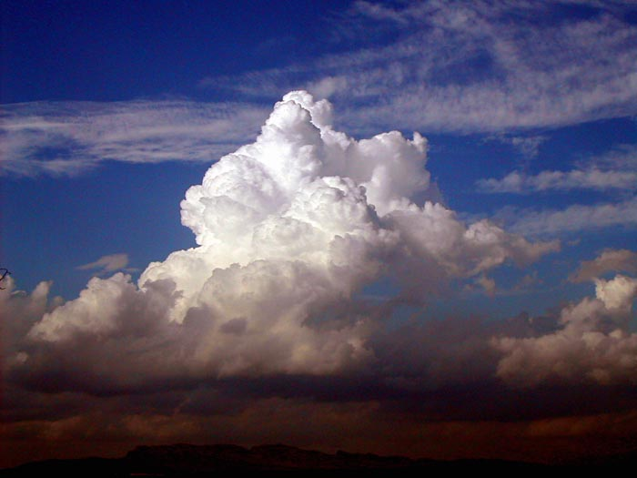
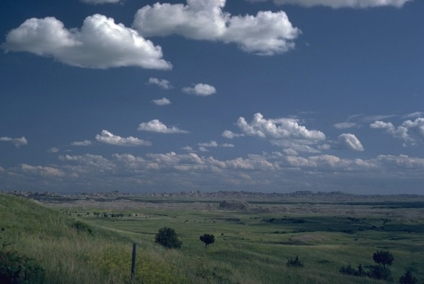
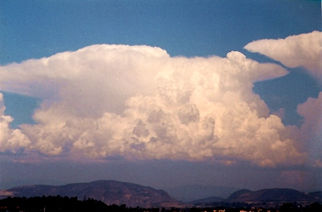
Clouds in a Conditionally Unstable Environment
Cumulus Congestus
Cumulus Humilis
Cumulonimbus
Basically any type of cumulus cloud indicates conditional instability somewhere in the atmosphere.
What process of heat transfer is happening here?

Slide 10
Causes of Instability in the Atmosphere
Can occur from any process that increases the environmental lapse rate. Any way you do it—increases chance of convection!
Cooling Aloft
Winds bringing in colder air
Cloud tops (radiative cooling)
Warming of the surface
Daytime solar heating
Winds bringing in warmer air
Air moving over a warm surface.
Similar to
Convection in boiling pot
Put in ice cubes
Heat from burner

Slide 11

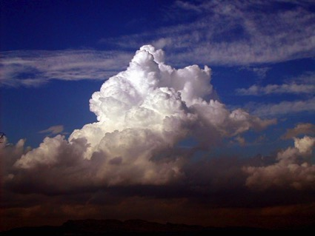
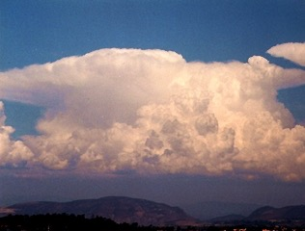
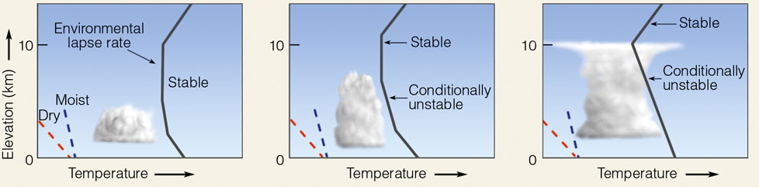
How deep convection gets depends on the depth of the instability in the atmosphere
Cumulus humilis
Cumulus congestus
Cumulonimbus
Conditionally unstable in a shallow layer
Conditionally unstable about midway through troposphere
Conditionally unstable nearly to the tropopause

Slide 12
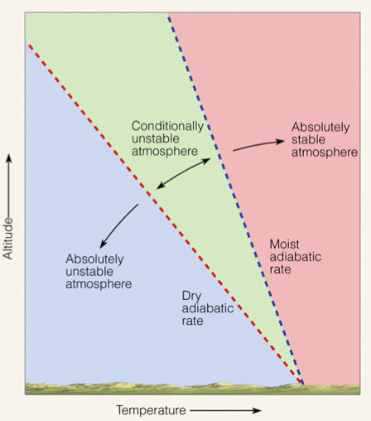
What determines whether the atmosphere is
stable, unstable or conditionally unstable?
Environmental Lapse Rate
6°C km⁻¹
Standard
Lapse Rate
6.5°C km⁻¹
10°C km⁻¹
Ahrens: Met. Today

Slide 13
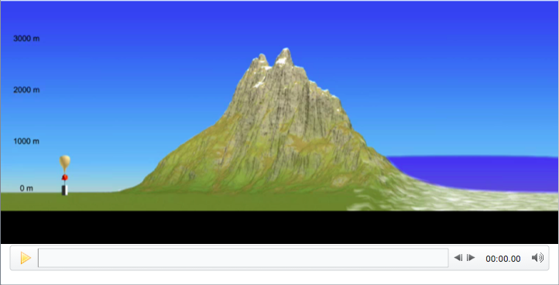
Moist Flow over Mountain Range
Link to Video
http://www.atmo.arizona.edu/~mullen/atmo170A1/animations/AirRisingUpandOveraMountain.mov
Balloon measures ELR (environmental lapse rate)
Note parcel is always colder than environmental air

Slide 14
Summary of Major Lecture Points
Stability refers to the tendency of an object to return to its original position when disturbed. In the atmosphere this is related to the buoyancy.
Absolutely stable: Air resists upward motion. Results in flat, spread out clouds.
Absolutely unstable: Air does not resist upward motion. Rare in the atmosphere.
Conditionally unstable: Air does not resist upward motion if the parcel is sufficiently lifted and condensation is occurring. Results in vertically developed clouds.

Slide 15
Summary of Major Lecture Points
Convective clouds are caused by warm air rising which condenses. How deep the convection goes depends on the depth of the conditional instability. Severity of the updraft also depends on the temperature difference between the environment and parcel.
Topography can cause clouds to form by orographic lift. Clouds can be stratiform or cumuliform.
Even a conditionally unstable lapse rate and a saturated parcel does not guarantee formation of cumuliform clouds.

