Slide 1
We just looked at all the various types of clouds.
Now we will get some insights on how the clouds reflect the thermodynamic characteristics of the atmosphere.

Slide 2
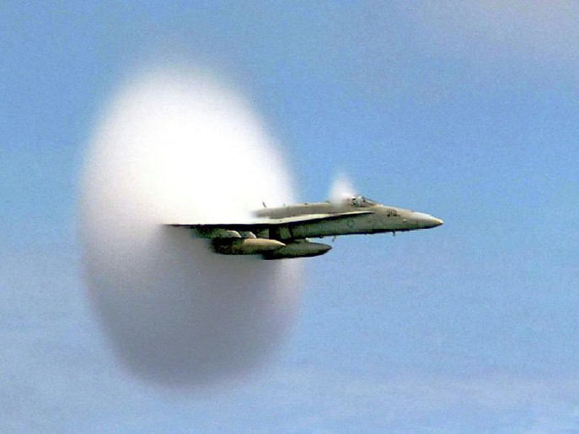

ATMO 170A1
Online
Adiabatic Processes
Condensation of water caused by rapid expansion and resultant adiabatic cooling of air parcels that are induced by shock waves (expansion/compression) as US Navy jet breaks the speed of sound at 75 feet above the Pacific Ocean. Photo by John Gay. Won 1st place.
http://dspace.mit.edu/bitstream/handle/1721.1/47288/12-003Fall-2007/NR/rdonlyres/Earth--Atmospheric--and-Planetary-Sciences/12-003Fall-2007/D92915BF-9CB7-4B49-AD23-AC85FFF2A156/0/supersonic.jpg

Slide 3
Goals of this Overview
Formalize the concept of an “air parcel”. ✔
Conservation of thermodynamic energy. ✔
Adiabatic process. ✔
Why rising/sinking air parcels cool/warm. ✔
Why rising saturated air parcels cool at a slower rate than unsaturated air parcels. ✔
Consequences of the difference. ✔

Slide 4
A “Parcel” of Air
In the case of the atmosphere, our “object” is not a rock but a parcel of air.
Characteristics of air parcel
Volume which expands and contracts freely
Does not break apart
Does not interact with the surrounding environment and remains a single unit.
Parcel has a temperature (T), density (d) and pressure (P)
Pressure in the parcel is equal to the pressure outside.
PARCEL
T, d, P

Slide 5
The First Law of Thermodynamics as applied to air parcel
Energy exchange between parcel and the
surrounding
environment
Change in
parcel
volume
(work done)
Change in
parcel
temperature
(internal energy)
=
+
Heating (+)
or
Cooling (−)
Expansion (+)
or
Compression (−)
Warming (+)
or
Cooling (−)

Slide 6
Adiabatic process
No exchange of heat with surroundings
Change in
parcel
volume
(work done)
Change in
parcel
temperature
(internal energy)
0
+
=
Expansion (+)
or
Compression (−)
Warming (+)
or
Cooling (−)

Slide 7
ADIABATIC
EXPANSION
Parcel rising
ADIABATIC
COMPRESSION
Parcel sinking
Temperature
decreases
Outside air pushes parcel inward
Lower air pressure
Parcel pushes outside air away
Compression
Expansion
Temperature
increases
Higher air pressure

Slide 8
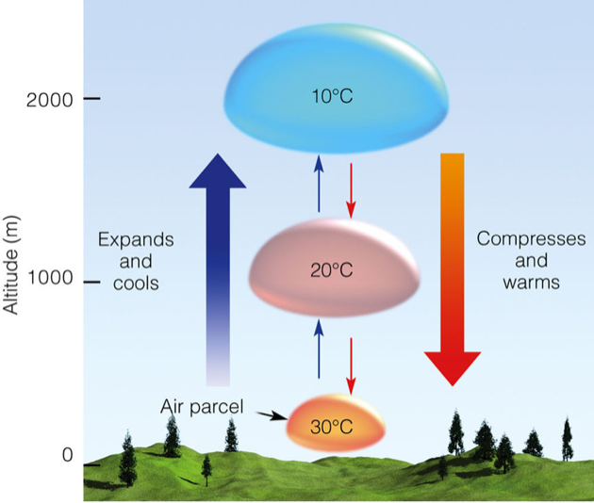
In the atmosphere, the rate of adiabatic warming or cooling remains constant.
Dry Adiabatic Lapse rate = 9.8°C per km
We will use the approximate value ≈ 10°C per km

Slide 9
But the temperature profile is rarely dry adiabatic in the earth’s atmosphere
We have not accounted for processes involving moisture.

Slide 10
Latent Heat Release by Condensation
UNSATURATED PARCEL
SATURATED PARCEL
Temperature is LESS than that of saturated parcel
Parcel unsaturated
(RH < 100%).
T₁
Temperature AT the dew point
Parcel saturated and RH = 100%
Condensation RELEASES latent heat and warms the parcel.
T₁ < T₂
T₂
T₀
T₀
DRY ADIABATIC PROCESS
LAPSE RATE = 10°C per km
MOIST ADIABATIC PROCESS
LAPSE RATE < 10°C per km

Slide 11
The moist adiabatic lapse rate is NOT constant.
It varies with temperature and moisture content. Always less than the dry adiabatic lapse rate.
We will use the approximate value = 6ºC per km
It approaches the dry adiabatic lapse rate when the temperature gets very cold because the SVP approaches zero and the air contains little water vapor at low temperatures.

Slide 12
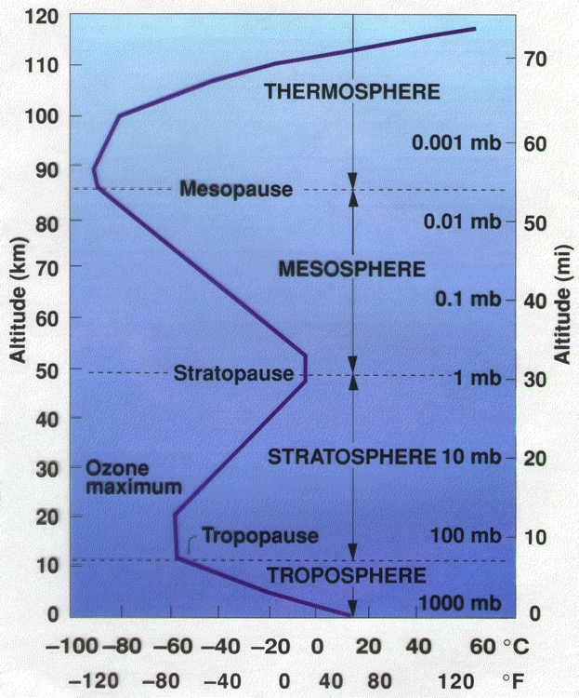
Why is the lapse rate the way it is in the troposphere?
Because there is condensation, the average lapse rate of the troposphere is 6.5°C per km — much closer to the “average” moist lapse rate than the adiabatic lapse rate.
inversion
isothermal
6.5ºC/km

Slide 13
Recap of possibilities for the parcel
1. Parcel rising and no condensation:
    Temperature decreases at the dry adiabatic lapse rate of 10.0°C per kilometer
2. Parcel rising, saturated, and there is condensation:
    Temperature decreases at the moist adiabatic lapse rate, about 6°C per kilometer.
3. Parcel sinking :
    Temperature increases at the dry adiabatic lapse rate, since the parcel is warming and no condensation is taking place.

Slide 14
What about Dew Point?
1. Parcel rising and no condensation:
    Dew point decreases at a rate of 2.0°C per km
2. Parcel rising, saturated, and there is condensation:
    Dew point must decrease at the moist adiabatic lapse rate of 6.0°C per km.
    Why? Water vapor is condensed. Latent heat released.
3. Parcel sinking :
    Dew point always increases at a rate of 2.0°C per km

Slide 15
Take Home Points
Know These Important Concepts
Rising unsaturated air and all sinking air
Dry Adiabatic Rate of 10ºC/km
Dew Point changes at rate of 2ºC/km
Saturation occurs with sufficient lifting
Rising saturated air
Temperature and Dew Point decrease at Moist Adiabatic Rate of 6ºC/km
Moist Rate always less than the Dry Rate
Latent heating mitigates adiabatic cooling

