Slide 1
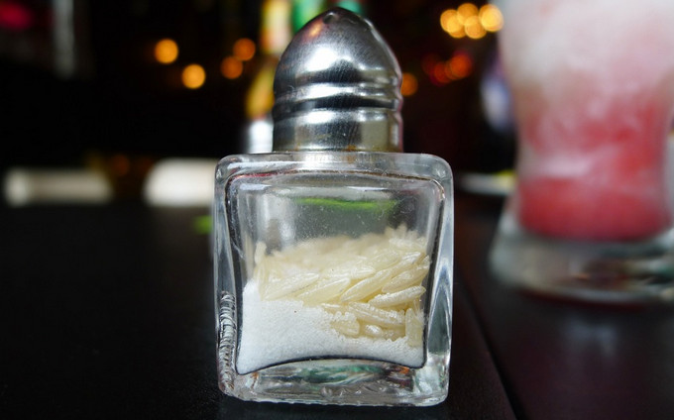

ATMO 170A1
Online
Condensation
H&P §5.5
Why does putting rice in a salt shaker prevent clumping of the salt?
Figure credit: https://experthometips.com//wp-content/uploads/2016/02/Salt-Clumps.jpg

Slide 2
Summary: Moisture Measures
Saturation Vapor Pressure (SVP) - Highest possible partial pressure for water vapor
Vapor Pressure (VP) - Actual partial pressure of water vapor
Relative Humidity – Ratio of
actual content (VP)
saturation value (SVP)

Slide 3
Summary: Moisture Measures
Dew Point (DP) - temperature to which air must be cooled at constant pressure to become saturated. Plotted on WX maps.
Wet Bulb Temperature - lowest temperature to which air can be cooled by evaporation of water into the air.
Temp ≥ Wet Bulb Temp ≥ Dew Point
Only Equal When R.H.=100%

Slide 4
Condensation
Condensation => phase change from vapor to liquid.
Warming of surrounding air is realized.
Latent heat of vaporization for H₂O is large. 540 cal/gm of heat transferred to the air.
It is difficult to condense H₂O vapor in pristine air!

Slide 5
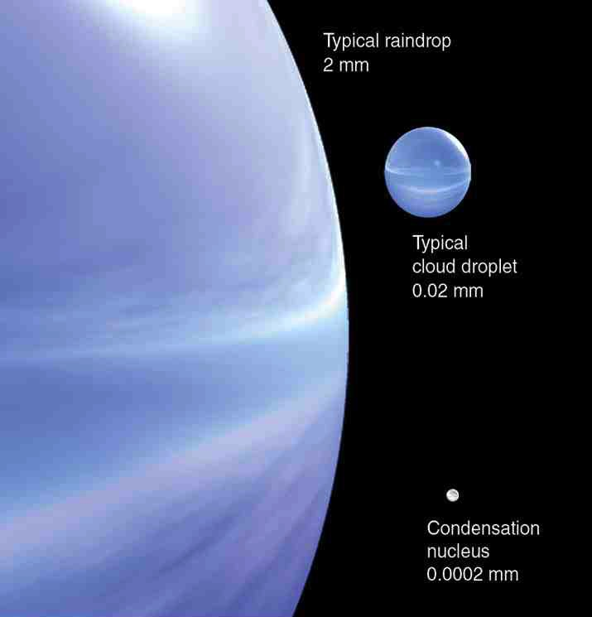
Diameters of H2O molecule ￫ CCN
￫ Cloud Droplet ￫ Raindrop
100 times
100 times
˚
H₂O molecule
2.75 × 10⁻⁷ mm
1000 times
Ahrens earlier ed.
Notes:
WHAT WE NEED TO EXPLAIN
Volume grows million times when CCN->Droplet and another million times when Droplet->Raindrop.
Volume grows one trillion times for CCN->Raindrop transition. One hour or less

Slide 6
Cloud Condensation Nuclei
Small, airborne particles provide a surface on which water vapor can condense to produce cloud droplets.
Without such particles, RH>100% would be needed to produce clouds. Why? Because droplets are round, not flat.
Such surfaces are called Cloud Condensation Nuclei (CCN)
CCN are small, light and stay suspended for days.

Slide 7
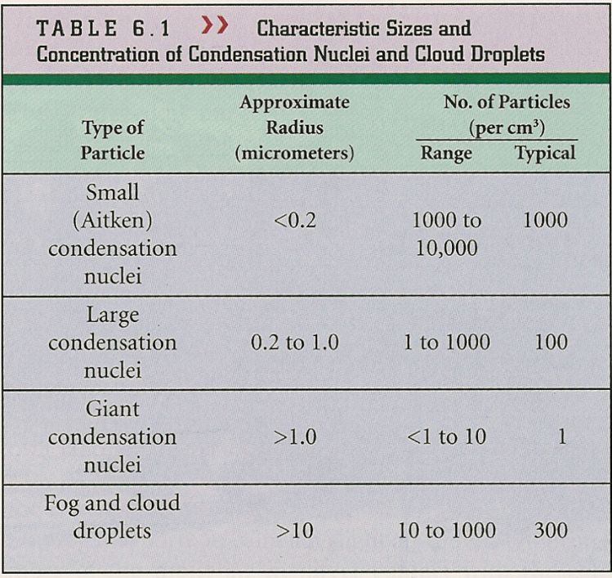
Cloud Condensation Nuclei
Sources
Dust, volcanic ash, smoke, soot, salt, sulfate particles
Concentrations
1,000-10,000 per cc Higher concentrations
Near the surface
Over continents
Over megacities
Ahrens, Met. Today, 5th Ed.

Slide 8
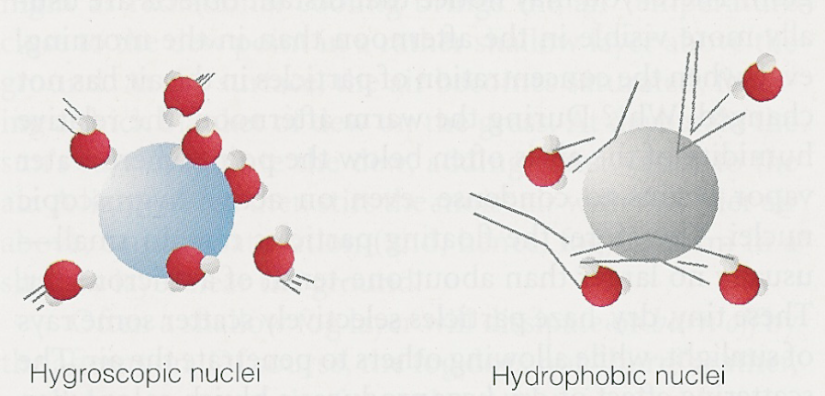
Cloud Condensation Nuclei
Ahrens, Met. Today, 5th Ed.
Hygroscopic nuclei Hydrophobic nuclei
Water-Seeking
Salt
Sulfuric acid
Nitric acid
Water-Repelling
Oils
Gasoline
Waxes
Condensation can occur on hygroscopic CCN at RH’s < 100% Accounts for Haze when the RH approaches 60-80%

Slide 9

Haze at Sunrise near Ashville NC
http://www.fotothing.com/photos/64b/64b04ad23a6ee44bc58efeea1b79dfa9.jpg
Credit: Dave Allen Photography / Shutterstock
http://www.fodors.com/world/north-america/usa/tennessee/great-smoky-mtns-national-park/gallery/great-smoky-mountains-national-park-tennessee-usa

Slide 10
Summary: Condensation
Condensation
Can occur by cooling or moistening of air
Cloud Condensation Nuclei (CCN)
Permit condensation at RH’s < 100%
Small airborne particles (<0.2 to 1 microns) Can stay suspended for weeks
Responsible for haze at RH < 100%

Slide 11
This ends the overview.
Thank you for listening.

