Slide 1
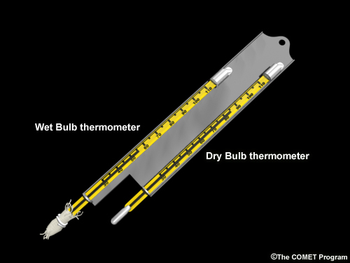
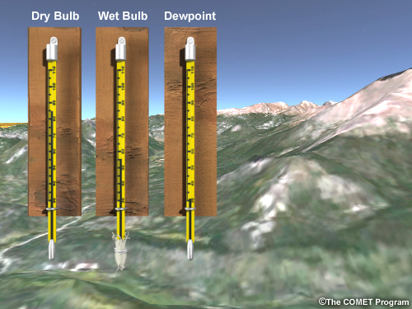

ATMO 170A1
Online
Measures of Moisture
Sling psychrometer is used to measure wet-bulb temperature

Slide 2
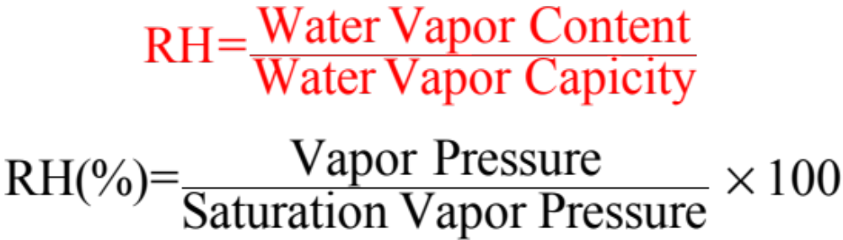
Measures of Atmospheric Moisture
Relative Humidity (RH)
RH changes by either changing the water vapor content or temperature
Air with a RH=100% is said to be saturated at which point condensation occurs

Slide 3
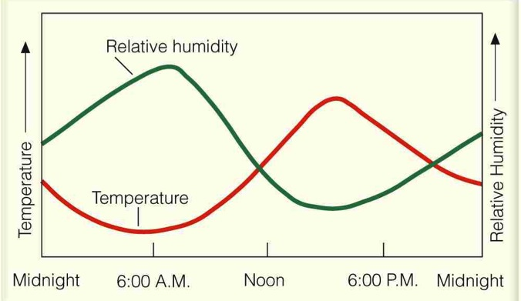

Relative Humidity Temperature Sensitivity
Vapor Pressure Constant
Ahrens 6th ed.
RH is very sensitive to air temperature. It can vary radially even if VP remains constant
Because of the sensitivity of RH to temperature change, meteorologists use other measures for water vapor

Slide 4
Measures of Atmospheric Moisture
Relative Humidity (RH)
Consider air that starts saturated at 0ºC
Temp VP SVP RH
0ºC 6 mb 6 mb 100%
10ºC 6 mb 12 mb 50%
20ºC 6 mb 22 mb 26%
30ºC 6 mb 40 mb 14%
40ºC 6 mb 70 mb 8%
(See Appendix B of Ahrens)

Slide 5
Measures of Atmospheric Moisture
Dew Point (T_{d})
Dew Point (T_{d})
  Temperature to which air must be cooled at constant pressure to become saturated.
Higher T_{d} => higher water vapor content
Because T_{d} does not vary as temperature changes
Excellent indicator of the water vapor content
T_{d} is relatively insensitive to modest pressure changes
      2˚C smaller per 100 mb decrease
      2˚C smaller per km increase in altitude
      (15˚C in Denver <=> 17°C in Tucson)
Reason T_{d} is plotted on surface weather maps

Slide 6
Measures of Atmospheric Moisture
Dew Point Ranges for Arizona
Vapor Pressure Dew Point
24 mb 20ºC
12 mb 10ºC
6 mb 0ºC
3 mb -10ºC
Rule of Thumb: Vapor pressure almost doubles
for every T_{d} increase of 10˚C
Water Vapor Applet

Slide 7

Measures of Atmospheric Moisture
Wet Bulb Temperature (T_{w})
Wet Bulb Temp - Lowest temp to which air can be cooled by evaporation of water into it.
Higher than Dew Point - H₂O vapor is added to unsaturated air which raises its dew point.
Measured with sling psychrometer
wet bulb
dry thermometer
Ahrens 6th ed.

Slide 8
Very crude approximation of T_{w}
Wet bulb temperature T_{w} is close to the average of T and T_{d}. Smaller than average when temperatures warmer than ~65˚F.
Wet bulb temperature gives the maximum possible cooling of a swamp cooler…or in the downdraft of a thunderstorm.
Month Temperature Dew Point Web Bulb
Dec 40ºF 20ºF 33ºF
Jan 60ºF 30ºF 46ºF
June 100ºF 37ºF 64ºF
July 100ºF 63ºF 74ºF
Approximation Approximation
(40ºF + 20˚F)/2 = 30˚F (100ºF + 37˚F)/2 = 62˚F
(60ºF + 30˚F)/2 = 45˚F (100ºF + 63˚F)/2 = 82˚F
Calculator - http://www.weather.gov/epz/wxcalc
Calculator - http://www.kwangu.com/work/psychrometric.htm

Slide 9
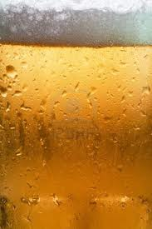
Is the dew point temperature higher or lower than the glass temperature?
Yes
No
Insufficient information. Must know air temperature too.
http://www.123rf.com/

Slide 10
Is the dew point temperature higher or lower than the glass temperature?
Yes
No
Insufficient information. Must know air temperature too.
http://www.123rf.com/

Slide 11
Human comfort and atmospheric moisture

Slide 12
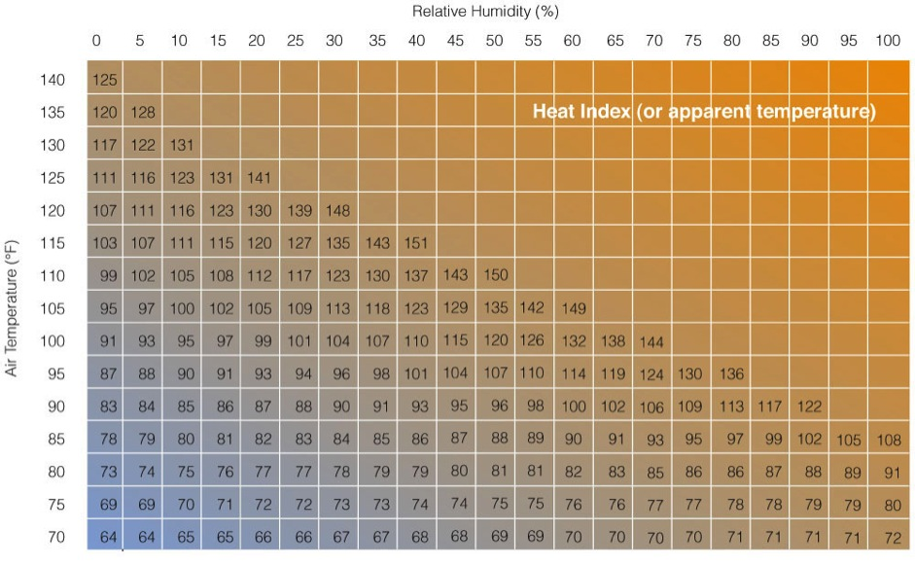
Heat Index
Record MAX
Higher humidity reduces the rate at which sweat evaporates. Thus, the cooling rate is lower.
June MAX
July MAX
Rocky Pt
Ahrens 6th ed.

Slide 13
Summary: Moisture
Water vapor mostly comes from the evaporation of sea water 85%
H₂O molecules reside in atmosphere for 7-10 days
Humid air is any air that contains H₂O molecules.
Less dense than dry air since the molecular weight of H₂O (18 gm/mole) is less than that of
N₂ (28 gm/mole) and O₂ (32 gm/mole).

Slide 14
Summary: Moisture
Air has a saturation level for water vapor, beyond which it cannot get bigger
Saturation level depends on air temperature
Actual water vapor content of air can be quantified by several measures
Vapor Pressure, Relative Humidity
Dew Point, Wet-Bulb

Slide 15
Summary: Moisture Measures
Saturation Vapor Pressure (SVP) -
Highest possible partial pressure for water vapor
Vapor Pressure –
Actual partial pressure of water vapor
Relative Humidity – Ratio of
actual content (VP)
saturation value (SVP)

Slide 16
Summary: Moisture Measures
Dew Point (DP) - temperature to which air must be cooled at constant pressure to become saturated. Plotted on WX maps.
Wet Bulb Temperature - lowest temperature to which air can be cooled by evaporation of water into the air. Higher than DP since water vapor is added to air.
Temp ≥ Wet Bulb Temp ≥ Dew Point
Only Equal When R.H.=100%

Slide 17
Moisture parameter calculator
Enter T in ˚C and station altitude in meters
plus either T_{d} (˚C), T_{w} (˚C) or RH (%)
to get the other moisture parameters.
Link to calculator http://www.kwangu.com/work/psychrometric.htm

Slide 18
Moisture parameter calculator
Enter T (˚C/˚F) and station pressure plus
one of T_{d} (˚C/˚F), T_{w} (˚C/˚F) or RH (%)
to get the other moisture parameters.
Link to calculator http://www.weather.gov/epz/wxcalc
Portable version
http://www.weather.gov/epz/wxcalc_wxcalc2go

Slide 19
End of overview.
Thank you for listening.

