Slide 1


ATMO 170A1
Online
Atmospheric Moisture
H&P §5.1-5.7

Slide 2
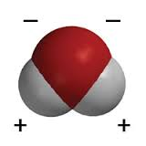
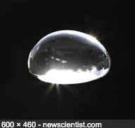
Some unusual properties of water
Boiling points and freezing points of polarized hydrogen compounds typically decrease as molecule size decreases.
  H₂O has an incredibly high boiling point and freezing point for its molecular weight.
Cohesion is an intermolecular force between like molecules. It is why liquids can hold themselves together as a drop.
  H₂O is very cohesive because of the molecule’s polarity.
  Strong cohesion is why H₂O can easily form and maintain drops.
  Intro to the Uniqueness of Water
  (Recommended article)

Slide 3
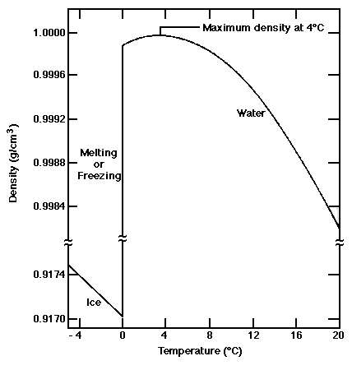
Some unusual properties of water
Substances typically become less dense when heated and more dense when cooled.
H₂O is rare in that its solid state floats on its liquid state.
When H₂O cools below 4°C, it becomes LESS dense.
Link

Slide 4
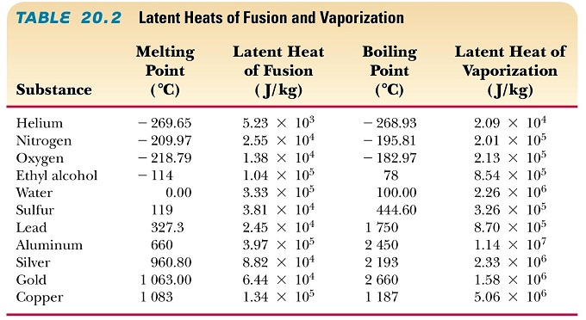
Some unusual properties of water
H₂O has a very high latent heat of vaporization, 540 cal/gm, for its molecular weight. Its value rivals that of metals.
H₂O vapor flows from the tropics to the poles, where it later condenses and warms the surrounding air. Phase changes of water play a major role transferring heat poleward/upward.
earthguide.ucsd.edu
Figure Credit

Slide 5
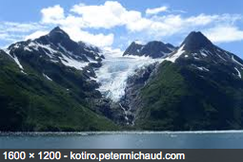
Some unusual properties of water
H₂O is unusual in that it can exist as solid , liquid or gas at the temperatures and pressures that characterize Earth.
This property of H₂O greatly facilitates the formation of precipitation and hence production of fresh water on Earth.
And life on our planet!

Slide 6
Hydrological Cycle
Atmospheric Sciences deals with the aerological branch of the hydrological cycle.
    – sources/sinks of atmospheric water
    – transport of water in the atmosphere
    – phase changes of water in atmosphere
    – precipitation

Slide 7
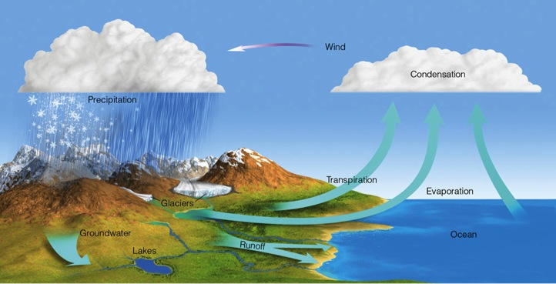
Hydrological Cycle
H&P §5.1
1 week
15%
85%
50%
50%
Ahrens & Hanson Fig. 4.1
85% of water vapor in atmosphere evaporates from oceans
Precipitation that falls over land 50% is runoff to the ocean 50% evaporated/transpired back to atmosphere
Water vapor molecules reside in atmosphere for 7-10 days

Slide 8
Metrics for Atmospheric Water Vapor
First order of business for this module…
How do we measure water content of the air?

Slide 9
Measures of Water Vapor
Dalton’s Law of Partial Pressures
“In a mixture of gases (such as air), each gas has a partial pressure which is the hypothetical pressure of that gas if it alone occupied the volume of the mixture at the same temperature.^{[1]} ” From en.wiki.org
“The total pressure of a mixture of gases is the sum of the partial pressures of each individual gas in the mixture.” From en.wiki.org
Notes:
Just define partial pressure

Slide 10
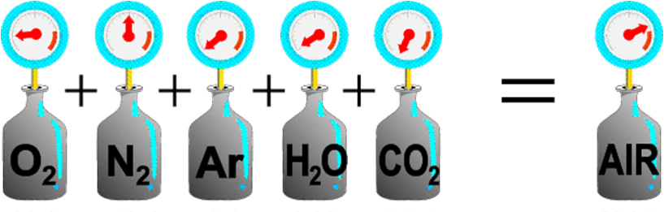




Dalton’s Law of Partial Pressures
•••
Link
Link
209 mb + 781 mb + 12.9 mb + 9.7 mb + 0.4 mb = 1013.0 mb
Figure Credit: http://resources.yesican-science.ca/plp/csa/trans_daltons_law1.gif
Humid air is a mixture of dry air (N₂, O₂, trace gases) and lighter H₂O
Pressure Moist Air = Partial Pressures of N₂+O₂+H₂O+(Other Trace Gases)
partial pressure
of water vapor
Notes:
Example N2+O2=pressure of dry air

Slide 11
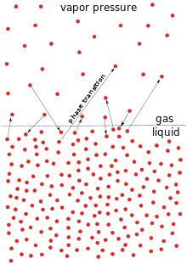
Partial Pressure of Water Vapor
H&P Box 5.1
The partial pressure of H₂O vapor is termed
Vapor Pressure
en.wikipedia.org
Notes:
Just define partial pressure

Slide 12
Saturation Vapor Pressure
H&P §5.2
Partial pressure of water vapor has an upper-limit above which it cannot exceed.
The limiting value is termed Saturation Vapor Pressure
Depends strongly on temperature
higher temp ⇾ higher SVP
saturation
vapor pressure
en.wikipedia.org
en.wikipedia.org
en.wikipedia.org

Slide 13
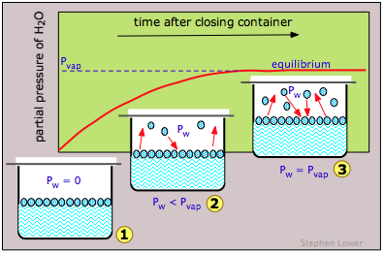
What is Saturation?
Saturation is a state of equilibrium where Evaporation Rate = Condensation Rate
(It is not Evaporation = Condensation = 0)
Example of Dynamic Equilibrium
SVP
dry air
chemwiki.ucdavis.edu

Slide 14
  Vapor pressure and saturation vapor pressure, illustrated by an applet from the Department of Meteorology at Penn State.
  Quick link from local mirror site
  http://www.atmo.arizona.edu/~mullen/atmo170A1/flash/vpressure0603_5.swf
Figure Credit
Might have to cut and paste the credit URL into your browser.
Active link does not always work for some reason.

Slide 15
SVP of Ice and Liquid
H&P §7.3
Water can exist simultaneously as a solid and liquid.
But SVP over ice is less than SVP over liquid. Why?
SVP ice
Molecular bonds are stronger in ice than liquid. It takes more energy to break them.
Thus, at the same temperature fewer molecules can escape from ice than liquid.
SVP is lower over ice than over liquid
SVP liquid
gas
ice
gas
liquid
chemwiki.ucdavis.edu
en.wikipedia.org
en.wikipedia.org
Notes:
Just define partial pressure

Slide 16
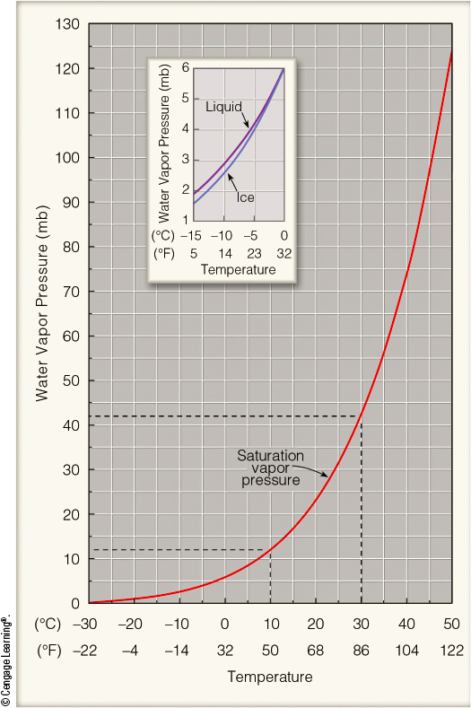
SVP and Temperature
SVP nearly doubles for each 10ºC warming at temps that characterize Tucson
Supercooled water droplets can exist down to temps as cold as -40ºC
For temps below 0ºC SVP runs up to 15% lower over ice than liquid
Water Vapor Applet
42
23
12
6
Ahrens & Henson Fig. 4.5 Akin to H&P Fig. 5. 10

Slide 17
Summary
Vapor pressure is a measure of
actual water vapor content
Saturation vapor pressure (SVP) is a measure of
potential water vapor capacity
strong temperature dependence
higher over liquid than ice at the same temp

Slide 18
This ends the overview.
Thank you for listening.

Slide 19
Map Discussion

