Slide 1
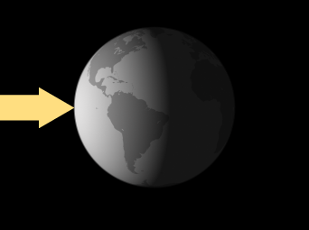
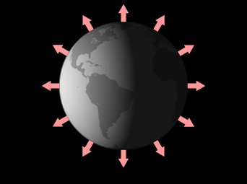
ATMO 170A1
Online
Earth’s Energy Balance
=
Solar radiation absorbed
by Earth
Infrared radiation emitted
from Earth
Figure Credit: NASA

Slide 2

Key Points from Last Time
FOUR POSSIBLE FATES FOR A PHOTON OF RADIATION WHEN IT ENCOUNTERS MATTER
        Absorbed
        Transmitted
        Scattered NOT Absorbed
        Reflected
    The atmosphere does ALL of these…
Notes:
Four possible fates for a photon when it encounters matter…
Absorbed
Transmitted
Reflected NOT ABSORBED
Scattered

Slide 3
Key Points from Last Time
Each molecule has an unique distribution of permitted, quantum energy states
Unique spectrum of absorbed and emitted wavelengths of radiation
Good absorbers are good emitters of radiation
Air is transparent to incoming solar opaque to outgoing infrared

Slide 4
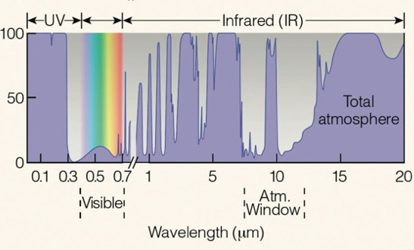
Absorption Spectrum
All Gases
Source: Ahrens and Hanson 8th
O₂ & O₃ absorb UV Radiation
Transparent to Visible Light
Selective of Infrared Radiation
H₂O & CO₂ strong absorbers
Little absorption near 10 μm
Notes:
Absorption spectrum for the atmosphere. Percent of wavelength absorbed.
X-axis: wavelength in microns. Y-axis: purple shading denotes percent of wavelength absorbed.
Air is…
Transparent to incoming visible radiation.
Selectively absorbent of emitted IR radation.
Strongest absorbers of IR radiation are water vapor and carbon dioxide.
Spike at 8 microns is due to O₃.
Atmospheric Window between 8-14 microns where most IR is emitted from the SFC. The window plays in important role in preventing the Earth from getting too hot.
Last, air absorbs UV up to 0.3 microns due to dissociation of O₂ and O₃

Slide 5
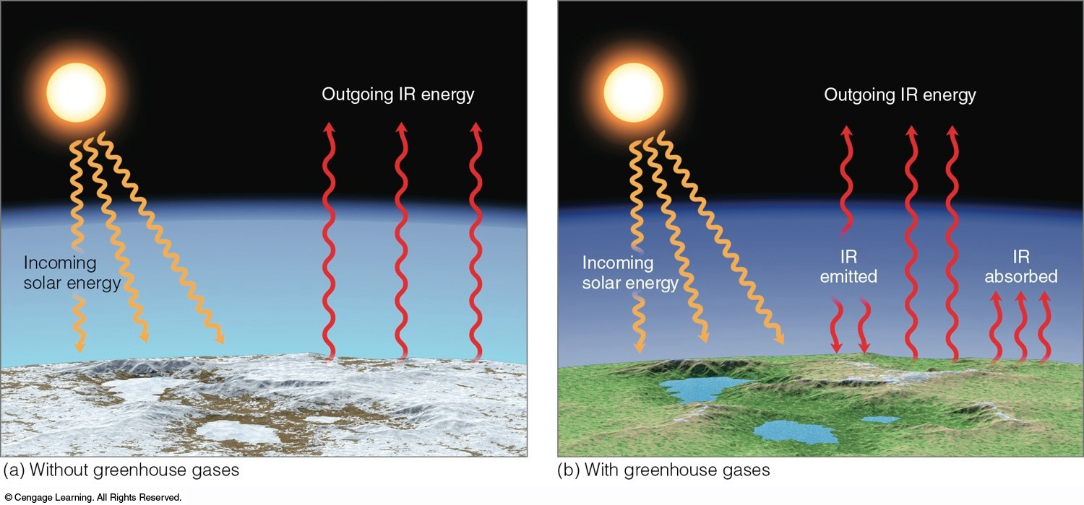
The Greenhouse Effect is a Good Thing
0°F (265 K)
59°F (288 K)
The presence of the gases in our atmosphere that absorb and emit IR radiation helps maintain the Earth’s average surface temperature of 59°F.
Greenhouse Explanation
Ahrens & Hanson
Notes:
Atmosphere with and without GHG’s if the same amount of solar radiation is absorbed by the Earth’s surface
Without GHG’s 0°F.
With GHG’s 59°F.
Presence of Atmospheric Window prevents too much outbound IR from being absorbed.

Slide 6
Summary
Quantum properties of matter accounts
for the selective absorption of radiation
The Earth’s atmosphere is...
  Transparent to incoming visible radiation
  Selectively absorbent of IR radiation
  Opaque to incoming UV radiation

Slide 7
Learning Goals for this Overview
Radiative Equilibrium
Earth’s Energy Balance
    Incoming Solar Radiation
    Outgoing IR Radiation from Surface
    Space-Atmosphere-Surface Balance

Slide 8
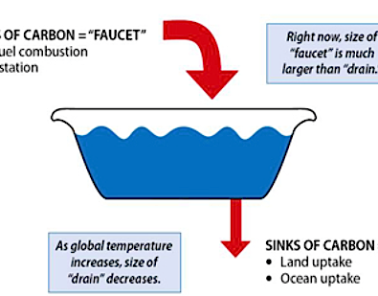


Radiative Equilibrium
Concept is analogous to a filling a bathtub with water when the faucet is on and the drain is open.
Flow In Exceeds Flow Out ⇒ Water Level Rises
Flow Out Exceeds Flow In ⇒ Water Level Falls
Flow In Equals Flow Out ⇒ Water Level is Constant
Or it can be said that the... Water Level is at Equilibrium
Flow In
Flow Out
Original source
Notes:
Introduce a simple but powerful concept that is used throughout science: Equilibrium.
First apply concept to the water level in a bathtub and what can happen when the faucet on and the drain open.

Slide 9
Radiative Equilibrium
Figure credit
Solar radiation absorbed
Infrared radiation emitted
If solar radiation absorbed exceeds IR radiation emitted => Earth’s Average Temperature Warms
If IR radiation emitted exceeds solar radiation absorbed => Earth’s Average Temperature Cools

Slide 10
Radiative Equilibrium
Figure credit
Solar radiation absorbed
Infrared radiation emitted
When radiation absorbed equals radiation emitted, the balance is termed Radiative Equilibrium.
The corresponding constant temperature is the termed Radiative Equilibrium Temperature.
The Radiative Equilibrium Temperature of the Earth’s average surface temperature is currently 15°C or 59°F.
Notes:
Radiative Equilibrium occurs when Absorbed = Emitted
Radiative Equilibrium Temperature => constant temperature that occurs when there is Radiative Equilibrium
We can apply the idea of equilibrium to components of the earth-atmosphere-ocean system. For example, Rad Eq. Temp for Earth’s surface is currently 59°F or 15°C.

Slide 11
Let’s look at the radiation balance for the earth-atmosphere-ocean system
We will emphasize the global energy balance that is averaged over all seasons
Notes:
11

Slide 12
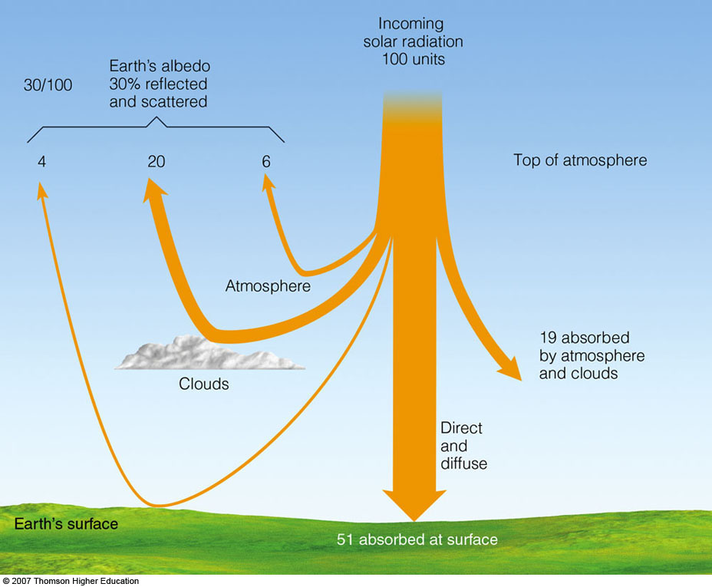
Global Balance of Solar Radiation
340 Wm⁻²
100 units
30% Solar reflected back to space
30% Solar reflected back to space
Albedo: percent of solar reflected back to space
~20% absorbed by atmosphere
~20% absorbed by atmosphere
70% absorbed by surface-atmosphere
70% absorbed by surface-atmosphere
~50% absorbed by surface
~50% absorbed by surface
Ahrens & Hanson 8th
Notes:
Start by considering the fate of incoming solar radiation
The average intensity of solar radiation that hits the TOP is 340 Wm⁻². We will call that value 100 units, which would denote the percentage of solar radiation that hits TOP.
Reflection: Total Albedo is 30%...mostly reflected by tops of clouds
Absorption by Air: About 20% is absorbed by air…mostly by clouds
Absorption by Surface: About 50% is absorbed by surface

Slide 13
100 Units of Incoming Solar
30 units reflected back to Space
  Mostly by clouds
20 units absorbed by Atmosphere
  Mostly by clouds
50 units absorbed by Ground
70 units absorbed by Earth System
Notes:
And these ideas are summarized on this slide

Slide 14
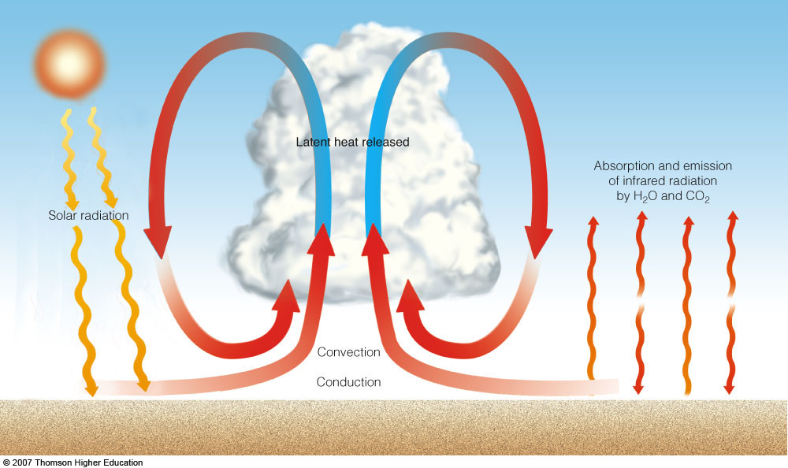
If air is mostly transparent to incoming solar, then how does the atmosphere warm?
Ahrens & Hanson, 8th ed.
Air aloft heats by
Absorption of IR
Latent heating
Convection
Absorbed solar radiation
warms the surface and evaporates water
Ground heats further through absorption of IR from atmosphere
Air “touching” the ground heats by conduction, and by absorption of IR and moistening from evaporation
Atmosphere is Heated From Below
Notes:
The prior slide leads to a question that must be answered…
If air is mostly transparent to incoming solar radiation with only 20% absorbed by water substance,
how does atmosphere gain the heat that is necessary to maintain an average surface temp of 278 K = 15°C (59°F)?
Stefan-Boltzmann Law would give a radiative equilibrium temperature of 20% x 340 Wm⁻² => 186 K = -87°C
Let’s consider what happens to the solar radiation that is absorbed by the surface
=> It goes into warming surface and evaporating ocean water
2) As the surface warms, it emits IR radiation upward,
So the air aloft warms
Absorption of IR that is emitted from surface
Convection currents (fluid motion)
Condensation of Water Vapor (Latent Heating)
Air “touching” the surface would get a boost from conduction
3) But there is another source of energy input for the surface…
Surface warms further though absorption of IR from air,
which in turns increasing heat transport from the surface to the atmosphere by IR emission, convection, latent heating and conduction
It turns out that heat transport from the surface accounts of 85% of the energy absorbed by the atmosphere
4) As a consequence…
Atmosphere is primarily heating from below!!!

Slide 15
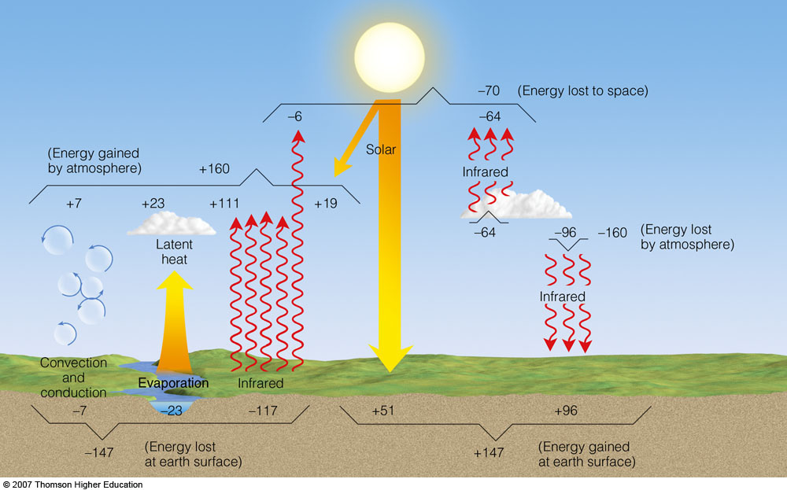
Atmospheric Energy Balance
Complex Balance
Notes:
Strive to understand the BIG picture…Separate the Forest from the Trees
Specific values are not important. Values can vary by a few percent between studies.

Slide 16
Atmospheric Energy Balance
Consider Top of Atmosphere
Solar
70 in = 70 out 30 reflected
Incoming
100
Ahrens & Hanson 8th ed.
Notes:
100 units of solar radiation that hits the Earth must be balanced by an equal amount of energy transferred back to Space
Approximate percentages of radiation are…
30% is reflected SW radiation, mostly be clouds
65% is IR from Atmosphere (64 units)
5% is IR emitted directly from Surface (6 units)

Slide 17
Energy Back to Space
100 units Solar at the Top of the Atmosphere
  30% is Solar reflected by mostly clouds
  65% is IR emitted by the Atmosphere
  5% is IR directly from Surface
100 Units In = 100 Units Out
Earth is in Radiative Balance
  Temperature of Earth System Constant
Notes:
100 units of radiation absorbed by Earth from Sun must balance that emitted by Earth to Space
30% reflected SW radiation
60% IR from Atmosphere
10% IR from Surface

Slide 18
Atmospheric Energy Balance
Consider Surface
Ahrens & Hanson 8th ed.
Ground
147 in = 147 out
Surface
147 in = 147 out
Notes:
Surface Balance
1) Energy Absorbed = Energy Emitted => Radiative Equilibrium => Constant Temperature
147 in = 147 out
2) 147units absorbed at Surface
65% IR from Atmosphere
35% Solar
3) 147units emitted from Surface
80% IR emission
Remaining 20% mostly goes into Evaporation

Slide 19
Surface Balance
150 units absorbed at Surface
  65% IR from Atmosphere
  35% Solar
150 units emitted from Surface
  80% IR emission
  Remaining 20% mostly goes into Evaporation
Notes:
Surface Emission
Vast majority is upwelling IR 80%
Remainder mostly goes to evaporation
Surface Absorption
Majority is downwelling IR from Air 65%
Remainder is from Solar

Slide 20
Atmospheric Energy Balance
Consider Atmosphere
Ahrens & Hanson 8th ed.
Atmosphere
160 in = 160 out
+15 units
Greenhouse
Effect
Notes:
Now that we have discussed energy balance at the upper and lower boundaries of the Atmosphere, we are can examine the Atmosphere’s Energy Balance
Energy Absorbed = Energy Emitted => Radiative Equilibrium
160 in = 160 out
1) The 160 units of absorbed energy come from…
70% IR from Surface (111 units)
12% SW absorbed by clouds, aerosols, water vapor and ozone (19 units)
18% Latent Heat Release, Convection and Conduction (30 units)
2) The 160 units of emitted IR radiation is partitioned between…
60% is directed to the Surface where it is absorbed (96 units)
40% is emitted to Space (64 units)
3) Net IR radiation absorbed by Atmosphere must equal 64 units emitted to Space for Radiative Equilibrium
+19 directly from Sun
+30 from Latent Heating, Convection and Conduction
+15 net IR absorbed from Surface, which comes from 111 units absorbed – 96 units emitted
The net IR denotes the Greenhouse Effect

Slide 21
Atmospheric Balance
160 units absorbed by Atmosphere
  70% comes from IR from Surface
  12% is Shortwave from Sun
  18% is Latent Heating/Convection/Conduction
160 units of IR emitted by Atmosphere
  60% is directed to the Surface
  40% goes to Outer Space
Notes:
Atmospheric Absorption of the 160 units of radiation is partitioned between…
70% IR from Surface
12% Solar by clouds
18% Convection and associated Latent Heat Release
Atmospheric Emission of the 160 units of IR radiation is partitioned between…
60% goes to Surface where it is re-absorbed
40% goes to Surface

Slide 22
Atmospheric Balance
Radiation Equilibrium requires that…
  Amount of energy absorbed by the Atmosphere must equal the 64 units of IR emitted to Space +19 units directly from Sun
  +30 units from Latent Heating and Convection
  +15 units net from Surface
  64 units absorbed = 64 units emitted
The 15 units of net IR from the surface is the Greenhouse (Gases) Effect
Notes:
Atmospheric Absorption of the 160 units of radiation is partitioned between…
70% IR from Surface
12% Solar by clouds
18% Convection and associated Latent Heat Release
Atmospheric Emission of the 160 units of IR radiation is partitioned between…
60% goes to Surface where it is re-absorbed
40% goes to Surface

Slide 23
Atmospheric Energy Balance
Complex Balance
Solar
70 in = 70 out 30 reflected
Incoming
100
Ahrens & Hanson 8th ed.
Atmosphere 160 in = 160 out
Surface
147 in = 147 out
Notes:
Specific values are not important. Values vary by 1%-2% between studies.
Strive to understand the BIG picture…Forest from the Trees

Slide 24
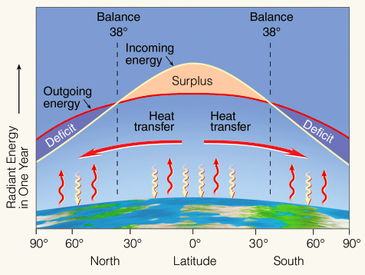
Radiation at the Top of the Atmosphere
Ahrens and Hanson 8th
Begs the question…
What keeps tropics from getting warmer
and the poles from growing colder?
Surplus in tropics
Deficit at poles
=>
Notes:
Instead of averaging over the entire globe, if we only average in an East-West direction or along latitude bands…
What emerges is the North-South Distribution of Net Radiation at the T.O.A.
Surplus of absorbed energy in tropics => warming
Deficit of absorbed energy at the poles => cooling
We observed, however, that temperatures remain essentially constant from year-to-year.
There must be Heat Transfer from the tropics to the poles to keep temperatures constant.
The energy transport is done mostly by the atmosphere, but there is significant contributions from ocean currents

Slide 25
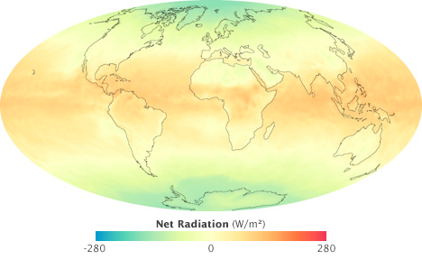
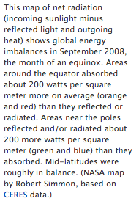
Net Radiation at the Top of the Atmosphere
Credit: NASA
Begs the question…
What keeps tropics from getting warmer?
What keeps poles from growing colder?
Surplus in tropics
Deficit at poles
=>
Notes:
Consider the Global Distribution of Net Radiation at the T.O.P.
Surplus of inbound radiation in tropics (absorbed SW > emitted IR)
Deficit of outbound radiation at the poles (absorbed SW < emitted IR)
What prevents tropics from warming?
What prevents poles from cooling?
Tropics-to-Poles heat transport by Atmosphere-Ocean System

Slide 26
Take Home Points
Radiative Equilibrium
When energy absorbed equals energy emitted
Temperature is constant
Radiative Equilibrium Temperature
Energy Balance
Complex system with an intricate balance
Greenhouse Effect comes from net absorption of IR radiation from the Surface
Surplus of radiation in tropics; deficit at poles
Notes:
Radiative Equilibrium
When energy absorbed equals energy emitted
Temperature is constant
Radiative Equilibrium Temperature
Energy Balance
Complex system with an intricate balance. Must consider all sources and sinks of heat. Change one component of the system, the others will change.
Greenhouse Effect comes from net absorption of IR radiation from the Surface. Accounts for nearly 25% of the total content of the Atmosphere.
Surplus of radiation in tropics; deficit at poles => Requires tropics-to-poles heat transfer to maintain constant temperatures => Driving force for wind and ocean currents

Slide 27
Thank you for listening.
This ends the overview on
Earth’s Energy Balance
27

