Slide 1
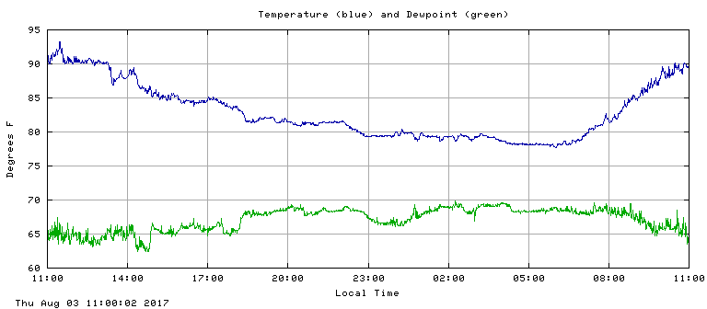




ATMO 170A1
Online
Diurnal Cycle of Temperature
24 h temps at UA ending 8-3-2017 11:00 AM
MAX at 11:45 AM (45 min before solar noon)
MIN at 06:00 AM (40 min after sunrise)
What controls the time of MAX/MIN temp?

Slide 2
Last time
Seasons
Obliquity (23.5º) is primary reason for seasons
Tilt of Earth’s axis changes two important factors
  Angle at which solar rays strike the Earth’s surface
  Number of hours of daylight
What determines warmest/coldest times of the year
Balance between incoming and outgoing energy
  Occur after solstices…typically
  On date at which radiative equilibrium is reached

Slide 3
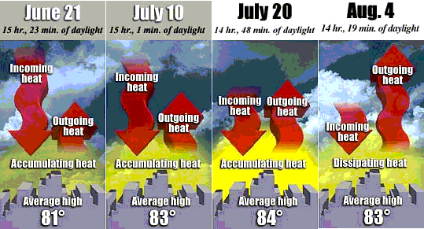
Chicago, where the hottest day of year occurs one month after summer solstice
Consider Average Daily Temperature for Chicago IL
warming
warming
equilibruim
cooling
USA Today WWW Site

Slide 4
Overview Goals
Temperature Variations
  Diurnal Cycle of Temperature
  When MAX/MIN temperatures occur
  Factors that affect MAX/MIN temperatures
Notes:
Continue discussion of Temperature Variations
Look at Diurnal Cycle
Controls of Temperature or “What determines how warm or cold MAX/MIN temperatures will be.”
Concepts can be applied to diurnal and seasonal temperatures.

Slide 5
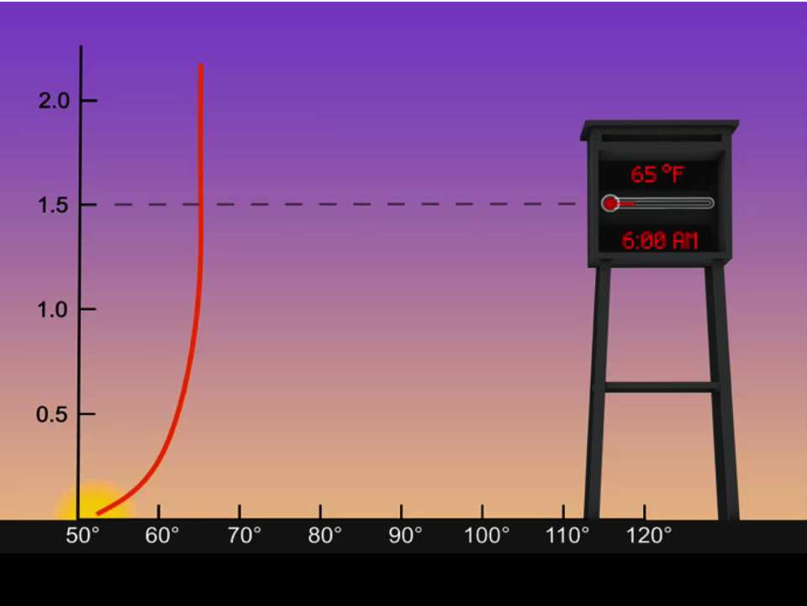
Diurnal Temperature Changes at Ground and Instrument Level
Notes:
Recall from earlier material that the atmosphere is heated/cooled from below by the surface.
So in order to understand diurnal temperature changes for air near the surface, we must understand the diurnal cycle of ground temperatures.
The animation gives the diurnal cycle of temperature for clear conditions.
As the ground warms and cools, so does the air with a few millimeters of the surface.
But the air at instrument level (about 6’) warms and cools at a slower rate, and the temperature changes lag behind the ground changes.
(Correction to narrative of the animation: the ground continues for sometime after solar noon on sunny day.)
From http://weatherfaqs.org.uk/node/27
“A common misconception, is that it must be coldest in the middle of the night, and warmest around midday. On some occasions, mainly due to air mass changes, this may be correct, but not usually. The lowest (minimum) temperature usually occurs a little while after sunrise, and the highest (maximum) temperature usually occurs after midday --- sometimes as late as 3 or 4 hours after midday.
To understand why, it is necessary to consider that thermal energy during the 24 hours is radiating continually from the surface of the earth (at long wavelengths), and incoming solar (relatively short wave) radiation obviously only when the sun is above the horizon. With the sun below the horizon (night), outgoing radiation allows the surface to cool, and the temperature drops. After sunrise, incoming solar radiation counteracts this loss of heat, but only after a lag - which can be up to an hour or so in winter with a low solar elevation.
The minimum temperature occurs when there is a balance between outgoing and incoming radiation. As the sun rides higher in the sky, increasing amounts of short-wave radiation are available to heat the ground, and therefore available to heat the overlying air. Although outgoing land-based radiation is also increasing, solar heating is dominant. The temperature rises, until, past noon, incoming solar radiation starts to decline again.
The highest(maximum) temperature occurs when heat gain due to incoming solar radiation, and heat loss due to outgoing terrestrial radiation balance: this occurs some time after midday.”

Slide 6
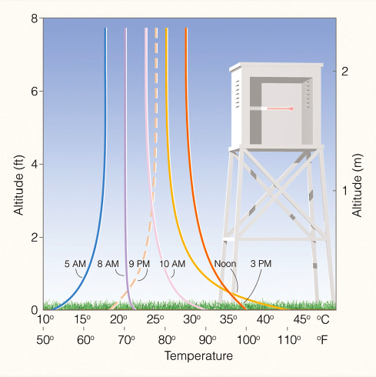
Ahrens & Hanson
Notes:
Ideas of last animation are summarized in the figure
0’: 112˚F – 52˚F at ground level, or a 60˚F swing in day-night temperature
6’: 87˚F – 65˚F at instrument level, or much smaller range that the ground itself

Slide 7
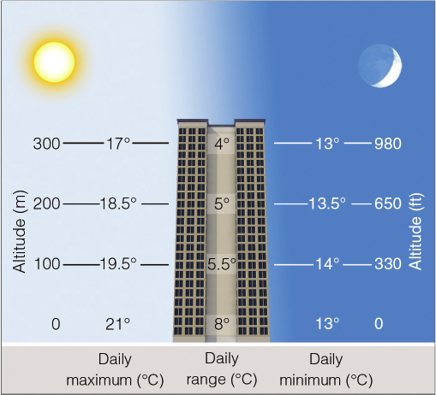
Daily Range of Temperatures
Ahrens & Hanson
MAX-MIN temperature swings decrease with height
Cycle is “felt” to about 1 km AGL
Notes:
If the diurnal cycle rapidly weakens rapidly with altitude (AGL) close to the grounds, then how high does a non-negligible diurnal cycle extend?
About 1 km on average, but there is large variability depending upon the season and the region
Diurnal variability is quite high over lower deserts of AZ during the summer.
The diurnal cycle can extend above ~4 km AGL, or 13,000 feet.
You can feel where top of the diurnal signal begins when you first experience turbulence during your descent into PHX or TUS

Slide 8
What Affects MAX Temperature?
Cloud Cover
Clear skies-solar absorbed
Cloudy skies-solar reflected
Land Characteristics
Water-large heat capacity
Ground-small heat capacity
Wind Speed (winter mostly)
Calm winds-strong inversion
Strong winds-breaks inversion and mixes warm air aloft to surface
Reflection Absorption
Small warming
Much warming
Warm
Cold
Mixing with Fast Winds

Slide 9
What Affects Min Temperature?
Cloud Cover
Clear skies-strong inversion
Cloudy skies-weak inversion
Land Characteristics
Snow cover-strong inversion
Bare ground-weaker inversion
Wind Speed
Light winds-strong inversion
Strong winds-breaks inversion and mixes warm air aloft to surface
Absorption Emission
Weak IR
Strong IR
Warm
Cold
Mixing with Fast Winds

Slide 10
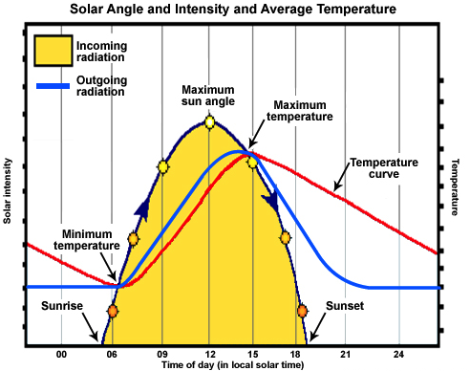
What determines when the MAX/MIN occur?
When incoming Solar exceeds outgoing IR
Temperature rises
When outgoing IR exceeds incoming Solar
Temperature falls
When outgoing IR equals incoming Solar
Radiative equilibrium
Temperature constant
MAX occurs
Late afternoon
MIN occurs
After sunrise
Figure Credit
Ahrens
Notes:
Explain diagram
Graph shows incoming and outgoing radiation
X-axis is time in local solar time (12-noon; 00/24 is midnight)
Y-axis left is radiation intensity.
Y-axis right is temperature.
Red curve - temperature
Black curve – incoming solar radiation
Blue curve – outgoing IR radiation
ADVANCE Black > Blue curve: surplus of absorbed radiation => warming
ADVANCE Black < Blue: curve: deficit of absorbed radiation => cooling
ADVANCE Black = Blue: Radiative equilibrium => Radiative equilibrium temperature => MAX or MIN temp
ADVANCE =>
MAX late afternoon
MIN after sunrise

Slide 11
Take Home Points
Balance between incoming and outgoing energy controls temperature rises and falls
MAX late afternoon, MIN just after sunrise
Brief moment when Radiative Equilibrium occurs (i.e. absorbed energy equal emitted energy)
Diurnal temperature changes are largest at ground
Diurnal changes extend up to 1 km on average
Affected by weather (wind, cloud cover) and land type

Slide 12
This ends the overview on diurnal temperature variations
and factors that affect MAX/MIN temperatures.

