Slide 1
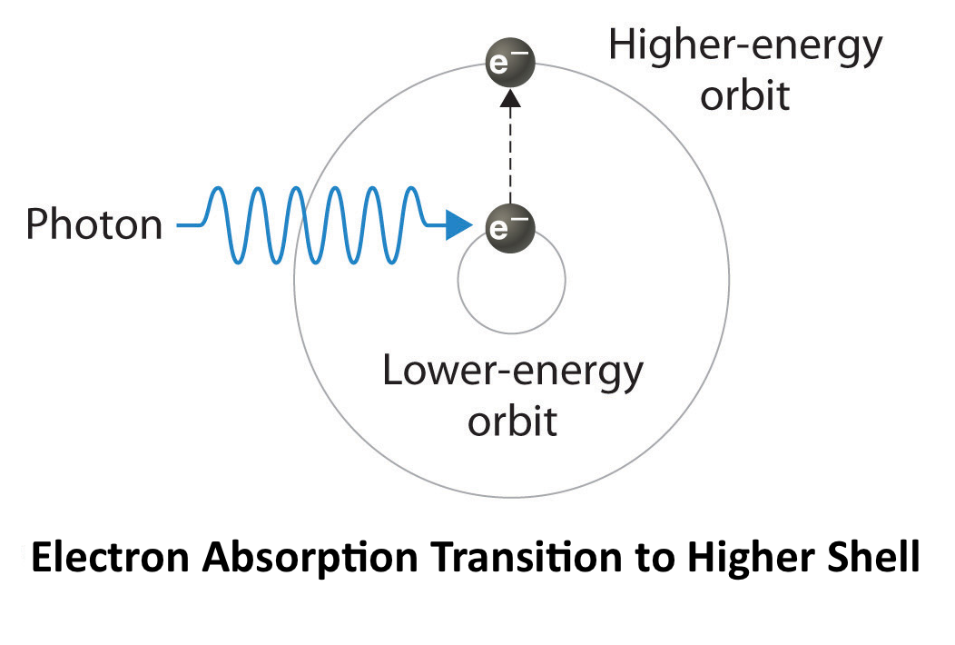
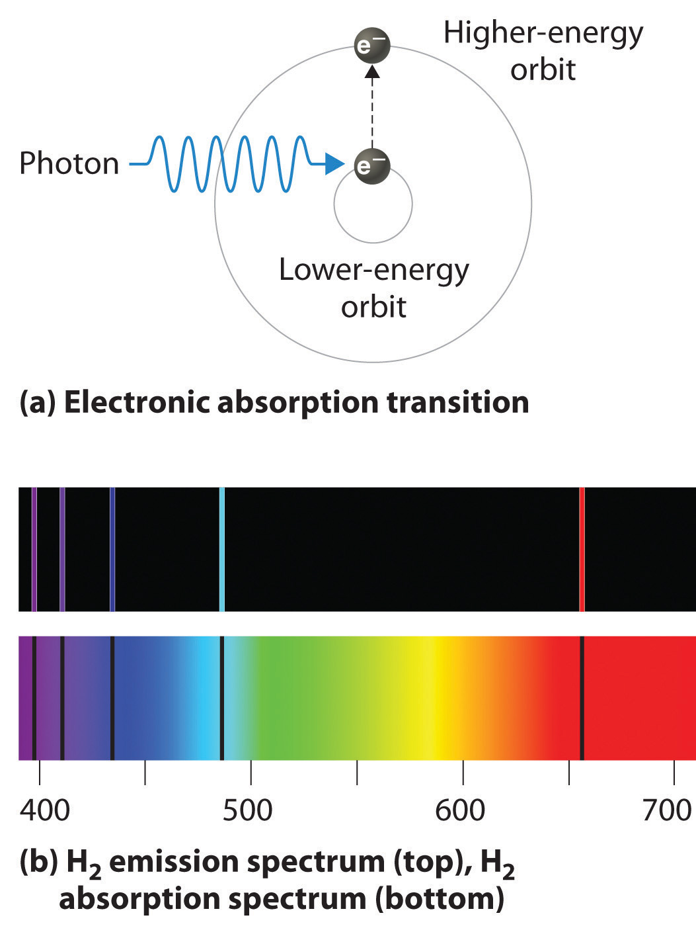
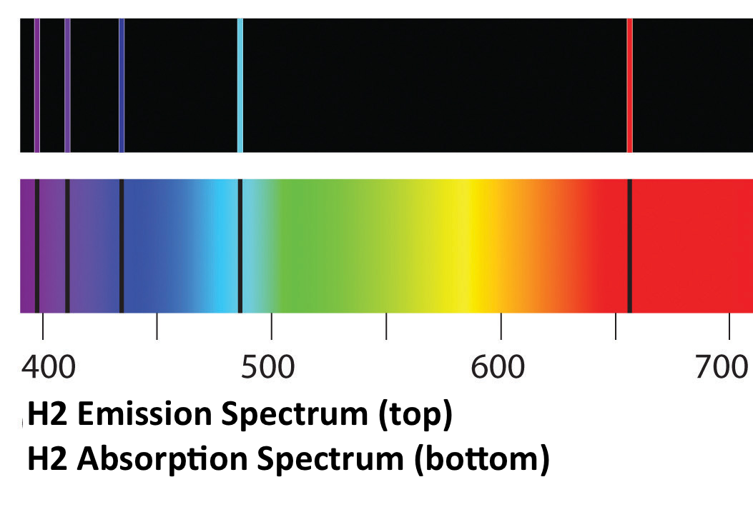

ATMO 170A1
Online
Selective
Absorption
Emission and Absorption Spectra of Hydrogen Gas in the Visible

Slide 2
Prior slide sets
Three modes of heat transfer
  Conduction: molecule-to-molecule con
  Convection-Advection: fluid motion ✚
  Latent Heating: phase change gas⬄liquid
  works with fluid motion
  Radiation: electromagnetic waves

Slide 3
Learning Goals for this Overview
What is Selective Absorption
Why Selective Absorption/Emission
Earth’s “Greenhouse” Effect

Slide 4
Selective Absorption of Radiation
FOUR POSSIBLE FATES FOR A PHOTON OF RADIATION
WHEN IT ENCOUNTERS MATTER:
        Absorbed
        Transmitted
        Scattered NOT Absorbed
        Reflected
    The atmosphere does ALL of these…
    Lets look at each in the above order
Notes:
Four possible fates for a photon when it encounters matter…
Absorbed
Transmitted
Reflected NOT ABSORBED
Scattered

Slide 5
Absorbed:
Radiation transferred to object
Blackbody
A perfect absorber and emitter of radiation of all wavelengths
BLACK BOX
SUNLIGHT

Slide 6
Transmitted:
Radiation passes through object
GLASS WINDOW
SUNLIGHT
TRANSMITTED
SUNLIGHT

Slide 7
Scattered:
Path of radiation deflected in all directions
SCATTERED
SUNLIGHT
FROSTED GLASS
SUNLIGHT

Slide 8
Reflected: angle of incident = angle of reflection
MIRROR
FORM OF SCATTERING
SUNLIGHT

Slide 9
FOUR POSSIBLE FATES FOR A WAVELENGTH OF RADIATION WHEN IT ENCOUNTERS MATTER
        Absorbed
        Transmitted
        Scattered NOT Absorbed
        Reflected
Notes:
Four possible fates for a photon when it encounters matter…
Absorbed
Transmitted
Reflected NOT ABSORBED
Scattered

Slide 10
Radiative Equilibrium:
Absorption = Emission
INFRARED
(LONGWAVE)
EMISSION
BLACK BOX
SUNLIGHT
(SHORTWAVE)
Notes:
Consider an isolated slab of air as a black box that only absorbs shortwave (solar) radiation and is in radiative equilibrium
Absorbed sunlight can be consider to come from a single direction since Earth is far away from the sun).
Emitted IR radiation would be sent in all directions equally.

Slide 11
“Grey Body” = Not all radiation absorbed
Some wavelengths are. Some are not.
How the Earth’s Atmosphere Responds to Solar
SOME
REFELECTION
SCATTERING
OF SUNLIGHT
BY AIR
SOME
TRANSMISSION
OF SUNLIGHT
  THROUGH AIR
GREY BOX
SUNLIGHT
(SHORTWAVE)
INFRARED
(LONGWAVE)
EMISSION
SOME ABSORPTION
OF SUNLIGHT BY AIR
Notes:
The atmosphere is not a block box!
Shortwave radiation that is not scattered back to space would be transmitted by pristine, dry air to the ground.
In reality, H2O (clouds especially) absorbs some SW radiation though.
If the atmosphere only received energy from absorption of solar, it would be much colder than it currently is.

Slide 12
“Grey Body” = Not all radiation absorbed
Some wavelengths are. Some are not.
How the Earth’s Atmosphere Responds to IR
IR FROM AIR
  TO SURFACE
IR FROM AIR
  TO SPACE
SOME
TRANSMISSION
OF LONGWAVE
  TO SPACE
GREY BOX
IR RADIAITON
(LONGWAVE)
FROM SURFACE
LONGWAVE
EMISSION
IR FROM AIR
  TO SURFACE
SOME ABSORPTION
OF LONGWAVE BY AIR
Notes:
Most of the IR radiation emitted from the Earth’s surface is absorbed by air.
And much of that absorbed IR from the Earth in redirected back to the Earth’s surface where it is absorbed!
Causes air to be much warmer than it be otherwise.

Slide 13
But why selective absorption?

Slide 14
To explain the selective absorption radiation by air, we must turn to the strange, fascinating world of
Quantum Mechanics

Slide 15
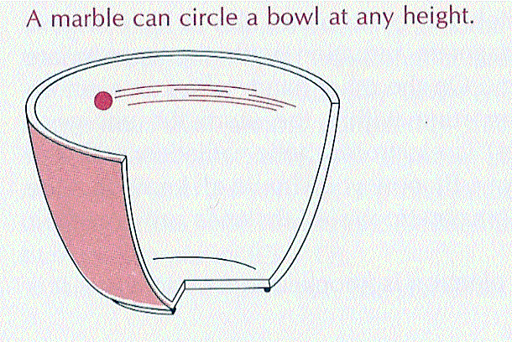
Macroscopic Perspective
A Continuous World
Life as we perceive it: Continuous world
where marbles can orbit in a bowl at any level
Gedzelman 1980, p 103

Slide 16
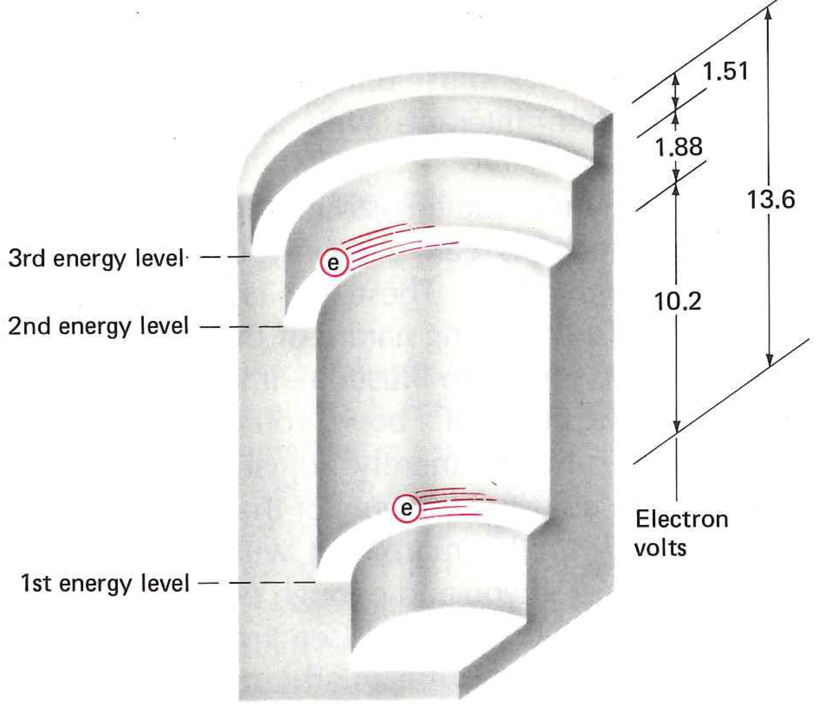
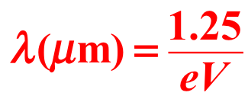
Molecular Perspective
A Quantum World
Hydrogen Atom
Gedzelman 1980, p 104
Molecular perspective: Quantum world
where electrons can only orbit about the nucleus at a specific levels
0.66
0.09
0.12
Notes:
From an atomic/molecular perspective, behavior is quantized. Sort of like living your entire life under a strobe light.
Consider a Hydrogen atom. One proton; one electron.
Unlike the marble rolling inside the bowl, electrons can only orbit at discrete distances form the proton.
Each interval between orbital distances corresponds to a specific amount of energy.

Slide 17
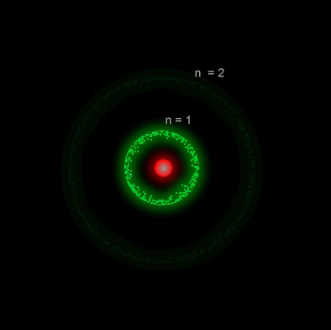
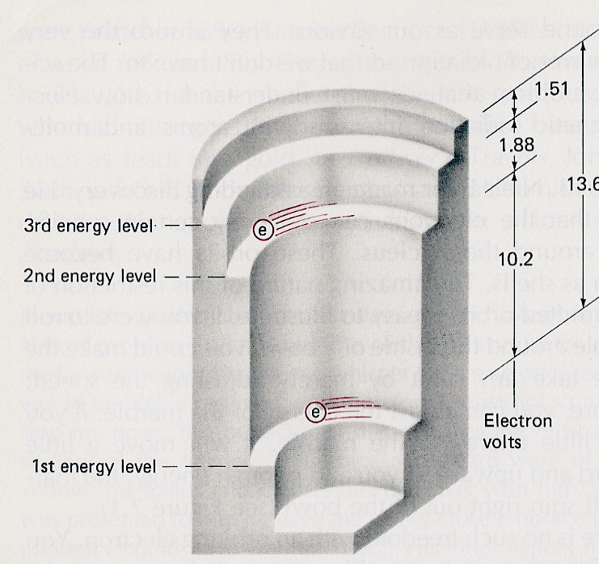
Energy States for Atoms
Electrons only orbit in permitted states or shells
Each shell corresponds to specific energy level
Quantum jumps only allowed between shells
Each quantum jump corresponds to a specific wavelength of radiation
How Atoms Produce Light
Gedzelman 1980, p 104
Hydrogen Atom
10.4 eV
0.12 μm
http://www.kcvs.ca/martin/astro/au/unit2/61/chp6_1.html
Notes:
Animation shows a photon of radiation hitting a hydrogen atom.
The photon is absorbed by the atom, and instantaneously, the electron jumps from its lowest orbital distance (lowest shell) to the next higher permitted shell.
The electron then jumps from shell level #2 to the lowest shell as it emits a photon radiation with the exact same energy that it absorbed.
The specific energy needed to jump from shell #1 to #2 is 10.4 eV, which corresponds to a wavelength of 0.12 μm of EM radiation (UV light).

Slide 18
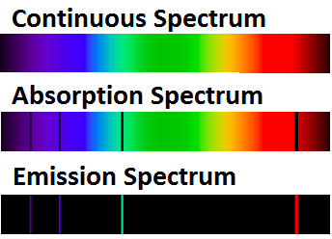
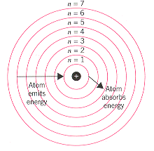
Absorption-Emission Spectrocopy of Hydrogen Gas in the Visible
Bohr Model
=> absorbed
=> emitted
Credit
Spectrum of reflected light
1=>2: 1.20 eV
2=>3: 0.66 eV
3=>1: -1.88 eV
Spectrum of emitted light
Figure credit
Notes:
Bohr Model of Hydrogen
There are 7 permitted shells or orbit levels for hydrogen. The shells are quantized.
Transitions from a lower to a higher orbit requires absorption of a specific wavelength of EM radiation.
Transitions from the same higher to lower orbit would emit a specific wavelength of EM radiation that was absorbed.
Energy levels between shells are additive. EXPLAIN 1.20 eV (1=>2 jump) + 0.66 eV (2=>3 jump) - 1.88 eV (3=>1 fall) = 0
Spectrum for H2 gas in the visible range is shown to right.
Top – visible spectrum
Middle – spectrum after visible light penetrates H2 gas. Black lines denote photons that are absorbed. Colored bands photons transmitted.
Bottom– spectrum emitted in visible range by H2 gas. Colored lines denote photons that are emitted by H2 gas.
Emitted lines match absorbed lines
21 possible transitions between different orbit levels for simple hydrogen with its single electron and 7 shells.
Most of these transitions are outside of the visible range.
Elements with more electrons have many more possible transitions

Slide 19

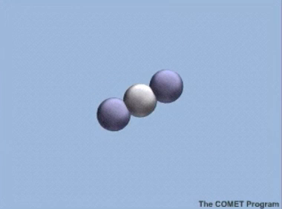
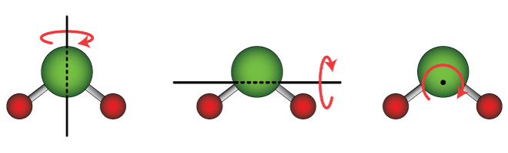
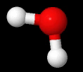
Quantum States of Molecules
H₂O vibrational modes
Molecules also rotate and vibrate
But at specific frequencies or energy levels only
Intervals between energy levels correspond to specific wavelengths of electromagnetic radiation
15 μm
CO₂ vibrational mode
H₂O rotational modes
⬄
Source
Notes:
While it’s likely clear that atoms with more electrons than hydrogen would have many more transitions between permitted orbits,
Molecules can also vibrate and rotate.
In general, the complex the molecule => the more quantum frequencies of vibration and rotation (called modes).
And just like electron transitions, each vibrational mode or rotational mode corresponds to a specific wavelength of EM radiation.
A CO2 molecule is shown to the left. Example shows photon of 0.08 eV (15 μm) hitting the CO2 molecule.
Molecule absorbs the photon of IR => oscillates => emits the same photon of IR.
Note that O-C-O atoms are along a line. Only one rotation of consequence exists…a dumbbell spinning motion. Rotation along the alignment axis do not exist.
H2O is shown in the right column). It is polarized: H-O-H are at an angle of 104. It has many vibrational and rotational bands, and they are broader.
Vibrations include Symmetric Stretching. Scissoring. Asymmetric Stretching. There are other possible vibration types, and the same type can have many permitted frequencies.
Rotation can occur about three axis as shown in the lower right.
Animation shows a rotation about the vertical axis as depicted in the lower hand picture

Slide 20
Quantum States of Molecules
H₂O vibrational modes
Molecules also rotate and vibrate
But at specific frequencies or energy levels only
Intervals between energy levels correspond to specific wavelengths of electromagnetic radiation
15 μm
CO₂ linear molecule
CO₂ vibrational mode
H₂O rotational modes
⬄
Source
Notes:
While it’s likely clear that atoms with more electrons than hydrogen would have many more transitions between permitted orbits,
Molecules can also vibrate and rotate.
In general, the complex the molecule => the more quantum frequencies of vibration and rotation (called modes).
And just like electron transitions, each vibrational mode or rotational mode corresponds to a specific wavelength of EM radiation.
A CO2 molecule is shown to the left. Example shows photon of 0.08 eV (15 μm) hitting the CO2 molecule.
Molecule absorbs the photon of IR => oscillates => emits the same photon of IR.
Note that O-C-O atoms are along a line. Only one rotation of consequence exists…a dumbbell spinning motion. Rotation along the alignment axis do not exist.
H2O is shown in the right column). It is polarized: H-O-H are at an angle of 104. It has many vibrational and rotational bands, and they are broader.
Vibrations include Symmetric Stretching. Scissoring. Asymmetric Stretching. There are other possible vibration types, and the same type can have many permitted frequencies.
Rotation can occur about three axis as shown in the lower right.
Animation shows a rotation about the vertical axis as depicted in the lower hand picture

Slide 21
To generalize for the Earth’s atmosphere…
UV & VIS => electron levels
IR => vibrational modes
Microwave => rotational modes

Slide 22
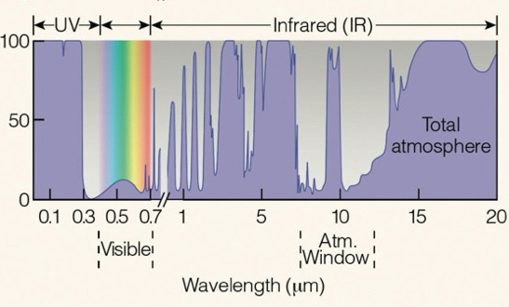
Absorption Spectrum
All Gases
Source: Ahrens and Hanson 8th
O₂ & O₃ absorb UV Radiation
Transparent to Visible Light
Selective of Infrared Radiation
H₂O & CO₂ strong absorbers
Little absorption near 10 μm
Notes:
Absorption spectrum for the atmosphere. Percent of wavelength absorbed.
X-axis: wavelength in microns. Y-axis: purple shading denotes percent of wavelength absorbed.
Air is…
Transparent to incoming visible radiation.
Selectively absorbent of emitted IR radation.
Strongest absorbers of IR radiation are water vapor and carbon dioxide.
Spike at 8 microns is due to O₃.
Atmospheric Window between 8-14 microns where most IR is emitted from the SFC. The window plays in important role in preventing the Earth from getting too hot.
Last, air absorbs UV up to 0.3 microns due to dissociation of O₂ and O₃

Slide 23
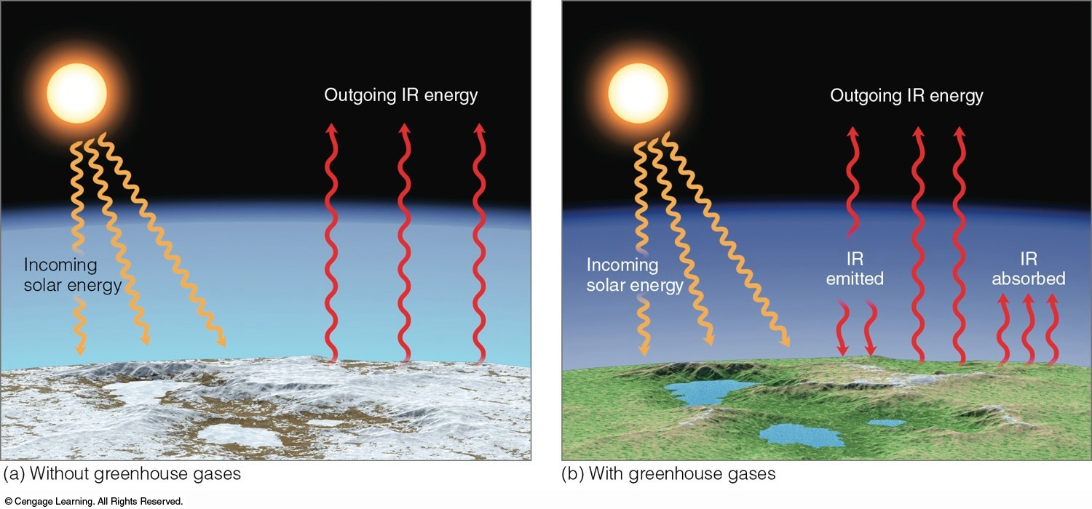
The Greenhouse Effect is a Good Thing
0°F (265 K)
59°F (288 K)
The presence of the gases in our atmosphere that absorb and emit IR radiation helps maintain the Earth’s average surface temperature of 59°F.
Greenhouse Explanation
Ahrens & Hanson
Notes:
Atmosphere with and without GHG’s if the same amount of solar radiation is absorbed by the Earth’s surface
Without GHG’s 0°F.
With GHG’s 59°F.
Presence of Atmospheric Window prevents too much outbound IR from being absorbed.

Slide 24
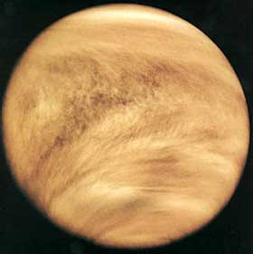
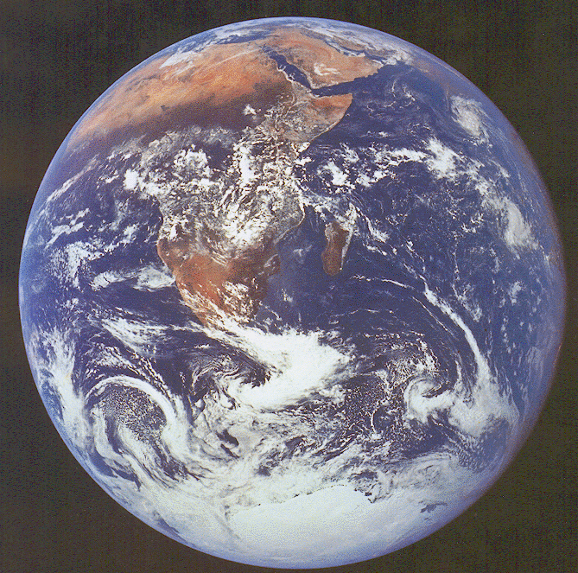
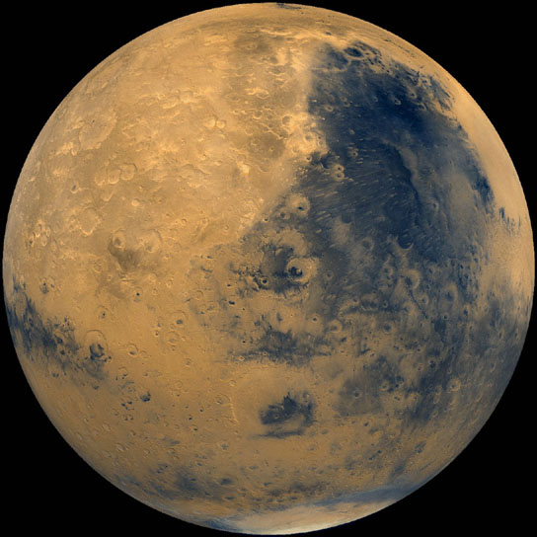
But too much/little Greenhouse Effect is Not
Consider Venus, Earth, and Mars
VENUS
(Same size as Earth)
MARS
(Half size of Earth)
EARTH
Pressure = 93,000 mb
Atmosphere composed
of 96% CO₂
Temperature = 482°C
Pressure = 1,013 mb
Atmosphere composed of 1% H₂O + 0.04% CO₂
Temperature = 15°C
Pressure = 8 mb
Atmosphere composed of 95% CO₂
Temperature = -63°C
GREENHOUSE EFFECT
ON STERIODS!
GREENHOUSE EFFECT
JUST RIGHT
VIRTUALLY NO ATMOSPHERE NO GREENHOUSE EFFECT
Notes:
24
Venus
Same size as Earth. Gravity 90% of Earth
108 million km from Sun.
CO2 atmosphere with SFC pressure of 93,000 mb.
Temperature of 482°C
Mars
Half size of Earth. Gravity 38% of Earth.
228 million km from Sun.
CO2 atmosphere with SFC pressure of 8 mb.
Temperature of -63°C
Earth
Goldilocks zone!

Slide 25
Summary
Quantum properties of matter accounts
for the selective absorption of radiation
The Earth’s atmosphere is...
  Transparent to incoming visible radiation
  Selectively absorbent of IR radiation
  Opaque to incoming UV radiation

Slide 26
Thank you for listening.
This ends the overview on greenhouse gases and selective absorption.
26

