Slide 1
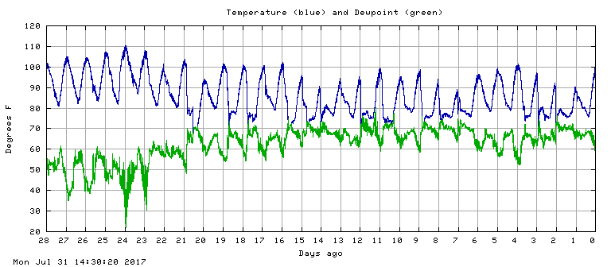

ATMO 170A1
Online
Temperature Variations

Slide 2
Temperature Questions
What is the cause of seasonal changes and day-to-night changes in the temperature?
Do the warmest/coldest temperatures occur at the same time as the maximum/minimum input of solar radiation? If not, then why not?
What physical processes modulate local variations in temperature?

Slide 3

ATMO 170A1
Online
Seasons
http://yashikibuta.wordpress.com/2011/05/20/four-seasons/

Slide 4
Learning Goals for this Overview
Why do seasons exist?
What is the impact of the seasons on…
    Distribution of Incoming Solar Radiation
    Temperatures and Outgoing IR Radiation
    Atmospheric Energy Balance

Slide 5
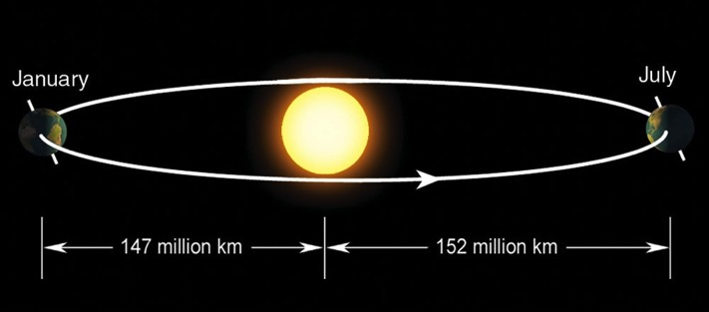
Reasons for Seasons
Possible Suspects
Eccentricity of Earth’s Orbit
Earth-Sun distance varies during year
Tilt of Earth’s Axis - Obliquity
Angle between the equatorial plane and the orbital plane
23.5°

Slide 6

Eccentricity of Orbit
Perihelion
Aphelion
Ahrens 6th Ed.
Earth is 5 million km closer to the Sun on Jan. 4 than July 4.*
Solar radiation is 7% more intense on January 3 than July 4.
Makes a noticeable difference in the apparent size of the Sun.
*The date of perihelion currently varies from 1-2 to 1-5 and aphelion from 7-3 to 7-6. The dates progress through the season, and complete an annual cycle every 22,000 to 24,000 years.

Slide 7
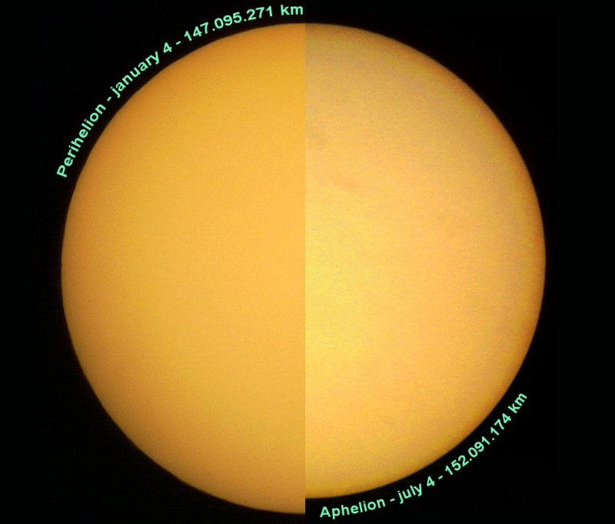
Apparent size of Sun
January July
perihelion aphelion
Apparent size of sun at perihelion and aphelion
wikipedia

Slide 8
If Earth is 3% closer to the Sun in January than July
and
If solar radiation is 7% stronger in January than July
Why is July (aphelion) warmer than January (perihelion)
in Northern Hemisphere?
Why doesn’t summer and winter occur at the same time in both hemispheres?
Earth-Sun Relationship (animation)
Seaasons Simulator App

Slide 9
Conclusion
Eccentricity of the Earth’s orbit is not the primary reason for seasons.
Tilt of the Earth’s axis is.

Slide 10
Obliquity affects two important factors
Intensity of solar radiation at the surface
Length of day
Seasons and Ecliptic Simulator: http://astro.unl.edu/naap/motion1/animations/seasons_ecliptic.html

Slide 11
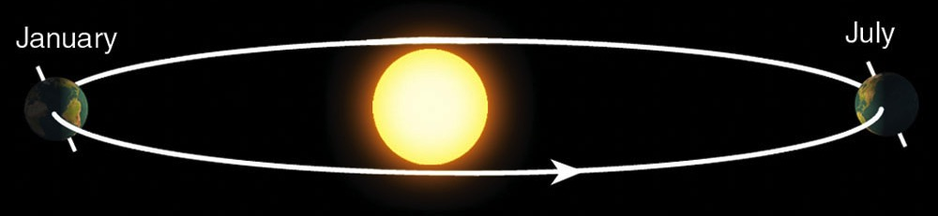
Tilt of Orbit
Northern Hemisphere Winter
Southern Hemisphere Summer
Northern Hemisphere Summer
Southern Hemisphere Winter
Earth-Sun Relationship (animation)
Seasons Simulator App

Slide 12
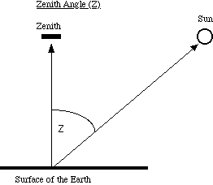
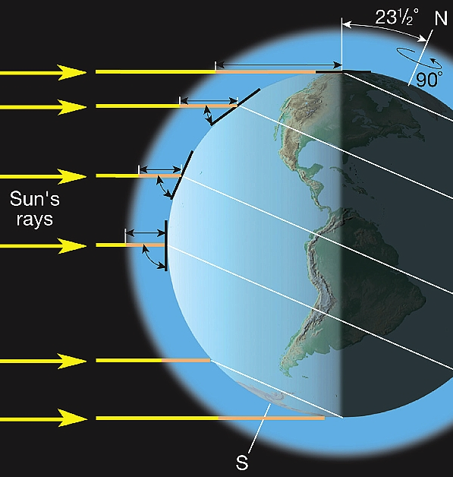
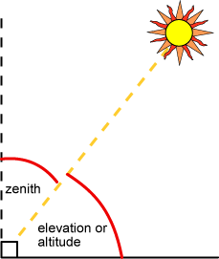
Solar Zenith Angle
Depends on latitude, season, and time of day
Has two effects on an incoming solar beam
Primary Factor
Surface area covered Spreading of beam
Secondary Factor
Path length through air Attenuation of beam
Long Path
Large Area
Short Path
Small Area
Equal Energy
Lutgens Tarbuck
Notes:
Intensity of radiation is controlled by solar zenith angle.
Angle between the Sun and a line extending straight overhead is called the Solar Zenith Angle
Larger the angle => the lower the sun is in the sky
Zenith angle depends on latitude, season, and time of day.
ADVANCE
Zenith angle affects two things:
Larger the angle => the greater area an equivalent amount of solar radiation covers
Larger the angle => the longer the path length through the atmosphere
Let’s look at these factors in more detail

Slide 13
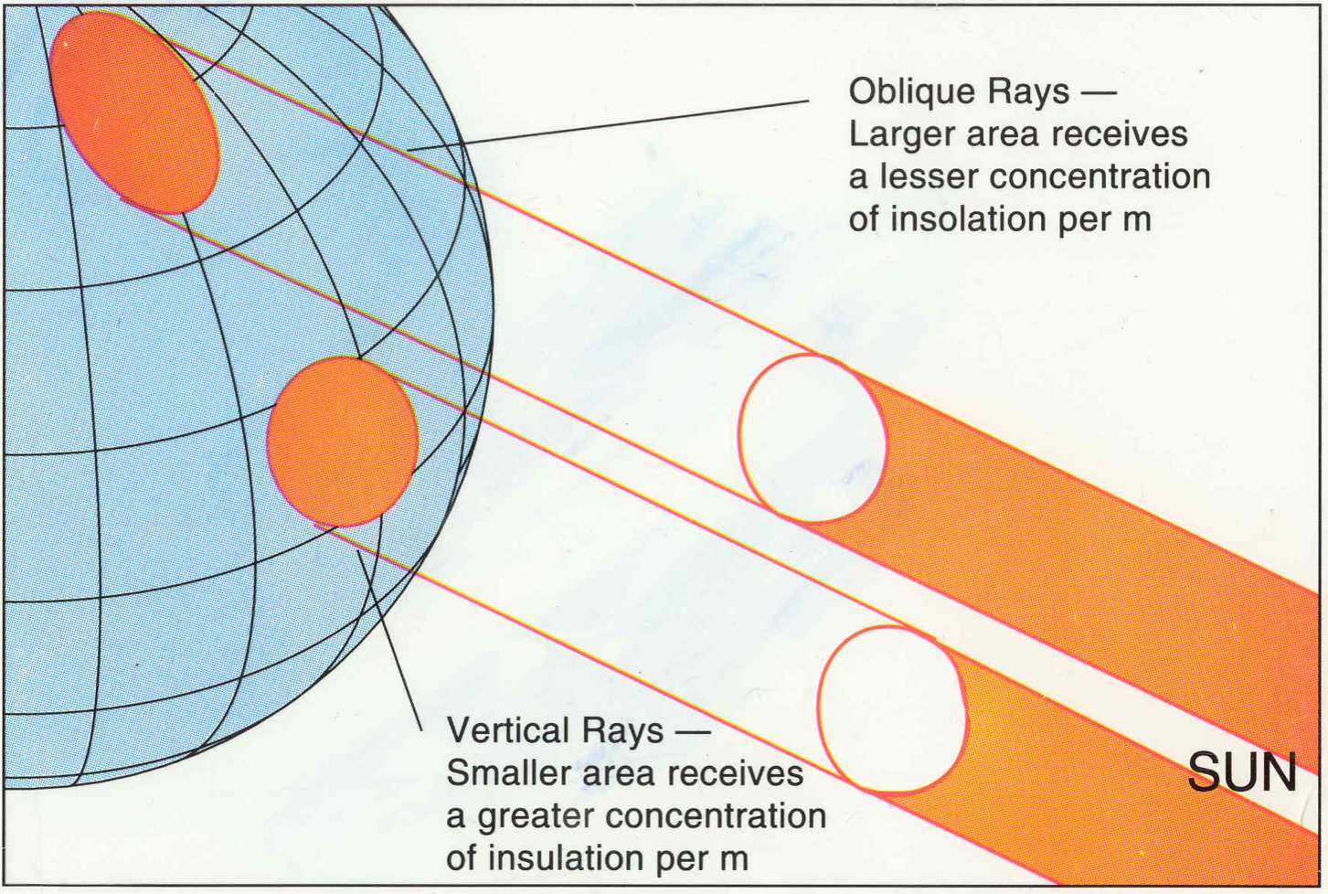
Beam Spreading with Latitude
hendrix2.oregon.edu/~imamura
Notes:
3D perspective of insolation varying with latitude

Slide 14
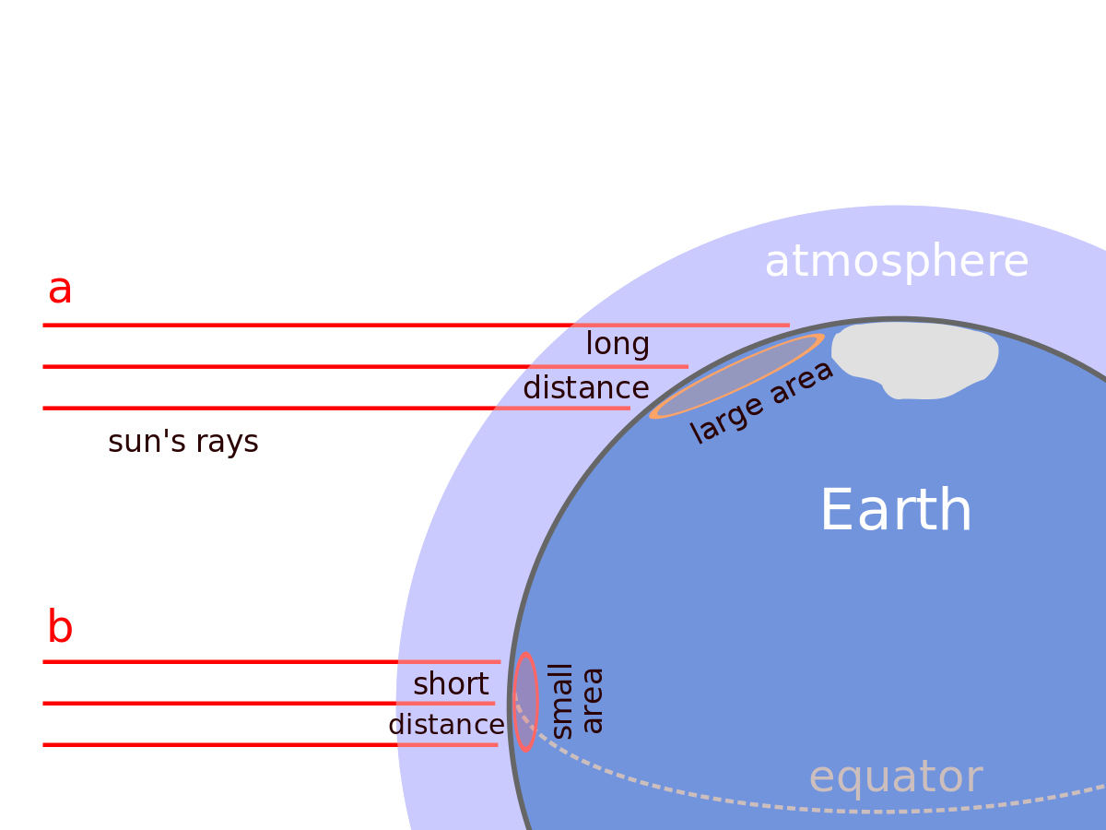
How Beam Spreading and Path Length Vary with Latitude
Insolation spread over a larger area
Insolation spread a smaller area
Credit: upload.wikimedia.org
Notes:
How insolation (solar radiation) varies with latitude
Two sets of 3 parallel lines denote same amount of solar energy
Set A hits high latitudes. Set B hits equator.
1) Because of the curvature of the earth, the same amount of energy is distributed over a smaller surface area at equator then near the poles.
2) Secondary factor: Because the path length through the atmosphere is shorter over the equator, there is less absorption of solar radiation by air over equator than poles

Slide 15
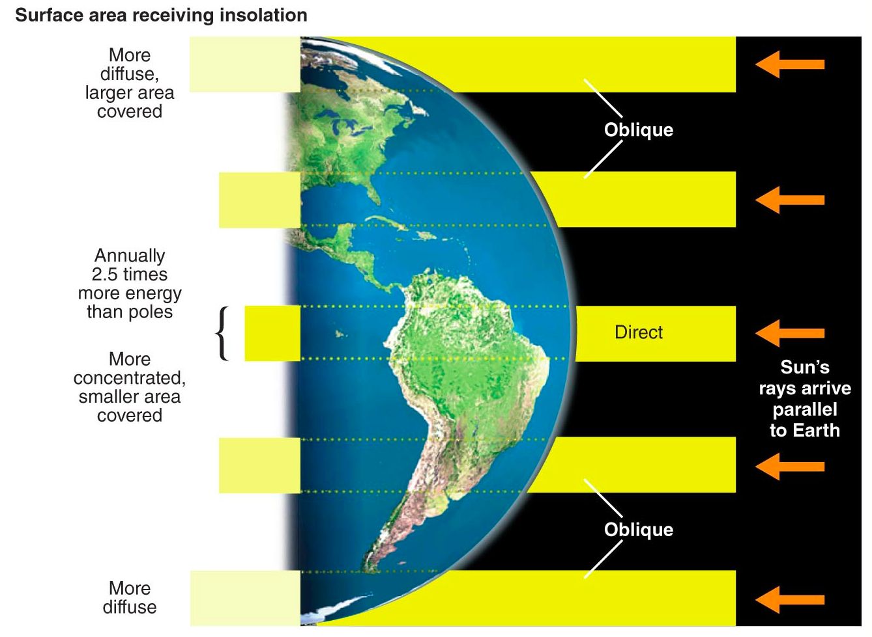
Beam Spreading with Latitude
Figure Credit
Notes:
3D perspective of insolation varying with latitude

Slide 16
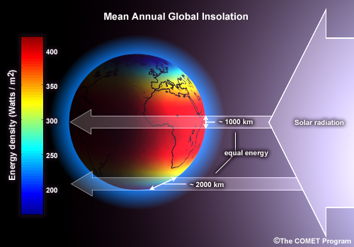

Slide 17
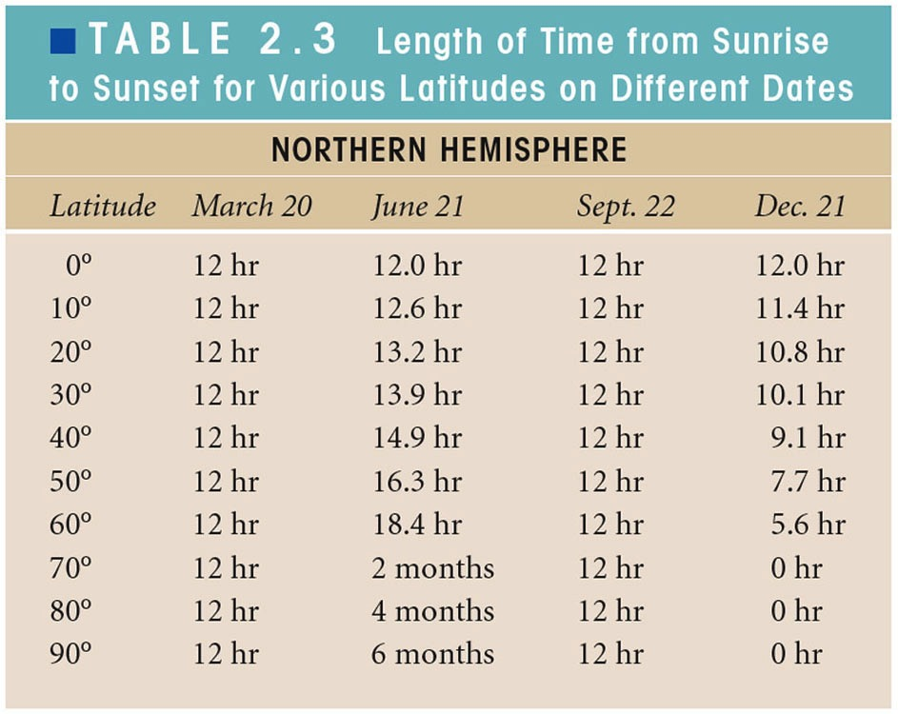
Credit: Ahrens & Hanson
Navy Sunrise-Sunset and Twilight Calendar UCSB Length of Day Applet
Notes:
The second factor that obliquity affects is the number of daylight hours.
Table shows hours of daylight every 10° latitude on the equinoxes and solstices (time of maximum tilt toward or away from Sun).
Daylight hours vary by season and latitude
12 hours daylight everywhere at equinoxes
Equator has12 hours of daylight year round
Summer-Winter differences at the solstices increase with latitude
North Pole has approximately 185 days of 24 hours of light; 180 days of no daylight.
Arctic Circle
Red line gives latitude of Tucson AZ (32°N) where there are 14 & 10 hours of day/night on solstices

Slide 18
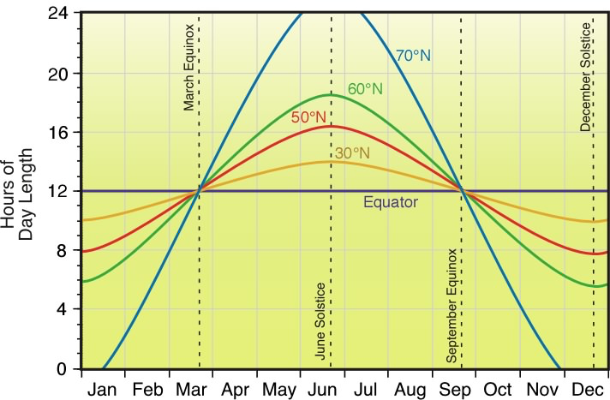
Hours of Daylight
90°N
Figure Source
Navy Sunrise-Sunset and Twilight Calendar UCSB Length of Day Applet
Notes:
Seasonal Cycle of Daylight Hours for Northern Hemisphere
Curves give insolation in W m⁻². Four latitudes shown: Equator (Amazon River), 30° (New Orleans LA), 50° (Vancouver BC) , 60° (Anchorage AK), 70° (Barrow AK)
Y-axis is hour of light.
X-axis is date
Equinoxes and solstices are noted.
Note following features:
Daylight hours vary by season and latitude
12 hours daylight everywhere at equinoxes
Equator has12 hours of daylight year round
Difference in summer-winter hours of daylight increases with latitude.
North Pole has approximately 185 days of 24 hours of light; 180 days of no daylight.

Slide 19
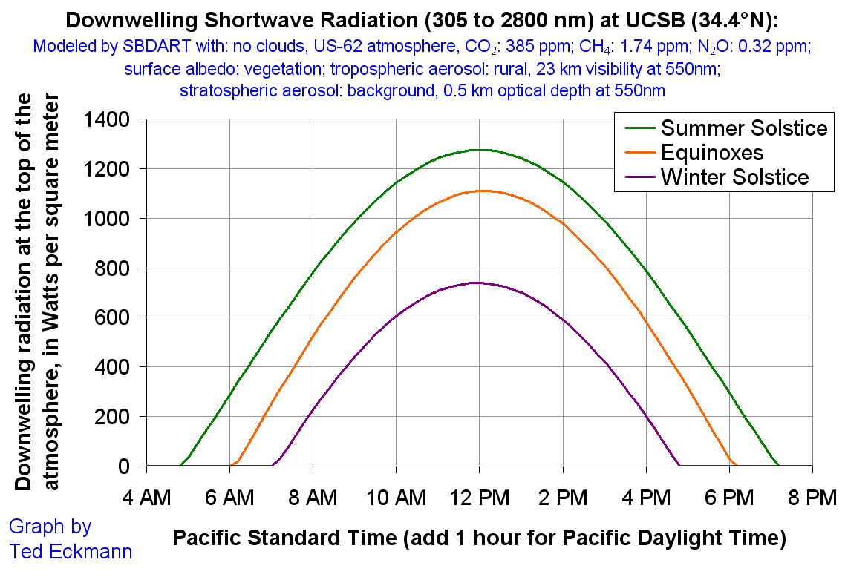
Link to figure

Slide 20
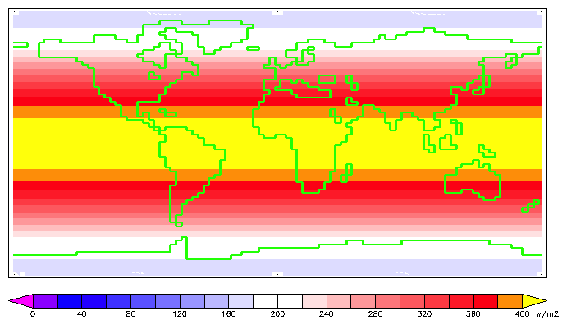
Annual Mean Insolation at the Top of Atmosphere
Figure Source
Notes:
Annual Mean Insolation at T.O.A.
Averaged over all seasons
Essentially symmetric about equator
Tropics receive 2.5X more radiation than poles
But…there are significant seasonal variations

Slide 21
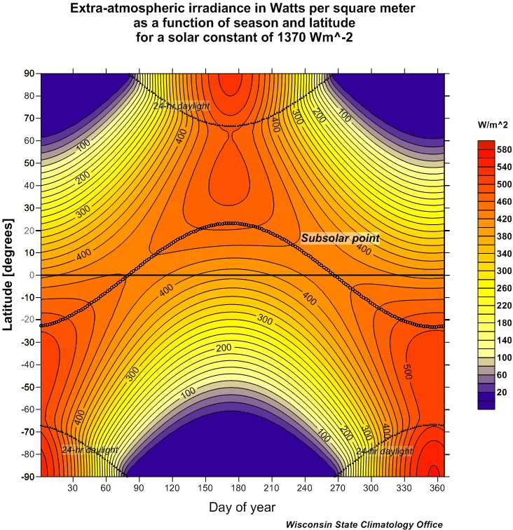
Isolation at Top of the Atmosphere
Figure Source
80* (March 21) – Equinox
172 (June 21) – Solstice
265 (September 22) – Equinox
355 (December 21) – Solstice
Link to Julian Day Calendar for 2017
*All dates are GMT
Notes:
Total solar radiation for date at T.O.A. by latitude in W m⁻²
Contours with shading give irradiance every 20 W m⁻². Contours range from 0 to 560 W m⁻² at South Pole.
Y-axis is latitude.
X-axis is date in Julian Day. (Jan 01 =JDay 01; Dec 31 = JDay 365 for non-leap years)
Sun icons denote dates of solstices and equinoxes.
Note following features:
Asymmetry between hemispheres. (Insolation in Southern Hemisphere is larger than in Northern Hemisphere. Why?)
Seasonal change of insolation increases with latitude.
Equator has two maxima of insolation at equinoxes. (Why?)

Slide 22
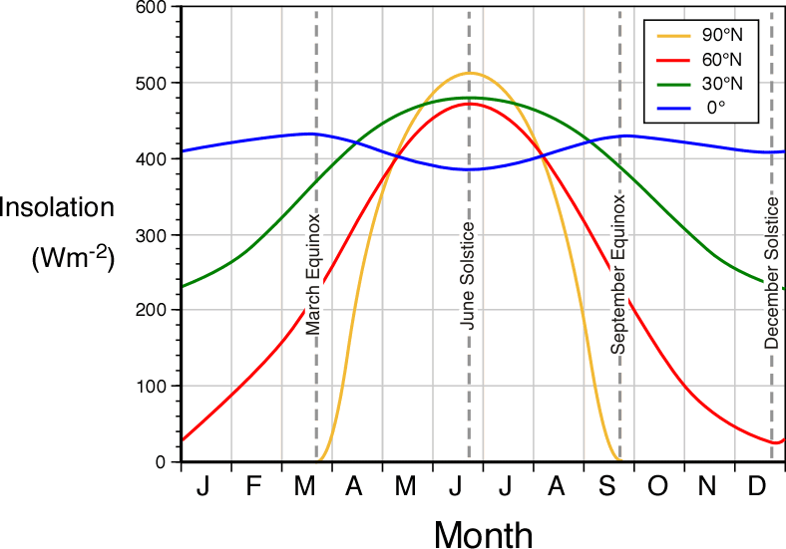
Isolation at Top of the Atmosphere
Figure Source
March 21 – Equinox
June 21 – Solstice
September 22 – Equinox
December 21 – Solstice
Link to Julian Day Calendar for 2017
*All dates are GMT non
Notes:
How does incoming solar radiation vary by season and latitude?
Annual Cycle of Total Insolation at T.O.A. by latitude in W m⁻²
Curves give insolation as a function of time of year. Four latitudes shown: 0° (Blue-Amazon Basin), 30° (Green-New Orleans LA), 60° (Red-Anchorage AK), 90° (Gold-North Pole)
Y-axis is Insolation (W m⁻²)
X-axis is date
Equinoxes and solstices are noted by vertical dashed lines.
Note following features:
Seasonal variation of insolation increases with latitude.
Pole is extreme: maximum value anywhere/anytime at June solstice to zero for approximately six months between Sept and March equinoxes.
Asymmetry at equator.
Equator has two maxima of insolation at equinoxes and not the solstices. (Why?)
Insolation at equator is larger on December Solstice than June Solstice. (Why?)

Slide 23
When is the warmest/coldest time of year?
The first day of summer/winter (solstices), when insolation at T.O.A. is at their extreme values.
Another date. If so, when and why?

Slide 24
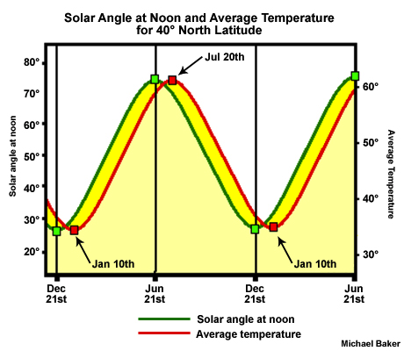
comet.ucar.edu
Warmest and coldest times of year occur typically about one month after solstices,
but there is significant variability
Notes:
Warmest / Coldest times of years
Figure shows angle of sun above the horizon (90- zenith angle) at solar noon (green) and daily average temperature (red) for date
Extreme values of insolation at solstices occur a few weeks prior to warmest/coldest times of year
WARMEST/COLDEST TIMES OF YEAR LAG SUMMER/WINTER SOLSTICES

Slide 25
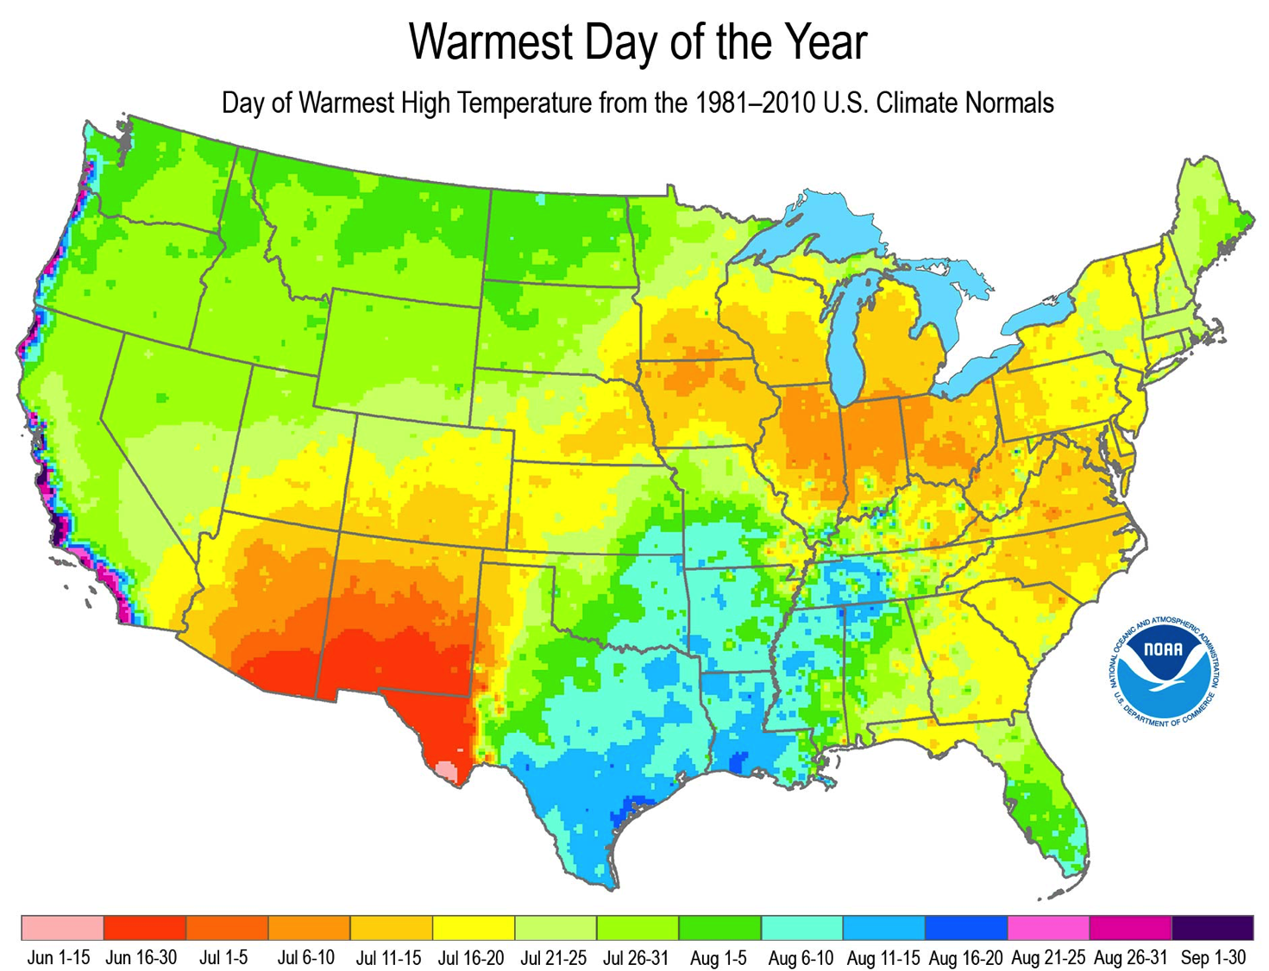
★
Figure Source

Slide 26
★
Sliver of bright yellow along shoreline of Lake Michigan
Chicago: July 16-20

Slide 27
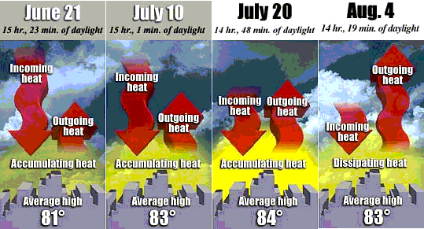
Chicago, where the hottest day of year occurs about one month after the summer solstice
Consider Average Daily Temperature for Chicago IL (42°N)
warming
warming
equilibruim
cooling
USA Today WWW Site

Slide 28
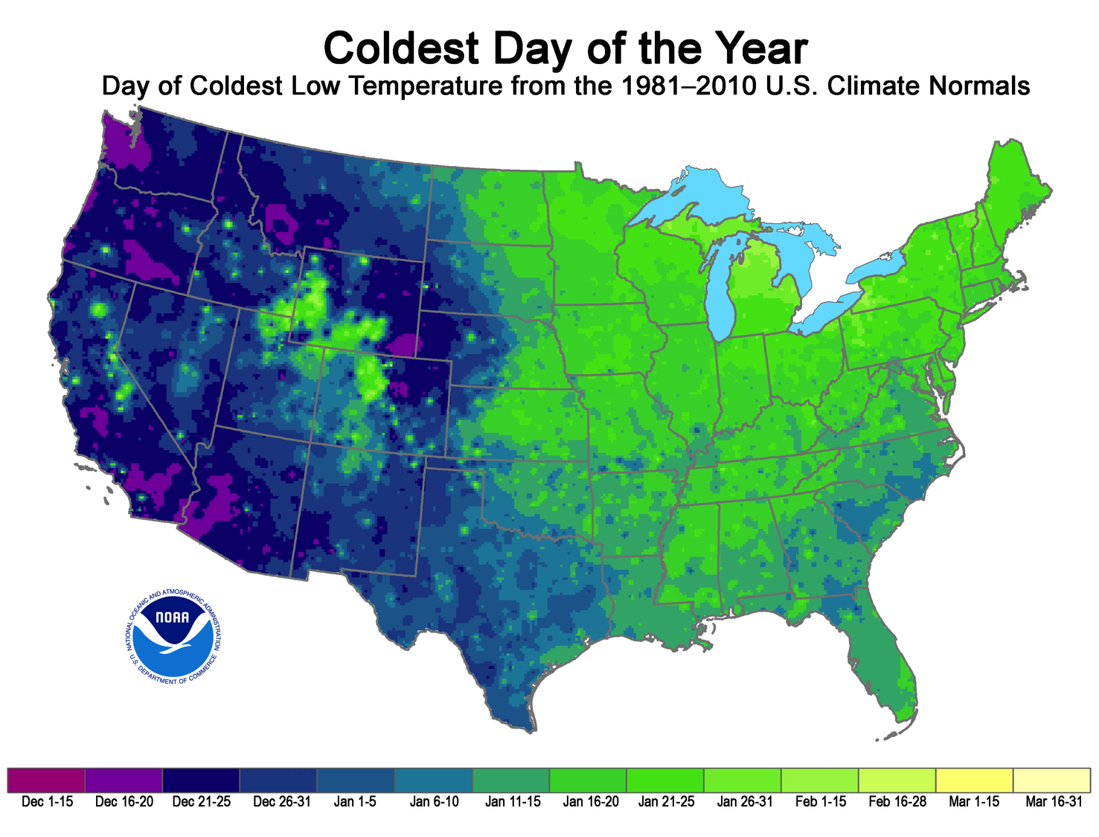
Figure Source

Slide 29
Take Home Points
Seasons –
Tilt (23.5º) is primary reason for seasons
Tilt changes two important factors
  Angle at which solar rays strike the Earth’s surface
  Number of hours of daylight
Warmest/Coldest Times of Year –
Balance between incoming and outgoing energy determines warmest and coldest times of the year
  Occur after solstices; on average about one month later
  On date at which radiative equilibrium is reached

Slide 30
This ends the discussion on seasons

Slide 31
Next Class Assignment
Temperature Variations
Reading – Ahrens
Pg: 46-55; 59-77
Study “Questions for Review” – Ahrens
Pg. 81-82: 1, 2, 5, 6, 14, 17,18

