Slide 1
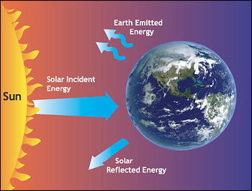

ATMO 170A1
Online
Laws of Radiation
Figure credit
Depiction of the Earth’s radiation balance as viewed from space

Slide 2
Weather
Map Time

Slide 3
You wearily deplane after an all-night flight to London when you hear in the terminal, “Today’s maximum temperature in London will be 25˚ Celsius.”
What is the maximum temperature in ˚F?
(Give answer to the nearest whole ˚F.)

Slide 4
Big Picture from Last Time
Three primary modes of heat transfer
1) Conduction – molecule to molecule
2) Convection – vertical transport of fluid
Advection – horizontal transport of fluid
+
Latent Heat – energy of phase changes
Works with convection/advection
Large for H₂O Vapor <=> Cloud Droplets
Vapor => Droplets => surrounding air warms
Liquid => Vapor => surrounding air cools

Slide 5
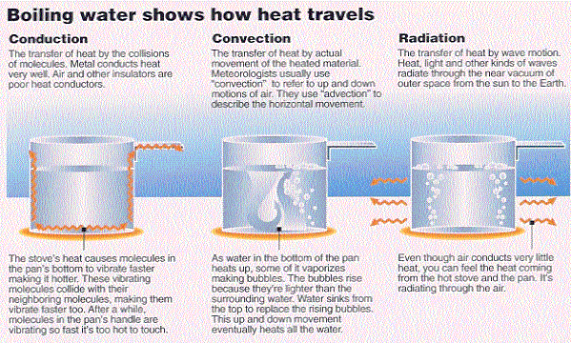
Modes of Heat Transfer
Latent Heat
Williams, p. 19

Slide 6
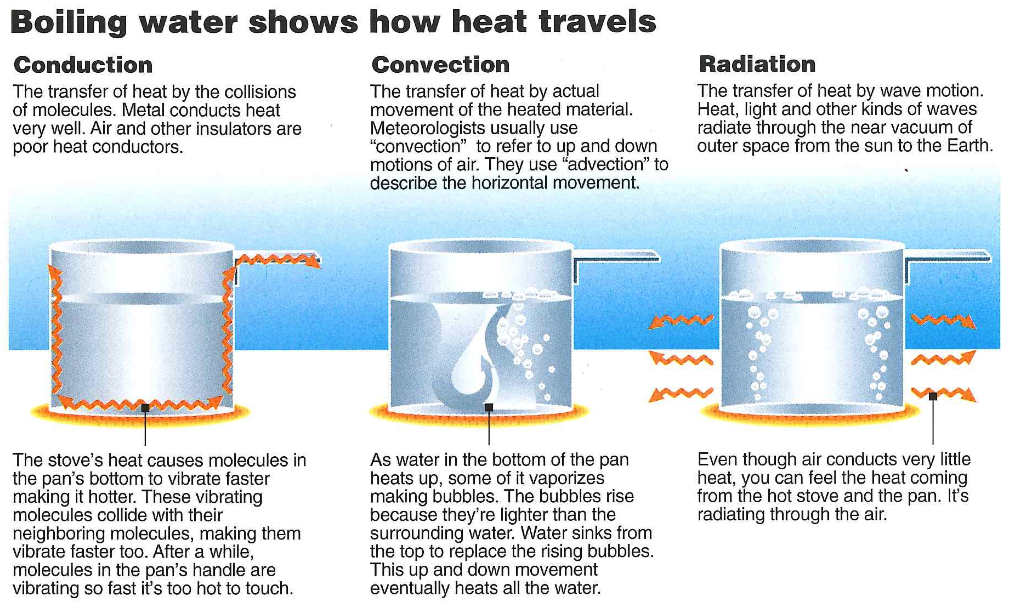
Modes of Heat Transfer
Latent Heat
Williams, p. 19
Notes:
Conduction-heat transfer by molecular collisions
Convection/Advection-heat transfer by fluid motions
Latent Heating-energy of phase changes
Radiation-heat transfer by EM waves

Slide 7
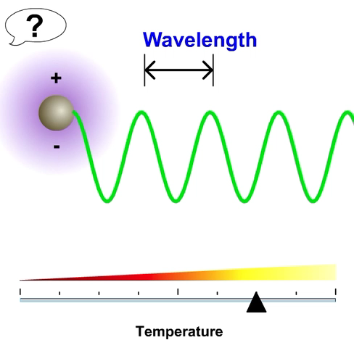
Radiation
All mass that has a temperature greater than 0 K emits radiation.
Radiation is in the form
of electromagnetic waves.
Produced by the acceleration
of electric charges.
These waves do not need matter to propagate; they move at the “speed of light” in a vacuum.
300,000 km s⁻¹ or 186,000 miles s⁻¹
e-education.psu.edu/meteo003
Notes:
Radiation -
Any object that has a temperature greater than absolute zero (0 K), emits radiant energy. The radiation is in the form of waves that have both electric and magnetic properties. Thus, they are called electromagnetic wave.
The waves are produced by electric charges moving.
This means of energy transfer does not involve matter, but instead electro-magnetic waves that travel at 300,000 km/sec. This is the major method of transferring energy from the sun to the earth, and at this rate it takes about 8 minutes for radiation to travel from the sun to the earth.

Slide 8
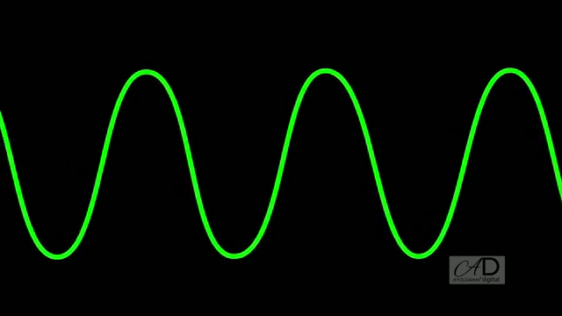
Wave Principles
Important aspects of waves are:
  Wavelength: Distance between peaks.
  Amplitude: Height of crests
  Frequency: # waves that pass a point per second
  Period: Time it takes one wave to pass a point
Wavelength
Distance
btw peaks
Amplitude Height of crests/troughs
Frequency # crests per second
Link
Notes:
The picture of electromagnetic waves passing through the atmosphere is much like that of the waves on the surface of the water. There are three important aspects about the waves:
1. What kind of wave is it?: Wavelength or distance between the peaks of the waves.
2. How big is it? Amplitude or distance between peaks and valley. When more radiation is emitted, the amplitude increases.
3. How fast is the wave moving? How many waves pass a point per unit time.

Slide 9
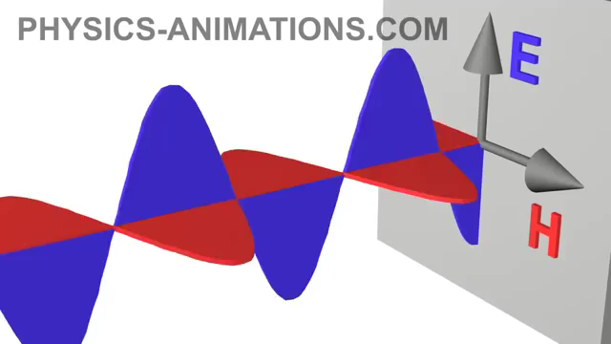
Photons
One can also think of radiation as discrete packets of energy or PHOTONS.
Photons are massless.
Their energy is measured
in electron Volts (eV)
Photons of short wavelengths have more energy than ones with longer wavelengths
Notes:
Not to confuse you, but I just wanted to touch on the fact that sometimes it is convenient to think of radiation in terms of particles or discrete packets of energy or “photons.” When doing this remember the relation, photons with shorter wavelengths have more energy. That is why, in spite of the fact that the sun emits more visible photons than UV photons, the UV photons have much more energy than visible photons and are thus more dangerous to humans than visible photons…although visible photons can harm a person in large doses, i.e. looking directly at the bright light.

Slide 10
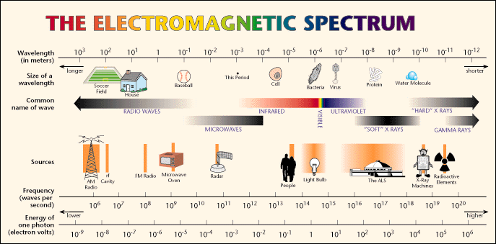
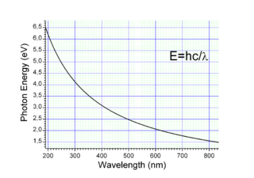
Electromagnetic Spectrum
Wavelengths of Meteorological Significance
Figure Credit
WAVELENGTH
FREQUENCY
Notes:
The electromagnetic waves can occurs with any size of wavelength. In meteorology, however, the unit of measure commonly for the EM waves is the micrometer.

Slide 11
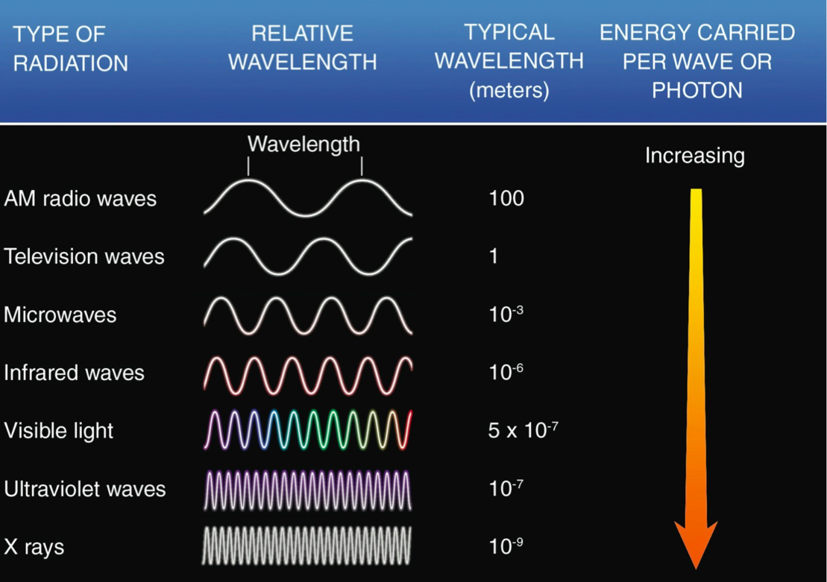
Radiation – Last Time
Ahrens & Hanson 8th ed.
Notes:
Looked at EM spectrum
EM waves span all wavelengths. No upper or lower bound on their size.
Certain wavelength bands of spectrum are given special names, e.g. Infrared-Visible-Ultraviolet
Character of an EM wave is uniquely defined by either its wavelength or frequency.
Shorter wavelengths are more energetic than longer wavelengths.
Higher frequencies more energetic than longer frequencies

Slide 12

Radiation – Last Time
20 μm
0.5 μm
0.1 μm
Meteorological Significance
Ahrens & Hanson 8th ed.
Notes:
EM waves of significance in the study of the Earth’s atmosphere are between 0.1 microns – 20 microns
Infrared (20-10 microns) - Visible (0.5 microns) – UV

Slide 13
Today, the last mode of heat transfer Radiation – electromagnetic waves
Laws of radiation
Radiative equilibrium
Selective absorption/emission

Slide 14
We now examine three fundamental laws of electromagnetic radiation
Planck’s Law of radiation
Wien’s Law of maximum emission
Stefan-Boltzmann Law of total emission

Slide 15
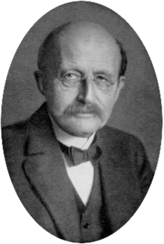
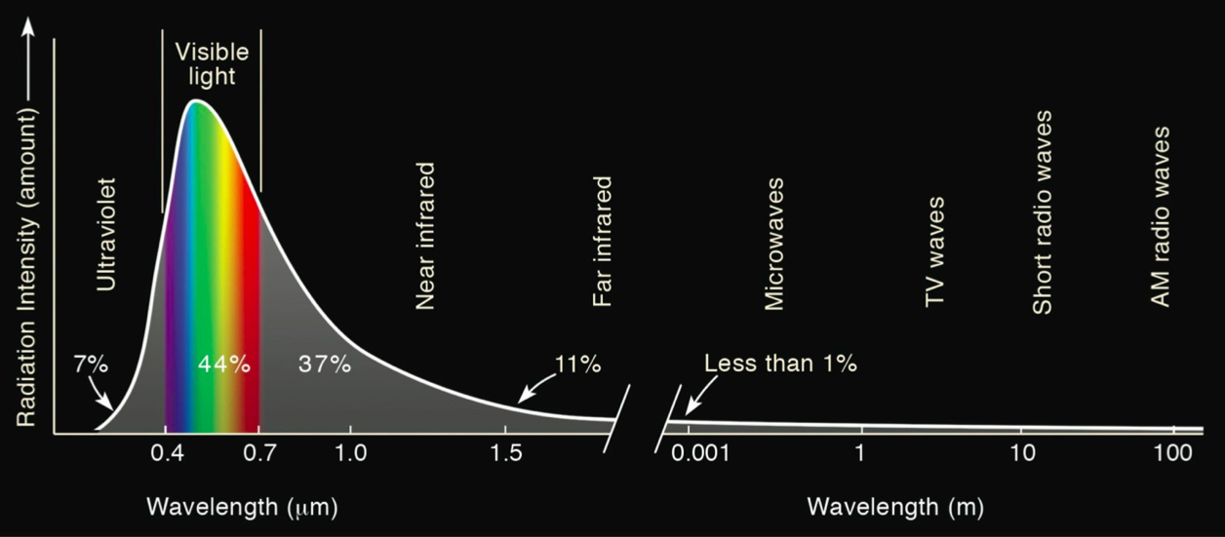
1) Planck’s Law
All objects warmer than 0 K emit radiation.
Temperature determines the distribution of electromagnetic waves emitted by an object.
Max Planck
Emission spectrum of the Sun
Ahrens & Hanson 8th
Notes:
All objects warmer than 0 K emit radiation
Temperature uniquely determines the emission spectrum of radiation emitted by an object. Shape and amplitude of EM curve.
Figure shows emission spectrum for the Sun, which has an effective radiative temperature 5800 K.
X-axis: wavelength in microns. Y-axis: intensity per wavelength.
Peak emission occurs at 0.5 micron, which corresponds to green light in the visible band of 0.4-0.7 micron.
UV – 7%. VIS – 44%. IR – 48%.
Nearly 99% of emitted energy lies between 0.1-5.0 microns.

Slide 16
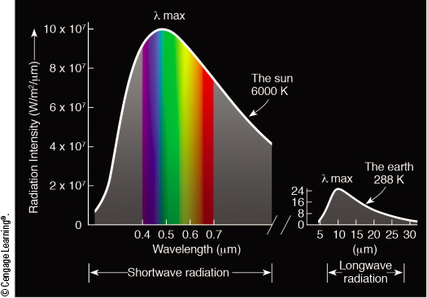
Planck’s Law
Note different scales of y-axis
Ahrens & Hanson 8th
Hotter the object => Shorter the wavelength of maximum emission.
Hotter the object => More radiation emitted - larger area under curve.
Notes:
Can use Planck’s Law to compare the emission spectrum from the Sun to Earth, and the spectrum from the Earth to outer space.
Sun (left) shows max emission near 0.5 microns (green), where the intensity is 10 x 10⁷ W/m²/micron (4 million times larger than peak emission from earth at 20 microns).
Nearly 99% of emitted energy lies between 0.1-5.0 microns.
Earth (right) has max emission at 10 microns, where the intensity is 25 W/m²/microns. (4 million times smaller than peak emission at 0.5 from sun.)
99% of emitted energy lies between 5-30 microns.
=> Sun’s and Earth’s spectra are widely separated!

Slide 17
Laws of Radiation
The key properties of Planck’s Law can be summarized by two simple equations…
Wien’s Law - wavelength of max emission:
λ_{MAX} (μm) = (0.29 ×10⁴ μm K) × T⁻¹
1 micron (μm) = 10⁻⁶ m
Stefan-Boltzmann Law - total emission:
E (W m⁻²) = (5.67×10⁻⁸ W m⁻² K⁻⁴ ) × T⁴
W = Watt (power = Joule s⁻¹)

Slide 18
2) Wien’s Law
What is the radiative temperature of the Sun whose wavelength of maximum emission is approximately 0.5 μm?
Apply Wien’s Law:
λ_{MAX}= (0.29 ×10⁴ μm K) × T⁻¹
Effective radiative temperature of Sun
T(K) = (0.29 × 10⁴ μm K) × (λ_{MAX})⁻¹
T(K) = (0.29 × 10⁴ μm K) × (0.5 μm)⁻¹ ≈ 5800K
Wien’s Law Applet by e-education.psu.edu/meteo003

Slide 19
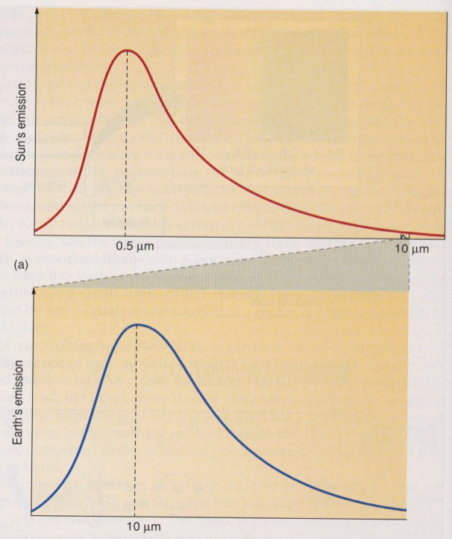
3) Stefan-Boltzmann Law
Relates the total radiation emitted to temperature
Warmer the Object => More Radiation Emitted
Double the temperature: Total emitted radiation increases 16 times!
Stefan-Boltzmann Law
E= (5.67×10⁻⁸ W m⁻² K⁻⁴ ) × T⁴ E=2×2×2×2=16
  2⁴
Sun Temp: 6000K
Earth Temp: 300K
Aguado and Burt

Slide 20
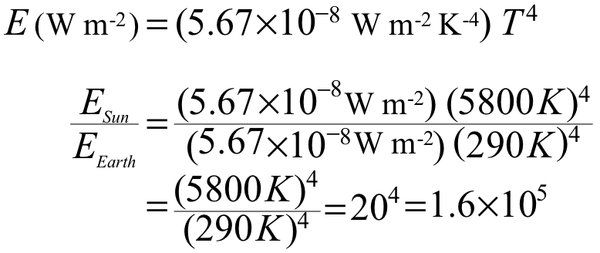
3) Stefan-Boltzmann Law
How much more power per meter squared is emitted by the Sun than the Earth?
Apply Stefan-Boltzmann Law
Sun is 160,000 times more energetic per m². Hence, the area under the Sun’s energy curve is 160,000 times larger than under the Earth’s energy curve.

Slide 21
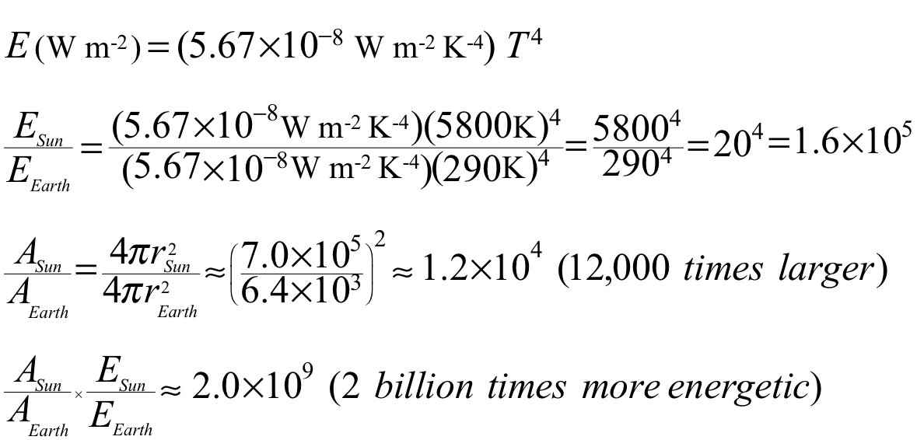
3) Stefan-Boltzmann Law’s
How much more energy is emitted by the Sun than by the Earth’s surface?
Apply Stefan-Boltzmann Law

Slide 22
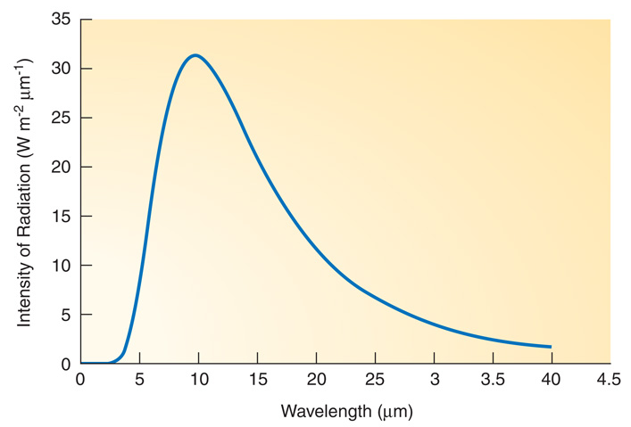
Laws of Radiation
Peak
Wien’s Law
SB Law
Planck’s Law
Area
Shape
Planck’s Law quantifies distribution of emitted radiation over all wavelengths as a function of temperature
Wien’s Law gives the wavelength of maximum emission
λ_{MAX} (μm) = (0.29 ×10⁴ μm K) × T⁻¹
Stefan-Boltzmann’s Law gives total emission of radiation
E (W m⁻²) = (5.67×10⁻⁸ Wm⁻²K⁻⁴ ) × T⁴
Notes:
Planck’s Law quantifies distribution of emitted radiation over all wavelengths as a function of temperature.
Amplitude of curve as function of wavelength
Wien’s Law gives the wavelength of maximum emission
Peak of curve as function of temperature
Stefan-Boltzmann’s Law gives total emission of radiation
Area of curve as function of temperature

Slide 23
Light bulbs obey
Wien’s Law
Stefan-Boltzmann Law

Slide 24
Radiative Equilibrium
Analogous to a checking account with deposits of paychecks and withdrawals for bills.
Deposits Exceed Withdrawals ⇒ Balance Rises
Withdrawals Exceed Deposits ⇒ Balance Falls
Deposits Equal Withdrawals ⇒ Balance Constant
Or it can be said that the account is at an Equilibrium

Slide 25
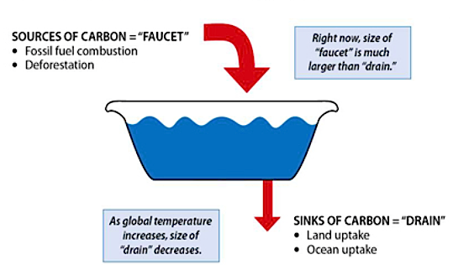


2) Radiative Equilibrium
Concept is analogous to a filling a bathtub with water when the faucet is on and the drain is open.
Flow In Exceeds Flow Out ⇒ Water Level Rises
Flow Out Exceeds Flow In ⇒ Water Level Falls
Flow In Equals Flow Out ⇒ Water Level is Constant
Or it can be said that the... Water Level is at Equilibrium
Flow In
Flow Out
Original source
Akin to Fig. 3.4 H&P
Notes:
Introduce a simple but powerful concept used throughout science: equilibrium.
First apply concept to a bathtub with the faucet on and the drain open.

Slide 26
Radiative Equilibrium
Radiation absorbed/emitted by an object increases/decreases the energy of the object.
  If absorbed radiation exceeds emitted radiation, temperature warms
  If emitted radiation exceeds absorbed radiation, temperature cools

Slide 27
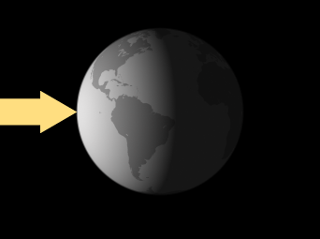
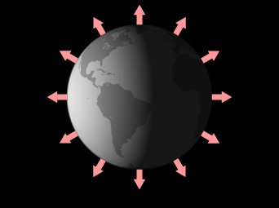
Radiative Equilibrium
Figure credit
Solar radiation absorbed
Infrared radiation emitted
If solar radiation absorbed exceeds IR radiation emitted => Earth’s Average Temperature Warms
If IR radiation emitted exceeds solar radiation absorbed => Earth’s Average Temperature Cools

Slide 28
Radiative Equilibrium
Radiation absorbed/emitted by an object increases/decreases the energy of the object.
  If absorbed radiation exceeds emitted radiation, temperature warms
  If emitted radiation exceeds absorbed radiation, temperature cools
Absorbed
Emitted

Slide 29
Radiative Equilibrium
When radiation absorbed equals that emitted, the condition is termed Radiative Equilibrium.
The corresponding constant temperature is the termed Radiative Equilibrium Temperature.
The Radiative Equilibrium Temperature of the Earth’s average surface temperature is currently 15°C or 59°F.

Slide 30
Radiative Equilibrium
Figure credit
=
Solar radiation absorbed
Infrared radiation emitted
When radiation absorbed equals radiation emitted, the balance is termed Radiative Equilibrium.
The corresponding constant temperature is the termed Radiative Equilibrium Temperature.
The Radiative Equilibrium Temperature of the Earth’s average surface temperature is currently 15°C or 59°F.
Notes:
Radiative Equilibrium occurs when Absorbed = Emitted
Radiative Equilibrium Temperature => constant temperature that occurs when there is Radiative Equilibrium
We can apply the idea of equilibrium to components of the earth-atmosphere-ocean system. For example, Rad Eq. Temp for Earth’s surface is currently 59F or 15C.

Slide 31
Thank you for listening.
This ends the overview of
Laws of Radiation and
Radiative Equilibrium.

Slide 32
3) Selective Absorption of Radiation
FOUR POSSIBLE FATES OF RADIATION:
        Transmitted
        Reflected
        Scattered
        Absorbed
    The atmosphere does ALL of these…
    Lets look at each in the above order

Slide 33
Transmitted:
Radiation passes through object
GLASS WINDOW
SUNLIGHT
TRANSMITTED
SUNLIGHT

Slide 34
Reflected:
Path of radiation reflected
MIRROR
SCATTERED
SUNLIGHT
SUNLIGHT

Slide 35
Scattered:
Path of radiation deflected (equally) in all directions
SCATTERED
SUNLIGHT
FROSTED GLASS
SUNLIGHT

Slide 36
Absorbed:
Radiation transferred to object
Blackbody
A perfect absorber and emitter of radiation in equilibrium, with no reflection or scattering
BLACK BOX
SUNLIGHT

Slide 37
Radiative equilibrium:
Absorption = Emission
(Kirchoff’s Law)
INFRARED
(LONGWAVE)
EMISSION
BLACK BOX
SUNLIGHT
(SHORTWAVE)

Slide 38
A “Grey Body” = Not all wavelengths absorbed
Some are. Some are not.
This is How the Atmosphere Behaves
SOME
REFELECTION
SCATTERING
OF SUNLIGHT
FROM BOX
SOME
TRANSMISSION
OF SUNLIGHT
THROUGH BOX
GREY BOX
SUNLIGHT
(SHORTWAVE)
INFRARED
(LONGWAVE)
EMISSION
SOME ABSORPTION
OF SUNLIGHT BY BOX

Slide 39
Why are my blue jeans “blue”?
  They absorb the color blue
  They emit the color blue
  They scatter the color blue

Slide 40
But why selective absorption?

Slide 41
To explain selective absorption, we must turn to the strange and fascinating world of
Quantum Mechanics
Next Time

Slide 42

Take Home Points
All objects above 0K emit radiation
Hotter the object, shorter the wavelength of maximum emission: Wien’s Law Know it
Hotter objects radiate more energy than colder objects: Stefan-Boltzman Law Know it

Slide 43
Take Home Points
Radiative Equilibrium and
Energy In = Energy Out
Radiative Equilibrium Temperature
Temperature of object at radiative equilibrium
Objects that are good absorbers of radiation are also good emitters.

Slide 44
Take Home Points
Radiation has four possible fates
        Transmitted
        Reflected
        Scattered
        Absorbed
All four are important in the atmosphere

Slide 45
Next Time
Greenhouse Effect
Energy Balance & Seasons
Reading – Ahrens
7th: 35-46; 46-55
Suggested “Questions for Review” – Ahrens
Pg. 55-56: 7, 9, 10, 11, 12, 13, 14
15, 17, 18, 19, 21

Slide 46
End of lecture 20160902F
46

