Slide 1
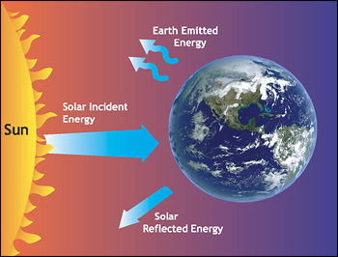

ATMO 170A1
Online
Laws of Radiation
Figure credit
Depiction of the Earth’s radiation balance as viewed from space

Slide 2
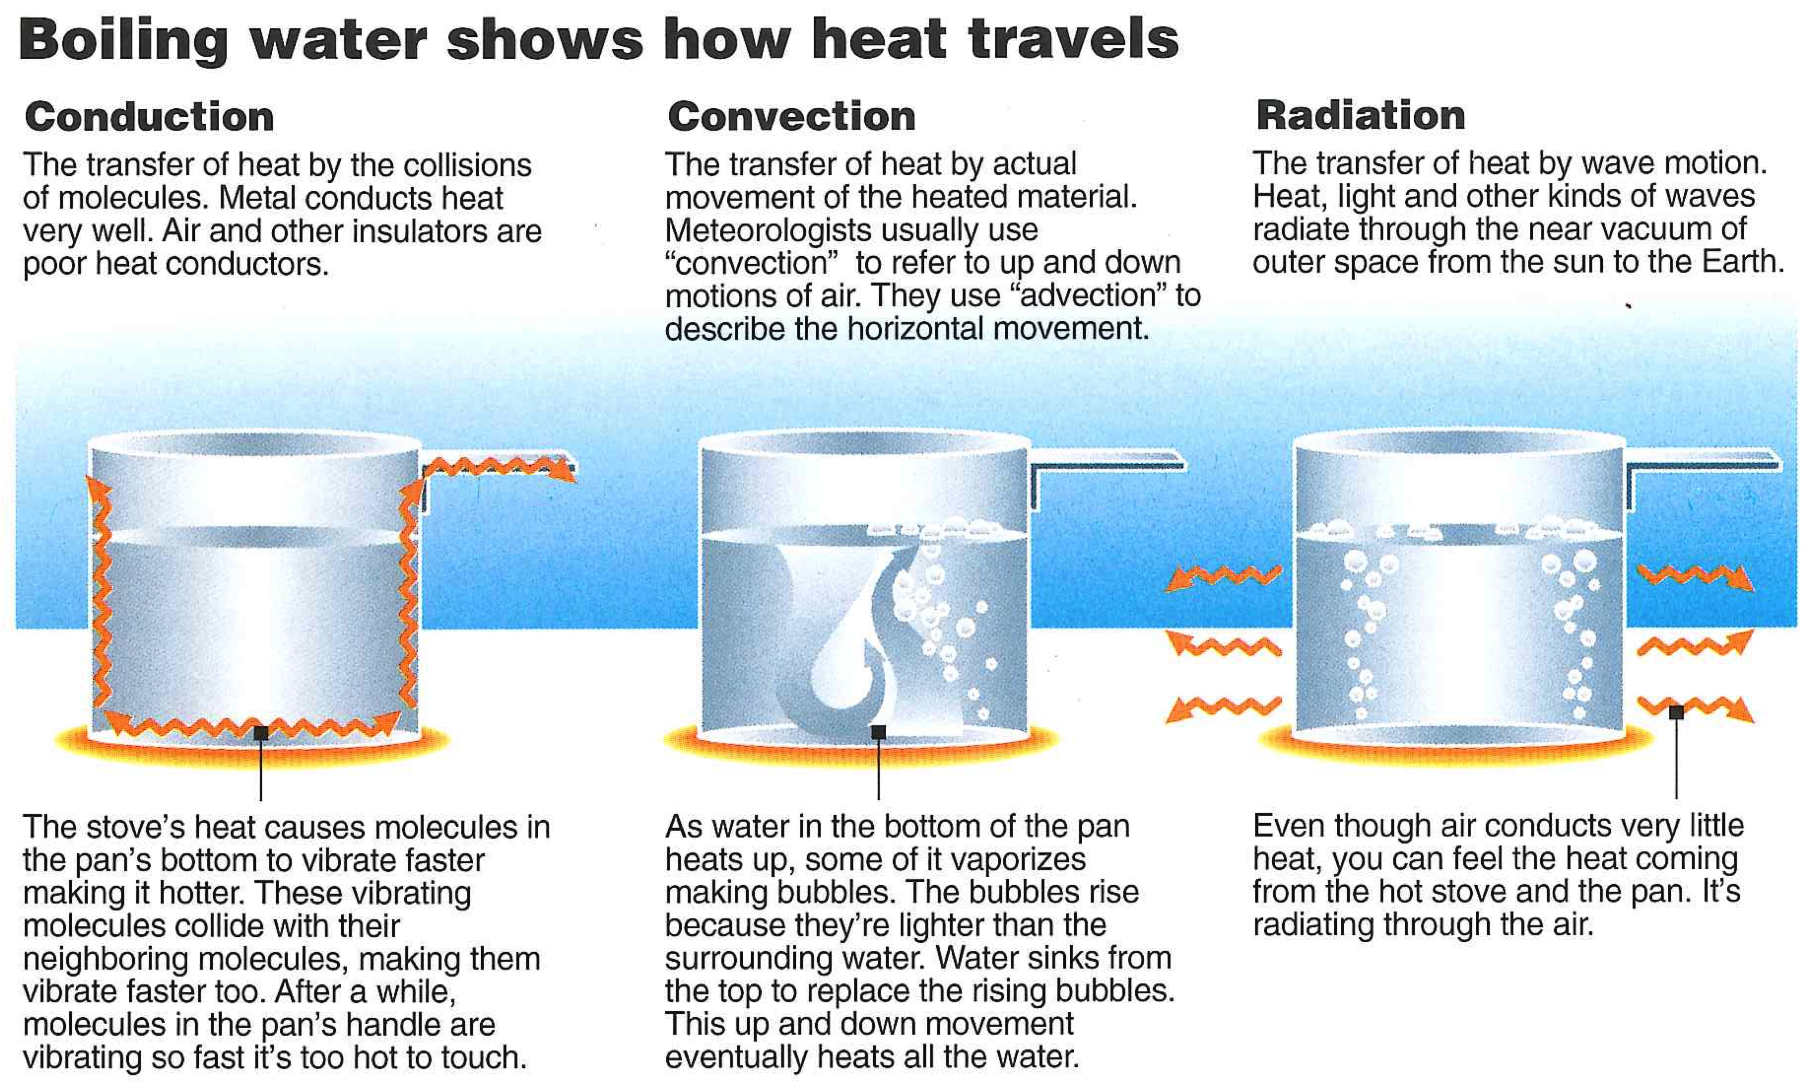
Modes of Heat Transfer
Latent Heat
Williams, p. 19
Notes:
Conduction-heat transfer by molecular collisions
Convection/Advection-heat transfer by fluid motions
Latent Heating-energy of phase changes
Radiation-heat transfer by EM waves

Slide 3
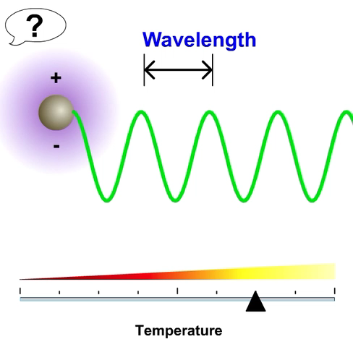
Radiation
All mass that has a temperature greater than 0 K emits radiation.
Radiation is in the form
of electromagnetic waves.
Produced by the acceleration
of electric charges.
These waves do not need matter to propagate; they move at the “speed of light” in a vacuum.
300,000 km s⁻¹ or 186,000 miles s⁻¹
e-education.psu.edu/meteo003
Notes:
Radiation -
Any object that has a temperature greater than absolute zero (0 K), emits radiant energy. The radiation is in the form of waves that have both electric and magnetic properties. Thus, they are called electromagnetic wave.
The waves are produced by electric charges moving.
This means of energy transfer does not involve matter, but instead electro-magnetic waves that travel at 300,000 km/sec. This is the major method of transferring energy from the sun to the earth, and at this rate it takes about 8 minutes for radiation to travel from the sun to the earth.

Slide 4
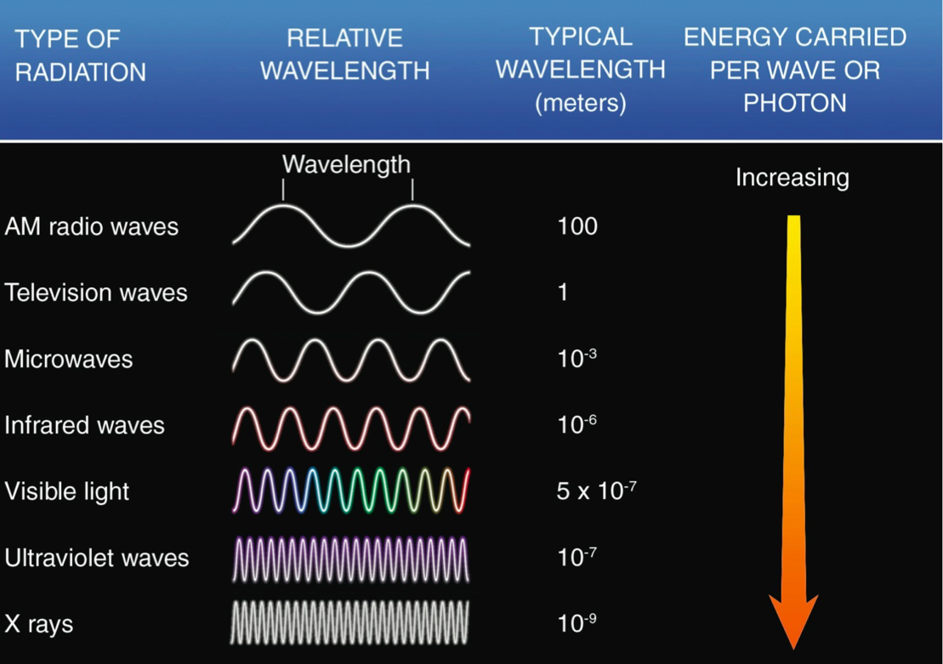
Radiation – Last Time
Ahrens & Hanson 8th ed.
Notes:
Looked at EM spectrum
EM waves span all wavelengths. No upper or lower bound on their size.
Certain wavelength bands of spectrum are given special names, e.g. Infrared-Visible-Ultraviolet
Character of an EM wave is uniquely defined by either its wavelength or frequency.
Shorter wavelengths are more energetic than longer wavelengths.
Higher frequencies more energetic than longer frequencies

Slide 5

Radiation – Last Time
20 μm
0.5 μm
0.1 μm
Meteorological Significance
Ahrens & Hanson 8th ed.
Notes:
EM waves of significance in the study of the Earth’s atmosphere are between 0.1 microns – 20 microns
Infrared (20-10 microns) - Visible (0.5 microns) – UV

Slide 6
We now examine three fundamental laws of electromagnetic radiation
Planck’s Law of radiation
Wien’s Law of maximum emission
Stefan-Boltzmann Law of total emission

Slide 7
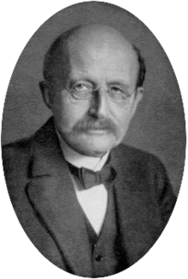
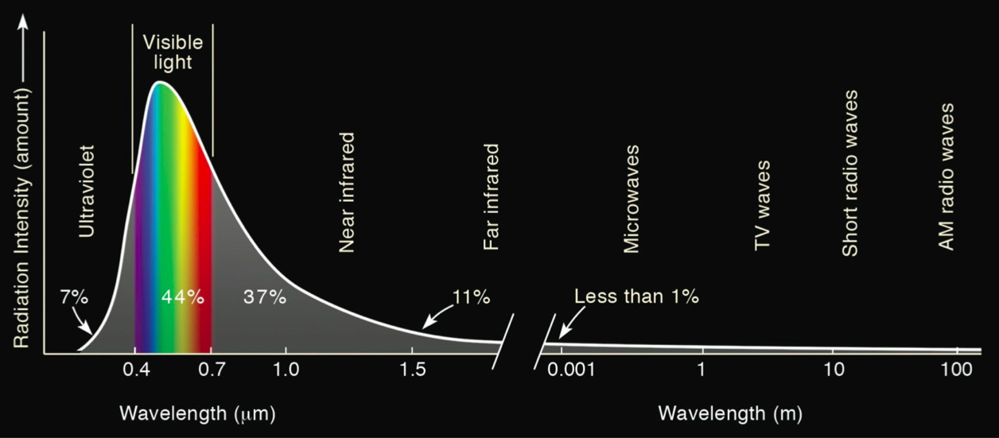
1) Planck’s Law
All objects warmer than 0 K emit radiation.
Temperature determines the distribution of electromagnetic waves emitted by an object.
Max Planck
Emission spectrum of the Sun
Ahrens & Hanson 8th
Notes:
All objects warmer than 0 K emit radiation
Temperature uniquely determines the emission spectrum of radiation emitted by an object. Shape and amplitude of EM curve.
Figure shows emission spectrum for the Sun, which has an effective radiative temperature 5800 K.
X-axis: wavelength in microns. Y-axis: intensity per wavelength.
Peak emission occurs at 0.5 micron, which corresponds to green light in the visible band of 0.4-0.7 micron.
UV – 7%. VIS – 44%. IR – 48%.
Nearly 99% of emitted energy lies between 0.1-5.0 microns.

Slide 8
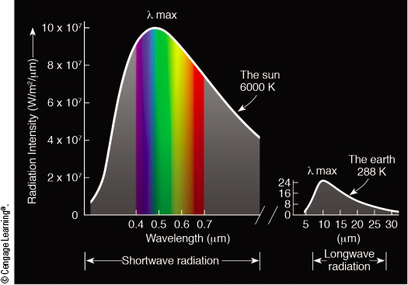
Planck’s Law
Note different scales of y-axis
Ahrens & Hanson 8th
Hotter the object => Shorter the wavelength of maximum emission.
Hotter the object => More radiation emitted - larger area under curve.
Notes:
Can use Planck’s Law to compare the emission spectrum from the Sun to Earth, and the spectrum from the Earth to outer space.
Sun (left) shows max emission near 0.5 microns (green), where the intensity is 10 x 10⁷ W/m²/micron (4 million times larger than peak emission from earth at 20 microns).
Nearly 99% of emitted energy lies between 0.1-5.0 microns.
Earth (right) has max emission at 10 microns, where the intensity is 25 W/m²/microns. (4 million times smaller than peak emission at 0.5 from sun.)
99% of emitted energy lies between 5-30 microns.
=> Sun’s and Earth’s spectra are widely separated!

Slide 9
Laws of Radiation
The key properties of Planck’s Law can be summarized by two simple equations…
Wien’s Law - wavelength of max emission:
λ_{MAX} (μm) = (0.29 ×10⁴ μm K) × T⁻¹
1 micron (μm) = 10⁻⁶ m
Stefan-Boltzmann Law - total emission:
E (W m⁻²) = (5.67×10⁻⁸ W m⁻² K⁻⁴ ) × T⁴
W = Watt (power = Joule s⁻¹)

Slide 10
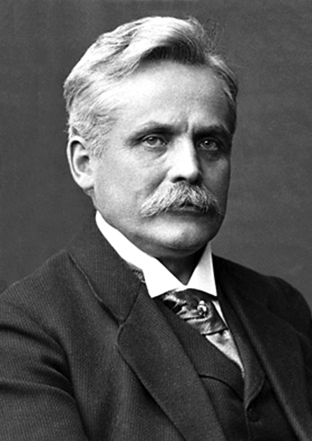
2) Wien’s Law
What is the radiative temperature of the Sun whose wavelength of maximum emission is approximately 0.5 μm?
Apply Wien’s Law:
λ_{MAX}= (0.29 ×10⁴ μm K) × T⁻¹
Effective radiative temperature of Sun
T(K) = (0.29 × 10⁴ μm K) × (λ_{MAX})⁻¹
T(K) = (0.29 × 10⁴ μm K) × (0.5 μm)⁻¹ ≈ 5800K
Wilhelm Wien
Wien’s Law Applet by e-education.psu.edu/meteo003

Slide 11
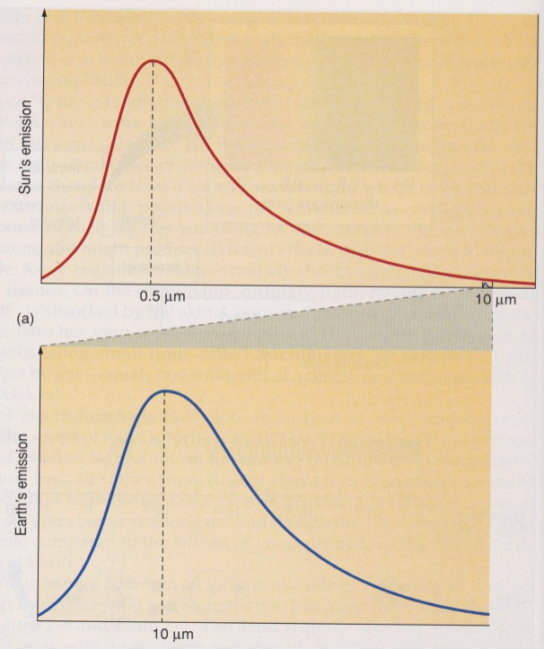
3) Stefan-Boltzmann Law
Relates the total radiation emitted to temperature
Warmer the Object => More Radiation Emitted
Double the temperature: Total emitted radiation increases 16 times!
Stefan-Boltzmann Law
E= (5.67×10⁻⁸ W m⁻² K⁻⁴ ) × T⁴ E=2×2×2×2=16
  2⁴
Sun Temp: 6000K
Earth Temp: 300K
Aguado and Burt

Slide 12
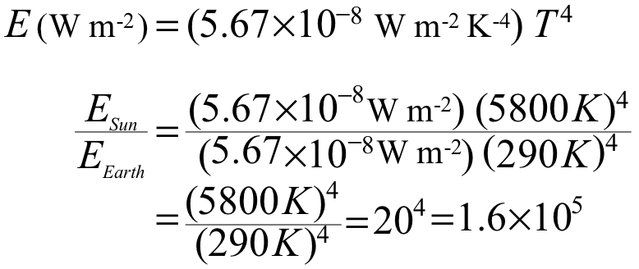
3) Stefan-Boltzmann Law
How much more power per meter squared is emitted by the Sun than the Earth?
Apply Stefan-Boltzmann Law
Sun is 160,000 times more energetic per m². Hence, the area under the Sun’s energy curve is 160,000 times larger than under the Earth’s energy curve.

Slide 13
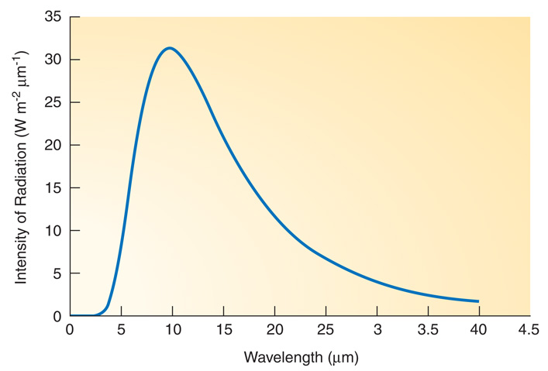
Laws of Radiation
Peak
Wien’s Law
SB Law
Planck’s Law
Area
Shape
Planck’s Law quantifies distribution of emitted radiation over all wavelengths as a function of temperature
Wien’s Law gives the wavelength of maximum emission
λ_{MAX} (μm) = (0.29 ×10⁴ μm K) × T⁻¹
Stefan-Boltzmann’s Law gives total emission of radiation
E (W m⁻²) = (5.67×10⁻⁸ Wm⁻²K⁻⁴ ) × T⁴
Notes:
Planck’s Law quantifies distribution of emitted radiation over all wavelengths as a function of temperature.
Amplitude of curve as function of wavelength
Wien’s Law gives the wavelength of maximum emission
Peak of curve as function of temperature
Stefan-Boltzmann’s Law gives total emission of radiation
Area of curve as function of temperature

Slide 14
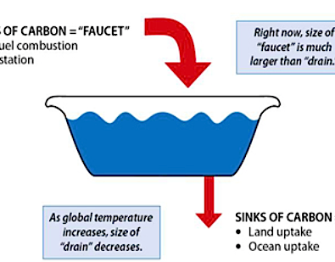


2) Radiative Equilibrium
Concept is analogous to a filling a bathtub with water when the faucet is on and the drain is open.
Flow In Exceeds Flow Out ⇒ Water Level Rises
Flow Out Exceeds Flow In ⇒ Water Level Falls
Flow In Equals Flow Out ⇒ Water Level is Constant
Or it can be said that the... Water Level is at Equilibrium
Flow In
Flow Out
Original source
Akin to Fig. 3.4 H&P
Notes:
Introduce a simple but powerful concept used throughout science: equilibrium.
First apply concept to a bathtub with the faucet on and the drain open.

Slide 15
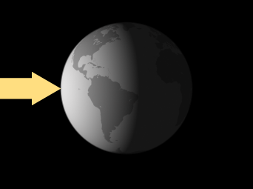
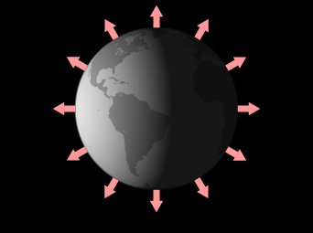
Radiative Equilibrium
Figure credit
Solar radiation absorbed
Infrared radiation emitted
If solar radiation absorbed exceeds IR radiation emitted => Earth’s Average Temperature Warms
If IR radiation emitted exceeds solar radiation absorbed => Earth’s Average Temperature Cools

Slide 16
Radiative Equilibrium
Figure credit
=
Solar radiation absorbed
Infrared radiation emitted
When radiation absorbed equals radiation emitted, the balance is termed Radiative Equilibrium.
The corresponding constant temperature is the termed Radiative Equilibrium Temperature.
The Radiative Equilibrium Temperature of the Earth’s average surface temperature is currently 15°C or 59°F.
Notes:
Radiative Equilibrium occurs when Absorbed = Emitted
Radiative Equilibrium Temperature => constant temperature that occurs when there is Radiative Equilibrium
We can apply the idea of equilibrium to components of the earth-atmosphere-ocean system. For example, Rad Eq. Temp for Earth’s surface is currently 59F or 15C.

Slide 17
Thank you for listening.
This ends the overview of
Laws of Radiation and
Radiative Equilibrium.

