Slide 1
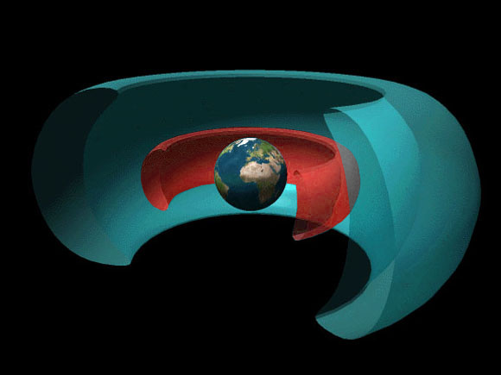


ATMO 170A1
Online
Heat and Energy Transfer
Properties of Radiation
Use Slide Show mode for narrative
Figure source
Rendering of Van Allen belt that protects Earth from harmful output from the sun

Slide 2
Last Time
Temperature – average speed of molecules
  - contrasted temperature and wind
  - different temperature scales
Internal Energy
- energy associated with random, disordered motion of an object’s molecules
Heat – energy transfer
- due to temperature differences
- heat flows from warmer => colder
- works to equilibrate temperature differences

Slide 3
Last Time
Three modes of heat transfer
1) Conduction – molecule to molecule
2) Convection – vertical transport of fluid
Advection – horizontal transport of fluid
+
Latent Heat – energy of phase changes
Works with convection & advection
3) Radiation – discussion starts with this lecture

Slide 4
Specific Goals
1) Radiation – electromagnetic waves
- What are EM waves
- Properties of EM waves
- Electromagnetic Spectrum

Slide 5
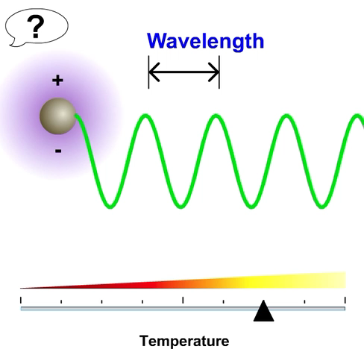
Radiation
All mass that has a temperature greater than 0 K, emits radiation.
Radiation is in the form
of electromagnetic waves.
Produced by the acceleration
of electric charges.
These waves do not need matter to propagate; they move at the “speed of light” in a vacuum
300,000 km s⁻¹ or 186,000 miles s⁻¹
e-education.psu.edu/meteo003
Notes:
Radiation -
Any object that has a temperature greater than absolute zero (0 K) emits radiant energy.
Radiation is in the form of waves that has both electric and magnetic properties. Hence, they are called electromagnetic waves.
Waves are produced by the acceleration of electric charges.
This means of energy transfer does not involve matter, but instead electro-magnetic (EM) waves that travel at 300,000 km/sec. This is the major method of transferring energy from the sun to the earth, and at this speed it takes about 8 minutes for solar radiation to travel from the sun to the earth.

Slide 6
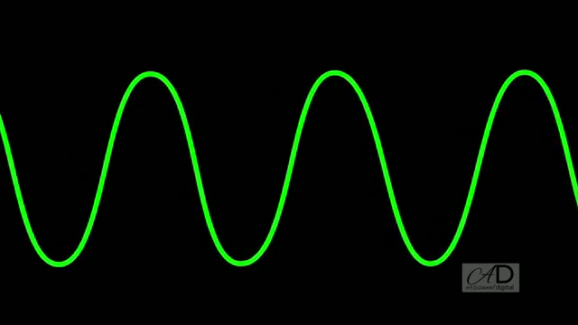
Wave Principles
Important aspects that define waves are:
  Wavelength: Distance between peaks.
  Amplitude: Height of crests
  Frequency: # waves that pass a point per second
  Period: Time it takes one wave to pass a point
Wavelength
Distance
btw peaks
Amplitude Height of crests/troughs
Frequency # crests per second
Figure credit: Link to figure
Notes:
The picture of EM waves passing through the atmosphere is much like that of the waves on the surface of the water. There are three important aspects about the waves:
1. Wavelength or horizontal distance (as portrayed) between the peaks of the waves.
2. How big is it? Amplitude or half the vertical distance (as pictured) between peaks and valley. When more intense radiation at a specific wavelength is emitted, one can think of the amplitude increasing.
ADVANCE SLIDE
3. How fast is the wave moving…its Speed? Or how many waves pass a point per unit time…its Frequency.

Slide 7
Photons
One can also think of radiation as discrete packets of energy or PHOTONS.
Photons are massless.
Their energy is measured
in electron Volts (eV)
Photons of shorter wavelengths have more energy ts of longer wavelength
e-education.psu.edu/meteo003
Notes:
Not to confuse you, but I just wanted to touch on the fact that sometimes it is also convenient to think of radiation in terms of particles or discrete packets of energy or “photons.”
When considering photons remember the relation: photons with higher frequencies (i,.e. shorter wavelengths) have more energy.
That is why, in spite of the fact that the sun emits far more visible photons than UV photons, the UV photons have much more energy than visible photons and are thus more dangerous to humans than visible photons…although visible photons can harm a person in large doses, i.e. looking directly at the bright light of the sun.

Slide 8
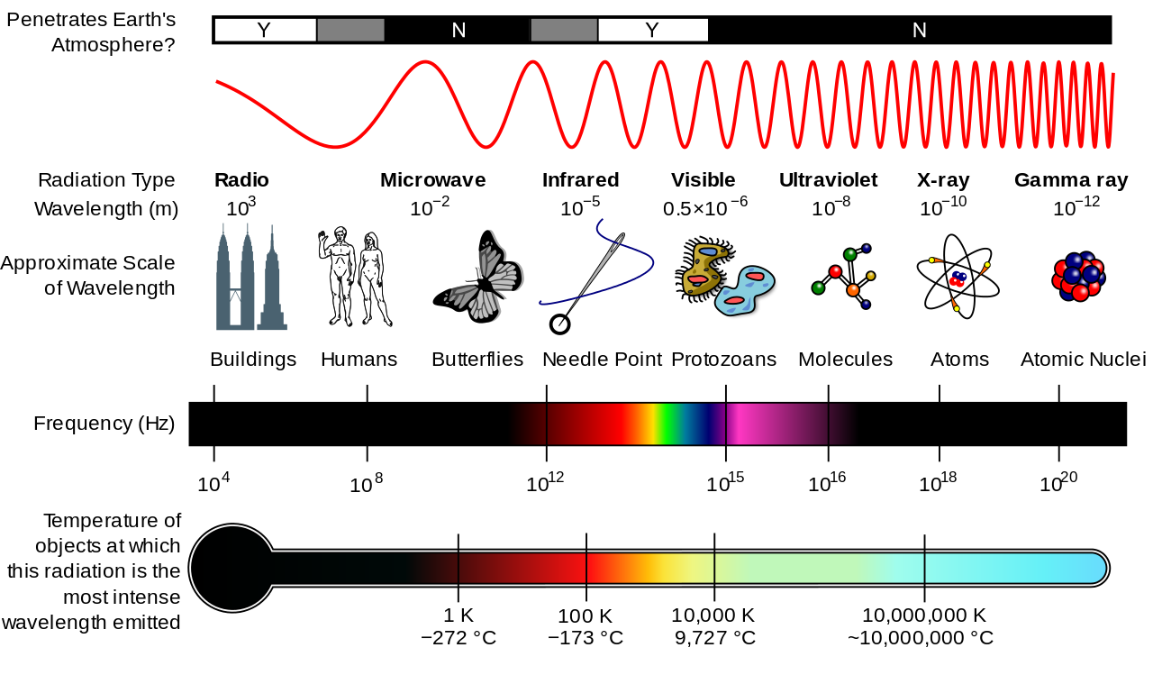
Electromagnetic Spectrum
WAVELENGTH
FREQUENCY
Figure credit: upload.wikimedia.org
Notes:
OVERVIEW OF EM radiation.
Figure portrays wavelengths (meters) by red curvy line. Longest wavelengths to the left; shortest to the right. (Wavelengths are NOT draw to scale.)
=> The electromagnetic waves can be any wavelength. No upper or lower bound.
Below the red curve, names of bands of radiation appear that are associated with particular wavelengths. (Name some: IR, Vis, UV.)
The figure also shows for comparative purposes objects of similar size that occur in nature.
Figure shows wavelengths are in meters. IR: 10 x 10⁻⁵. VIS 0.5 x 10⁻⁶. UV: 1.0 x 10⁻⁸.
In the atmospheric sciences, the unit of measure that is commonly used to quantify wavelength of EM radiation is the micrometer (μm) = 10⁻⁶ meters.
(Nanometer (nm)=10⁻⁹ m is sometimes encountered.)
=> Wavelength uniquely determines the energy associated with a band of radiation. Shorter wavelengths are more energetic than longer waves.
Black bar with the rainbow colors in middle shows the frequency of radiation.
=> Frequency also uniquely defines radiation. (wavelength x frequency = wave speed = 3.0 x 10⁸ m/s)
Relevance of thermometer (at bottom) will become clear next slide set.
PAGE FORWARD
Top bar indicates whether the atmosphere transmits (Y) or absorbs (N) a band of EM radiation. Grey denotes some wavelengths are absorbed, some transmitted.
IR and Visible bands are of the greatest importance in the study of weather and climate.
Air is transparent to visible light, but it is selectively absorbent of IR radiation.
IR region of interest is centered around 10 μm
Visible range is 0.4 μm ⬄ 0.7 μm
(UV between 0.1 μm ⬄ 0.4 μm)

Slide 9
Electromagnetic Spectrum
20 μm-0.1 μm
WAVELENGTH
FREQUENCY
Figure credit: upload.wikimedia.org
Notes:
PAGE FORWARD
Top bar indicates whether the atmosphere transmits (Clear segment Y) or absorbs (Black portion N) a band of EM radiation.
Grey denotes some wavelengths are absorbed, some transmitted.
Air is transparent to visible light, but it is selectively absorbent of IR radiation. Air is opaque to UV radiation.
IR and Visible bands are of the greatest importance in the study of weather and climate.
IR region of interest is centered around 10 μm (20 μm ⬄ 5 μm)
Visible range is 0.4 μm ⬄ 0.7 μm
(UV between 0.1 μm ⬄ 0.4 μm)

Slide 10
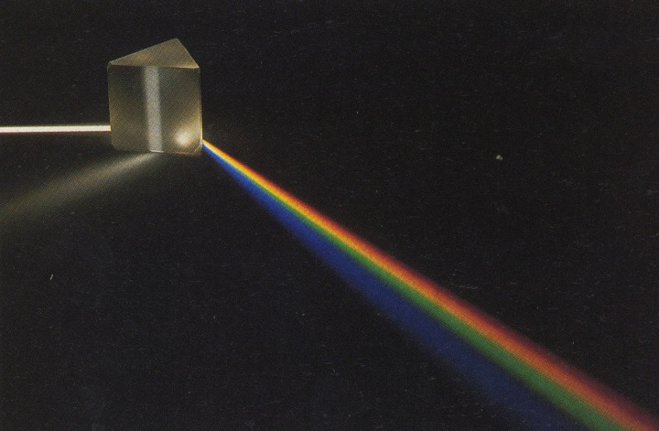
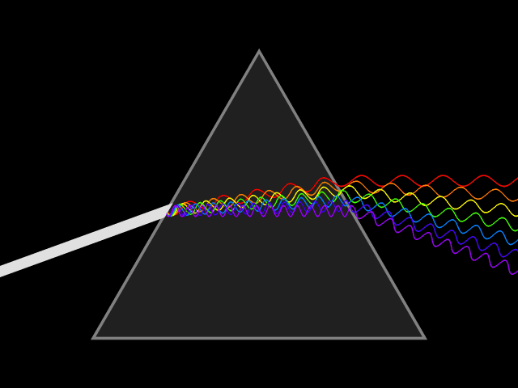
Visible Light Spectrum
White Light
Prism
Red
Purple
Green
Wavelengths between 0.4 to 0.7 microns
Shorter Wavelengths => Longer Wavelengths
violet=>blue=>green=>yellow=>orange=>red
Notes:
You are intuitively familiar with the concept of visible light being composed of different wavelengths of EM radiation.
Visible light, when passed through a prism, disperses into the separate colors (i.e. wavelengths) of the “rainbow.”

Slide 11
Remember...
  Electromagnetic waves are uniquely determined by
  either their frequency or their wavelength
  (Frequency = Speed/Wavelength)
Notes:
Why?
Because their speed is a constant 300,000 km s⁻¹
Frequency = Speed/Wavelength

Slide 12
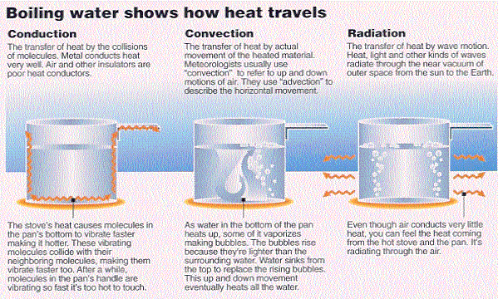
Modes of Heat Transfer
Latent Heat
Williams, p. 19

Slide 13
Take Home Points
Temperature – a measure of the average speed speed of molecules
Heat – energy transfer due to temperature differences
Heat flows from warmer => colder
Equilibrates temperature differences

Slide 14
Take Home Points
Three primary modes of heat transfer
1) Conduction – molecule to molecule
2) Convection – vertical transport of fluid
Advection – horizontal transport of fluid
+
Latent Heat – energy of phase changes
Works with convection & advection
Large for H₂O vapor <=> liquid
3) Radiation – electromagnetic waves

Slide 15
Energy and Heat Transfer
Energy can only be
converted from one form to another or transferred from one place to another
Total energy is conserved
It cannot be destroyed
Notes:
1. Energy can only be converted from one form to another or transferred from one place to another. It cannot be created or destroyed.
2. Energy transfer is done from hot to cold

Slide 16
Thank you for listening.
This ends the presentation.

