Slide 1
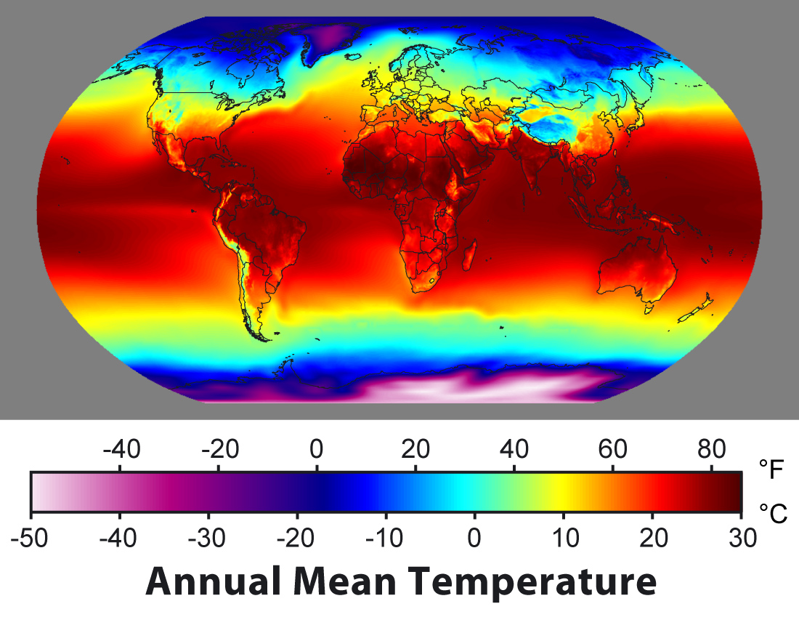

ATMO 170A1
Online
Heat & Energy Transfer
Use Slide mode to hear narrative
Figure credit upload.wikimedia.org

Slide 2
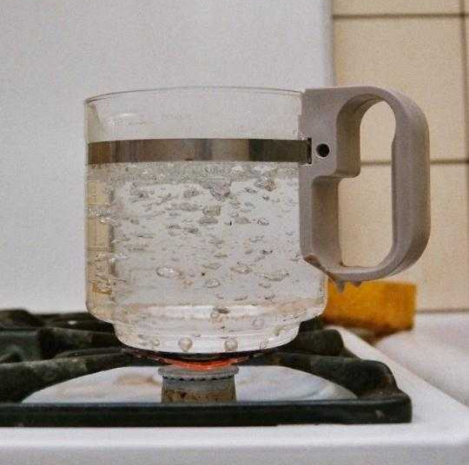
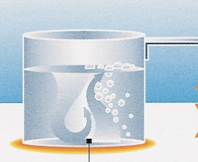
What is Heat?
Internal Energy – energy associated with random, disordered motion of an object’s molecules
Heat or Heat Transfer – energy transfer from a hotter to colder object
Consider a pot of water on a hot burner and the following questions:
A boiling pot of water examplifies all modes of heat transfer
Williams, p. 19

Slide 3
Heat Transfer Questions
What causes the…
Bottom of the pot to get warmer?
Top of the water to get warmer?
Temperature of the water to not exceed 100ºC?
Region away from the side of the pot to feel warm?
A boiling pot of water examplifies all modes of heat transfer
Williams, p. 19

Slide 4
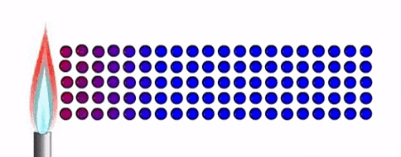
Conduction
Source: T Davies 2011
Heat transfer due to collision of molecules
Conduction warms the bottom of the pan!
It warms air on top of asphalt on a hot summer day
Conduction Applet from e-education.psu.edu
Recommended
sites.google.com

Slide 5
Heat Conductivity
Conductivity - rate of heat transfer across a 1 cm slab of material if one side is kept 1ºC warmer than the other
Material | Heat Conductivity (Cal s⁻¹ cm⁻¹ ºC⁻¹)
Still Air | 6.1 x 10⁻⁵
Dry Soil | 6.0 x 10⁻⁴
Still Water | 1.4 x 10⁻³
Wet Soil | 5.0 x 10⁻²
Granite (Rock) | 6.5 x 10⁻²
Iron (Metal) | 0.16
Silver (Metal) | 1.01
Bigger value => better heat conductor
☞Air is a very poor conductor of heat
0ºC
1ºC
Heat
Transfer
cm
Air
Water
Metal

Slide 6

Convection
Heat transfer due to vertical exchange of mass
Occurs in fluids (liquids, gases)
Warm, buoyant fluid rises - Cool, dense fluid sinks
Convection warms top of liquid!
www.wiki.org
Schlieren movie of convection from e-education. psu.edu

Slide 7
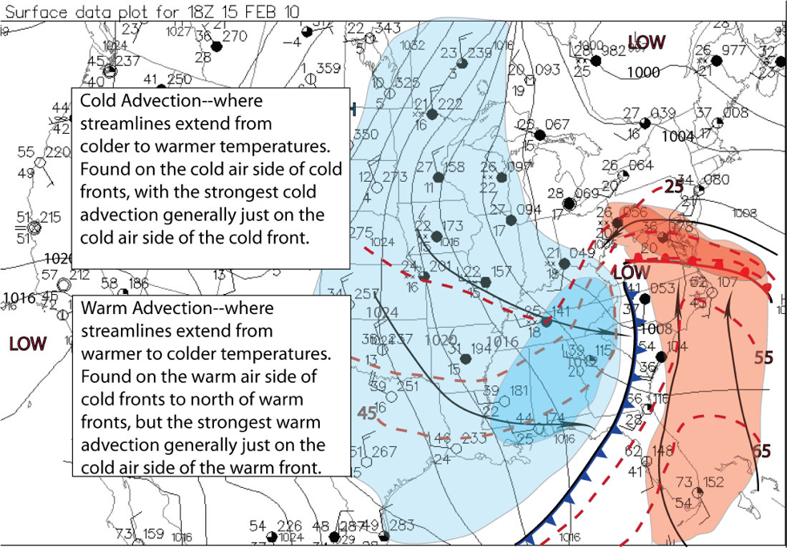
Advection
Heat transfer due to horizontal exchange of mass
is termed Advection
Warm air flows poleward
Cold air flows equatorward
Cold advection - where wind blows from colder to warmer temperatures. Usually winds from poles.
Warm advection - where wind blows from warmer to colder temperatures. Usually winds from tropics.
Figure Credit
http://tornado.sfsu.edu/

Slide 8
Why does the temperature of boiling water never exceed 100°C (212°F*) at mean sea level?
  A look ahead to a topic in Chapter 5 that has important ramifications to heat transfer in our atmosphere.
*(≈207°F in Tucson at ~2,500’)
*(≈202°F in Denver at ~5,200’)
Boiling point is approximately 1°F lower for every 500’ increase above MSL

Slide 9
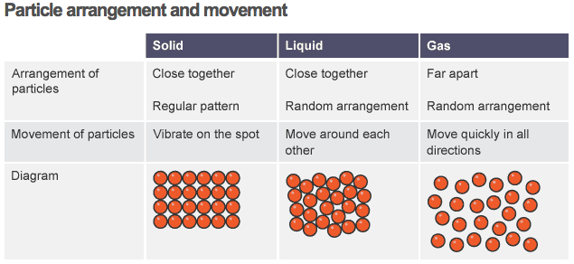
Energy Levels of Phases of State
LOWEST ENERGY STATE
HIGHER ENERGY STATE
EXTEMELY HIGH ENERGY STATE
Figure Credit: http://www.bbc.co.uk/education/guides/zgr2pv4/revision/1
Notes:
Molecular perspective of the three phases of water aids our understanding
Solid - molecules close together; aligned in regular pattern; only vibrate; object maintains its shape (for our purposes), does not flow; cannot (for our purposes) be compressed. VERY LOW ENERGY STATE
Liquid - molecules still close together but in random arrangement; can move around each other but remain next to each other; can flow and take shape of container; cannot be compressed. MODERATE ENERGY STATE
Vapor - molecules far part and have space to move; move quickly in all directions; completely fill container; can be compressed or squished. VERY HIGH ENERGY STATE
Solid => Liquid requires heat transfer to object
Liquid => Vapor requires a lot of heat transfer to the object

Slide 10
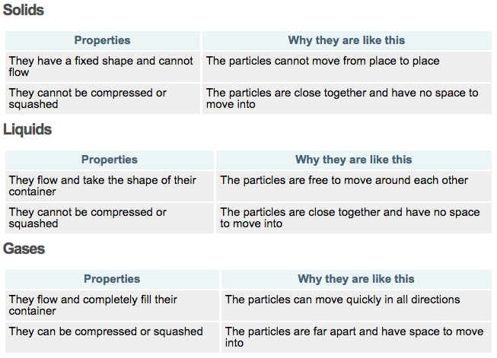
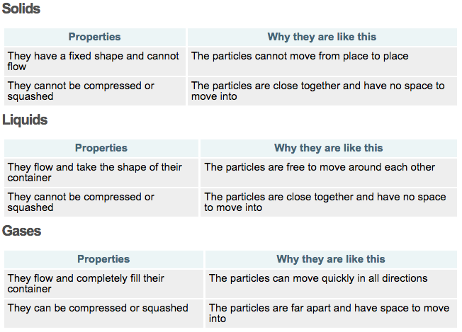
Solids, Liquids, Gases
Figure Credit: http://www.bbc.co.uk/education/guides/zgr2pv4/revision/1

Slide 11
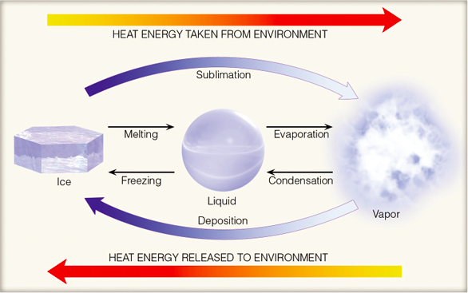
Latent Heat works with fluid motions to transfer heat
Surrounding air COOLS
More Ordered Phase
Less Ordered Phase
-620 cal/gm
-80 cal/gm
-540 cal/gm
Strong attraction between molecules
Weak attraction between molecules
Some attraction
+80 cal/gm
+540 cal/gm
+620 cal/gm
Surrounding air WARMS
Ahrens & Hanson
Akin to Fig. 5.2 H&P
Notes:
Energy associated with changes of state for water
Aside: the calories of science that are discussed above are not equal to calories that are listed in the ingredients of food manufactured in the US. The calorie listed for US food packages is in reality a kilo-calorie (kcal) or 1000 “scientific” calories. If you purchased a food item produced outside of the US, its caloric content will be specified as kcal. To relate this aside to the above diagram, It would take 80 kcal to melt one kilogram (2.2 lbs) of ice.

Slide 12
Latent heating works with the fluid motions
Heat transfer due to transport of water vapor upward and poleward.
Evaporation Tropics => Transport => Condensation Higher Latitudes.
Warm, moist air flows poleward where it rises, cools and condenses, releasing latent heat
Cold, dry air flows equatorward and does not release appreciable latent heat.
Cold advection - where dry air flows from colder to warmer temperatures. Usually winds from poles.
Warm advection - where moist air flows from warmer to colder temperatures. Usually winds from tropics.
http://tornado.sfsu.edu/

Slide 13
Invisible gas
Water Vapor Bubbles
Boiling liquid + heat => gas

Slide 14
Take Home Points
Three primary modes of heat transfer
1) Conduction – molecule to molecule
2) Convection – vertical transport of fluid
Advection – horizontal transport of fluid
+
Latent Heat – energy of phase changes
Works with convection & advection
Large for H₂O transitions btw vapor <=> liquid
3) Radiation – electromagnetic waves
(next discussion)

