Slide 1
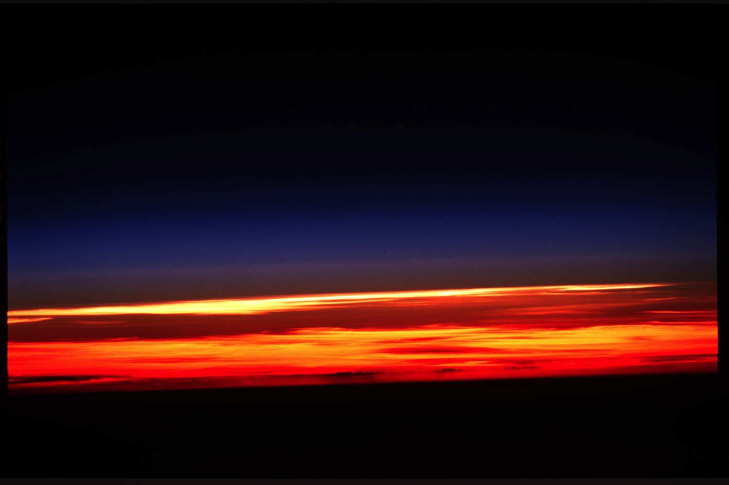
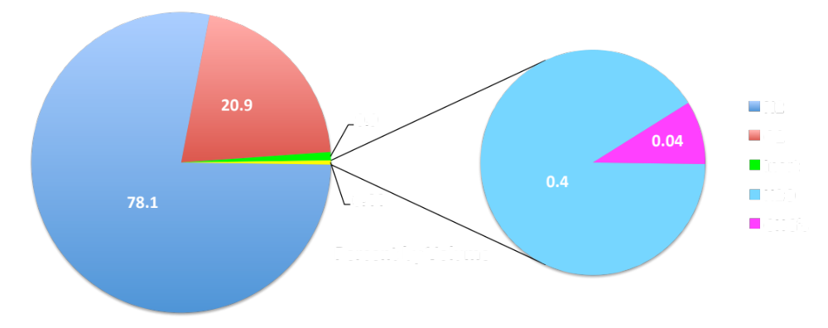

ATMO 170A1
Online
Atmospheric Composition
Use Slide Show mode to hear narrative
Earth’s limb from the International Space Station
Source: earthobservatory.nasa.gov

Slide 2
Overview Goals
Atmospheric Composition
  Primary constituents
  Trace gases
  Aerosols

Slide 3
First order of business
What is air?
Can you see air?
Can you smell or taste air?
Can you feel or touch air?
What is air made of?
At first glance, these questions seem simple.

Slide 4
What is air?
1) Can you see air?
  No. Air is clear, transparent…
  But air is reflective. The sky is blue!
  And sometimes air looks foggy or hazy because you are seeing the bulk effects of small water droplets (fog) or small particles of some material (aerosols) that are suspended in air. Droplets and particles may be too small to be seen with the naked eye, but they redirect light.

Slide 5
What is air?
2) Can you smell or taste air?
  Not usually.
  We can, however, smell certain air pollutants and trace gases, even when their concentrations are as small as a few parts per million.

Slide 6
What is air?
3) Can you feel or touch air?
  Complicated.
  At sea level, air pressure pushes on every square inch of our bodies with almost 15 pounds of force. If that were to change suddenly, we'd feel it, probably painfully…ears popping!
  We feel air when the wind blows.
  We sense air through temperature, which is a measure of the random speed of air molecules.

Slide 7
What is air?
4) What is air made of?
  Simplest answer. Lots of different gases.
  Two most abundant gases are
  N₂ (28 gm/mole) and O₂ (32 gm/mole)

Slide 8
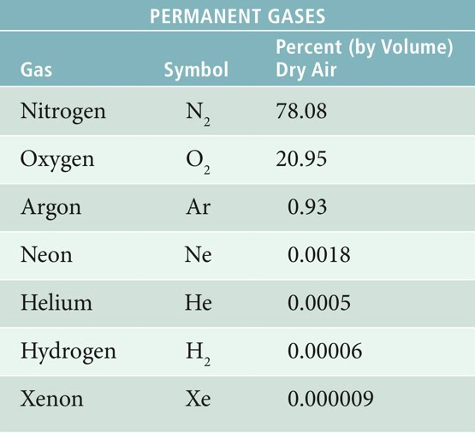

Atmospheric Composition
Permanent Gases Today
Dominant Gases
N₂ and O₂ are the most abundant gases
N₂ and O₂ are chemically active, continuously cycled
Trace Gases
Ar, Ne, He, and Xe are chemically inert
H2 chemically active
Ahrens and Hanson, 8th ed.
Akin to Table 3.1 H&P
Percentages constant up to 80 km
Ahrens and Hanson, 8th ed.

Slide 9
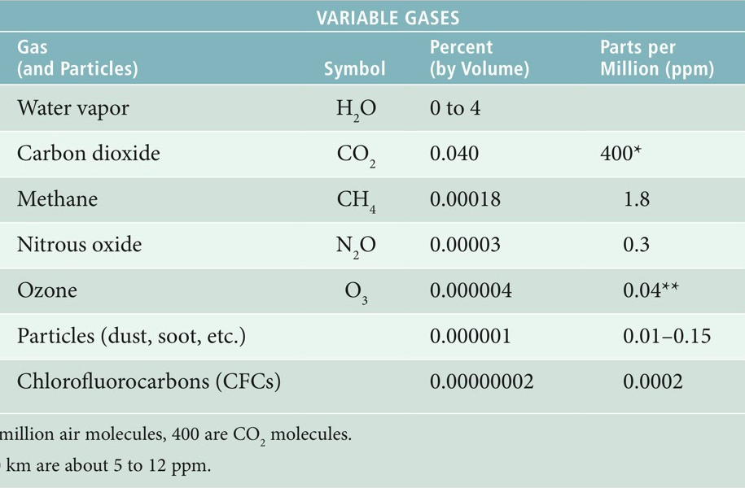
Atmospheric Composition
Important Trace Gases
variable
0.4
greenhouse gases
Which of these values is now in error?
Ahrens and Hanson, 8th ed.
Notes:
Water vapor is invisible. It is not what we see in clouds

Slide 10
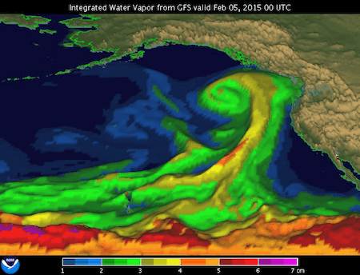
Variability of Water Vapor
Total vapor in a column of air (cm)
http://www.esrl.noaa.gov/psd/atmrivers/questions/
5X-10X Difference
H₂O vapor varies from day-to-day, place-to-place.
Highest values are where air is the warmest.

Slide 11
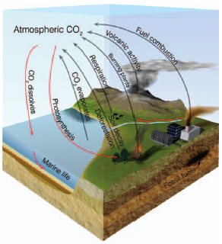
Gases are Continuously Recycled Balance when Sources=Sinks
CO₂ balance is complex
-Sources of CO₂
  vegetative decay
  volcanic emissions
  animal respiration
  fossil fuel combustion
  CH₄ + 2 O₂ ➔ 2 H₂O + CO₂ + Heat
-Sinks of CO₂
  photosynthesis (O₂ production)
  6 CO₂ + 6 H₂O + sunlight ➔ C₆H₁₂O₆ + 6 O₂
  dissolves in water (ocean uptake)
  phytoplankton absorption (limestone formation)
Word Conundrum of Day: continually or continuously? What’s the difference?
Figure Credit: Ahrens and Hanson
Animation: A year of carbon cycle
See Appendix 3.1 H&P

Slide 12
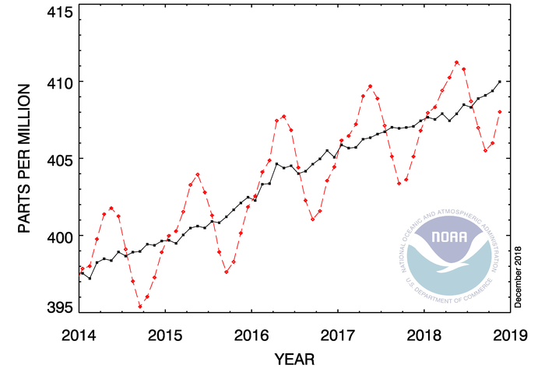
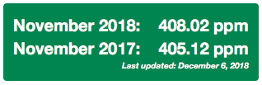
CO₂ Trend Past ~5 Years at Mauna Loa
Falls in Summer ⇾ Growing season
Active photosynthesis in NH
High CO₂ uptake by land plants
Rises in Winter ⇾ Dormant season
Less photosynthesis in NH
Low CO₂ uptake by land plants
Rising at ~2.4 ppm/yr
Figure is an update of the narrative.
http://www.esrl.noaa.gov/gmd/ccgg/trends/ Current values

Slide 13
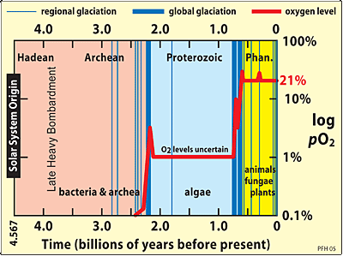
Today’s air is not yesterday’s air
Consider atmospheric oxygen
Figure Credit
Notes:
Earth is approximately 4.5 billion years old. (4. 5 Ga)
Consider oxygen
Cyanobacteria that created the first O2 appeared about 3.8 Gya, but atmospheric O2 levels were not appreciable until 2.5 - 2.0 Gya when photosynthesis was established.
Stage 1 (≈ 3.85–2.45 Ga) basically indicates that no O2 was in the atmosphere. Life began around 3.8 Gya
Stage 2 (≈ 2.45–1.85 Ga) describes a phase of production of O2, but most was absorbed in oceans and seabed rocks.
Stage 3 (≈ 1.85–0.85 Ga) reveals that O2 starts to gas out of the oceans but is absorbed by land surfaces.
Finally, during stages 4 (≈ 0.85–0.54 Ga) and 5 (≈ 0.54 Ga–present), sinks of O2 fill and the gas accumulates in the atmosphere.

Slide 14
Know the basics…
N₂ (78%) and O₂ (21%) are most abundant gases. (Think approximate values 80% and 20%)
  Concentrations constant up to ~80 km
  N₂ and O₂ chemically active
Trace gases
  Noble gases Ar (0.9%), He, Ne, Xe are inert
  H₂O, CO₂, CH₄, O₃ are radiatively active Important greenhouse gases
  H₂O vapor variable (0-4%); concentrations highest where temps are warmest (surface and tropics)
  CO₂ rising ~2.4 ppm/yr from anthropogenic inputs

Slide 15
Aerosols
1 cm³ of air can contain as many as 200,000
non-gaseous (solid or liquid) particles.
  dust
  dirt (soil)
  salt from ocean spray
  volcanic ash
  pollen
  pollutants
  water (e.g. cloud droplets and ice crystals)

Slide 16
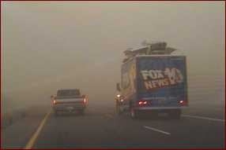
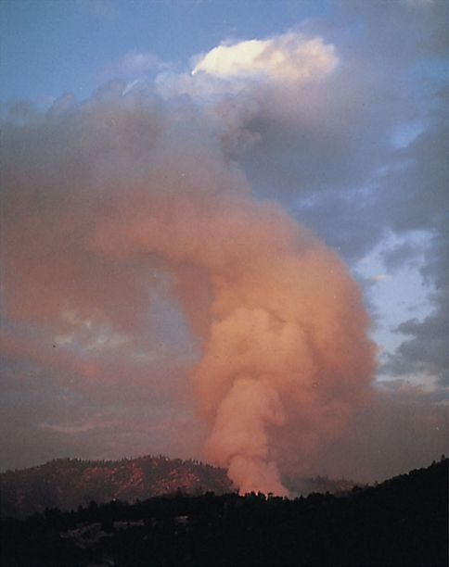
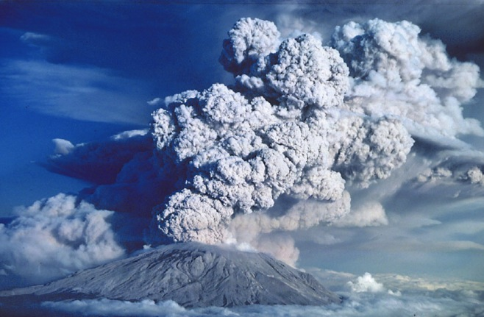
Aerosols – Natural Sources
Dust Storm on I10.
Phoenix Haboob July 5 2011
Ahrens 7th ed
Source: apollo.lsc.vsc.edu

Slide 17
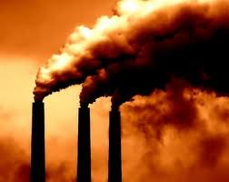
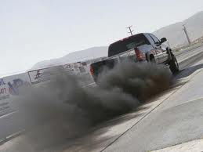
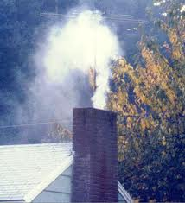
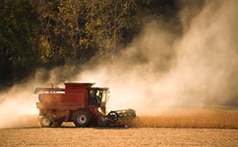
Aerosols – Anthropogenic Sources
old.tehrantimes.com
www.cancercureways.com
daviddarling.info
planetearth.nerc.ac.uk

Slide 18
Importance of Aerosols
Provide surfaces on which water vapor can condense. Needed to produce cloud droplets.
Provide a surface area or catalyst that is needed for much atmospheric chemistry.
Can deplete stratospheric ozone.
Can also cool the planet by reflecting sunlight back to space – counteract greenhouse warming.

Slide 19
Know the basics…
Aerosol Sources
  Know some natural and anthropogenic sources
Importance of Aerosols in Atmosphere
  How they affect clouds, chemistry, temperature

