Slide 1
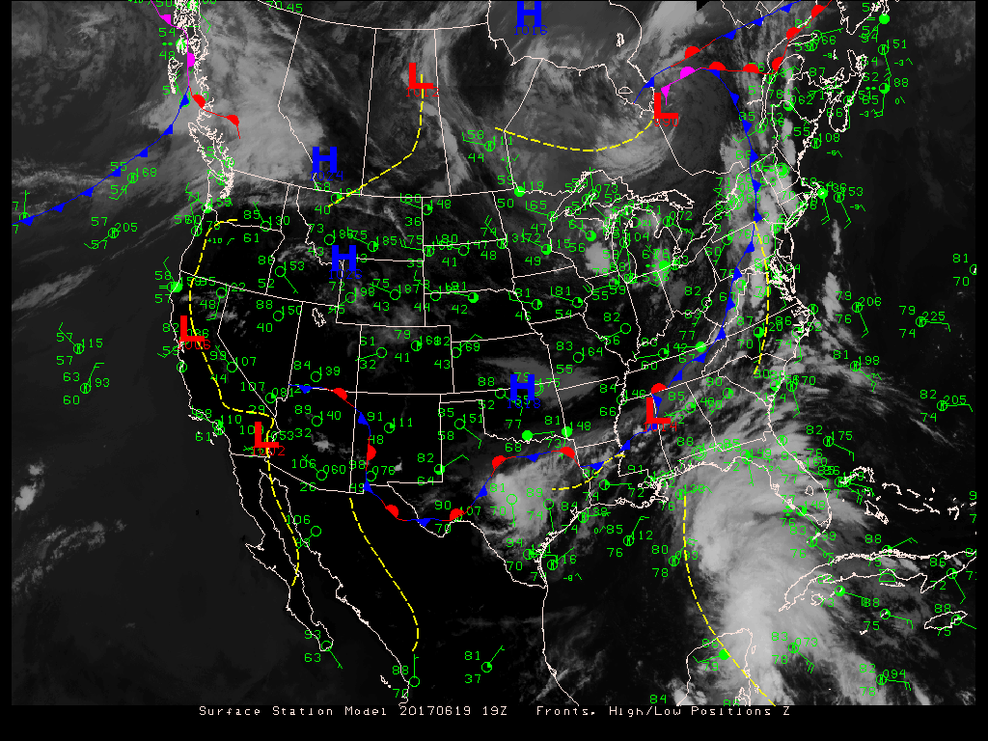

ATMO 170A1
Online
Spatial Representations of Data:
Surface Maps
(To activate links, open pptx file in show mode.)
Surface analysis for 20170619 19Z

Slide 2
Overview Goals
Weather
  Surface weather maps: how we display surface weather conditions across a region
Notes:
Two part overview
Part 1: How we communicate wx info
Part 2: What is climate? How are weather and climate related?

Slide 3
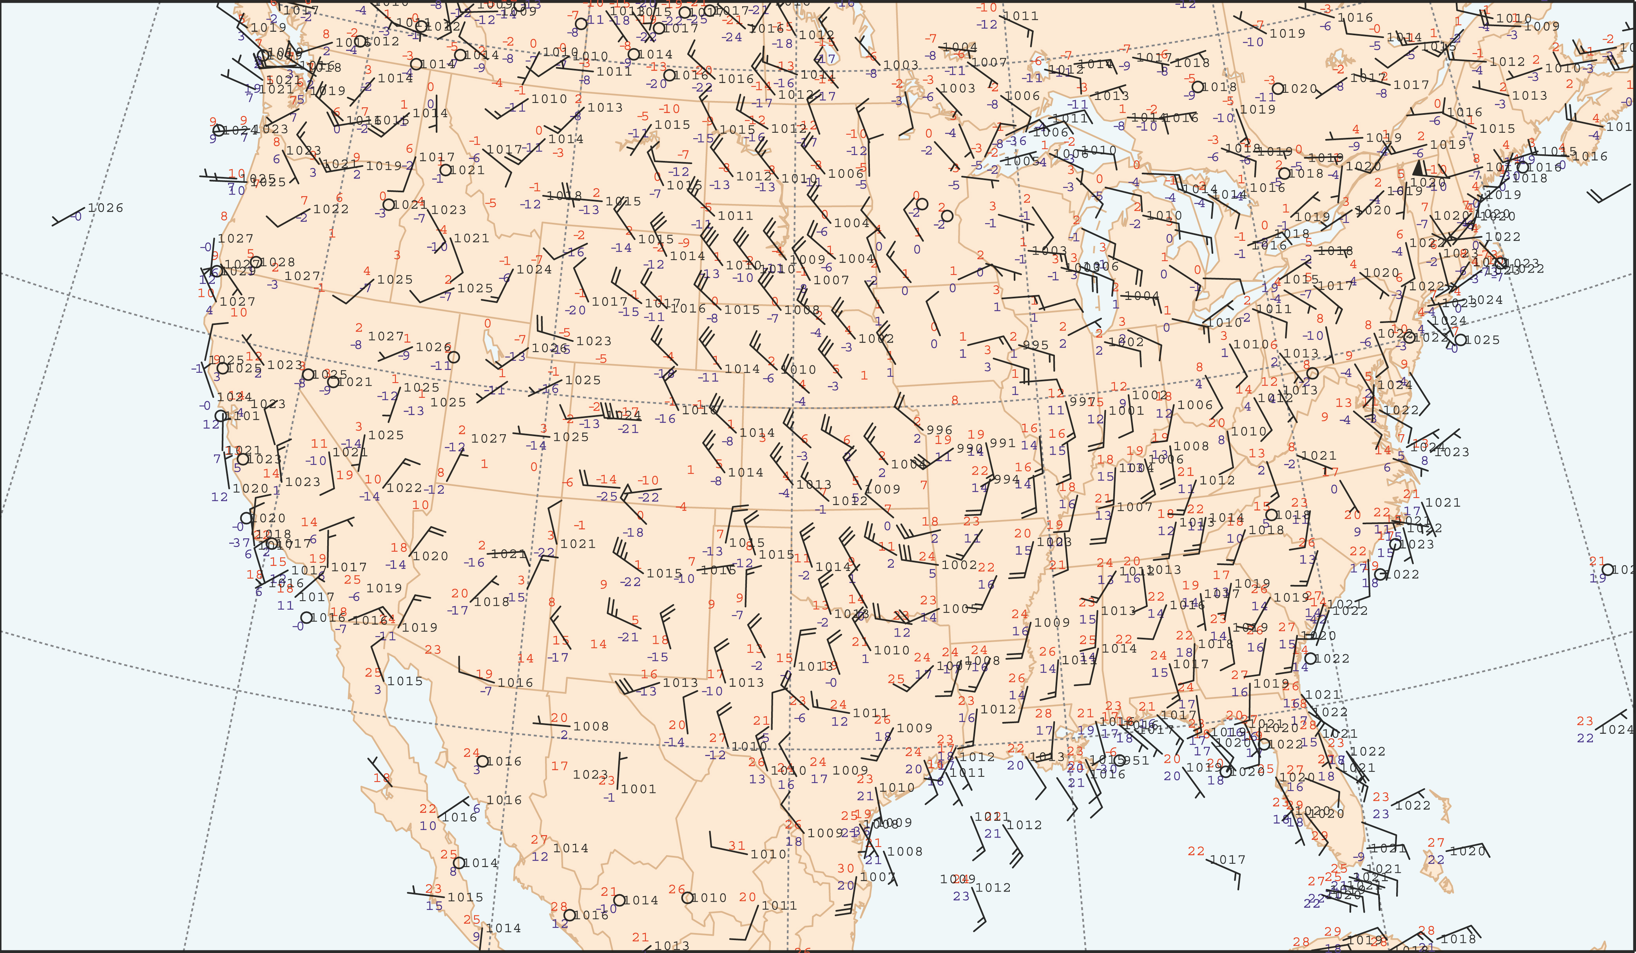
Surface map for 20140220 1800 UTC
Fig. 2.1
H&P
It can be difficult to comprehend the distributions of weather elements at a glance from a map with only station plots.
To address the situation, we analyze and complement surface plots with additional fields.

Slide 4
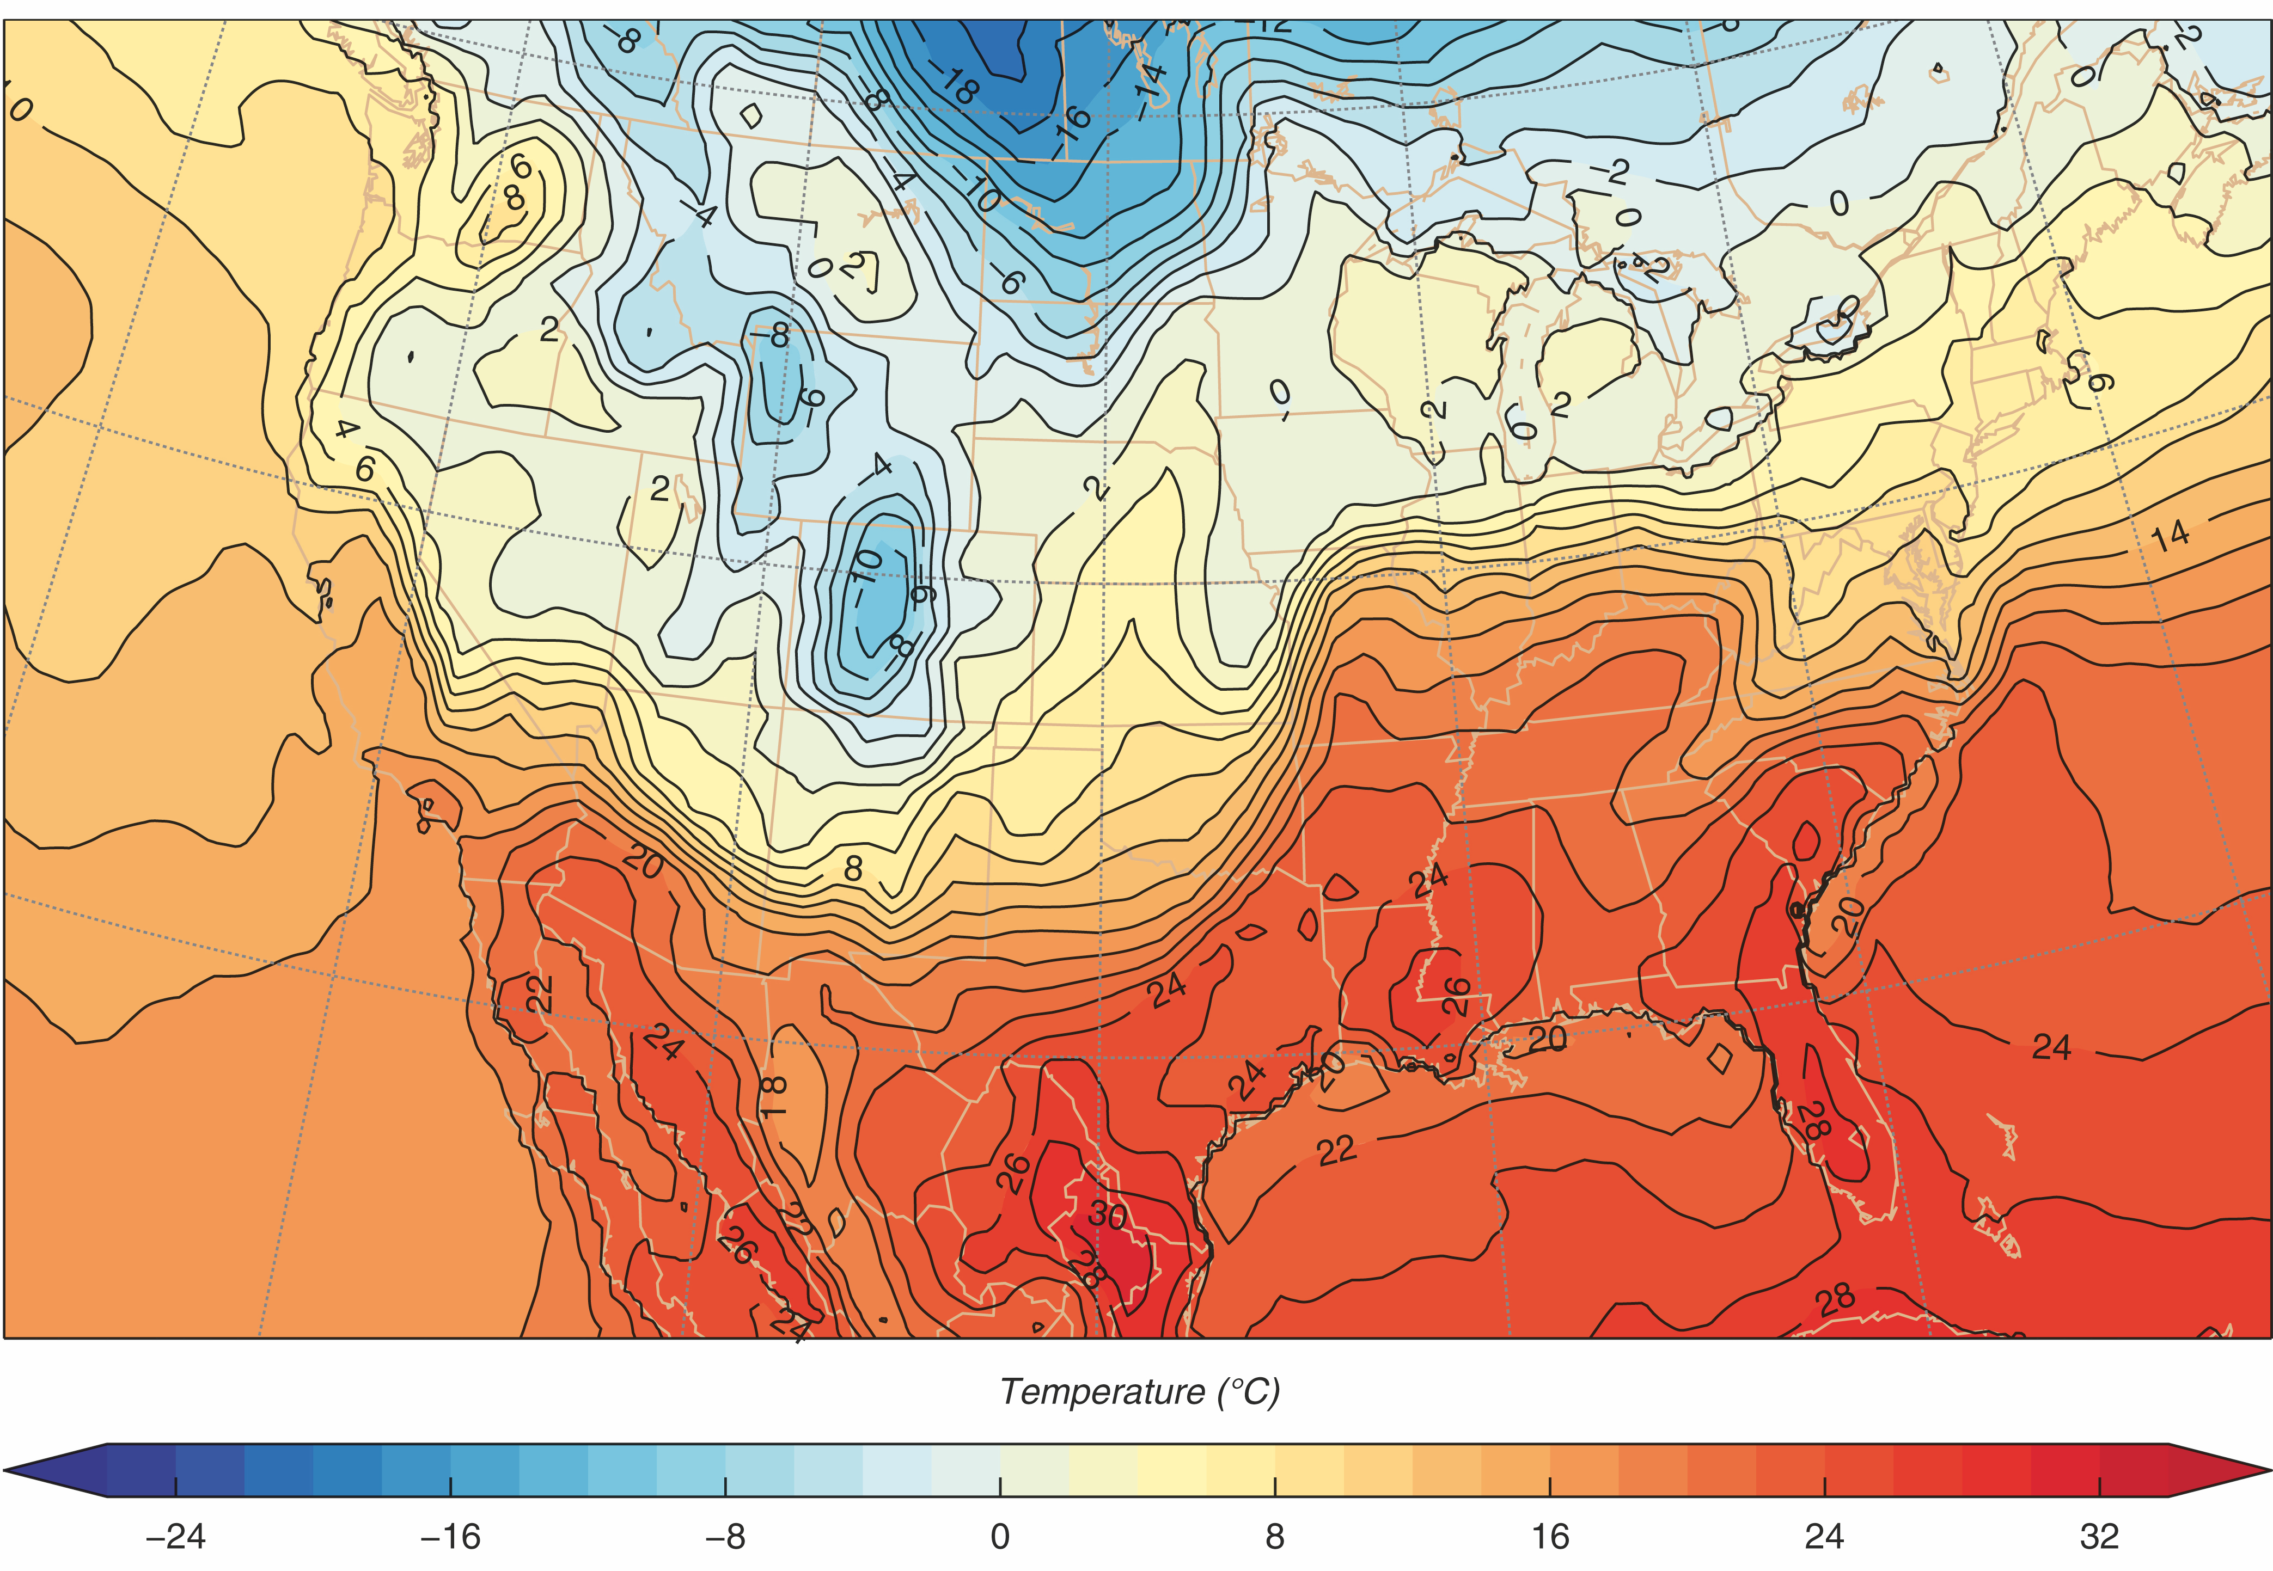
Surface temperature map for 20140220 1800 UTC
15 C in 300 km
Fig. 2.2
H&P
Color code the temperature field using intuitive color scale.
Cold colors (blues) => Cold temps.
Warm colors (reds) => Warm temps.
Notes:
Can easily identify:
Air masses => regions where temperatures are relatively uniform.
Fronts => regions of sharp temperature change

Slide 5
Surface temperature map for 20140220 1800 UTC
Fig. 2.2
H&P
Arrows => Wind directions from Fig. 2.1.
Blue shading => Region where colder air is replacing warmer air.
Red shading => Region where warmer air is replacing colder air.
Notes:
Arrows => Wind directions from Fig. 2.1.
Blue shading => Region where cold air mass is advancing toward warm air mass.
Red shading => Region where warm air mass is advancing toward cold air mass.

Slide 6
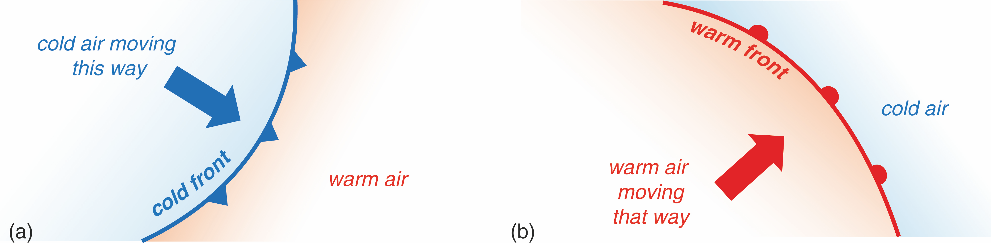
Representation of fronts on weather maps
Fig. 2.3
H&P
Leading edges of advancing air masses are designated by “fronts”.
Cold front => cold air mass advancing toward warm air mass.
Designated by blue line and triangles.
Triangles point in direction of movement.
Warm front => warm air mass advancing toward cold air mass.
Designated by red line and semicircles.
Semicircles point in direction of movement.
Notes:
Leading edges of advancing air masses are designated by “fronts”.
Cold front => cold air mass advancing toward warm air mass.
Designated by blue line and triangles.
Triangles point in direction of movement.
Warm front => warm air mass advancing toward cold air mass.
Designated by red line and semicircles.
Semicircles point in direction of movement.

Slide 7
Surface temperature map for 20140220 1800 UTC
Fig. 2.2
H&P
Arrows => Wind directions from Fig. 2.1.
Blue shading => Region where colder air is replacing warmer air.
Red shading => Region where warmer air is replacing colder air.
Notes:
Arrows => Wind directions from Fig. 2.1.
Blue shading => Region where cold air mass is advancing toward warm air mass.
Red shading => Region where warm air mass is advancing toward cold air mass.

Slide 8
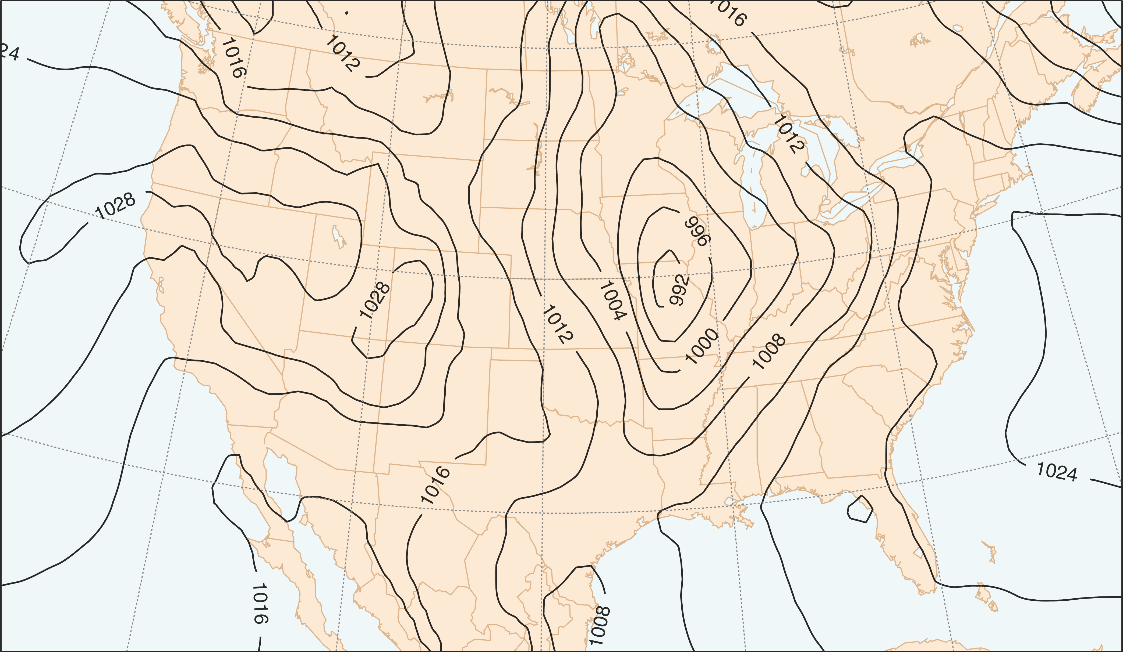
Isobars and Pressure Maps
Fig. 2.4
H&P
Isobars of SLP for 20140220 1800 UTC
It can be quite challenging to visualize the structure of the pressure field.
Hence, we contour observations to get a 2D portrait of the pressure field at the sea-level.
Contours of constant pressure are called ISOBARS.
Each isobar represents a specific value of SLP – typically at a 4 hPa interval.
The example has isobars at 992, 996, 1000, 1004, 1008, 1012, 1016, 1020, 1024, 1028 hPa.
Notes:
Analyze

Slide 9
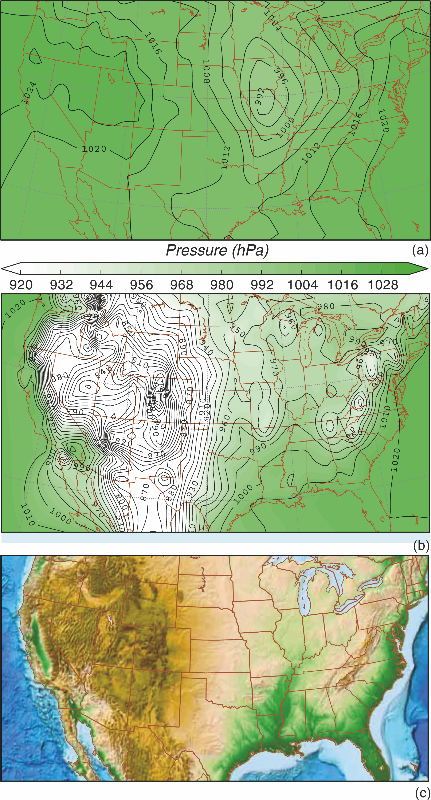
Adjustment of Pressure
to Mean Sea Level
Winds are caused by horizontal pressure variations, but pressure decreases far more rapidly upward than it changes horizontally
Pressure decreases by about 1 hPa for every 10 m increase in altitude, but it only changes on the order of 1 hPa every 100 km at mean-sea-level.
Differences in station pressures over land primarily reflect differences in station elevation, and not horizontal changes in pressure. See middle and bottom panels of Fig. 2.2.1.
To address the situation, we adjust station pressures to mean-sea-level. See top panel of Fig. 2.2.1. Note how much smaller the adjusted pressure differences are compared to the unadjusted pressures.
Pressures adjusted to mean-sea-level
Unadjusted pressures
Fig. 2.2.1
H&P
Topography
Notes:
Analyze

Slide 10
Adjustment of Pressure
Tucson Example
Elevation of Tucson is approximately 800 m.
Surface pressure runs between 925-930 hPa. (Smaller summer. Higher winter.)
To adjust station pressure of 930 hPa to sea-level-pressure, we would add an 80 hPa adjustment (1 hPa every 10 m) to the station pressure of 930 hPa to get a SLP of 1010 hPa.
Pressures adjusted to mean-sea-level
Unadjusted pressures
Fig. 2.2.1
H&P
Topography
Notes:
Analyze

Slide 11
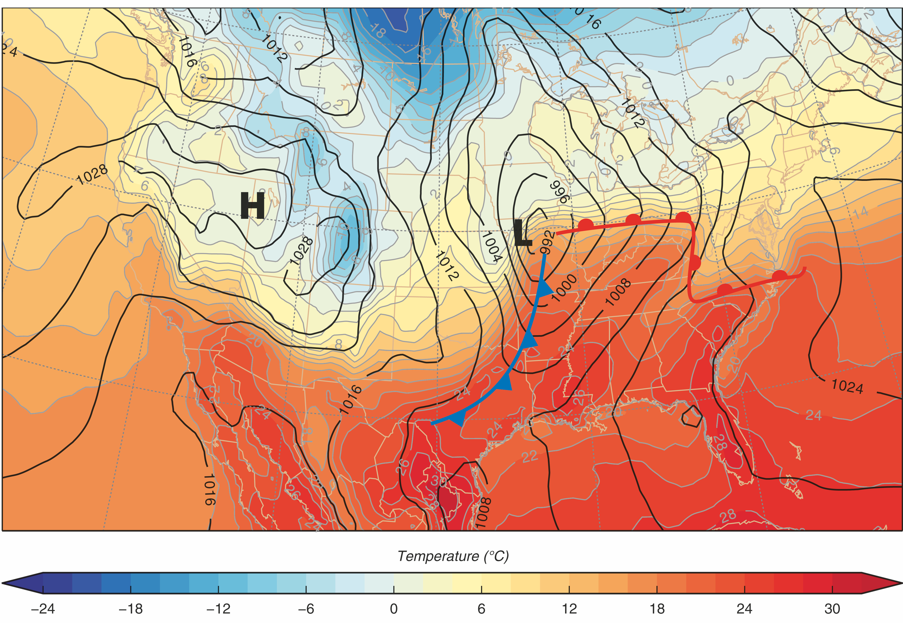
Surface Weather Map
Fig. 2.7
H&P
Isotherms, Isobars, Highs and Lows, and Fronts for 20140220 1800 UTC
We combine isotherms, isobars and fronts to construct a surface analysis.
Notes:
Analyze

Slide 12
More on the station model plots
and surface weather maps
throughout the course.
There is a D2L homework that provides practice
interpreting station model plots
and surface weather maps.
Notes:
Station Model and surface weather maps through the entire course
D2L homework on decoding station model plots and reading surface weather maps

Slide 13
So what’s happening above the surface?

Slide 14
It’s important to know.
Upper-level data and maps will be discussed in more detail throughout the course.

