Slide 1
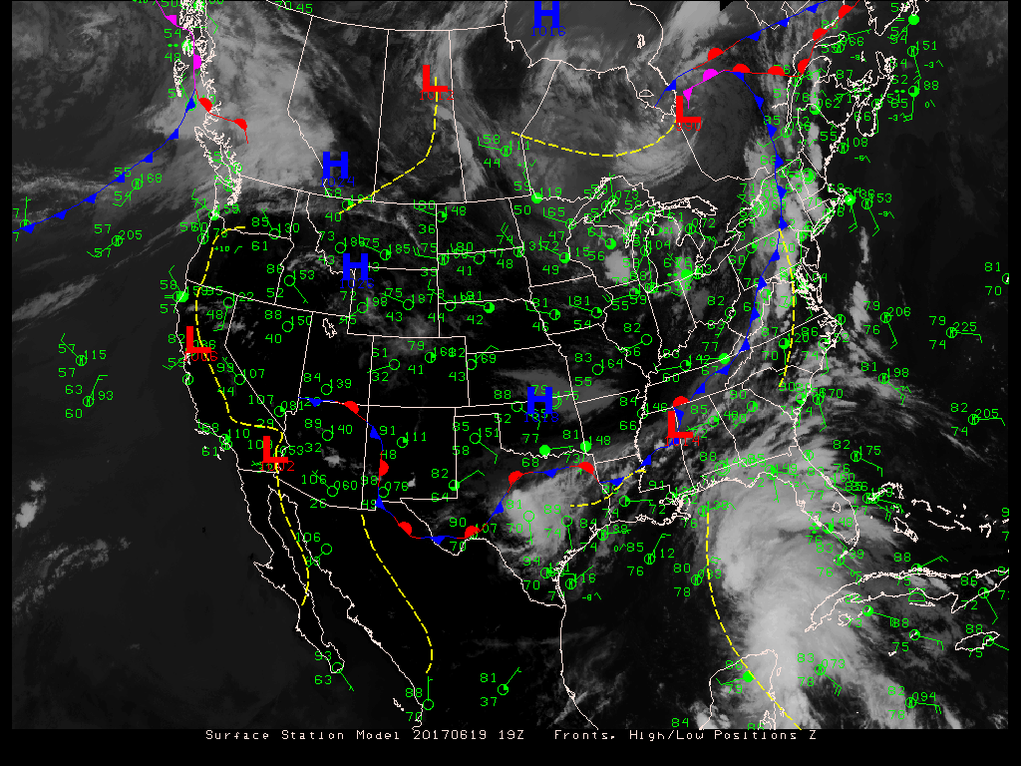

ATMO 170A1
Online
Spatial Representations of Data:
Surface Maps
(To activate links, open pptx file in show mode.)
Surface analysis for 20170619 19Z

Slide 2
Overview Goals
Weather
  Surface weather maps: how we display surface weather conditions across a region
Notes:
Two part overview
Part 1: How we communicate wx info
Part 2: What is climate? How are weather and climate related?

Slide 3

Learning Outcomes Addressed
1) Explain how the distribution of heating of the earth by the sun and energy transfer through the atmosphere drives weather and climate change.
2) Read surface weather maps and upper-air maps, and understand the connection between surface weather and conditions aloft in midlatitudes.
3) Recognize from weather maps commonly occurring, large-scale atmospheric phenomena, including midlatitude cyclones, upper-level troughs and ridges, jet streams, and trade winds, and their impact on local weather.
4) Identify commonly occurring, high-impact mesoscale weather phenomena such as severe thunderstorms and hurricanes, and recognize the larger-scale weather conditions in which they form.
5) Identify the primary cloud types and types of precipitation, and recognize their underlying formation mechanisms in terms of concurrent weather conditions.
6) Explain the impact that weather and climate have on life, and that life has on the evolution of the atmosphere and climate.
Notes:
Addressed to varying degree

Slide 4
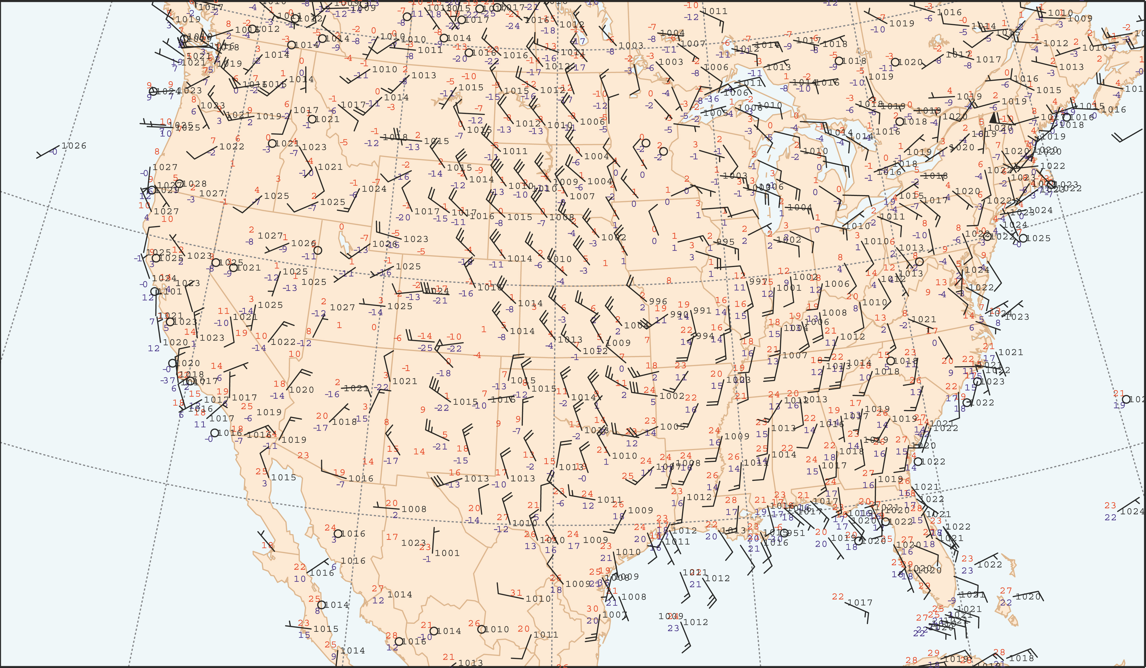
Surface map for 20140220 1800 UTC
Fig. 2.1
H&P
It can be difficult to comprehend the distributions of weather elements at a glance from a map with only station plots.
To address the situation, we analyze and complement surface plots with additional fields.

Slide 5
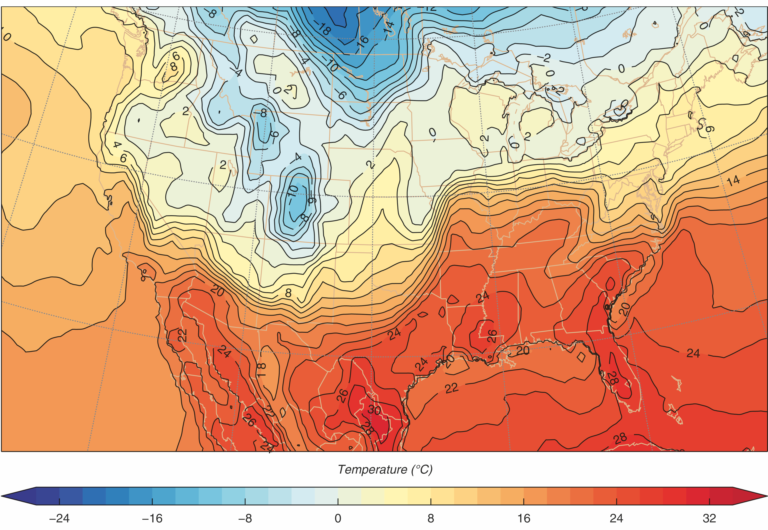
Surface temperature map for 20140220 1800 UTC
15 C in 300 km
Fig. 2.2
H&P
Color code the temperature field using intuitive color scale.
Cold colors (blues) => Cold temps.
Warm colors (reds) => Warm temps.
Notes:
Can easily identify:
Air masses => regions where temperatures are relatively uniform.
Fronts => regions of sharp temperature change

Slide 6
Surface temperature map for 20140220 1800 UTC
Fig. 2.2
H&P
Arrows => Wind directions from Fig. 2.1.
Blue shading => Region where colder air is replacing warmer air.
Red shading => Region where warmer air is replacing colder air.
Notes:
Arrows => Wind directions from Fig. 2.1.
Blue shading => Region where cold air mass is advancing toward warm air mass.
Red shading => Region where warm air mass is advancing toward cold air mass.

Slide 7
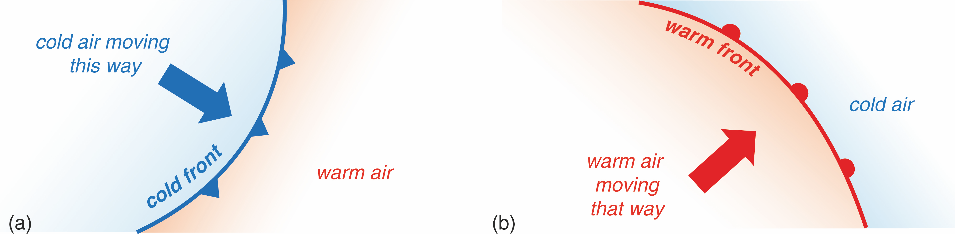
Representation of fronts on weather maps
Fig. 2.3
H&P
Leading edges of advancing air masses are designated by “fronts”.
Cold front => cold air mass advancing toward warm air mass.
Designated by blue line and triangles.
Triangles point in direction of movement.
Warm front => warm air mass advancing toward cold air mass.
Designated by red line and semicircles.
Semicircles point in direction of movement.
Notes:
Leading edges of advancing air masses are designated by “fronts”.
Cold front => cold air mass advancing toward warm air mass.
Designated by blue line and triangles.
Triangles point in direction of movement.
Warm front => warm air mass advancing toward cold air mass.
Designated by red line and semicircles.
Semicircles point in direction of movement.

Slide 8
Surface temperature map for 20140220 1800 UTC
Fig. 2.2
H&P
Arrows => Wind directions from Fig. 2.1.
Blue shading => Region where colder air is replacing warmer air.
Red shading => Region where warmer air is replacing colder air.
Notes:
Arrows => Wind directions from Fig. 2.1.
Blue shading => Region where cold air mass is advancing toward warm air mass.
Red shading => Region where warm air mass is advancing toward cold air mass.

Slide 9
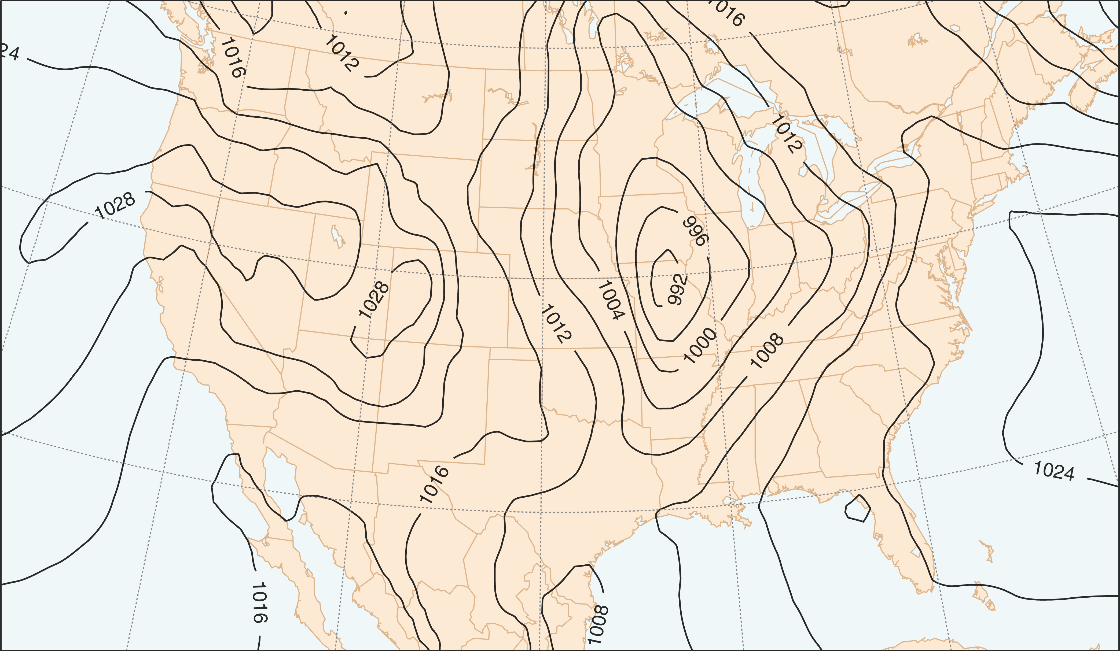
Isobars and Pressure Maps
Fig. 2.4
H&P
Isobars of SLP for 20140220 1800 UTC
It can be quite challenging to visualize the structure of the pressure field.
Hence, we contour observations to get a 2D portrait of the pressure field at the sea-level.
Contours of constant pressure are called ISOBARS.
Each isobar represents a specific value of SLP – typically at a 4 hPa interval.
The example has isobars at 992, 996, 1000, 1004, 1008, 1012, 1016, 1020, 1024, 1028 hPa.
Notes:
Analyze

Slide 10
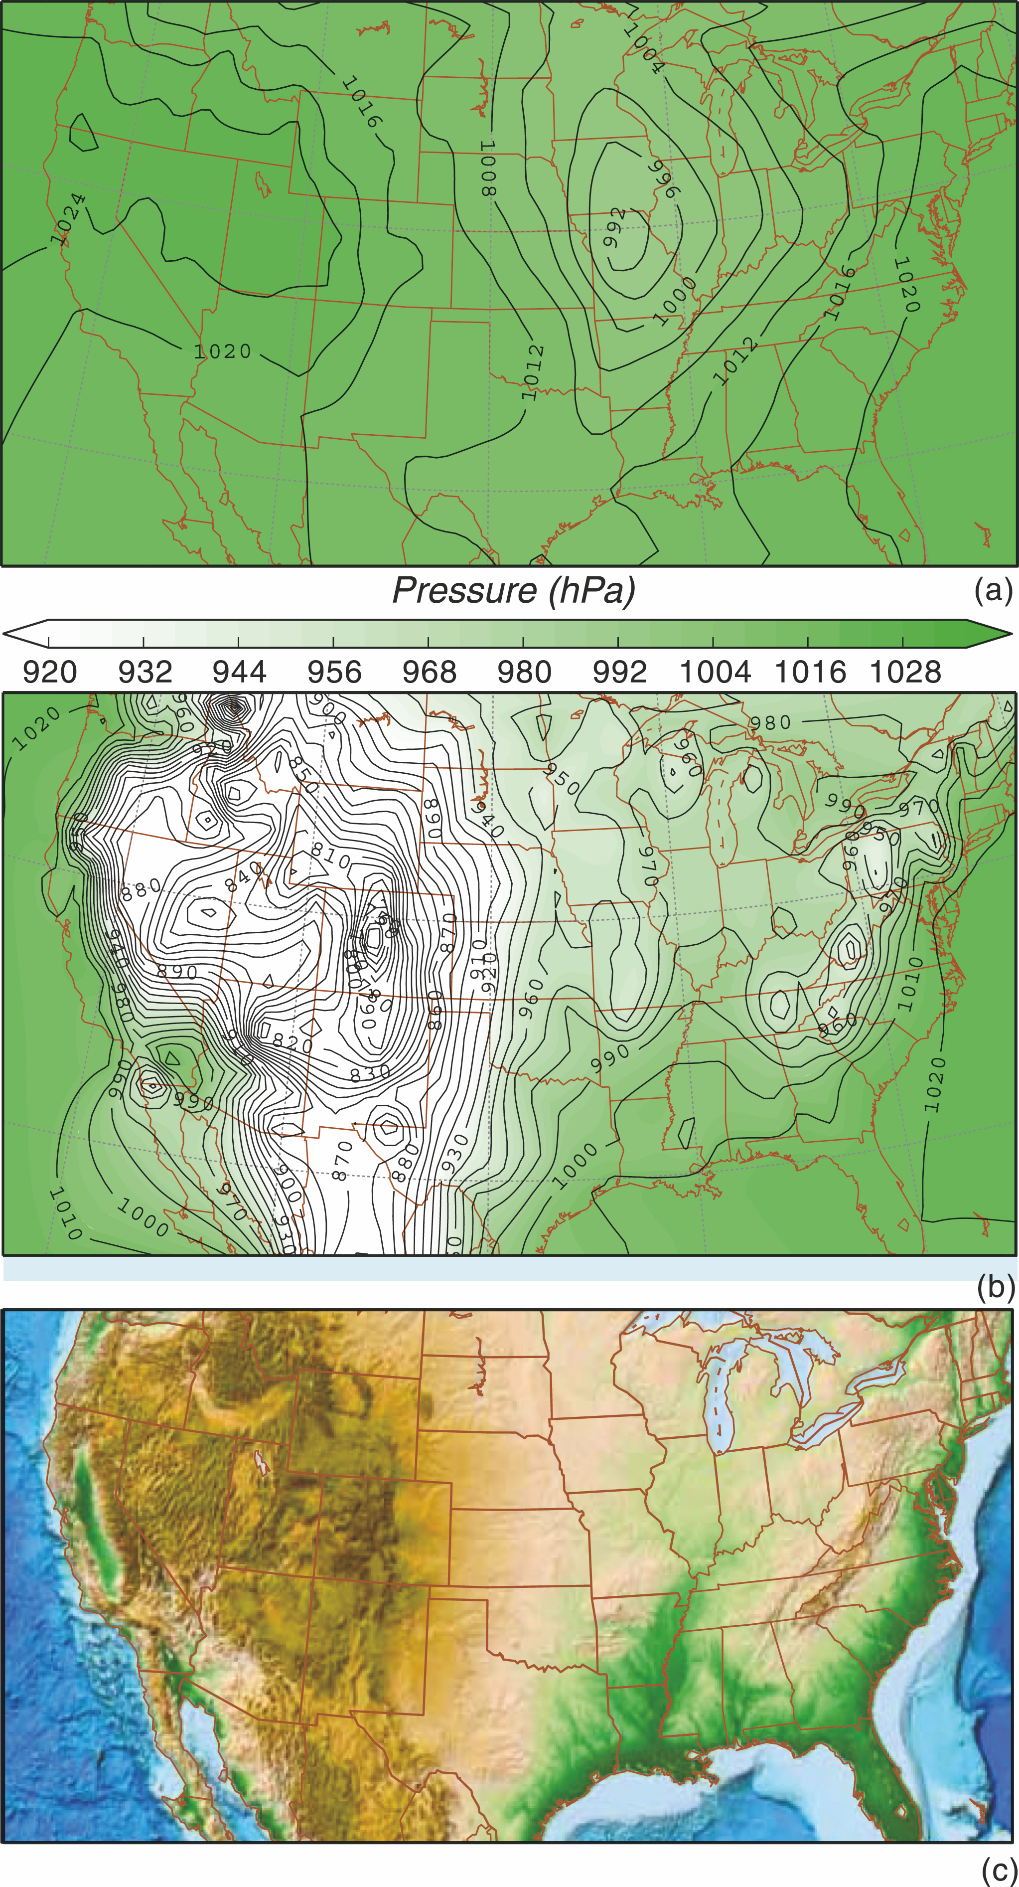
Adjustment of Pressure
to Mean Sea Level
Winds are caused by horizontal pressure variations, but pressure decreases far more rapidly upward than it changes horizontally
Pressure decreases by about 1 hPa for every 10 m increase in altitude, but it only changes on the order of 1 hPa every 100 km at mean-sea-level.
Differences in station pressures over land primarily reflect differences in station elevation, and not horizontal changes in pressure. See middle and bottom panels of Fig. 2.2.1.
To address the situation, we adjust station pressures to mean-sea-level. See top panel of Fig. 2.2.1. Note how much smaller the adjusted pressure differences are compared to the unadjusted pressures.
Pressures adjusted to mean-sea-level
Unadjusted pressures
Fig. 2.2.1
H&P
Topography
Notes:
Analyze

Slide 11
Adjustment of Pressure
Tucson Example
Elevation of Tucson is approximately 810 m.
Surface pressure runs between 925-930 hPa. (Smaller summer. Higher winter.)
To adjust station pressure of 930 hPa to sea-level-pressure, we would add an 81 hPa adjustment (1 hPa every 10 m) to the station pressure of 930 hPa to get a SLP of 1011 hPa.
Pressures adjusted to mean-sea-level
Unadjusted pressures
Fig. 2.2.1
H&P
Topography
Notes:
Analyze

Slide 12
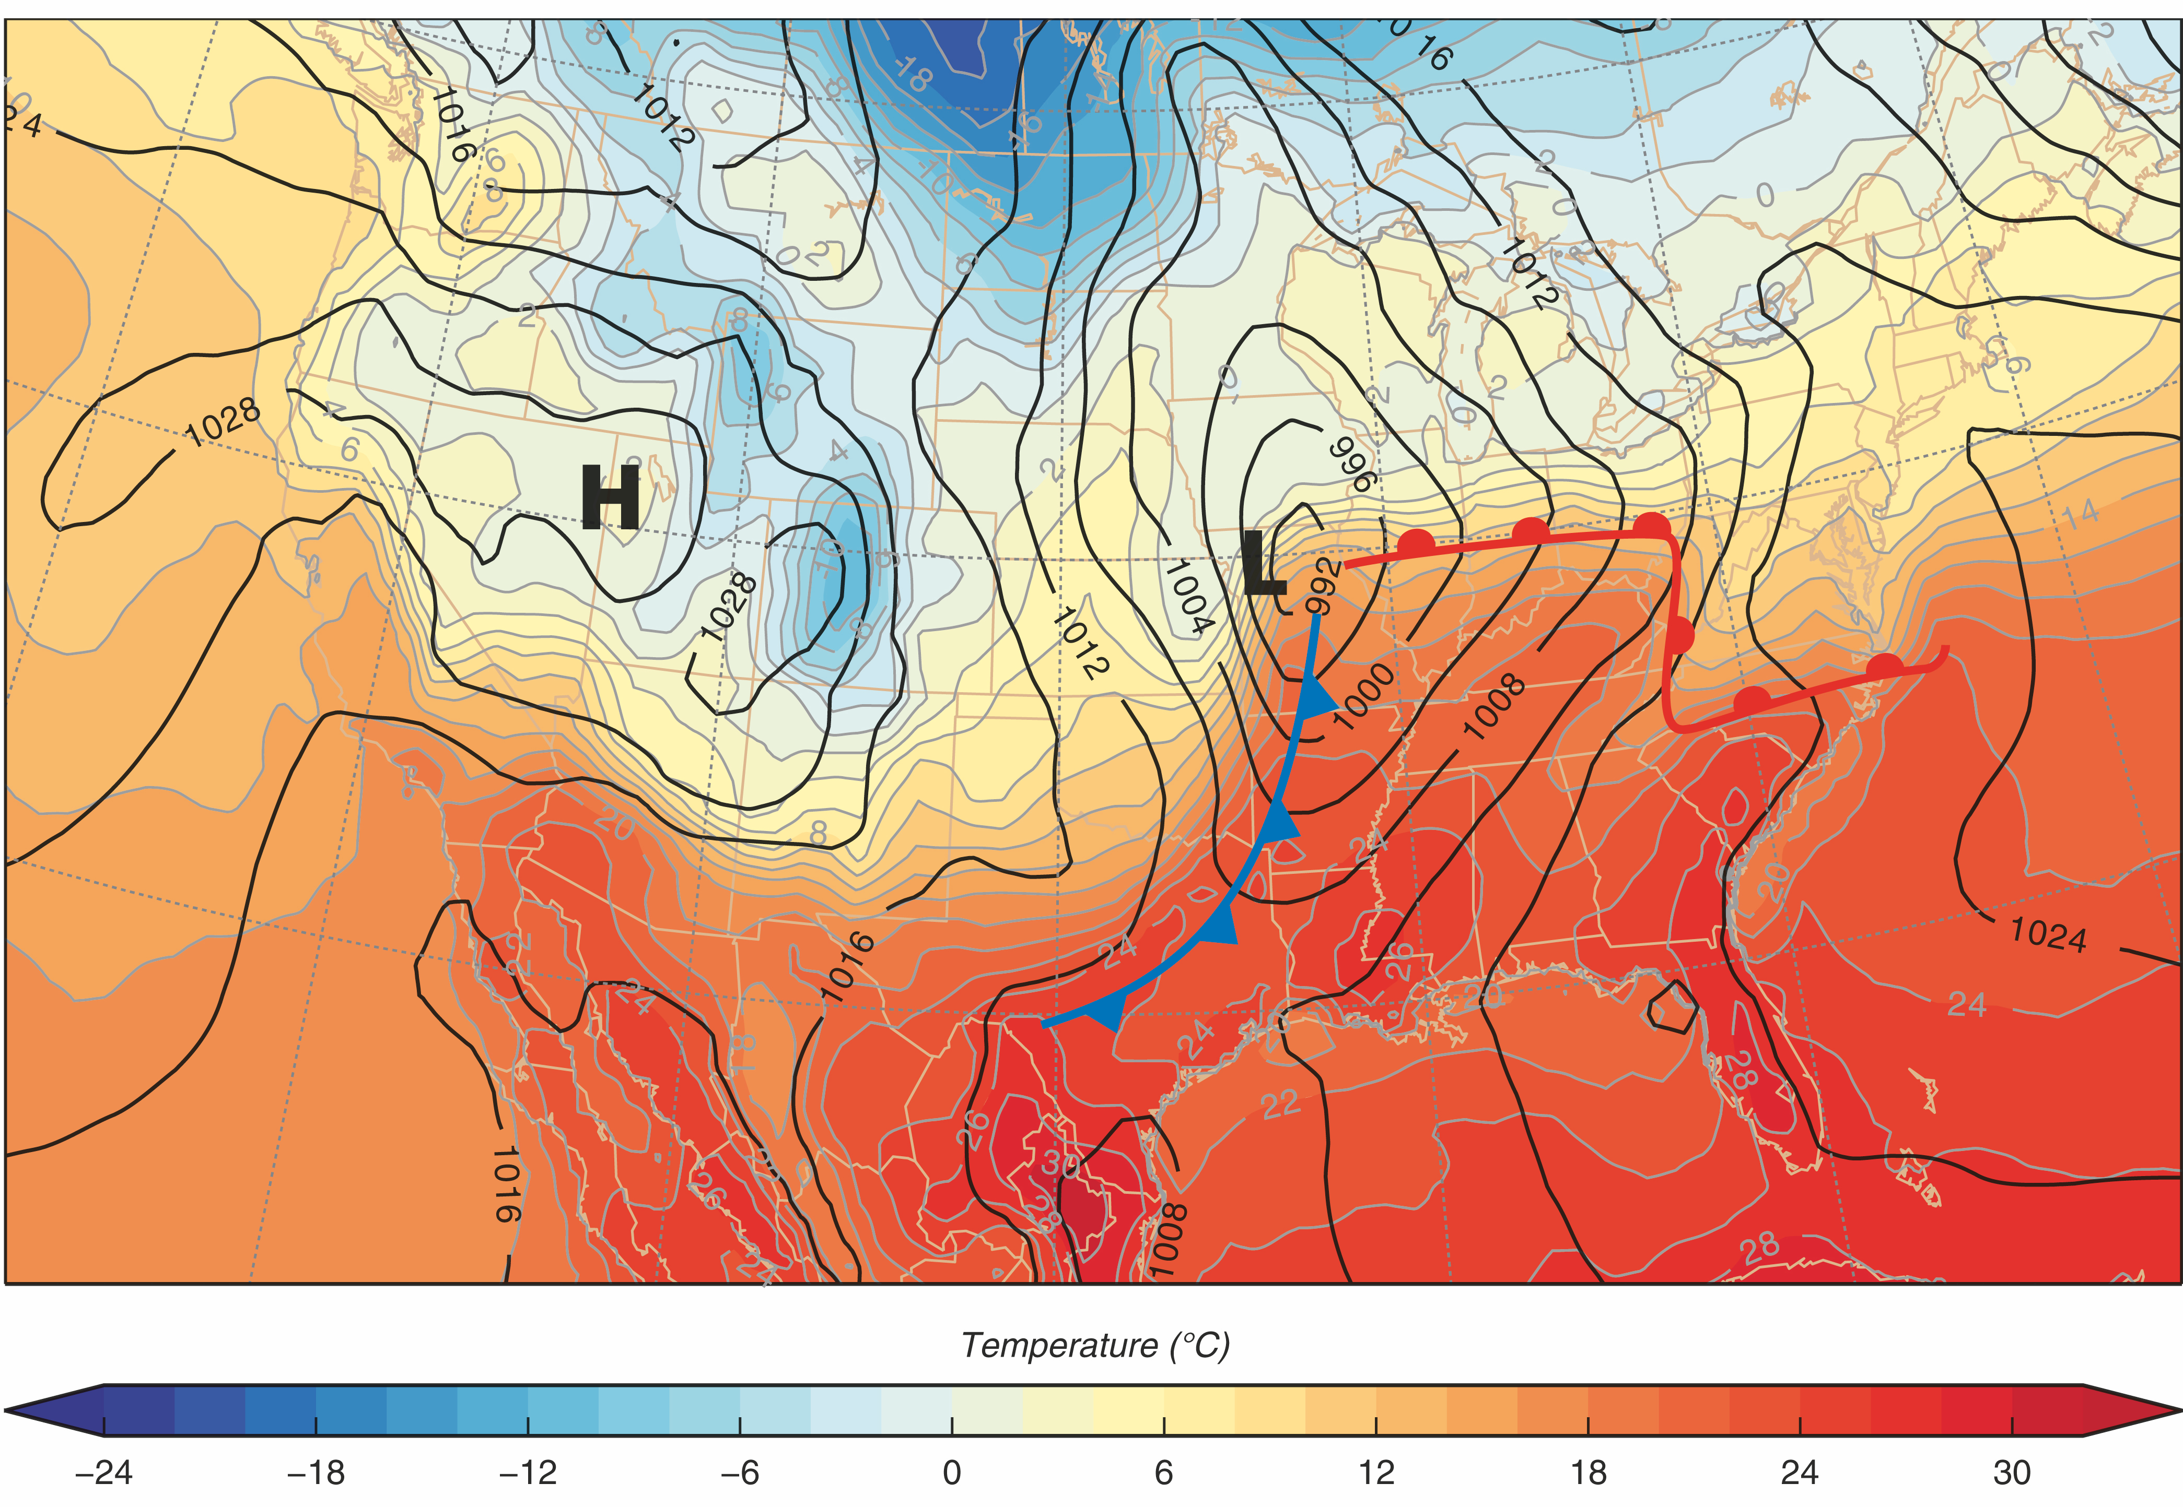
Surface Weather Map
Fig. 2.7
H&P
Isotherms, Isobars, Highs and Lows, and Fronts for 20140220 1800 UTC
We combine isotherms, isobars and fronts to construct a surface analysis.
Notes:
Analyze

Slide 13
More on the station model plots
and surface weather maps
throughout the course.
There is a D2L homework that provides practice
interpreting station model plots
and surface weather maps.
Notes:
Station Model and surface weather maps through the entire course
D2L homework on decoding station model plots and reading surface weather maps

Slide 14
So what’s happening above the surface?

Slide 15
It’s important to know.
Upper-level data and maps will be discussed in more detail throughout the course.

Slide 16
This ends the presentation.

Slide 17
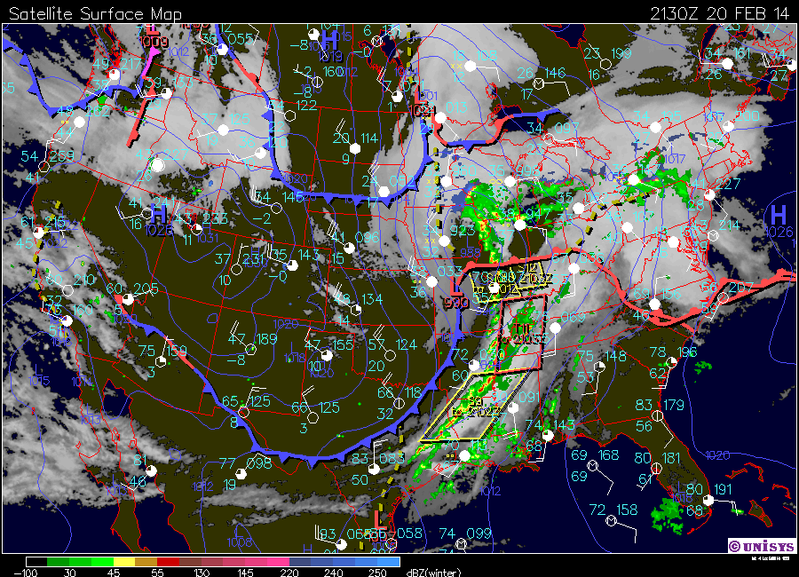
ATMO 170A1
Online
Adjustment to Sea-Level-Pressure
Composite surface map with isobars, radar reflectivity, and satellite imagery
hhttp://www.atmo.arizona.edu/gifs/USPLOT.GIF/

Slide 18
Overview Goals
Adjusting station pressures to pressure at mean sea-level (MSL) for land stations.
Define a fast, easy way to make the adjustment.
Sea Level Pressure ⟹ SFC Maps

Slide 19
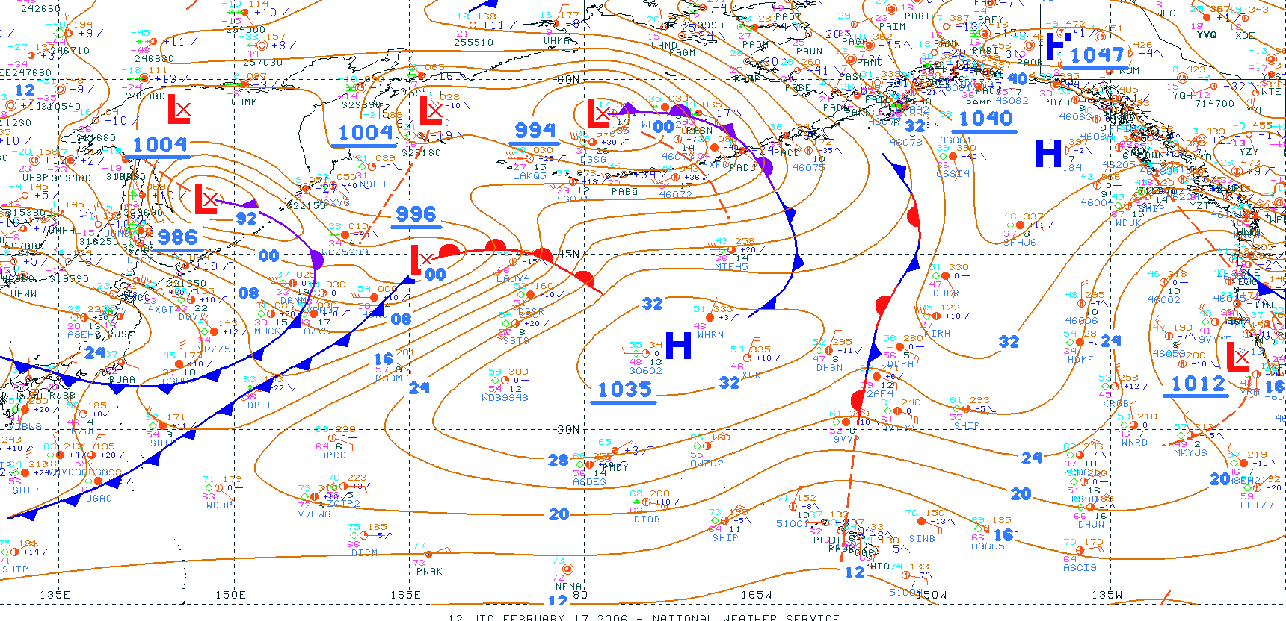
North Pacific Surface Analysis
(isobars every 4 mb)
3000 km
Pressure varies by 1 mb per 100 km horizontally
0.0001 mb per 10 m
Notes:
Surface map for North Pacific Ocean.
We see red L’s and blue H’s denoting centers of low pressure and high pressure. Underlined values (in blue) next to L’s and H’s are SLP at center of low/high.
Cold fronts are blue w/triangle; warm fronts are red w/semicircles; occluded fronts are purple.
Gold contours are isobars (contours of constant pressure). Lines are every 4 mb, divisible by 4.
24=>1024 mb. 16=>1016 mb. 92=>992 mb.
Fine dotted lines are latitude and longitude lines, spaced every 15 degrees. 1˚ latitude is a little more than 100 km. (111 km to be precise).
Note spacing between isobars (4 mb intervals). It varies from very tight near deep low pressure centers, to very wide around high pressure centers.
A typical value for the spacing is around 1 mb every 100 km.
There are several weather station plots for ships at sea. They directly measure pressure at MSL.
Drawing isobars solely from ship reports over the oceans would be straightforward.
Not the case for stations over land. They are not at MSL, but the report SLP. How do they “measure” SLP over land?

Slide 20
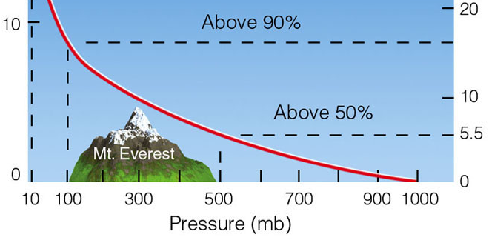
Review: Pressure-Height
Contrast horizontal and vertical change of pressure
Pressure falls very rapidly with height near sea-level
3,000 m 701 mb
2,500 m 747 mb
2,000 m 795 mb
1,500 m 846 mb
1,000 m 899 mb
500 m 955 mb
0 m 1013 mb
1 mb per 10 m height
46
48
51
53
55
58
Ahrens & Hanson
Consequently………. Pressure changes from differences in station altitudes dominate horizontal changes
by a factor of 10,000 (10⁴)
Notes:
Let’s look at the issue of how pressures vary over land.
We know that pressure decreases with increasing elevation at the rate of approximately 1 mb per 10 meters.
A small change in elevation between land stations would dominate horizontal differences at MSL.
So how is SLP over land computed where station pressure is measure, elevations can be 1000’s of meters above MSL?
We examine that issue next.

Slide 21
For every 10 m increase in altitude …
Pressure decreases by about 1.0 mb
For every 10 m change in position at MSL …
SLP changes on average by 0.0001 mb
“Signal to Noise” ratio of 0.01%
Notes:
To summarize….
10 m increase in height => pressure falls by 1.0 mb
10 m displacement at MSL => SLP changes by 0.0001 mb (one-tenth thousandth)
We need to measure a signal that is 0.01% the size of the noise.

Slide 22
The Challenge
  Horizontal pressure differences must be known to infer the force that Produces the horizontal wind
Poses a challenge over land where Elevations of weather stations can differ by 100’s to 1000’s of meters!

Slide 23
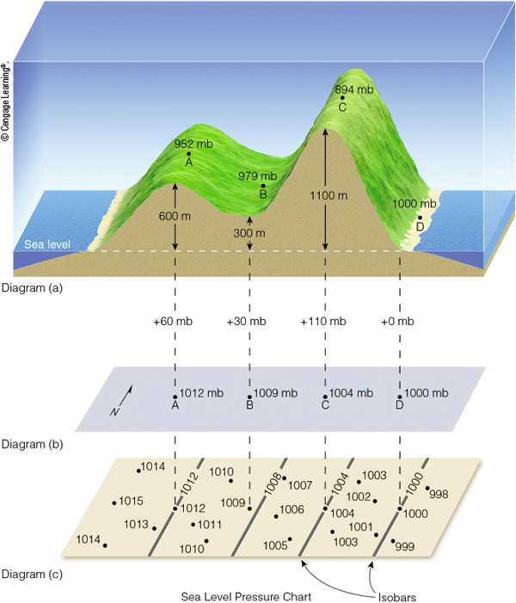
Station Pressure
Ahrens & Hanson
Station pressure differences mainly reflect height differences
Vertical pressure changes near sea-level are 1 mb per 10 m
Horizontal pressure changes at sea-level are 1 mb per 100 km
We reduce station pressures to a standard horizontal level:
Mean Sea Level

Slide 24
Reduction of Station Pressure to
Mean-Sea-Level
Ahrens & Hanson
To adjust station pressures to a Sea Level Pressure
Make altitude correction of 1 mb per 10 m elevation

Slide 25
The Magic Rule
  For every 10 m of elevation above MSL
  Add 1 mb to the station pressure

Slide 26
Correction for Tucson
Elevation of Tucson AZ is approximately 810 m
Station pressure at Tucson was 926 mb (late August)
So SLP for Tucson would be
SLP = 926 mb + (1 mb / 10 m) × 810 m
SLP = 926 mb + 81 mb = 1007 mb (1006.5 mb)

Slide 27
Correction for Denver
Elevation of Denver CO is approximately 1660 m
Station pressure at Denver was 833 mb (8-24-17)
So SLP for Denver would be
SLP = 833 mb + (1 mb / 10 m) × 1660 m
SLP = 833 mb + 166 mb = 999 mb (1017.2mb)
The accuracy of the 1 mb per 10 m adjustment worsens as the elevation of the station increases

Slide 28
How is SLP actually estimated?
Actual pressure corrections take into account temperature and pressure-height variations that vary by location, time of day and past weather, but 1 mb per 10 m is close enough to use for now.

Slide 29
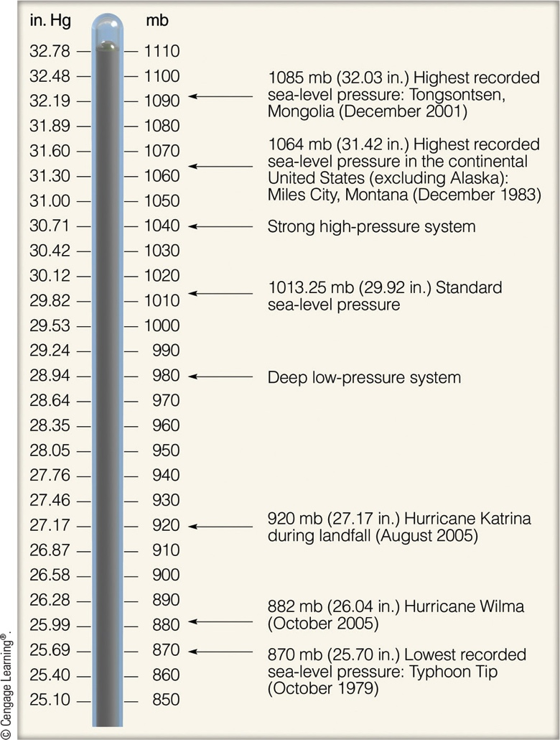
SLP Values
Ahrens & Hanson
Notes:
29
SLP lies between 950-1050 mb more than 99.9% at any time or location.
When it lies outside these limits, it will be obvious by looking at weather maps and satellite images.

Slide 30
PGF
Notes:
Altitude adjustments allow one to infer the PGF from station pressures over land, which is this case is directed from the left coast to the right coast.
Direction of Pressure Gradient Force is indicated by the red arrow.

Slide 31
This ends the presentation.

