Slide 1
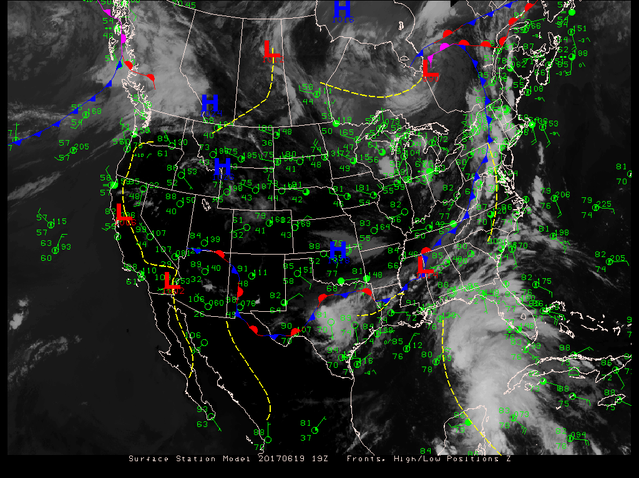

ATMO 170A1
Online
Surface Weather Stations
(To activate links, open pptx file in show mode.)
Surface analysis for 20170619 19Z

Slide 2
Overview Goals
Weather vs. Climate
Part I
  Define weather and weather elements
  Where are surface weather observations taken
Part II
  How does weather differ from climate?
  How are weather and climate related?
Notes:
Two part overview
Part 1: How we communicate wx info
Part 2: What is climate? How are weather and climate related?

Slide 3
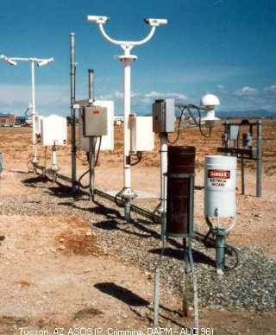
What is Weather?
Weather – Atmospheric conditions for a specific location and time
Weather Elements
Temperature
Wind
Pressure
Precipitation Amount
Humidity (Dew Point)
Visibility
Clouds/Ceiling
Significant Weather
An Automated Surface Observing System (ASOS),
like the one at Tucson International Airport (KTUS)
Notes:
Weather Elements
Explain each element
Most observations are automated. Exception is some types of Significant Weather

Slide 4
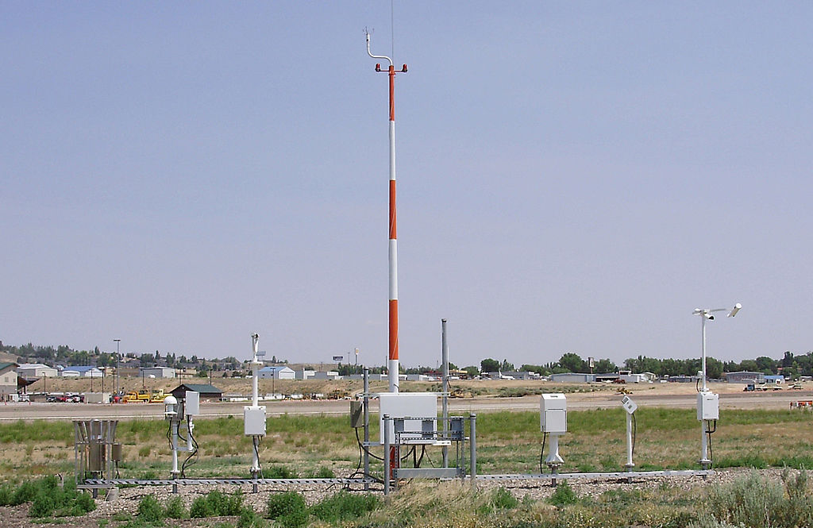
ASOS: Automated Surface Observing Station
ASOS at Elko NV
Wind
Visibility
Weather
Dew Point
Freezing Rain
Temperature
Ceiling
Precipitation

Slide 5
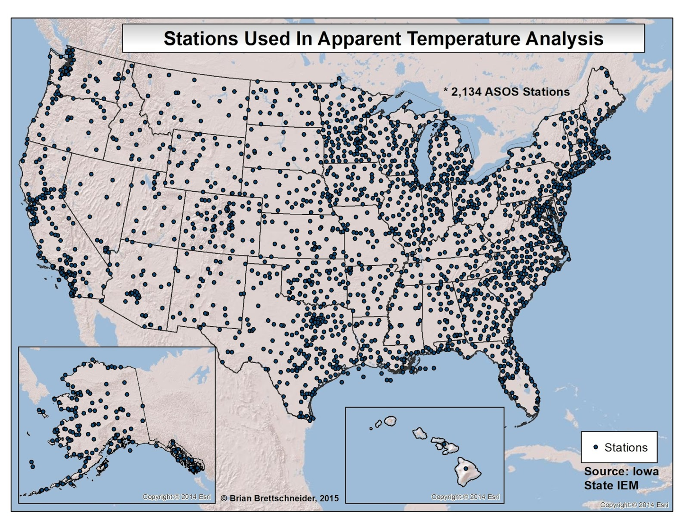
ASOS Locations and Current Observations for Every State
Figure Credit
Akin to 1.21 H&P
Notes:
Network of automated weather stations funded by Federal Government

Slide 6
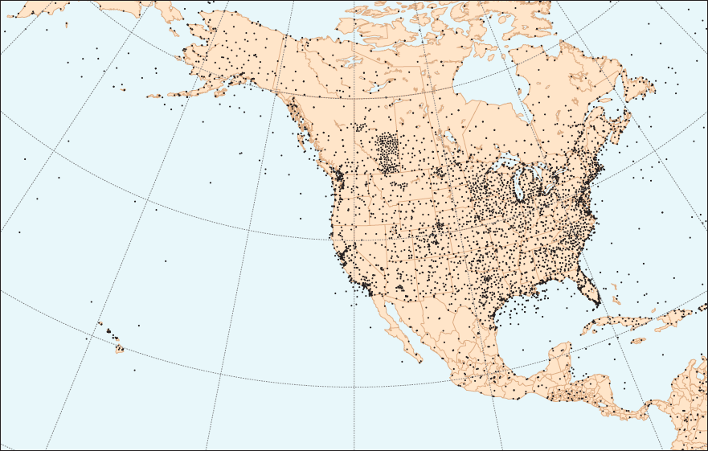
Map showing the distribution of land-based stations and weather buoys in and around North America.
Fig. 1.21 H&P
Notes:
Network of automated weather stations funded by Federal Government

Slide 7
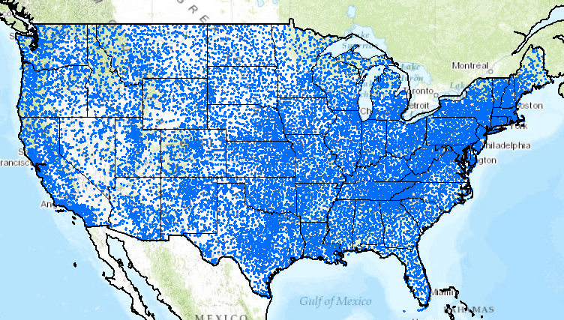
Cooperative Observers Program Stations
More than 12,000 sites that take weather obs in contiguous U.S.
Figure Source
https://www.climate.gov/maps-data/primer/processing-climate-data
Notes:
Network of coop sites sponsored by private sector and citizens.
About 12,000 coop sites across U.S.

Slide 8
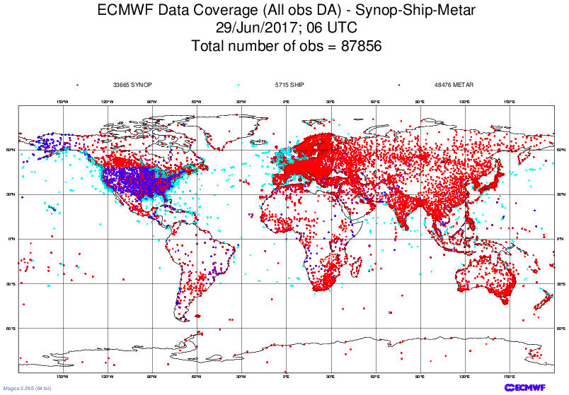
Surface obs (land and ships) used to start a weather forecast model
Notes:
Land and ships obs that were used to start weather forecast model.
88,000

Slide 9
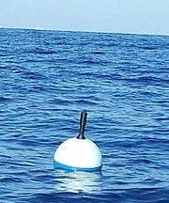
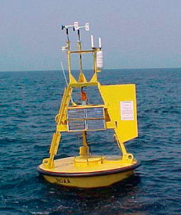
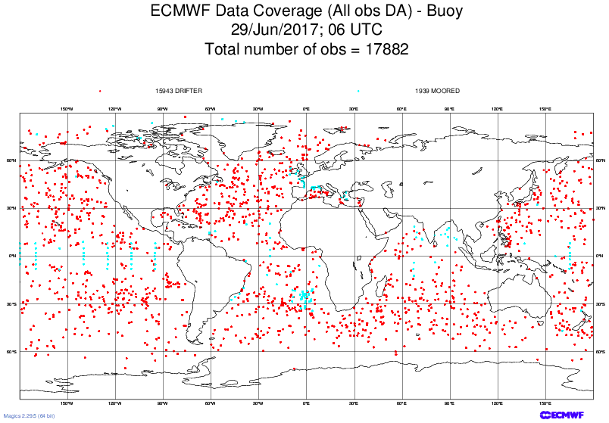
Drifter
Moored
Buoy observations used to start a weather forecast model
Notes:
Buoy data used to start weather forecast.
Unmanned weather stations on buoys.
Common obs are temperature, dew point, SLP, winds, SST and waves.
18,000

Slide 10
Synop-Ship-Metar-Buoys
Surface obs (land and ships) used to start a weather forecast model
Buoy observations used to start a weather forecast model
Notes:
Buoy data used to start weather forecast.
Unmanned weather stations on buoys.
Common obs are temperature, dew point, SLP, winds, SST and waves.
18,000

Slide 11
Approximately 100,000 surface observations are used to start weather forecast models.
Thousands of other observations are also taken that are not used to start models, but they provide invaluable data for monitoring weather and climate.

Slide 12
This is a natural point to take a break if you need a breather before tackling the next 11 minutes of the presentation

Slide 13
How do meteorologists and forecasters communicate weather conditions?
We use weather maps
Combination of digits and symbols

Slide 14
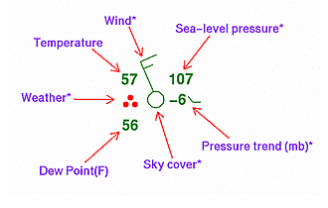
Surface Station Model
Responsible for knowing every parameter
Station located at center of circle.
Weather Elements
Temperature
Wind
Sea-level Pressure
Pressure Tendency
Sky Cover
Dew Point
Significant Weather
Figure Credit: NOAA
Decoding Station Model
http://www.wpc.ncep.noaa.gov/html/stationplot_printer.html
Practice from CIMMS
http://profhorn.aos.wisc.edu/wxwise/station/page5.html
Note: Cloud cover answer to #1 not correct.
Notes:
Figure shows a representative example of a surface station plot.
Following wx elements are reported. Going clockwise and starting with the UL corner:
Temp (upper left quadrant) Nearest degree Fahrenheit in U.S.
Dew point (lower left quadrant)
SLP (upper right quadrant)
Pressure change (to the right of circle)
Sky Cover (shading of circle)
Weather (symbol to left of circle)
Wind Direction (line extending from circle)
Wind Speed (segments perpendicular to wind direction

Slide 15
Temperature and Dew Point
Temperatures
Plotted to nearest degree °F in U.S. (°C elsewhere)
Station plots shows
Temp = 57°F
Dew Point = 56°F
Figure Credit: NOAA
Decoding Station Model
http://www.wpc.ncep.noaa.gov/html/stationplot_printer.html
Practice from CIMMS
http://profhorn.aos.wisc.edu/wxwise/station/page5.html
Notes:
Consider temperature and dew point
Simplest fields to read
Temp (upper left quadrant) Nearest degree Fahrenheit in U.S.
Dew point (lower left quadrant)

Slide 16
Sea Level Pressure (SLP)
Sea Level Pressure
- Average SLP value is 1013 mb
- SLP typically lies between 950 mb – 1050 mb
- SLP measured to nearest tenth of mb
(e.g. 1010.7 mb)
- Only last three digits are plotted without decimal point
Examples:
  1003.8 mb plotted as 038
  988.7 mb plotted as 887
  1036.1 mb plotted as 361
.
✗
10
✗
✗
Figure Credit: NOAA
Station plot shows SLP of 1010.7 mb.
Two steps required to decode SLP.
1) Put decimal point between 2nd and 3rd digits
2) Next place a 9 and 10 in front of 3 digits.
Answer the question, “Is 910.7 mb or 1010.7” closer to 1013?”
Best choice: 1010.7 mb
Notes:
How to decode SLP
Most challenging parameter to decode for many students
Preliminary facts.
SLP has average value of 1013 mb.
It typically lies between 950 mb - 1050 mb.
Two steps are needed to decode SLP on weather maps.
Place decimal point between 2nd and 3rd digit
Place a 9 or 10 to front of string. Ask the following question:
“Is 910.7 or 1010.7 closer to 1013 mb?”
Pick value closest to 1013 mb.

Slide 17
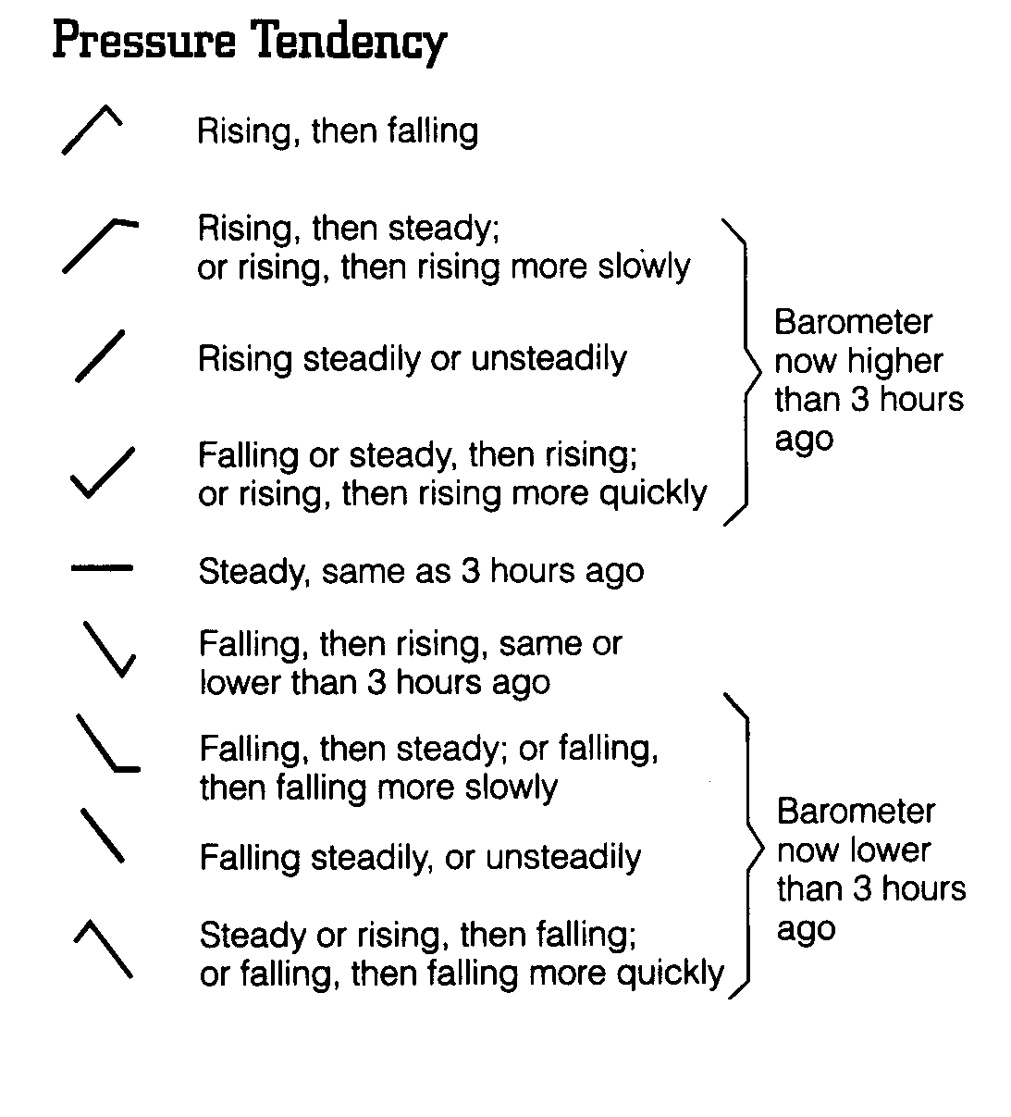
Pressure (Barometric) Tendency
Gives change in station pressure during the prior 3 hours
Units are tenths of a mb
Only plotted every 3rd UTC* hour
Ahrens and Hanson 8th
Figure Credit: NOAA
Recognize symbol types for rising, falling, and steady
Plot shows -0.6 mb, falling then steady
*Information on UTC time is a separate document
Notes:
Pressure Tendency. Also called Barometric Tendency.
Gives pressure change for prior 3 hours at station pressure.
Value in tenths of millibars. Followed by symbol
Rising or fall determined by trailing symbol
Plots shows -0.6 mb, falling then steady

Slide 18
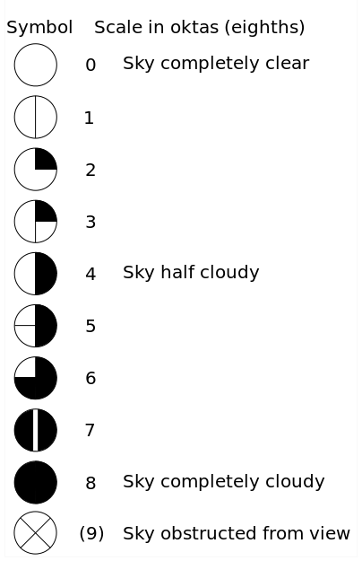
Sky Cover
Total Cloud Cover
Given in eighths of sky covered or oktas.
CLR (0/8’s)
FEW (1/8 - 2/8’s)
SCT (3/8 – 4/8’s)
BKN (5/8 - 7/8’s)
Figure Credit: NOAA
OVC (8/8’s)
Station plot shows clear skies.
Figure Credit
Notes:
Sky Cover
Gives total amount of sky cover in eighths
Amount of shading defines fraction of sky directly overhead that is covered by cloud
INTUITIVE. More shading => More coverage
Plot shows clear skies

Slide 19

Wind Direction
Compass direction from which wind is blowing.
NORTHERLY
From the north
The wind is in my face.
I am facing east.
The wind is easterly.
EASTERLY
From the east
360°
🐧
90°
270°
WESTERLY
From the west
180°
SOUTHERLY
From the south
Notes:
Wind Direction
Symbol gives compass direction from which wind is blowing.
Face the wind directly. Determine compass direction that you are facing. That defines the wind direction.

Slide 20
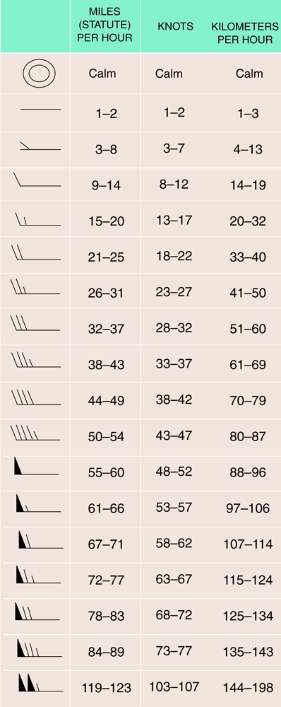
Wind Speed
How to read:
Half barb = 5 knots*
Full barb = 10 knots
Flag = 50 knots
Speed is sum of barbs and flags
*1 knot = 1 nautical mile per hour = 1.15 mph
= 1.85 km/hr
= 0.51 m/sec
75
= ______ knots
50+10+10+5
Ahrens and Hanson 8th
Notes:
Wind symbols
Shows speed and wind direction
Speed given in knots. 1 knot = 1.15 mph = 1.85 km/hr

Slide 21

Wind Direction and Speed
Station plot shows
Direction from the north-northwest
(Penguin is looking toward NNW)
Speed of 15 knots
(one full barb; one half barb)
Figure Credit: NOAA
Notes:
Plots shows
Speed 15 knots
Direction from NNW

Slide 22
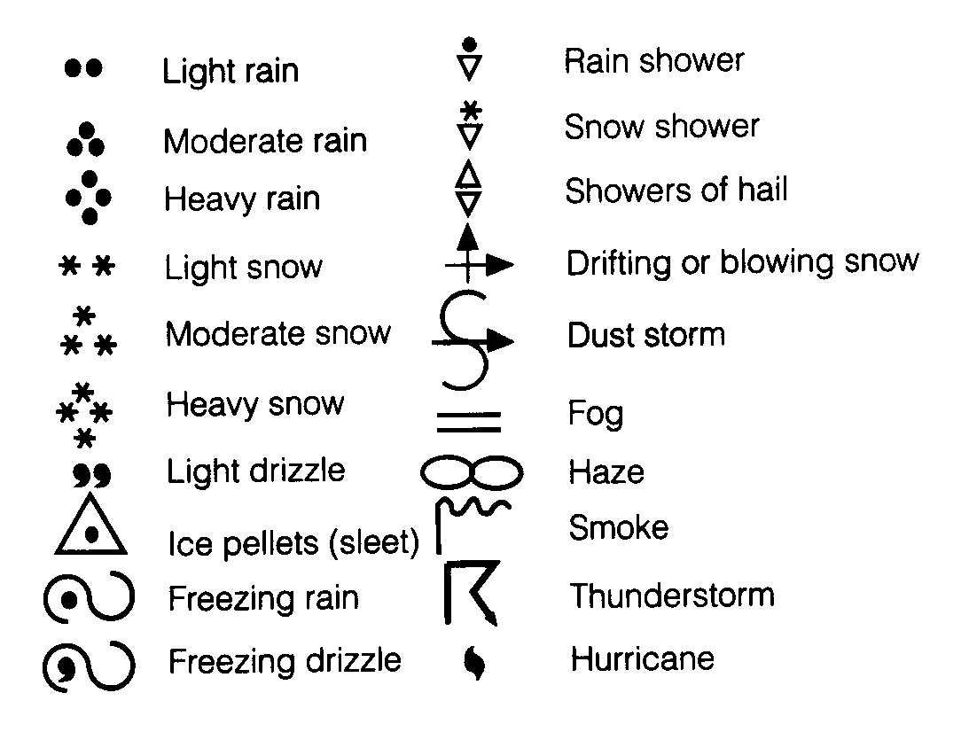
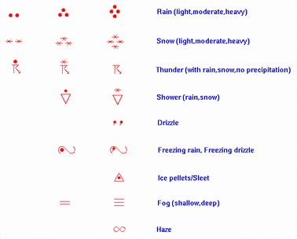
Weather Symbols
Common Weather Symbols
Figure Credit: NOAA
Ahrens and Hanson 8th
Station plot shows moderate rain.
Not responsible for knowing all 100 weather symbols, but you need to recognize the most common weather symbols such as rain, snow, showers, thunderstorms, fog, freezing rain, haze, dust storm, etc.
Notes:
Significant weather symbols
Symbol denote weather at time of observation
100 unique symbols are used
Not responsible for knowing every symbol
But know types of observations
Map shows moderate rain

Slide 23
Practice Surface Station
988
I recommend that you pause the presentation and attempt to decode the station model before advancing to the next slide with the solution
42
••
18
+35
What are Temp, Dew Point, SLP, Cloud Cover, Wind Speed and Direction, Pressure Tendency?
Decoding Station Model http://www.wpc.ncep.noaa.gov/html/stationplot_printer.html

Slide 24
Solution to Practice Surface Station
Temperature
42°F (°F on U.S.)
Dew Point Temperature
18°F
Wind Speed & Direction
15 knots from SW
Cloud Cover
5/8’s (5 oktas)
Significant Weather
Light rain
Pressure Tendency
3.5 mb, rising steadily
42
988
••
18
+35
What are Temp, Dew Point, SLP, Cloud Cover, Wind Speed and Direction, Pressure Tendency?
Decoding Station Model http://www.wpc.ncep.noaa.gov/html/stationplot_printer.html
Notes:
Temp: 42F
Dew point: 18
Wind: 15 knots from SW
Cloud Cover: 5/8’s
3-hour Pressure Change: 3.5 mb, rising steadily
(Some maps don’t show sign, only the trailing symbol)

Slide 25
Solution to Practice Surface Station
Sea Level Pressure
SLP averages 1013 mb
Typically lies between
950 mb - 1050 mb
Nearest tenth of mb
Decimal not shown
Leading 10 or 9 dropped
42
988
••
18
+35
What are Temp, Dew Point, SLP, Cloud Cover, Wind Speed and Direction, Pressure Tendency?
Place decimal between 2nd and 3rd digits (98.8)
Ask yourself, “Is 998.8 or 1098.8” closer to 1013?”
SLP is 998.8 mb
Notes:
How to decode SLP
Place decimal point between 2nd and 3rd digit
Add 10 or 9 to front of string.
Is 998.8 or 1098.8 closer to 1013 mb?
Pick value closest to 1013 mb.

Slide 26
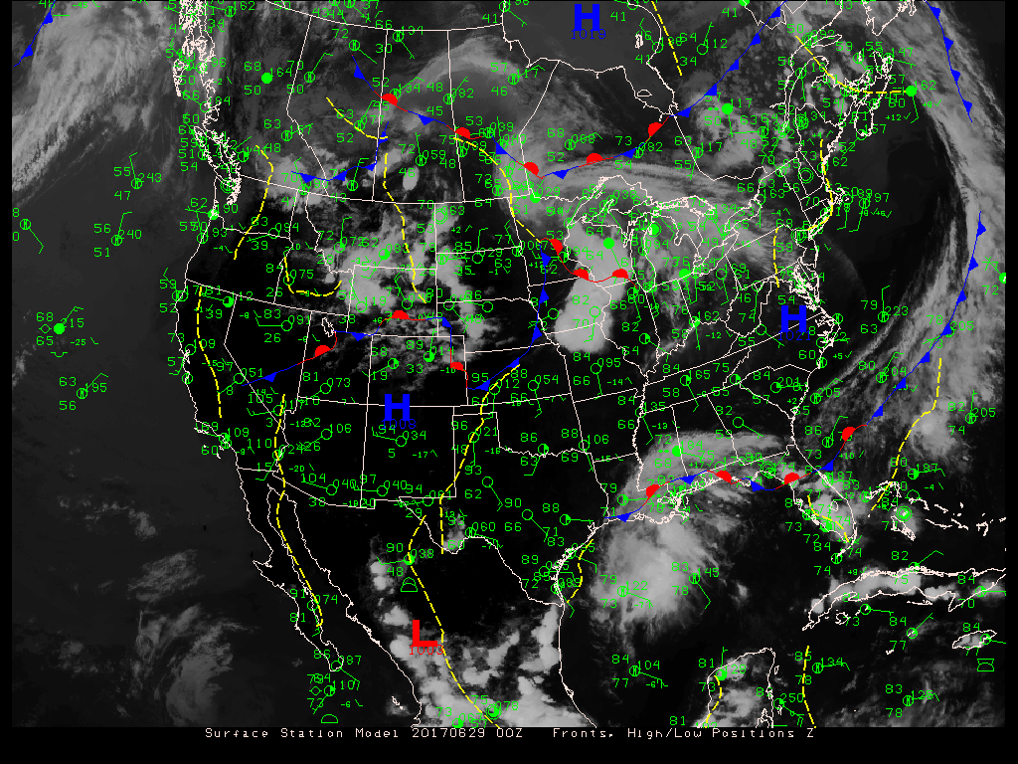
20170629 0000 UTC
Current Station Hourly Map with Fronts, High/Low Positions, IR Satellite Imagery
Current Surface Map from NOAA: https://www.wpc.ncep.noaa.gov/sfc/namussfcwbg.gif
https://www.wpc.ncep.noaa.gov/html/sfc2.shtml
Notes:
Weather map from ATMO Web Page.
Link to current map is shown.
Link to the current 3-hourly map of NWS is also shown.

Slide 27
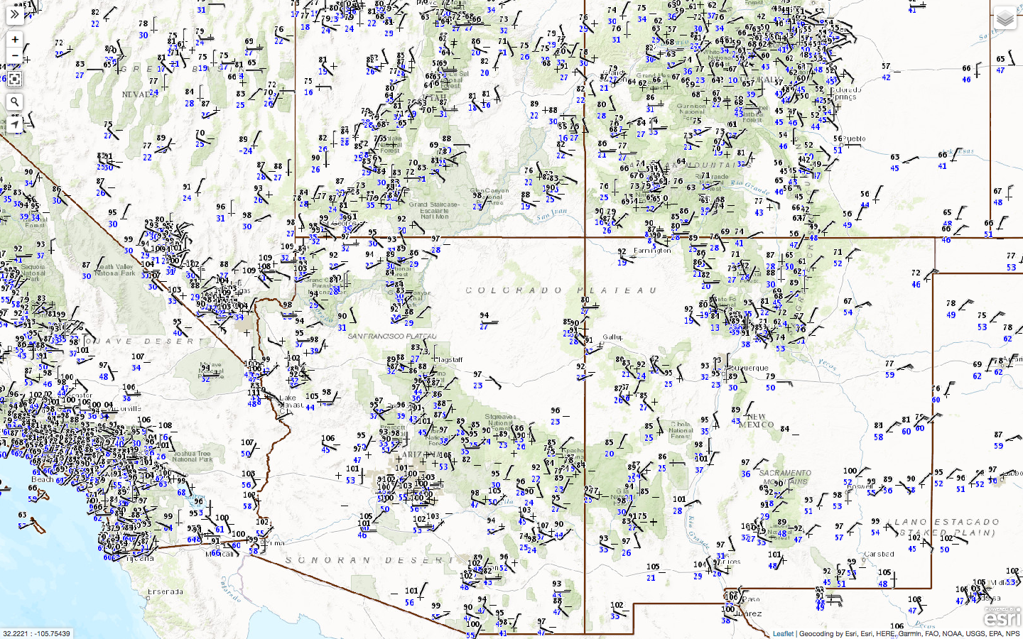
Surface Plots 20170623 1900 UTC
http://www.wrh.noaa.gov/map/?obs=true&wfo=twc&basemap=OpenStreetMap&boundaries=true,false&obs_popup=true
Link to current surface map for the Southwest
Notes:
Map shows some the weather observations available over Southwest from NWS.
Link to site given at top of page.

Slide 28
More on the station model plots
and surface weather maps
throughout the course.
There is a D2L homework that provides practice
interpreting station model plots
and simple surface weather maps.
Notes:
Station Model and surface weather maps through the entire course
D2L homework on decoding station model plots and reading surface weather maps

Slide 29
So what’s happening above the ground?

Slide 30
It’s important to know.
Upper air data and maps will be discussed in more detail throughout the course.

