Slide 1
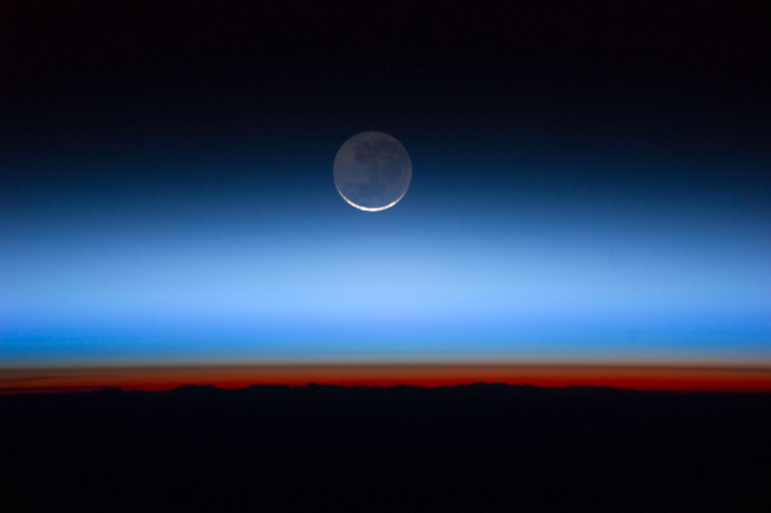

ATMO 170A1
Online
Density (Mass) and Pressure Atmospheric Vertical Structure
Use Slide Show with sound on to hear narrative
(Apologies upfront as the sound is full of static. Why?)
Earth’s limb from International Space Station
Figure Credit

Slide 2
Overview Goals
Atmospheric field variables
  Define pressure and density (and mass)
Atmospheric vertical structure
  Quantify the relation between pressure and height
  Temperature variation with height

Slide 3
Fundamental Concepts
We now introduce two variables that define the state of the atmosphere
Density (mass) and Pressure

Slide 4
What is Mass?
Mass (m) can be thought of as…
- Amount of matter or “stuff”
- Inertia of substance
Resistance to change in motion
- Units: kilograms (kg), grams (gm)

Slide 5
Aside: Mass is not Weight!
Weight is a force!
Force = mass × acceleration
Weight = mass × acceleration due to gravity (g)
Weight (1 kg) = 1 kg × 9.81 m/s² = 9.81 Newtons
= 2.2 lbs

Slide 6
What is Density?
Density (d) = Mass (M) per unit Volume (V)
d = (Mass) / (Volume)
Typical Units: kg/m³
Density can be thought of as…
Amount of matter or “stuff” in a box
1 meter
1 meter
1 meter

Slide 7
Density Change
Density (d) can change by altering either
a) mass in a constant volume
b) volume occupied by a constant mass
a
b
same mass smaller volume
more mass same volume

Slide 8
What is Pressure?
Pressure (P) = Force (F) per unit Area (A) = F/A
What is a force? It is like a push or pull.
Unit of Force is termed a Newton,
where 1 Newton = 1 kg x 1 m/sec²
Units of Pressure encountered in meteorology:
Pascal (Pa) = 1 Newton/m² for computations
millibars (mb)/hectopascals (hPa) on surface weather maps
1 mb = 100 Pa = 1 hPa;
1000 mb = 10⁵ Pa = 1000 hPa
(hecto- is prefix for 100)
pounds per square inch (psi); inches of mercury (Hg)

Slide 9
Pressure at Mean-Sea-Level
Pressure can be thought of as the weight of the air directly overhead
Pressure at MSL ⬄ Weight of air overhead
14.7 psi
10,130 Pa (1013 mb)
Pressure at MSL can support a column of mercury 29.92” high and of water 33’ high!

Slide 10
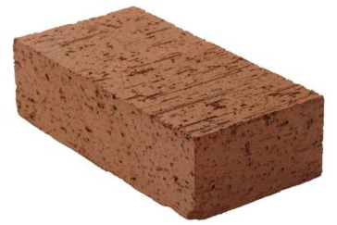
How Does Atmospheric Pressure Vary with Altitude?
Consider a stack of bricks
As your altitude increases, there are fewer bricks above you.
So pressure must decrease.
Higher elevation
Less weight above you
Lower pressure
Each brick weights ~5 lbs
Size is 8” x 4” x 2¼”
0.156 psi per brick
Lower elevation
More weight above you
Higher pressure
5 lbs
5 lbs
5 lbs
5 lbs
5 lbs
5 lbs
5 lbs
5 lbs
5 lbs
5 lbs
5 lbs
5 lbs
5 lbs
8”
5 lbs
4”
5 lbs
5 lbs
5 lbs
2¼”
5 lbs
5 lbs
5 lbs
5 lbs
14.7 psi => 94 bricks
17.6 feet

Slide 11
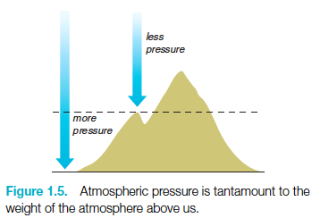
Pressure Decreases with Altitude
Higher elevation
Less weight above you
Lower pressure
Lower elevation
More weight above you
Higher pressure

Slide 12

Air is more like mattresses than bricks
3 ft
Stack ten mattresses on top of each other
Lower mattresses compress more than upper ones
☞ More weight above them
Mattresses are compressible
☞ Mass constant; volume not
Air acts like stacked mattresses
Air is compressible
2 ft
height
1 ft
0 ft

Slide 13
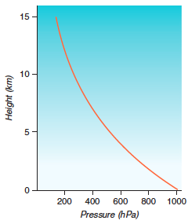
Pressure Decreases Rapidly with Altitude
Stack ten mattresses on top of each other
Lower mattresses compress more than upper ones
☞ More weight above them
Mattresses are compressible
☞ Mass constant; volume not
Air acts like stacked mattresses
Air is compressible
Fig. 1.6
H&P

Slide 14
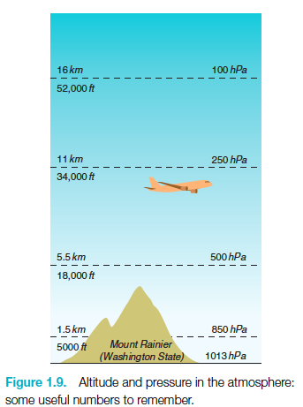
How Pressure Changes with Height?
1 mb
48 km - 1 mb
log 10⁰ = 0
log 10¹ = 1
log 10² = 2
log 10³ = 3
48 km
±16 km
10x change
10 mb
32 km - 10 mb
32 km
±16 km
10x change
100 mb
16 km - 100 mb
16 km
±16 km
10x change
0 km - 1000 mb
Ahrens & Hansen
Observations reveal that for every
16 km increase in altitude
☞
Pressure decreases
by a power of ten

Slide 15
How Pressure Changes with Height
In words…pressure decreases by a factor of 10 for every 16 km increase in height
Such a relationship is called an
  Exponential Relationship
One can quantify the relationship between pressure and height by a simple equation
Separate Subject
(not covered in this course)

Slide 16
Know the Basics…
Pressure and Density
Know their definitions
Pressure/density decrease rapidly with height
Understand the 16 km ⟺ factor-of-ten relationship
Temperature (Section 3.5 H&P)
More complex vertical structure than pressure
Environmental Lapse Rate (ELR)
ELR defines layers of atmosphere
Know the four lowest atmospheric layers, their order and whether temperature increases or decreases w/height

Slide 17
End of Presentation

