Slide 1


ATMO 170A1
Online
Density (Mass) and Pressure Atmospheric Vertical Structure
Use Slide Show with sound on to hear narrative
(Apologies upfront as the sound is full of static)
Earth’s limb from International Space Station
Figure Credit

Slide 2
Overview Goals
Atmospheric field variables
  Define pressure and density (and mass)
Atmospheric vertical structure
  Quantify the relation between pressure and height
  Temperature variation with height

Slide 3
Fundamental Concepts
We now introduce two variables that define the state of the atmosphere
Density (mass) and Pressure

Slide 4
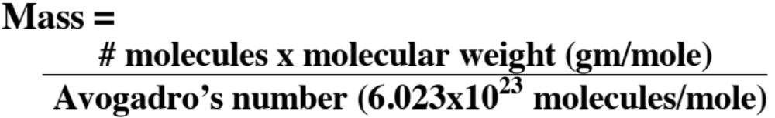
What is Mass?
Mass (m) can be thought of as…
- Amount of matter or “stuff”
- Inertia of substance
Resistance to change in motion
- Units: kilograms (kg), grams (gm)

Slide 5
Aside: Mass is not Weight!
Weight is a force!
Force = mass × acceleration
Weight = mass × acceleration due to gravity (g)
Weight (1 kg) = 1 kg × 9.81 m/s² = 9.81 Newtons
= 2.2 lbs

Slide 6
What is Density?
Density (d) = Mass (M) per unit Volume (V)
d = (Mass) / (Volume)
Typical Units: kg/m³
Density can be thought of as…
Amount of matter or “stuff” in a box
1 meter
1 meter
1 meter

Slide 7
Density Change
Density (d) can change by altering either
a) mass in a constant volume
b) volume occupied by a constant mass
a
b
same mass smaller volume
more mass same volume

Slide 8
What is Pressure?
Pressure (P) = Force (F) per unit Area (A) = F/A
What is a force? It is like a push or pull.
Units of Force is a Newton,
where 1 Newton = 1 kg x 1 m/sec²
Units of Pressure encountered in meteorology:
Pascal (Pa) = 1 Newton/m² for computations
millibars (mb) on surface weather maps
1 mb = 100 Pa = 1 hPa; 1000 mb = 10⁵ Pa
pounds per square inch (psi); inches of mercury (Hg)

Slide 9
Pressure at Mean-Sea-Level
Pressure can be thought of as the weight of the air directly overhead
Pressure at MSL ⬄ Weight of air overhead
14.7 psi
10,130 Pa (1013 mb)
Pressure at MSL can support a column of mercury 29.92” high and of water 33’ high!

Slide 10
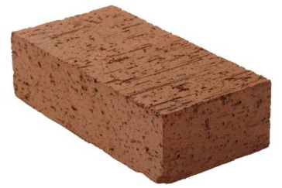
How Does Atmospheric Pressure Vary with Altitude?
Consider a stack of bricks
As your altitude increases, there are fewer bricks above you.
So pressure must decrease.
Higher elevation
Less weight above you
Lower pressure
Each brick weights ~5 lbs
Size is 8” x 4” x 2¼”
0.156 psi per brick
Lower elevation
More weight above you
Higher pressure
5 lbs
5 lbs
5 lbs
5 lbs
5 lbs
5 lbs
5 lbs
5 lbs
5 lbs
5 lbs
5 lbs
5 lbs
5 lbs
8”
5 lbs
4”
5 lbs
5 lbs
5 lbs
2¼”
5 lbs
5 lbs
5 lbs
5 lbs
14.7 psi => 94 bricks
17.6 feet

Slide 11

Air is more like mattresses than bricks
3 ft
Stack ten mattresses on top of each other
Lower mattresses compress more than upper ones
☞ More weight above them
Mattresses are compressible
☞ Mass constant; volume not
Air acts like stacked mattresses
Air is compressible
2 ft
height
1 ft
0 ft

Slide 12
How does pressure in the Earth’s atmosphere change?
Since air compressible, boxes at the lower altitude are always thinner one directly above it...
Density decreases at faster rate at low altitudes than high
Because pressure is related to the mass of the air overhead and lower boxes are denser than ones above it...
Pressure must decrease at faster rate at low altitudes than high altitudes
3km
Δp
2km
Δp
1km
Δp
Δp
0km
Notes:
Equal number of molecules in each volume => same mass in each volume
Air compressible => density higher near surface than aloft

Slide 13
What about the sides?
If the parcels compress vertically, then why don’t they expand sideways since pressure also acts equally in all directions?
Arrows show lateral force of pressure
Reason
Because the adjacent air parcels are pushing back with (nearly) equal force.
Notes:
Consider the sides of the boxes?
Why don’t they expand sideways since pressure acts equally in all directions?
Reason: adjacent columns of air push back

Slide 14
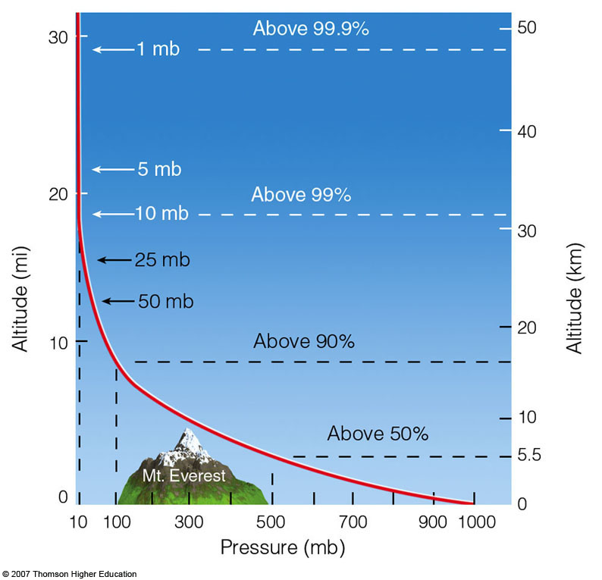
How Pressure Changes with Height?
1 mb
48 km - 1 mb
log 10⁰ = 0
log 10¹ = 1
log 10² = 2
log 10³ = 3
48 km
±16 km
10x change
10 mb
32 km - 10 mb
32 km
±16 km
10x change
100 mb
16 km - 100 mb
16 km
±16 km
10x change
0 km - 1000 mb
Ahrens & Hansen
Observations reveal that for every
16 km increase in altitude
☞
Pressure decreases
by a power of ten

Slide 15
How Pressure Changes with Height
In words…pressure decreases by a factor of 10 for every 16 km increase in height
Such a relationship is called an
  Exponential Relationship
One can quantify the relationship between pressure and height by a simple equation
Separate Subject
(not covered in this course)

Slide 16
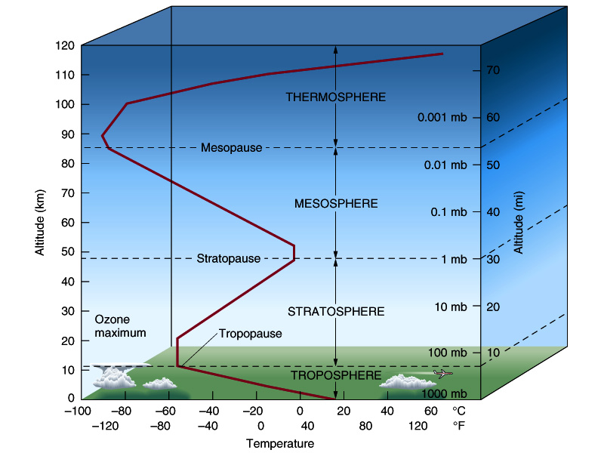
Vertical Temperature Distribution
Chapter 3 H&P
More Complex
Than Pressure
Environmental Lapse Rate
  Rate at which temperature changes with height. Troposphere on average cools at rate of 6.5˚C km⁻¹
Inversion
  Layer where temperature increases with height.
Isothermal
  Layer where temperature is constant with height.
Isothermal
Inversion
6.5ºC/km
Source: apollo.lsc.vsc.edu
Akin to Fig. 3.3 H&P

Slide 17
Vertical Temperature Distribution
Defines layers of the atmosphere
Thermosphere
  Warms w/height
Mesosphere
  Cools w/height
Stratosphere
  Warms w/height
Troposphere
  Cools w/height
Isothermal
Inversion
6.5ºC/km
Source: apollo.lsc.vsc.edu
Akin to Fig. 3.3 H&P
Source: apollo.lsc.vsc.edu

Slide 18
Know the Basics…
Pressure and Density
Know their definitions
Pressure/density decrease rapidly with height
Understand the 16 km ⟺ factor-of-ten relationship
Temperature (Section 3.5 H&P)
More complex vertical structure than pressure
Environmental Lapse Rate (ELR)
ELR defines layers of atmosphere
Know the four lowest atmospheric layers, their order and whether temperature increases or decreases w/height

Slide 19
End of Presentation

