Slide 1
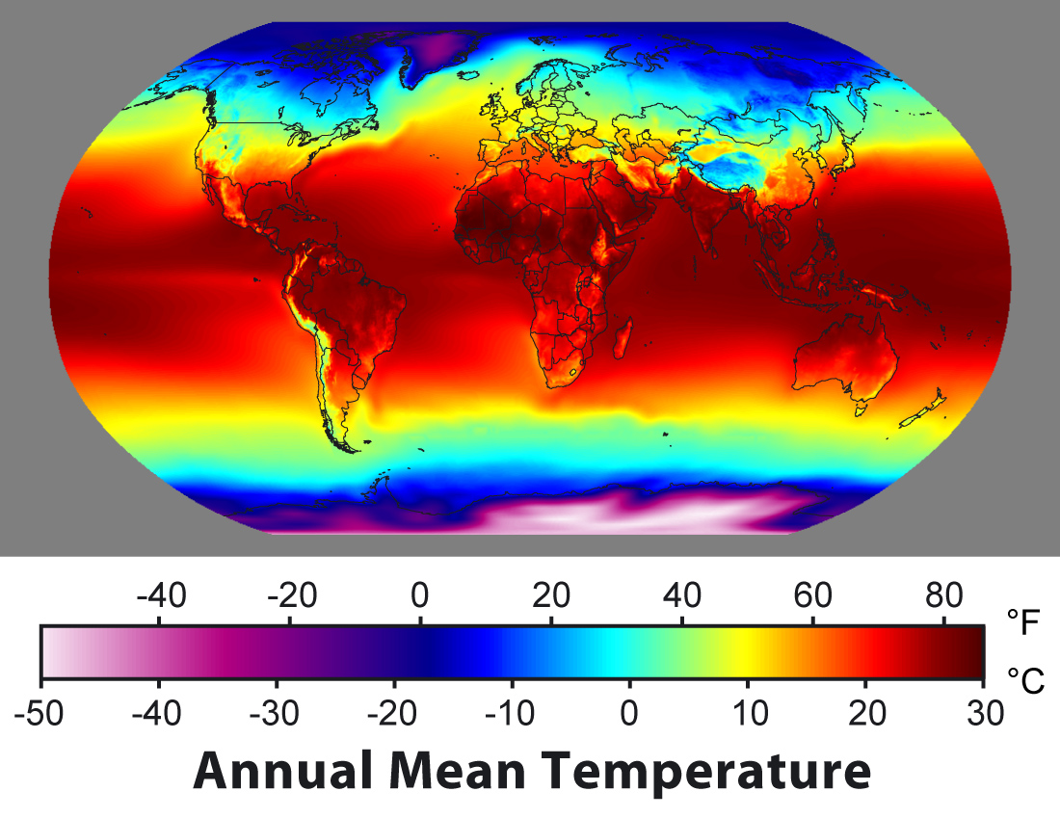

ATMO 170A1
Online
Temperature and Wind
Use Slide mode to hear narrative
Figure credit upload.wikimedia.org

Slide 2
What is Temperature?
Microscopic View
Energy due to random speed of molecules
Related to average molecular speed Nearly 500 m/s at room temperature for air
Maxwell Distribution
KE theory of gases shows
T is proportion to speed²
ADVANCED: Molecular Speed Calculation
Notes:
Microscopic perspective
Energy of random speed of molecules
Temp related to the square of the average molecular speed
Speed is 500 m/s for air at room temperature

Slide 3
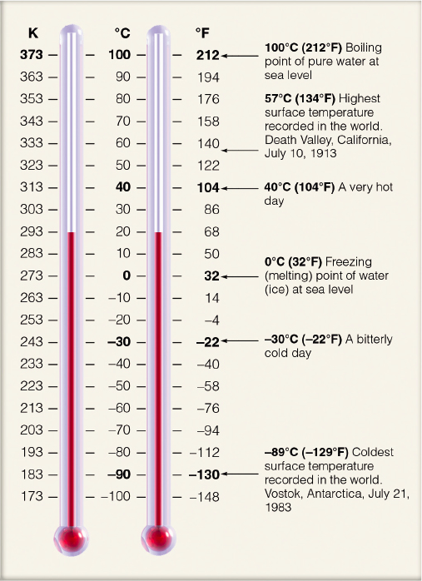
Temperature Scales
Fahrenheit (ºF) - relative
US public standard
Celsius (ºC) - relative
Freezing point 0ºC
Boiling point 100ºC
ºC = 5/9 (ºF-32)
Kelvin (k) - absolute
k = ºC+273
Note that the symbol for kelvin does not have a degree symbol and uses a lower case “k” when referring to a specific absolute temperature (e.g. 273 k)
Know how to do conversions
Ahrens & Hanson

Slide 4
So what is the difference between temperature and wind?
Temperature - random motion of molecules
Wind - bulk movement of molecules
WIND
What is the impact of wind speed on temperature?
Notes:
Temp => Random motion of molecules
Wind => Bulk movement of molecules in one direction

Slide 5
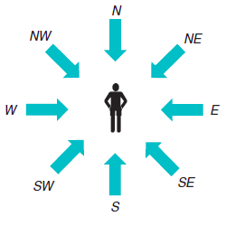
Wind has two components: direction and speed
Direction
Stated as the compass direction from which the wind is coming from
A northerly wind (N) is coming from the north
Fig. 1.11(a)
H&P

Slide 6
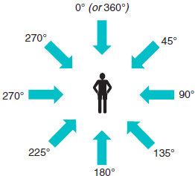
Wind has two components: direction and speed
Direction
Numerically defined by degrees from true north.
East => 90˚
South => 180˚
West => 270˚
North => 360˚ or 0˚
Northwest => 315˚
315˚
Fig. 1.11(b)
H&P

Slide 7
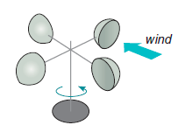
Wind has two components: direction and speed
Speed
Given in knots
1 knot = 1 nautical mile (1 minute of latitude) per hour
= 1.85 km/h
= 0.5 m/s
= 1.15 mph
Cup Anemometer
Measures Speed
Fig. 1.12(a)
H&P

Slide 8
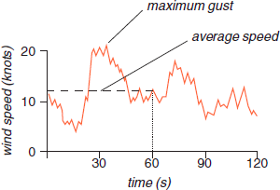
Wind has two components: direction and speed
Variability
Sustained Wind: Reported as the two-minute average speed by the NOAA.
Gust: a sudden brief increase in the speed of the wind. Reported as the maximum 3-second wind speed burst to occur within a two-minute interval by the NOAA.
Wind Variability:
Gusts and Sustained Wind
Fig. 1.13
H&P
Page 4: http://www.nws.noaa.gov/directives/sym/pd01010004curr.pdf

Slide 9
Take Home Points
Temperature – a measure of the average speed of molecules
Wind – a measure of the bulk motion (direction and speed) of a parcel or “blob” of molecules
Its contribution to temperature is trivial

