Slide 1
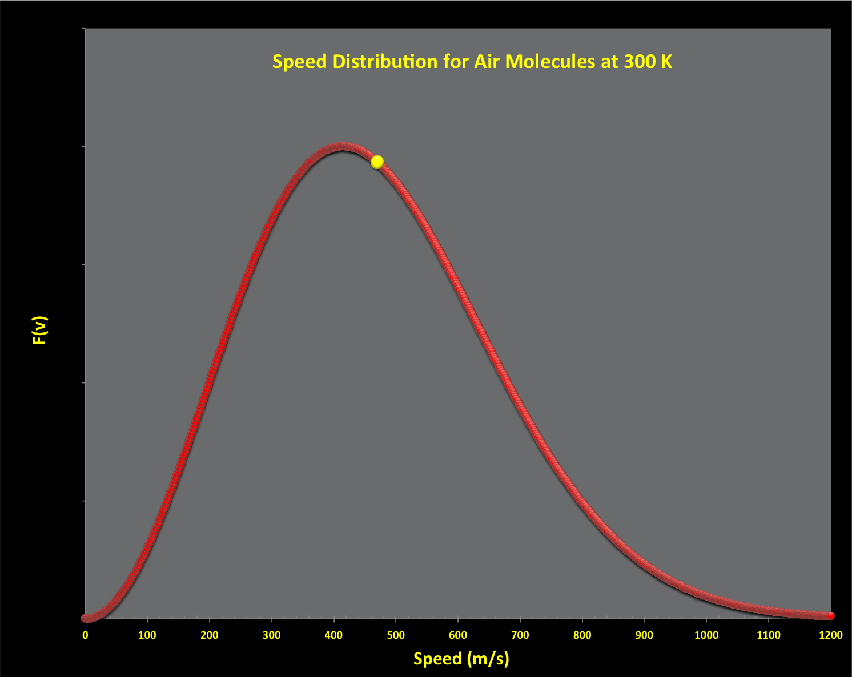

ATMO 170A1
Online
Weather Variables -
Temperature and Wind
Use Slide Show mode with sound on to hear narrative
Maxwell-Boltzmann speed distribution for air molecules at 300 k (80 ˚F)
Yellow dot is the average speed (468 m/s).
Figure Credit

Slide 2
ATMO 170A1
Online
Weather Variables -
Temperature and Wind
Use Slide Show mode with sound on to hear narrative
Maxwell-Boltzmann speed distribution for air molecules at 300 k (80 ˚F)
Yellow dot is the average speed (468 m/s).
Figure Credit

Slide 3
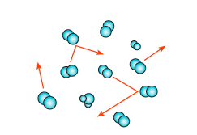
What is Temperature?
Molecular Perspective
Kinetic energy due to the random motion of molecules.
Related to average molecular speed.
Average speed of dry air at 80˚F is approximately 468 m/s
Maxwell-Boltzmann Distribution
KE theory of gases shows
T is proportion to (Speed)²
Distribution for dry air at 300 k is shown on the intro slide
Fig. 1.1
Hakim & Patoux (H&P)
ADVANCED: Molecular Speed Calculation
Notes:
Microscopic perspective
Energy of random speed of molecules
Temp related to the square of the average molecular speed
Speed is almost 500 m/s for air at room temperature

Slide 4
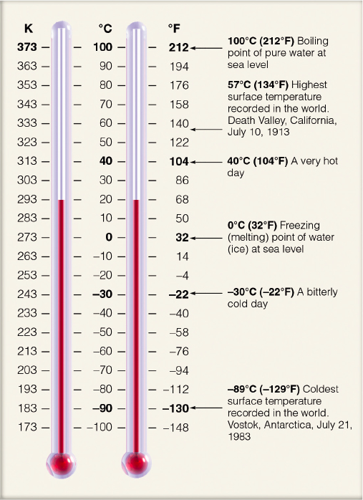
Temperature Scales
Fahrenheit (ºF) – relative scale
US public standard
Freezing point 32˚F
Boiling point 212˚F
Celsius (ºC) - relative scale
World standard
Freezing point 0˚C
Boiling point 100˚C
T_{C} = T_{F}-32*5/9 or T_{F} = T_{C}*9/5 + 32
Kelvin (k) - absolute scale
k = ºC+273
Note that the symbol for kelvin does not have a degree symbol and uses a lower case “k” when referring to a specific temperature (e.g. 273 k).
Use Kelvin for all physics formulas.
Know how to do conversions
Ahrens & Hanson

Slide 5
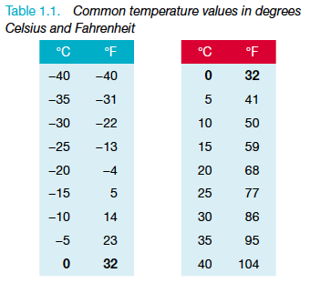
Some Key Temperatures in Degrees Celsius and Fahrenheit
Freezing point of fresh water at sea-level-pressure
0 ˚C 32 ˚F
Boiling point of fresh water at sea-level-pressure
100 ˚C 212 ˚F
Average body temperature
37 ˚C 98.6 ˚F
Typical room temperatures
15-25 ˚C 59-77 ˚F
Table 1.1
H&P

Slide 6
So what is the difference between temperature and wind?
Temperature - random motion of molecules
Wind - bulk movement of molecules
WIND
What is the impact of wind speed on temperature?
Notes:
Temp => Random motion of molecules
Wind => Bulk movement of molecules in one direction

Slide 7
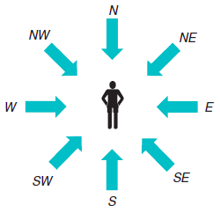
Wind has two components: direction and speed
Direction
Stated as the compass direction from which the wind is coming from
A northerly wind (N) is coming from the north
Fig. 1.11(a)
H&P

Slide 8
Wind has two components: direction and speed
Direction
Numerically defined by degrees from true north.
East => 90˚
South => 180˚
West => 270˚
North => 360˚ (or 0˚)
Northwest => 315˚
315˚
Fig. 1.11(b)
H&P

Slide 9
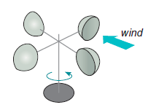
Wind has two components: direction and speed
Speed
Given in knots or ms⁻¹
1 knot = 1 nautical mile (1 minute of latitude) per hour
= 1.15 mph
= 1.85 km/h
= 0.51 ms⁻¹
Use m/s for physics formulas
Cup Anemometer
Measures Speed
Fig. 1.12(a)
H&P

Slide 10
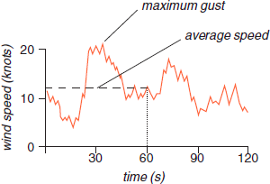
Wind has two components: direction and speed
Variability
Sustained Wind: Reported as the two-minute average speed by the NOAA.
Gust: a sudden brief increase in the speed of the wind. Reported as the maximum 3-second wind speed burst to occur within a two-minute interval by the NOAA.
Wind Variability:
Gusts and Sustained Wind
Fig. 1.13
H&P
ASOS Observations: https://www.weather.gov/media/asos/aum-toc.pdf

Slide 11
Summary Points
Temperature – average random speed of molecules
Wind – bulk movement of air
has two components
  Direction – measured by compass direction from which wind is coming
  Speed – measured in knots (nmi per hour) or ms⁻¹
  Must consider variability
  Sustained Wind: measured as two-minute average speed for surface observation.
  Gust: a sudden brief increase in wind speed; reported as 3 second average in two minute period

