Slide 1

The “Potential”
Southwest Sucker
By: Ryan Dennis & Casey Oswant
ATMO 574
10/24/2016

Slide 2
Outline
Use of a Case Study
Surface Analysis
Satellite Imagery/Radar
Upper Air Analysis- 850 mb, 700 mb, 500 mb, 250 mb
Model Analysis- NAM vs. GFS
Weather Discussion

Slide 3
Use of a Case Study
The storm that we will be looking at is taking a track that is very common for many low-pressure systems that form in this area.
Storms that form in this area do not always make landfall, but instead make a left turn up towards Canada and Alaska.
This makes these storms commonly form very strong winds along the coast in the Pacific Northwest with gusts sometimes being hurricane-force.
In our specific case we will be comparing this current storm with a severe windstorm that occurred on 1/1/2006 to see how similar or different their tracks, strength and impacts are/may be.

Slide 4
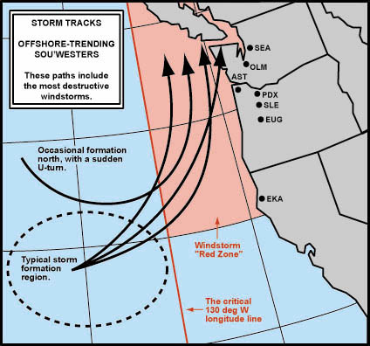
Southwest Sucker Track

Slide 5
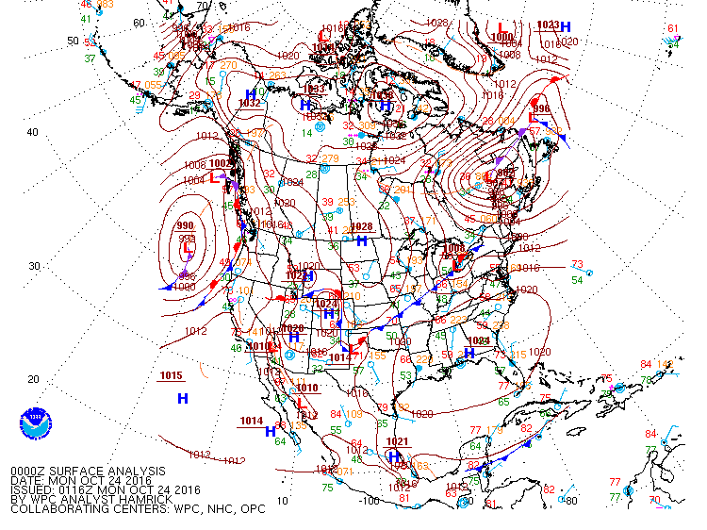
0Z Surface Map (Our 0Z)

Slide 6
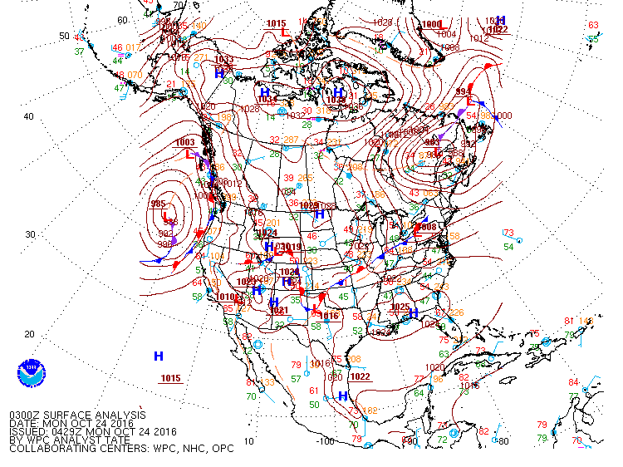
3Z Surface Map

Slide 7
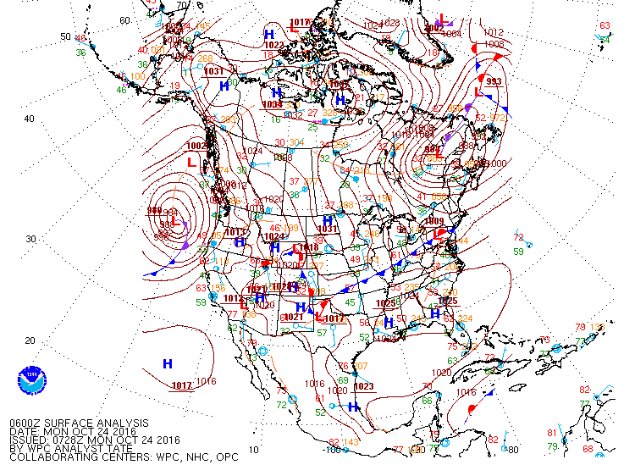
6Z Surface Map

Slide 8
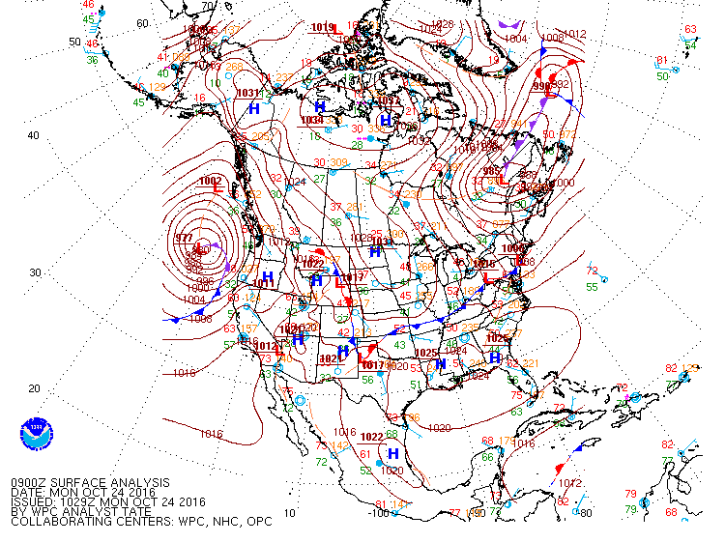
9Z Surface Map

Slide 9
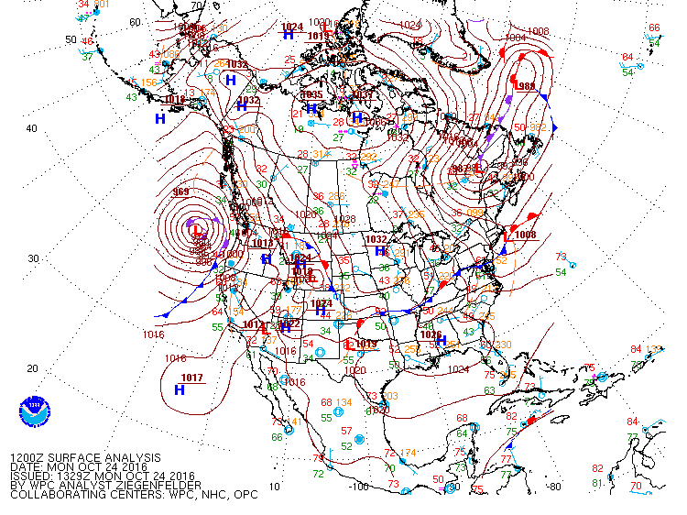
12Z Surface Map

Slide 10
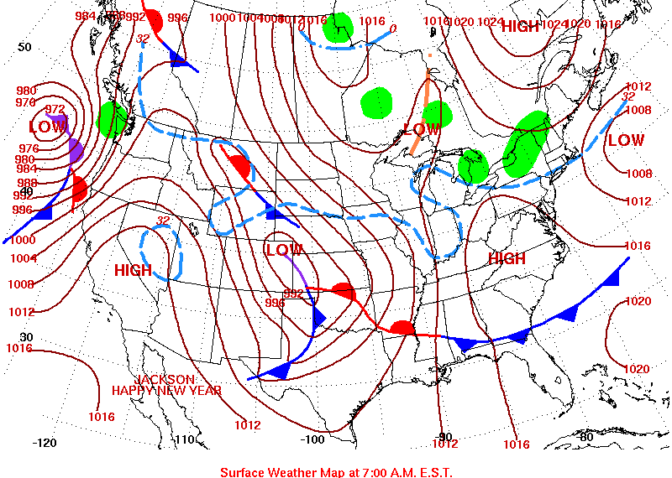
Case Study- Surface Map

Slide 11
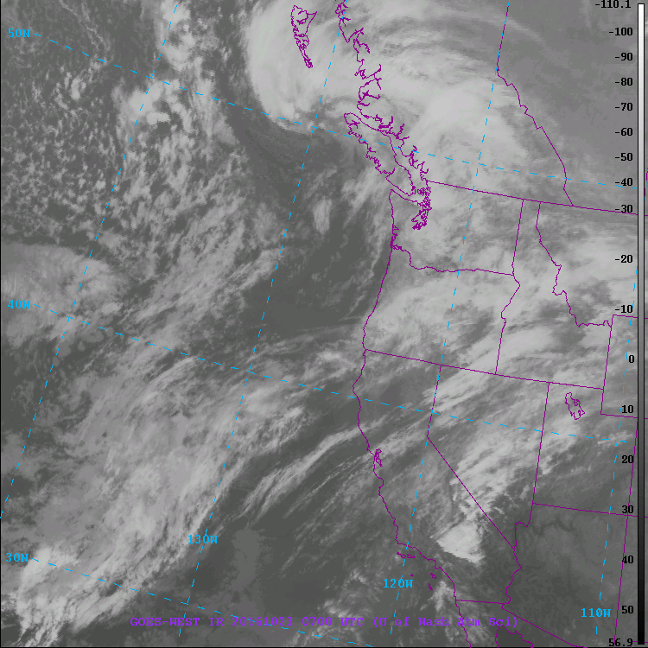
Development of the Storm: IR Imagery (12am- 10/23)

Slide 12
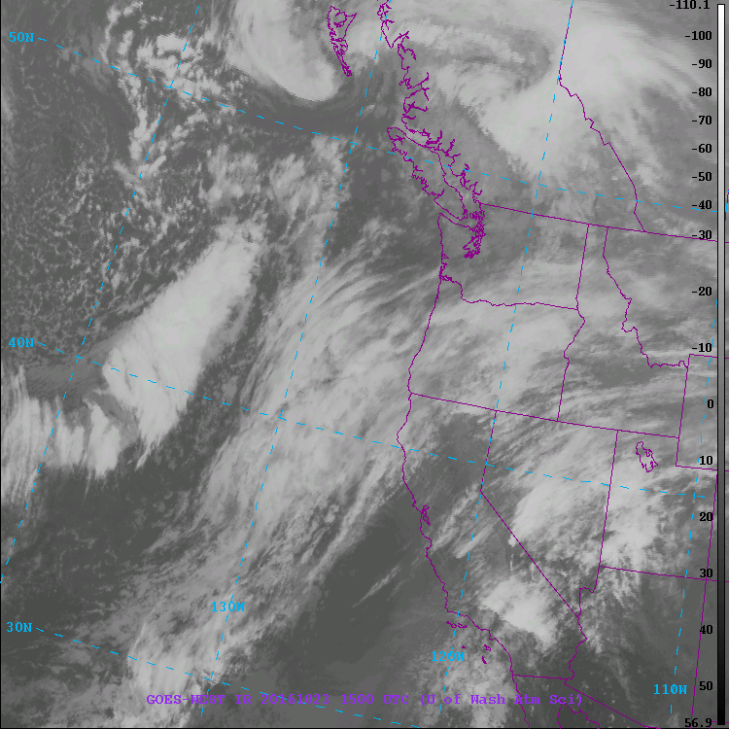
Development of the Storm: IR Imagery (8am- 10/23)

Slide 13
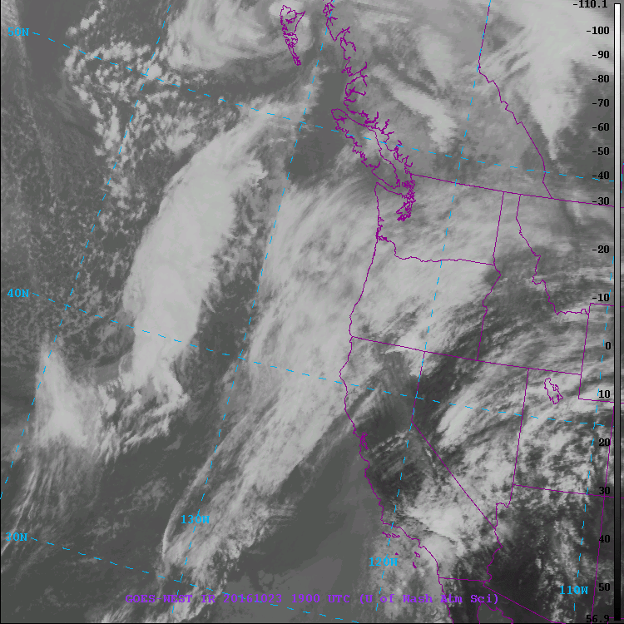
Development of the Storm: IR Imagery (12pm- 10/23)

Slide 14
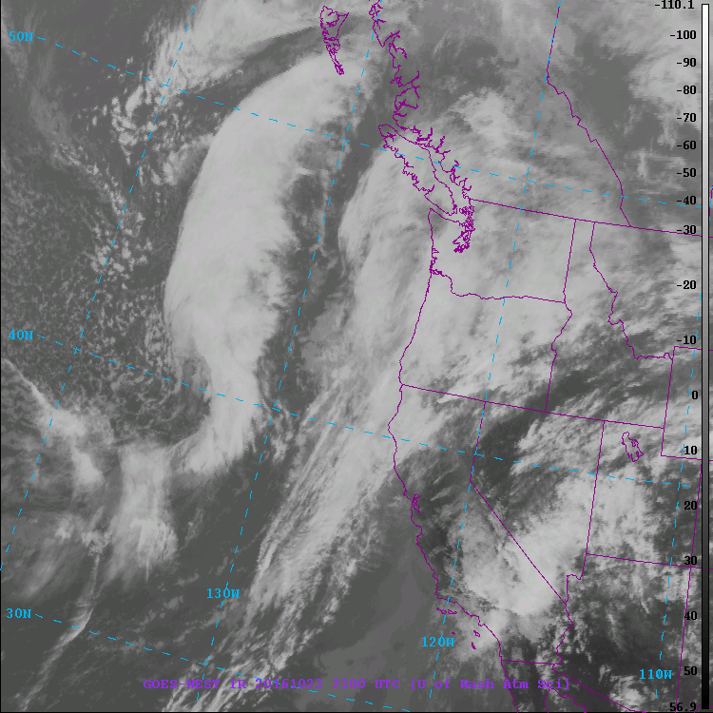
Development of the Storm: IR Imagery (4pm- 10/23)

Slide 15
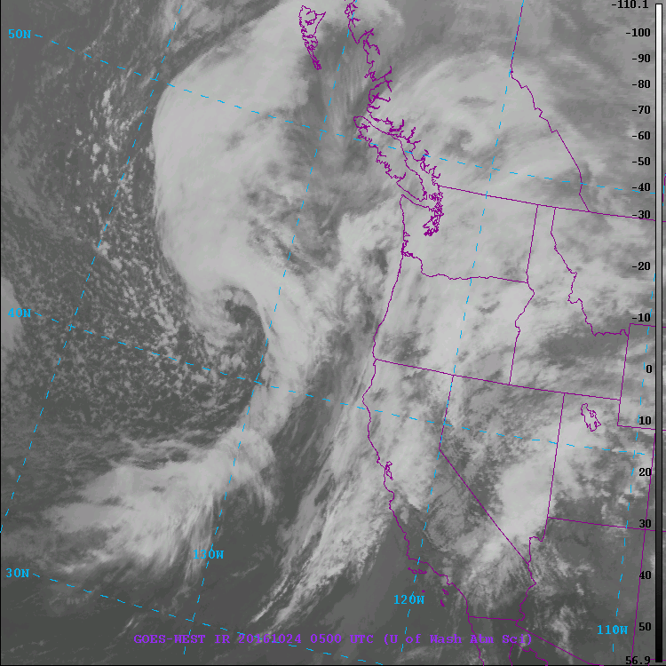
Development of the Storm: IR Imagery (10pm- 10/23)

Slide 16
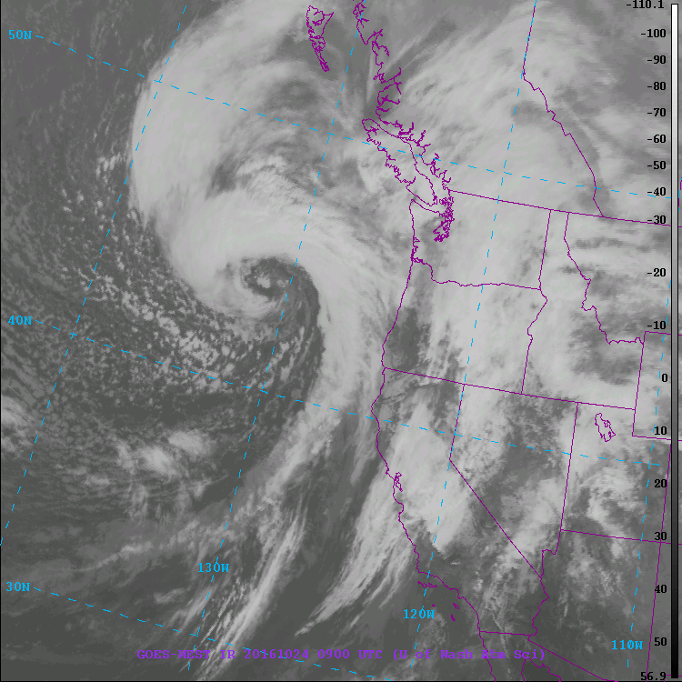
Development of the Storm: IR Imagery (2am- 10/24)

Slide 17
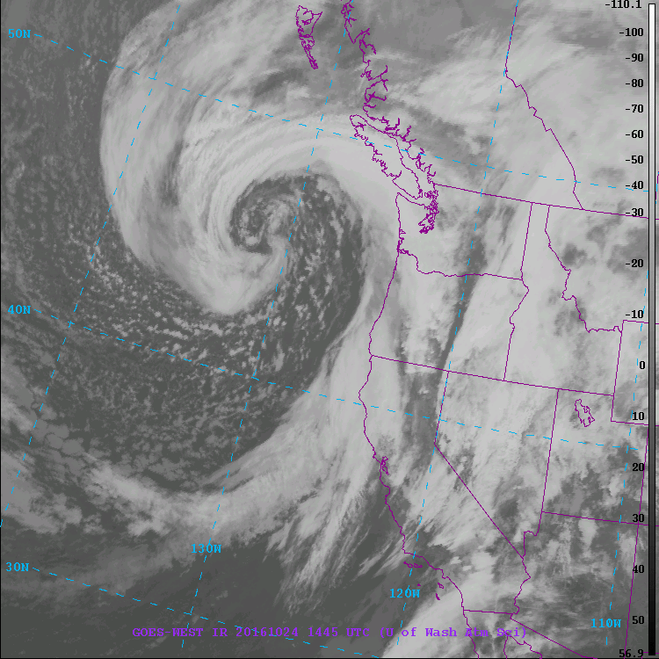
Development of the Storm: IR Imagery (7:45am- 10/24)
https://www.atmos.washington.edu/weather/sat.shtml#

Slide 18
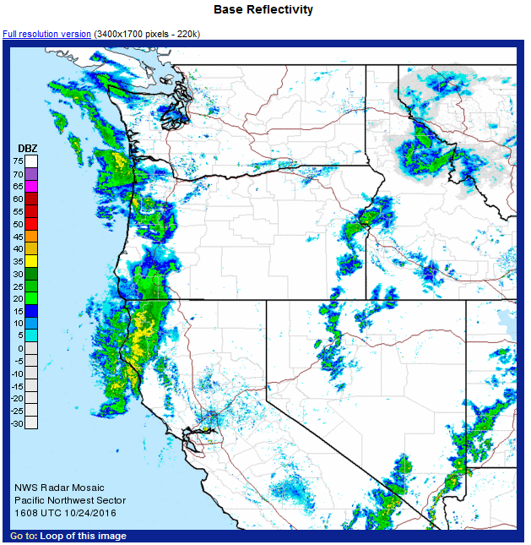
Current Radar (9am)

Slide 19
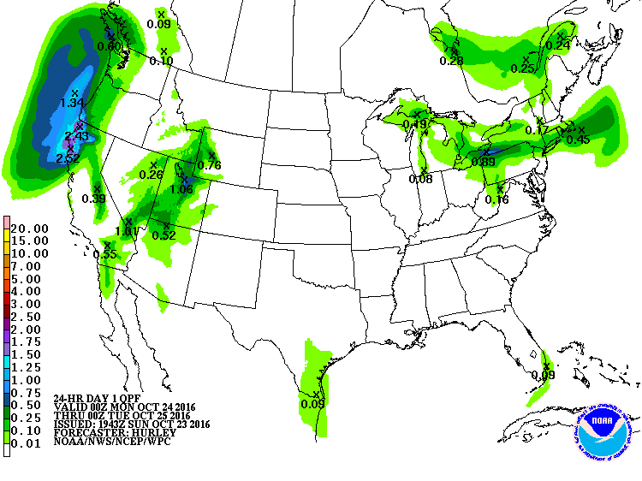
QPF Forecast(0Z)

Slide 20
Southwest Sucker Track

Slide 21
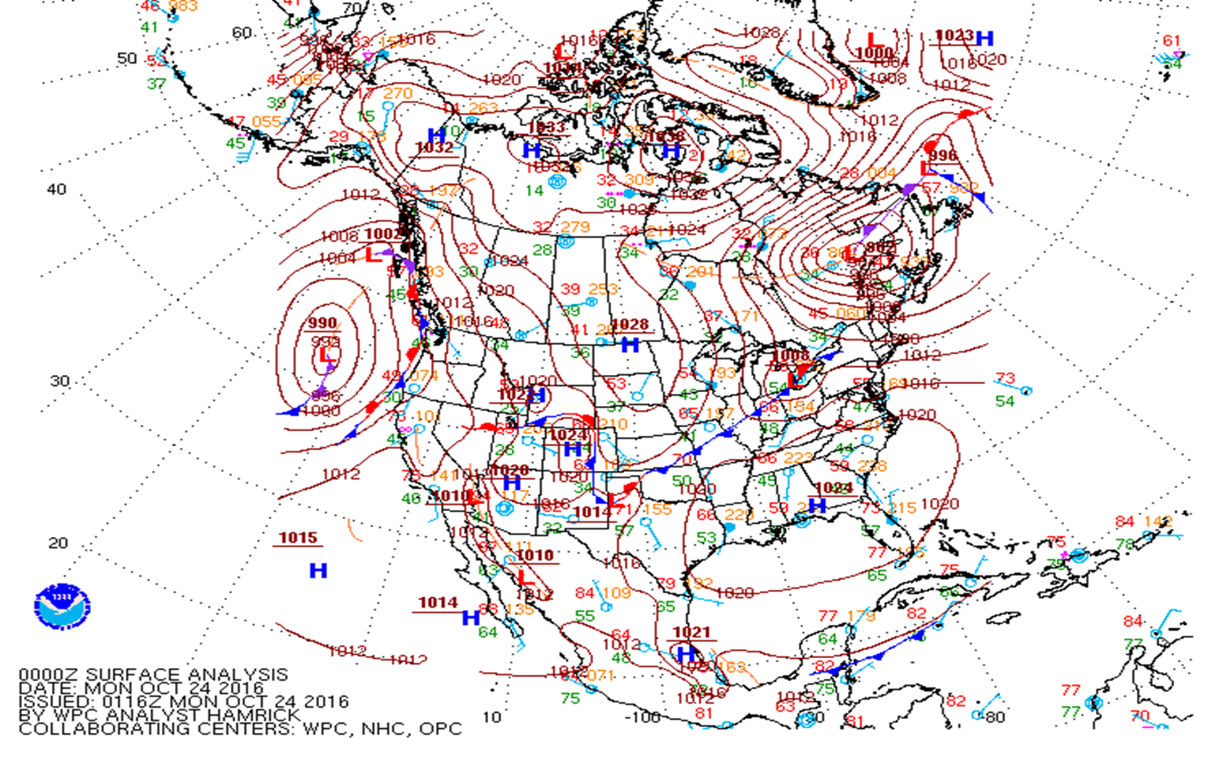
0Z Surface Map vs. Current Surface Map

Slide 22
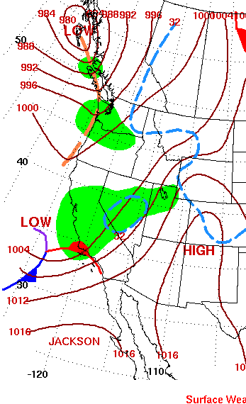
1/1/2006 Surface Map vs. 1/2/2006 Surface Map

Slide 23
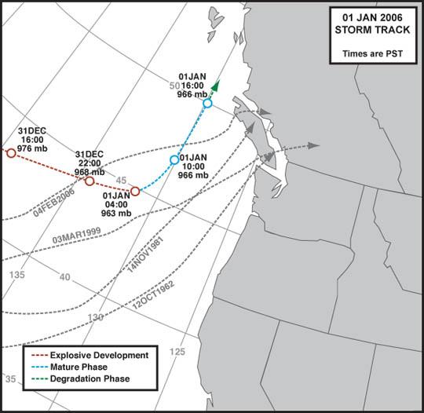
Case Study Track

Slide 24
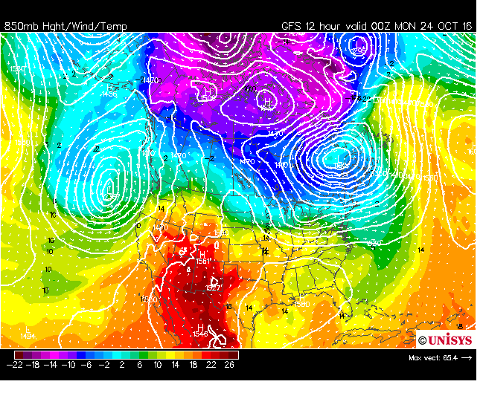
850 mb Analysis (0Z)

Slide 25
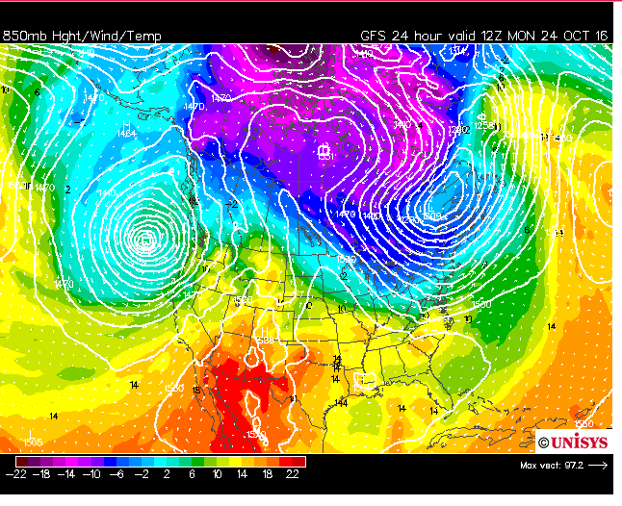
850 mb Analysis (12Z)

Slide 26
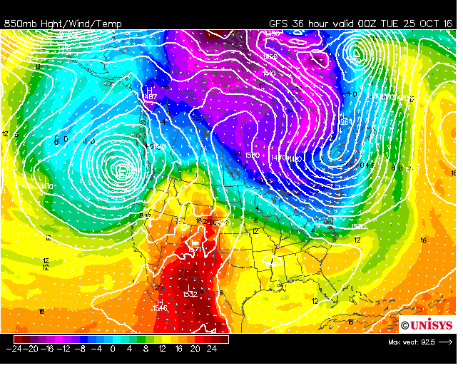
850 mb Analysis (0Z Tuesday)

Slide 27
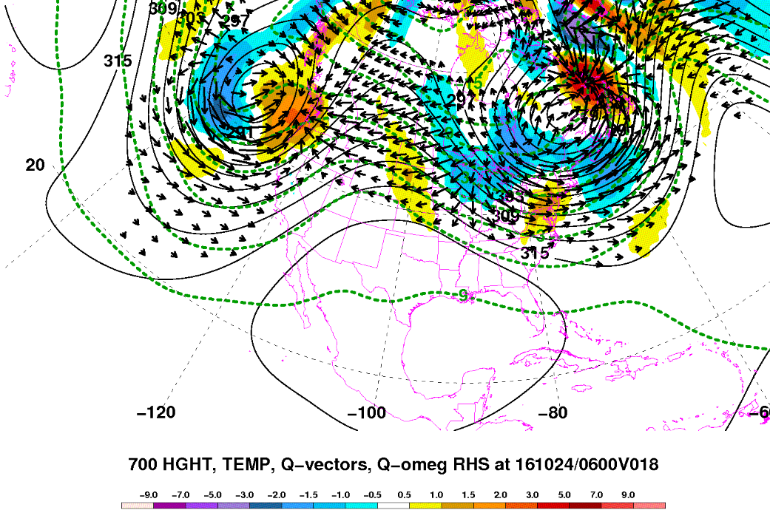
700 mb Analysis (6Z)

Slide 28
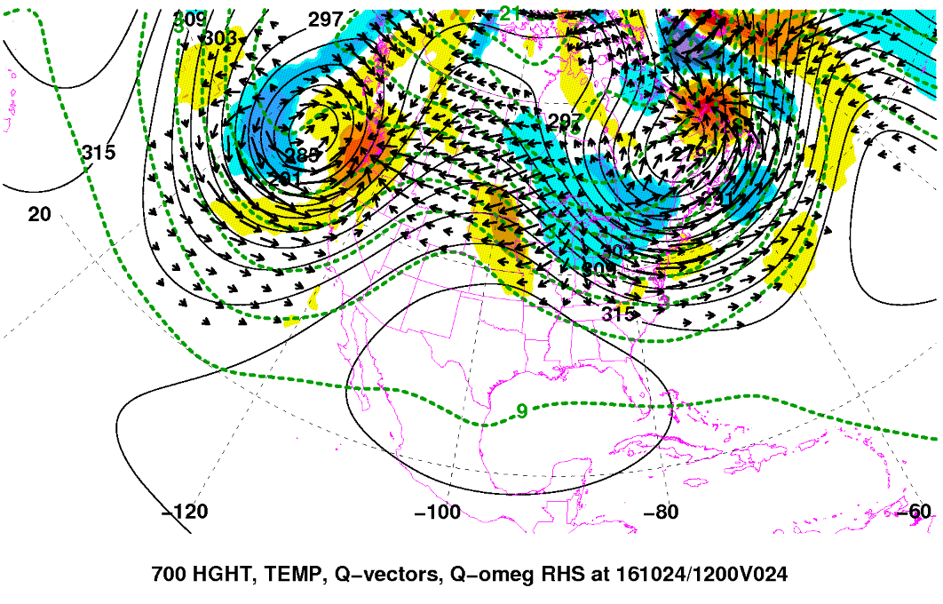
700 mb Analysis (12Z)

Slide 29
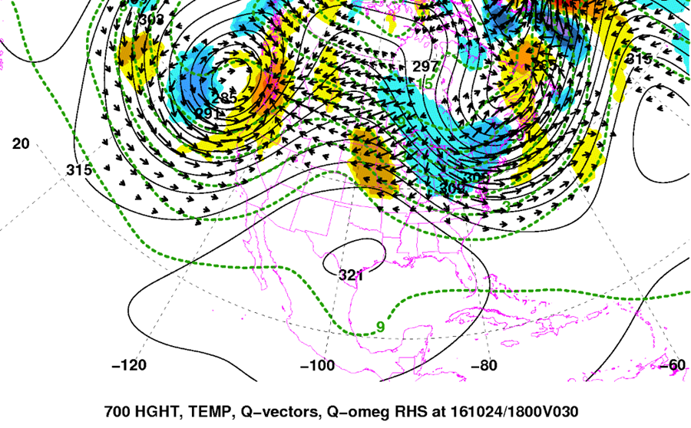
700 mb Analysis (18Z)

Slide 30
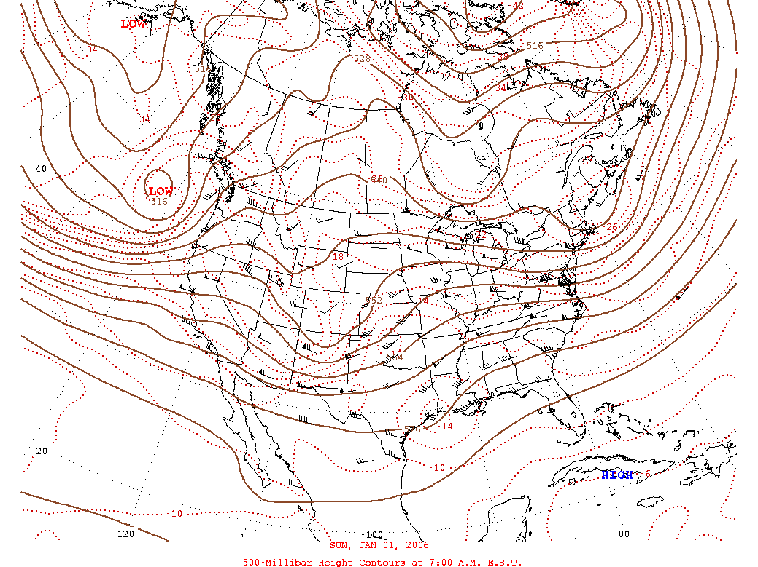
500 mb Case Study- 1/1/06

Slide 31
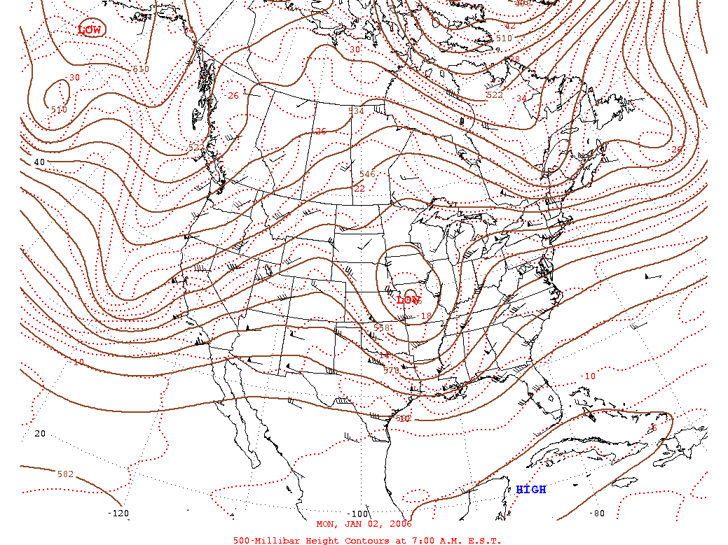
500 mb Case Study-1/2/06

Slide 32
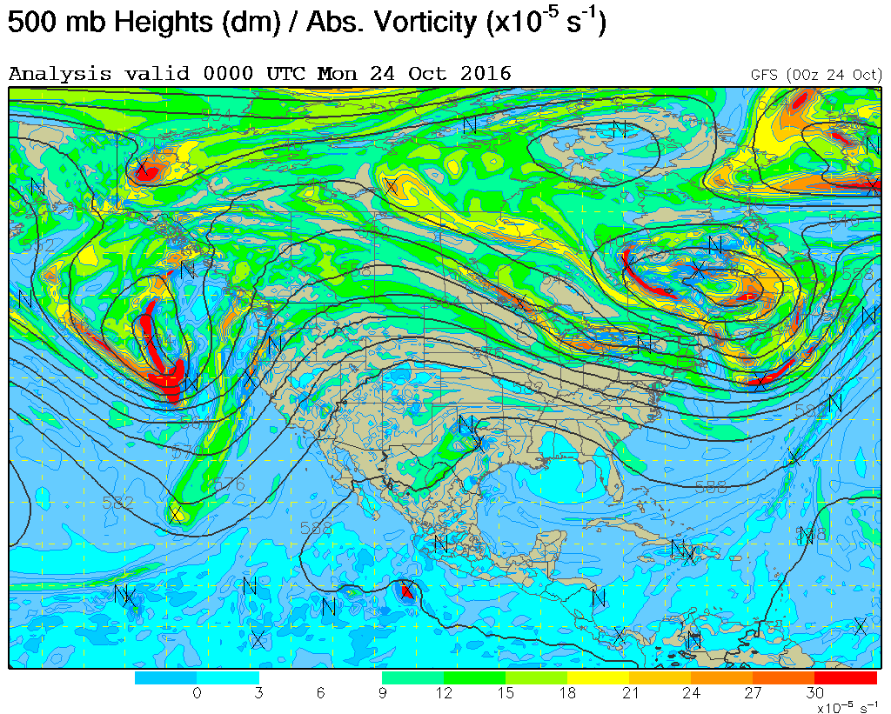
500 mb- Vorticity(0Z)

Slide 33
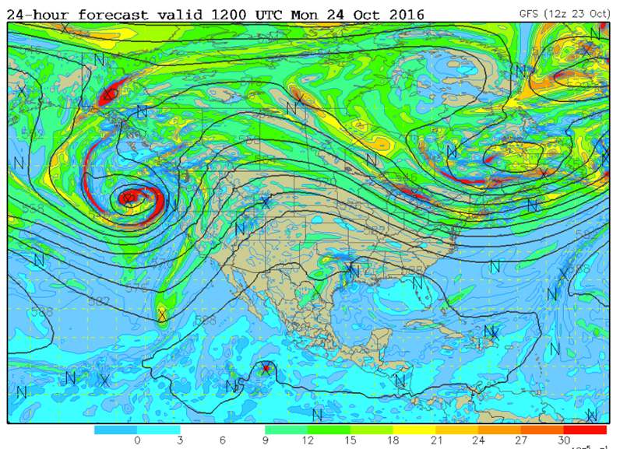
500 mb- Vorticity (12Z)

Slide 34
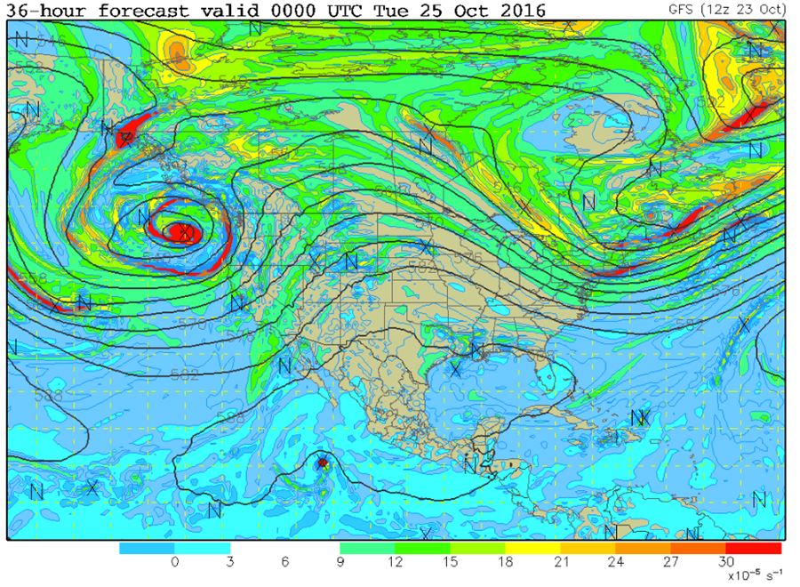
500 mb- Vorticity (0Z- 10/25)

Slide 35
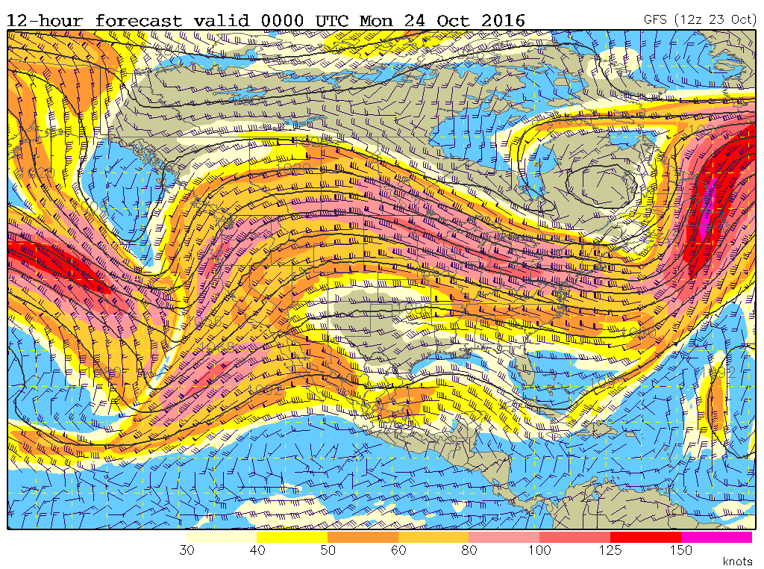
250 mb Analysis (0Z)

Slide 36
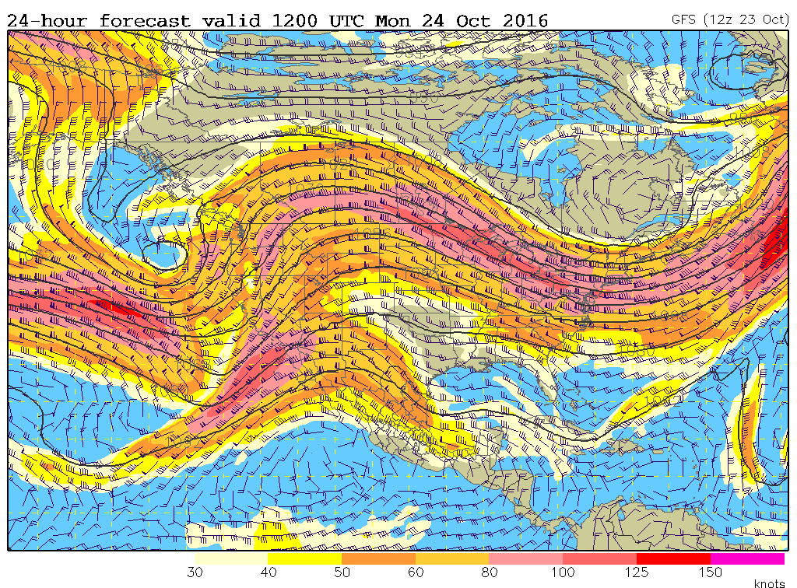
250 mb Analysis (12Z)

Slide 37
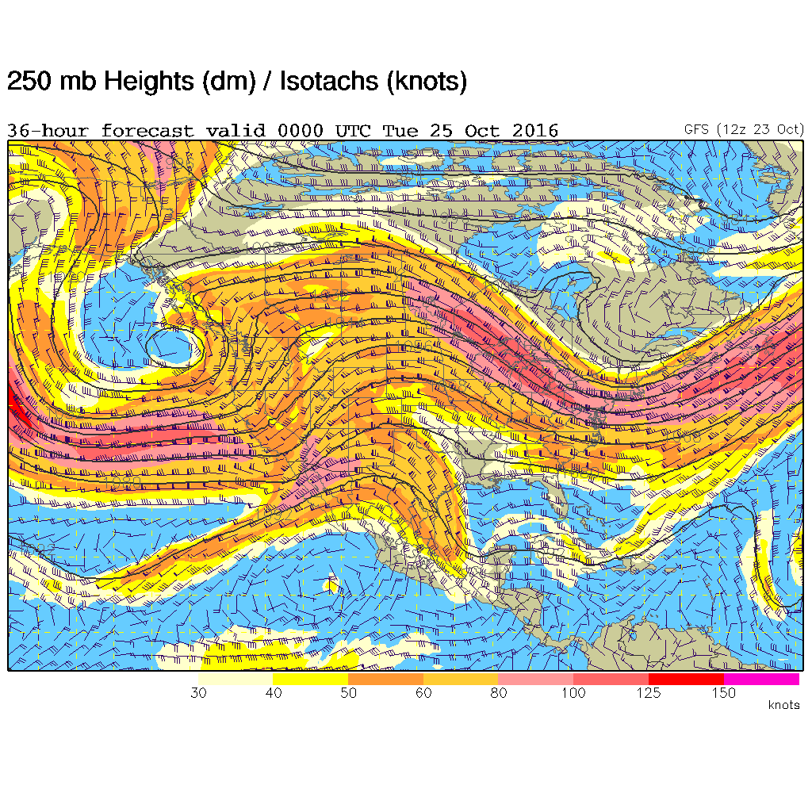
250 mb Analysis (0Z- 10/25)

Slide 38
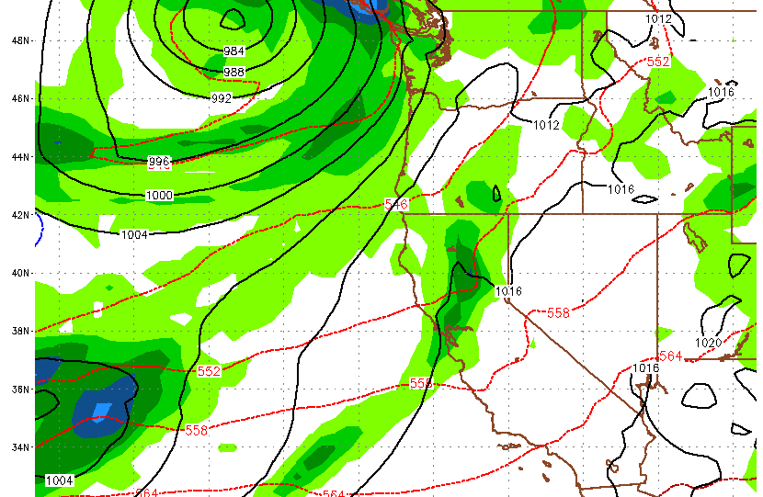
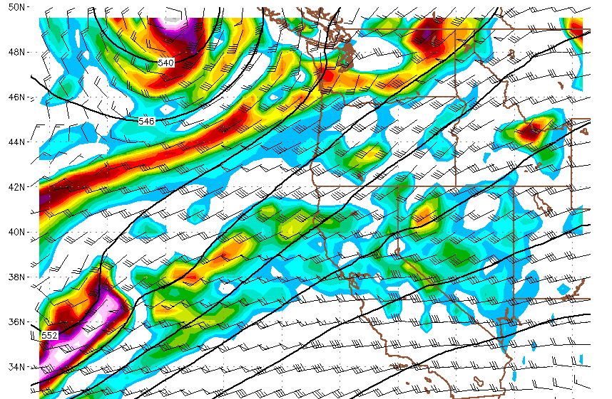
Model Forecast: NAM 48 hour(0Z- 10/26)

Slide 39
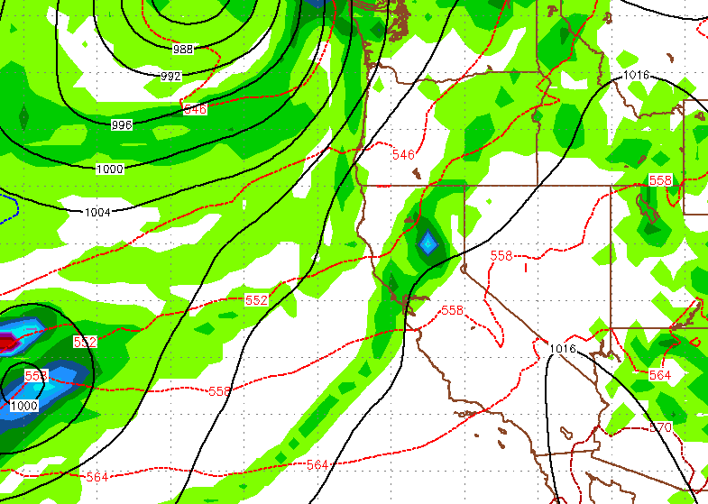
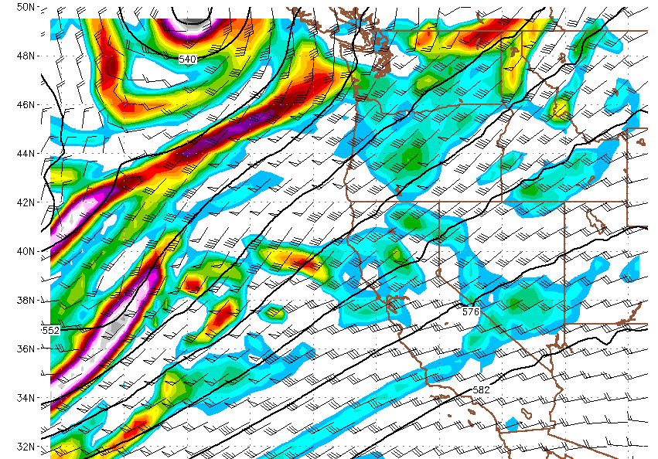
Model Forecast: GFS 48 hour (0Z- 10/26)

Slide 40
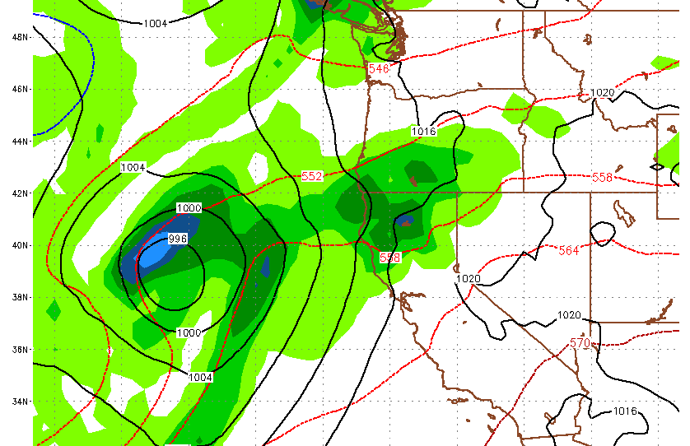
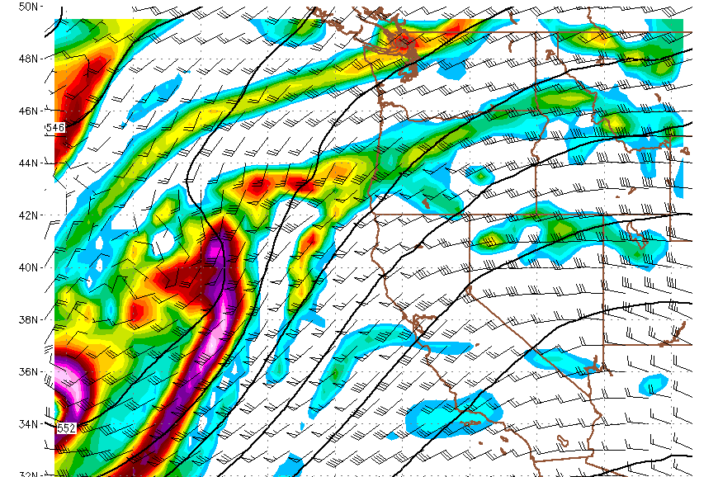
Model Forecast: NAM 60 hour (12Z- 10/26)

Slide 41
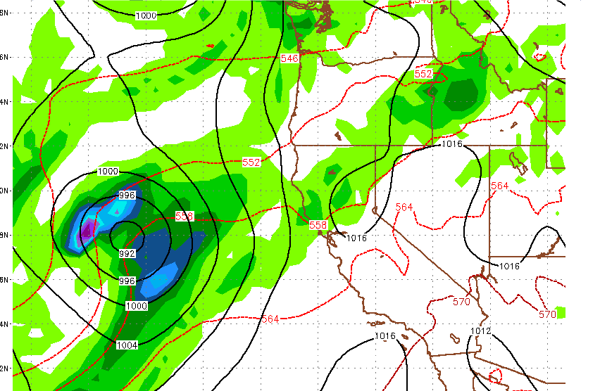
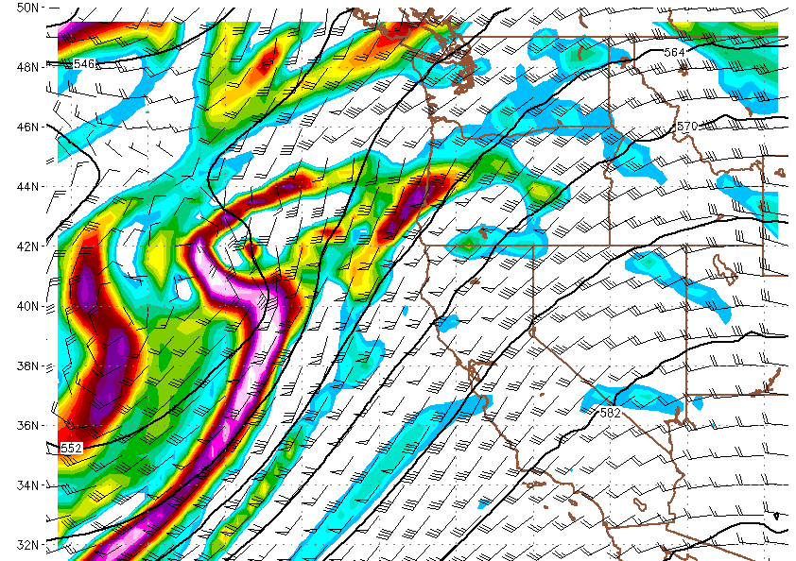
Model Forecast: GFS 60 hour(12Z- 10/26)

Slide 42
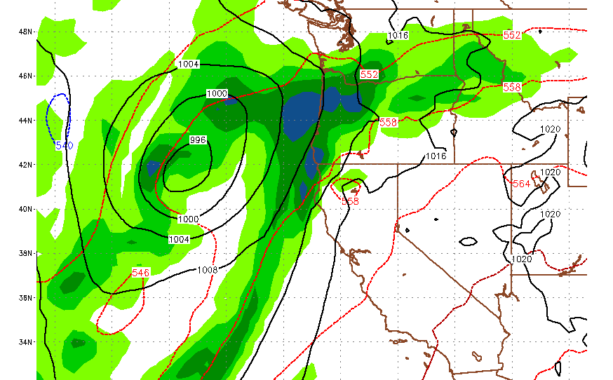
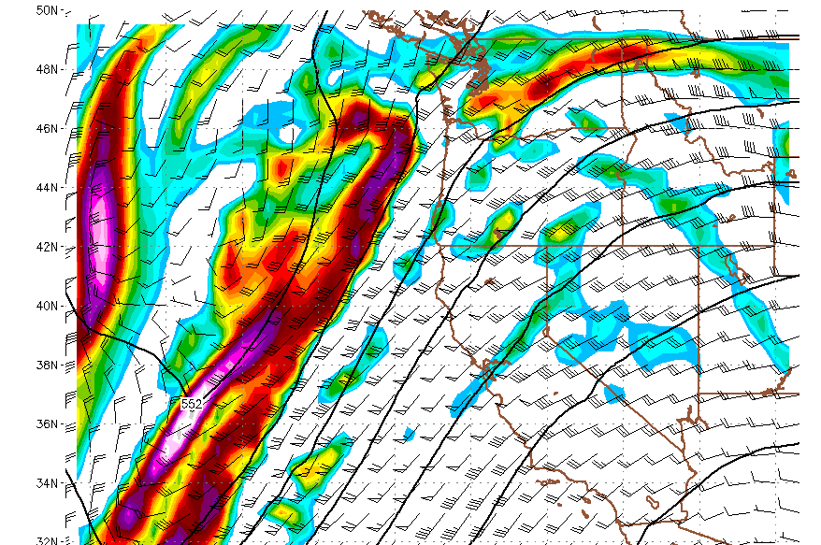
Model Forecast: NAM 72 hour(0Z- 10/27)

Slide 43
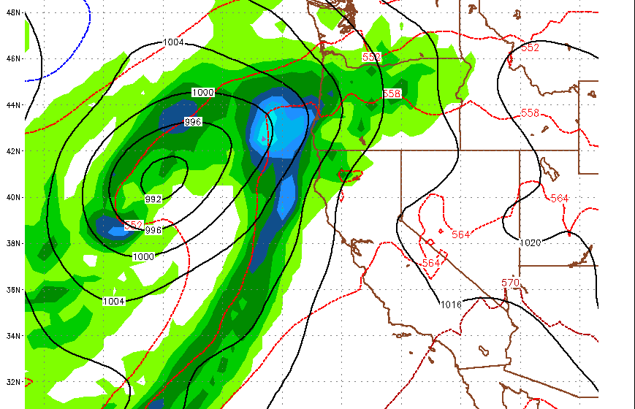
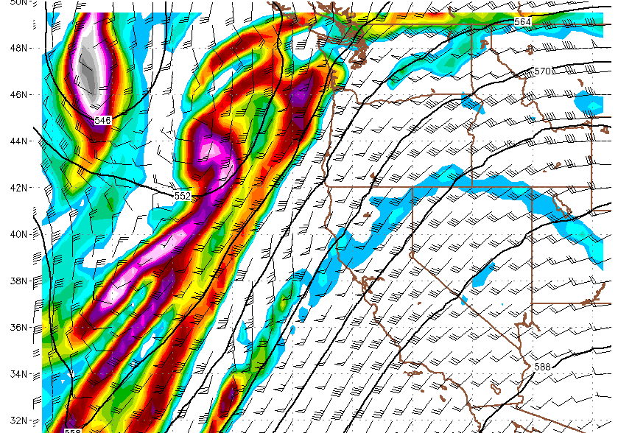
Model Forecast: GFS 72 hour(0Z- 10/27)

Slide 44
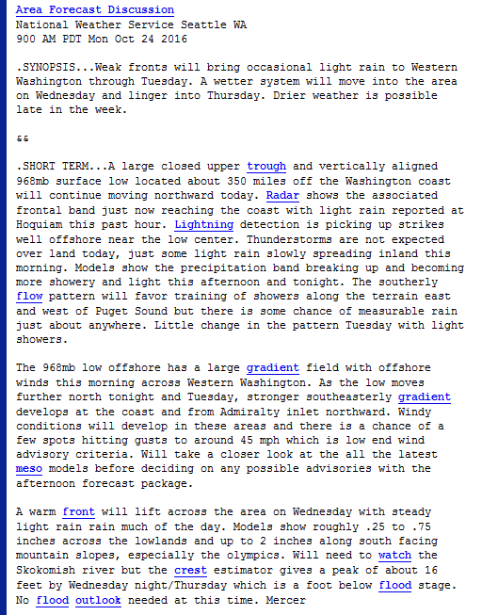
Current Weather Discussion- Seattle

Slide 45
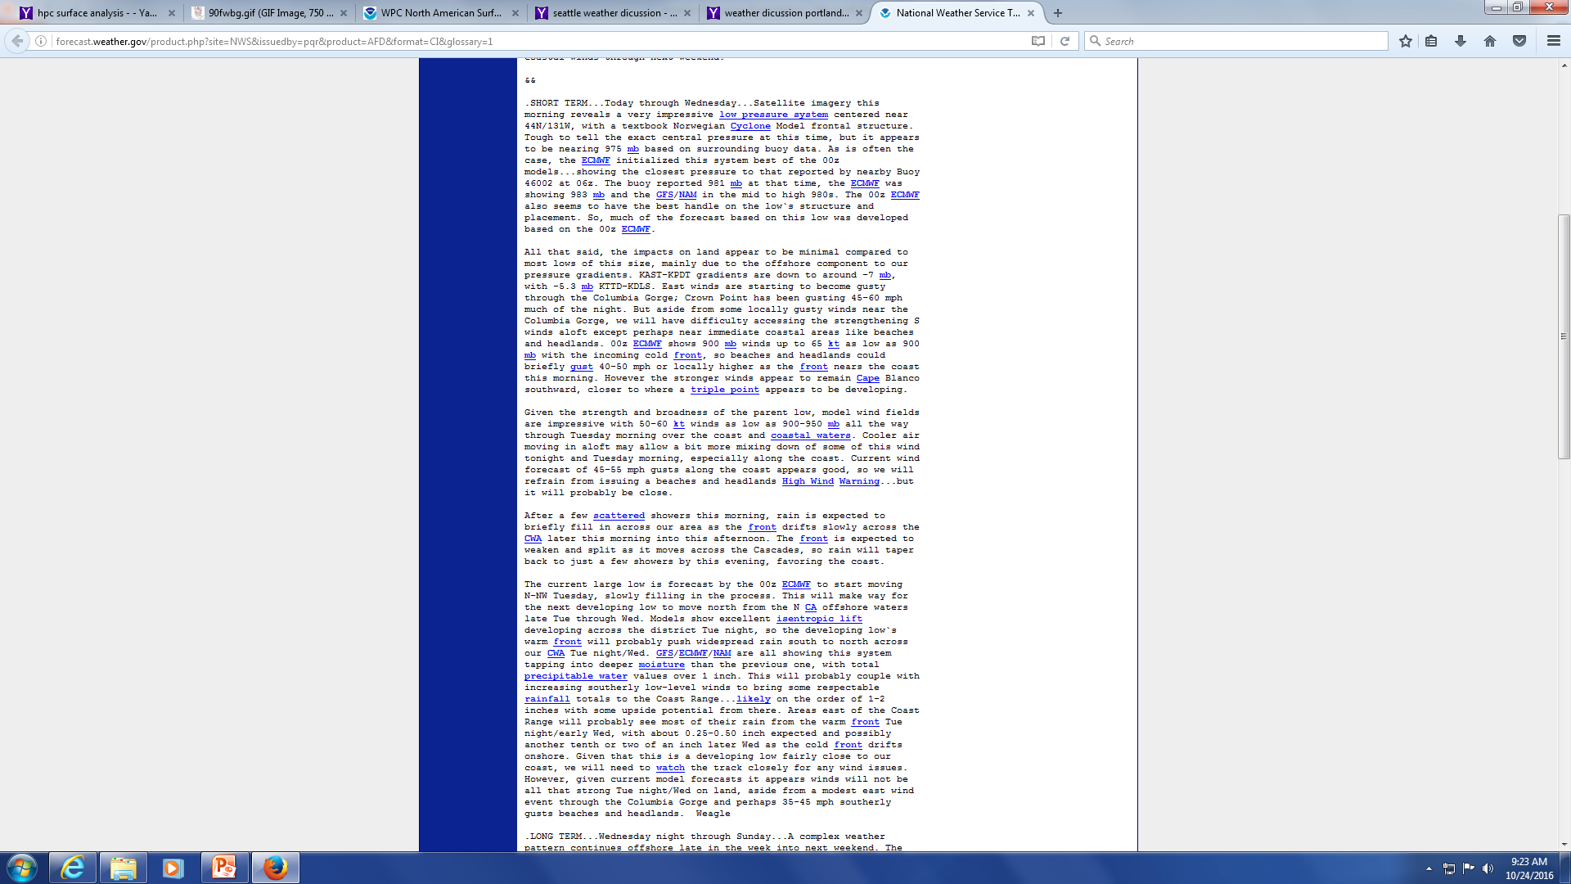
Current Weather Discussion- Portland

Slide 46
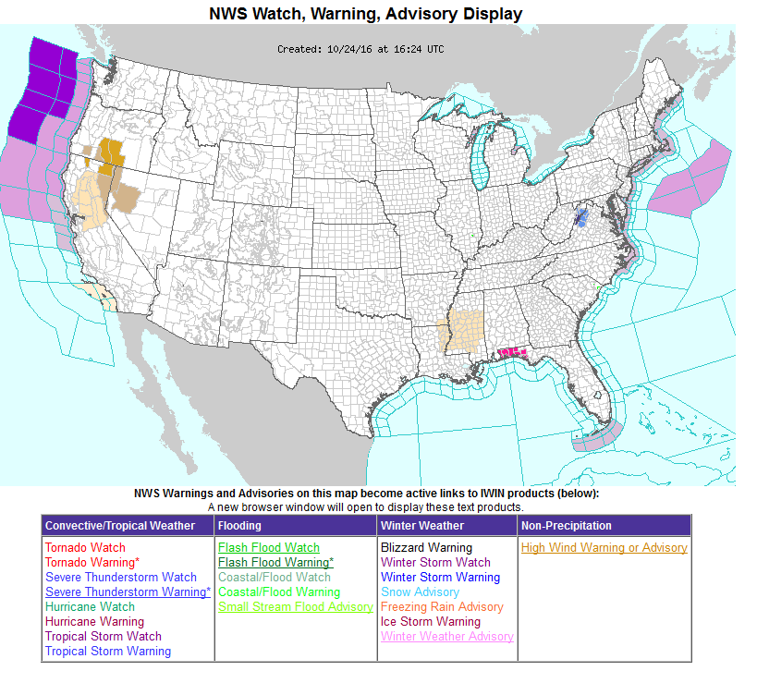
Current Warnings/Watches

Slide 47
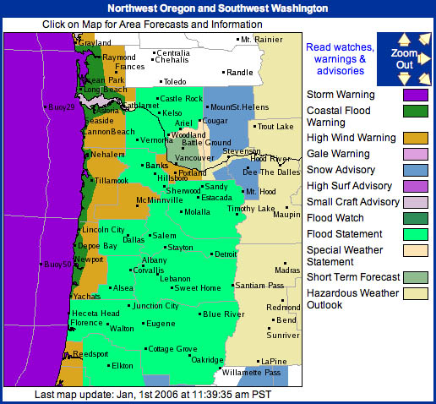
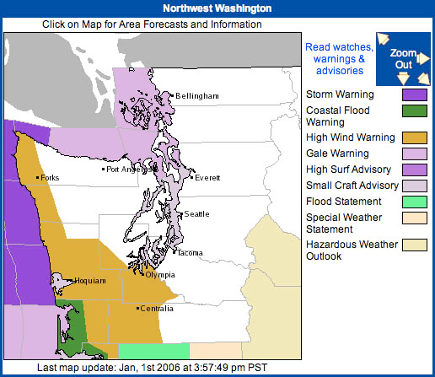
Case Study- Warnings/Watches

Slide 48



Case Study Wind Gusts vs. Projected Wind Gusts

Slide 49
Conclusions/Questions?!?!?

